Slide 1
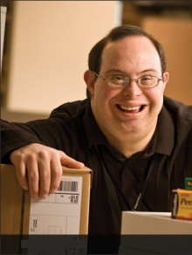
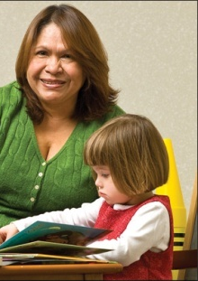
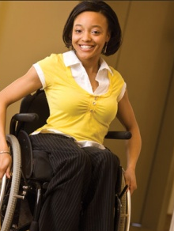
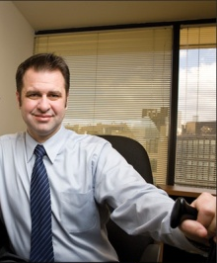

Tools, Techniques, and Technologies for Creating Inclusive Workplaces
Lou Orslene, JAN Co-Director
Orslene@jan.wvu.edu

Slide 2



Where I come from…
Notes:
Tell the story of the mine accident and recovery and mention Kate.

Slide 3

Where I come from…
Notes:
Tell the story of the mine accident and recovery and mention Kate.

Slide 4
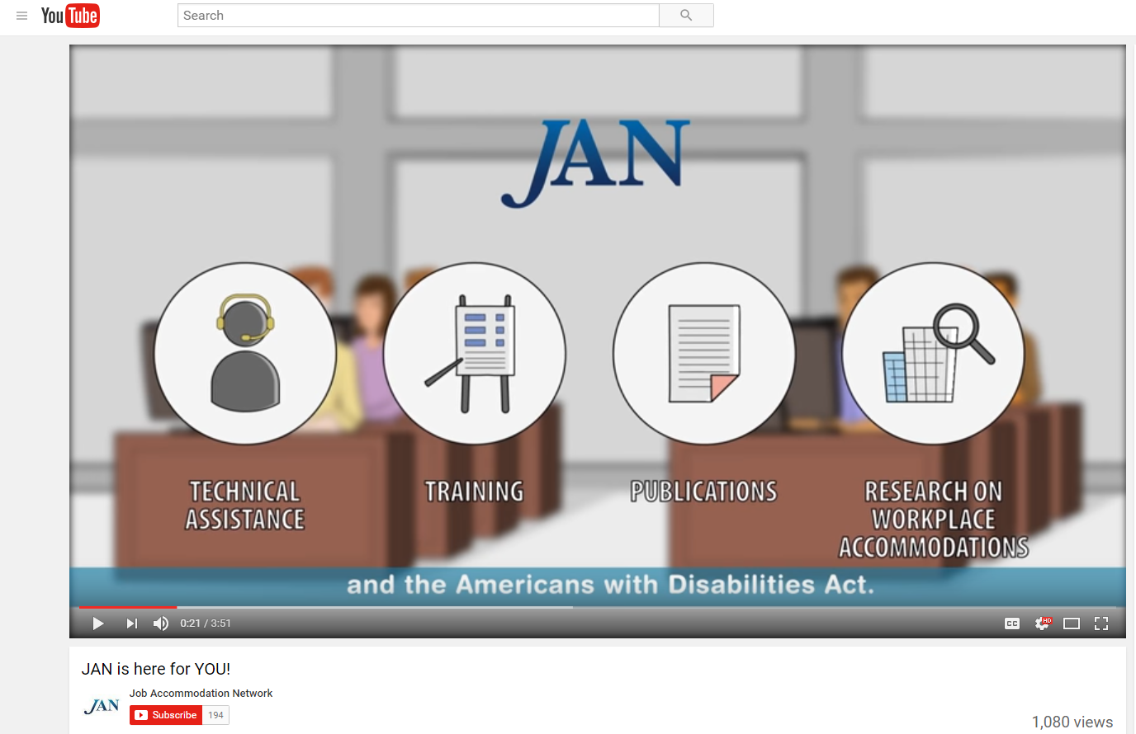
Who is JAN?
Notes:
The Job Accommodation Network (JAN) is the leading source of free, expert, and confidential one-on-one guidance on reasonable accommodation (RA) in the workplace, the Americans with Disabilities Act (ADA) and related legislation, and disability employment issues.

Slide 5
Critical Issue of Our Time
The Conference Board – established to help member companies understand and deal with the most critical issues of our time – believes disability in the workplace is one of these critical issues.
Trends noted in the report:
      Employees aging in the workplace
      Development of new, more universally accessible workplace technologies
      Greater acceptance of remote work
      Health care advances
      Incentives provided by government
Source: The Conference Board, “Leveling the Playing Field: ATTRACTING, ENGAGING, AND ADVANCING PEOPLE WITH DISABILITIES.”
Notes:
The Conference Board, established to help private industry understand and deal with the most critical issues of our time, believes disability in the workplace is one of these critical issues. The Board notes that there are a number of trends driving inclusion including:
Employees aging in the workplace
Development of new, more universally accessible workplace technologies
Greater acceptance of remote work
Health care advances
Incentives provided by government
1 in 5 people report a disability

Slide 6
The Value Proposition
Emerging Markets: People With Disabilities
People with Disabilities (PWD) are positioned to be the focus of brands within the next five years. Controlling $8 trillion dollars in disposable income, People with Disabilities, together with their friends and family represent 53% of global consumers.
Source: People with Disabilities — The World’s Largest Emerging Market October 14, 2015 from Association of National Advertisers.
“… marketing programs aimed at people with disabilities can reach as many as four out of every 10 consumers.”
Source: The Business Case for Inclusion and Engagement, Marcus Robinson (2003).
Notes:
Disability has also become an emerging market for a growing number of enterprises. So more than ever there is a value proposition to hiring people with disabilities and involving these employees in the development and marketing of products and services.
Often, these days I hear of products designed for “ease of use”, or “designed for all”, or “universally designed”. This shift in thinking about consumers and particularly about consumers with disabilities is signaling fundamental market changes. Microsoft is a great exemplar here. Believing that “disability is an engine of innovation”, Microsoft and its “design for all” effort was featured in a recent Fast Company article.
According to an Association of National Advertisers blog, people with disabilities globally control $8 trillion dollars in disposal income, and together with their friends and family represent 53% of global consumers.
According to the author of this blog, people with Disabilities (PWD) are positioned to be the focus of brands within the next five years.
Marcus Robinson in his book, “The Business Case for Inclusion and Engagement”, writes that marketing programs aimed at people with disabilities can reach as many as four out of every 10 consumers. As the largest of all U.S.-based minority groups, this group is comprised of people of all ethnic backgrounds, cultures and ages.
And we know from 2006 study conducted by Siperstein and Romano that “…87% of survey participants specifically agreed that they would prefer to give their business to companies that hire individuals with disabilities.”
Thus, disability is becoming mainstream in the workplace and influencing many of the products and services we use.

Slide 7
Creating Workplace Inclusion
  Inclusive ethos - particularly language
  Inclusive public relations and marketing
  Inclusive policies and practices
  Physically accessible workplace
  Enabling workplace technologies

Slide 8
Creating Workplace Inclusion
The three C’s: Increase comfort, confidence, and competence
Develop skills that help to more effectively communicate at work with people with disabilities
Develop and effectively communicate actionable policy and procedures
Develop normative practices for engaging with people with disabilities throughout the employee life cycle
Notes:
It is typical for companies to have challenges in 3 key areas: culture that embraces disability inclusion, technical assistance, and integration of disability inclusion into HR policies, processes, and training.

Slide 9
Key to Inclusive Culture
Accommodation
=
Equal Employment
=
Inclusive Workplace Culture

Slide 10
Accommodation Primer
The basis for inclusive employment is the reasonable accommodation (RA) policy and process
The foundation for reasonable accommodation is a robust interactive process (IP)
The trigger for RA and IP is a request for an accommodation or recognition of an obvious barrier to someone with a known disability
A request for accommodation includes two essential elements – a medical condition and a related challenge at work

Slide 11
Eight Most Common Types of RA
Modifying schedule or allowing leave time
Making workplace or work station accessible
Modifying methods – testing, communication, etc.
Modifying or creating policies
Purchasing or modifying equipment or products
Purchasing a service – reader or interpreter
Restructuring job
Reassignment
Other accommodations
  Telework
  Adjusting supervisory method
  Using a service animal

Slide 12
JAN’s Interactive Process
Step 1: Recognizing an Accommodation Request
Step 2: Gathering information
Step 3: Exploring Accommodation Options
Step 4: Choosing an Accommodation
Step 5: Implementing the Accommodation
Step 6: Monitoring the Accommodation
https://AskJAN.org/topics/interactive.cfm

Slide 13
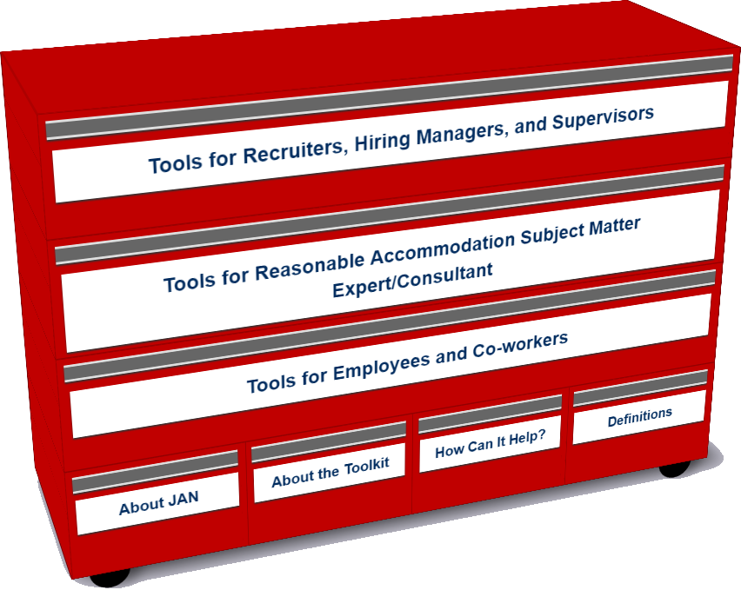
Who uses the Toolkit?
Recruiters, Hiring Managers and Supervisors
Accommodation Consultant/Subject Matter Expert
Employees and Co-workers — Allies
Notes:
An free, online “living” toolkit that captures and continuously updates best and emerging practices in providing accommodations in the workplace
Many companies have noted that they could benefit for emulating best/emerging RA practices including:
Easier-to-navigate RA processes for employees and managers
Better mechanisms for tracking and reporting
Enhanced data-gathering practices (to gauge how satisfied employees and their managers are with RAs, financial savings, return to work, etc.)
More transparent and effective intersections between Section 503 self-ID encouragement and identifying as a person with a disability for purposes of obtaining an RA

Slide 14
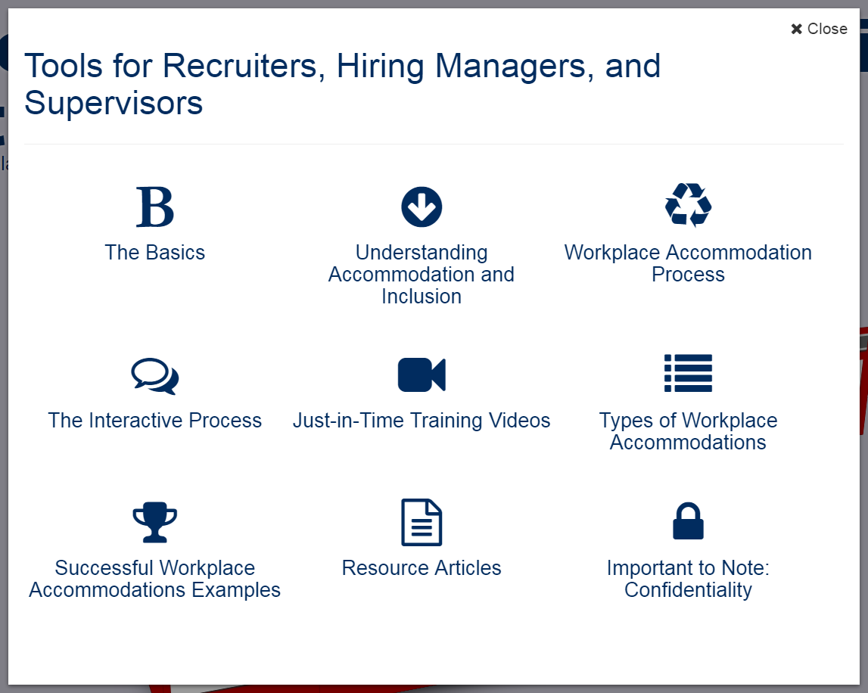
Accommodation Toolkit
Recruiters, Hiring Managers and Supervisors
Notes:
LO

Slide 15
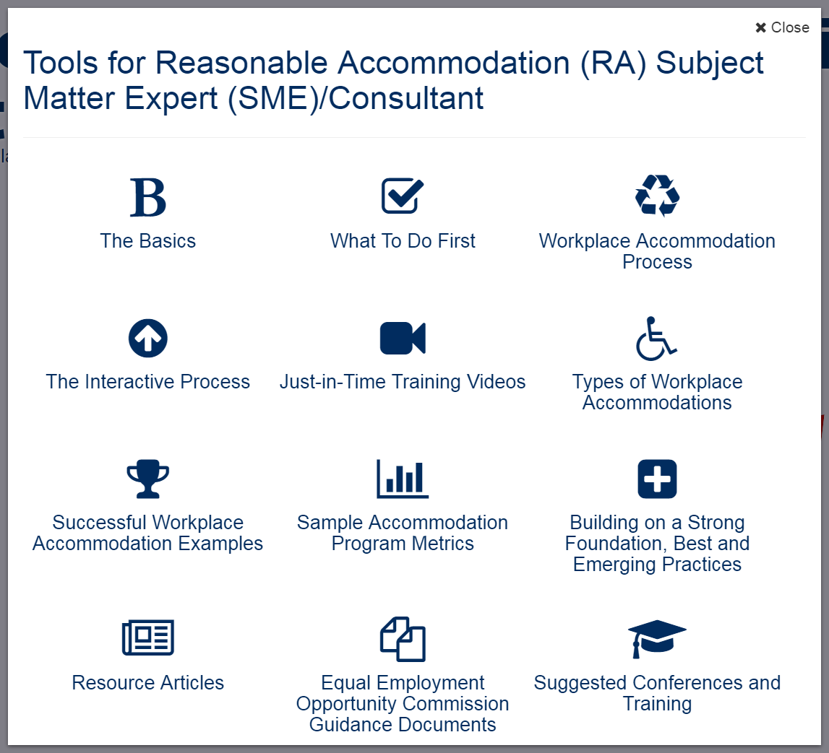
Accommodation Toolkit
Accommodation Consultant/Subject Matter Expert
Notes:
LO

Slide 16
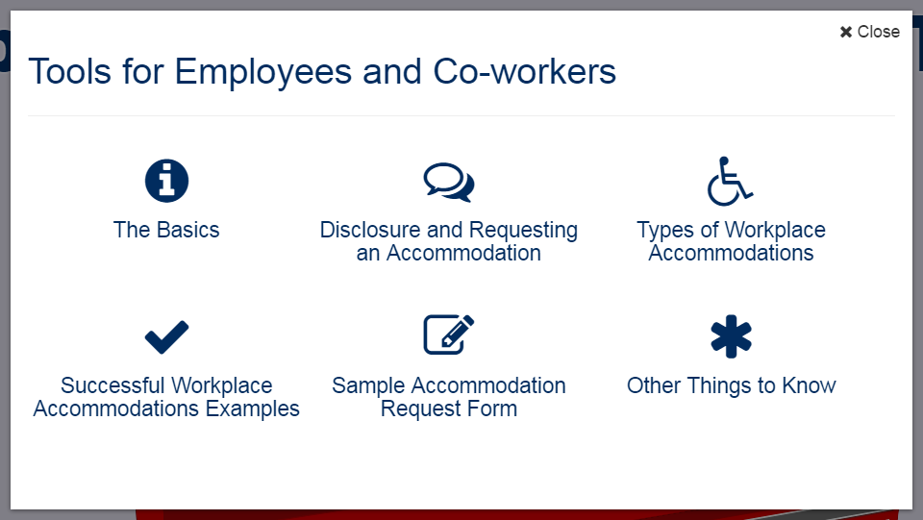
Accommodation Toolkit
Employees and Co-workers — Allies
Notes:
DD

Slide 17
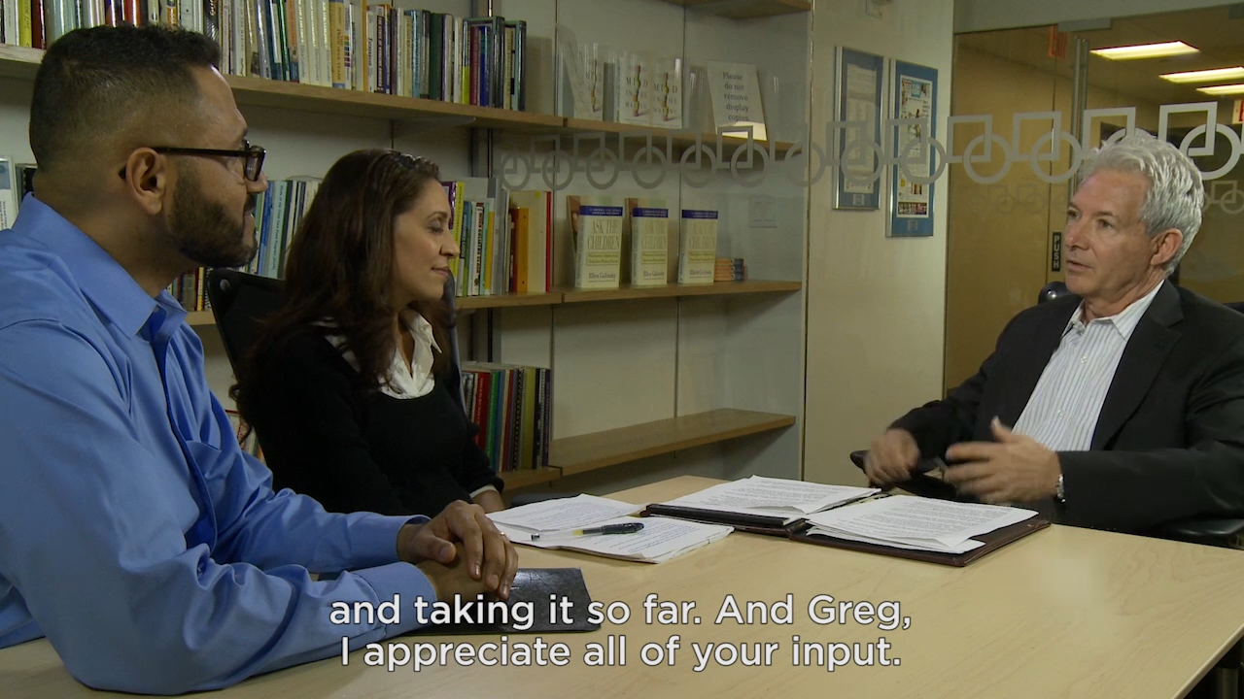
Video: Interactive Process

Slide 18
Techniques for Creating Inclusion
Adopting facilities/IT access for all: universal design reduces the need for individualized accommodations
Focusing on diverse abilities — experience, skills, prior performance, not diagnosis or interviewing skills — this contributes to higher productivity & innovation
Gathering/reporting meaningful metrics (e.g. reduction in lost work time, retention & leave costs, enhanced engagement scores)
Utilizing/leveraging commonly requested accommodations by job function to develop an internal catalogue of accommodations for specific jobs

Slide 19
Techniques for Creating Inclusion
  Develop a list of preapproved accommodations not requiring a full assessment and interactive process (Just do it!)
  Developing a “task bank” of jobs that a person can perform when unable to perform prior duties
  Integrated or harmonized model — Single point of leave and accommodation oversight
  Internal value proposition shared with everyone, including managers
  Training and more training — consider building training prompts into processes
  Build out from a successful return-to-work program
  Purchase or develop a tracking system

Slide 20
Techniques for Creating Inclusion
  Use outside resources more effectively — do not recreate the wheel internally
  Create a centralized accommodation fund with expedited procurement fulfillment
  Ensure the accessibility of your career portal, pre-hire assessment, etc.
  Embed at least one accessibility expert in your IT team — Join the International Association for Accessibility Professionals and add accessibility requirements to job posting and descriptions
  Provide boilerplate accessibility contract language with providers and vendors
Notes:
Applicant Tracking Systems
Pre-hire Testing Software
Accommodation Tracking Systems
Legacy Information Systems i.e. HRIS
Learning Management Systems
JAN Accommodation Toolkit
Mobile Accommodation Solution

Slide 21
Free MAS App
Big Idea
The Mobile Accommodation Solution (MAS) is designed to help streamline the disability accommodation process at various phases of the employment cycle.
Funded by the National Institute on Disability, Independent Living, and Rehabilitation Research (NIDILRR)

Slide 22
Free MAS App
Collaborators
Center for Disability Inclusion
Job Accommodation Network (JAN)
IBM
US Business Leadership Network
American Association of People with Disabilities
Council of State Administrators of Vocational Rehabilitation
National Business and Disability Council
Disability Management Employers Coalition

Slide 23
Free MAS App
Users
Talent management, human resources, employer relations, and/or accommodation staff
Employment service providers
Applicants and employees with disabilities

Slide 24
Free MAS App
Functionality
Easy to use, secure, mobile case management tool
Accommodation tracking tool
Best and emerging accommodation practices and forms embedded within tool
Easy access to JAN Consultants and myriad of other resources

Slide 25
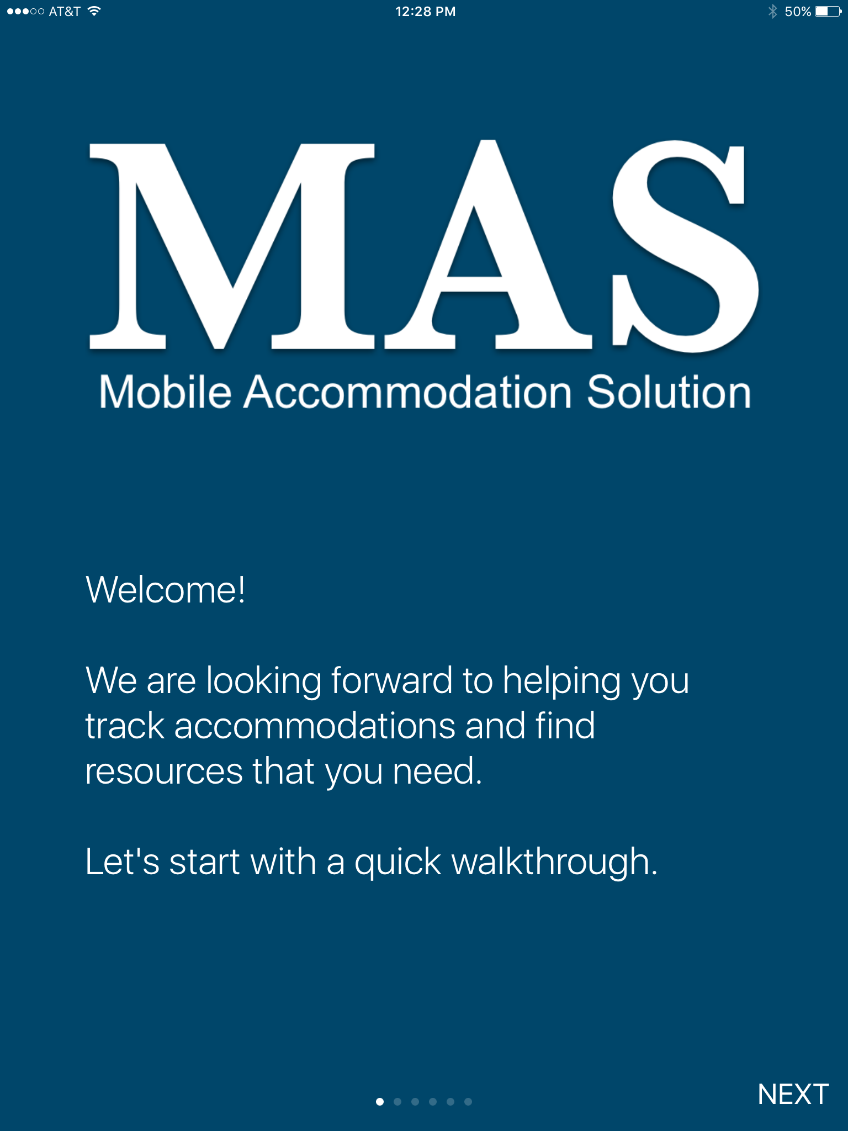
Free MAS App

Slide 26
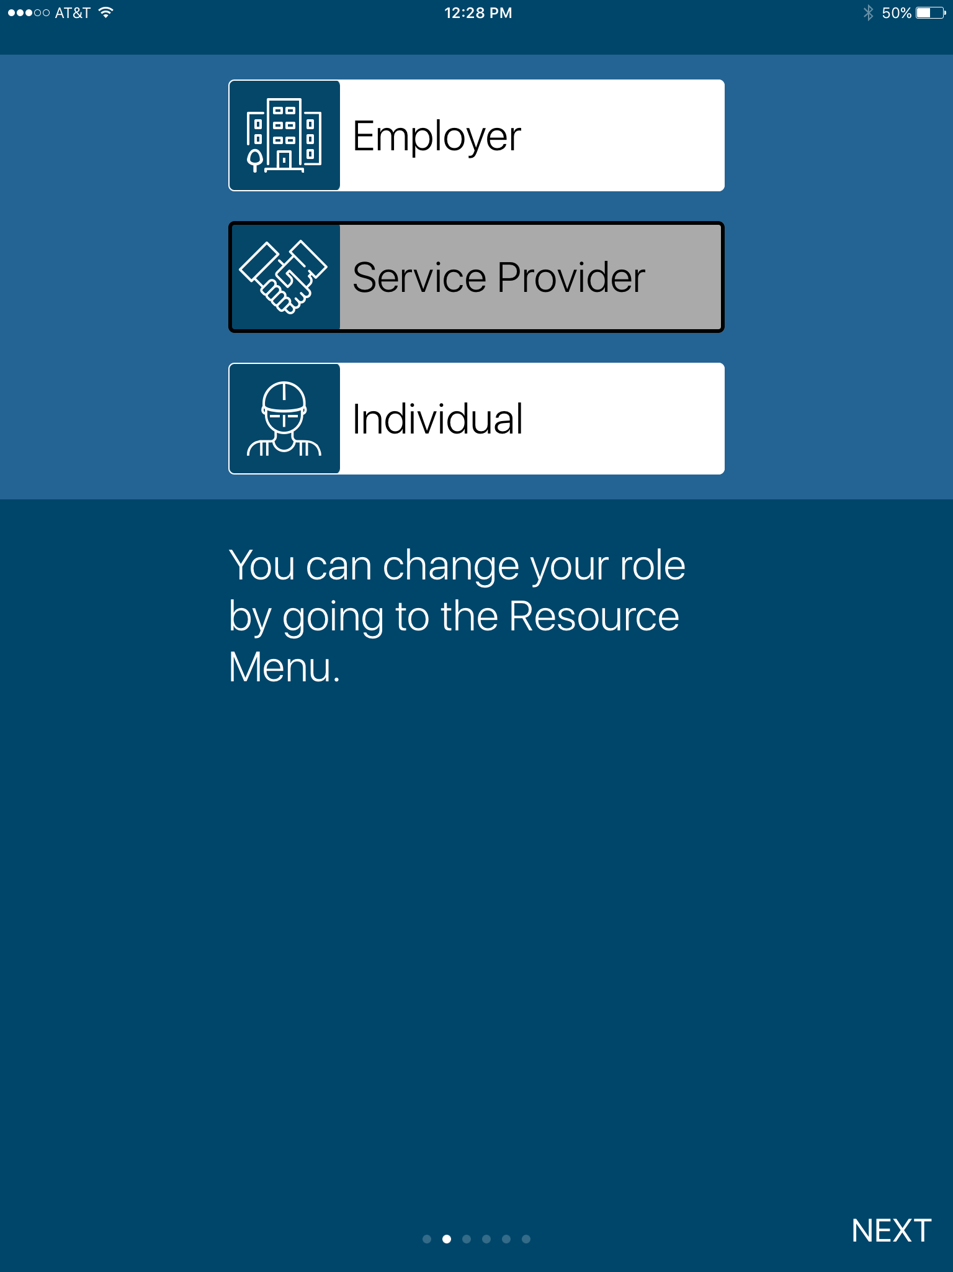
Free MAS App

Slide 27
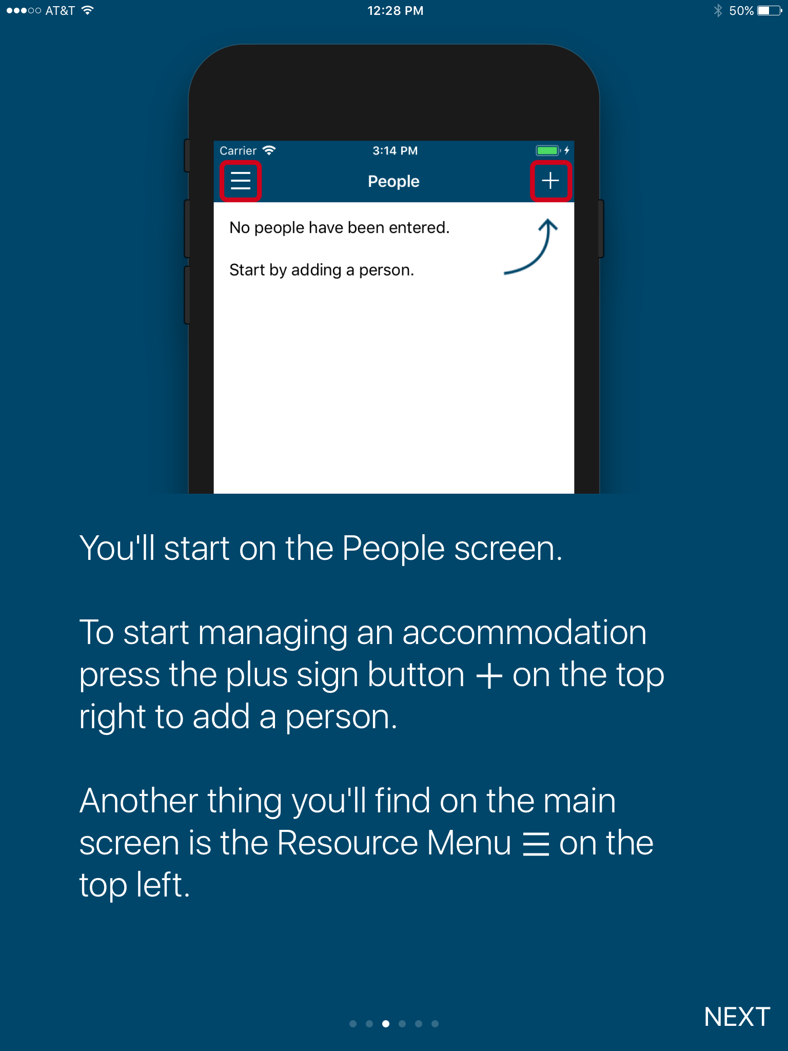
Free MAS App

Slide 28
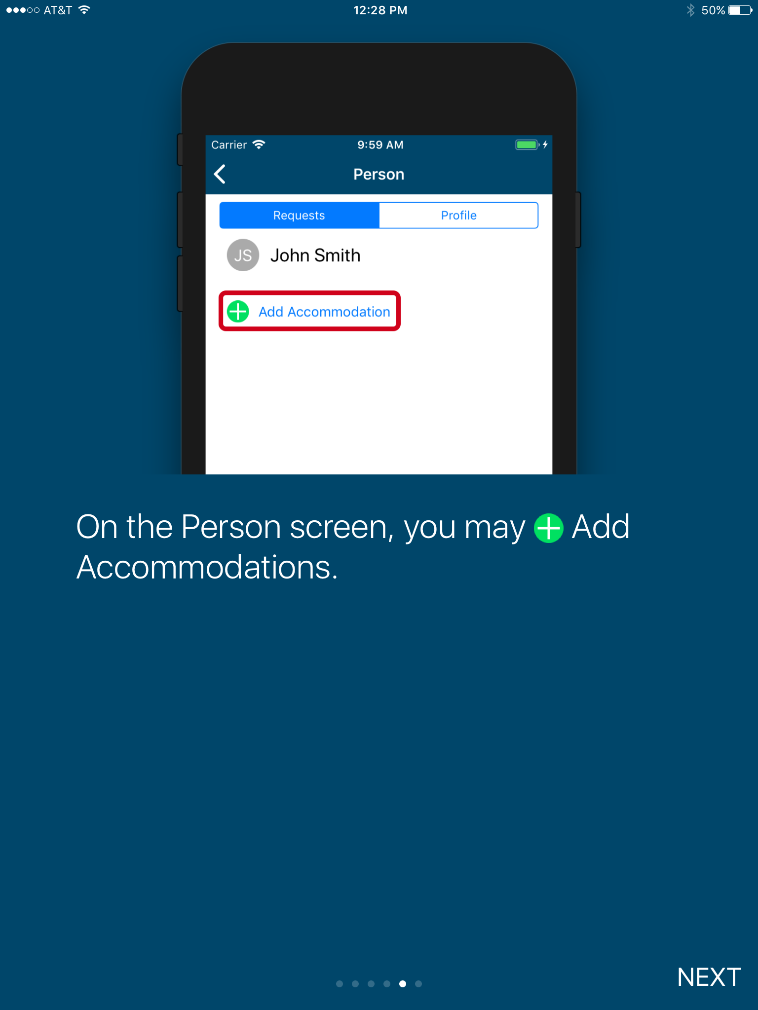
Free MAS App

Slide 29
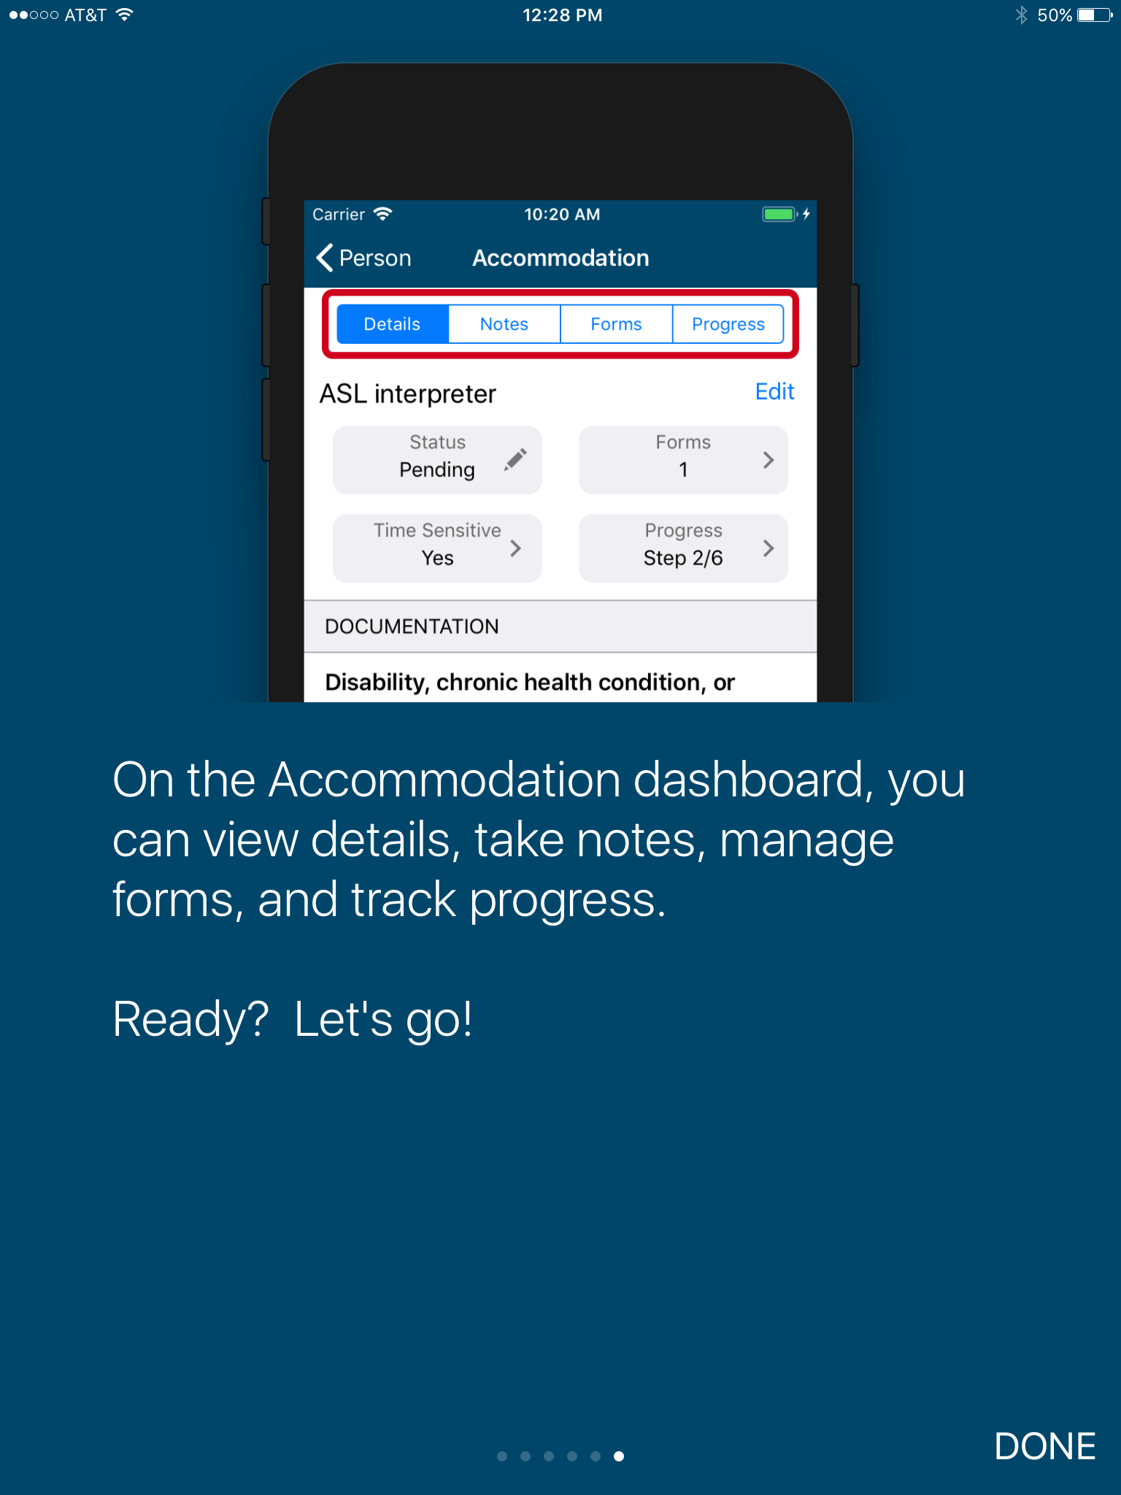
Free MAS App

Slide 30
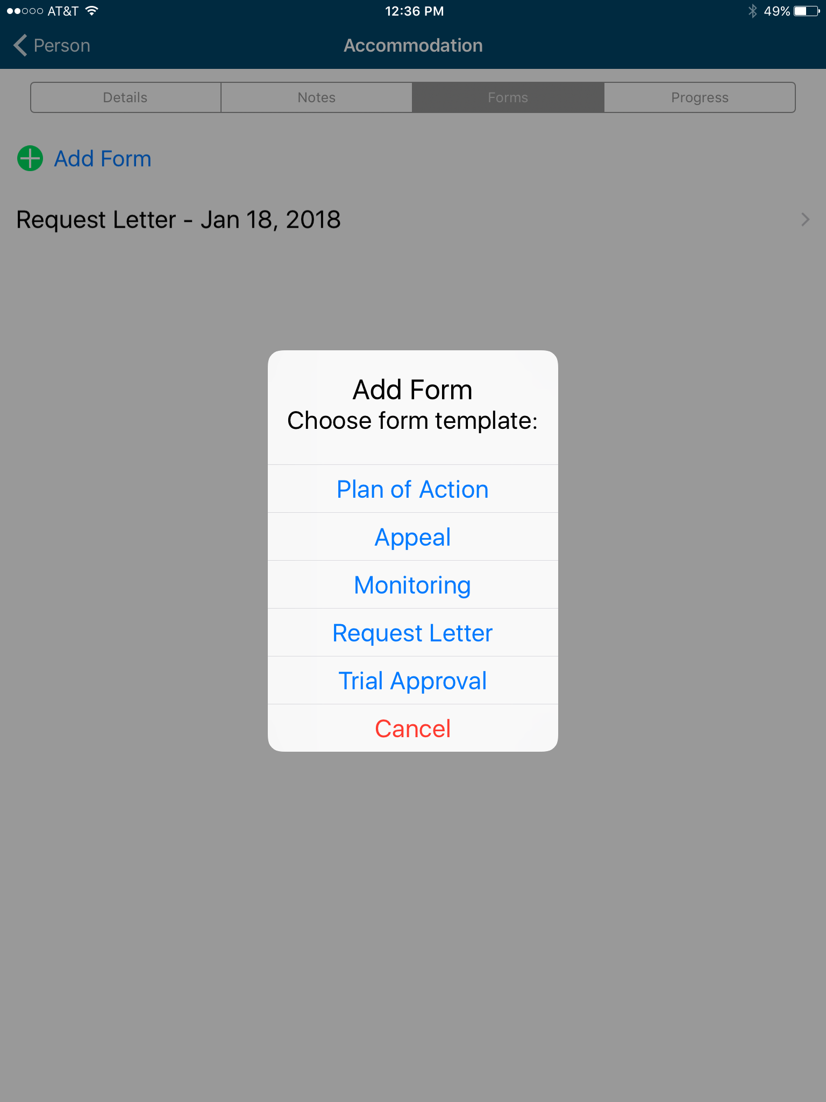
Free MAS App

Slide 31
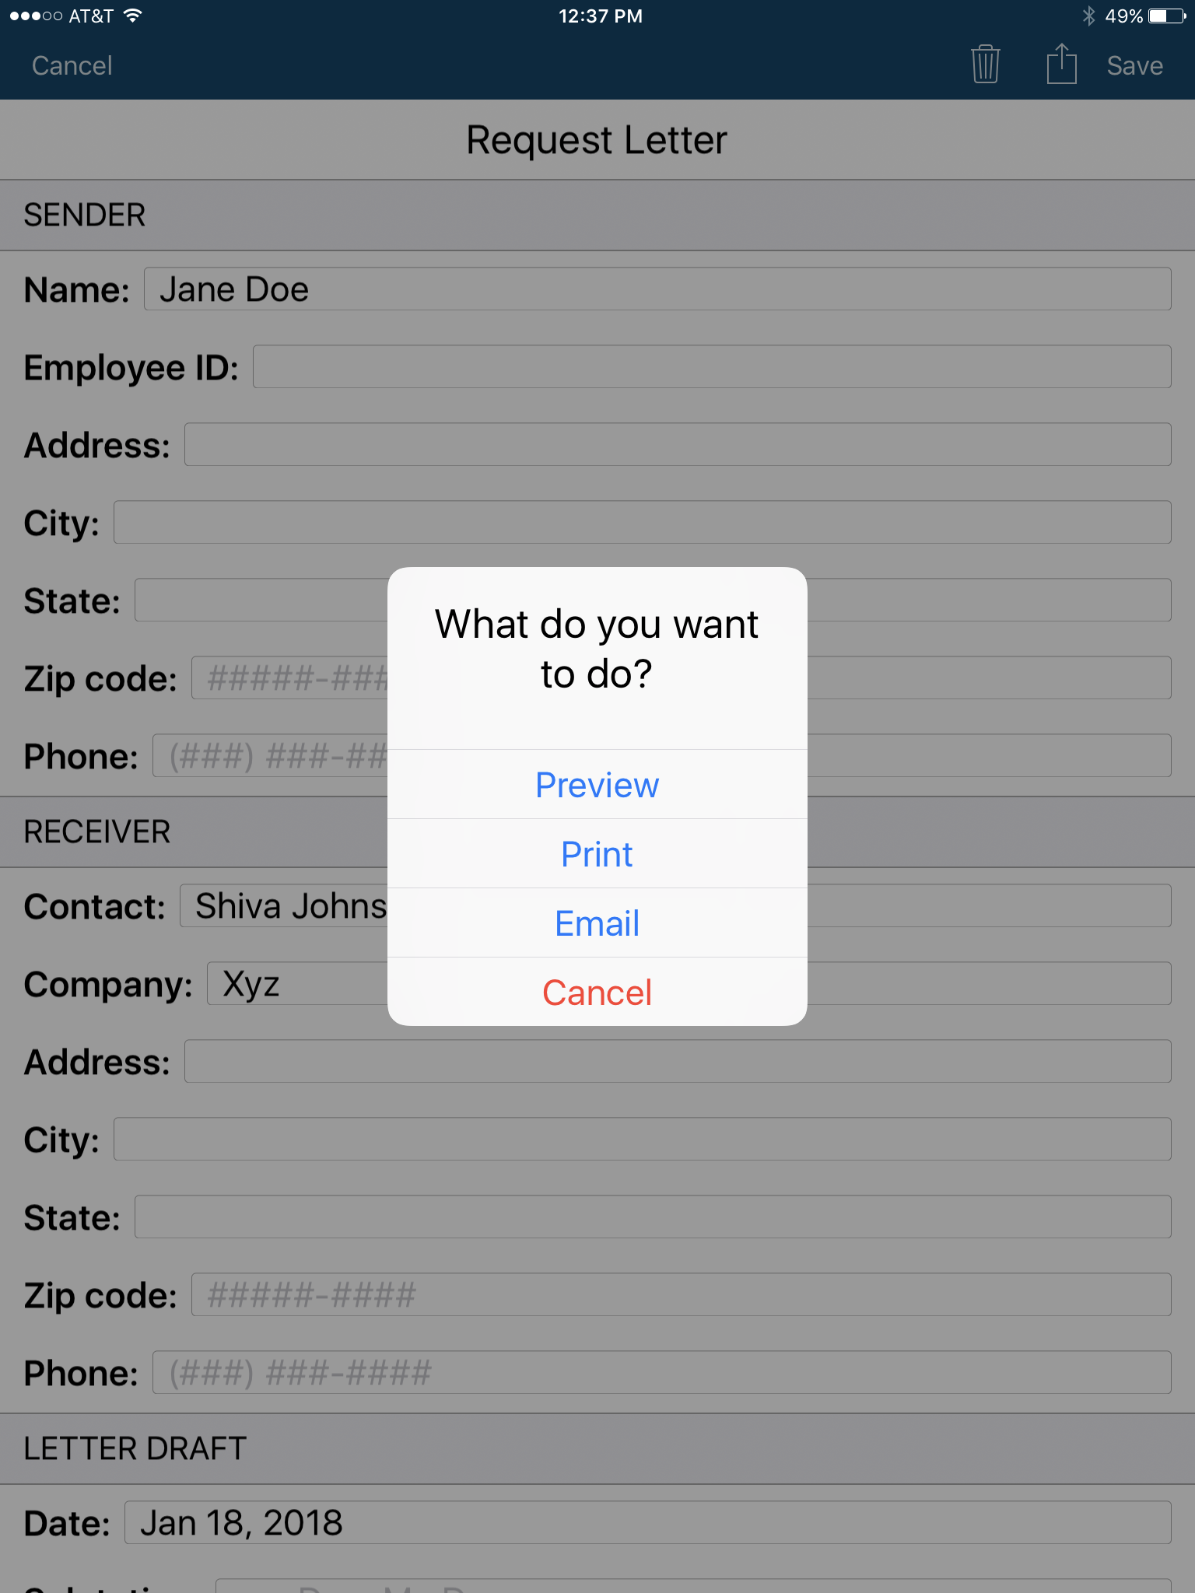
Free MAS App

Slide 32
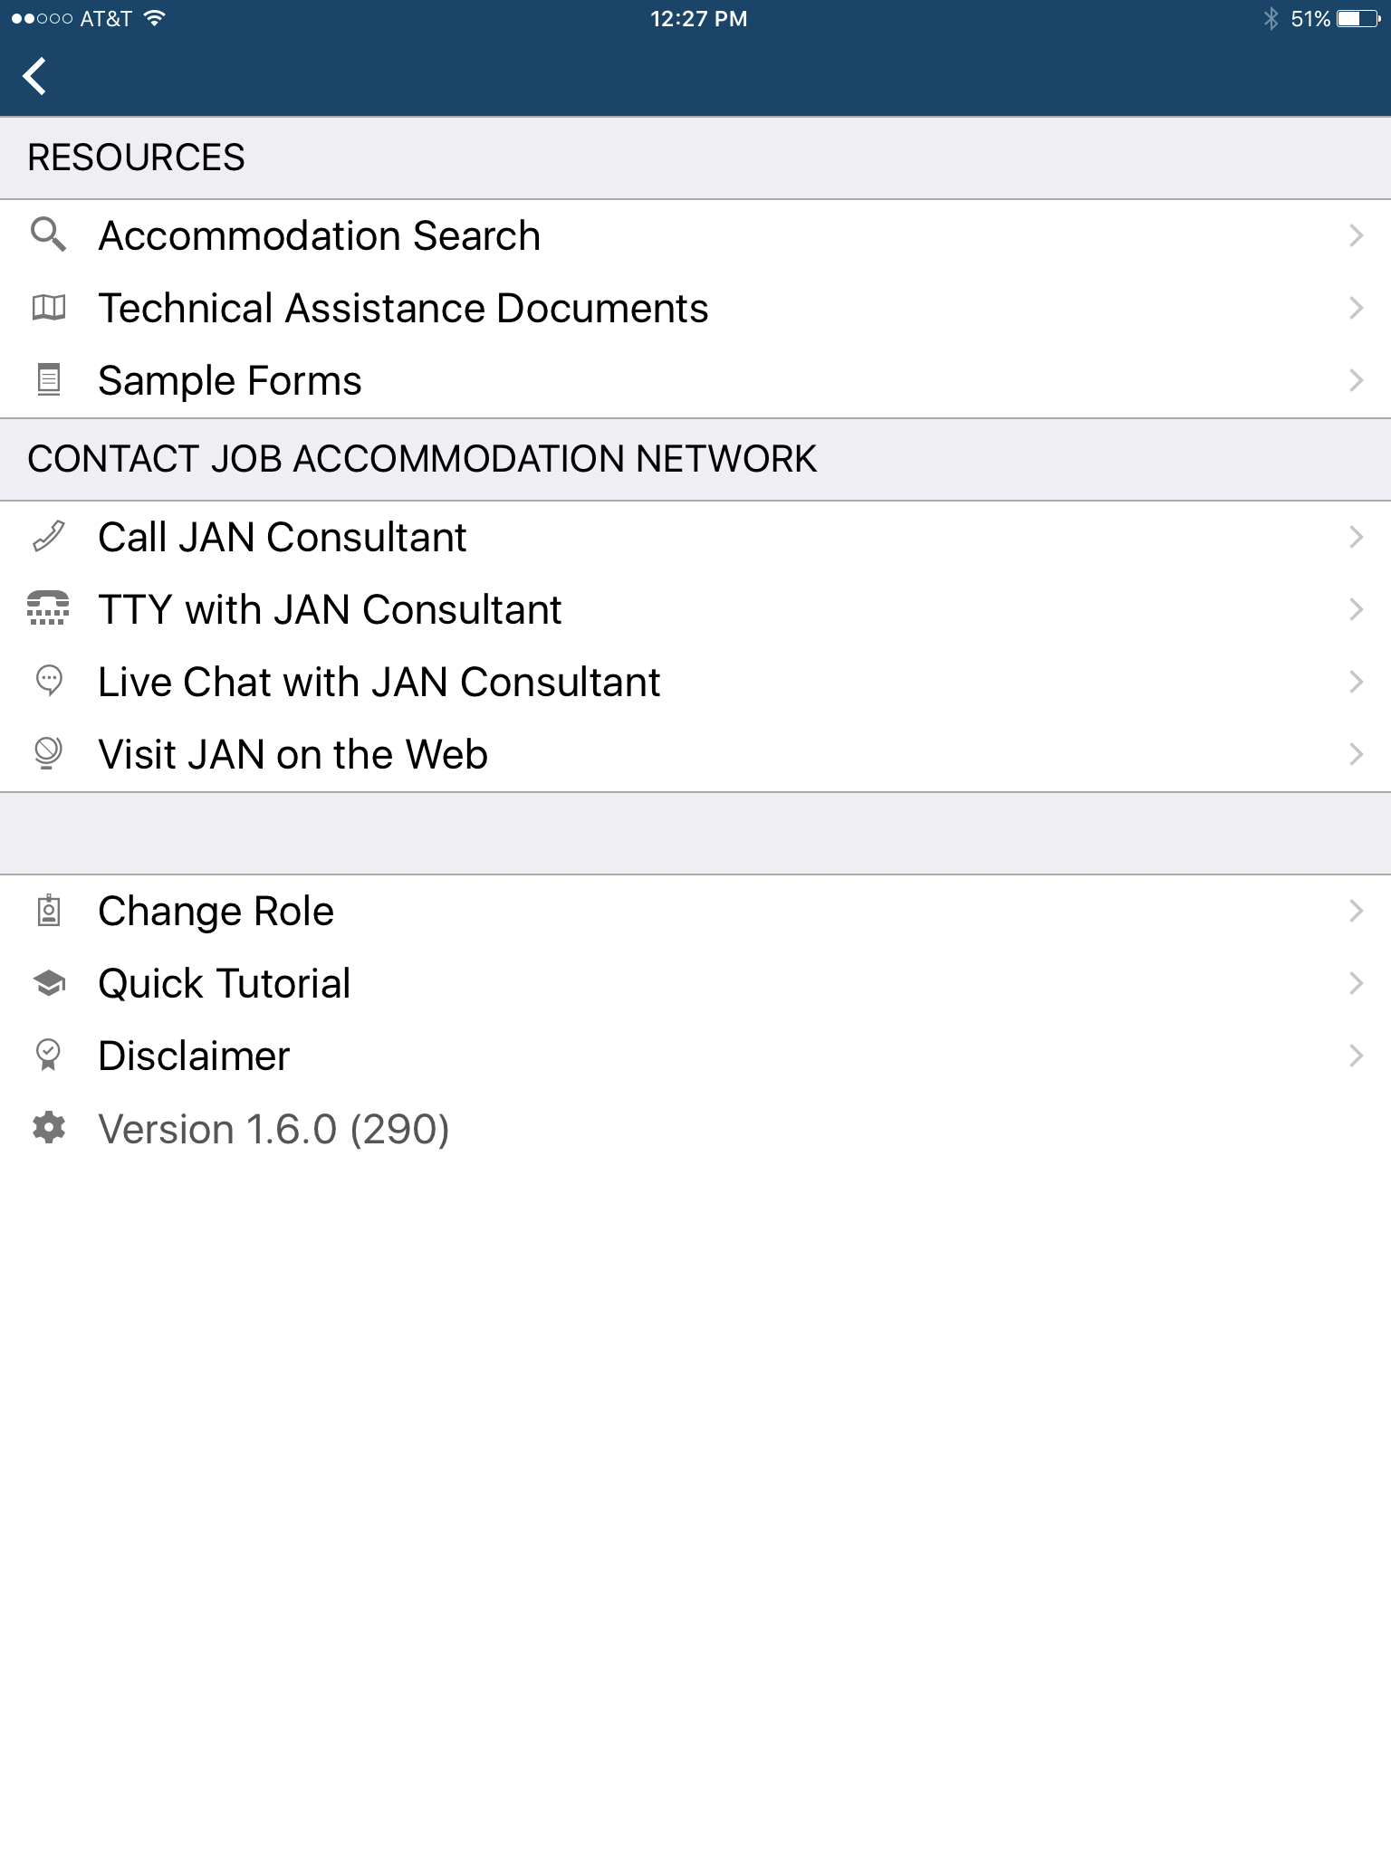
Free MAS App

Slide 33
JAN Resources
Expert consultation
Over 250 JAN-authored Publications
JAN’s A-Z (Disability, Topic, condition)
Legal libraries that include regulations and EEOC guidance documents
JAN Quarterly ENewsletter
JAN Training Modules and FREE Webcast Series
Easy access:
  AskJAN.org
  800.526.7234 or 877.781.9403 (TTY)
  Chat, JAN on Demand, Skype, Text, Social Media

Slide 34







For More Information
Contact JAN
(800) 526-7234 (V) - (877) 781-9403 (TTY)
AskJAN.org
jan@askjan.org
(304) 216-8189 via Text
janconsultants via Skype
Thank you for attending!

Slide 35

Tools, Techniques, and Technologies for Creating Inclusive Workplaces

