Slide 1
Beyond the Diagnosis: A Transparent Look at Job Accommodations for Mental Health
Beth Loy, Ph.D., Principal Consultant
Job Accommodation Network

Slide 2
Mental Health Accommodations
Overview
About JAN
Impairments
Limitations
Limitations
Obstacles
Helpful Tips

Slide 3
Mental Health Accommodations
JAN: Free Resource
Job Accommodations
Americans with Disabilities Act (ADA)
Resources

Slide 4
Mental Health Accommodations
JAN: Free Resource
Meet you where you are.
Help meet timelines.
Assist with the interactive process.
Give targeted technical assistance.
Provide comprehensive resources.
Maintain confidentiality.
Work as your partner.

Slide 5
Mental Health Accommodations
Common Mental Health Impairments
Anxiety
Bipolar Disorder
Major Depression
Obsessive Compulsive Disorder (OCD)
Panic Disorder
Post-Traumatic Stress Disorder (PTSD)
Seasonal Affective Disorder (SAD)

Slide 6
Mental Health Accommodations
Limitations
Concentration
Memory
Organization
Time Management
Stress / Emotions
Panic
Sleep Disturbances
Attendance
Coworker Interaction
Working Effectively

Slide 7
Mental Health Accommodations
Obstacles
Disclosure
Medical Documentation
Policy Modification
Service Animals
Reassignment
Performance Standards
Conduct Standards
Job Restructuring
Modified Schedule/Leave
Confidentiality
Direct Threat

Slide 8
Disclosure
Tilly has bipolar disorder. She needs to disclose her disability and ask for an accommodation of a flexible schedule while she adjusts to new medication. Tilly is having difficulty sleeping and waking up and has been late three days in a row. She is wary of disclosing her medical condition but doesn’t want to get into disciplinary action.

Slide 9
Accommodation
Tilly discloses and provides medical documentation. Since her work doesn’t depend on or affect others, her employer found no hardship in flexing her schedule as long as she gets her time in between the core business hours of 8:00 am to 6:00 pm.

Slide 10
Disclosure

Slide 11
Medical Documentation
Jon, a longtime IT employee of a university, discloses that he has been having severe bouts of depression that have affected his ability to work the night shift. Jon requests that his shift be changed to help him better regulate his sleep. The manager is totally surprised, because Jon has had no performance problems.

Slide 12
Accommodation
The manager asks Jon for medical documentation that will provide information as to why the accommodation is needed. The manager then takes a look at the IT schedules to see what can be done to assist this employee.

Slide 13
Medical Documentation

Slide 14
Policy Modification
Rico worked the help desk, where his main job functions were troubleshooting the problems of other staff members. Rico was highly competent in solving problems but became impatient, rude, and disrespectful to coworkers who contacted him for assistance.

Slide 15
Accommodation
A new policy was instituted which allowed Rico to take requests for help by e-mail instead of in person or by phone, reducing the stress caused by interactions with his coworkers. This enabled him to keep his emotions and behavior in check.

Slide 16
Policy Modification

Slide 17
Service Animals
Tana is a file clerk with an anxiety disorder who uses a service animal to help her deal with stress in the workplace.

Slide 18
Accommodation
The employer modified its “no animal” policy and allowed the service dog in the workplace.

Slide 19
Service Animals

Slide 20
Reassignment
Vaughn, an RN with nearly twenty years of experience in a veteran’s hospital, was having great difficulty working in the emergency and critical care units due to an increase in symptoms when dealing with trauma. He asked for the accommodation of a reassignment.

Slide 21
Accommodation
The hospital HR department worked with Vaughn to determine positions he was qualified for that were open or would be soon. Together they ranked the positions in the order of which were best suited to him. Vaughn was able to choose among three different positions in the veterans’ healthcare system.

Slide 22
Reassignment

Slide 23
Performance Standards
A hotel employer conducts a meeting with Mina, a housekeeper, to talk about her recent performance. The employer knows of Mina’s OCD diagnosis, but he doesn’t mention the disability and is prepared to handle the situation as a
performance issue, giving a
verbal warning. Mina relates
her low performance to her
OCD and asks for help in
meeting performance
standards.

Slide 24
Accommodation
The employer documents that this is a first verbal warning but doesn’t rescind the discipline. He does start the interactive process at this time and asks Mina what she feels would help her meet the timelines of her tasks.

Slide 25
Performance Standards

Slide 26
Conduct Standards
Jo is a nurse with severe depression who is written up after several verbal warnings for inappropriate conduct. She is placed on a thirty-day plan of improvement and warned that if the behavior doesn’t stop within the stated time period, she will be
let go. Jo decides to
disclose her disability
and ask for accommodations
to assist her in responding
more appropriately to
co-workers.

Slide 27
Accommodation
Since Jo discloses and requests accommodations, the employer puts the PIP on hold until they receive medical documentation and put accommodations into place but does not rescind the discipline that occurred before the disability was known. Once accommodations are put into place, the employer starts the PIP.

Slide 28
Conduct Standards

Slide 29
Job Restructuring
Jack is an elementary teacher who experienced temporary but extreme fatigue, expected to persist for several months due to a change in medication and the onset of winter.

Slide 30
Accommodation
He was accommodated with the removal of two extra duty requirements. Job restructuring, which consisted of temporarily removing his early and late bus duties, caused no hardship to the employer and greatly reduced Jack’s expenditure of depleted energy.

Slide 31
Job Restructuring

Slide 32
Modified Schedule and Leave
Sally is an employee who works in a corrections facility. She was having difficulty waking due to newly prescribed medications. Sally has had increasing symptoms of PTSD with the approaching ten-year anniversary of the traumatic event.

Slide 33
Accommodation
Because of her inability to get to work on time and attend work at all on some days, Sally’s employer provided her with an accommodation of leave to help her manage the temporary side effects of the medications.

Slide 34
Modified Schedule and Leave

Slide 35
Confidentiality
Jasmine confronts her supervisor with a request to be provided an opportunity to work from home as one of her coworkers in now doing. Although there is no formal policy that allows telework, Jasmine states that what is available for one employee should be available to all employees.

Slide 36
Accommodation
The supervisor cannot disclose that another employee is receiving an accommodation. The employer emphasizes the policy of assisting an employee who encounters difficulties in the workplace and the need for privacy.

Slide 37
Confidentiality

Slide 38
Direct Threat
A 911 dispatcher begins to have panic attacks on the job that cause him to leave his workstation and the phone lines to take a walk outside the building to calm himself down. The episodes can last anywhere from 20-45 minutes and are increasing
in frequency. What started
out as a couple of episodes
a month have progressed
to several daily episodes.

Slide 39
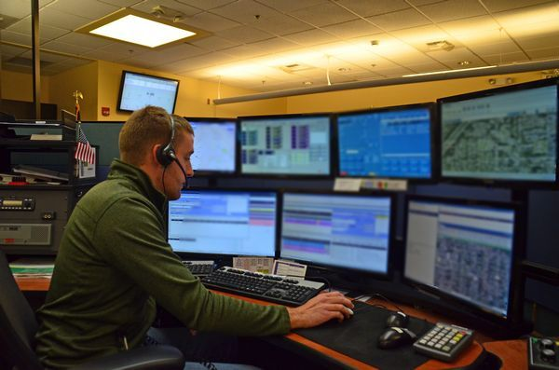
Accommodation
The supervisor views this situation as a direct threat and requests medical information from the employee that includes a job description review form and strategies to keep the panic at bay.

Slide 40
Direct Threat

Slide 42
Contact
(800)526-7234 (V) & (877)781-9403 (TTY)
AskJAN.org & jan@askjan.org
(304)216-8189 via Text
janconsultants via Skype

