Slide 1

Fostering Deaf Success
Attracting, Engaging and Retaining Deaf and
Hard of Hearing Employees
Communication Service for the Deaf, Inc.
Kylie Baker
Robert Siebert

Slide 2
National Deaf History Month https://www.deaf-interpreter.com/the-fascinating-origins-of-deaf-history-month/

Slide 3


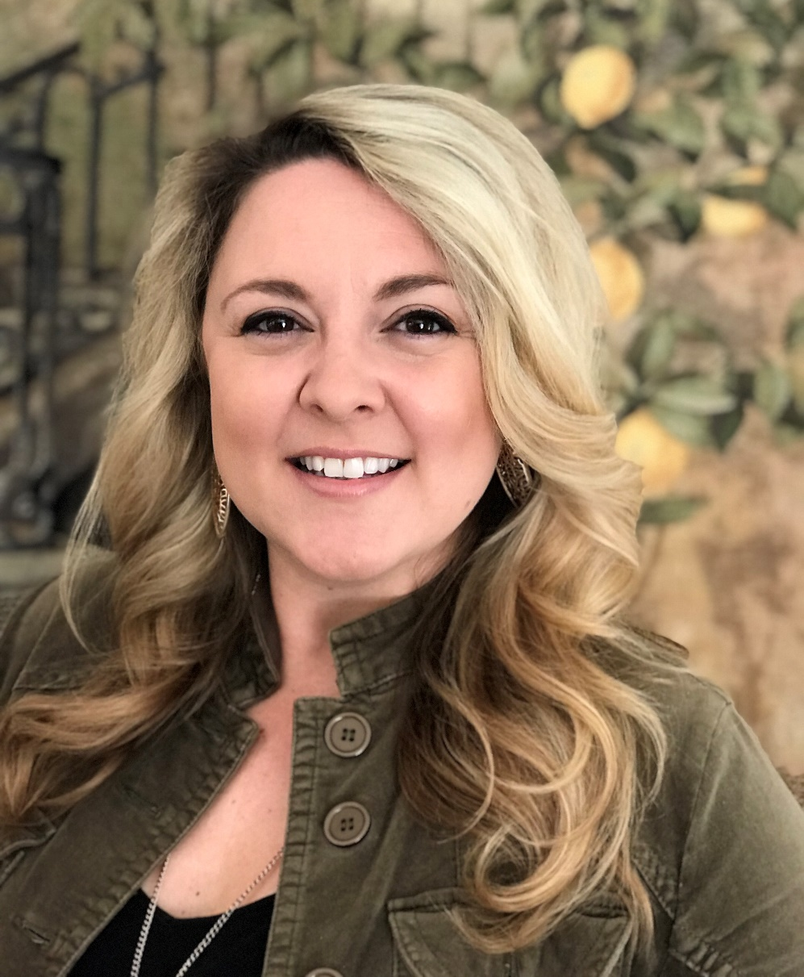
Introductions
Development Team
Kylie Baker,
Business Engagement Manager
Robert Siebert,
Development Manager

Slide 4





Slide 5
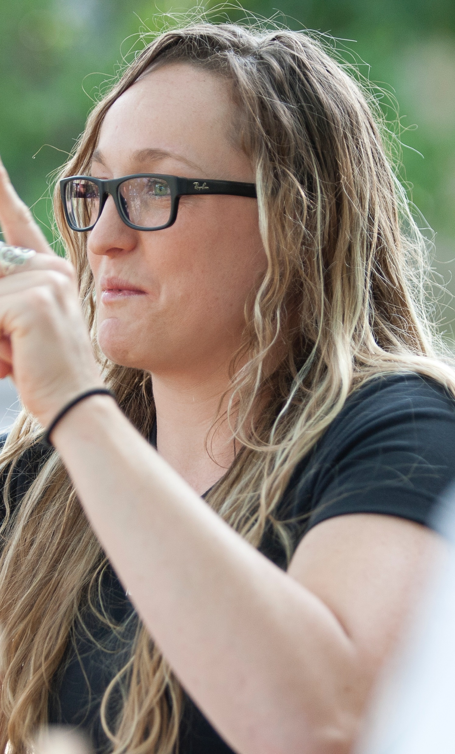
Overview
About Deaf Community
Value of Hiring Deaf People
Preparing Your Workplace
Accommodations
Recruiting Deaf Employees
Onboarding & Retaining Deaf Employees
Resources

Slide 6

About Deaf Community
Number of Deaf and Hard of Hearing People in US
Common Misconceptions
Communication Preferences
Deaf Culture Aspect
Bilingual (English as second language)
Success in all career fields

Slide 7
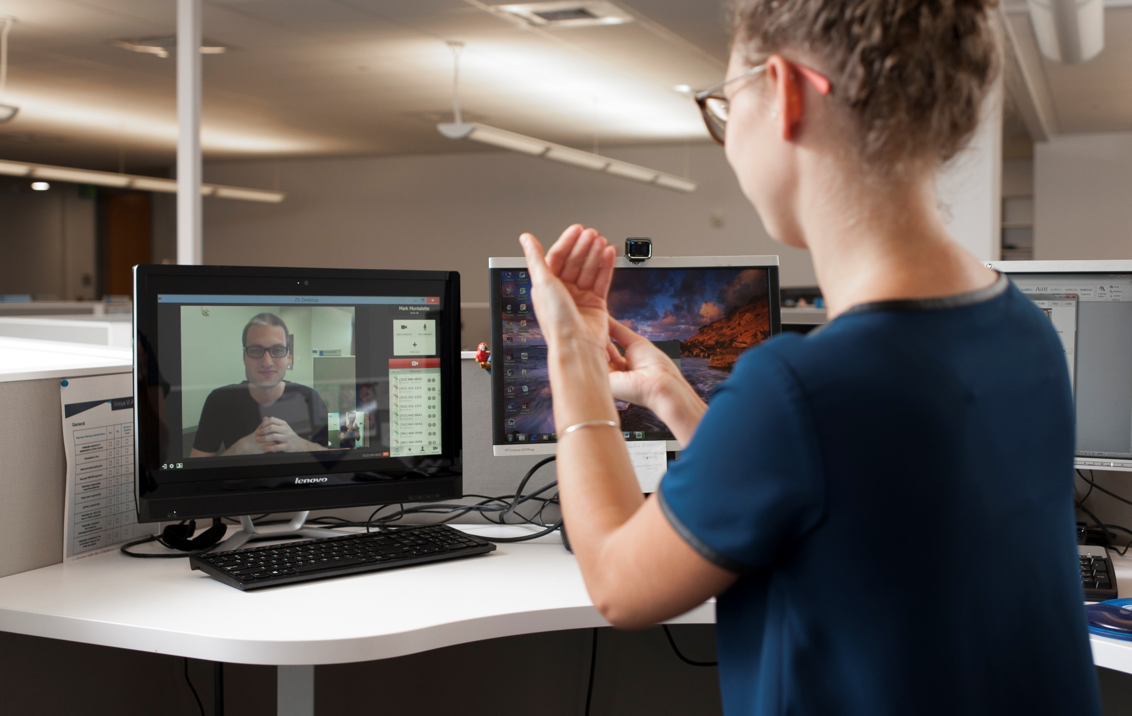
Value of Hiring Deaf People
Increase Diversity!
Increased labor pool
Good for business
Deaf Community = Brand Loyal

Slide 8

Preparing Your Workplace
First Steps
Define your Goals
Assess your environment: are you “Deaf Friendly”?
Explore Resources
Look in-house
Look to industry leaders
Dedicated Support Organizations - Free & Low Cost resources
Engage and Educate
Be Transparent
Create Champions

Slide 9

Accommodations
TRUE or FALSE?
Accommodations for deaf employees are typically expensive and can impact your ability to hire within your budget

Slide 10

Accommodations
Many accommodations cost next to nothing. The most frequently-requested paid accommodations come with an average annual cost of around $500
FALSE!

Slide 11
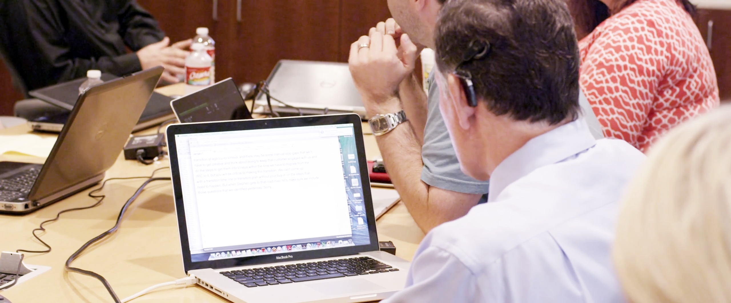
Evaluating Accommodation Tools
Factors to consider when evaluating accommodations
Preference
Situational
Types of Accommodations
ASL Interpreters
        Captioning
        Amplified Devices
        Messaging and E-Mail
        Pen & Paper

Slide 12
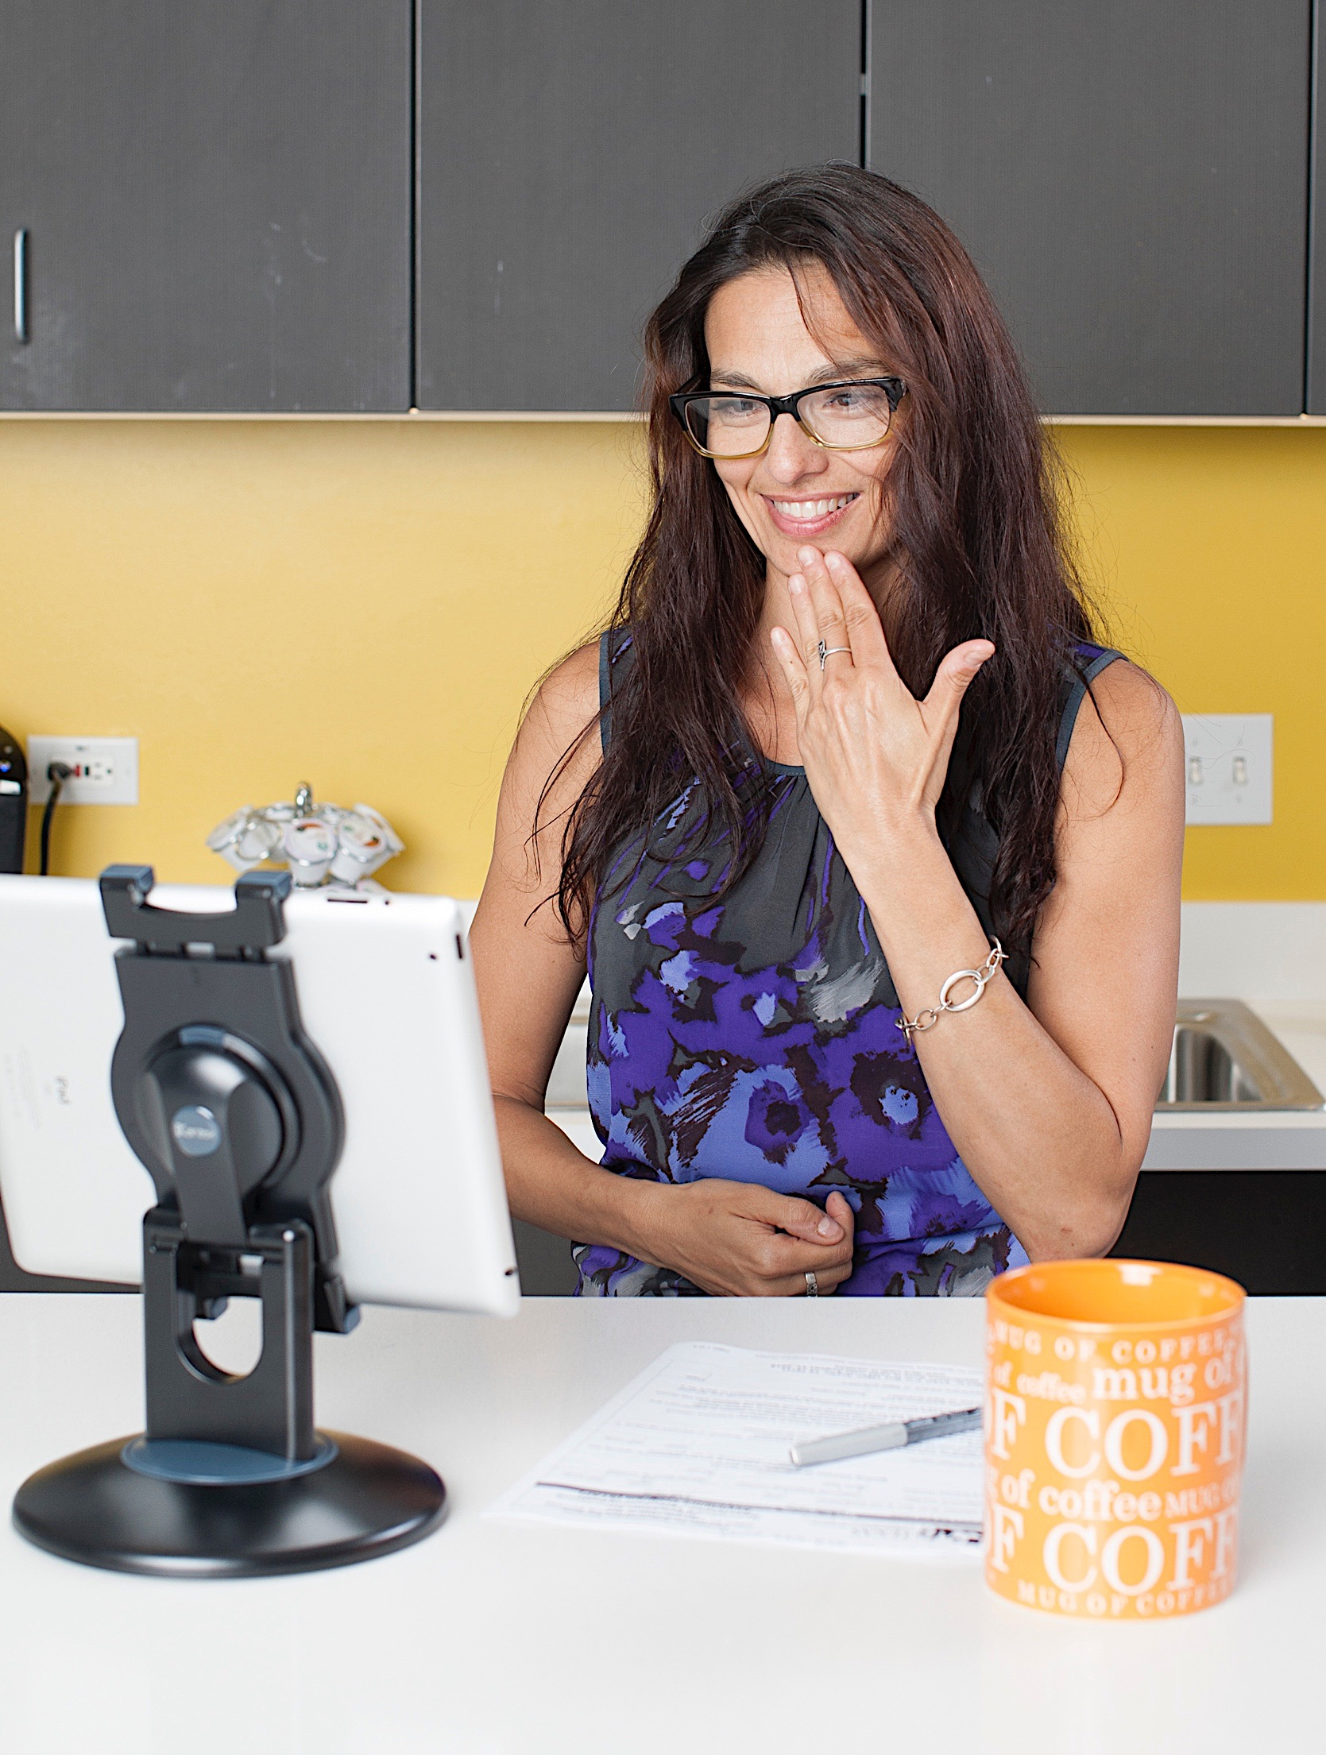
Recruiting and Interviews
Sourcing & Attracting Deaf Talent
Application Process
The Interview Process

Slide 13

Onboarding and Retaining
Training and Support
Open Communication
Create Inclusion Opportunities
Treat D/HH individual as you would with others

Slide 14






Resources

Slide 15
Q & A
Deaf Culture or Community
Workplace Solutions
Accommodations
CSD’s Products or Service Lines

Slide 16





Let’s Keep the Conversation Going…
Ask us questions, share your feedback or inquire about CSD's various services!
https://www.surveymonkey.com/r/ConnectCSDN
Visit our website:
Follow us on Social Media:
www.csdworks.com

Slide 17
THANK YOU

