Slide 1
Adopting an Accessible
Technology Mindset
JAN Academy, USBLN
July 9, 2018
Josh Christianson, Project Director, PEAT
1
Notes:
1

Slide 2
Agenda
What is PEAT?
Accessibility Discussion
Accessible Workplace Technology Ecosystem
Employment Lifecycle
Staff Training
Web Development and Design
CIO and Procurement Officers
Marketing and Public Relations
Human Resources
Legal and Regulatory Staff
Resources
2
Notes:
2

Slide 3
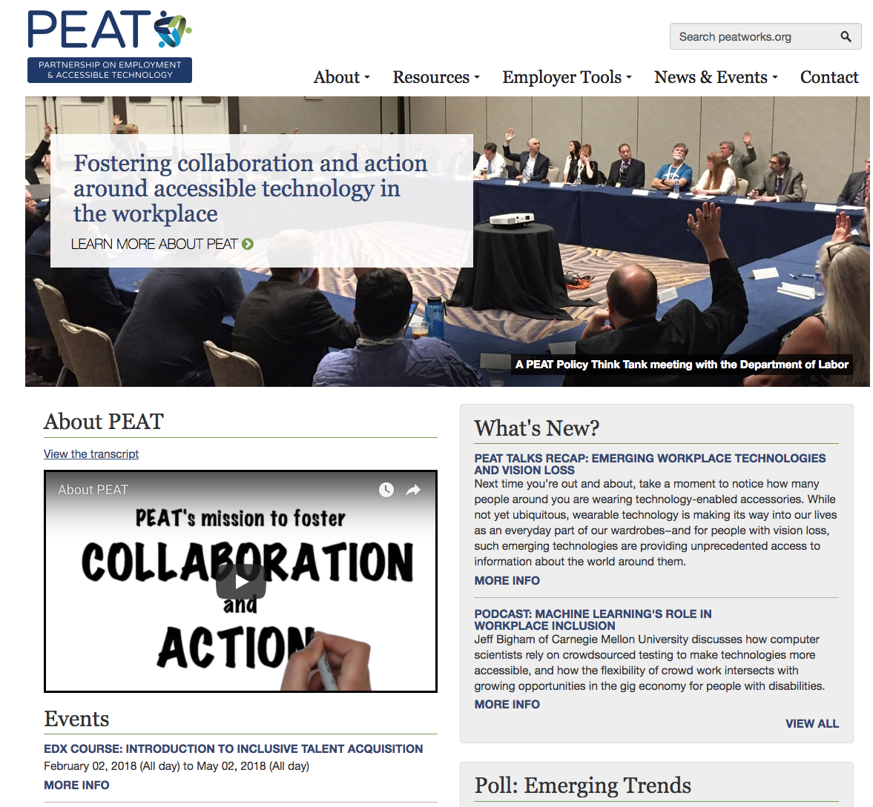
About PEAT
3
Notes:
3

Slide 4
Accessibility Discussion
What is it?
Who uses it?
Where is it?
4
Notes:
4

Slide 5
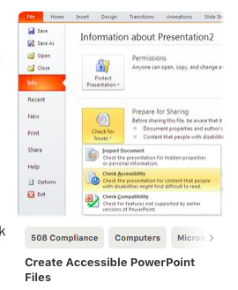
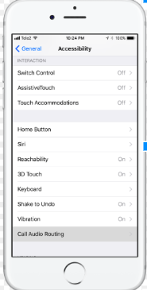
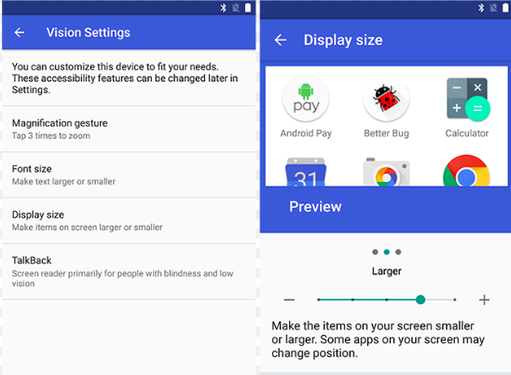
Accessibility Features

Slide 6
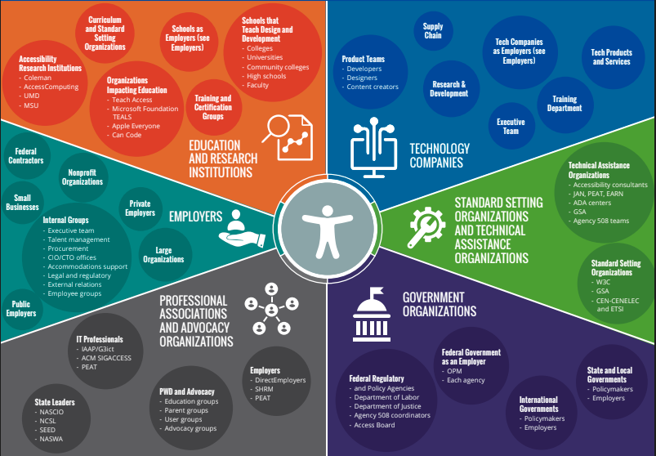
Accessible Workplace
Technology Ecosystem
6
Notes:
6

Slide 7
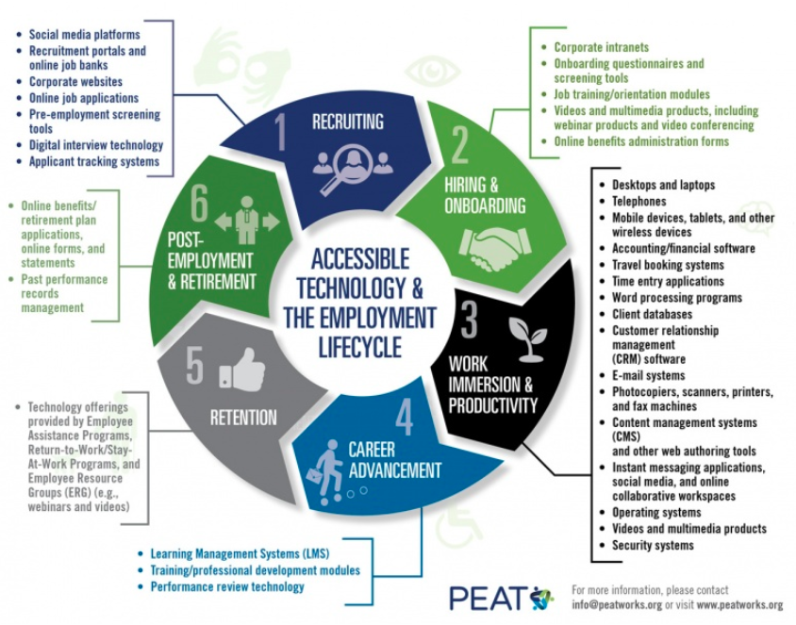
Employment Lifecycle
7
Notes:
7

Slide 8
Staff Training
Web Development and Design
Ten Tips
CIO and Procurement Officers
Procurement Lifecycle
Marketing and Public Relations
Social Media
Human Resources
Job Applications
Legal and Regulatory Staff
Policy
8
Notes:
8

Slide 9
Web Development
and Design
Keyboard accessibility
Plain language
Color contrast
Screen reader compatibility
Alternative text for images
Labeled forms
Captions
Controls for moving content
Controls for timed content
Accessible downloadable files
9
Notes:
9

Slide 10
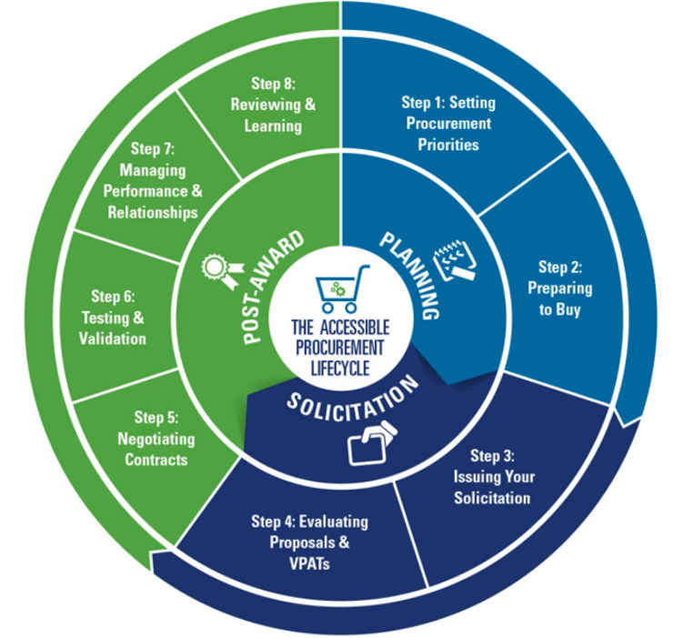
CIO and Procurement Officers
10
Notes:
10

Slide 11
Marketing and
Public Relations
11
Notes:
11

Slide 12
Human Resources
12
Notes:
12

Slide 13
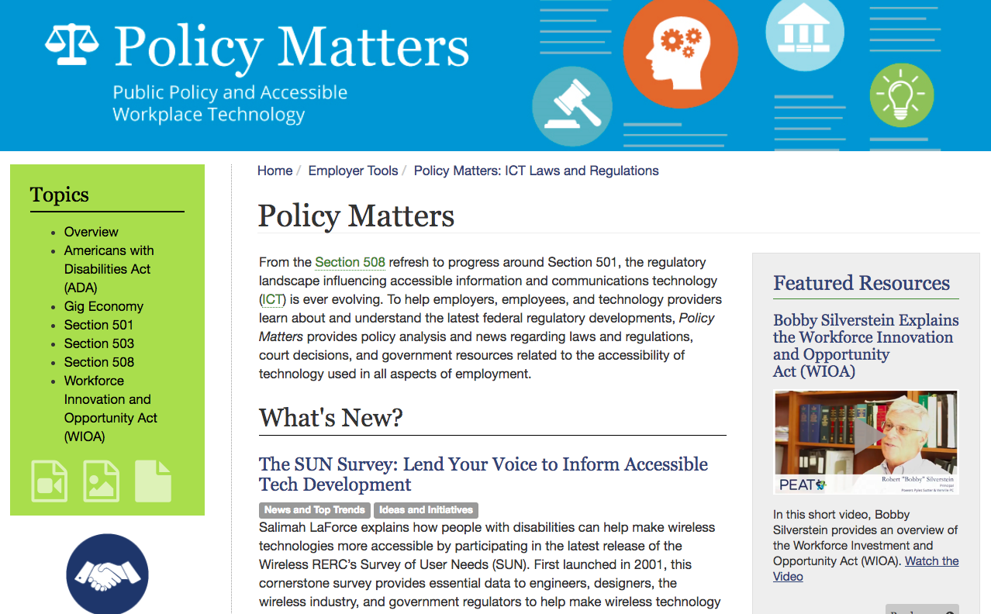
Legal and Regulatory Staff
13
Notes:
13

Slide 14
Resources
Josh Christianson
jchristianson@peatworks.org
www.peatworks.org
Accessible Technology vs. Assistive Technology: http://www.peatworks.org/talentworks/resources/accessible-vs-assistive
Employment Lifecycle: http://www.peatworks.org/talentworks/resources/employment-lifecycle-video
Ensure your practices are inclusive: http://www.peatworks.org/talentworks
Buy technologies that are accessible: http://www.peatworks.org/Buy-IT
Develop and design accessible website: http://www.peatworks.org/content/10-tips-accessible-website
Understand implications of policy: http://www.peatworks.org/policy-matters
14
Notes:
14

