Slide 1
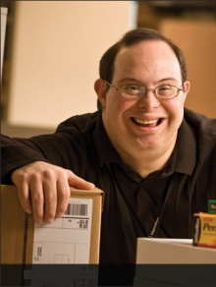
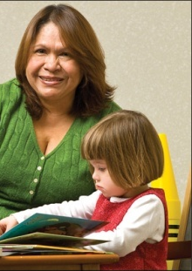

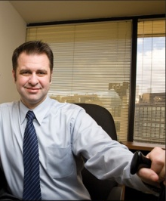
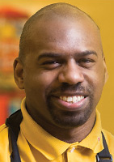
America’s Workforce: Empowering All
Disability in the Workplace
Anne Hirsh, MS, CPDM
JAN Co-Director
October 25, 2018

Slide 2


JAN as YOUR Resource
Overview
  JAN as YOUR Resource
  Normalcy of Disability
  Reasonable Accommodation and the Interactive Process
  Inclusive Practices

Slide 3


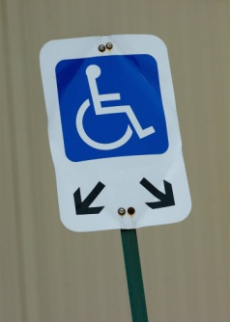
JAN as YOUR Resource
Overview
  Job Accommodation
  Americans with Disabilities Act / Rehabilitation Act
  Entrepreneurship

Slide 4

JAN as YOUR Resource
Overview
  35 Years of Service
  Experienced
  Free
  National
  Easy to Use

Slide 5

JAN as YOUR Resource
Overview
  Employers
  Individuals
  Service Providers
  Others

Slide 6
JAN as YOUR Resource
Our Process
What limitations is the employee experiencing?
How do these limitations affect the employee and the employee’s job performance?
What specific job tasks are problematic as a result of these limitations?
What accommodations are available to reduce or eliminate these problems? Are all possible resources being used to determine possible accommodations?

Slide 7
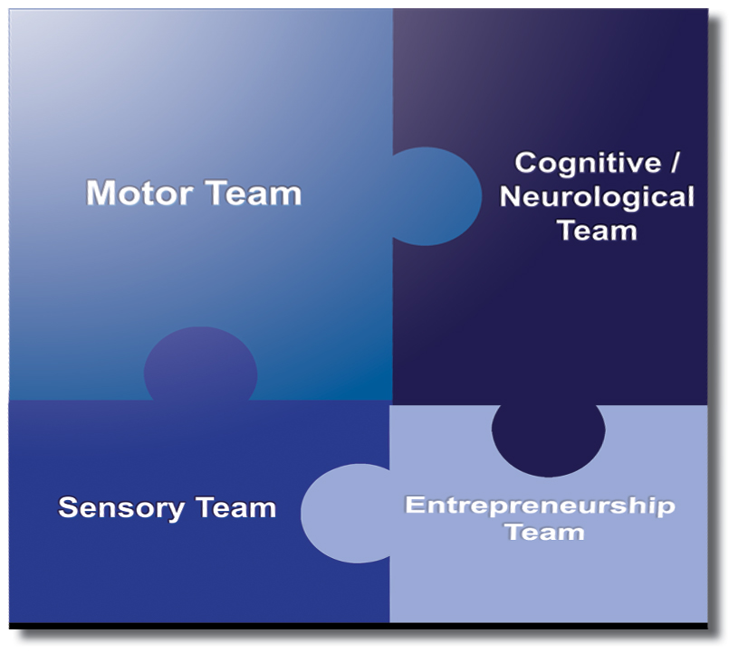


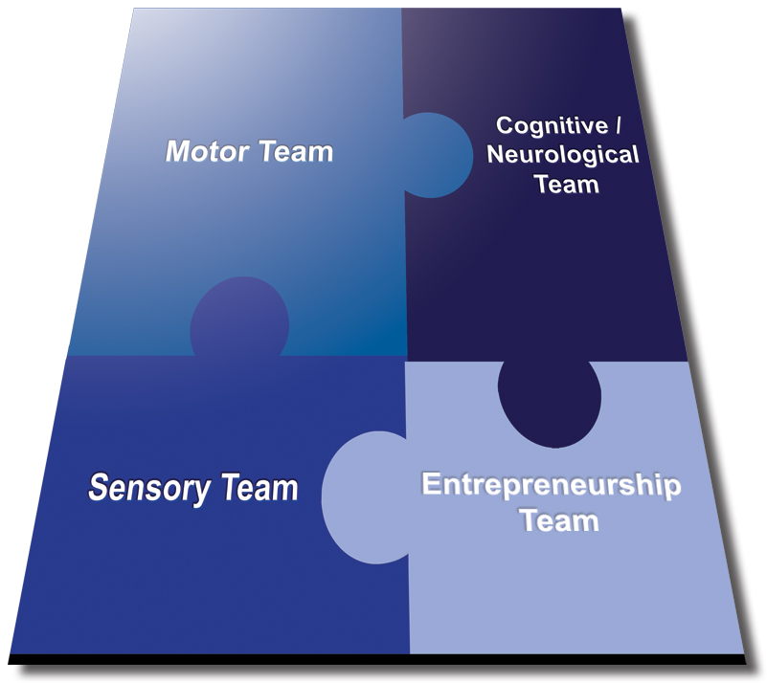


JAN as YOUR Resource

Slide 8
JAN as YOUR Resource
Ask JAN and we…
Meet you where you are.
Help meet timelines.
Assist with the interactive process.
Give targeted technical assistance.
Provide comprehensive resources.
Maintain confidentiality.
Work as your partner to enable you to hire and retain talent.

Slide 9
JAN as YOUR Resource
Expert consultation
Nearly 300 JAN-authored Publications
JAN’s A-Z (Disability, Topic, Limitation, coming soon- accommodation)
Legal libraries that include regulations and EEOC guidance documents
JAN Training Modules and FREE Webcast Series
Contact JAN:
  Live help @ AskJAN.org
  Chat, JAN on Demand, Skype, Text, Social Media

Slide 10
Normalcy of Disability
Disability is Natural
Most everyone has or will experience some form of disability during their lifetime
More than 56 million Americans report having a disability
Graphic Developed by Julie Ballinger, Southwest ADA Center Regional Affiliate, Disability Rights & Issues Consultant, StarReach Enterprises

Slide 11

Normalcy of Disability
10,000 baby boomers reaching age of 65 every day
In 2010, 19% of people with disabilities have reportedly graduated from college …up from 14% in 2004
47,000 service members
  have been wounded in
  action. Hundreds of
  thousands more, nearly
  25 percent of all who
  served, will be diagnosed
  upon returning home with
  other “invisible wounds”

Slide 12

Normalcy of Disability

Slide 13

Normalcy of Disability
Americans with Disabilities Act, as amended (ADAAA)
Section 503, 508, 501 of the Rehabilitation Act of 1973
Executive Orders
Workforce Innovation and Opportunity Act (WIOA)

Slide 14
The Three C’s
Increase Comfort, Confidence, and Competence require developing:
Skills that help to more effectively communicate at work with people with disabilities
Effective and actionable policy and procedures that are executed on a timely basis
Robust communications that make the RA process east to access
Normative practices for engaging with people with disabilities throughout the employee life cycle

Slide 15
Five Signs the Doors are Open
…..and Remain Open
Accessible buildings, technology, etc.
Inclusive ethos - particularly language
Inclusive public relations and marketing, particularly on social media
Collaborative and authentic relationships with national and local resources to recruit/retain talent
Inclusive policies and practices

Slide 16
Accommodation Primer
The basis for inclusive employment is the reasonable accommodation (RA) policy and process
The foundation for reasonable accommodation is a robust interactive process (IP)
The trigger for RA and IP is a request for an accommodation or recognition of an obvious barrier to someone with a known disability
A request for accommodation includes two essential elements – a medical condition and a related challenge at work

Slide 17

What is the Interactive Process (IP)?
A collaborative effort to identify effective accommodation solutions – it’s that simple.
Creates a standard of practice
Facilitates communication and inclusion
Demonstrates good faith
Leads to ADA/Section 501 compliance

Slide 18

  Eight Most Common Types of RA
Modifying schedule or allowing leave time
Making workplace or work station accessible
Modifying methods — testing, communication, or training
Modifying or creating policies
Purchasing or modifying equipment or products
Purchasing a service — reader or interpreter
Restructuring job
Reassignment
Other accommodations
  Telework
  Adjusting supervisory method
  Using a service animal

Slide 19
JAN’s Interactive Process
Step 1: Recognizing an Accommodation Request
Step 2: Gathering information
Step 3: Exploring Accommodation Options
Step 4: Choosing an Accommodation
Step 5: Implementing the Accommodation
Step 6: Monitoring the Accommodation
https://AskJAN.org/topics/interactive.cfm

Slide 20
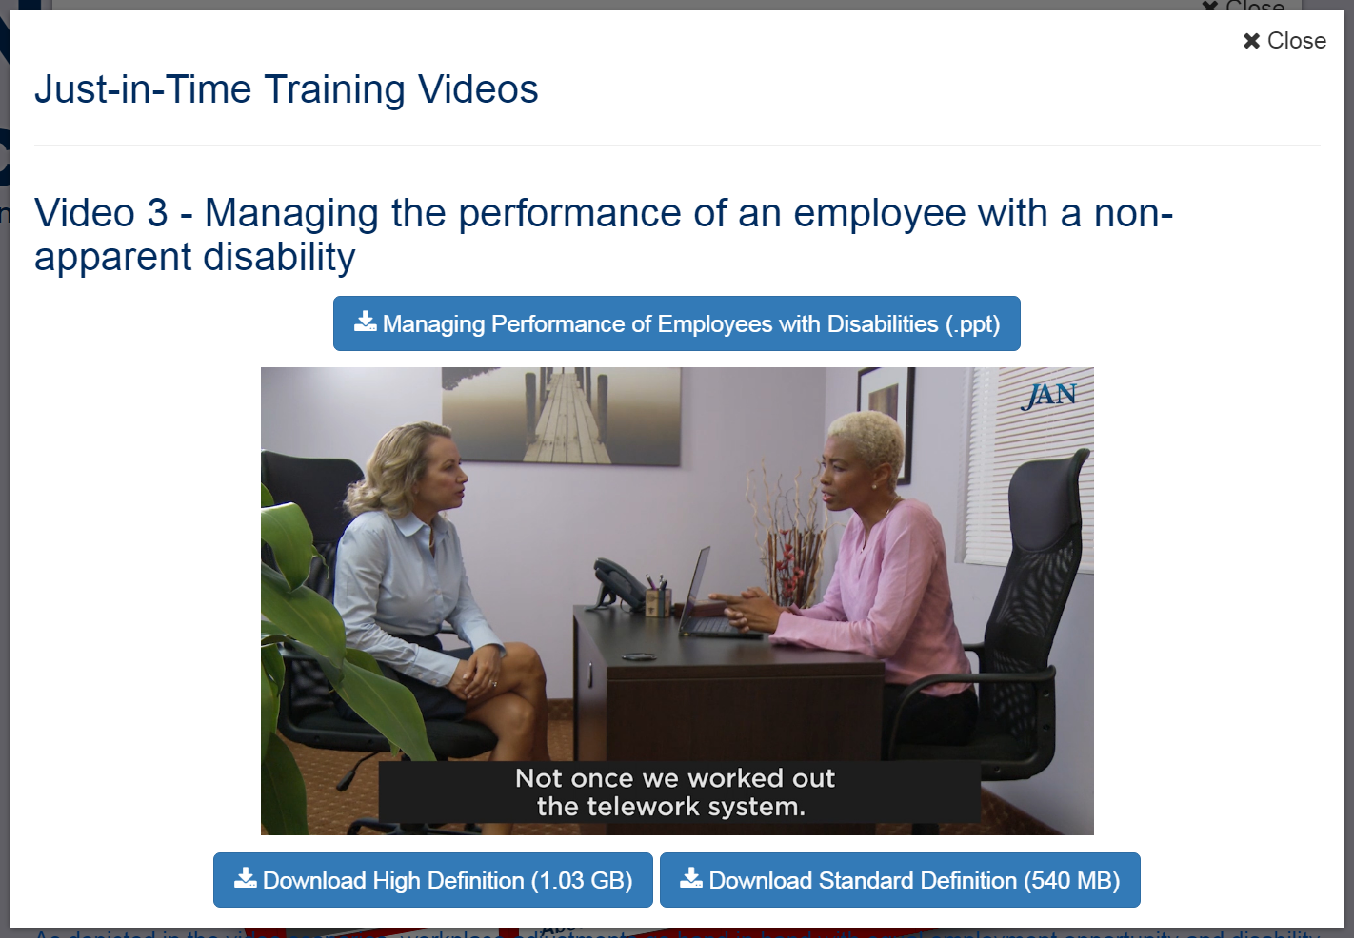
Accommodation Toolkit

Slide 21
Accommodation Resources
  Disability Program Manager
  Department of Defense Computer/Electronic Accommodations Program http://www.cap.mil/
  USDA Target Center https://www.targetcenter.dm.usda.gov/
  JAN https://AskJAN.org/

Slide 22
Being Inclusive: The Basics
Do your part to dispel myths and stereotypes. Speak out when you hear others talk negatively about people with disabilities.
Do ensure your office spaces and business social event venues are accessible.
Do realize and then let it be reflected in your behavior that people with disabilities are more like you then not.
Do offer assistance in that rare instance when a person’s safety may be in jeopardy.

Slide 23

Communication Strategies
We all communicate in various ways with or without a disability.
Pay attention to cues from the person you are communicating with.
Don’t be afraid to say that you do not understand, if you have trouble understanding the person’s speech or request.
Model professional behaviors such as active listening, a service-minded orientation, and a results-focus.

Slide 24
Watch Your Language
Preferred phrases
Person with intellectual/cognitive disabilities
Person who is blind, person who is visually impaired
Person who is deaf, person who is hard of hearing
Person with epilepsy
Person who uses a wheelchair
A person who uses synthetic speech
Person with a disability

Slide 25
Watch Your Language
Antiquated and offensive phrases
Retarded, mentally defective
The blind
The deaf
Afflicted/Stricken by/Victim of
Crippled, lame, deformed
Confined or restricted to a wheelchair
Dumb/mute
Psycho/crazy/nuts/abnormal
A special needs person

Slide 26
Tips for engaging…
Relax. Be approachable.
Smile and look a person with a disability in the eyes as you would with anyone else and listen attentively.
Talk directly to the person with a disability not a companion, assistant, or sign language interpreter.
Use “people first” language like “a person who uses a wheelchair,” but only mention a disability if it is essential to a conversation.

Slide 27
The Don’ts
Don’t be afraid to say that you do not understand. Consider writing information down.
Don’t touch, play with, distract or feed a service animal without the person’s permission.
Don’t touch, lean on, or move a person's mobility device or wheelchair without consent.
Don’t elevate your speech when interacting with people who have disabilities – maintain a natural tone.

Slide 28
The Do’s
Be considerate of the extra time it may take a person with a disability to walk, talk, write or perform a task.
Extend your hand to shake if that is what you normally do. A person who cannot shake hands will let you know.
Sit down when speaking for more than a few minutes with a person who uses a wheelchair so you are at eye level.

Slide 29
In general
I’m working to create a more inclusive work environment. What should I do?
Focus on abilities
Ask the person first
Be aware of adaptive devices and assistive technologies
Be aware of the worksite and its accessible and inaccessible elements.

Slide 30
In general
I’m working to create a more inclusive work environment. What should I do?
Keep accessibility in mind in work-related meetings.
Provide various ways to communicate.
Provide work-related materials such as handbooks or benefits information in accessible format.
Do not make subjective judgments about what a person can or cannot do.

Slide 31
In general
I’m working to create a more inclusive work environment. What should I do?
Do not assume just because a person takes more time to do something that they are not intelligent.
Provide a sign language interpreter for complex meeting or social events where interaction is expected.
Respect personal space.
If a person is in crisis, ask what you can do to help.

Slide 32
Supervision
I am responsible for supervising a new employee with a disability. To be as inclusive as possible, what should I do?
Immediately orient employees with disabilities to the facility and equipment while assessing what is and what is not accessible for the employee
Orient the person to the emergency evacuation procedures.
Respect privacy. All disability information should be confidential.
Know that employee requests for assistance can open discussions of accommodation needs.

Slide 33
Meetings and Trainings
I am planning a face-to-face meeting/training for our unit. To be as inclusive as possible, what should I do?
Send out a request for participant accommodations in advance of the meeting
Know and communicate any emergency evacuation procedures to your audience
Customize information provided in print. (Braille, Large Print, Electronic, etc.)

Slide 34
Meetings and Trainings
I am planning a face-to-face meeting/training for our unit. To be as inclusive as possible, what should I do?
Ensure accessibility of information to be shared including PowerPoint presentations.
Send out information to be discussed during the meeting or the PowerPoint presentation in advance.
Be prepared to describe slides during the presentation.

Slide 35
In assisting someone who is blind
Verbally identify yourself when you approach and then let a person know when you are leaving
Offer assistance and wait for an answer
Ask for specific instructions on how you can assist — “Would you like directions to…?” “Would you like to take my arm?”
If offering to assist someone to find a seat, speak the person’s name and tap on the table where a space is available
If offering to help someone as they sit down, let the person know as you guide the person’s hand towards the back of the chair.

Slide 36
In assisting someone who is hard of hearing or deaf
To get a person’s attention, it is okay to tap the person on the shoulder or by waving your hand.
Ask what is the best way to communicate — reading lips, signing, gesturing, in writing, texting, etc.
When possible speak in a well-lit room that is free from background noises.
Do not put hands in front of your face or food items in your mouth when talking.
Maintain eye contact and direct your communication to the person who is deaf.

Slide 37
In assisting someone who has a mental health condition
Avoid stereotypes and assumptions about the individual and how they may act.
Recognize but respect differences in people. A person may act differently and have problems interpreting social cues.
Be patient. Allow the individual to think and answer questions.
Know that stress can aggravate a situation, alleviating some of that stress may de-escalate the situation.
In a crisis, stay calm and be supportive as you would with anyone. Ask how you can help, and find out if there is a support person who can be sent for.

Slide 38
Remember this…
Do not refer to or talk about a person’s disability at all unless it is crucial to the conversation.
Do not make it your role to advocate for a person with a disability.
Do not assume a person cannot function on their own or perform a task.
Do your part to dispel myths and stereotypes. Speak out when you hear others talk negatively about people with disabilities.
Do ensure your office spaces and business social event venues are accessible.
Do realize and then let it be reflected in your behavior that people with disabilities are more like you then not.
Do offer assistance in that rare instance when a person’s safety may be in jeopardy.

Slide 39
Key to Inclusive Culture
Accommodation
=
Equal Employment
=
Inclusive Workplace Culture

Slide 40

Inclusive Workplace

Slide 41






Contact JAN
JAN Consultants can be reached M-F 9am-6pm ET by
Phone – (800) 526-7234 voice; (877) 781-9403 TTY
Email - jan@AskJAN.org
JANonDemand -https://AskJAN.org/JANonDemand.cfm
Chat available online at http://AskJAN.org
Skype - Janconsultants
Text – (304) 216-8189
Website - http://AskJAN.org

Slide 42

Questions?

