Slide 1
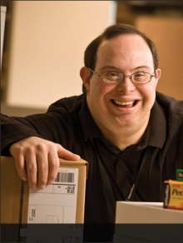



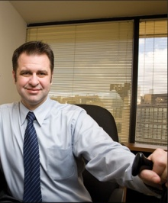
JAN Academy 2018
Developing a NextGen Disability Inclusive Workplace

Slide 2
Agenda
9:00 AM to Noon
Part 1 includes two workshops - “Developing a NextGen Accommodation Infrastructure” and “Developing Your NextGen Disability Inclusive Culture.”
Noon to 1:00 PM
Lunch on Your Own
1:00 PM to 4:00 PM
Part 2 includes a workshop – “Adopting an Accessible Technology Mindset” and a panel of employee experts in “Perspectives from the Field: How leading companies create accommodating workplaces.”

Slide 3
Goal
Provide disability-inclusive strategies and tactics enabling you to leapfrog into the NextGen of corporate disability leadership.

Slide 4

About JAN
JAN supports workplace inclusion by providing:
Free, national, confidential consultation on workplace accommodation and Title 1 of the ADA
Coaching to customers on the interactive process
Product information for technologies used as accommodations in the workplace
Localized referrals to service organizations
and government agencies throughout
the U.S.

Slide 5
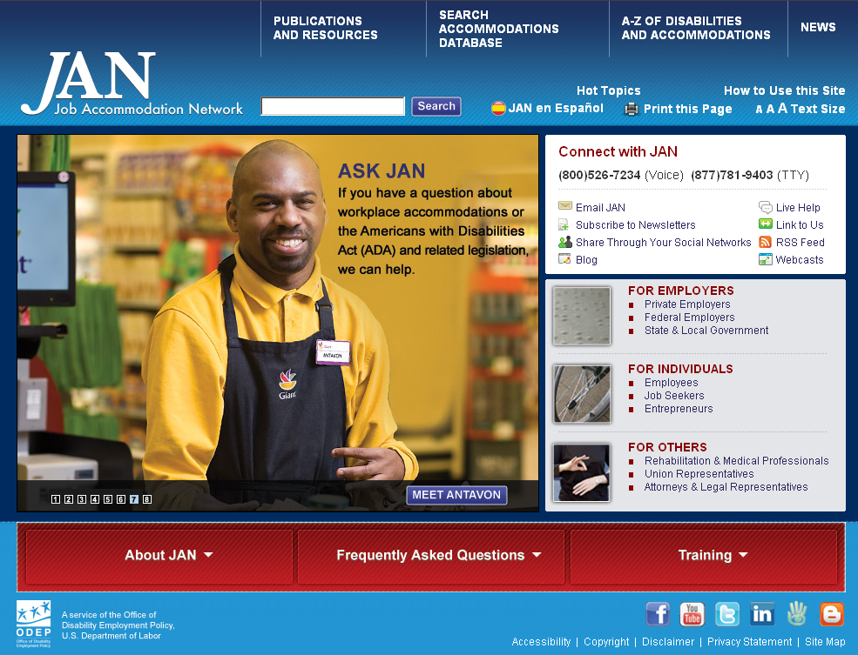
About JAN
On-site, online, and archived training
Most comprehensive Website available on practical job accommodations

Slide 6
Five Signs the Doors are Open
  1. Inclusive public relations and marketing
  2. Accessible buildings, event planning, etc.
  3. Inclusive Accommodation policies and practices
  4. Inclusive ethos or culture
  5. Inclusive Information and Communication Technology (ICT)

Slide 7
Assess Your Workplace
Audit your accommodation process and practices
Audit your culture
Audit your ICT
Notes:
Baseline

Slide 8
Assess Your Workplace
How many accommodation requests are made per year?
What disability/chronic health condition is most frequently involved?
What accommodations are the most common accommodations granted?
Who is involved in the process and how are they trained?

Slide 9
Assess Your Workplace
What is your denial rate?
How many accommodation appeals have been submitted?
How long does it take for a typical accommodation to be made?
How many EEOC disability complaints has your company had? What are the charges?
What is your average cost of accommodation?

Slide 10
Assess Your Workplace
Is your policy actionable?
Who is covered?
What is the step-by-step process?
How is the process initiated?
Where does one access a request form?
What is everyone’s role in the process?

Slide 11
Assess Your Workplace
Is your policy actionable?
What are the touchpoints for communication?
What are the timelines for a decision?
What is a temporary or trial accommodation?
What is the appeals process?
Is confidentiality assured and communicated?

Slide 12
Assess Your Workplace
What is the current state of our process?
Take a “Secret Shopper” approach
Choose 3-5 disability/chronic health conditions and create scenarios
Have the secret shopper initiate a accommodation
Monitor the request throughout the process
Detect process dysfunction, bottlenecks, and communications challenges

Slide 13
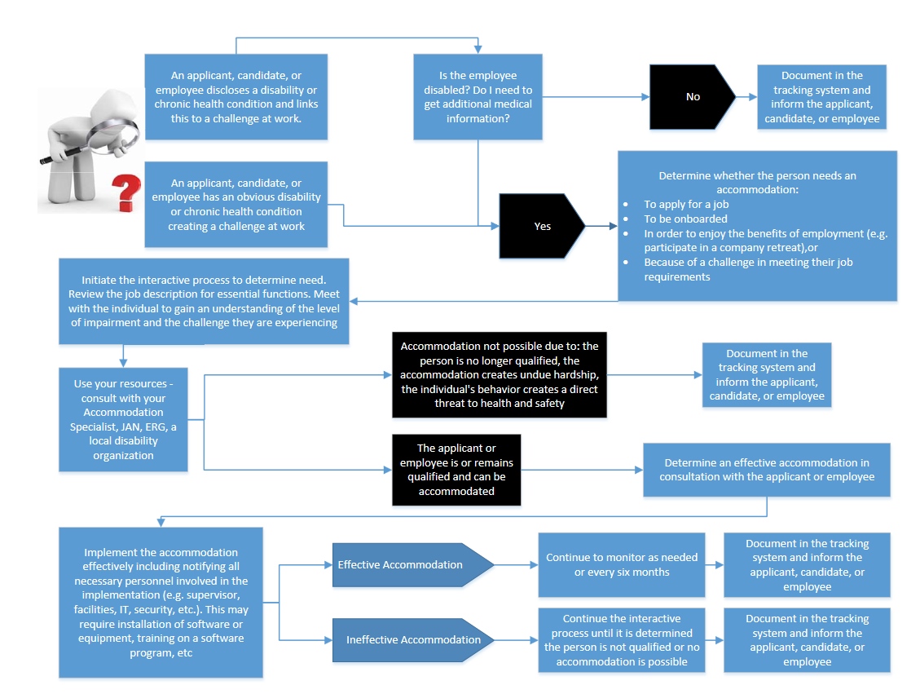
Design a Process Flowchart
Notes:
Use this to check the results of your review and secret shopper exercise.

Slide 14
Assess Your Workplace
What are other companies doing?
Centralized team for intake and triage of requests
Centralized fund to pay for accommodations
Accommodation Tracking system
Integration with talent acquisition, benefits (STD, LTD, Workers Compensation, RTW
Expedited Accommodation Procurement

Slide 15
Assess Your Workplace
What are other companies doing?
Third-party vendor
Develop a list of preapproved accommodation items not requiring a full RA assessment
Identified Executive Sponsor to resolve interdepartmental challenges
Having an accommodation satisfaction question in your employee engagement survey

Slide 16
Refresh Your Practice
Develop robust, actionable policy and process
Develop a Suite of Accompanying Accommodation Forms
Develop Process Flow Chart and Checklist(s)
Develop or Purchase an Accommodation Tracking System
Communicate and Educate

Slide 17
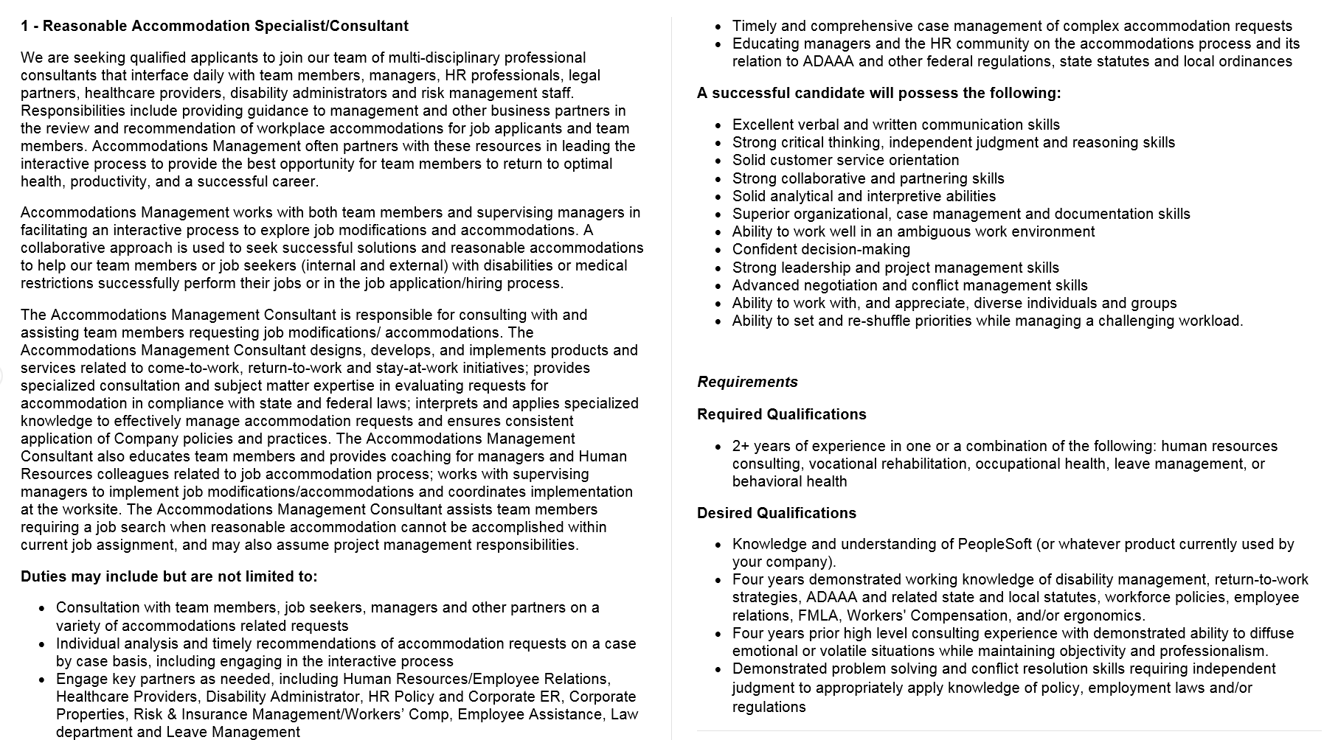
Refresh Your Practice
Notes:
Subject Matter expert

Slide 18
Refresh Your Practice
Notes:
Checklist

Slide 19
What is the Toolkit?
An free, online “living” toolkit that captures and continuously updates best and emerging practices in providing accommodations in the workplace.
http://AskJAN.org/toolkit/
Notes:
Many companies have noted that they could benefit for emulating best/emerging RA practices including:
Easier-to-navigate RA processes for employees and managers
Better mechanisms for tracking and reporting
Enhanced data-gathering practices (to gauge how satisfied employees and their managers are with RAs, financial savings, return to work, etc.)
More transparent and effective intersections between Section 503 self-ID encouragement and identifying as a person with a disability for purposes of obtaining an RA

Slide 20
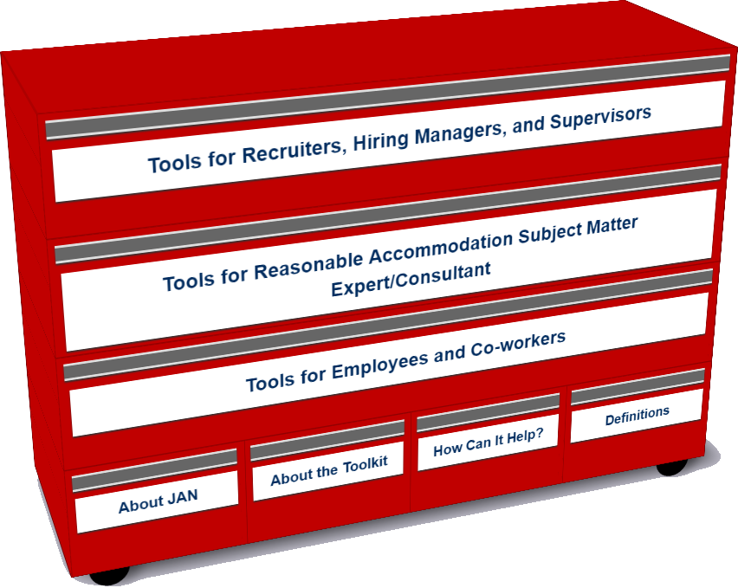
Who uses the Toolkit?
Recruiters, Hiring Managers and Supervisors
Accommodation Consultant/Subject Matter Expert
Employees and Co-workers — Allies
Notes:
LO

Slide 21
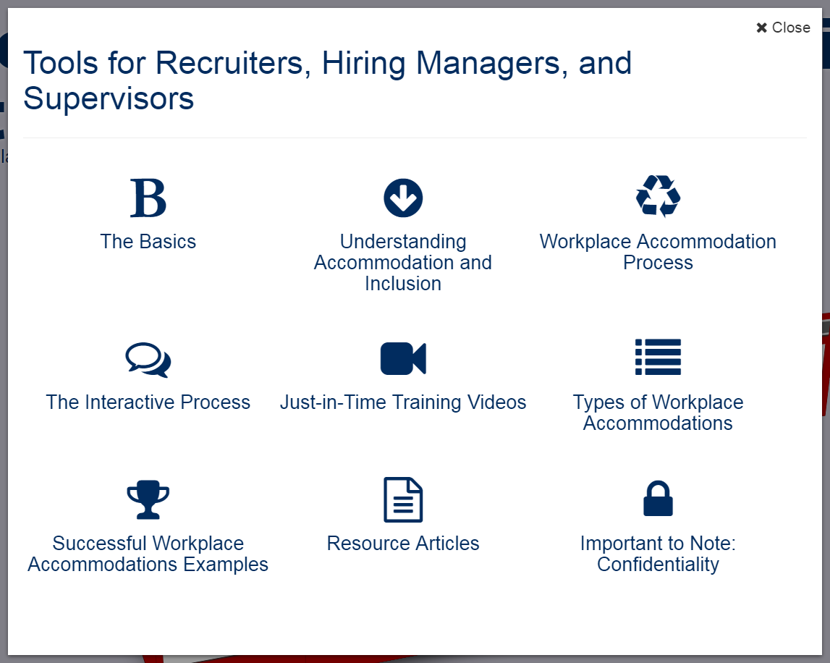
Accommodation Toolkit
Recruiters, Hiring Managers and Supervisors
Notes:
LO

Slide 22
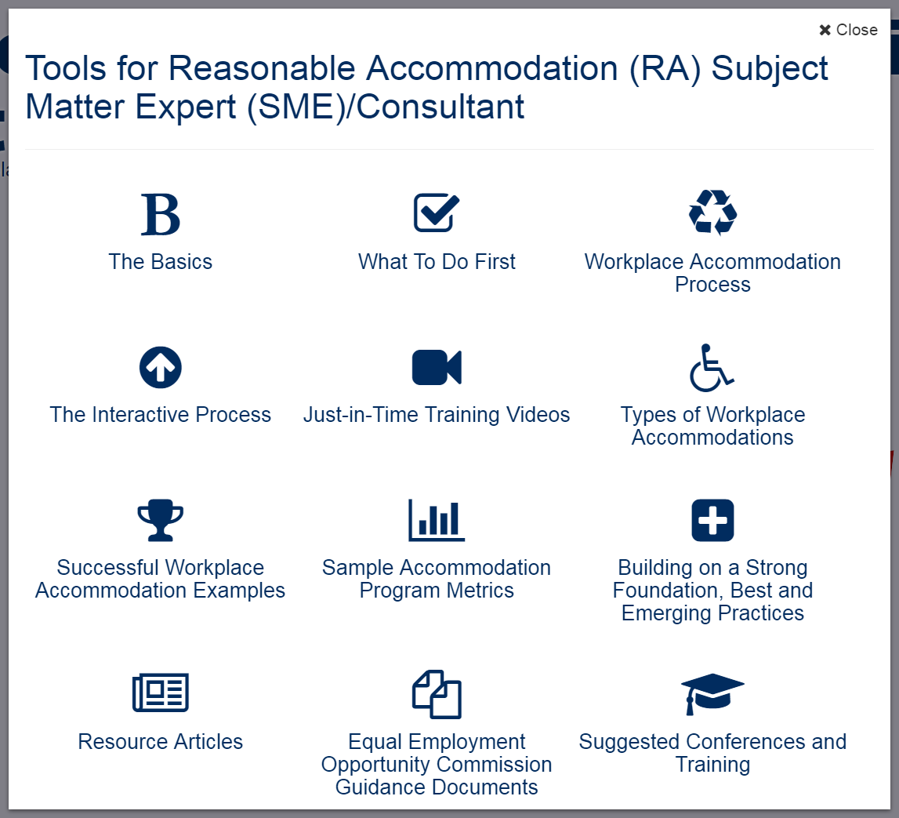
Accommodation Toolkit
Accommodation Consultant/Subject Matter Expert
Notes:
LO

Slide 23
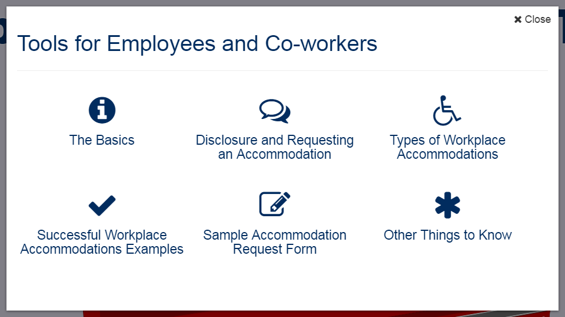
Accommodation Toolkit
Employees and Co-workers — Allies
Notes:
DD

Slide 24
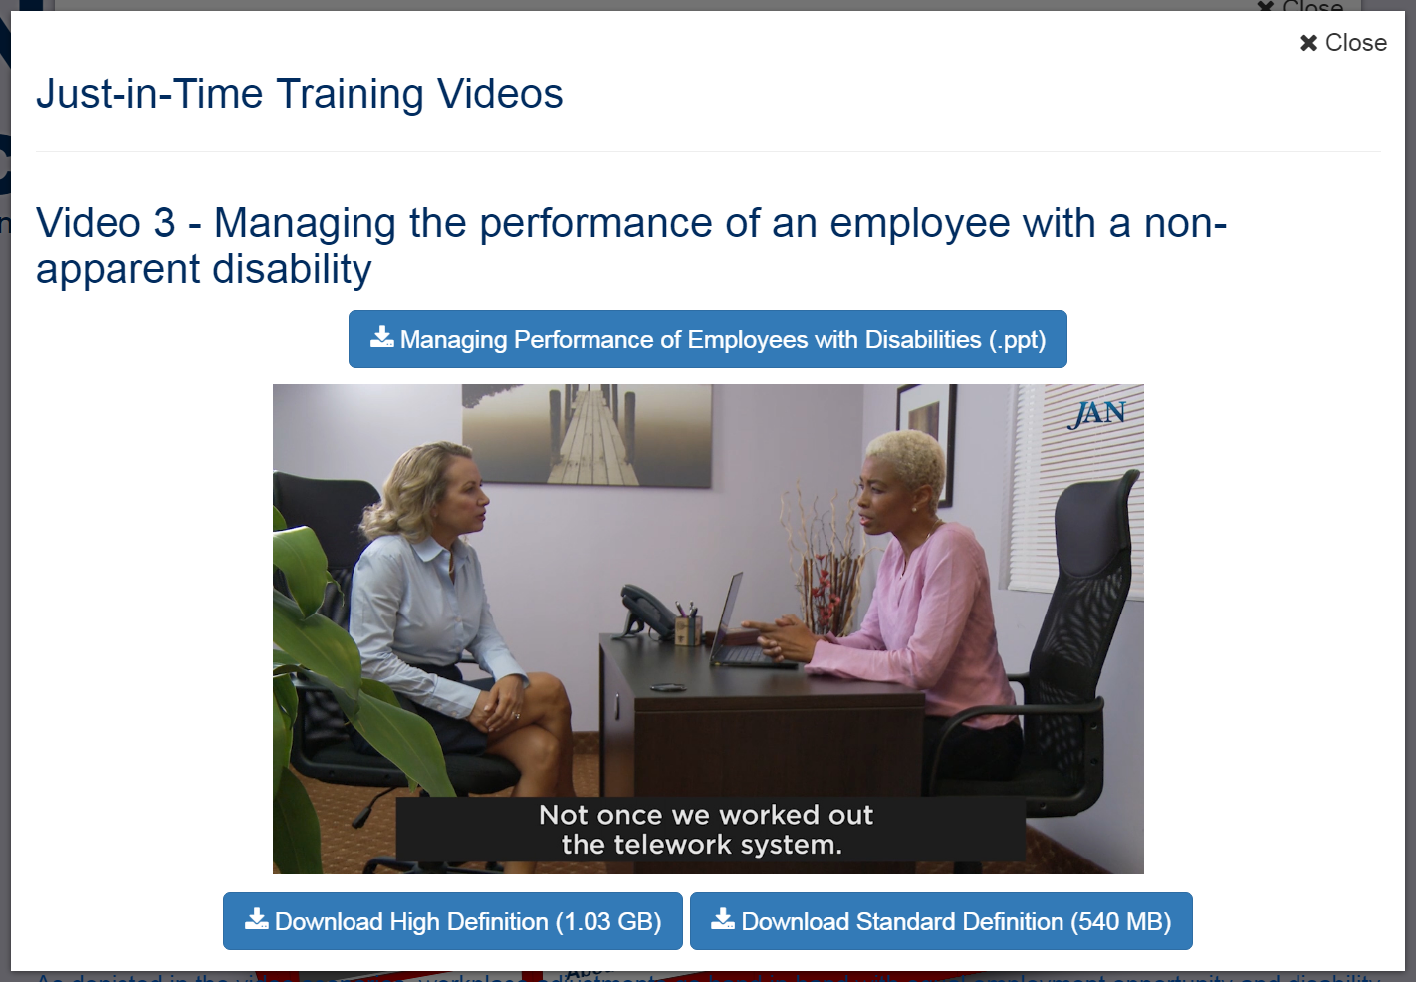
Accommodation Toolkit
Notes:
DD tee up video

Slide 25
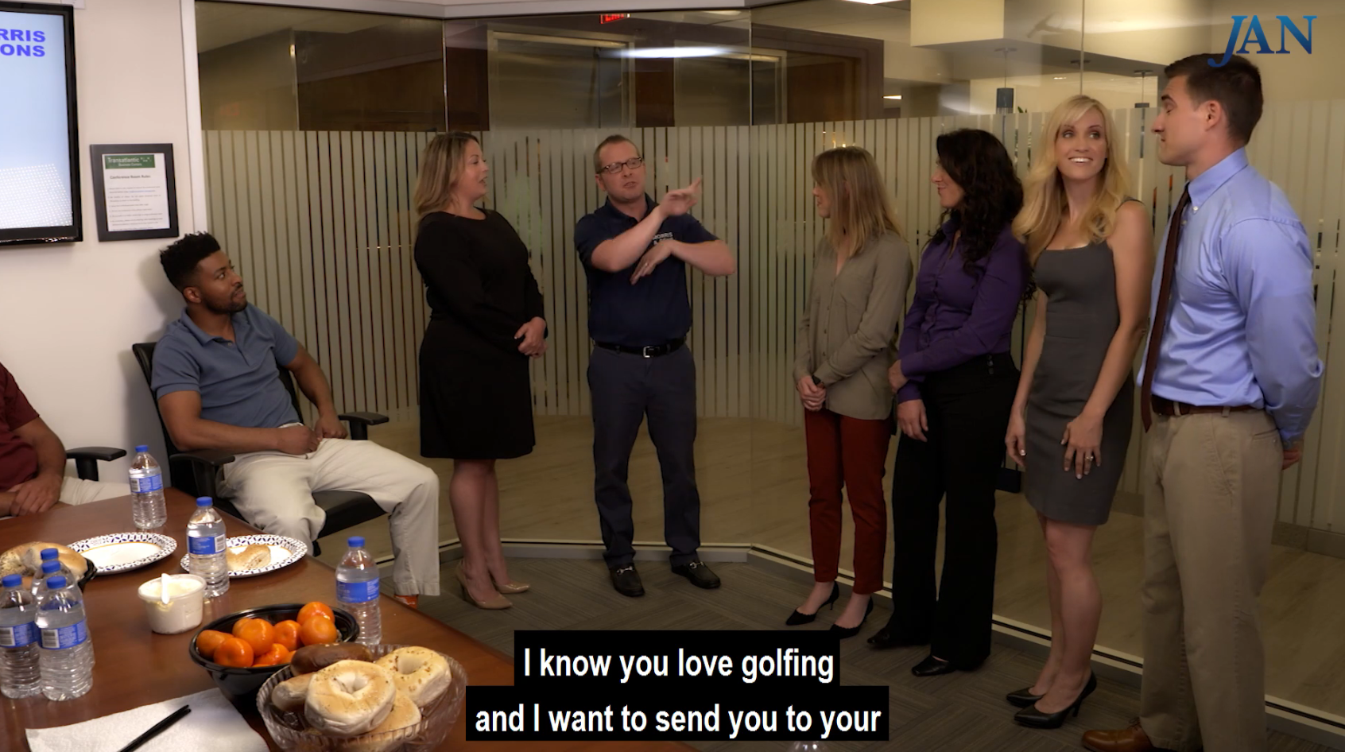
Accommodation Toolkit
Advancing an Employee Who is Deaf
Notes:
DD tee up video

Slide 26
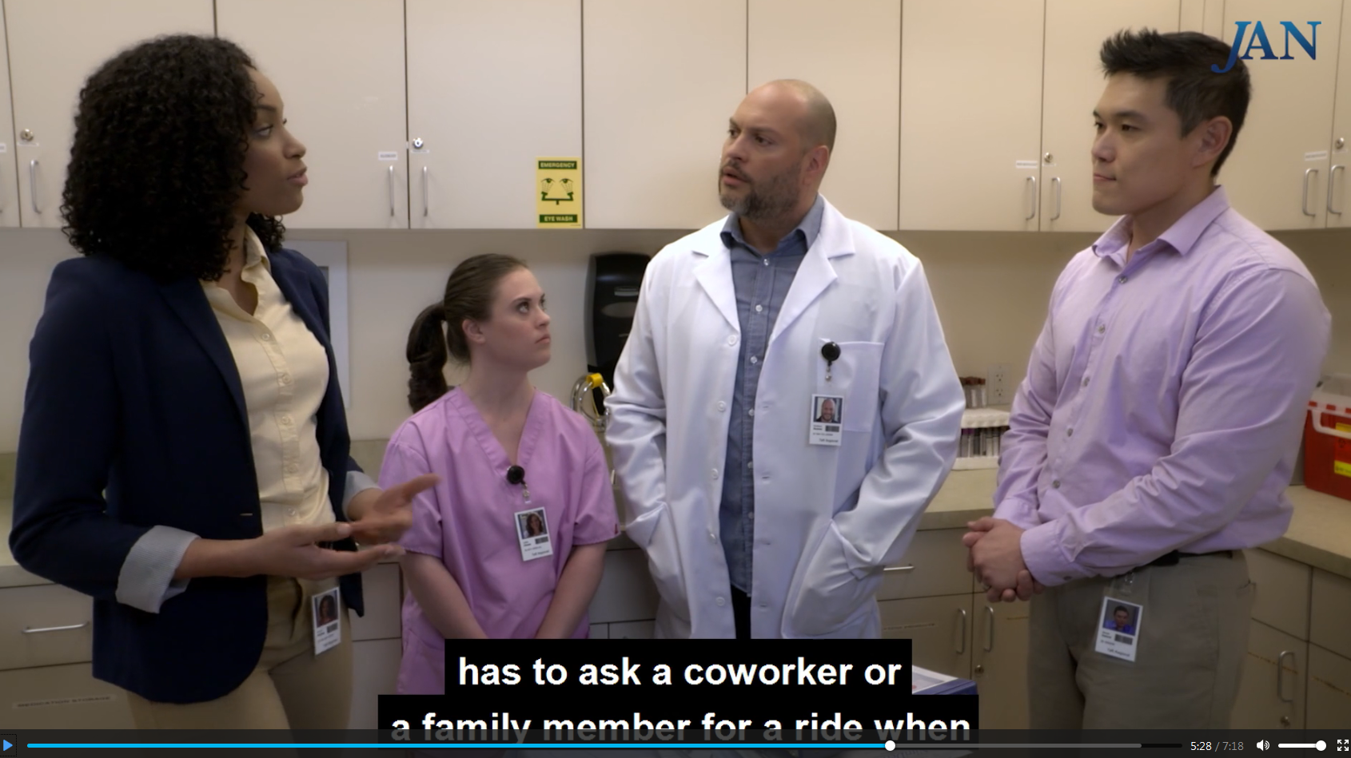
Accommodation Toolkit
Retaining an Employee Who has an Intellectual Disability
Notes:
DD tee up video

Slide 27
Enabling Technologies
Big Idea
Mobile Accommodation Solution (MAS) is designed to help streamline the disability accommodation process at various phases of the employment cycle.
https://AskJAN.org/landingpage/MobileAccommodationSolution/
Funded by the National Institute on Disability, Independent Living, and Rehabilitation Research (NIDILRR)

Slide 28
MAS App
Collaborators
Center for Disability Inclusion
Job Accommodation Network (JAN)
IBM
US Business Leadership Network
American Association of People with Disabilities
Council of State Administrators of Vocational Rehabilitation
National Business and Disability Council
Disability Management Employers Coalition

Slide 29
MAS App
Users
Talent management, human resources, employer relations, and/or accommodation staff
Employment service providers
Applicants and employees with disabilities

Slide 30
MAS App
Functionality
Easy-to-use, secure mobile case management tool
Robust accommodation tracking tool
Best and emerging accommodation practices and forms embedded within tool
Access to JAN Consultants and myriad other resources

Slide 31
MAS App
Future Functionality
PC-based MAS
Capable of video upload
Open source
Cloud-enhanced
Store medical and accommodation history
Reporting function

Slide 32







For More Information
Contact JAN
(800) 526-7234 (V) - (877) 781-9403 (TTY)
AskJAN.org
jan@askjan.org
(304) 216-8189 via Text
janconsultants via Skype
Thank you for attending!

