Slide 1
Inclusion@Work
JAN Academy
Notes:
EARN Logo: Employer Assistance and Resource Center on Disability Inclusion: Advancing Workforce Diversity
Presentation Title: #InclusionWorks: Disability in the Workplace
Presentation Subtitle: General Electric – October 18, 2016
Presenter Name: Derek Shields, EARN Consultant
AskEARN.org

Slide 2
Employer Assistance and Resource Network on Disability Inclusion (EARN)
Resource for employers seeking to proactively recruit, hire, retain, and advance people with disabilities
Access trainings, webinars and publications
Funded by U.S. Department of Labor’s Office of Disability Employment Policy (ODEP) under a cooperative agreement with The Viscardi Center
Collaborative of multiple partners with different perspectives
EARN Website: www.AskEARN.org
Notes:
This Center is a resource for employers seeking to recruit, hire, retain and advance qualified employees with disabilities. It is funded through a cooperative agreement with the U.S. Department of Labor’s Office of Disability Employment Policy, or ODEP. But we’re not doing it all alone; rather, we lead a collaborative of partners, each of whom brings a different perspective to the issue.
What exactly does EARN do for employers? We support them in their efforts to recruit, hire, retain and advance qualified individuals with disabilities. Here’s how:
Education and Resources:
This website—AskEARN.org—is the initiative’s online hub, serving as a centralized source of employer-focused tools, resources and publications on disability inclusion. Check out our easy-to-navigate information on a wide range of topics, from recruiting qualified job candidates to tax incentives for hiring people with disabilities.
In-Person and Online Training:
EARN is your gateway to free training on the latest disability inclusion topics. Take advantage of our interactive webinars, download free training resources to share with your staff, or request a customized, in-person training delivered by an EARN expert. Topics include, but are not limited to: disability etiquette, interviewing job candidates with disabilities and reasonable accommodations. (EARN webinars frequently offer HRCI credits for attendance!)
One-on-One Technical Assistance:
EARN also provides one-on-one online consultations with disability employment experts. We’ll answer your questions about your specific situation and connect you with local resources that can help you source and support job candidates with disabilities. Rest assured that all inquiries are confidential; no contact information is shared with any outside entity.
News and Information:
EARN makes it easy to stay up to date on the latest disability employment news and information. Subscribe to our e-newsletter and e-blasts, follow us on Facebook, Twitter, LinkedIn, YouTube, and visit our home page to learn about upcoming events, developing news and promising practices in the world of disability diversity and inclusion.
Research and Exemplary Practices:
Behind the scenes, EARN is busy researching disability inclusion issues and gathering exemplary policies and practices from employers who are getting it right. This research informs the tools and resources we bring to you through AskEARN.org and ensures that we bring you the latest, most effective technical assistance.
To learn more about the Employer TA Center’s activities, I encourage you to visit our main website at AskEARN.org, where you can find out about its trainings, webinars and publications. AskEARN.org is also where you can also learn about the Workforce Recruitment Program, or WRP, a great program that connects employers, both private and public, with highly qualified college students and recent graduates with disabilities seeking summer internships or permanent employment. While on the site, be sure to sign up for our biweekly newsletter and alerts for upcoming webinars and other educational events.
Partners in the Employer TA Center include:
The National Conference of State Legislatures
The U.S. Business Leadership Network
The George Washington University
The Georgia Institute of Technology’s Center for the Study and Advancement of Disability Policy
Concepts Communications
DiversityInc

Slide 3
EARN
The Viscardi Center
Georgetown University
Concepts Communications
Trainers & Consultants
George Washington University

Slide 4
Framework to Build an Inclusive Culture
Develop and communicate policy statements and other illustrations of the company’s commitment to inclusion of workers with disabilities
Establish an enterprise-wide team consisting of executives, managers and employees with disabilities to support and advance the recruiting, hiring, retention and promotion of individuals with disabilities
Disability-focused employee resource group (ERG) or affinity group
Make and publicize the business case for employing qualified individuals with disabilities
Include disability as part of the company’s diversity activities
Notes:
Build and Inclusive Culture
From Business Strategies that Work - Lead the Way
LEAD THE WAY: INCLUSIVE BUSINESS CULTURE
Commitment at all levels of an organization is critical to creating and maintaining a truly diverse and inclusive work environment. Establishing an inclusive business culture begins with leadership at the highest levels, including top executives, their leadership teams, and boards of directors. Mid-level managers and supervisors, and particularly human resources staff and other personnel involved in hiring decisions, must also understand the role they play in facilitating an inclusive environment. Finally, communicating the company’s goal of an inclusive and diverse workplace to employees at all levels of the organization and indicating what they can do to help are also extremely important. One action company leaders can take is to adopt formal expressions of commitment and intent related to the recruitment, hiring, retention, and advancement of qualified individuals with disabilities, including veterans with disabilities. Successful approaches large and small employers have used in this area include the following:
1. Developing and communicating policy statements and other illustrations of the company’s commitment to inclusion of workers with disabilities. (For example, “Business is becoming increasingly global. As “COMPANY A” continues to expand, our differences—from our culture and work habits, communication style, and personal preferences—are becoming even more essential to our business strategy. We are working hard to create an environment in which all employees are valued and respected, including those with disabilities.”)
2. Establishing an enterprise-wide team consisting of executives, managers, and employees with disabilities to support and advance the recruiting, hiring, retention, and promotion of individuals with disabilities. This team may also function as a disability-focused employee resource group (ERG) or affinity group.
3. Making (and publicizing) the business case for employing qualified individuals with disabilities. (For example, framing the issue in communication with managers, employers, etc. in terms of return on investment and direct and indirect benefits to the company and its employees; stressing that enhancing diversity by employing people with disabilities recognizes changing demographics of the workforce; improving employee engagement, productivity, and reduction of costs; and enhancing retention and advancement).
4. Including disability as part of all of the company’s diversity policies and activities. This includes using the words “disability” and “people with disabilities” in statements defining the company’s diversity policies, inviting disability organizations and people with disabilities to the company’s diversity events, and recognizing that people with disabilities are part of the company’s other diverse communities (including racial and ethnic minorities, veterans, and the LGBT community).
5. Affirming in policy statements the company’s commitment to equal employment opportunity for people with disabilities and taking affirmative steps to employ, retain, and advance qualified individuals with disabilities at all levels.
6. Encouraging workers with disabilities and other employees to identify barriers and individual and systemic concerns without fear of reprisal, and also providing mechanisms to allow them to provide this information anonymously or confidentially.
Establishing a universal policy providing workplace flexibility and accommodations for all applicants and employees, with and without disabilities, including the use of telework options, if appropriate.

Slide 5
Inclusion@Work Framework
9
Notes:
Inclusion @ Work Framework
Circular graphic in the middle of the screen with each of the following phases in a different color:
Lead the Way: Inclusive Business Culture
Build the Pipeline: Outreach and Recruitment
Hire (and Keep) the Best: Personnel Processes
Ensure Productivity: Reasonable Accommodation Procedures
Communicate: External and Internal Communication of Company Policies and Practices
Be Tech Savvy: Accessible Information and Communication Technology
Partnership on Employment & Accessible Technology (PEAT) TalentWorks
Grow Success: Accountability and Continuous Improvement Systems
Image and content available at: www.askearn.org/inclusion-work/

Slide 6
Lead the Way: Inclusive Business Culture

Slide 7
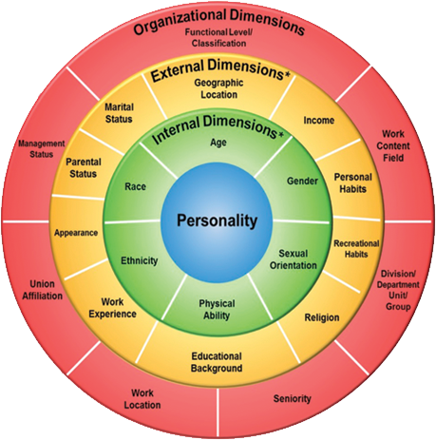
Four Layers of Diversity
7

Slide 8
Brewer's Optimal Distinctiveness Framework
 | Low Belongingness | High belongingness
High value in uniqueness | Differentiation: | Inclusion:
 | Individual is not treated as an organizational insider in the work group but their unique characteristics are seen as valuable and required for group/ organization success. | Individual is treated as an insider and also allowed/ encouraged to retain uniqueness within the work group.
Low value in uniqueness | Exclusion: | Assimilation:
 | Individual is not treated as an organizational insider with unique value in the work group but there are other employees or groups who are insiders. | Individual is treated as an insider in the work group when they conform to organizational/ dominant culture norms and downplay uniqueness.
Individuals experience feelings of inclusion when a high value is placed on uniqueness with a corresponding high value on belongingness
8
Notes:
Brewer's Optimal Distinctiveness Theory (ODT). This theory essentially explains the tension that people experience between the need to be a unique individual and the need to belong with others.
8

Slide 9
The Unconscious Mind
To create an inclusive environment, we must understand our unconscious mind
Why we do what we do
Why we think what we think
Why we feel what we feel
9
Notes:
9

Slide 10
Research Confirms….
< 15% of men are over 6’ tall
60 % of Corporate CEOs are over 6’ tall
< 4% of men are over 6’4” tall
36% of corporate CEOs are over 6’4” tall
https://www.youtube.com/watch?v=3EoNYklyShs
10
Notes:
Same is true for Generals and Admirals in the Military and Presidents of the US
< 15% of men are over 6’ tall
60% of corporate CEOs are over 6’ tall
< 4% of men are over 6’2” tall
36% of corporate CEOs are over 6’4” tall
10

Slide 11
Test Your Attentiveness
Wrong mental maps
lead to wrong solutions
which lead to lost resources
http://www.youtube.com/watch?v=Ahg6qcgoay4
11
Notes:
11

Slide 12
Conditions for Unconscious Filters and Bias
12
Notes:
A high need for cognitive closure might then invite bias in:
selecting the most relevant information one should attend to for increasing chances of adaptation
initiating and sustaining cognitive manipulations that are required to achieve particular outcomes
making judgments and assessments of input information
weighing information during the course of decision-making
12

Slide 13
Bias
Like Me Bias
Confirmation Bias
13
Notes:
We love to agree with people who agree with us. It's why we only visit websites that express our political opinions, and why we mostly hang around people who hold similar views and tastes. We tend to be put off by individuals, groups, and news sources that make us feel uncomfortable or insecure about our views — what the behavioral psychologist B. F. Skinner called cognitive dissonance. It's this preferential mode of behavior that leads to the confirmation bias — the often unconscious act of referencing only those perspectives that fuel our pre-existing views, while at the same time ignoring or dismissing opinions — no matter how valid — that threaten our world view. And paradoxically, the internet has only made this tendency even worse.
Somewhat similar to the confirmation bias is the ingroup bias, a manifestation of our innate tribalistic tendencies. And strangely, much of this effect may have to do with oxytocin — the so-called "love molecule." This neurotransmitter, while helping us to forge tighter bonds with people in our ingroup, performs the exact opposite function for those on the outside — it makes us suspicious, fearful, and even disdainful of others.
The theory assumes that the landscape "communicates" to people. A broken window transmits to criminals the message that a community displays a lack of informal social control and so is unable or unwilling to defend itself against a criminal invasion. It is not so much the actual broken window that is important but the message the broken window sends to people. It symbolizes the community's defenselessness and vulnerability and represents the lack of cohesiveness of the people within.
13

Slide 14
Check Yo Self
I'm talking to the person in the mirror
Notes:
Learning about inclusive disability diversity is a continuous journey. It is important to understand that we will occasionally make mistakes and commit to learning from them. Emphasize personal accountability while avoiding shaming and blaming.

Slide 15
Bias
Gambler’s Fallacy
Buyer’s Stockholm Syndrome
Neglecting Probability
15
Notes:
It's called a fallacy, but it's more a glitch in our thinking. We tend to put a tremendous amount of weight on previous events, believing that they'll somehow influence future outcomes. The classic example is coin-tossing. After flipping heads, say, five consecutive times, our inclination is to predict an increase in likelihood that the next coin toss will be tails — that the odds must certainly be in the favor of heads. But in reality, the odds are still 50/50.
Remember that time you bought something totally unnecessary, faulty, or overly expense, and then you rationalized the purchase to such an extent that you convinced yourself it was a great idea all along? Yeah, that's post-purchase rationalization in action — a kind of built-in mechanism that makes us feel better after we make crappy decisions.
Very few of us have a problem getting into a car and going for a drive, but many of us experience great trepidation about stepping inside an airplane and flying at 35,000 feet. Flying, quite obviously, is a wholly unnatural and seemingly hazardous activity. Yet virtually all of us know and acknowledge the fact that the probability of dying in an auto accident is significantly greater than getting killed in a plane crash — but our brains won't release us from this crystal clear logic (statistically, we have a 1 in 84 chance of dying in a vehicular accident, as compared to a 1 in 5,000 chance of dying in an plane crash [other sources indicate odds as high as 1 in 20,000]).
15

Slide 16
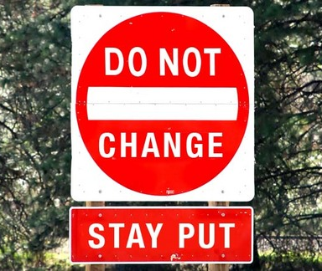
Bias
Observational Selection
Status Quo
Negativity
16
Notes:
This is that effect of suddenly noticing things we didn't notice that much before — but we wrongly assume that the frequency has increased. A perfect example is what happens after we buy a new car and we inexplicably start to see thesame car virtually everywhere.
We humans tend to be apprehensive of change, which often leads us to make choices that guarantee that things remain the same, or change as little as possible.
People tend to pay more attention to bad news — and it's not just because we're morbid. Social scientists theorize that it's on account of our selective attention and that, given the choice, we perceive negative news as being more important or profound. We also tend to give more credibility to bad news, perhaps because we're suspicious (or bored) of proclamations to the contrary.
16

Slide 17
Micro-messaging
Micro-inequity
Micro-affirmations
Ways we send subtle messages positively or negatively
17
Notes:
Micro-inequities are subtle, often unconscious, messages that devalue, discourage and impair workplace performance.^{[3]}They are conveyed through facial expressions, gestures, tone of voice, choice of words, nuance and syntax. Repeated sending, or receiving, of micro-inequities can erode commitment and loyalty and have the cumulative effect of diminishing overall workforce performance. As they are characteristically subtle, "only the most astute and aware communicators recognize how [micro-messages] are received and perceived,"
17

Slide 18
Workplace Micro-messages
Interrupting…constantly
Left out of discussion/project
Reading/sending emails/texts during conversation
Continuously using terms known to be offensive or inappropriate
Looking at watch…frequently
Not being introduced then ignored
Physical size or ability used to dominate intercalations
18

Slide 19
Workplace Micro-messages
Eye rolling
Cutting down ideas before they can be entertained
Looking to others to respond on behalf of an individual
Mispronouncing/misspelling name on an ongoing basis
Change in voice pitch, volume, or rate
Change in body posture
Change in hand movements and gestures
19
Notes:
19

Slide 20
Self-aware: Take the Implicit Association Test
http://implicit.harvard.edu
20
Notes:
Bring Awareness to all team members….including yourself.
20

Slide 21
21

Slide 22
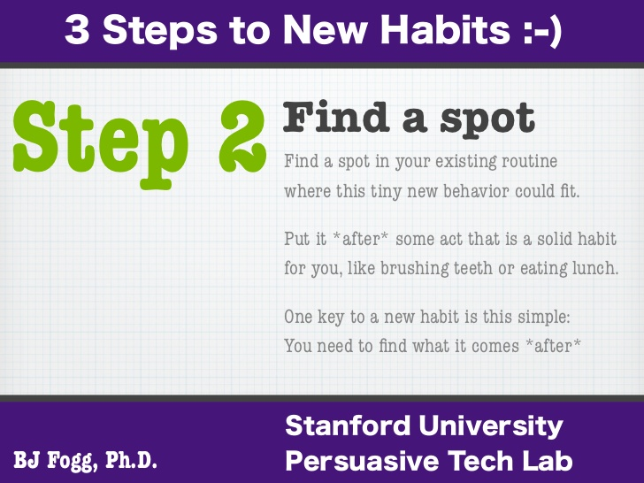
22

Slide 23
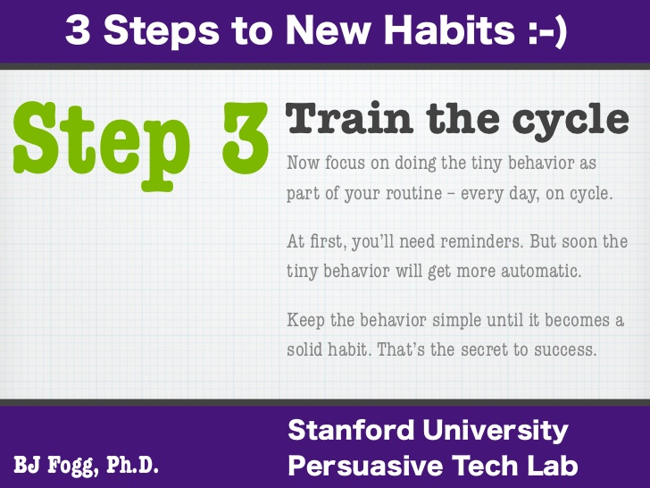
23
Notes:
A wheelchair user is rolling up to the front door ahead of you…how do you react?
-Check yo-self. Do you normally get the door for others? If not, why do you feel the need to get the door for the person in a wheelchair?
-This training has given you the skills to analyze your unconscious bias and change behaviors and habits to create inclusive environments. Today we have taught you how to fish. You do not have a list of rules. If you have meet one person with a disability, you have meet one person with a disability. There are no universal rules for engagement. Instead of a list of do’s and don’ts, you now have the tools to interact with people with disabilities in a way that creates an inclusive environment.
-Get to know the individual.
-Don’t make assumptions.
-Ask before you help---Just because someone has a disability, don’t assume she/he needs help.
-Avoid patting a person on the head or touching their wheelchair, scooter or cane. People with disabilities consider their equipment part of their personal space.
You are supervising a person who is blind. An opportunity to present in another state open’s up. What do you do?
-Check yo-self. Don’t make assumptions.
-People with disabilities are the best judge of what they can or cannot do. Don’t make decisions for them about participating in any activity.
-It’s okay to use idiomatic expressions when talking to people with disabilities. For example, saying, “It was good to see you,” and “See you later,” to a person who is blind is completely acceptable; they use these expressions themselves all the time.
You are planning an event after work for the staff. There is a Deaf person on your staff who uses American Sign Language (ASL). Do you invite the Deaf staff member?
-Don’t make assumptions.
-Many people who are Deaf communicate with sign language and consider themselves to be members of a cultural and linguistic minority group. They refer to themselves as Deaf with a capital “D,” and may be offended by the term “hearing impaired.” Others may not object to the term, but in general it is safest to refer to people who have hearing loss but who communicate in spoken language as “hard of hearing” and to people with profound hearing losses as Deaf or deaf.

Slide 24
Organizational Structures
Systems, Processes, and Policies
24

Slide 25
We are smarter like this
A Positive-Sum Game
An interactive networked organization
A stable, robust, high-performance system
Win
Win
Win
Win
Win
Win
Win
Win
Win
Win
Win
Win
Win
Win
Win
Win
Win
Win
Win
Win
Win
Win
Win
Win
25

Slide 26
We are less smart like this...
26

Slide 27
...And even less smart like this
A Zero-Sum Game
A hierarchical segregated organization
A fragile, unstable, low-performance system
27

Slide 28
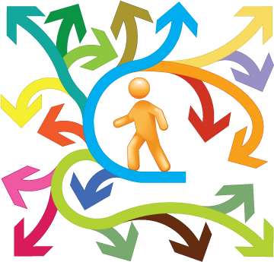
Organizational Structures
Develop and strengthen structures that increase communication, feedback and collaboration
For Example:
D&I Councils
Employee Resources Groups
28

Slide 29
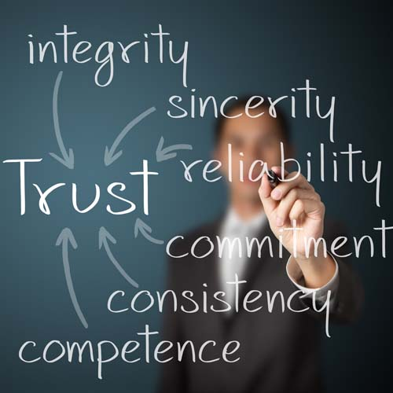
Organizational Structures
Examine systems for avoidable subjectivity
Change them to be more objective
For example:
Remove distinguishing features from resumes
Identify diverse interview panels
29

Slide 30
Organizational Structures
Establish clear criteria in advance of making decisions
Hiring
Training
Interview Panels
Task Forces
30

Slide 31
Lead the Way: Inclusive Business Culture
Making equal employment opportunity for individuals with disabilities an integral part of the company’s strategic mission
Implementing a comprehensive, continual series of equal employment opportunity initiatives and building a related infrastructure, with leadership as the catalyst
Developing and communicating policy statements and other illustrations of the company’s commitment to disability diversity and inclusion
Developing emergency management plans that specifically address the needs of employees with disabilities
Seeking input regarding the existence of an accessible and disability-inclusive workplace environment
Establishing an enterprise-wide team or affinity group
10
Notes:
Lead the Way: Inclusive Business Culture
Making equal employment opportunity for individuals with disabilities an integral part of the company’s strategic mission
Implementing a comprehensive, continual series of equal employment opportunity initiatives and building a related infrastructure, with leadership as the catalyst
Developing and communicating policy statements and other illustrations of the company’s commitment to disability diversity and inclusion
Developing emergency management plans that specifically address the needs of employees with disabilities
Seeking input regarding the existence of an accessible and disability-inclusive workplace environment
Establishing an enterprise-wide team or affinity group

Slide 32
Build the Pipeline: Outreach & Recruitment
State Vocational Rehabilitation Agencies
Directory of SRVAs
Workforce Development System Entities
Directory of American Job Centers
CareerOneStop Business Center: Where to Find Candidates
Department of Veterans Affairs Regional Offices
Social Security Ticket to Work Employment Networks
Local disability groups and Centers for Independent Living
Universities and Colleges
Apprenticeship, Internship and Mentoring Programs
15
Notes:
Image description: Build the Pipeline: Outreach & Recruitment in white text against a red background with the graphic of three people in the right bottom corner.
Build the Pipeline: Outreach and Recruitment
State Vocational Rehabilitation Agencies / Mental Health Agency / Developmental Disability Agency
Council of State Administrators of Vocational Rehabilitation (CSAVR) Talent Acquisition Portal
Link to SVRAs listing: http://askjan.org/cgi-win/TypeQuery.exe?902
Workforce Development System Entities
Directory of One Stop Centers: https://www.careeronestop.org/businesscenter/findjobcenters/american-job-center-finder.aspx
One Stop Business Center: Where to Find Candidates: https://www.careeronestop.org/businesscenter/recruitandhire/wheretofindcandidates/where-to-find-candidates.aspx
DEI Grants: The Disability Employment Initiative (DEI) aims to improve education, training and employment opportunities and outcomes for youth and adults with disabilities who are unemployed, underemployed and/or receiving Social Security disability benefits. ODEP jointly funds and administers the DEI with DOL's Employment and Training Administration (ETA).
Round 4 DEI Grantees include: AL Alabama Department of Economic and Community Affairs, Workforce Development Division AK Alaska Department of Labor and Workforce Development, Employment Security Division CT Connecticut Department of Labor, Office of Workforce Competitiveness ID Idaho Department of Labor IL Illinois Department of Commerce and Economic Opportunity, Office of Employment and Training ME Maine Department of Labor, Bureau of Employment Services NY New York State Department of Labor, Division of Employment and Workforce Solutions VA Virginia Community College System, Workforce Development Services
Round 5 DEI Grantees include: CA California Employment Development Department, Workforce Services Division IL Illinois Department of Commerce and Economic Opportunity, Office of Employment and Training KS Kansas Department of Commerce MA Massachusetts Executive Office of Labor and Workforce Development, Department of Career Services MN Minnesota Department of Employment and Economic Development, Division of Workforce Development SD South Dakota Department of Labor and Regulation (DLLR), Workforce Training
Round 6 DEI Grantees include: AK State of Alaska, Department of Labor and Workforce Development GA Georgia Department of Economic Development, Workforce Division HI State of Hawaii, Department of Labor and Industrial Relations IA Iowa Workforce Development NY New York State Department of Labor WA Washington State Employment Security Department
32

Slide 33
Hire (and Keep) the Best: Talent Acquisition & Retention Processes
Disability Disclosure
Invitations to Self-Identify
Qualification Standards
Job Announcements
Hiring Process
Career Development and Advancement
Retention/Promotion
Accommodations
20
Notes:
Image description: Hire (and Keep) the Best: Talent Acquisition and Retention Processes in white text against a yellow background with a graphic representing a handshake below.
Hire (and Keep) the Best: Talent Acquisition and Retention Processes
Disability Disclosure
Invitations to Self-Identify
Qualification Standards
Job Announcements
Hiring Process
Career Development and Advancement
Retention/Promotion
Accommodations

Slide 34
Ensure Productivity: Reasonable Accommodations
Written policies and procedures for processing requests for reasonable accommodations
Develop centralized accommodation fund and source of expertise
Provide training on new strategies and devices
Utilize Job Accommodation Network
Utilize online tracking system (database)
Allow line managers to approve, with upper management review of denials
Assign a full-time director of disability services or workplace supports to coordinate accommodation strategies
20
Notes:
Image description

Slide 35
Communicate: External & Internal Communication of Company Policies & Practices
External
Include individuals with visible disabilities in materials and advertising
Sponsor and participate in job fairs targeting individuals with disabilities
Invite disability organizations to career days
Communicate with union officials, when appropriate
Post the company’s disability inclusion policy statements online
Internal
Establish office that delivers holistic approach to disability inclusion
Establish a disability employee resource group
Publicize company’s commitment in internal publications
Conduct trainings to commit to fostering disability inclusive culture
Enable individuals with disabilities to be in decision-making bodies
Establish a policy that all supervisors share responsibility for the successful implementation of the company’s inclusion policy
As part of Employee Assistance Program, adopt return to work models
Develop a recognition program for employees with disabilities
20
Notes:
Image description

Slide 36
Be Tech Savvy: Accessible Information & Communication Technology
Leadership team and approach
Needs assessment, feedback and priorities
Formal policies, practices and procedures
Corporate-wide infrastructure
Evaluation and Accountability
Partnership on Employment & Accessible Technology (PEAT)
TalentWorks
TechCheck Benchmarking Tool
Buy IT!
Policy Matters
Staff Training Resources
20
Notes:
Image description:

Slide 37
Grow Success: Accountability & Continuous Improvement Systems
Training
Establishing Accountability Measures
Establishing Accountability and Continuous Improvement Mechanisms
Designating Responsible Individuals
20
Notes:
Image description:

Slide 38
Q & A
Notes:
Q&A

Slide 39
ODEP & EARN Contact Information
Michael Murray ODEP Employer Policy Team Director Michael.Murray.D@dol.gov
Brett Sheats EARN National Policy Director bsheats@viscardicenter.org
Derek Shields EARN Consultant | Trainer dshields@forwardworks.net
Notes:
Image description: Photograph of Derek Shields. He has short blond hair and is wearing a suit jacket and tie.
Contact Information
Derek Shields
Consultant | Trainer
Employer Assistance and Resource Network on Disability Inclusion (EARN)
dshields@forwardworks.net

