Slide 1
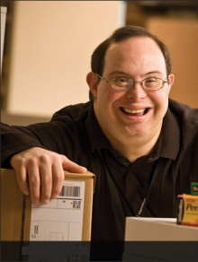
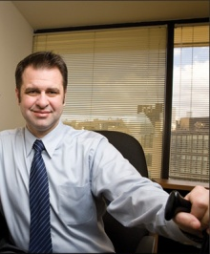
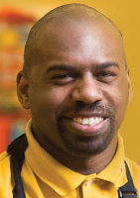
Tools, Techniques, and Technologies for Creating Inclusive Workplaces
Lou Orslene, JAN
Deb Dagit, Deb Dagit Diversity
Notes:
Good afternoon everyone. Today we talk a bit about Tools, Techniques, and Technologies for Creating Inclusive Workplaces.

Slide 2
Five Signs of Inclusion
Inclusive ethos - particularly language
Inclusive public relations and marketing
Inclusive policies and practices
Accessible workplace
Accessible/enabling workplace technologies
Notes:
DD: Many of you may remember the five signs that a workplace is inclusive but let me again talk about these.
Many companies are facing shortages of skilled employees and therefore need to explore all of the various pipelines to recruit and hire people; some companies are working to increase their market share inclusive of people with disabilities and their families; while others are working to retain valued employees but with the knowledge an aging baby boomers often have chronic health conditions; while others are working to comply with state and federal regulations…..
But whatever reason, if you want to create a workplace more inclusive of people with disabilities then it is important to communicate that your doors are open to them.
We can do this through GO TO SLIDE>

Slide 3
Enabling Technologies
Applicant Tracking Systems
Pre-hire Testing Software
Accommodation Tracking Systems
Accessible Legacy Information Systems i.e. HRIS
Learning Management Systems
JAN Accommodation Toolkit
Mobile Accommodation Solution
Notes:
LO: Enabling technologies are those workplace technologies either designed or modified to be accessible by all with the purpose of enhancing the productivity of employees with disabilities and more often than not increase the productivity of others in the workplace as well.
So what are examples of enabling technologies? These include GO TO SLIDE.
Give example of hiring a person who is blind who can’t use the current company legacy information system.

Slide 4
What is the Toolkit?
An free, online “living” toolkit that captures and continuously updates best and emerging practices in providing accommodations in the workplace.
http://AskJAN.org/toolkit/
Notes:
DD: Many companies have noted that they could benefit for emulating best/emerging RA practices including:
Easier-to-navigate RA processes for employees and managers
Better mechanisms for tracking and reporting
Enhanced data-gathering practices (to gauge how satisfied employees and their managers are with RAs, financial savings, return to work, etc.)
More transparent and effective intersections between Section 503 self-ID encouragement and identifying as a person with a disability for purposes of obtaining an RA

Slide 5
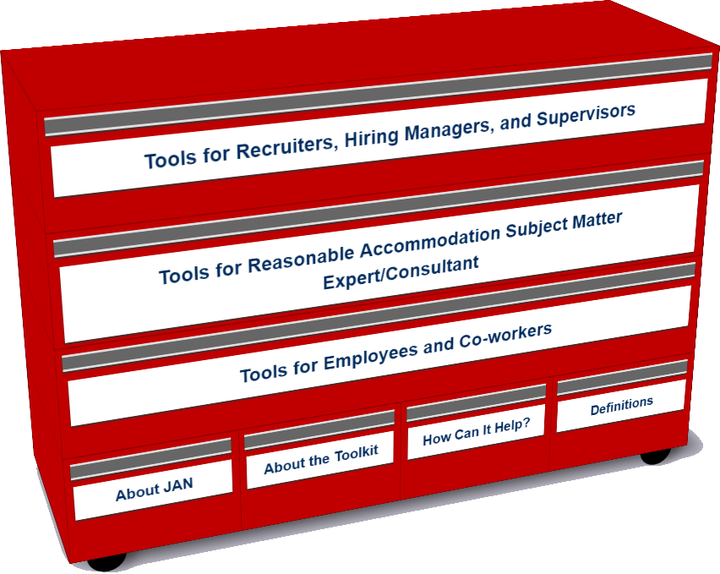
Who uses the Toolkit?
Recruiters, Hiring Managers and Supervisors
Accommodation Consultant/Subject Matter Expert
Employees and Co-workers — Allies
Notes:
LO

Slide 6
Accommodation Toolkit
Recruiters, Hiring Managers and Supervisors
Notes:
LO

Slide 7
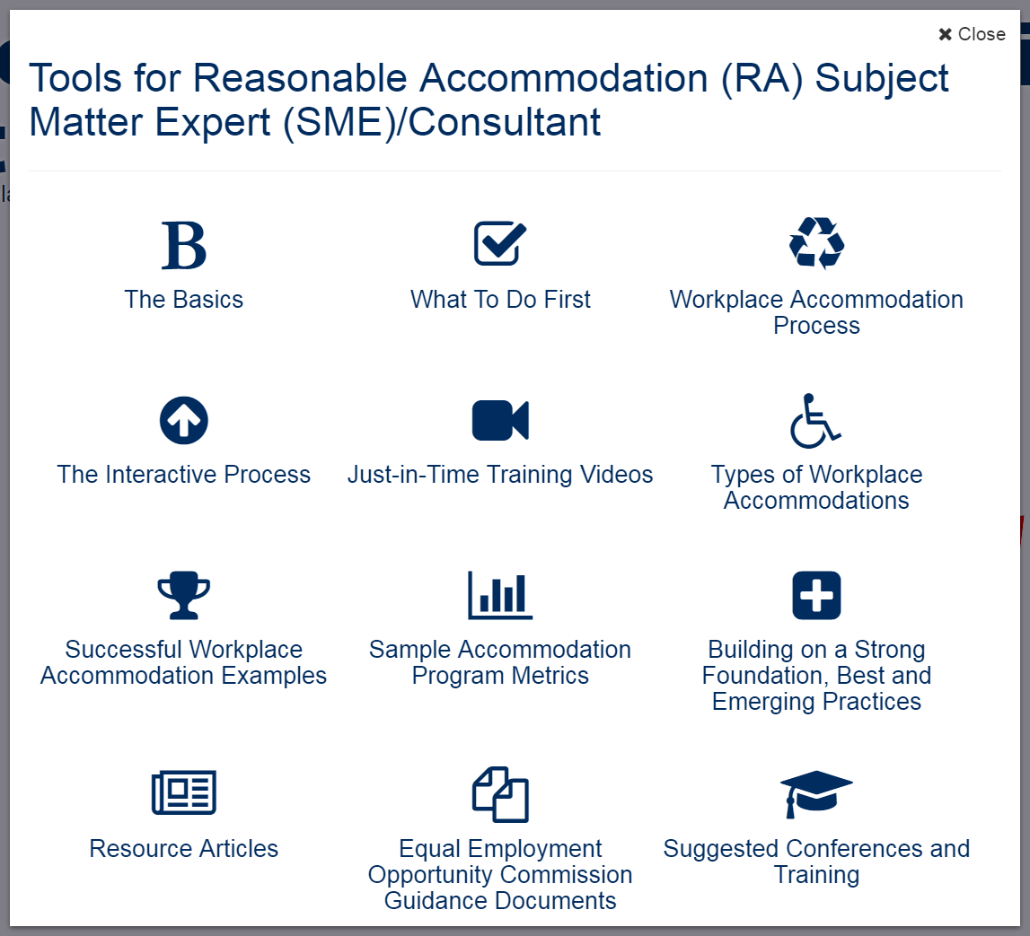
Accommodation Toolkit
Accommodation Consultant/Subject Matter Expert
Notes:
LO

Slide 8
Accommodation Toolkit
Employees and Co-workers — Allies
Notes:
DD

Slide 9
Accommodation Toolkit
Notes:
DD tee up video

Slide 10
Techniques for Creating Inclusion
Adopting facilities/IT access for all/universal design reduces the need for individualized accommodations
Focusing on diverse abilities contributes to productivity goals
Gathering/reporting key metrics (e.g. reduction in: lost work time, retention/leave costs, enhanced engagement scores
Utilizing/leveraging a list of commonly requested accommodations by job function
Developing a “task bank” of jobs that a person can perform when unable to perform prior duties
Notes:
DD: Need to start by talking about Mental Health stigma, incidence and why it is particularly important and sometimes challenging.
For instance, I’m very interested in this Comcast idea of starting from your return to work/lost work time to build the internal business case. Then use these analytics to sell an accommodation program broadly. I also saw this model at a recent Chevron presentation. I am intrigues by this idea of a task bank to bring people back from occupational injury and think this would be good for occupational injury as well as non-occupational injury. With a task bank, for instance, you can perhaps keep someone who has cancer at work doing less strenuous tasks with a more flexible schedule. Again using this “work as therapy” approach. And I’m intrigued by Walmart developing an internal database of accommodations for the jobs that the greatest number of people hold at the company.
do not have structured procedures or if they do they seem to be missing components that they talk about as being really important. Lou I am thinking of the one employer you have worked with on numerous occasions that we know uses a tracking system and a central fund for accommodations but still does not really have a written guidance or procedure for all to reference. I am also thinking of the employer that sent us the confidential policy/process document that was surprisingly scant of content.
I know one thing that was eye-opening for me was making the video with the person on the Autism Spectrum and how challenging and important it was to “get it right.” This speaks to building a more inclusive/accommodating process being difficult even for the “experts” when it comes to communications differences and being respectful of how to adjust things without labeling or stereotyping. We could leverage this Microsoft "Fast Company" article to help make this point:
http://tribunecontentagency.com/article/brain-trust/
I also think where disability accommodations have resulted in positive outcomes for all, e.g. by accommodating a person with a disability who needs a flexible work arrangement, helping a supervisor to get more comfortable with managing by objectives. Or, by addressing the needs of PwD in open office environment, being able to provide coping strategies for anyone who finds it distracting/challenging.
Finally, I think that the trend is to move towards addressing “diverse abilities” with productivity tools, and less how we have previously described as those with a medical condition who have a work restriction.

Slide 11
Enabling Technology
Big Idea
Mobile Accommodation Solution (MAS) is designed to help streamline the disability accommodation process at various phases of the employment cycle.
Funded by the National Institute on Disability, Independent Living, and Rehabilitation Research (NIDILRR)

Slide 12
MAS App
Collaborators
Center for Disability Inclusion
Job Accommodation Network (JAN)
IBM
US Business Leadership Network
American Association of People with Disabilities
Council of State Administrators of Vocational Rehabilitation
National Business and Disability Council
Disability Management Employers Coalition

Slide 13
MAS App
Users
Talent management, human resources, employer relations, and/or accommodation staff
Employment service providers
Applicants and employees with disabilities

Slide 14
MAS App
Functionality
Easy-to-use, secure mobile case management tool
Robust accommodation tracking tool
Best and emerging accommodation practices and forms embedded within tool
Access to JAN Consultants and myriad other resources

Slide 15
MAS App
Future Functionality
PC-based MAS
Capable of video upload
Open source
Cloud-enhanced
Store medical and accommodation history
Reporting function

Slide 16
Inclusive Technologies
Enabling Technologies +
Assistive Technologies
= Inclusion
Notes:
LO: So the free Apple version of the APP is available now at the Apple store and the Android version at the Google Store.
Note about security and the confidential info being stored natively.

Slide 17
Thank you for Attending!
Tools, Techniques, and Technologies for Creating Inclusive Workplaces
Orslene@jan.wvu.edu
Debdagit@gmail.com

Slide 18
For More Information
Contact JAN Contact Deb
(800) 526-7234 (V) Deb Dagit Diversity, LLC (877) 781-9403 (TTY) (918) 319-4793
http://AskJAN.org deb@debdagitdiversity.com
jan@askjan.org DebDagitDiversity.com
(304) 216-8189 via Text
janconsultants via Skype

