Slide 1
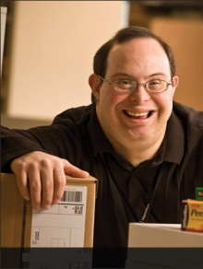
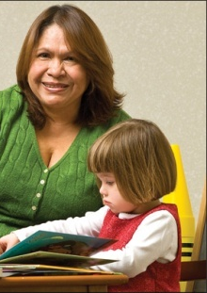



The ADA and Accommodations: Techniques and Tools for Workplace Success
Lou Orslene, JAN Co-Director
Orslene@jan.wvu.edu

Slide 2



Where I come from…
Notes:
Tell the story of the mine accident and recovery and mention Kate.

Slide 3

Where I come from…
Notes:
Tell the story of the mine accident and recovery and mention Kate.

Slide 4
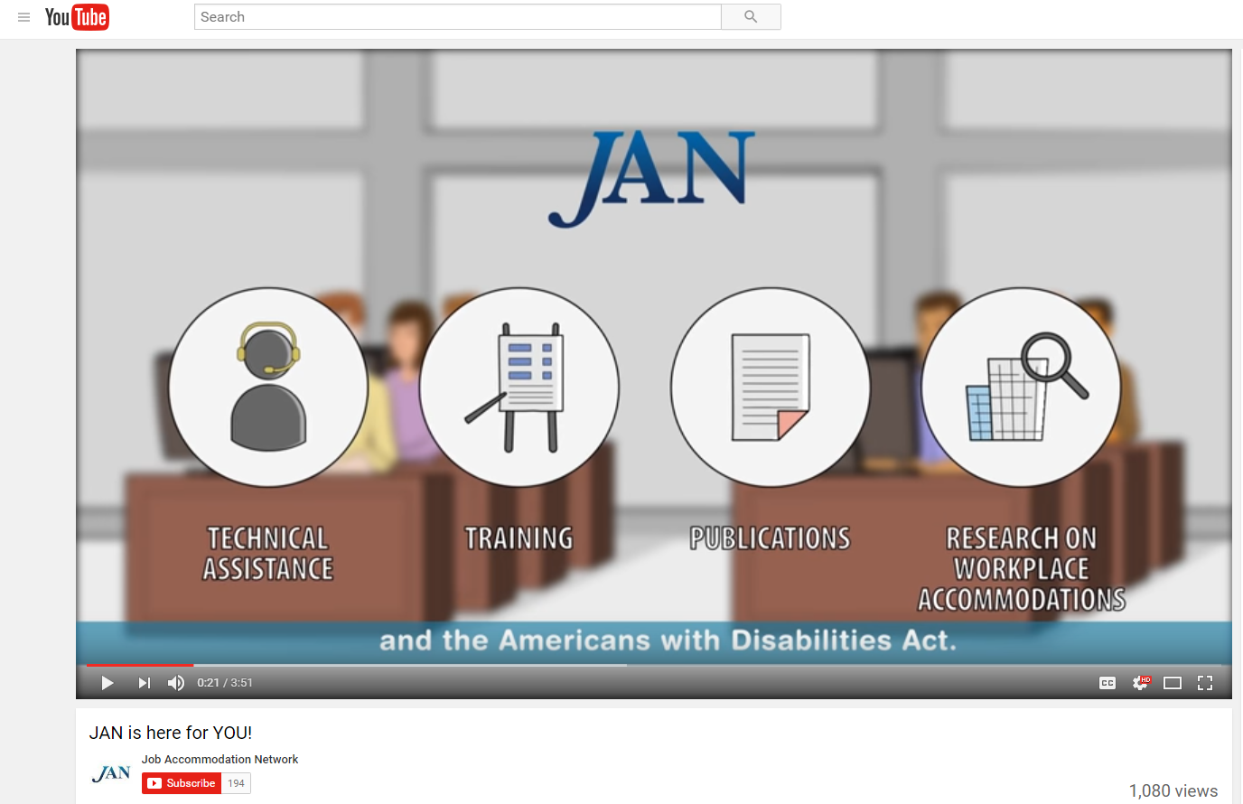
Who is JAN?
Notes:
The Job Accommodation Network (JAN) is the leading source of free, expert, and confidential one-on-one guidance on reasonable accommodation (RA) in the workplace, the Americans with Disabilities Act (ADA) and related legislation, and disability employment issues.

Slide 5

Why is this important?

Slide 6

Normalcy of Disability
10,000 baby boomers reaching age of 65 every day
In 2010, 19% of people with disabilities have reportedly graduated from college …up from 14% in 2004
47,000 service members
  have been wounded in
  action. Hundreds of
  thousands more, nearly
  25 percent of all who
  served, will be diagnosed
  upon returning home with
  other “invisible wounds”
Notes:
There are a number of other trends we should be aware of –
10,000 baby boomers reach the age of 65 every day.
Many of these boomers are deciding not to retire or are starting a new career. Thus, more than ever the workforce will be impacted by the chronic health conditions of aging workers. It is estimated that by the year 2020, half of the U.S. population will have at least one chronic condition and one-quarter will be living with multiple chronic conditions.” This information is from Center on an Aging Society, Georgetown University.
In 2010, 19% of people with disabilities have reportedly graduated from college, up from 14% in 2004.
The expectations of work for young people with disabilities are high as we now are seeing the first generation of young people who have benefited from the 1975 Individuals with Disabilities Education Act. With graduation rates growing, more young people who have benefitted from school mainstreaming are entering the nation’s workforce. These qualified young people have been empowered by the ADA and expect to work and expect not to be hindered by the barriers of the past.
47,000 service members have been wounded in action. Hundreds of thousands more, nearly 25 percent of all who served, will be diagnosed upon returning home with other “invisible wounds.”
Increasingly, the private and public sector are filling their ranks with veterans, including our wounded warriors. Leading the way are companies such as Lockheed Martin and Northrup Grumman.

Slide 7

Normalcy of Disability
Americans with Disabilities Act, as amended (ADAAA)
Section 503, 508, 501 of the Rehabilitation Act of 1973
Executive Order 13548
Workforce Innovation and Opportunity Act (WIOA)
Notes:
And over the past decade, disability legislation has and continues to be strengthened to increase opportunity for workers with disabilities, insure the federal government is a model employer for individuals with disabilities, and create an employment system that includes people with disabilities. This includes Americans with Disabilities Act, as amended (ADAAA), Section 503, 508, 501 of the Rehabilitation Act of 1973, Executive Order 13548 to increase the hiring of people with disabilities into the federal government, the Workforce Innovation and Opportunity Act (WIOA) which promises to create a more inclusive workforce preparation system.

Slide 8
Creating Workplace Inclusion
The three C’s: Increase comfort, confidence, and competence
Develop skills that help to more effectively communicate at work with people with disabilities
Develop and effectively communicate actionable policy and procedures
Develop normative practices for engaging with people with disabilities throughout the employee life cycle
Notes:
It is typical for companies to have challenges in 3 key areas: culture that embraces disability inclusion, technical assistance, and integration of disability inclusion into HR policies, processes, and training.

Slide 9
Creating Workplace Inclusion
The three C’s: Increase comfort, confidence, and competence
Develop skills that help to more effectively communicate at work with people with disabilities
Develop and effectively communicate actionable policy and procedures
Develop normative practices for engaging with people with disabilities throughout the employee life cycle
Notes:
It is typical for companies to have challenges in 3 key areas: culture that embraces disability inclusion, technical assistance, and integration of disability inclusion into HR policies, processes, and training.

Slide 10
Five Signs the Doors are Open
Accessible buildings, technology, etc.
Inclusive ethos - particularly language
Inclusive public relations and marketing, particularly on social media
Collaborative and authentic relationships with national and local resources to recruit/retain talent
Inclusive policies and practices

Slide 11


ADA and IDEA
How is the ADA different than IDEA?
  IDEA
    Entitlement
Grades Pre-K
through 12
  ADA
    Eligibility
  Post-secondary
  and Working
Notes:
Let’s look here at the differences between the IDEA, or the Individuals with Disabilities Education Act and the ADA, the Americans with Disabilities Act. IDEA is a law that protects you as a student with a disability while you are in the school system. It is called an entitlement because if you have a disability, you are automatically covered and provided a free appropriate public education. You receive special education services, supports, and accommodations. A team of people, including a special education teacher, and possibly a speech and language pathologist, an occupational and/or physical therapist or other support personnel meet at least once a year to make plans to insure that you are making progress and have the accommodations or modifications you need in the classroom.
Once you graduate from the school system, you are no longer covered by the IDEA, but rather the ADA or the Americans with Disabilities Act. It differs from IDEA in several ways. Now you have to qualify as a person with a disability, and the qualification standards have changed. To meet this definition of disability under the ADA, you have to have a physical or mental impairment that substantially limits one or more major life activities, have a record of such an impairment, or be regarded by others as having an impairment. We’ll talk about this in more detail in just a few slides. Once you exit the school system and enter post-secondary training or employment, the only way you will receive accommodations is if you ask for them yourself. You may be required to disclose your disability in order to receive the accommodations.

Slide 12

Goals of the ADA as Amended
So what are the goals of the Americans with Disabilities Act (ADA)
Prevent discrimination
Provide equal opportunity through reasonable accommodation
Notes:
First and foremost, it is very important to know and understand your rights as an individual with a disability under the ADA.
The next topic is disclosure, one that is vital to the transition process. We will discuss the who, what, when, how, and why of disclosure.
And last, but certainly not least, we will briefly discuss some common accommodation ideas that might be helpful.
Individuals will need to become their own advocate. Self-advocacy simply means that individuals need to know and speak up for themselves. They have to know their strengths and weaknesses, how they learn and what they will need to help them succeed. They will need to be comfortable talking about themselves and possibly their disability to prospective employers or to educational professionals. They also need to understand their rights and responsibilities under the ADA.
“The 411 on Disability Disclosure: A Workbook for Youth with Disabilities” is designed for youth and adults working with them to learn about disability disclosure.
This workbook helps young people make informed decisions about whether or not to disclose their disability and understand how that decision may impact their education, employment, and social lives.
Based on the premise that disclosure is a very personal decision, this workbook can help you think about and practice disclosing your disability.

Slide 13
Disclosure
Disclosure is when you give out specific, personal information about a your disability.
Important to provide:
The nature of the disability
The limitations, or how the disability affects your capacity to learn and/or perform the job effectively
Accommodations you will need in order to do the job
Notes:
Disclosure is when you give out specific, personal information about your disability. Deciding whether to disclose a disability can be a difficult decision. Individuals with disabilities sometimes struggle not only with wanting to be honest and open from the start of the job-seeking process, but also with knowing what might happen if they disclose too soon.
If and when you do decide to disclose your disability, it will be important to provide the following information:
The nature of your disability
The limitations, or how the disability affects your capacity to learn and/or perform the job effectively
And the accommodations you will need in order to do the job

Slide 14

Disclosure
When do I Disclose?
During the application or interview process
At any point during employment
To receive benefits and privileges
To explain an unusual circumstance
Notes:
When do you disclose? Anytime that you will need an accommodation or a change in the way things are done in the workplace. You never have to disclose a disability until you need an accommodation. Under the ADA, you are not required to disclose to an employer at any specific time. The only warning we would give is not to wait too long if there are performance or conduct issues that are directly related to your disability.
You can disclose during the application or interview process (an example would be to access an online application system, or if you need accommodations for pre-employment testing)
At any point during employment when an accommodation is needed – maybe if the disability changes or when the job tasks have changed
To receive benefits and privileges of employment ( an example here might be access to training, a company café, or an employer sponsored summer picnic that is available to all employees,) OR
To explain an unusual circumstance (an example here might be absences from work and the inability to call in at the specified time to report the absence)

Slide 15
Disclosure
How do I Disclose?
To request accommodation, an individual:
May use “plain English”
Need not mention the ADA
Need not use the phrase “reasonable accommodation”
Notes:
Now let’s talk a little about How to Disclose
The individual must let the employer know:
An adjustment or change at work is needed for a reason related to a medical condition
To request accommodation, an individual:
May use “plain English.”
Need not mention the ADA, and
Need not use the phrase “reasonable accommodation.”
It can be as easy as telling your employer “I have difficulty getting to work on time because of the medication I take for a medical condition. Could we talk about that?”

Slide 16
Disclosure
Who do I Disclose to?
Verbally or in writing, tell the…
Employer
Supervisor
HR representative, or
Other appropriate person provided in the accommodation policy.
Notes:
Under the ADA, an individual may disclose a disability and ask for an accommodation either verbally or in writing. At JAN, we recommend that you do so in writing so that you have documentation that you did indeed disclose and ask for an accommodation, and when you did so. We have a sample letter located on our website that can help you with that.
Who do you disclose to? The employer, a supervisor or manager, and/or a human resources representative can all be persons an employee would make their disclosure to. Often times an employee doesn’t want their supervisor or manager to know about their medical condition. In that case, it is wise to disclose to someone in HR. In many cases, a manager or supervisor may need to be informed of the process and be involved in the accommodations, but wouldn’t need information on the medical condition.
There may be other specific persons that you would disclose to – those persons or offices could be determined from the accommodation policy. And if you are a student, the Student Disability Services Office would be a good place to start.

Slide 17
Accommodation as a Key
Accommodation
=
Equal Employment
=
Inclusive Workplace Culture

Slide 18
Accommodation Primer
The basis for inclusive employment is the reasonable accommodation (RA) policy and process
The foundation for reasonable accommodation is a robust interactive process (IP)
The trigger for RA and IP is a disclosure and request for an accommodation or recognition of an obvious barrier to someone with a known disability
A request for accommodation includes two essential elements — a medical condition and a related challenge at work

Slide 19
JAN’s Interactive Process
Step 1: Recognizing an Accommodation Request
Step 2: Gathering information
Step 3: Exploring Accommodation Options
Step 4: Choosing an Accommodation
Step 5: Implementing the Accommodation
Step 6: Monitoring the Accommodation
https://AskJAN.org/topics/interactive.cfm
Notes:
A collaborative effort to identify effective accommodation solutions – it’s that simple.

Slide 20

  Eight Most Common Types of RA
Modifying schedule or allowing leave time
Making workplace or work station accessible
Modifying methods — testing, communication, or training
Modifying or creating policies
Purchasing or modifying equipment or products
Purchasing a service — reader or interpreter
Restructuring job
Reassignment
Other accommodations
  Telework
  Adjusting supervisory method
  Using a service animal

Slide 21

Questions to Consider
About the medical impairment:
What is the nature of the impairment?
What are the limitations/restrictions?
How long will the impairment last?
What is the duration of restrictions?
Can medical documentation be obtained?
Yes, when the disability and need for accommodation are not known or obvious

Slide 22

Questions to Consider
About job functions & performance:
What job functions, policies, or procedures are affected by the limitations?
Is performance or conduct affected?
Are there any safety issues?
Can job functions be performed in a different way?

Slide 23
Questions to Consider
About job accommodations:
What type of accommodation is needed?
  Job Restructuring, Modified Schedules, Modified Policies, Assistive Technology, Telework, Leave, Reassignment, Service Animal, etc.
Is the accommodation reasonable – meaning, feasible or plausible?
Will the accommodation be effective?
Is the employee still qualified?

Slide 24
JAN’s Interactive Process
Step 1: Recognizing an Accommodation Request
Tips for Service Providers:
• Make sure clients are aware of their rights under the ADA.
• Document the request.
• Be clear and specific.
Notes:
Title I of the ADA requires an employer, with 15 or more employees, to provide reasonable accommodation to qualified individuals with disabilities who are employees or applicants for employment, unless doing so would cause undue hardship.
While an accommodation request does not have to be in writing, the EEOC suggests that individuals with disabilities might find it useful to document accommodation requests in the event there is a dispute about whether or when they requested accommodation.
Service providers or the individual can describe specific needs and offer suggestions for accommodation ideas. Although not required, it may be helpful to specify that the individual is requesting a “reasonable accommodation” under the “ADA.”

Slide 25
JAN’s Interactive Process
Step 2: Providing Information
Tips for Service Providers:
• Describe the limitation and problem.
• Get information from the individual when possible.
• Use ADA language.
Notes:
To find effective accommodations, employers need to know what limitation is causing the problem. Service providers may be able to supply this information.
Individuals with disabilities are familiar with their limitations and often know what accommodations will work best for them.
When providing documentation, service providers may want to use the ADA’s specific language so the information will be helpful for employers.

Slide 26
JAN’s Interactive Process
Step 3: Exploring Accommodation Options
Tips for Service Providers:
Keep an open mind.
Invite the individual to suggest accommodations
Consult with other service providers.
Use JAN when needed.
Notes:
Accommodations are about doing things differently to help overcome disability-related limitations, so keep an open mind when exploring accommodation options.
.The individual who requested the accommodation may have some good accommodation ideas, but may be hesitant to bring them up without being asked to do so.
In many instances, it may be necessary for a team of service providers to work together to develop an effective accommodation strategy.
JAN is a free, national resource for individuals, employers, and service providers who are seeking help coming up with accommodation ideas.

Slide 27
JAN’s Interactive Process
Step 4: Choosing an Accommodation
Tips for Service Providers:
• Explain decision making process.
• Justify preferences
Notes:
Let the client know that employers have the right to choose among effective accommodation options in case the employer does not choose the client’s preferred accommodation.
If the client feels strongly about the preferred accommodation, help him/her develop a list of reasons why the preferred accommodation is the best accommodation.

Slide 28
JAN’s Interactive Process
Step 5: Implementing the Accommodation
Tips for Service Providers:
Offer assistance during the implementation of the accommodation.
Make sure to involve the individual throughout the implementation of the accommodation.
Notes:
Service providers can provide assistance setting up and training on equipment and devices and can provide support to the individual, who may need help adjusting to the accommodation.
Communicate with the client while implementing the accommodation to help ensure success.

Slide 29
JAN’s Interactive Process
Step 6: Monitoring the Accommodation
Tips for Service Providers:
Check on effectiveness
Leave the individual in good hands.
Encourage ongoing communication.
Notes:
As things change in the workplace, accommodations may need to also change. Service providers may be able to routinely check on the effectiveness of accommodations.
Make sure the individual can troubleshoot basic problems with equipment or devices and knows who to contact when products are not functioning properly.
For any workplace issue, ongoing communication is the key to success. The same is true for accommodations – individuals should be encouraged to communicate any issues they have with their accommodations.

Slide 30
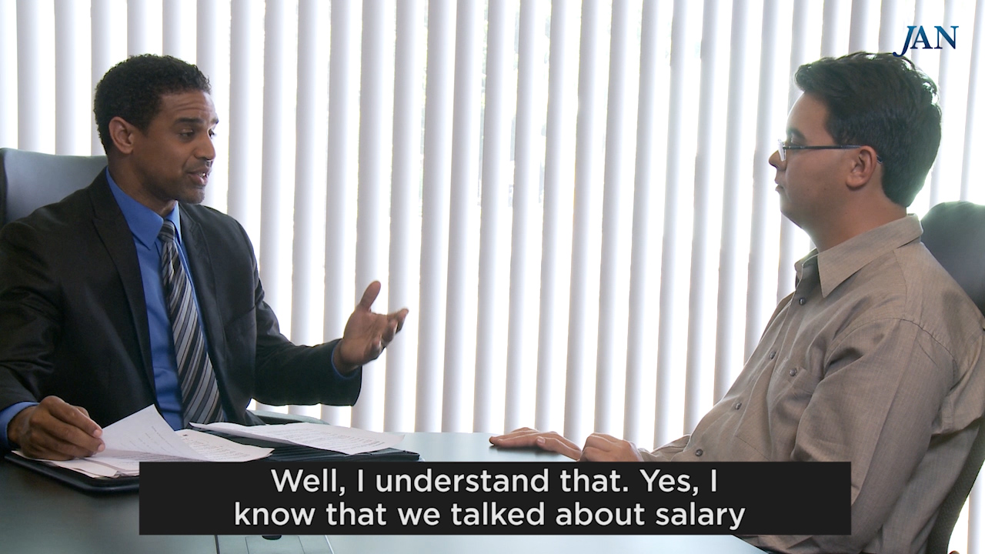
Interview Challenges

Slide 31
Hiring Best Practices
Interview applicants privately
  Limits distractions and preserves confidentiality
Adjust vocabulary to use concrete terms
when discussing job-related information
  Avoid acronyms, idioms, flowery or technical terms
Adjust conversational speech rate according to
the interview situation
  Observe when interviewee appears confused, distressed, or not responsive to questions
Modify interview questions according to responses

Slide 32

Hiring Best Practices
Consider a second chance interview
  Be flexible and consider a more effective method for asking questions or interview in a different location
Demonstrate the organization’s commitment to maintaining an environment where all employees can contribute and succeed

Slide 33

Accommodation Toolkit
Retaining an Employee Who has an Intellectual Disability
Notes:
DD tee up video

Slide 34

Interactive Process Best Practices
Privately engage IWD to discuss accommodation requests
Listen, express empathy, and exhibit understanding of concerns shared by IWD
Build trust through positive, constructive dialogue and by demonstrating interest in identifying solutions

Slide 35
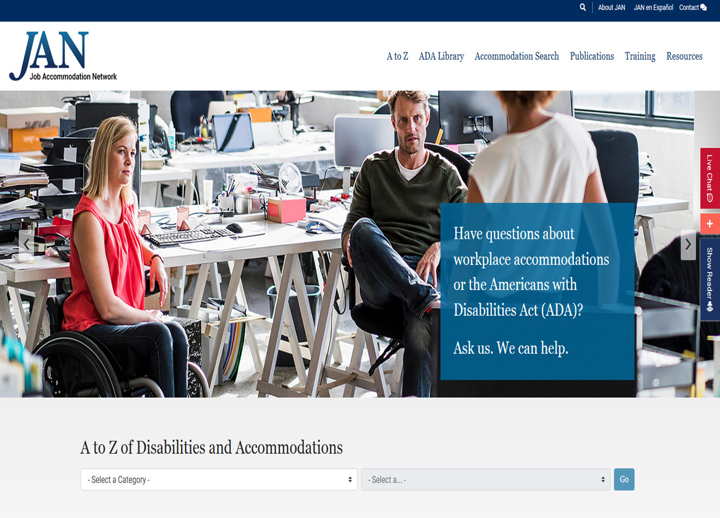
Interactive Process Best Practices
Use information about work-related limitations and barriers to explore accommodation solutions collaboratively with IWD
Break-down silos and engage internal and external resources to support the accommodation process

Slide 36

Interactive Process Best Practices
Document the interactive process – beginning to end, to benefit both parties
Be responsive – DO SOMETHING!
Inform essential personnel about accommodations, but preserve confidentiality of
medical information

Slide 37
Retention Best Practices
Commit to creating an environment where all employees have the ability to contribute and be successful
AMERICA’S WORKFORCE:EMPOWERING ALL
National Disability Employment Awareness Month
https://www.whatcanyoudocampaign.org/celebrate-ndeam/

Slide 38

Retention Best Practices
Keep disability and
accommodation-related
information confidential
Let employees know who to contact if there is a need for a modification at work due to a personal reason, so the issue can be addressed privately
Made a business decision for personal reasons and do not discuss employees' personal information with others

Slide 39
What is the Toolkit?
An free, online “living” toolkit that captures and continuously updates best and emerging practices in providing accommodations in the workplace.
http://AskJAN.org/toolkit/
Notes:
Many companies have noted that they could benefit for emulating best/emerging RA practices including:
Easier-to-navigate RA processes for employees and managers
Better mechanisms for tracking and reporting
Enhanced data-gathering practices (to gauge how satisfied employees and their managers are with RAs, financial savings, return to work, etc.)
More transparent and effective intersections between Section 503 self-ID encouragement and identifying as a person with a disability for purposes of obtaining an RA

Slide 40
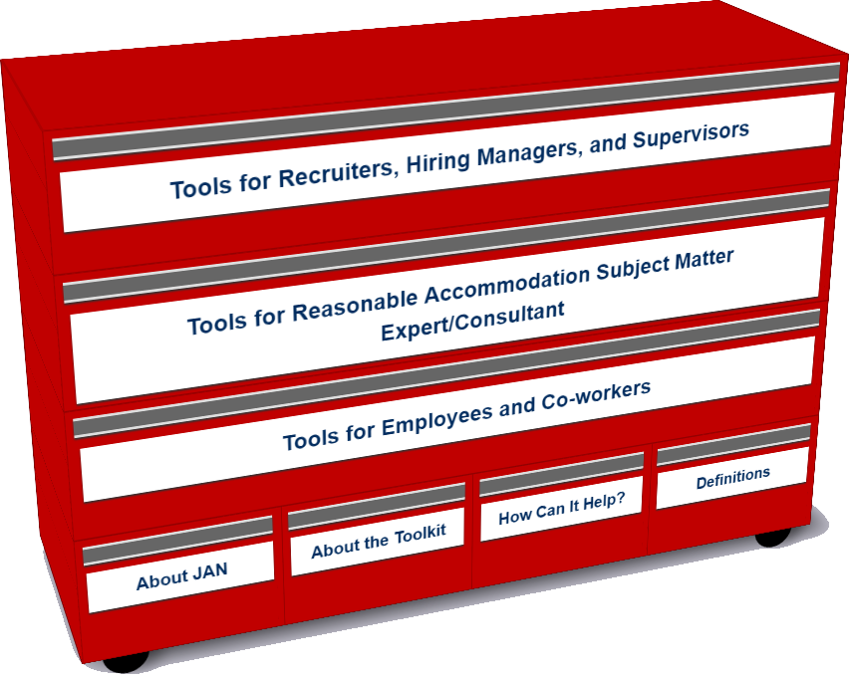
Who uses the Toolkit?
Recruiters, Hiring Managers and Supervisors
Accommodation Consultant/Subject Matter Expert
Employees and Co-workers — Allies

Slide 41
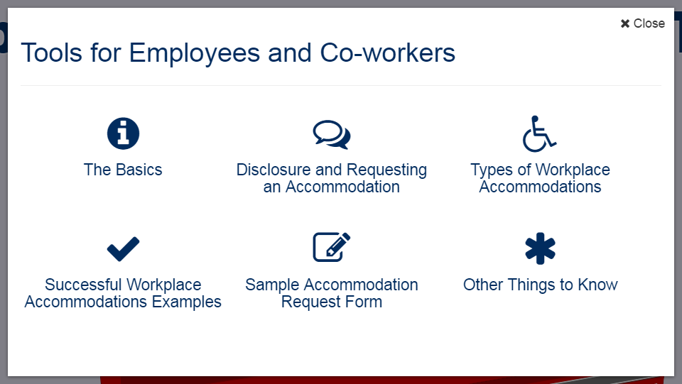
Accommodation Toolkit
Employees and Co-workers — Allies
Notes:
DD

Slide 42
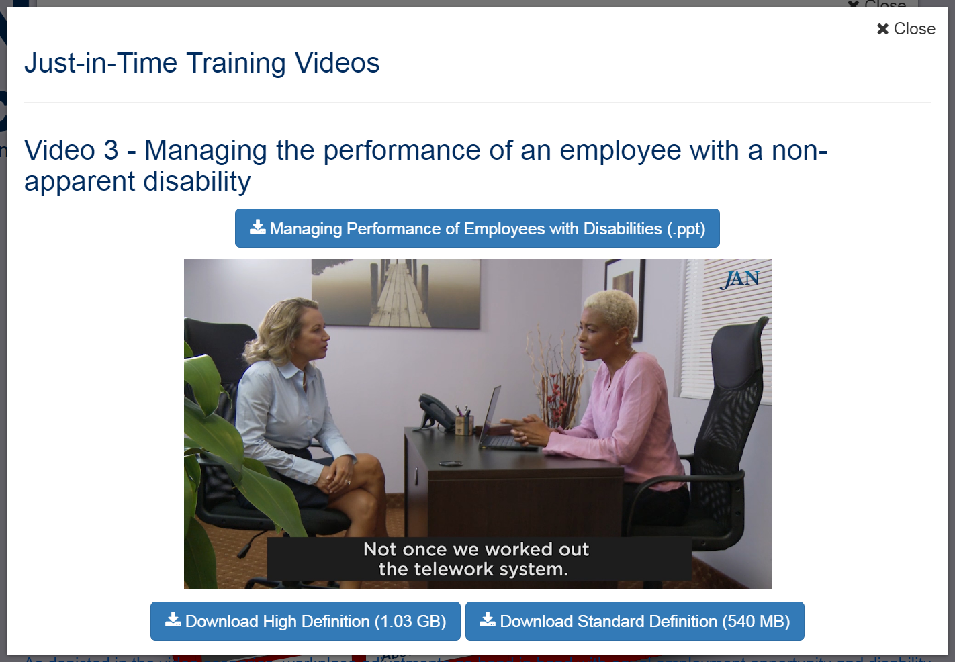
Performance Management
Notes:
DD tee up video

Slide 43
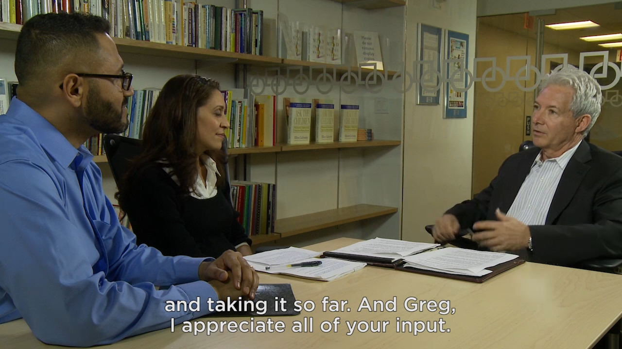
Video: Interactive Process

Slide 44
Technology
Big Idea
The Mobile Accommodation Solution (MAS) is designed to help streamline the disability accommodation process at various phases of the employment cycle.
Funded by the National Institute on Disability, Independent Living, and Rehabilitation Research (NIDILRR)
Notes:
Collaborators
Center for Disability Inclusion
Job Accommodation Network (JAN)
IBM
US Business Leadership Network
American Association of People with Disabilities
Council of State Administrators of Vocational Rehabilitation
National Business and Disability Council
Disability Management Employers Coalition

Slide 45
Free MAS App
Users
Talent management, human resources, employer relations, and/or accommodation staff
Employment service providers
Applicants and employees with disabilities

Slide 46
Free MAS App
Functionality
Easy to use, secure, mobile case management tool
Accommodation tracking tool
Best and emerging accommodation practices and forms embedded within tool
Easy access to JAN Consultants and myriad of other resources

Slide 47
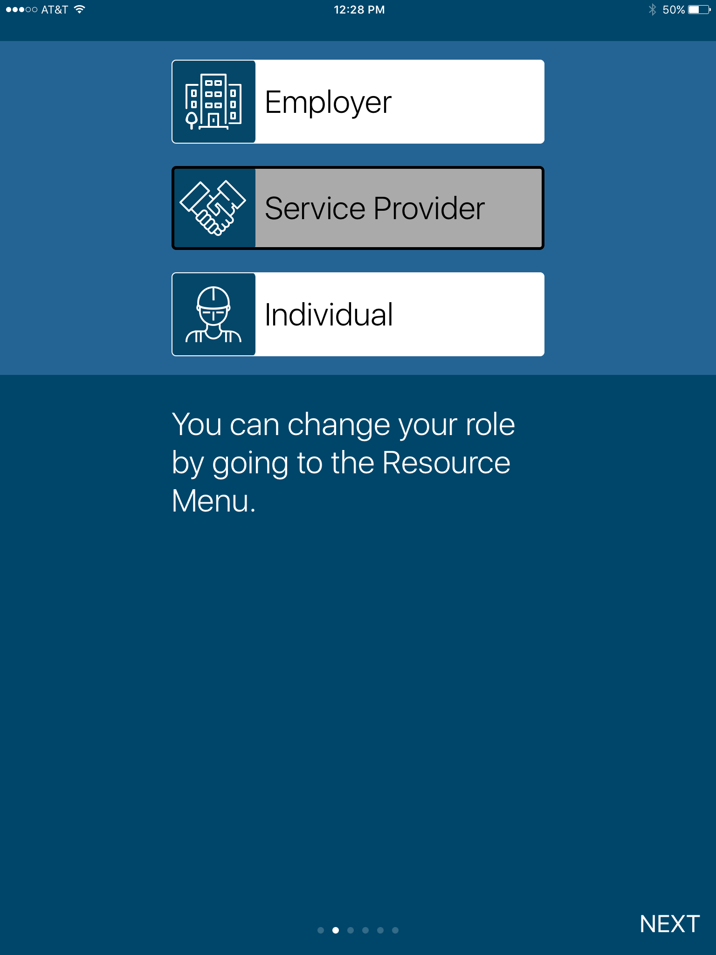
Free MAS App

Slide 48
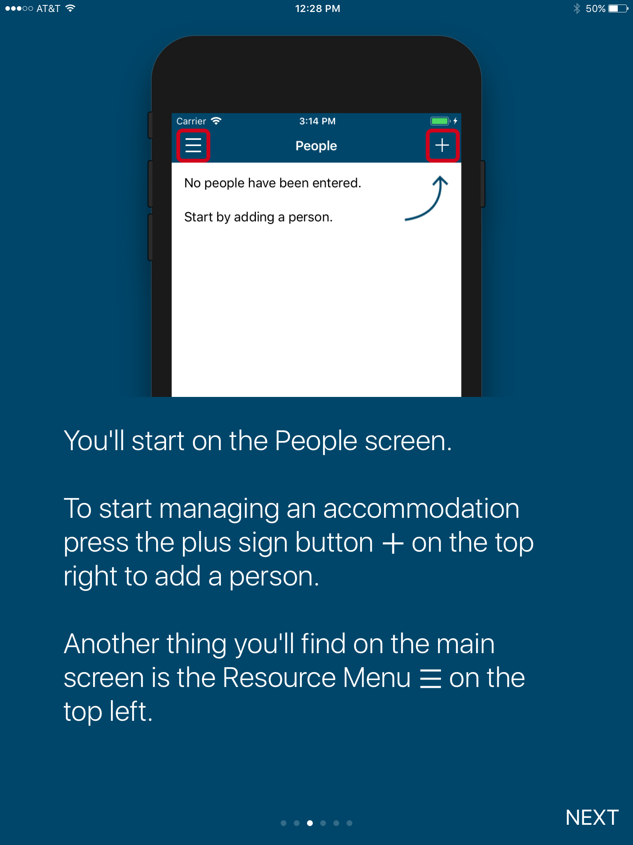
Free MAS App

Slide 49
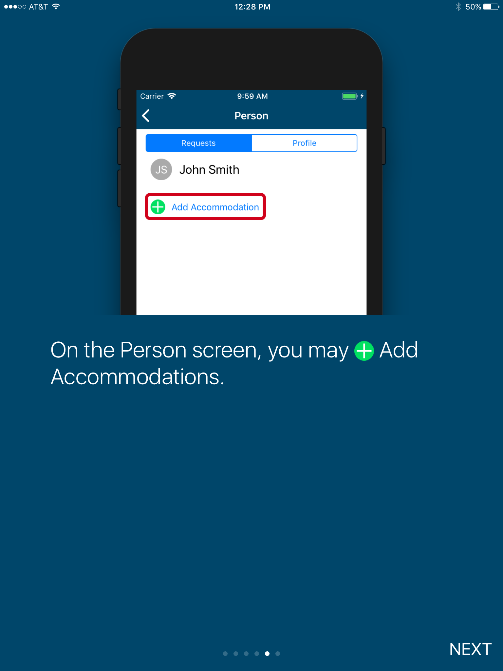
Free MAS App

Slide 50
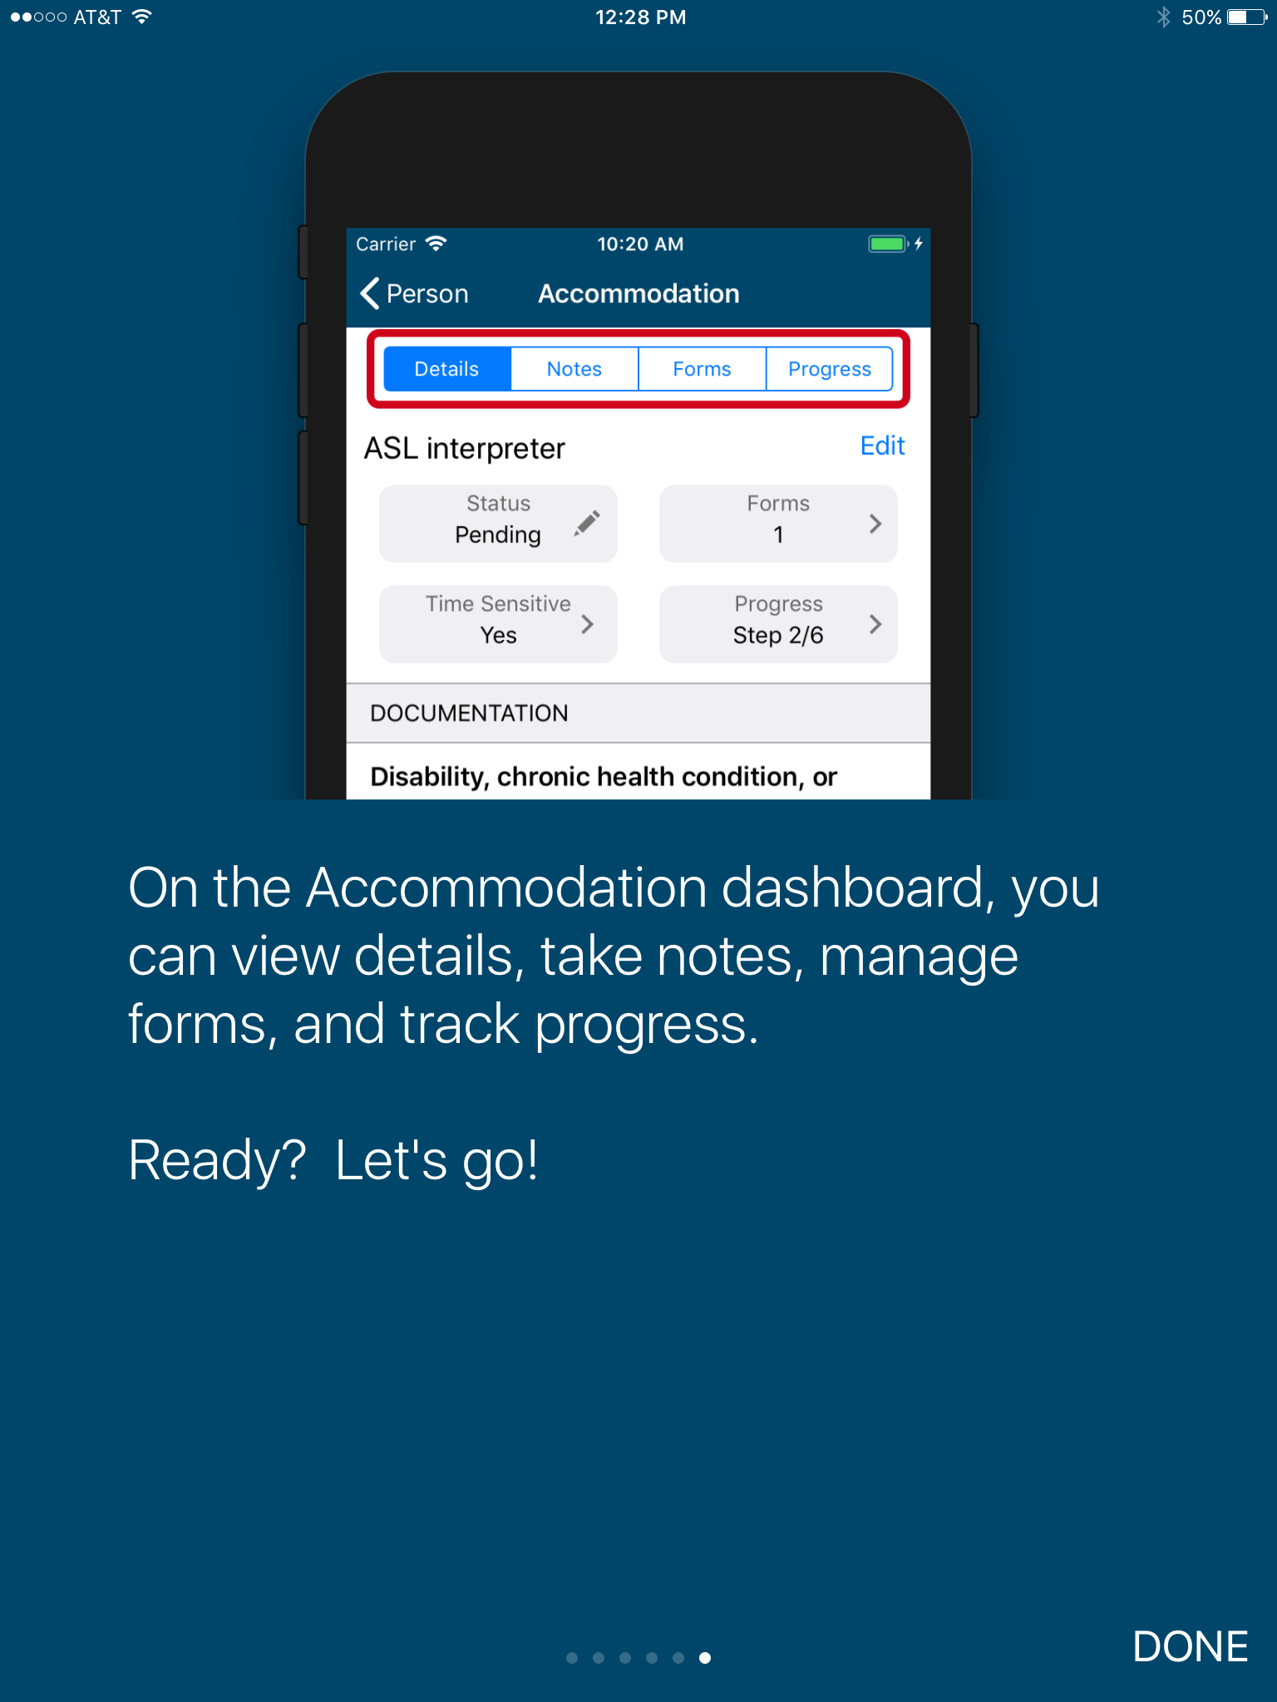
Free MAS App

Slide 51
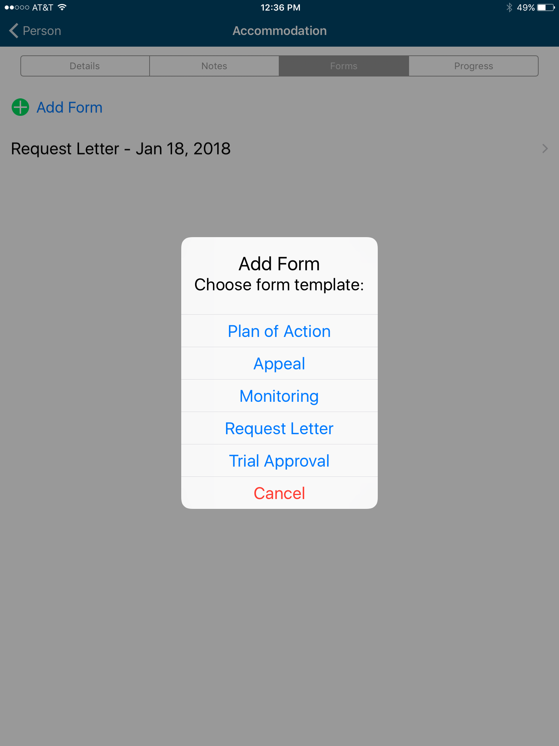
Free MAS App

Slide 52
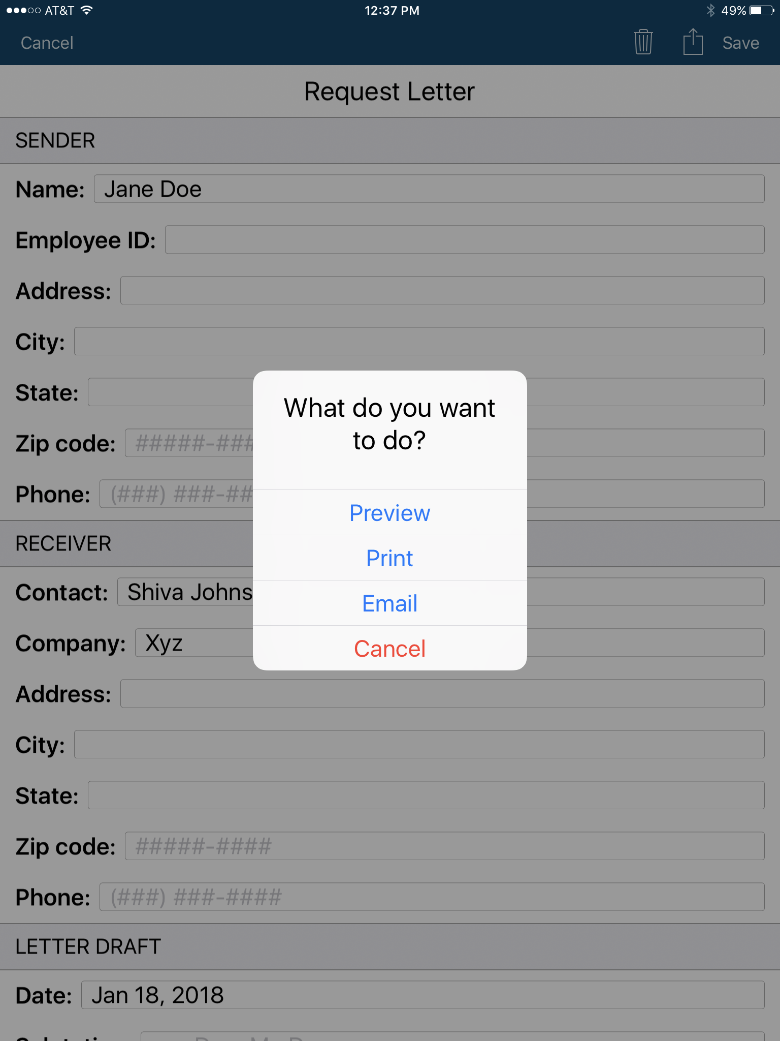
Free MAS App

Slide 53
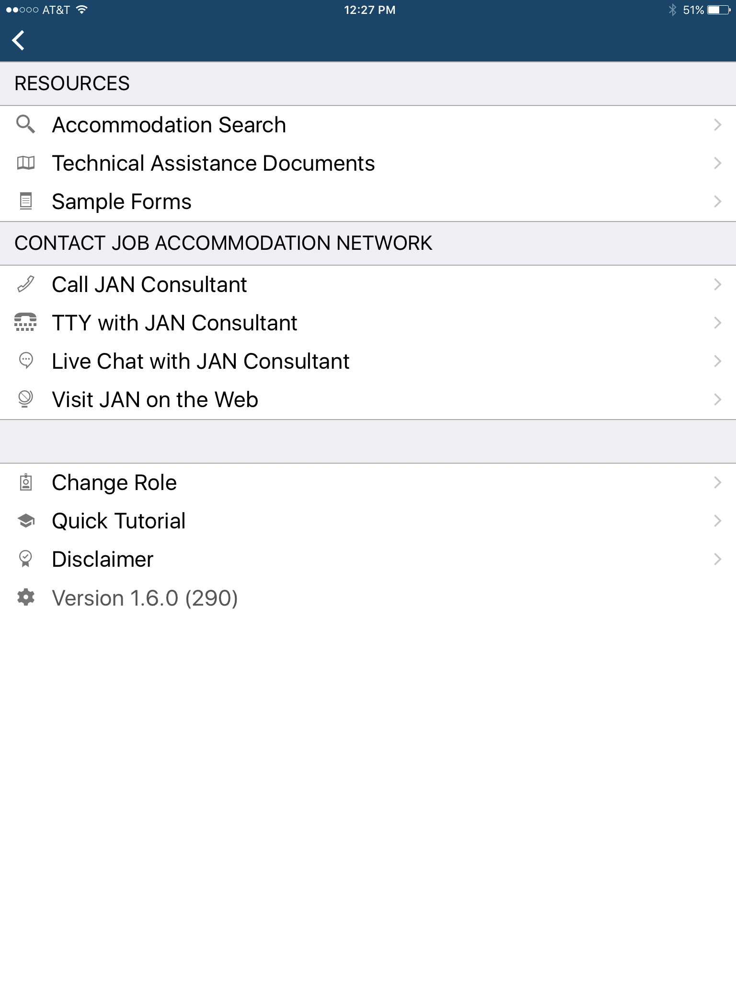
Free MAS App

Slide 54
JAN Resources
Expert consultation
Over 250 JAN-authored Publications
JAN’s A-Z (Disability, Topic, condition)
Legal libraries that include regulations and EEOC guidance documents
JAN Quarterly ENewsletter
JAN Training Modules and FREE Webcast Series
Easy access:
  AskJAN.org
  800.526.7234 or 877.781.9403 (TTY)
  Chat, JAN on Demand, Skype, Text, Social Media

Slide 55







For More Information
Contact JAN
(800) 526-7234 (V) - (877) 781-9403 (TTY)
AskJAN.org
jan@askjan.org
(304) 216-8189 via Text
janconsultants via Skype
Thank you for attending!

Slide 56

Tools, Techniques, and Technologies for Creating Inclusive Workplaces

