Slide 1
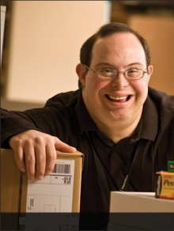
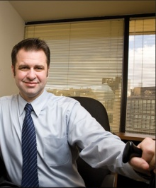
Tools, Techniques, and Technologies for Creating Inclusive Workplaces
Anne Hirsh, MS, CPDM
JAN Co-Director
October 2, 2018

Slide 2
JAN as YOUR Resource
Overview
JAN as YOUR Resource
Research Findings
Workplace Toolkit
Mobile Accommodation Solution

Slide 3
JAN as YOUR Resource
Overview
Job Accommodation
Americans with Disabilities Act / Rehabilitation Act
Entrepreneurship

Slide 4
JAN as YOUR Resource
Overview
35 Years of Service
Experienced
Free
National
Easy to Use

Slide 5
JAN as YOUR Resource
Overview
Employers
Individuals
Service Providers
Others

Slide 6
JAN as YOUR Resource
JAN supports employers and rehabilitation professionals by providing:
Consultation on workplace
accommodation solutions
Consultation on the ADAAA
Coach customers on the interactive process
Product information for technologies used as accommodations in the workplace

Slide 7
JAN as YOUR Resource
Our Process
What limitations is the employee experiencing?
How do these limitations affect the employee and the employee’s job performance?
What specific job tasks are problematic as a result of these limitations?
What accommodations are available to reduce or eliminate these problems? Are all possible resources being used to determine possible accommodations?

Slide 8
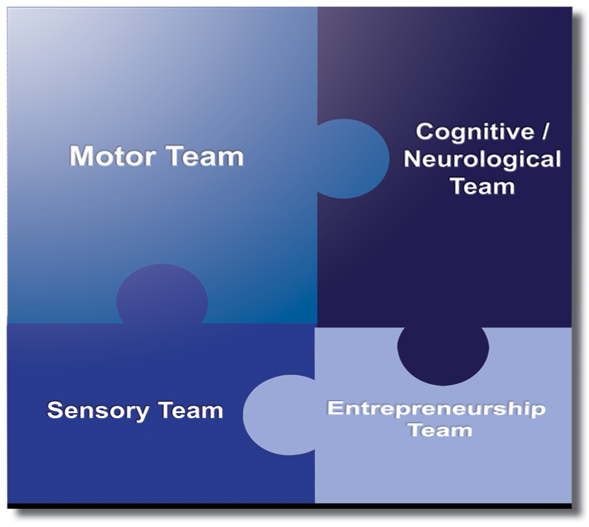
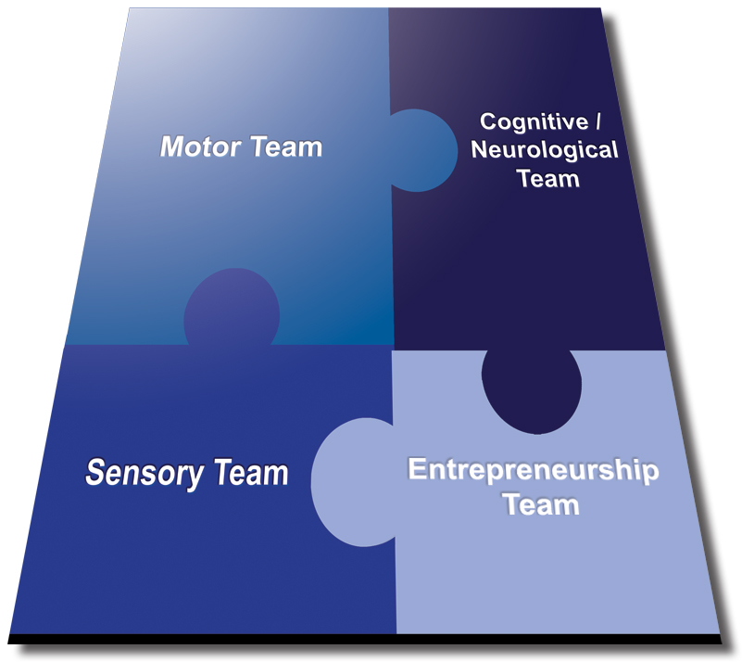
JAN as YOUR Resource

Slide 9
JAN as YOUR Resource
Ask JAN and we…
Meet you where you are.
Help meet timelines.
Assist with the interactive process.
Give targeted technical assistance.
Provide comprehensive resources.
Maintain confidentiality.
Work as your partner to enable you to hire and retain talent.

Slide 10
Use JAN Website
Expert consultation
Nearly 300 JAN-authored Publications
JAN’s A-Z (Disability, Topic, Limitation, coming soon- accommodation)
Legal libraries that include regulations and EEOC guidance documents
JAN Training Modules and FREE Webcast Series
Contact JAN:
Live help @ AskJAN.org
Chat, JAN on Demand, Skype, Text, Social Media

Slide 11
Research Findings
Employer Follow-up Study
1,182 employers interviewed between January, 2004, and December, 2006
807 employers interviewed between June 28, 2008, and July 31, 2017
Total of 2,370 Employers
Of the employers who called JAN for accommodation information and solutions, most were doing so to retain or promote (83%) a current employee.

Slide 12
Research Findings
Finding #1: Most employers report no cost or low cost for accommodating employees with disabilities.
Results
Over half of accommodations (59%) were made at no cost.
Of the 36% who experienced a one-time cost to make an accommodation, the typical cost of accommodating an employee was $500.
Only 25 (4%) said the accommodation resulted in an ongoing, annual cost to the company and 9 (1%) said the accommodation required a combination of one-time and annual costs.

Slide 13
Research Findings
Finding #2: Employers report accommodations are effective.
Results
Of those responding, 75% reported the accommodations were either very effective or extremely effective.

Slide 14
Research Findings
Finding #3: Employers experience multiple direct and indirect benefits after making accommodations.
Direct Benefits of Accommodation
90% Retained a valued employee
72% Increased employee’s productivity
56% Increased employee’s attendance
Indirect Benefits of Accommodation
64% Improved interactions with co-workers
62% Increased overall company morale
56% Increased overall company productivity

Slide 15
Research Findings
The study results consistently showed that the benefits employers receive from making workplace accommodations far outweigh the low cost.
https://askjan.org/topics/costs.cfm?cssearch=1919008_1

Slide 16
Creating Workplace Inclusion
The three C’s: Increase comfort, confidence, and competence
Develop skills that help to more effectively communicate at work with people with disabilities
Develop and effectively communicate actionable policy and procedures
Develop normative practices for engaging with people with disabilities throughout the employee life cycle

Slide 17
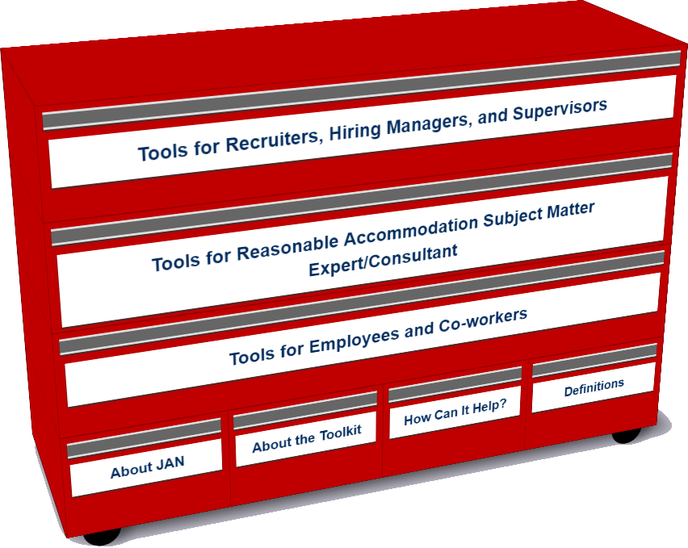
JAN Workplace Accommodation Toolkit
An online “living” toolkit that captures and continuously updates best and emerging practices in providing accommodations in the workplace.
https://AskJAN.org/toolkit/

Slide 18
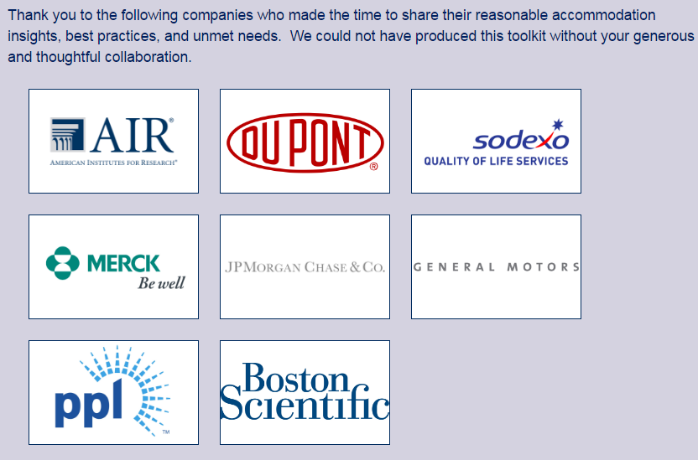
The Workplace Accommodation Toolkit

Slide 19
JAN Toolkit - The Insights
Many companies have noted that they could benefit for emulating best/emerging RA Practices including:
Easier-to-navigate RA processes
Better mechanisms for tracking and reporting
Enhanced data gathering practices (to gauge how satisfied employees and their managers are with RA’s, financial savings, return-to-work, etc.)
More transparent and effective intersections between Section 503 self-ID encouragement and identifying as a person with a disability for purposes of obtaining an RA

Slide 20
Key to Inclusive Culture
Accommodation
=
Equal Employment
=
Inclusive Workplace Culture

Slide 21
RA & IP
The basis for inclusive employment is the reasonable accommodation (RA) policy and process
The foundation for reasonable accommodation is a robust interactive process (IP)
The trigger for RA and IP is a request for an accommodation or recognition of an obvious barrier to someone with a known disability
A request for accommodation includes two essential elements — a medical condition and a related challenge at work

Slide 22
Eight Most Common Types of RA
Modifying schedule or allowing leave time
Making workplace or work station accessible
Modifying methods — testing, communication, or training
Modifying or creating policies
Purchasing or modifying equipment or products
Purchasing a service — reader or interpreter
Restructuring job
Reassignment
Other accommodations
Telework
Adjusting supervisory method
Using a service animal

Slide 23
JAN’s Interactive Process
Step 1: Recognizing an Accommodation Request
Step 2: Gathering information
Step 3: Exploring Accommodation Options
Step 4: Choosing an Accommodation
Step 5: Implementing the Accommodation
Step 6: Monitoring the Accommodation
https://AskJAN.org/topics/interactive.cfm

Slide 24
Who uses the Toolkit?
Recruiters, Hiring Managers and Supervisors
Accommodation Consultant/Subject Matter Expert
Employees and Co-workers — Allies

Slide 25
Accommodation Toolkit
Recruiters, Hiring Managers and Supervisors

Slide 26
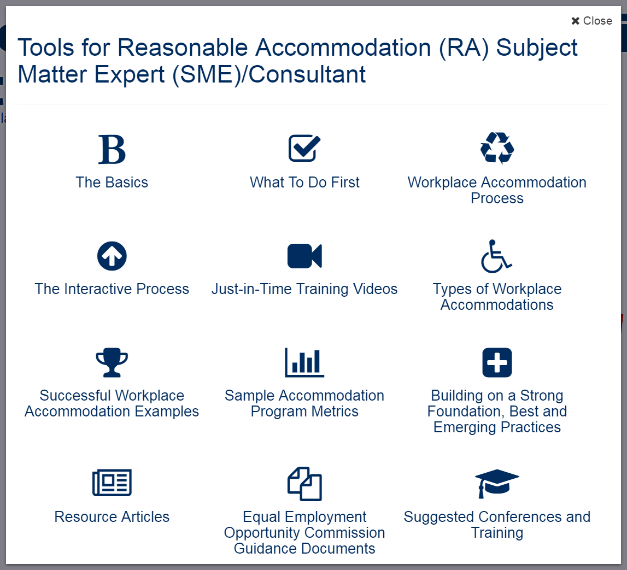
Accommodation Toolkit
Accommodation Consultant/Subject Matter Expert

Slide 27
Accommodation Toolkit
Employees and Co-workers — Allies

Slide 28
Accommodation Toolkit

Slide 29
JAN Toolkit video with PPT
Interviewing an individual on the Autism Spectrum
Accommodating employee with non-apparent disability – PTSD and hearing loss
Managing the performance of an employee with a non-apparent disability – mental health
Hiring an individual with anxiety and stuttering disorder
Retaining an individual with chronic health conditions
Returning a Back-Injured Employee to Work
Promoting an Individual who is Deaf
Retaining an Individual with an Intellectual Disability after a Change in Supervisor

Slide 30
Techniques for Creating Inclusion
Adopting facilities/IT access for all: universal design reduces the need for individualized accommodations
Focusing on diverse abilities — experience, skills, prior performance, not diagnosis or interviewing skills — this contributes to higher productivity & innovation
Gathering/reporting meaningful metrics (e.g. reduction in lost work time, retention & leave costs, enhanced engagement scores)
Utilizing/leveraging commonly requested accommodations by job function to develop an internal catalogue of accommodations for specific jobs

Slide 31
Techniques for Creating Inclusion
Develop a list of preapproved accommodations not requiring a full assessment and interactive process (Just do it!)
Developing a “task bank” of jobs that a person can perform when unable to perform prior duties
Integrated or harmonized model — Single point of leave and accommodation oversight
Internal value proposition shared with everyone, including managers
Training and more training — consider building training prompts into processes
Build out from a successful return-to-work program
Purchase or develop a tracking system

Slide 32
Techniques for Creating Inclusion
Use outside resources more effectively — do not recreate the wheel internally
Create a centralized accommodation fund with expedited procurement fulfillment
Ensure the accessibility of your career portal, pre-hire assessment, etc.
Embed at least one accessibility expert in your IT team — Join the International Association for Accessibility Professionals and add accessibility requirements to job posting and descriptions
Provide boilerplate accessibility contract language with providers and vendors

Slide 33
Enabling Technologies
Applicant Tracking Systems
Pre-hire Testing Software
Accommodation Tracking Systems
Legacy Information Systems i.e. HRIS
Learning Management Systems
JAN Accommodation Toolkit
Mobile Accommodation Solution

Slide 34
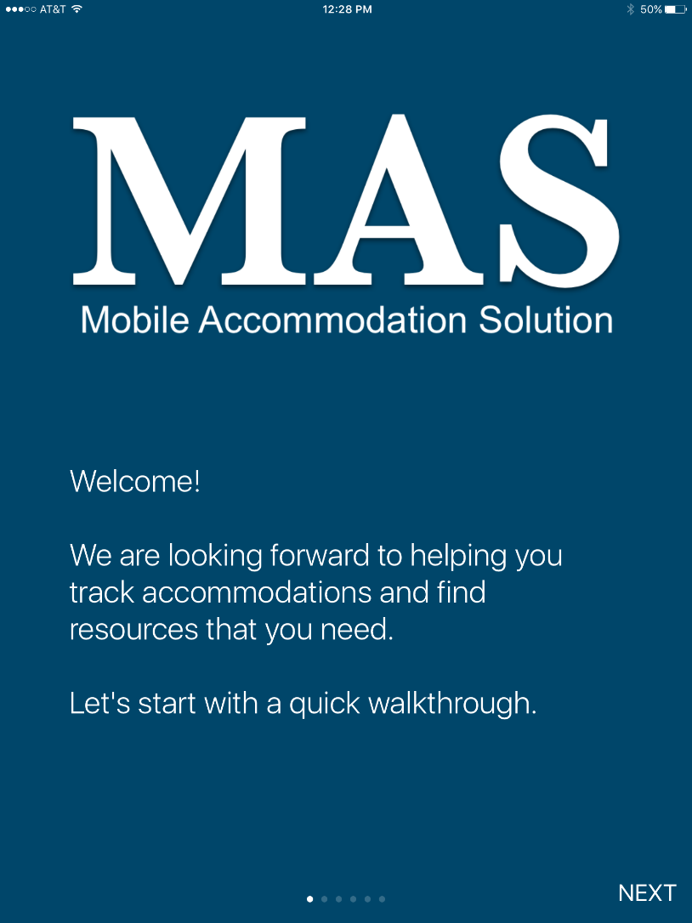
Free MAS App

Slide 35
Free MAS App
Big Idea
The Mobile Accommodation Solution (MAS) is designed to help streamline the disability accommodation process at various phases of the employment cycle.
Funded by the National Institute on Disability, Independent Living, and Rehabilitation Research (NIDILRR)

Slide 36
Free MAS App
Collaborators
Center for Disability Inclusion
Job Accommodation Network (JAN)
IBM
US Business Leadership Network
American Association of People with Disabilities
Council of State Administrators of Vocational Rehabilitation
National Business and Disability Council
Disability Management Employers Coalition

Slide 37
Free MAS App
Users
Talent management, human resources, employer relations, and/or accommodation staff
Employment service providers
Applicants and employees with disabilities

Slide 38
Free MAS App
Functionality
Easy to use, secure, mobile case management tool
Accommodation tracking tool
Best and emerging accommodation practices and forms embedded within tool
Easy access to JAN Consultants and myriad of other resources

Slide 39
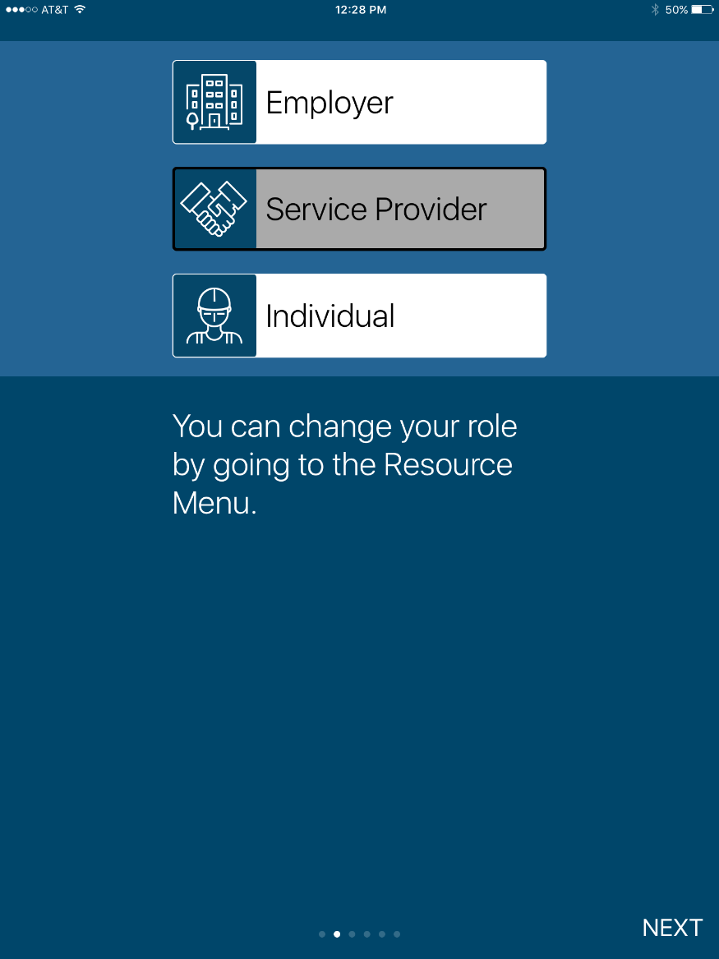
Free MAS App

Slide 40
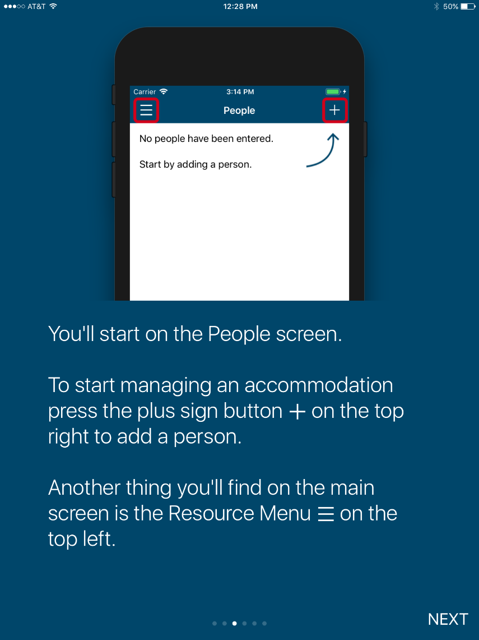
Free MAS App

Slide 41
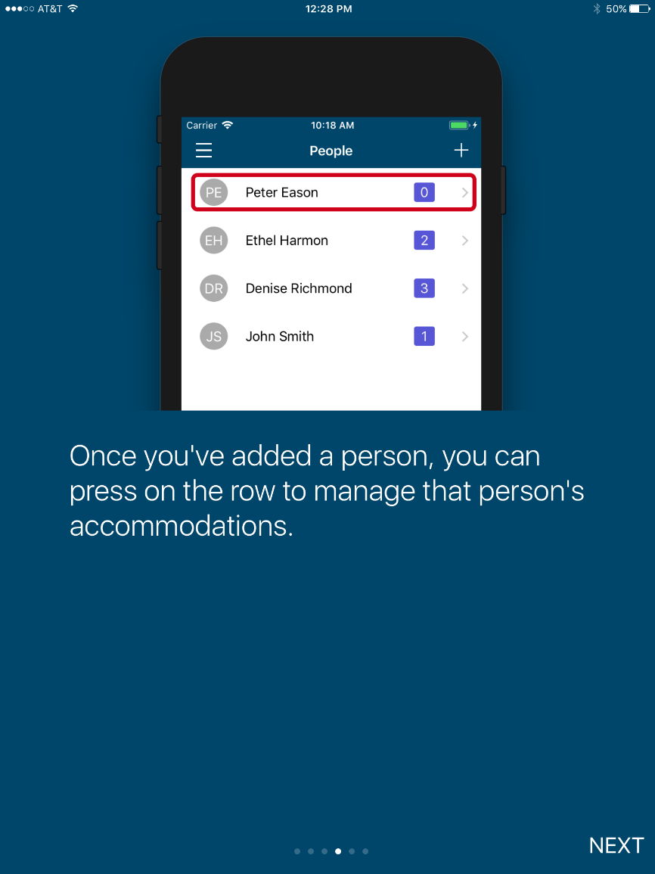
Free MAS App

Slide 42
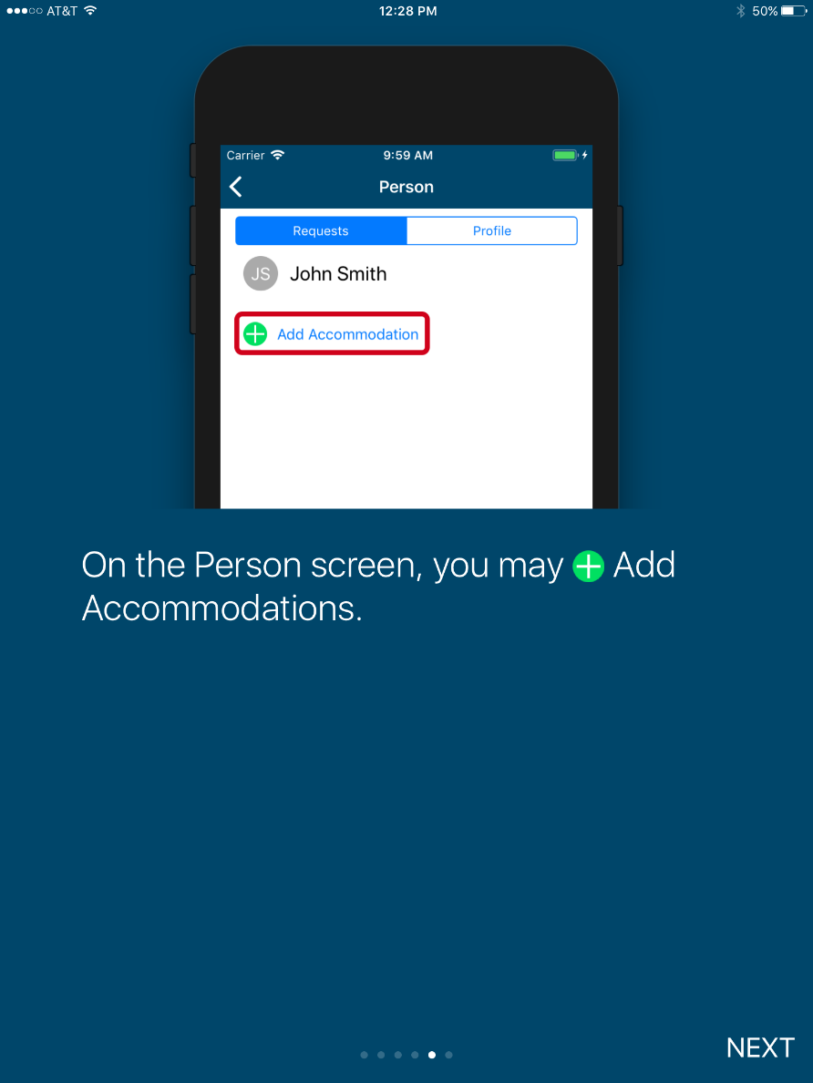
Free MAS App

Slide 43
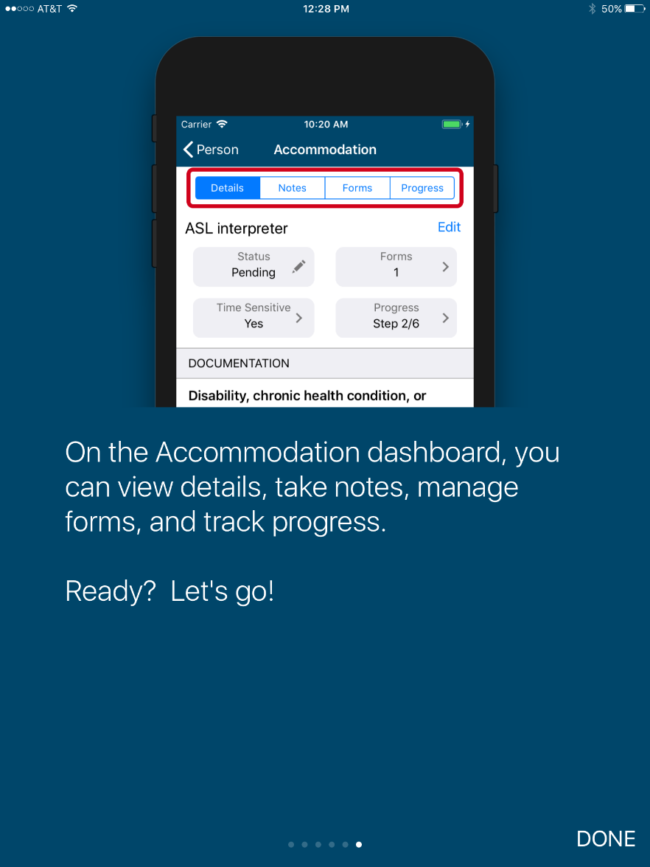
Free MAS App

Slide 44
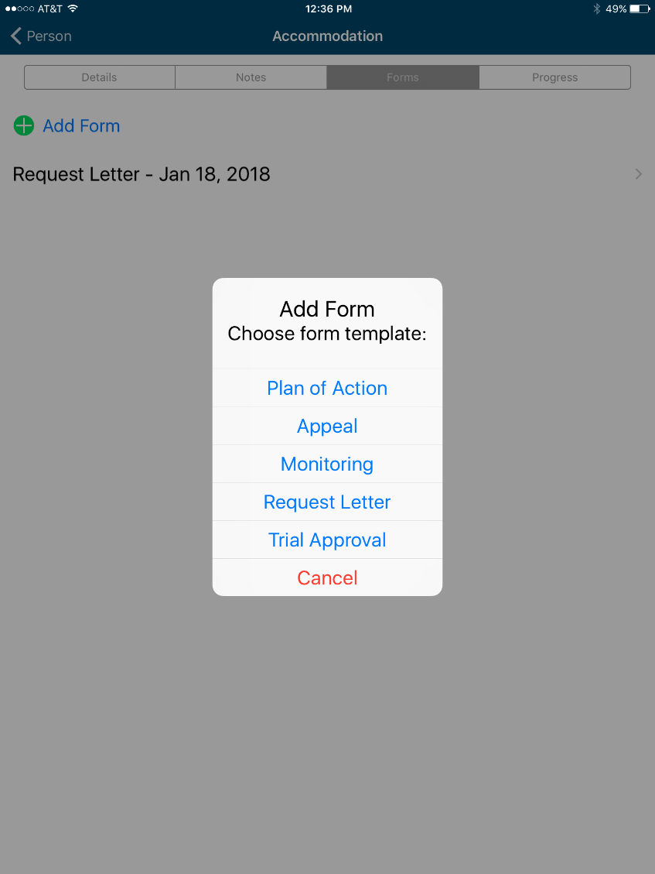
Free MAS App

Slide 45
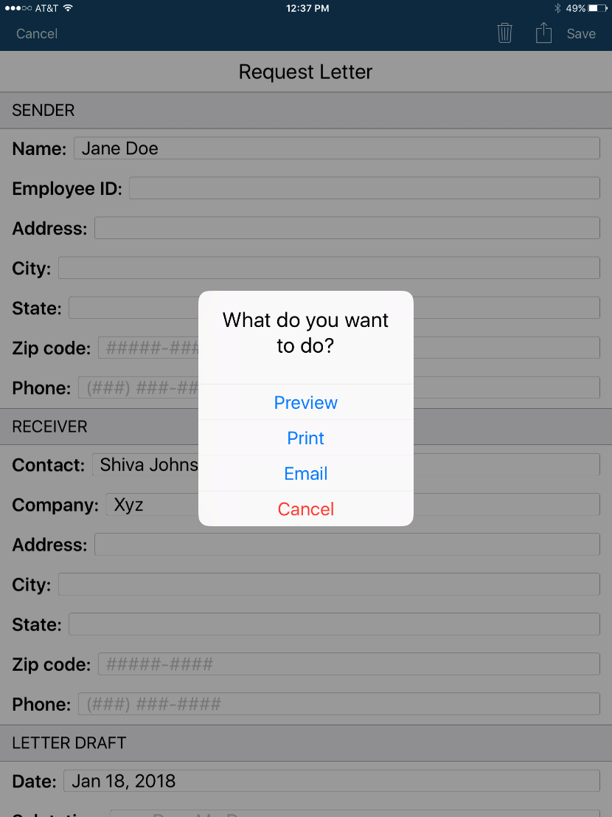
Free MAS App

Slide 46
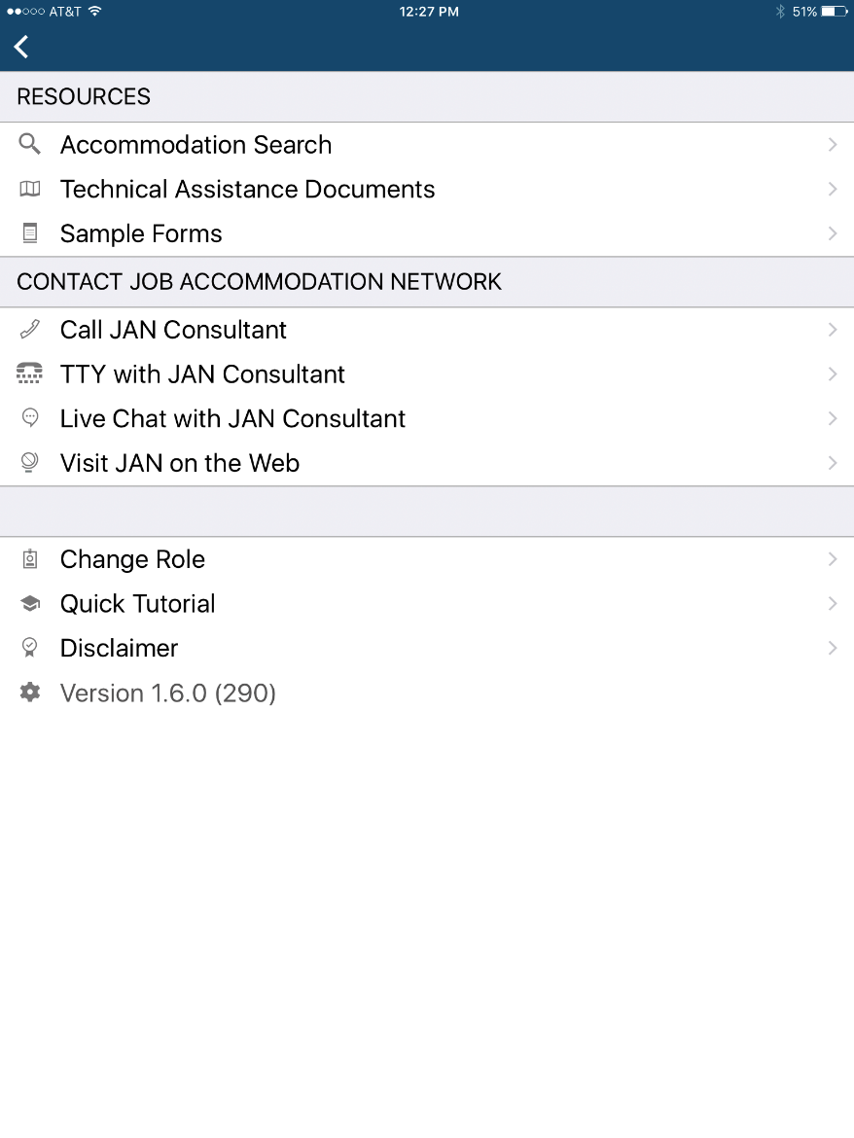
Free MAS App

Slide 47
MAS App
Future Functionality
PC-based MAS
Capable of video upload
Open source
Cloud-enhanced
Store medical and accommodation history
Reporting function

Slide 48
MAS APP
Free App!
iOS
https://itunes.apple.com/us/app/mobile-accommodation-solution/id1291959434?mt=8
Android
https://play.google.com/store/apps/details?id=org.askjan.mobile.android&pcampaignid=MKT-Other-global-all-co-prtnr-py-PartBadge-Mar2515-1

Slide 49
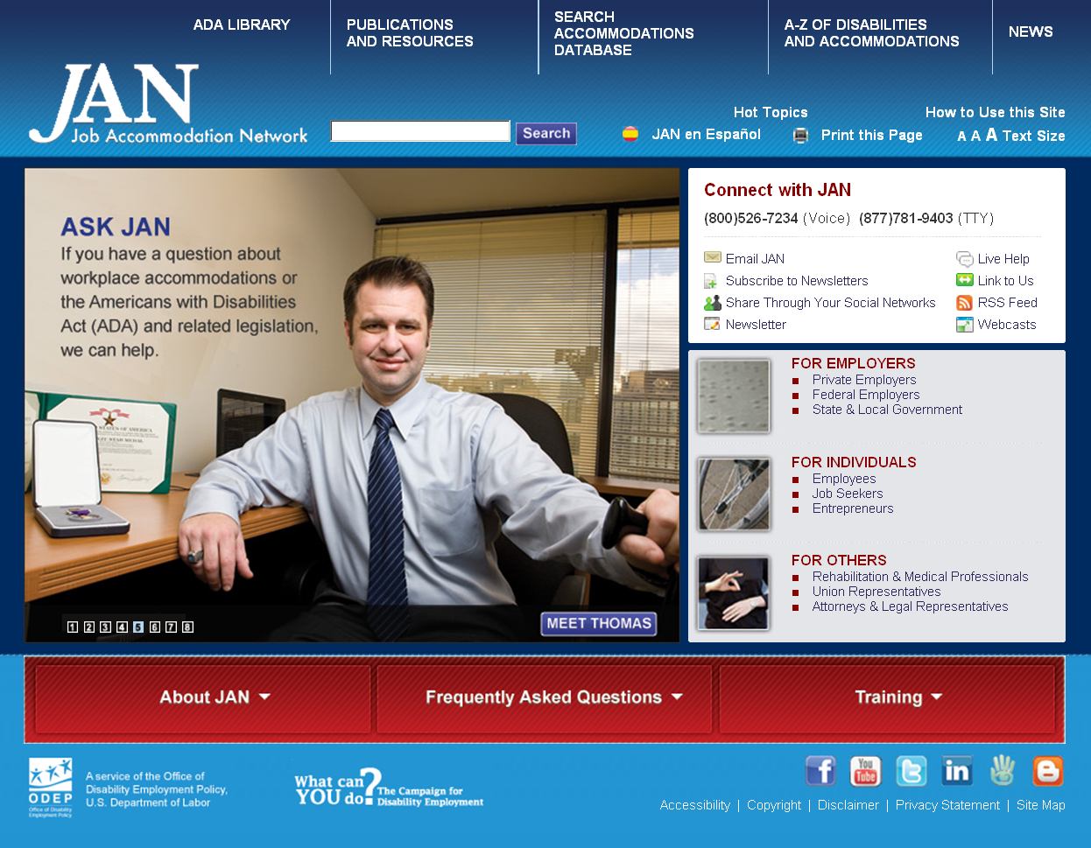
Contact JAN
JAN Consultants can be reached M-F 9am-6pm ET by
Phone – (800) 526-7234 voice; (877) 781-9403 TTY
Email - jan@AskJAN.org
JANonDemand -https://askjan.org/JANonDemand.cfm
Chat available online at http://AskJAN.org
Skype - Janconsultants
Text – (304) 216-8189
Website - http://AskJAN.org

Slide 50
Questions?

