Slide 1
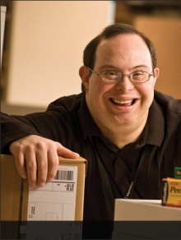
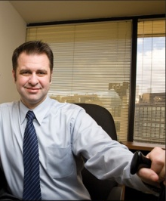
The ADA and Accommodations: Techniques and Tools for Workplace Success
Lou Orslene, JAN Co-Director
Orslene@jan.wvu.edu

Slide 2
Where I come from…
Notes:
Tell the story of the mine accident and recovery and mention Kate.

Slide 3
Where I come from…
Notes:
Tell the story of the mine accident and recovery and mention Kate.

Slide 4
Who is JAN?
Notes:
The Job Accommodation Network (JAN) is the leading source of free, expert, and confidential one-on-one guidance on reasonable accommodation (RA) in the workplace, the Americans with Disabilities Act (ADA) and related legislation, and disability employment issues.

Slide 5
Why is this important?

Slide 6
ADA and IDEA
How is the ADA different than IDEA?
IDEA
Entitlement
ADA
Eligibility
Grades Pre-K
through 12
Post-secondary
and Working
Notes:
Let’s look here at the differences between the IDEA, or the Individuals with Disabilities Education Act and the ADA, the Americans with Disabilities Act. IDEA is a law that protects you as a student with a disability while you are in the school system. It is called an entitlement because if you have a disability, you are automatically covered and provided a free appropriate public education. You receive special education services, supports, and accommodations. A team of people, including a special education teacher, and possibly a speech and language pathologist, an occupational and/or physical therapist or other support personnel meet at least once a year to make plans to insure that you are making progress and have the accommodations or modifications you need in the classroom.
Once you graduate from the school system, you are no longer covered by the IDEA, but rather the ADA or the Americans with Disabilities Act. It differs from IDEA in several ways. Now you have to qualify as a person with a disability, and the qualification standards have changed. To meet this definition of disability under the ADA, you have to have a physical or mental impairment that substantially limits one or more major life activities, have a record of such an impairment, or be regarded by others as having an impairment. We’ll talk about this in more detail in just a few slides. Once you exit the school system and enter post-secondary training or employment, the only way you will receive accommodations is if you ask for them yourself. You may be required to disclose your disability in order to receive the accommodations.

Slide 7
Goals of the ADA as Amended
So what are the goals of the Americans with Disabilities Act (ADA)
Prevent discrimination
Provide equal opportunity through reasonable accommodation
Notes:
First and foremost, it is very important to know and understand your rights as an individual with a disability under the ADA.
The next topic is disclosure, one that is vital to the transition process. We will discuss the who, what, when, how, and why of disclosure.
And last, but certainly not least, we will briefly discuss some common accommodation ideas that might be helpful.
Individuals will need to become their own advocate. Self-advocacy simply means that individuals need to know and speak up for themselves. They have to know their strengths and weaknesses, how they learn and what they will need to help them succeed. They will need to be comfortable talking about themselves and possibly their disability to prospective employers or to educational professionals. They also need to understand their rights and responsibilities under the ADA.
“The 411 on Disability Disclosure: A Workbook for Youth with Disabilities” is designed for youth and adults working with them to learn about disability disclosure.
This workbook helps young people make informed decisions about whether or not to disclose their disability and understand how that decision may impact their education, employment, and social lives.
Based on the premise that disclosure is a very personal decision, this workbook can help you think about and practice disclosing your disability.

Slide 8
Disclosure
Disclosure is when you give out specific, personal information about a your disability.
Important to provide:
The nature of the disability
The limitations, or how the disability affects your capacity to learn and/or perform the job effectively
Accommodations you will need in order to do the job
Notes:
Disclosure is when you give out specific, personal information about your disability. Deciding whether to disclose a disability can be a difficult decision. Individuals with disabilities sometimes struggle not only with wanting to be honest and open from the start of the job-seeking process, but also with knowing what might happen if they disclose too soon.
If and when you do decide to disclose your disability, it will be important to provide the following information:
The nature of your disability
The limitations, or how the disability affects your capacity to learn and/or perform the job effectively
And the accommodations you will need in order to do the job

Slide 9
Disclosure
When do I Disclose?
During the application or interview process
At any point during employment
To receive benefits and privileges
To explain an unusual circumstance
Notes:
When do you disclose? Anytime that you will need an accommodation or a change in the way things are done in the workplace. You never have to disclose a disability until you need an accommodation. Under the ADA, you are not required to disclose to an employer at any specific time. The only warning we would give is not to wait too long if there are performance or conduct issues that are directly related to your disability.
You can disclose during the application or interview process (an example would be to access an online application system, or if you need accommodations for pre-employment testing)
At any point during employment when an accommodation is needed – maybe if the disability changes or when the job tasks have changed
To receive benefits and privileges of employment ( an example here might be access to training, a company café, or an employer sponsored summer picnic that is available to all employees,) OR
To explain an unusual circumstance (an example here might be absences from work and the inability to call in at the specified time to report the absence)

Slide 10
Disclosure
How do I Disclose?
To request accommodation, an individual:
May use “plain English”
Need not mention the ADA
Need not use the phrase “reasonable accommodation”
Notes:
Now let’s talk a little about How to Disclose
The individual must let the employer know:
An adjustment or change at work is needed for a reason related to a medical condition
To request accommodation, an individual:
May use “plain English.”
Need not mention the ADA, and
Need not use the phrase “reasonable accommodation.”
It can be as easy as telling your employer “I have difficulty getting to work on time because of the medication I take for a medical condition. Could we talk about that?”

Slide 11
Disclosure
Who do I Disclose to?
Verbally or in writing, tell the…
Employer
Supervisor
HR representative, or
Other appropriate person provided in the accommodation policy.
Notes:
Under the ADA, an individual may disclose a disability and ask for an accommodation either verbally or in writing. At JAN, we recommend that you do so in writing so that you have documentation that you did indeed disclose and ask for an accommodation, and when you did so. We have a sample letter located on our website that can help you with that.
Who do you disclose to? The employer, a supervisor or manager, and/or a human resources representative can all be persons an employee would make their disclosure to. Often times an employee doesn’t want their supervisor or manager to know about their medical condition. In that case, it is wise to disclose to someone in HR. In many cases, a manager or supervisor may need to be informed of the process and be involved in the accommodations, but wouldn’t need information on the medical condition.
There may be other specific persons that you would disclose to – those persons or offices could be determined from the accommodation policy. And if you are a student, the Student Disability Services Office would be a good place to start.

Slide 12
RA & IP
The basis for inclusive employment is the reasonable accommodation (RA) policy and process
The foundation for reasonable accommodation is a robust interactive process (IP)
The trigger for RA and IP is a disclosure and request for an accommodation or recognition of an obvious barrier to someone with a known disability
A request for accommodation includes two essential elements — a medical condition and a related challenge at work

Slide 13
JAN’s Interactive Process
Step 1: Recognizing an Accommodation Request
Step 2: Gathering information
Step 3: Exploring Accommodation Options
Step 4: Choosing an Accommodation
Step 5: Implementing the Accommodation
Step 6: Monitoring the Accommodation
https://AskJAN.org/topics/interactive.cfm
Notes:
A collaborative effort to identify effective accommodation solutions – it’s that simple.

Slide 14
Eight Most Common Types of RA
Modifying schedule or allowing leave time
Making workplace or work station accessible
Modifying methods — testing, communication, or training
Modifying or creating policies
Purchasing or modifying equipment or products
Purchasing a service — reader or interpreter
Restructuring job
Reassignment
Other accommodations
Telework
Adjusting supervisory method
Using a service animal

Slide 15
What is the Toolkit?
An free, online “living” toolkit that captures and continuously updates best and emerging practices in providing accommodations in the workplace.
http://AskJAN.org/toolkit/
Notes:
Many companies have noted that they could benefit for emulating best/emerging RA practices including:
Easier-to-navigate RA processes for employees and managers
Better mechanisms for tracking and reporting
Enhanced data-gathering practices (to gauge how satisfied employees and their managers are with RAs, financial savings, return to work, etc.)
More transparent and effective intersections between Section 503 self-ID encouragement and identifying as a person with a disability for purposes of obtaining an RA

Slide 16
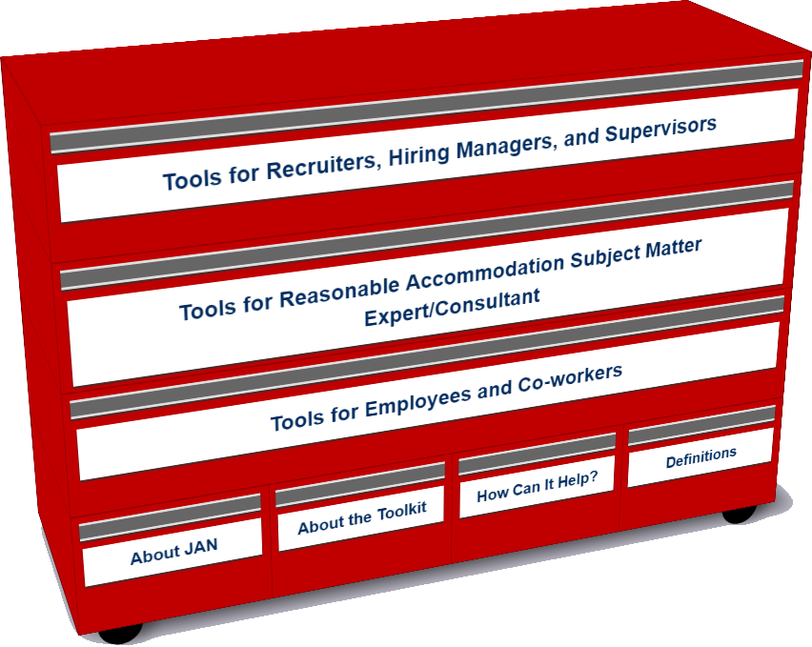
Who uses the Toolkit?
Recruiters, Hiring Managers and Supervisors
Accommodation Consultant/Subject Matter Expert
Employees and Co-workers — Allies

Slide 17
Accommodation Toolkit
Employees and Co-workers — Allies
Notes:
DD

Slide 18
Interview Challenges

Slide 19
Retaining Employee
With an Intellectual Disability
Notes:
DD tee up video

Slide 20
Technology
Big Idea
The Mobile Accommodation Solution (MAS) is designed to help streamline the disability accommodation process at various phases of the employment cycle.
Funded by the National Institute on Disability, Independent Living, and Rehabilitation Research (NIDILRR)
Notes:
Collaborators
Center for Disability Inclusion
Job Accommodation Network (JAN)
IBM
US Business Leadership Network
American Association of People with Disabilities
Council of State Administrators of Vocational Rehabilitation
National Business and Disability Council
Disability Management Employers Coalition

Slide 21
Free MAS App
Users
Talent management, human resources, employer relations, and/or accommodation staff
Employment service providers
Applicants and employees with disabilities

Slide 22
Free MAS App
Functionality
Easy to use, secure, mobile case management tool
Accommodation tracking tool
Best and emerging accommodation practices and forms embedded within tool
Easy access to JAN Consultants and myriad of other resources

Slide 23
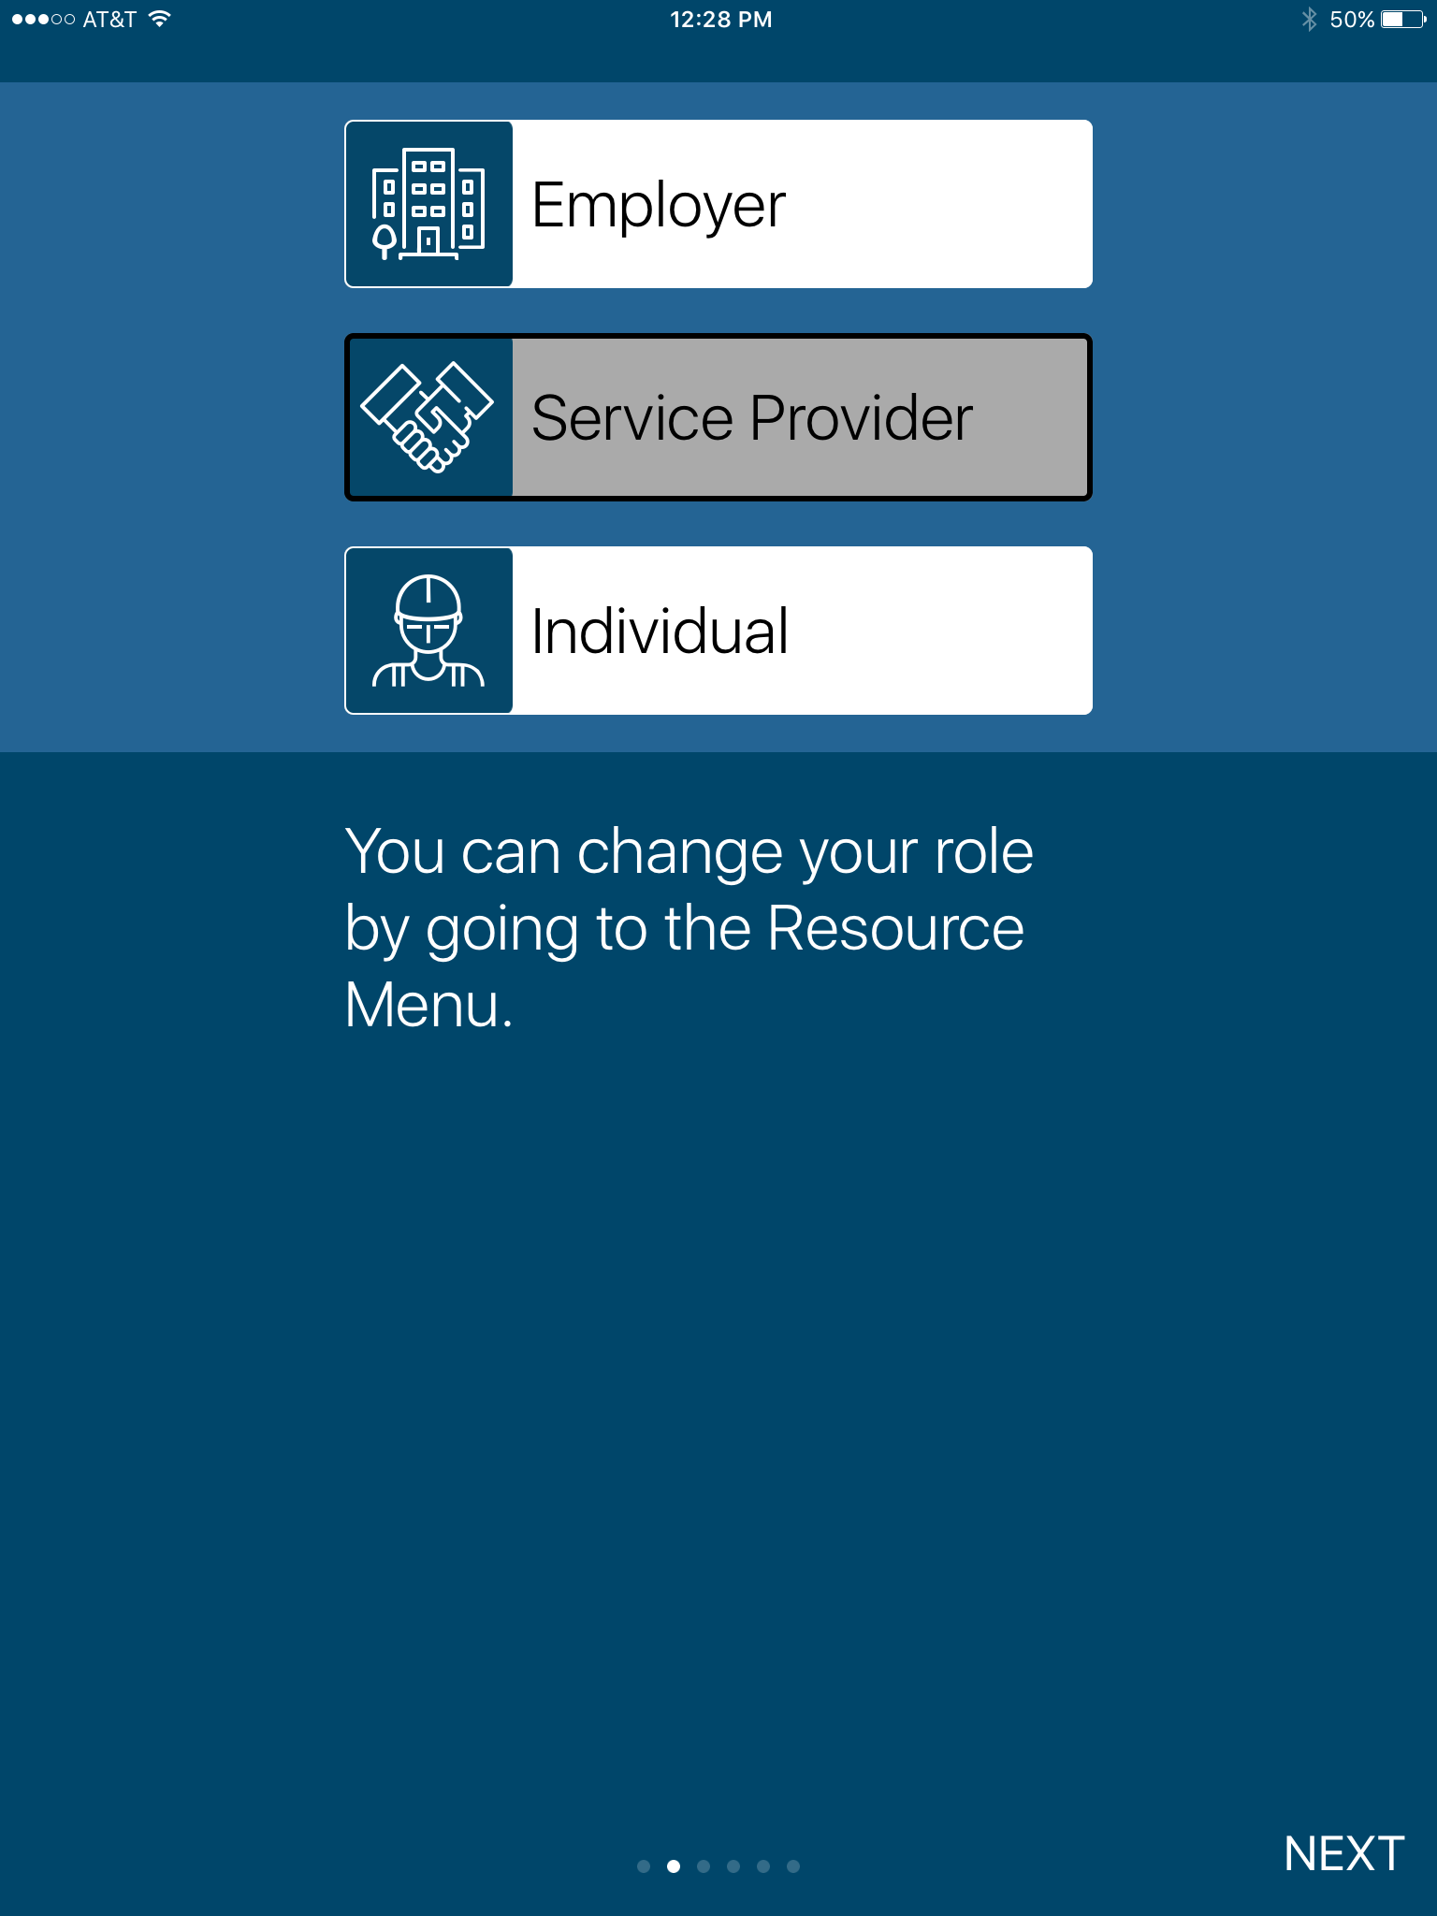
Free MAS App

Slide 24
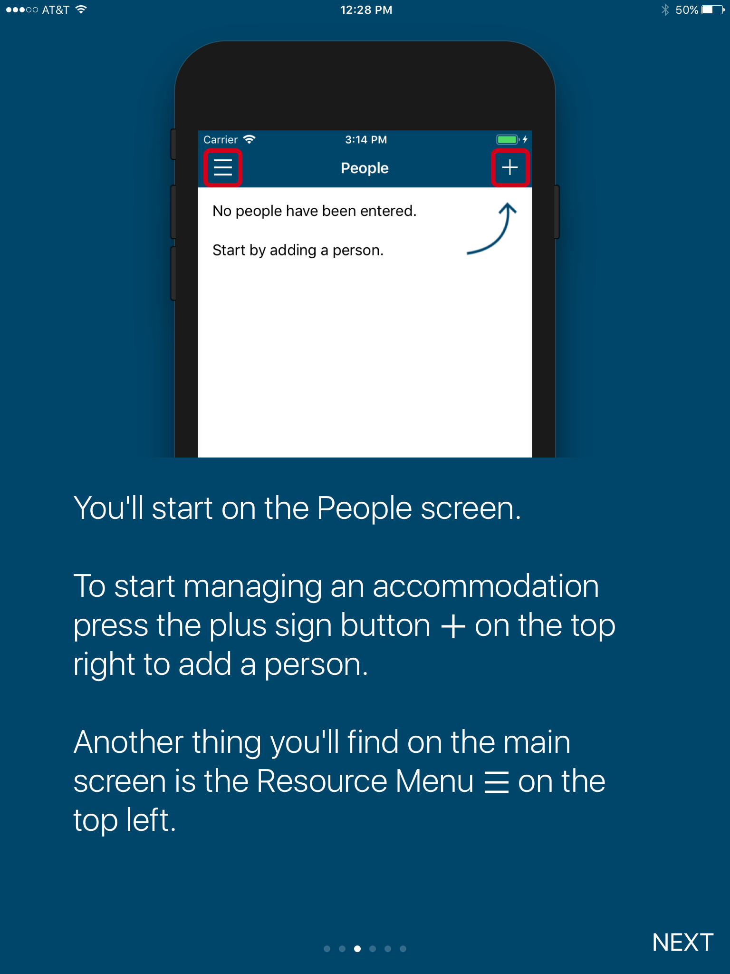
Free MAS App

Slide 25
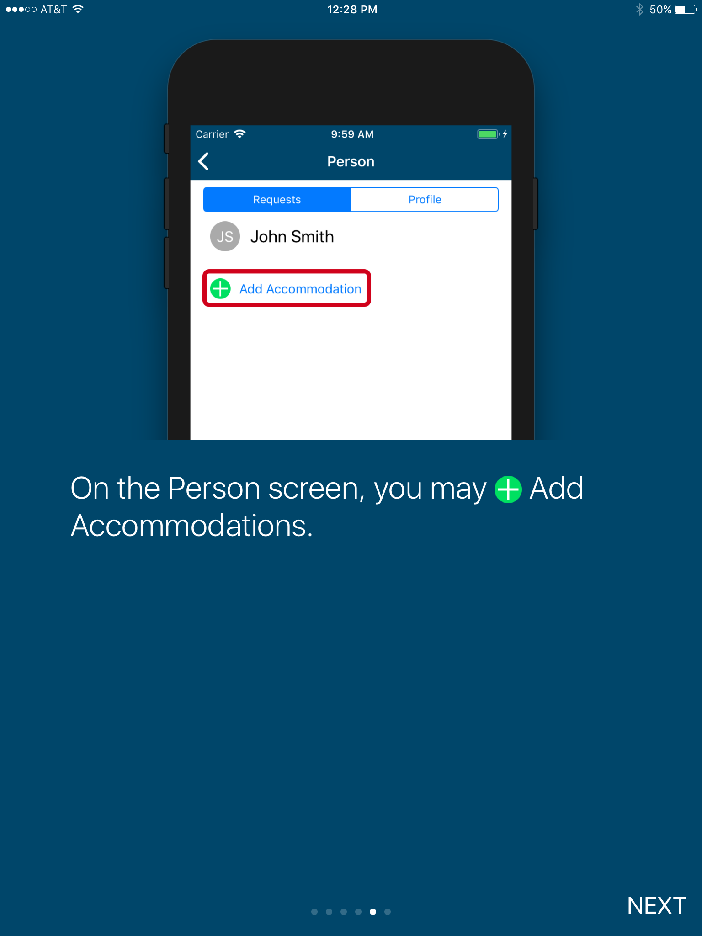
Free MAS App

Slide 26
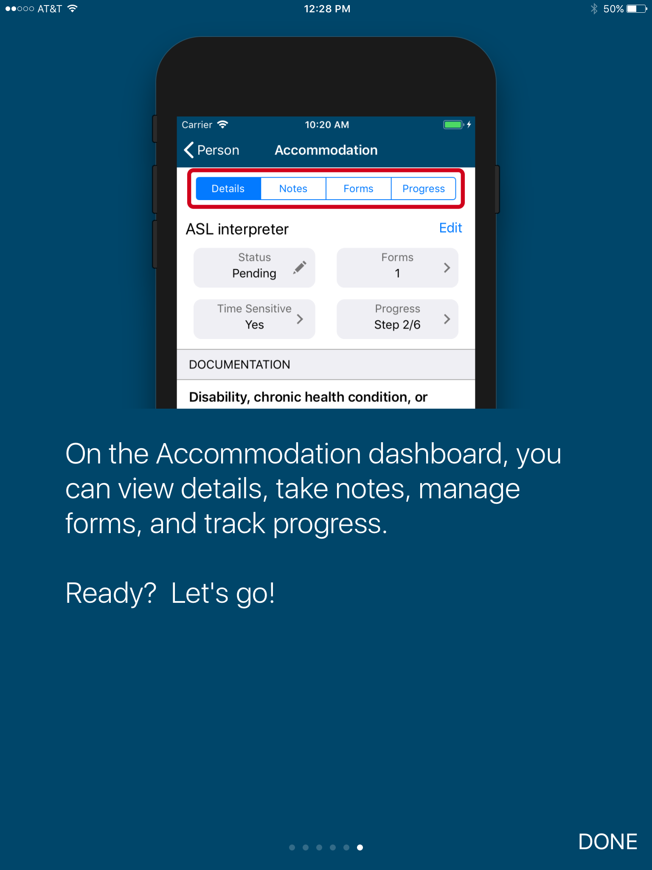
Free MAS App

Slide 27
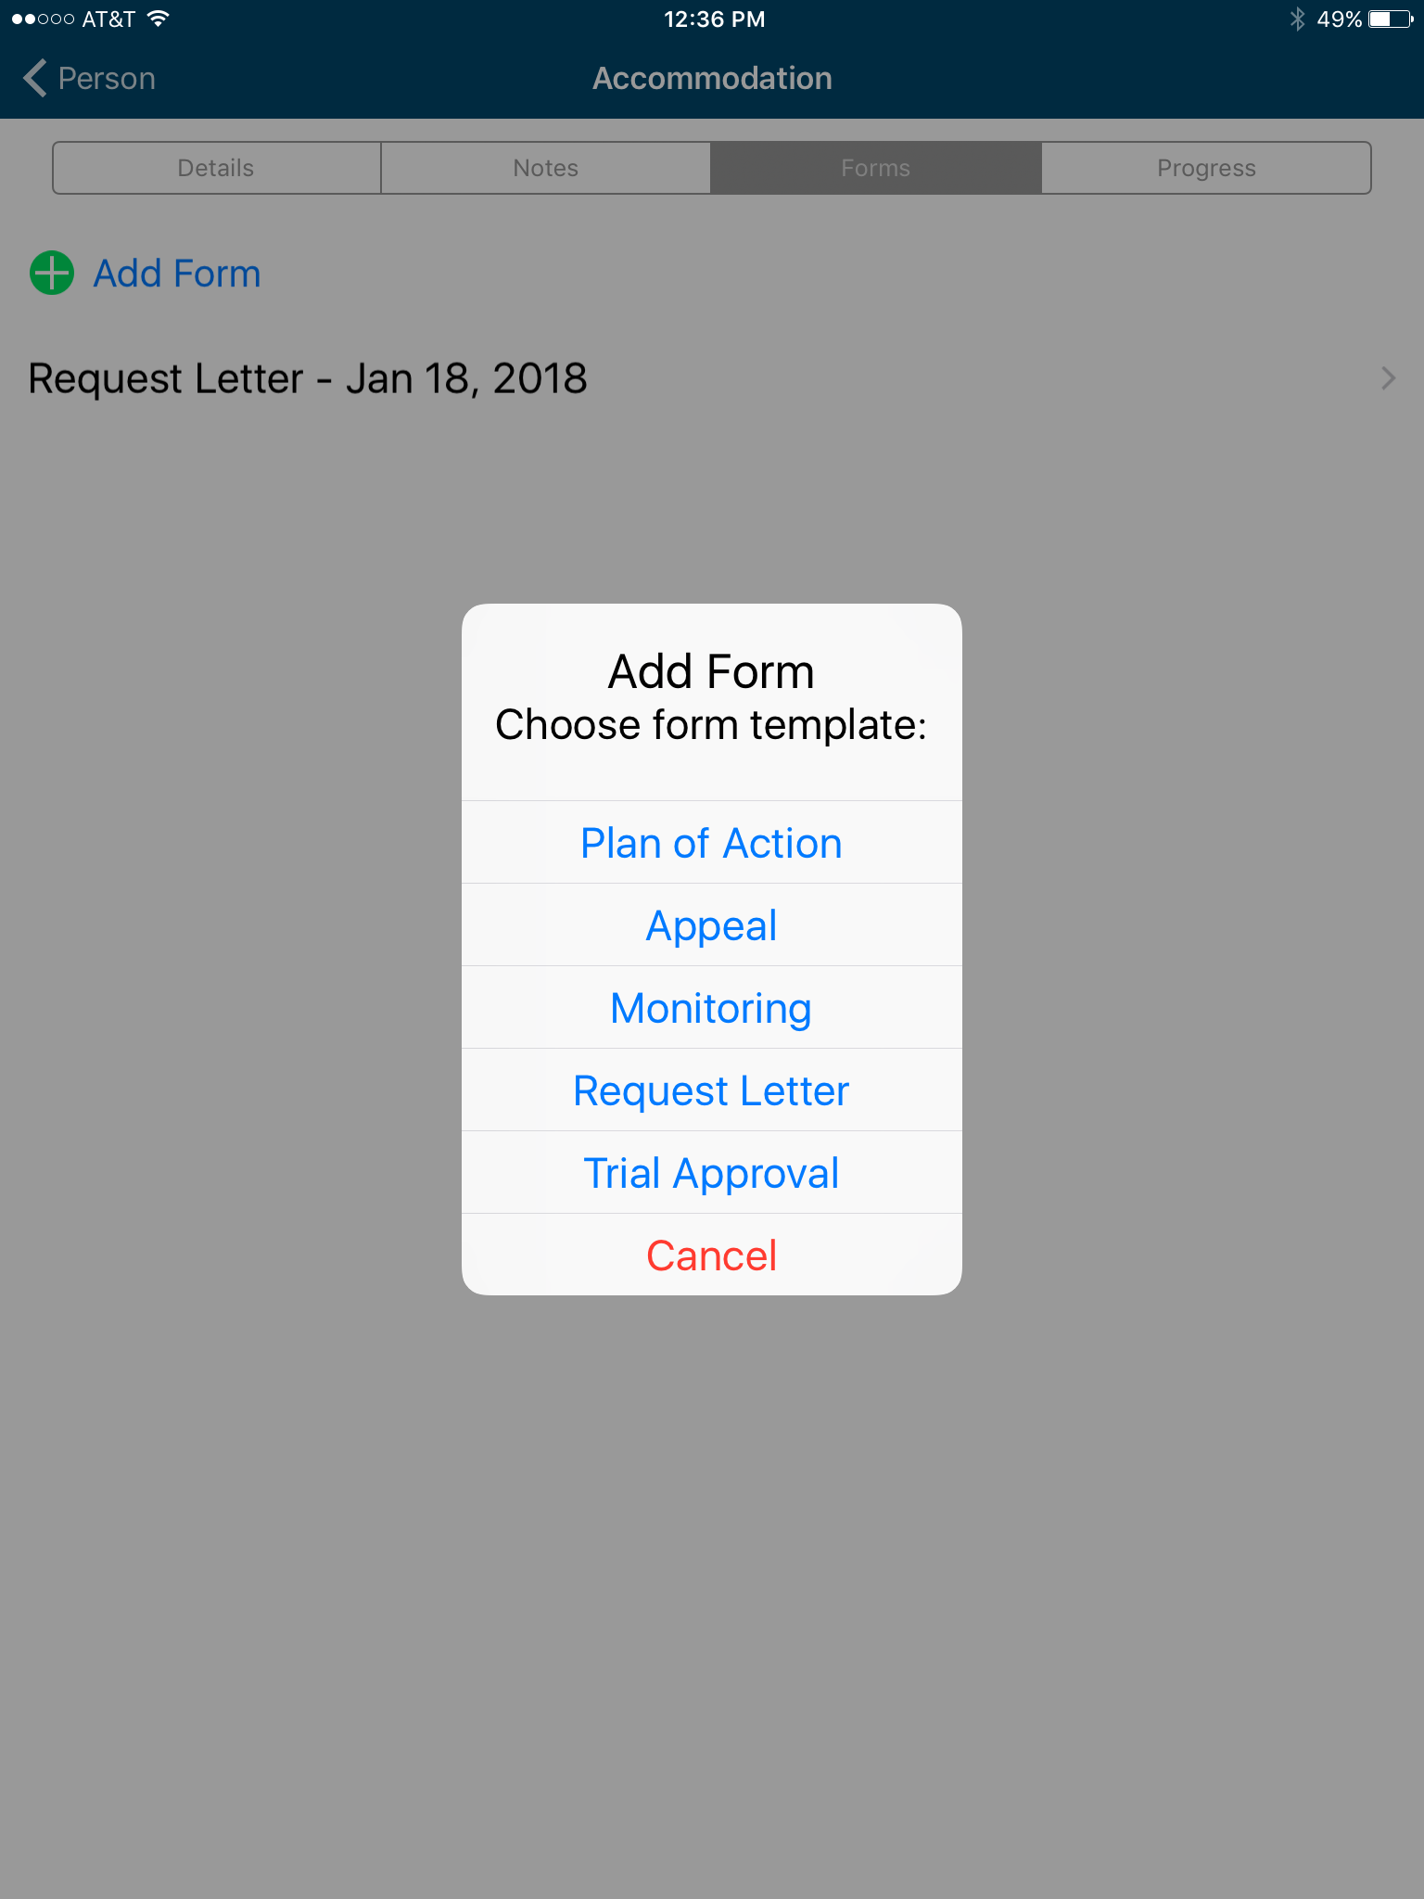
Free MAS App

Slide 28
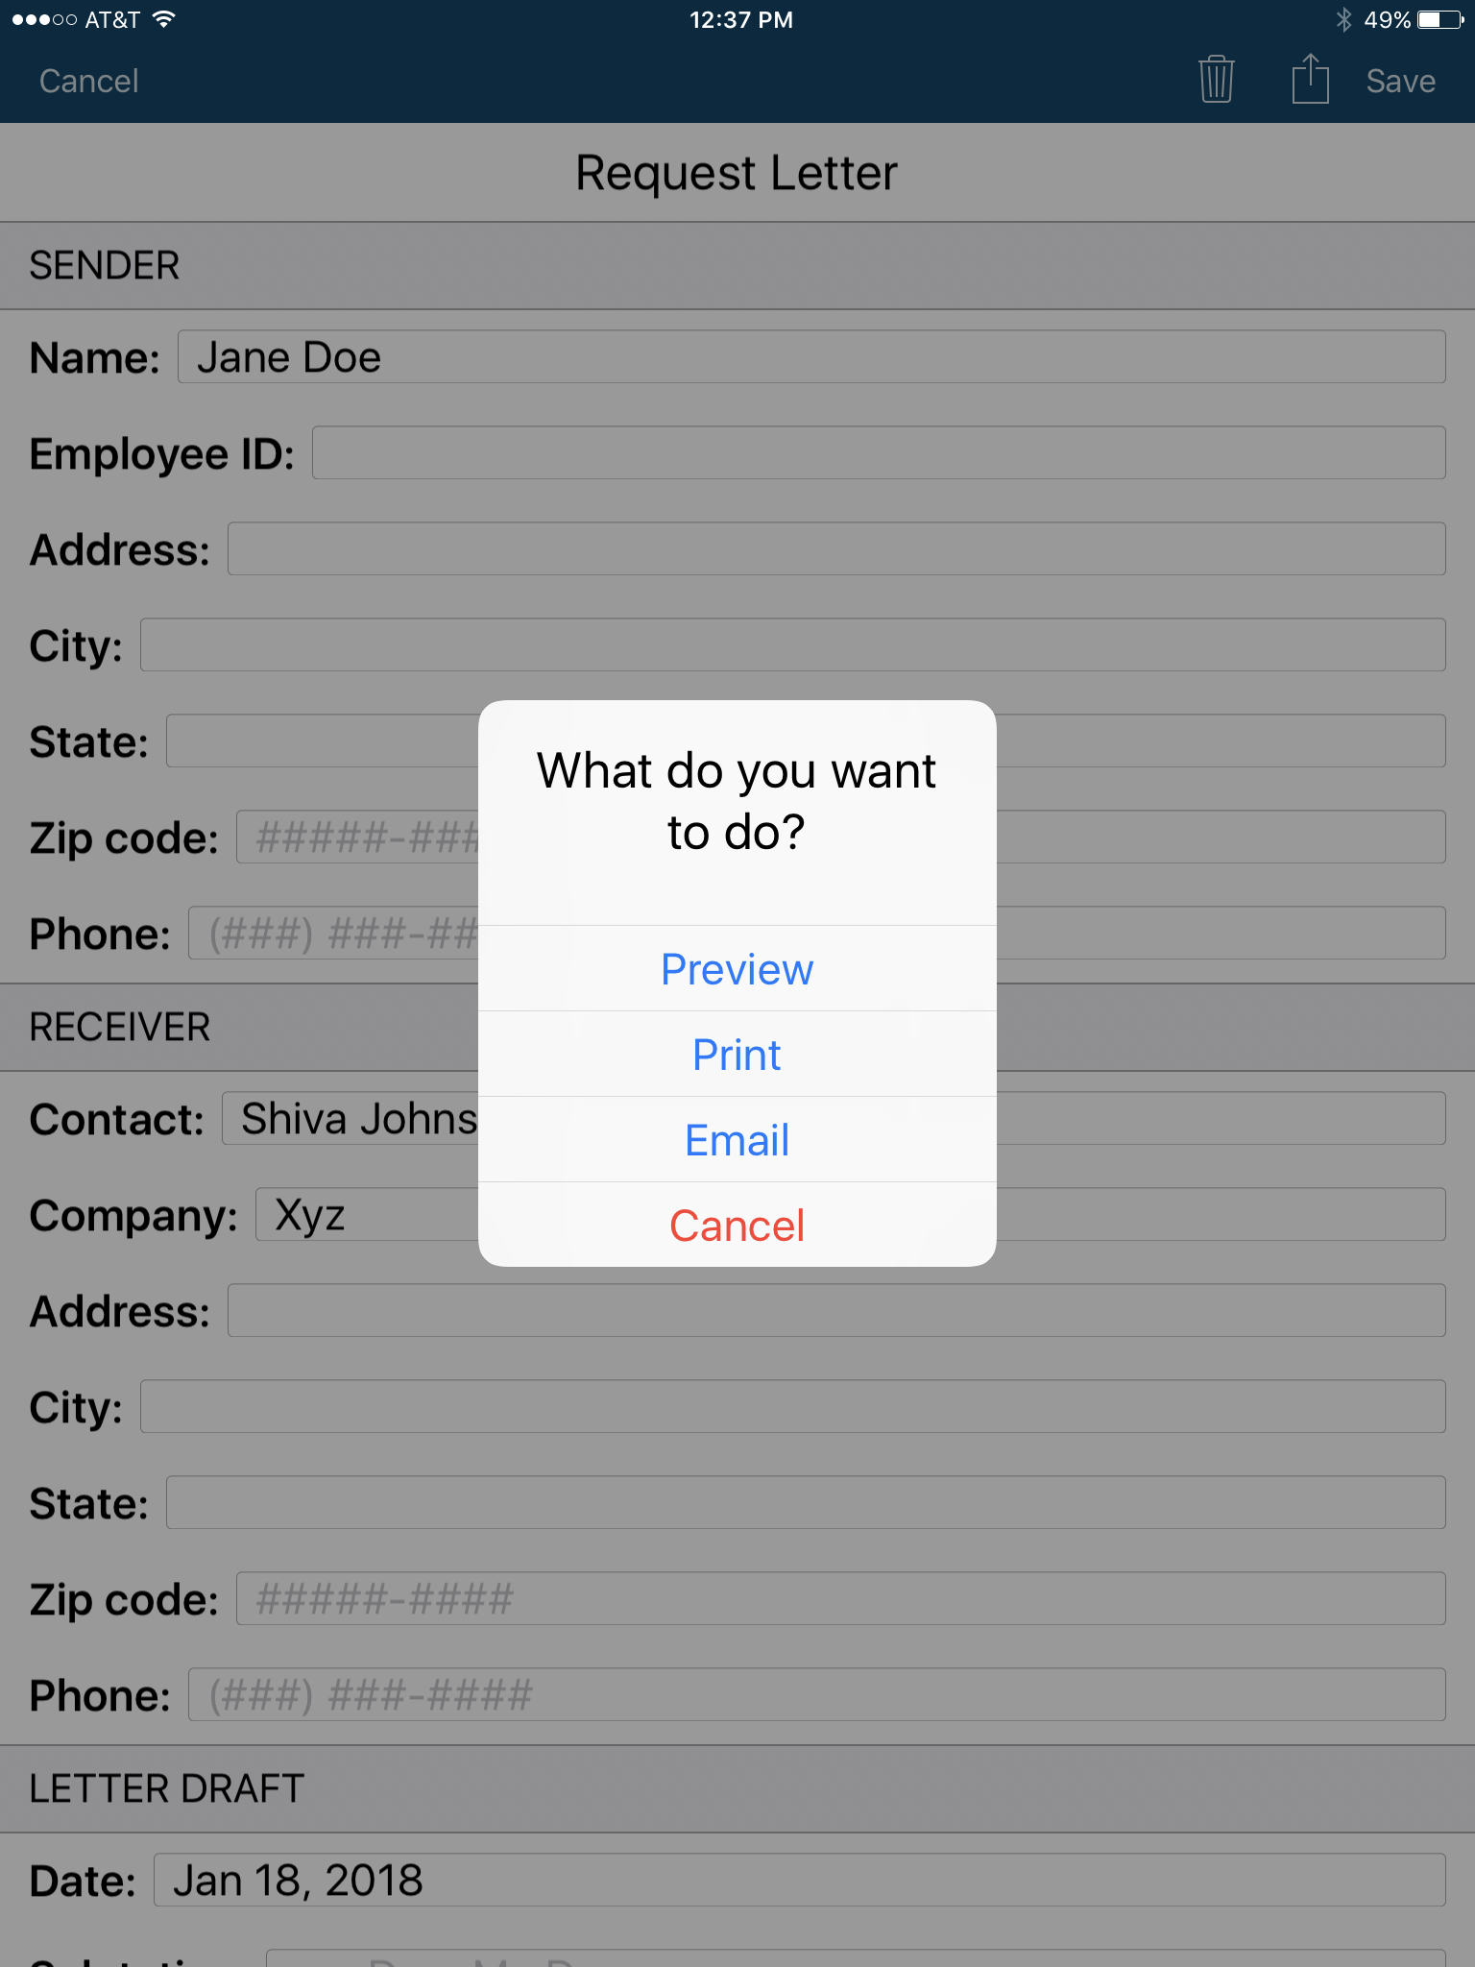
Free MAS App

Slide 29
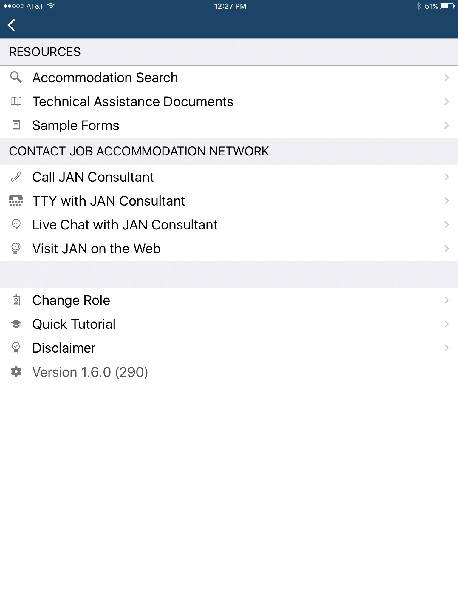
Free MAS App

Slide 30
JAN Resources
Expert consultation
Over 250 JAN-authored Publications
JAN’s A-Z (Disability, Topic, condition)
Legal libraries that include regulations and EEOC guidance documents
JAN Quarterly ENewsletter
JAN Training Modules and FREE Webcast Series
Easy access:
AskJAN.org
800.526.7234 or 877.781.9403 (TTY)
Chat, JAN on Demand, Skype, Text, Social Media

Slide 31
For More Information
Contact JAN
(800) 526-7234 (V) - (877) 781-9403 (TTY)
AskJAN.org
jan@askjan.org
(304) 216-8189 via Text
janconsultants via Skype
Thank you for attending!

Slide 32
Tools, Techniques, and Technologies for Creating Inclusive Workplaces

