Slide 1
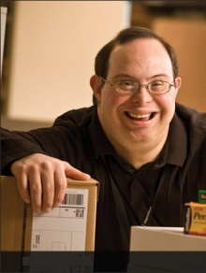
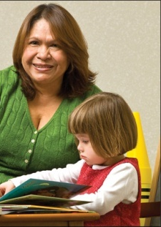
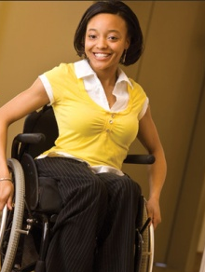
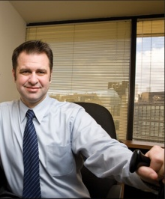

Tools, Techniques, and Technologies for Creating Inclusive Workplaces
Lou Orslene, JAN Co-Director
Orslene@jan.wvu.edu

Slide 2



Where I come from…
Notes:
Tell the story of the mine accident and recovery and mention Kate.

Slide 3

Where I come from…
Notes:
Tell the story of the mine accident and recovery and mention Kate.

Slide 4
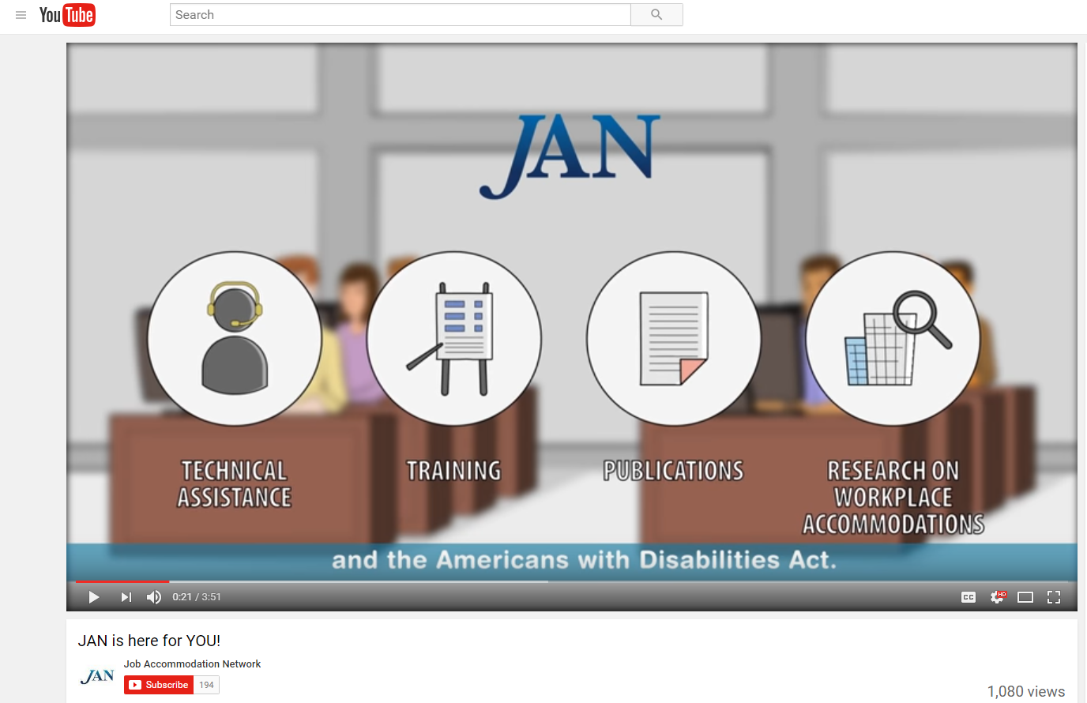
Who is JAN?
Notes:
The Job Accommodation Network (JAN) is the leading source of free, expert, and confidential one-on-one guidance on reasonable accommodation (RA) in the workplace, the Americans with Disabilities Act (ADA) and related legislation, and disability employment issues.

Slide 5
Normalcy of Disability
Disability is Natural
Most everyone has or will experience some form of disability during their lifetime
More than 56 million Americans report having a disability
Graphic Developed by Julie Ballinger, Southwest ADA Center Regional Affiliate, Disability Rights & Issues Consultant, StarReach Enterprises
Notes:
It is important to note from the outset that there is ability beyond disability. Disabilities, impairments, and chronic health conditions are a natural part of being human. We may be born with them or cycle in and out of disabilities through injury and recovery.
There are more than 56 million people in the US - or nearly 1 out of 5 people – who self identify as people with disabilities. And most have disabilities such as diabetes, cancer, a learning disability, or mental health condition that are non apparent to the rest of us.
And many individuals who report a disability are of working age and in our workplaces and are consumers.
So the better prepared we are in understanding disability, reasonable accommodation, and inclusion, the more fair and equitable our workplaces will be. And, research suggests that having a diverse and inclusive workplace also insures a productive workforce and success in the marketplace.

Slide 6

Normalcy of Disability
10,000 baby boomers reaching age of 65 every day
In 2010, 19% of people with disabilities have reportedly graduated from college …up from 14% in 2004
47,000 service members
  have been wounded in
  action. Hundreds of
  thousands more, nearly
  25 percent of all who
  served, will be diagnosed
  upon returning home with
  other “invisible wounds”
Notes:
There are a number of other trends we should be aware of –
10,000 baby boomers reach the age of 65 every day.
Many of these boomers are deciding not to retire or are starting a new career. Thus, more than ever the workforce will be impacted by the chronic health conditions of aging workers. It is estimated that by the year 2020, half of the U.S. population will have at least one chronic condition and one-quarter will be living with multiple chronic conditions.” This information is from Center on an Aging Society, Georgetown University.
In 2010, 19% of people with disabilities have reportedly graduated from college, up from 14% in 2004.
The expectations of work for young people with disabilities are high as we now are seeing the first generation of young people who have benefited from the 1975 Individuals with Disabilities Education Act. With graduation rates growing, more young people who have benefitted from school mainstreaming are entering the nation’s workforce. These qualified young people have been empowered by the ADA and expect to work and expect not to be hindered by the barriers of the past.
47,000 service members have been wounded in action. Hundreds of thousands more, nearly 25 percent of all who served, will be diagnosed upon returning home with other “invisible wounds.”
Increasingly, the private and public sector are filling their ranks with veterans, including our wounded warriors. Leading the way are companies such as Lockheed Martin and Northrup Grumman.

Slide 7

Normalcy of Disability
Americans with Disabilities Act, as amended (ADAAA)
Section 503, 508, 501 of the Rehabilitation Act of 1973
Executive Order 13548
Workforce Innovation and Opportunity Act (WIOA)
Notes:
And over the past decade, disability legislation has and continues to be strengthened to increase opportunity for workers with disabilities, insure the federal government is a model employer for individuals with disabilities, and create an employment system that includes people with disabilities. This includes Americans with Disabilities Act, as amended (ADAAA), Section 503, 508, 501 of the Rehabilitation Act of 1973, Executive Order 13548 to increase the hiring of people with disabilities into the federal government, the Workforce Innovation and Opportunity Act (WIOA) which promises to create a more inclusive workforce preparation system.

Slide 8
Critical Issue of Our Time
The Conference Board – established to help member companies understand and deal with the most critical issues of our time – believes disability in the workplace is one of these critical issues.
Trends noted in the report:
      Employees aging in the workplace
      Development of new, more universally accessible workplace technologies
      Greater acceptance of remote work
      Health care advances
      Incentives provided by government
Source: The Conference Board, “Leveling the Playing Field: ATTRACTING, ENGAGING, AND ADVANCING PEOPLE WITH DISABILITIES.”
Notes:
The Conference Board, established to help private industry understand and deal with the most critical issues of our time, believes disability in the workplace is one of these critical issues. The Board notes that there are a number of trends driving inclusion including:
Employees aging in the workplace
Development of new, more universally accessible workplace technologies
Greater acceptance of remote work
Health care advances
Incentives provided by government

Slide 9
The Value Proposition
Emerging Markets: People With Disabilities
People with Disabilities (PWD) are positioned to be the focus of brands within the next five years. Controlling $8 trillion dollars in disposable income, People with Disabilities, together with their friends and family represent 53% of global consumers.
Source: People with Disabilities — The World’s Largest Emerging Market October 14, 2015 from Association of National Advertisers.
“… marketing programs aimed at people with disabilities can reach as many as four out of every 10 consumers.”
Source: The Business Case for Inclusion and Engagement, Marcus Robinson (2003).
Notes:
Disability has also become an emerging market for a growing number of enterprises. So more than ever there is a value proposition to hiring people with disabilities and involving these employees in the development and marketing of products and services.
Often, these days I hear of products designed for “ease of use”, or “designed for all”, or “universally designed”. This shift in thinking about consumers and particularly about consumers with disabilities is signaling fundamental market changes. Microsoft is a great exemplar here. Believing that “disability is an engine of innovation”, Microsoft and its “design for all” effort was featured in a recent Fast Company article.
According to an Association of National Advertisers blog, people with disabilities globally control $8 trillion dollars in disposal income, and together with their friends and family represent 53% of global consumers.
According to the author of this blog, people with Disabilities (PWD) are positioned to be the focus of brands within the next five years.
Marcus Robinson in his book, “The Business Case for Inclusion and Engagement”, writes that marketing programs aimed at people with disabilities can reach as many as four out of every 10 consumers. As the largest of all U.S.-based minority groups, this group is comprised of people of all ethnic backgrounds, cultures and ages.
And we know from 2006 study conducted by Siperstein and Romano that “…87% of survey participants specifically agreed that they would prefer to give their business to companies that hire individuals with disabilities.”
Thus, disability is becoming mainstream in the workplace and influencing many of the products and services we use.

Slide 10
Creating Workplace Inclusion
The three C’s: Increase comfort, confidence, and competence
Develop skills that help to more effectively communicate at work with people with disabilities
Develop and effectively communicate actionable policy and procedures
Develop normative practices for engaging with people with disabilities throughout the employee life cycle
Notes:
It is typical for companies to have challenges in 3 key areas: culture that embraces disability inclusion, technical assistance, and integration of disability inclusion into HR policies, processes, and training.

Slide 11
Five Signs the Doors are Open
…..and Remain Open
Accessible buildings, technology, etc.
Inclusive ethos - particularly language
Inclusive public relations and marketing, particularly on social media
Collaborative and authentic relationships with national and local resources to recruit/retain talent
Inclusive policies and practices

Slide 12
Emerging Inclusion Practices
Focusing on diverse abilities and contributions to productivity goals instead of disability
Adopting facilities/IT access for all/universal design to reduce the need for individualized accommodations
Develop an integrated or harmonized model, including a single point of contact for leave and accommodation along with a centralized funding stream
Development of an internal business case shared with everyone, particularly with talent acquisition staff and managers
Notes:
Think of Employee Life Cycle
DMEC – Integrated Disability Management (Short term, long term, workers comp, fmal) , Toital Absence Mnanagement (sick leave and paid time off) , Health and Prodcutiivty Management EAP and wellness.)
reduction in lost work time, retention & leave costs, enhanced engagement scores

Slide 13
Emerging Inclusion Practices
Develop a list of preapproved accommodations not requiring a full assessment and interactive process
Purchase or develop an accommodation tracking system
Gathering/reporting meaningful metrics (e.g. accommodation inquiries, provided, denied, appealed, days lost to inaction)
Benchmarking against peers US BLN or NOD
Encouraging all employees to be visible/engaged allies

Slide 14
Emerging Inclusion Practices
Utilizing/leveraging an internal list of commonly requested accommodations by job function
Developing a “task bank” of jobs that an employee with a disability or injury can perform to keep them engaged with the workplace even though they cannot yet perform all of the essential functions of their job
Training and more training particularly for hiring managers and supervisors –Use outside resources more effectively – do not recreate the wheel internally
Provide boilerplate accessibility contract language to contract officers
Notes:
consider building educational prompts into the enterprises information system to guide employees through the accommodation process

Slide 15
Emerging Inclusion Practices
Recruitment, hiring, onboarding
Feature your EEO statement on career portal includes disability
Develop partnerships with CSAVR, NTID, Lime Connect, Bender, Sierra group
Develop internships and partner with WRP, Emerging Leaders, EntryPoint!
Use disability focused job bank – Ability Jobs, Gettinghired.com, Hire Disability
Train recruiters and hiring managers on what a disclosure looks like and what to do with it
Train recruiters and hiring managers in disability etiquette and awareness training
Provide a disability subject matter expert for more complex situations
Have an expedited procurement process for accommodations during the hiring process

Slide 16
Key to Inclusive Culture
Accommodation
=
Equal Employment
=
Inclusive Workplace Culture

Slide 17
Accommodation Primer
The basis for inclusive employment is the reasonable accommodation (RA) policy and process
The foundation for reasonable accommodation is a robust interactive process (IP)
The trigger for RA and IP is a request for an accommodation or recognition of an obvious barrier to someone with a known disability
A request for accommodation includes two essential elements – a medical condition and a related challenge at work

Slide 18

What is the Interactive Process (IP)?
A collaborative effort to identify effective accommodation solutions – it’s that simple.
Creates a standard of practice
Facilitates communication and inclusion
Demonstrates good faith
Leads to ADA/Section 503 compliance

Slide 19
Eight Most Common Types of RA
Modifying schedule or allowing leave time
Making workplace or work station accessible
Modifying methods – testing, communication, etc.
Modifying or creating policies
Purchasing or modifying equipment or products
Purchasing a service – reader or interpreter
Restructuring job
Reassignment
Other accommodations
  Telework
  Adjusting supervisory method
  Using a service animal

Slide 20
JAN’s Interactive Process
Step 1: Recognizing an Accommodation Request
Step 2: Gathering information
Step 3: Exploring Accommodation Options
Step 4: Choosing an Accommodation
Step 5: Implementing the Accommodation
Step 6: Monitoring the Accommodation
https://AskJAN.org/topics/interactive.cfm

Slide 21
So what is your policy?
Value Statement
Purpose
Who is covered?
What is reasonable accommodation and when is it provided?
What is the interactive Process?
Not all accommodations can be honored?
Responsibilities and Roles
Confidentiality

Slide 22
So what is your practice?
Whose responsibility it is to request accommodation?
What happens after a request? What is the internal process and who is involved? What are the touchpoints?
What is the timeframe for processing requests? Expedited process for procurement particularly for applicants?
But what happens if there is a delay?
What is a temporary accommodation?
Who communicates the determination?
Is there an appeal process if one is denied? What is the process?
How are accommodations tracked?

Slide 23
Technology Pain Points
Applicant Tracking Systems
Pre-hire Testing Software
Accommodation Tracking Systems
Legacy Information Systems i.e. HRIS
Learning Management Systems
Notes:
Normalize Accessibility and create a sustainable accommodation infrastructure.

Slide 24
What is the Toolkit?
An free, online “living” toolkit that captures and continuously updates best and emerging practices in providing accommodations in the workplace.
http://AskJAN.org/toolkit/
Notes:
Many companies have noted that they could benefit for emulating best/emerging RA practices including:
Easier-to-navigate RA processes for employees and managers
Better mechanisms for tracking and reporting
Enhanced data-gathering practices (to gauge how satisfied employees and their managers are with RAs, financial savings, return to work, etc.)
More transparent and effective intersections between Section 503 self-ID encouragement and identifying as a person with a disability for purposes of obtaining an RA

Slide 25
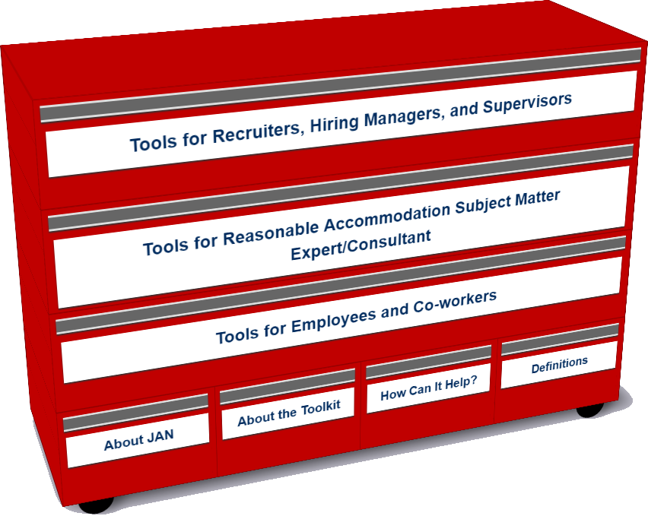
Who uses the Toolkit?
Recruiters, Hiring Managers and Supervisors
Accommodation Consultant/Subject Matter Expert
Employees and Co-workers — Allies

Slide 26
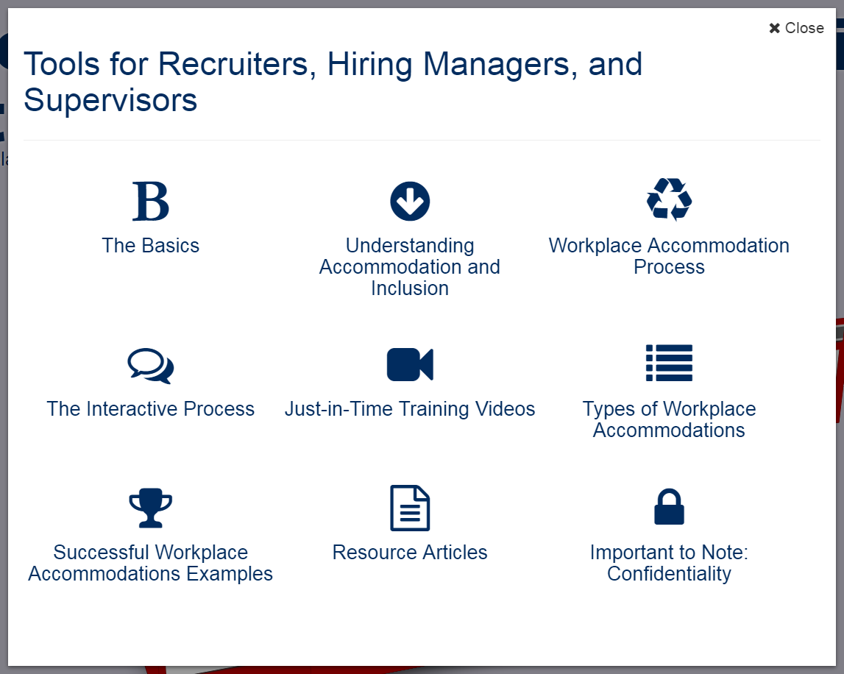
Accommodation Toolkit
Recruiters, Hiring Managers and Supervisors
Notes:
LO

Slide 27
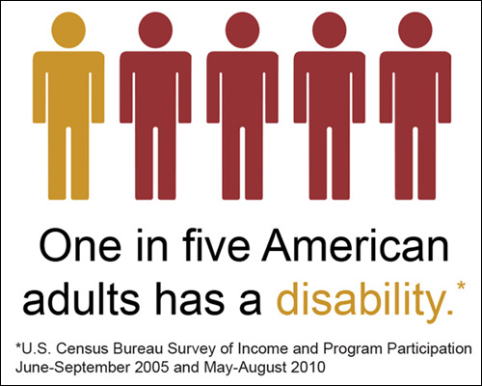
Tools for Hiring Managers/Supervisors
The Basics
Understanding Accommodation and Inclusion

Slide 28
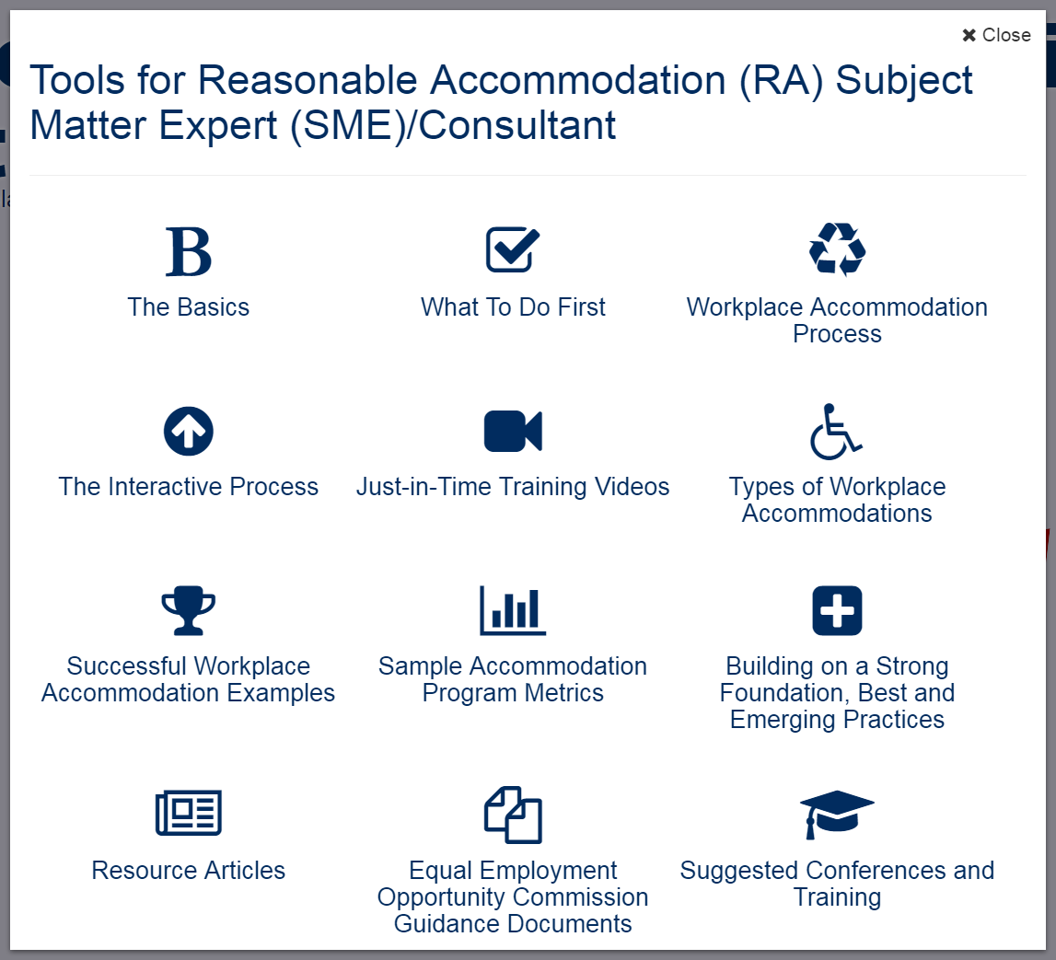
Accommodation Toolkit
Accommodation Consultant/Subject Matter Expert
Notes:
LO

Slide 29
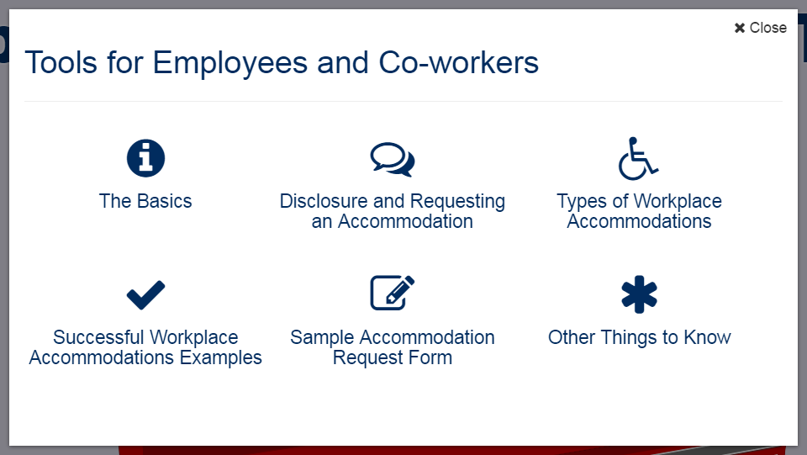
Accommodation Toolkit
Employees and Co-workers — Allies
Notes:
DD

Slide 30
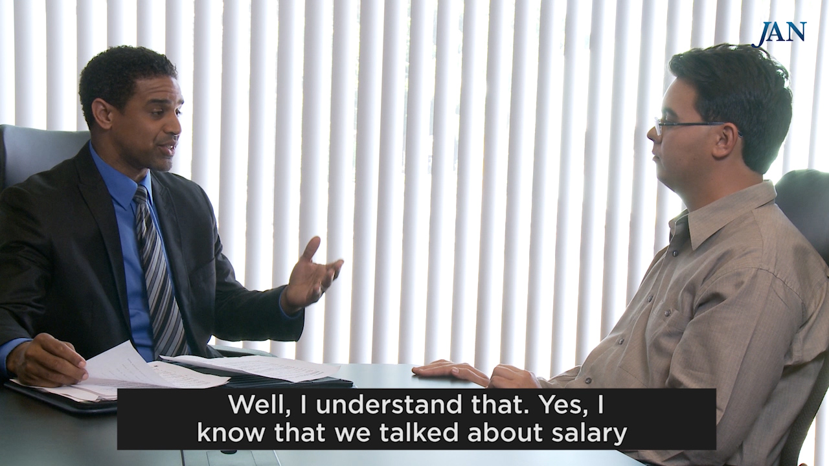
Interview Challenges

Slide 31
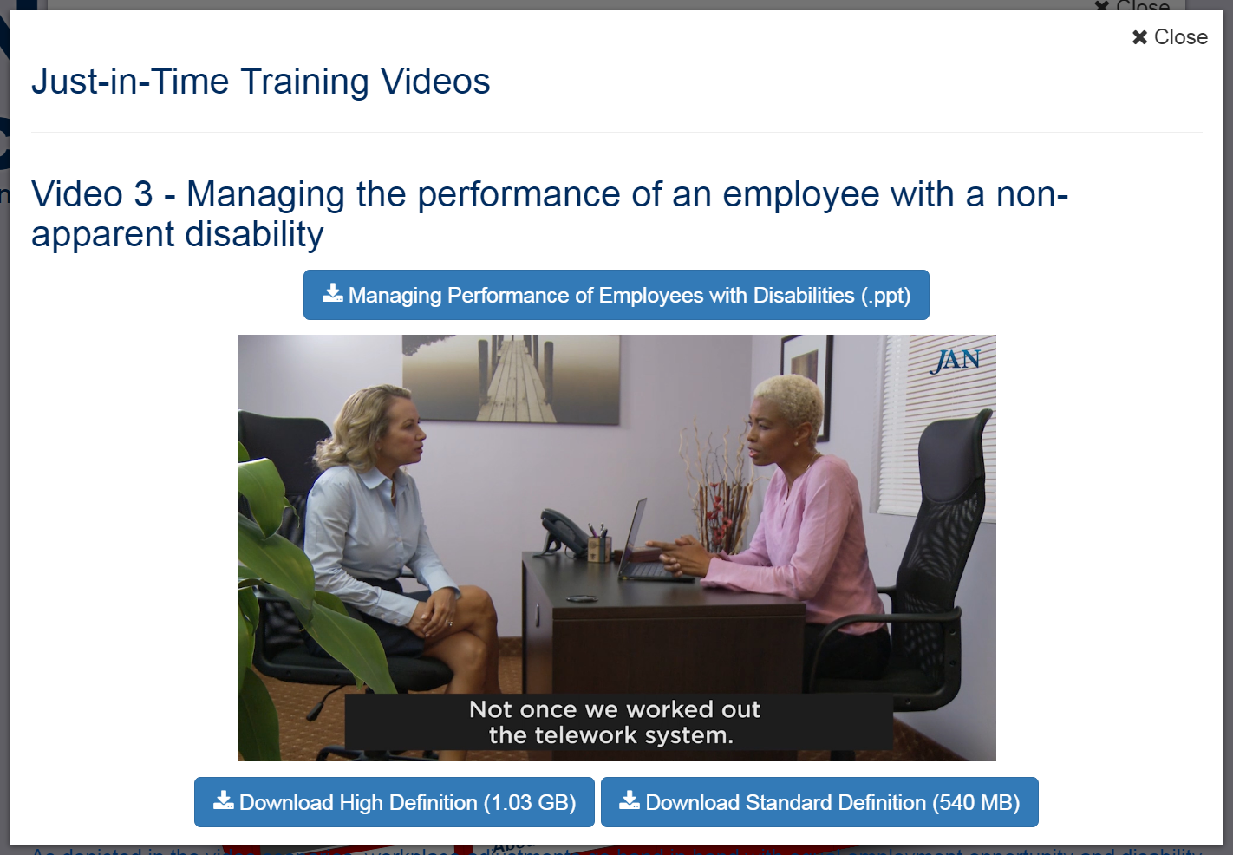
Performance Management
Notes:
DD tee up video

Slide 32
Free MAS App
Big Idea
The Mobile Accommodation Solution (MAS) is designed to help streamline the disability accommodation process at various phases of the employment cycle.
Funded by the National Institute on Disability, Independent Living, and Rehabilitation Research (NIDILRR)

Slide 33
Free MAS App
Collaborators
Center for Disability Inclusion
Job Accommodation Network (JAN)
IBM
US Business Leadership Network
American Association of People with Disabilities
Council of State Administrators of Vocational Rehabilitation
National Business and Disability Council
Disability Management Employers Coalition

Slide 34
Free MAS App
Users
Talent management, human resources, employer relations, and/or accommodation staff
Employment service providers
Applicants and employees with disabilities

Slide 35
Free MAS App
Functionality
Easy to use, secure, mobile case management tool
Accommodation tracking tool
Best and emerging accommodation practices and forms embedded within tool
Easy access to JAN Consultants and myriad of other resources

Slide 36
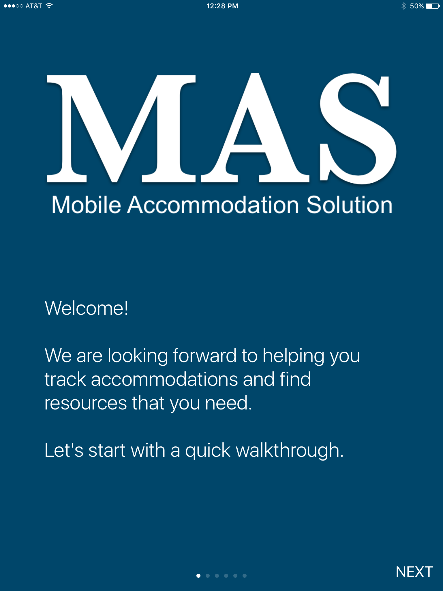
Free MAS App

Slide 37
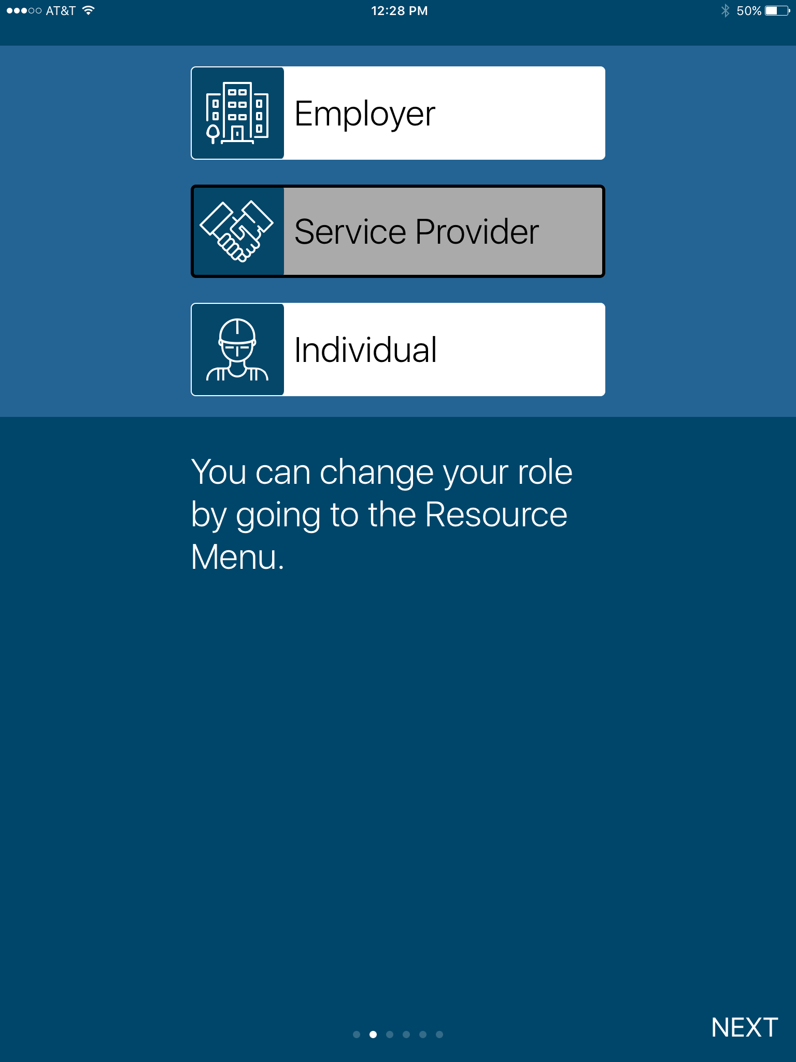
Free MAS App

Slide 38
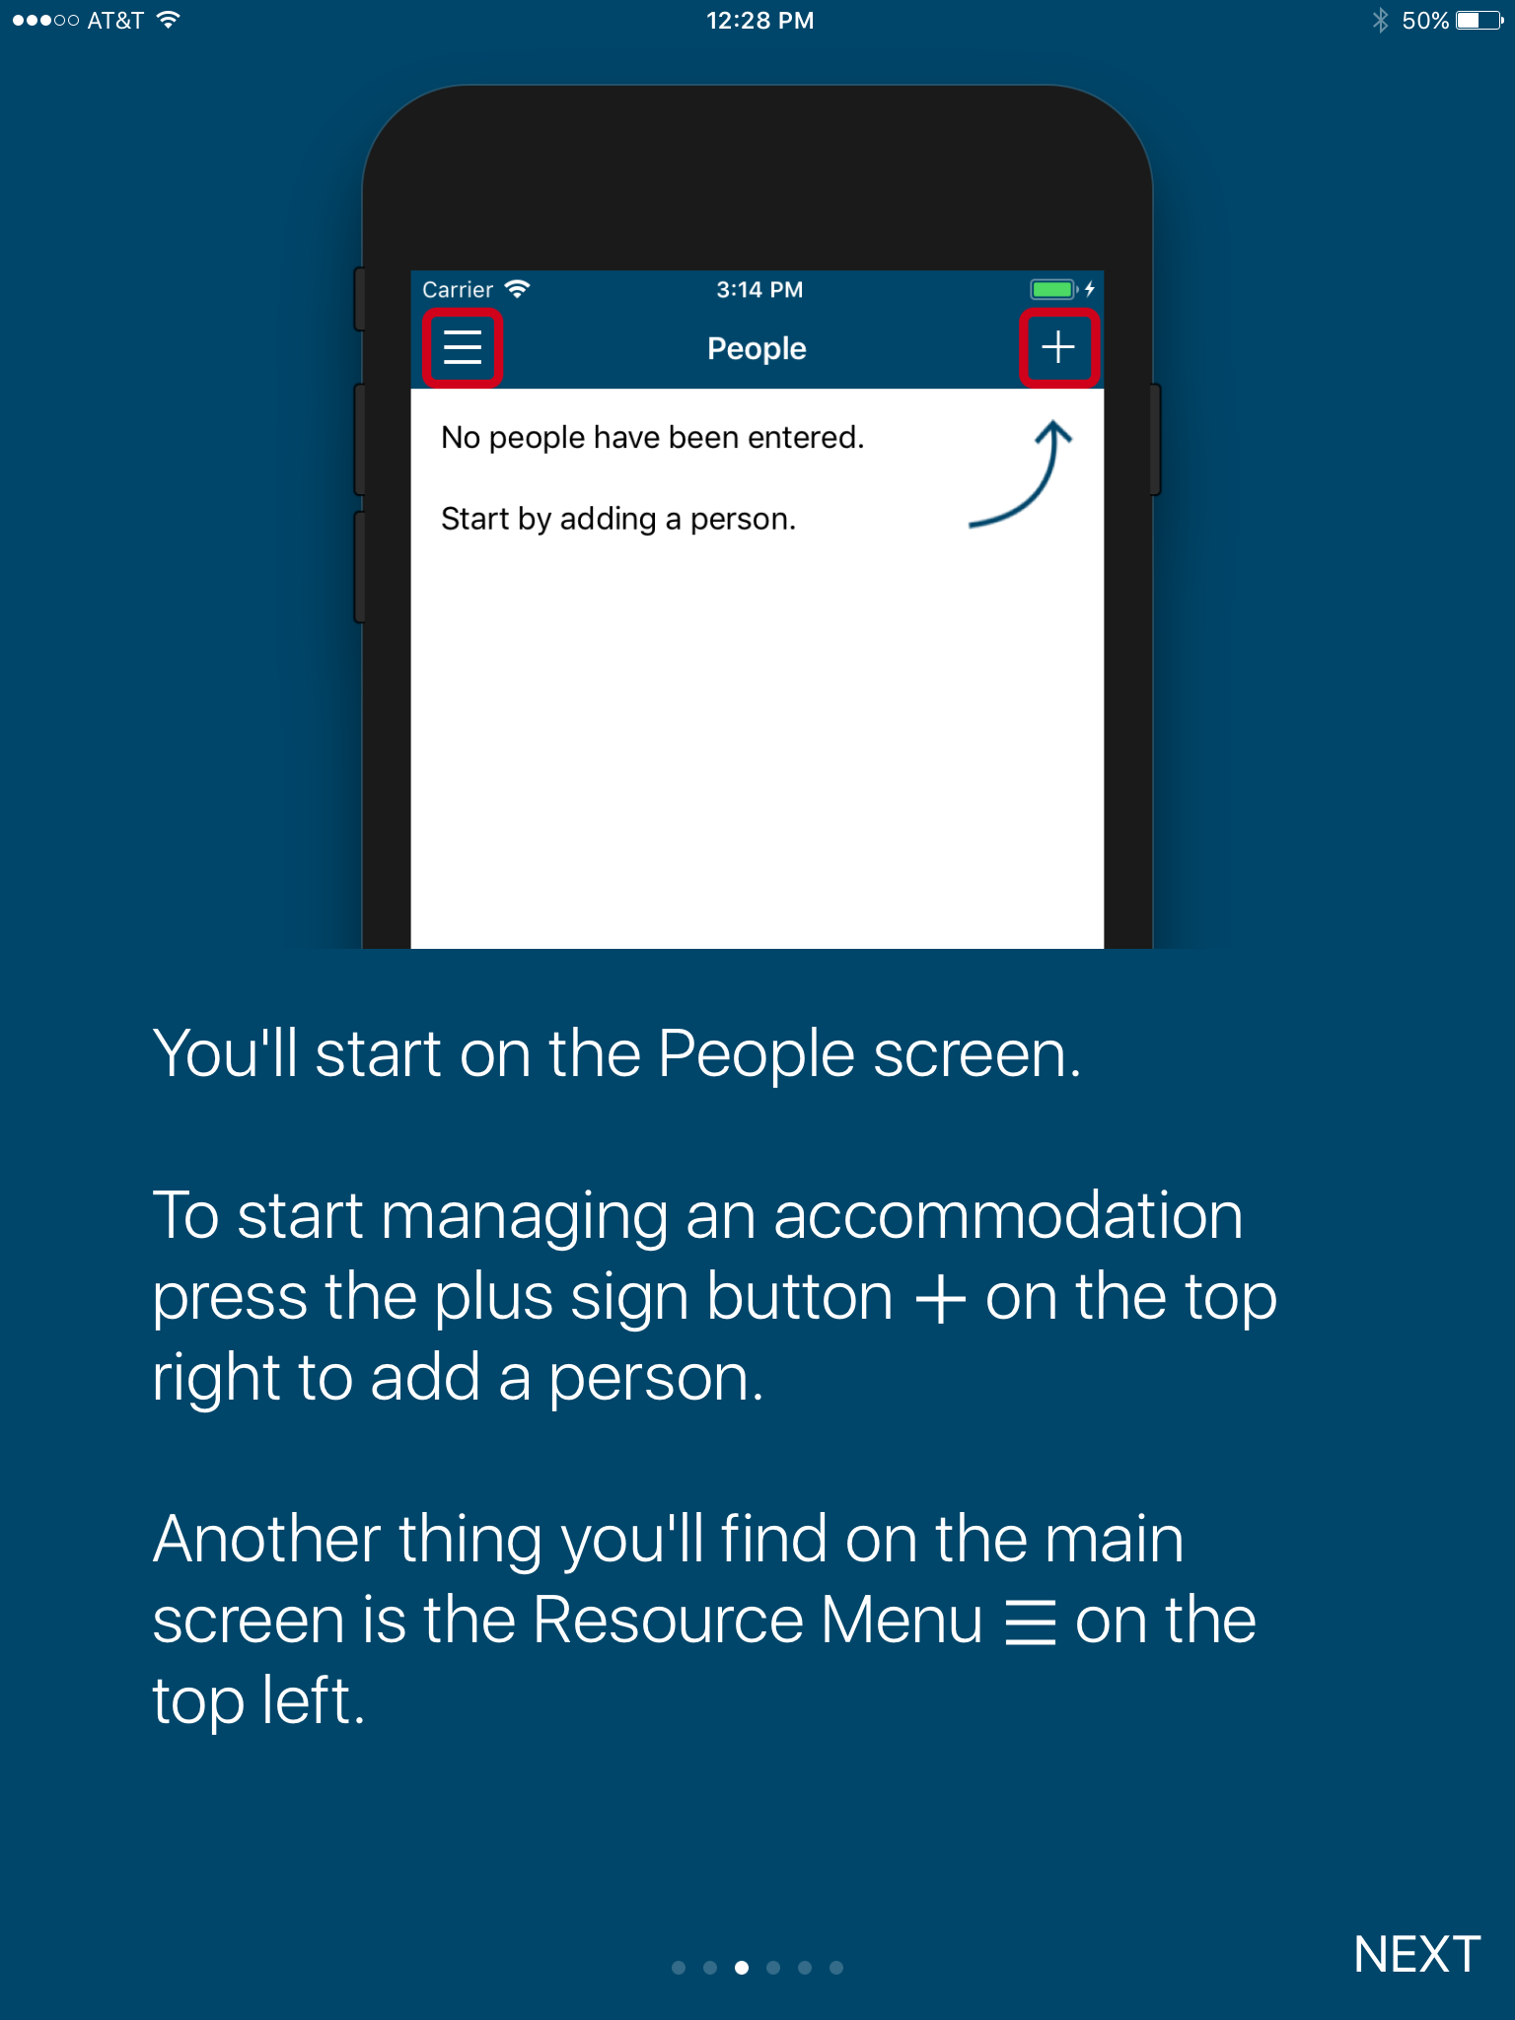
Free MAS App

Slide 39
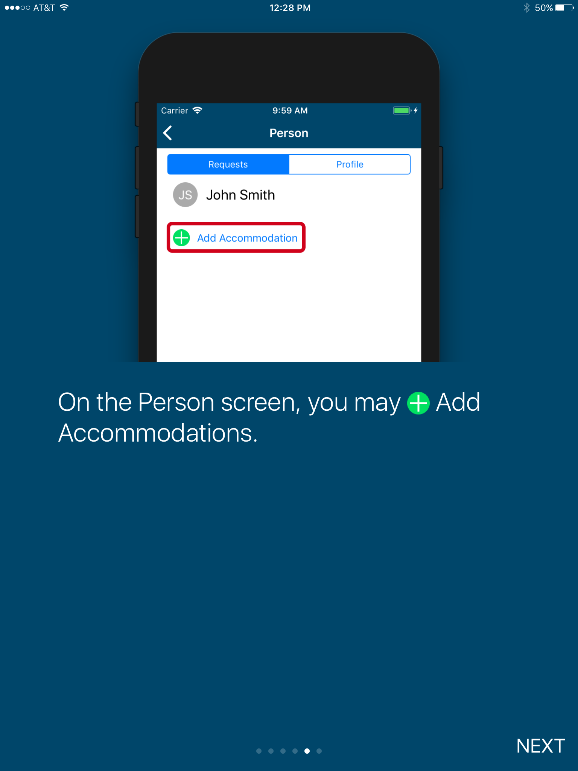
Free MAS App

Slide 40
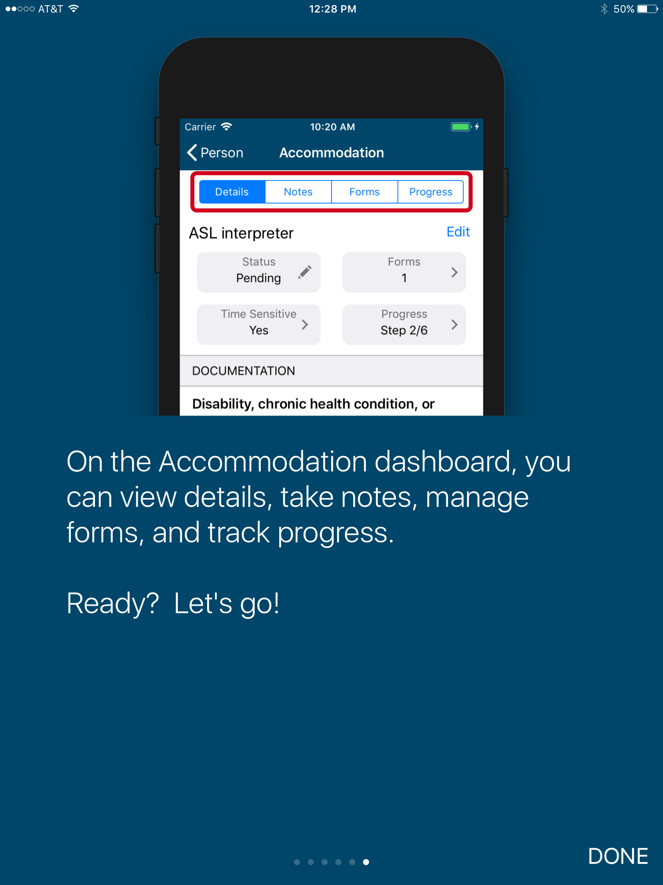
Free MAS App

Slide 41
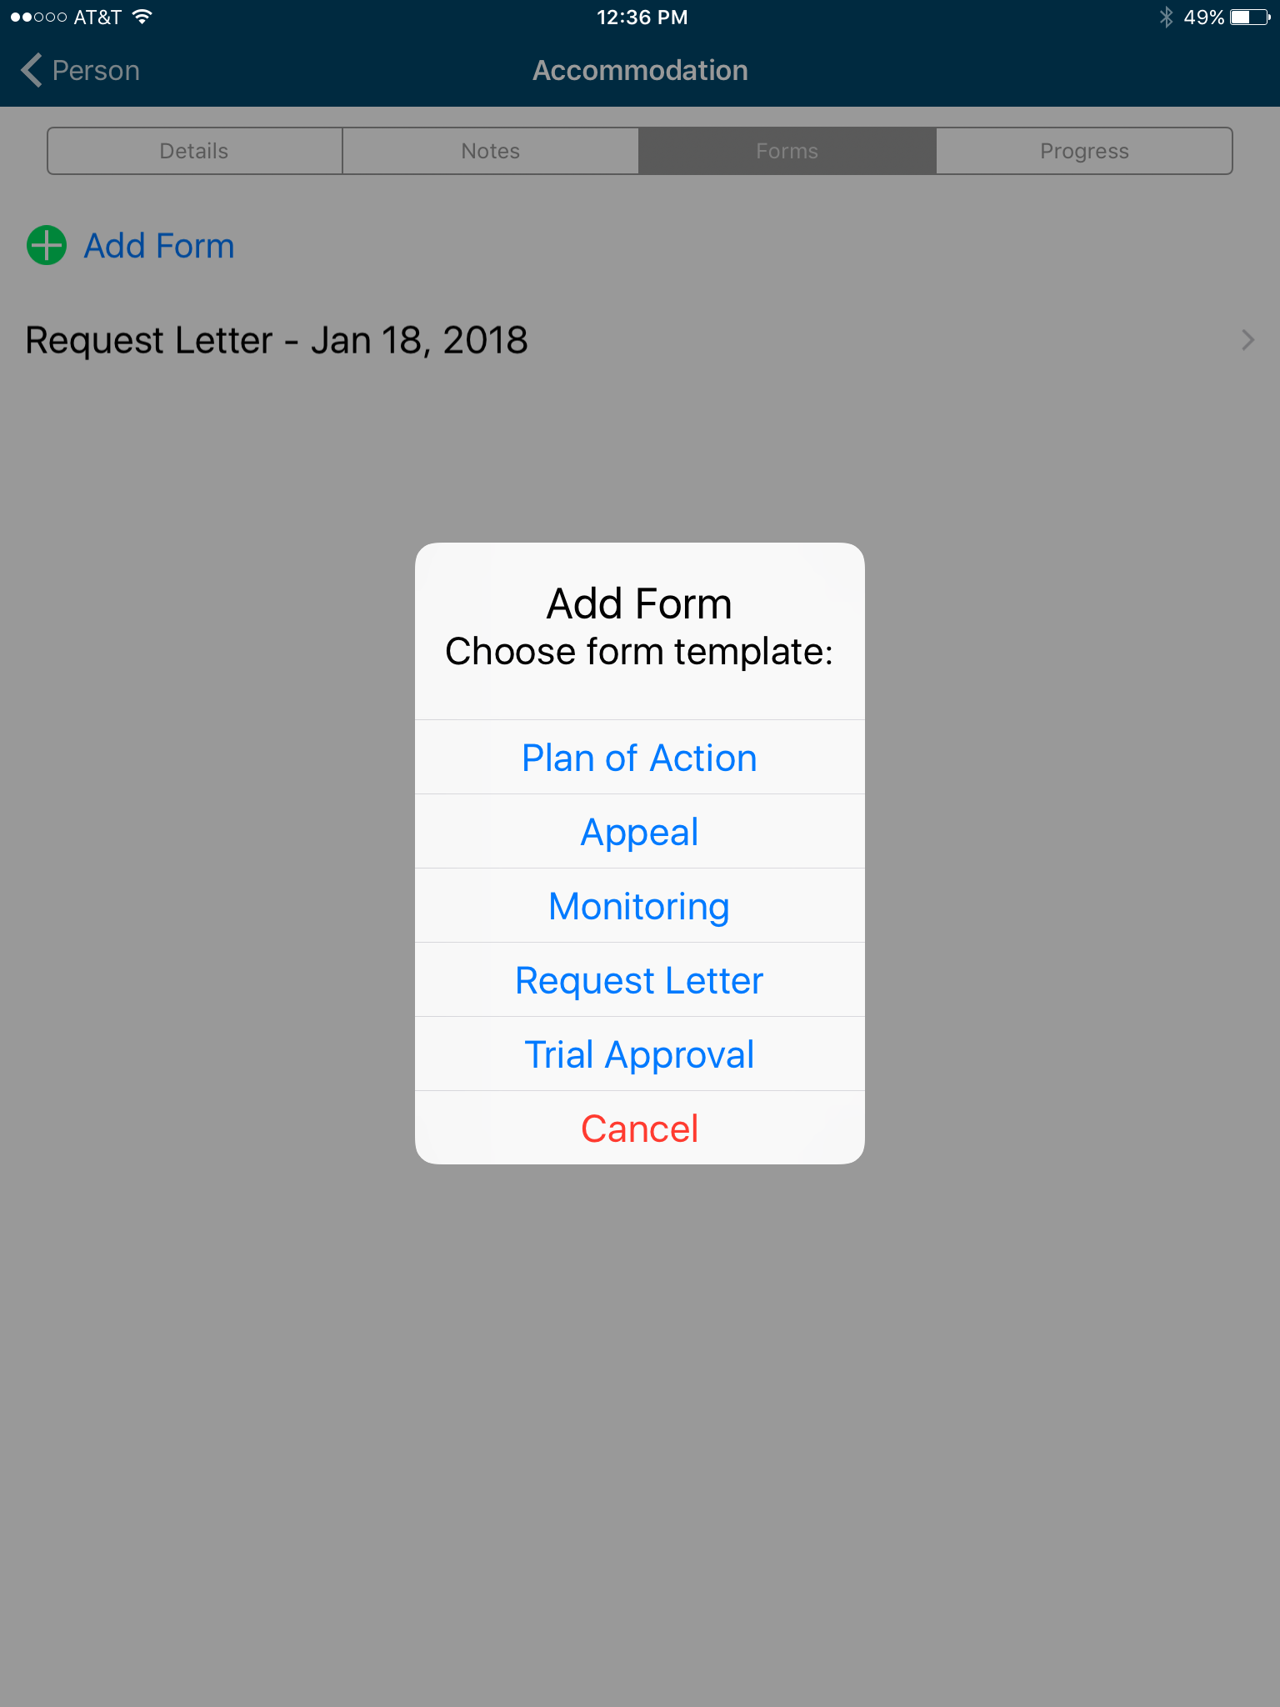
Free MAS App

Slide 42
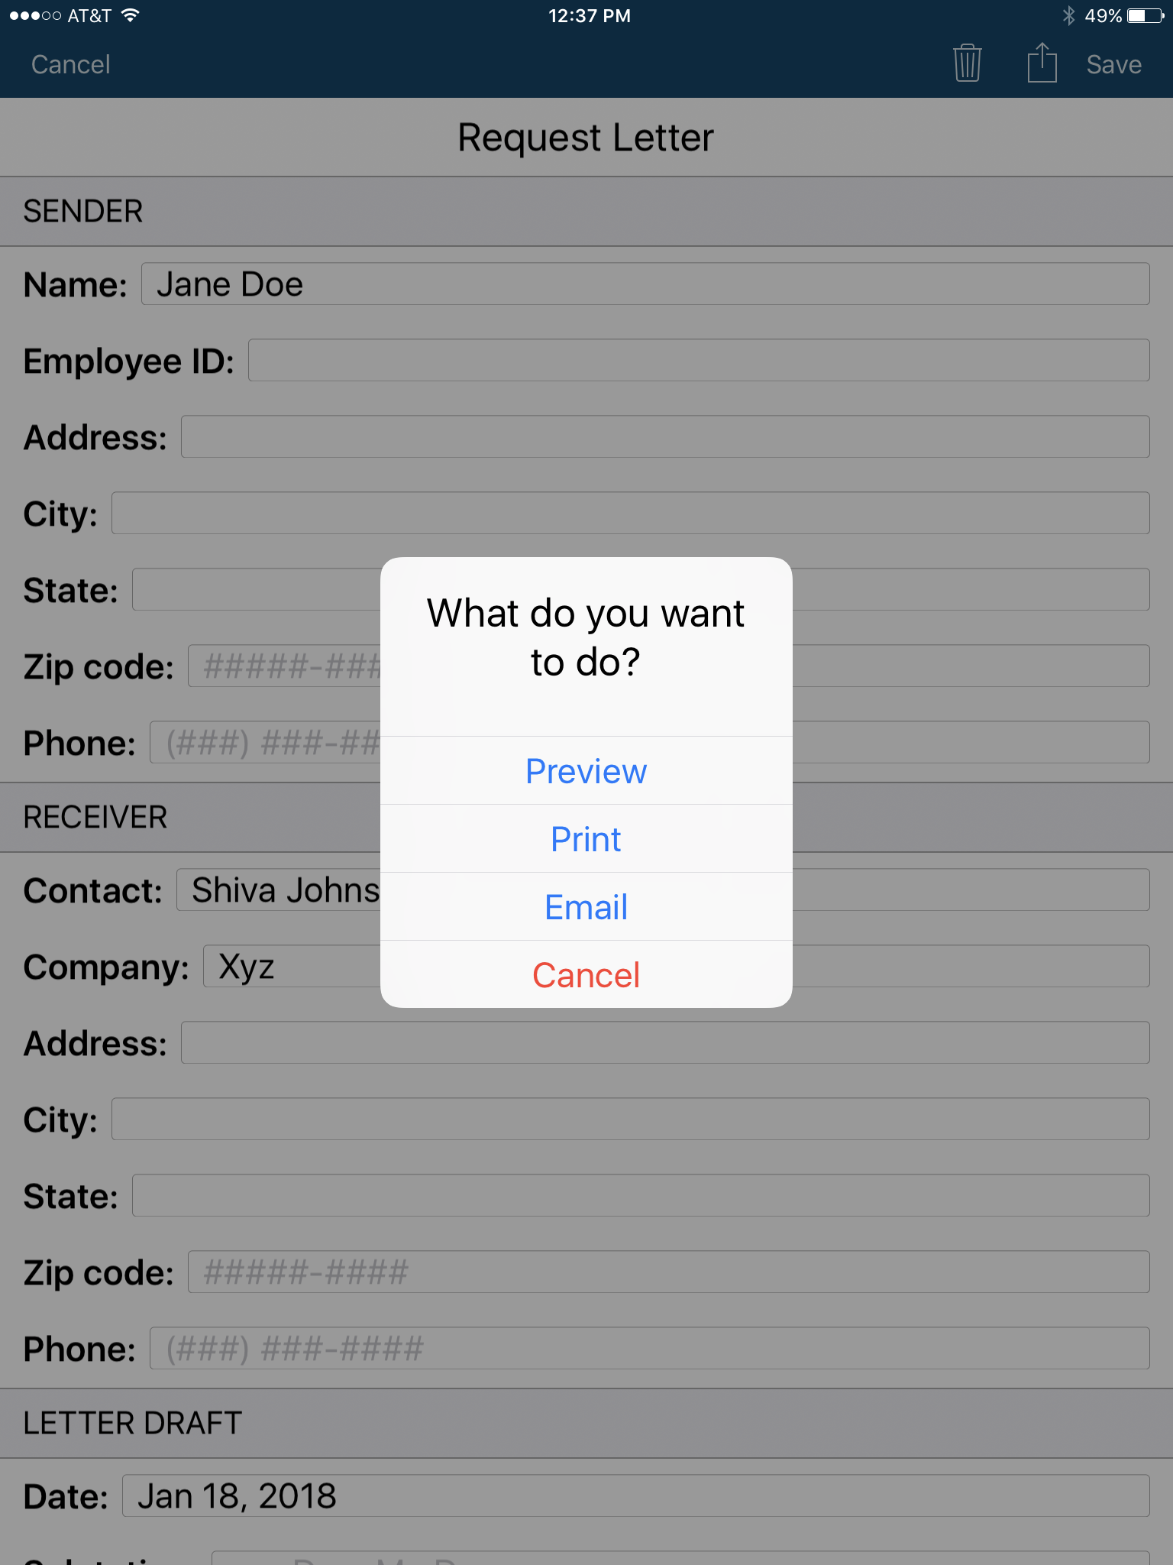
Free MAS App

Slide 43
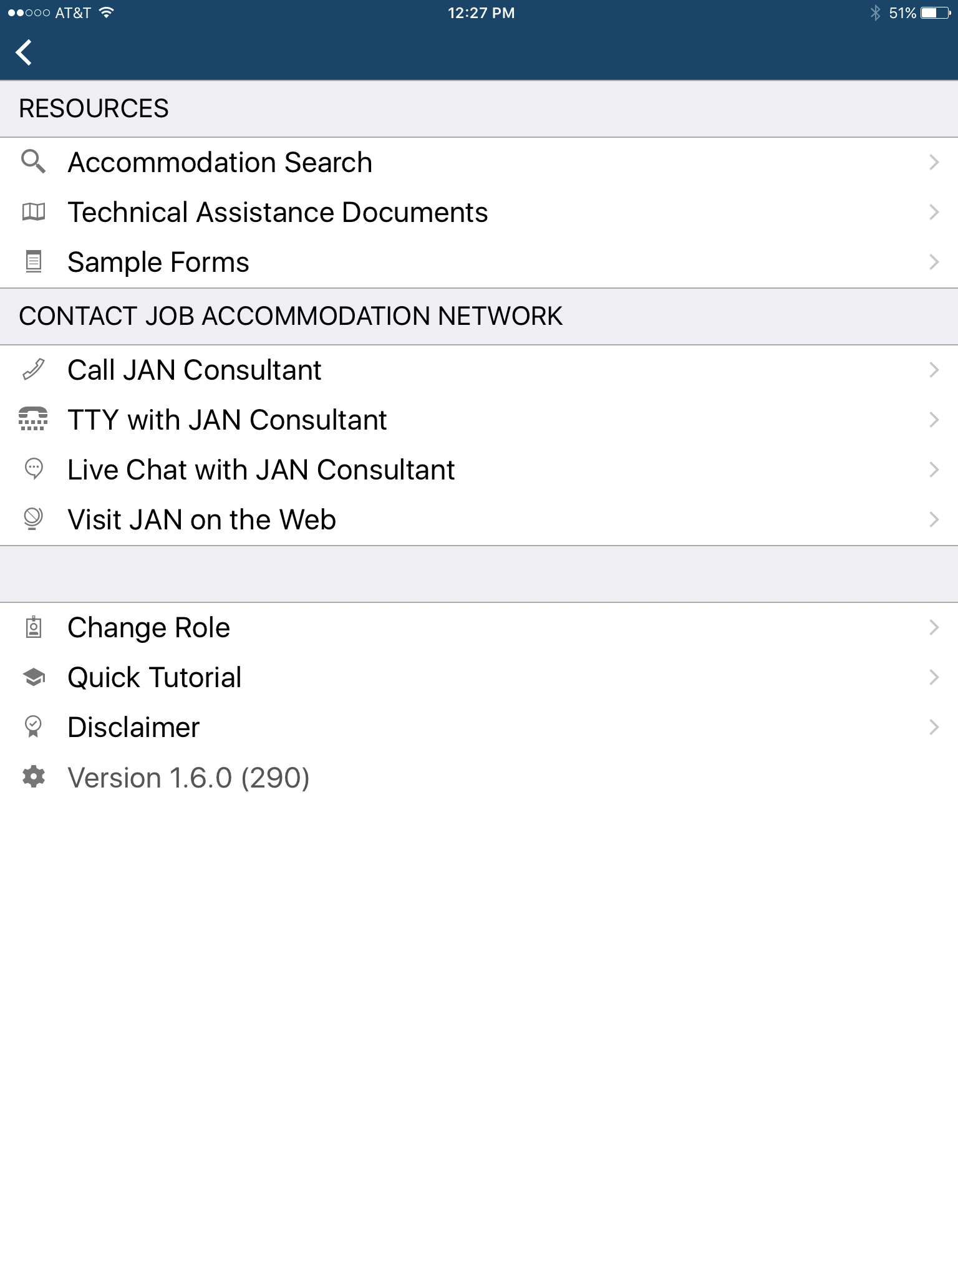
Free MAS App

Slide 44
JAN Resources
Expert consultation
Over 250 JAN-authored Publications
JAN’s A-Z (Disability, Topic, condition)
Legal libraries that include regulations and EEOC guidance documents
JAN Quarterly ENewsletter
JAN Training Modules and FREE Webcast Series
Easy access:
  AskJAN.org
  800.526.7234 or 877.781.9403 (TTY)
  Chat, JAN on Demand, Skype, Text, Social Media

Slide 45







For More Information
Contact JAN
(800) 526-7234 (V) - (877) 781-9403 (TTY)
AskJAN.org
jan@askjan.org
(304) 216-8189 via Text
janconsultants via Skype
Thank you for attending!

Slide 46

Tools, Techniques, and Technologies for Creating Inclusive Workplaces

