Slide 1
Top Ten Veterans’ Issues in the Workplace
James Potts, M.S., CRC, Senior Consultant
Melanie Whetzel, M.A., CBIS, Lead Consultant,

Slide 2
Job Accommodation Network (JAN)
Job accommodation ideas and information
Practical guidance on the Americans with Disabilities Act (ADA)
Resources for self-employment of people with disabilities

Slide 3
Issue: How to Request an accommodation
Situation: Veterans contacting JAN want to know how to request an accommodation, what information must be included in their request, and is the employer required to provide the request.

Slide 4
ADA
Disclosure
Documentation
Employer Obligation
Practical Guidance
Be specific
Put in writing
Must be effective

Slide 5
Issue: Inability to wear face masks because of PTSD
Situation: An employer is requiring all employees to wear masks at work. A Veteran contacted JAN to discuss potential accommodation options due to his inability to wear masks related to a traumatic event resulting in PTSD.

Slide 6
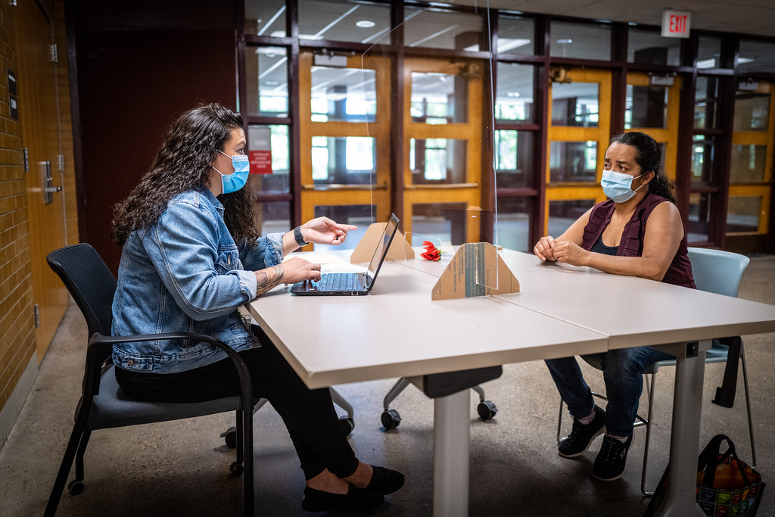
ADA
Within their rights to require PPE
Employee rights to accommodations
Practical Guidance
Temporary solutions
Flexibility
Find middle ground

Slide 7
Issue: Veterans with service animal not being allowed to work because inability to perform all their essential functions.
Situation: A Veteran was denied his service animal at work because the employer determined allowing the animal would prevent the employee from performing certain essential functions of his position.

Slide 8
ADA
Must be able to perform your essential functions
Not required to provide an accommodation that prevents the employee from performing essential functions
Practical Guidance
Possible restructuring
Full Conversation
Negotiating

Slide 9
Issue: Inability to perform an essential function of the position
Situation: A Veteran is requesting to not complete phone work at a call center because it worsens PTSD symptoms.

Slide 10
ADA
Must be able to perform essential functions
Accommodation in the current position
Practical Guidance
Reassignment

Slide 11
Issue: Returning to physical office during COVID
Situation: Veterans being required to return to the office after months of successfully working from home

Slide 12
ADA
Needed or preference?
Essential functions from home?
Practical Guidance
Record of good work
Seeking clarification if denied

Slide 13
Issue: Difficulty learning new tasks
Situation: Workplace changes and learning new tasks are difficult for a Veteran who remained in the office during COVID. Completing the additional office tasks of coworkers who are teleworking has been extremely demanding.

Slide 14
ADA
Business needs
Practical Guidance
Requesting accommodations
Negotiating/finding that middle ground

Slide 15
Issue: Family rights to request accommodations related to deployment
Situation: A service member is deploying, and her spouse reached out to JAN to see if reassignment or leave is an option for family members in this situation.

Slide 16
ADA
Only for individuals with disabilities
Practical Guidance
Existing employer policies?

Slide 17
Issue: Exploring new employment opportunities
Situation: Due to worsening disability limitations, Veterans are seeking assistance in job seeking and job placement.

Slide 18
ADA
Accommodations in current role
Reassignment to a vacant position
Practical Guidance
Not a JAN service
Vocational Rehabilitation Services

Slide 19
Issue: Inappropriate behavior/communication when engaging with coworkers
Situation: A Veteran has difficulty interacting with colleagues when they talk about non work-related topics.

Slide 20
ADA
Must follow conduct policies
Accommodations to help meet those standards
Practical Guidance
Talk with your coworkers

Slide 21
Issue: Requesting a service animal after years of employment with no previous accommodations in place.
Situation: Due to exacerbation of her symptoms, a Veteran asks to bring in her service animal to help reduce symptom intensity and allow her to meet attendance policies.

Slide 22
ADA
May request accommodation at any time
Needed versus preference
Practical Guidance
Trial period or demonstration
JAN as a resource

Slide 23
Overview - Self-Employment Team
Detailed intake process
Individualized consulting and resource materials
Provide local, state, and national resources
Ongoing electronic and telephone access and support, but not case management
JAN entrepreneurship Website access
For-profit, non-profit, customized self-employment, home-based business, microenterprise, and independent contracting

Slide 24
Provide Information On…
Self-employment & small business development programs for people with disabilities
Idea development and feasibility
Business planning
Low-cost marketing strategies
Business legal structures
Social Security benefits planning/WIPA
Financing options
Health and business insurance
Mentorship and coaching
Accommodations in self-employment

Slide 25
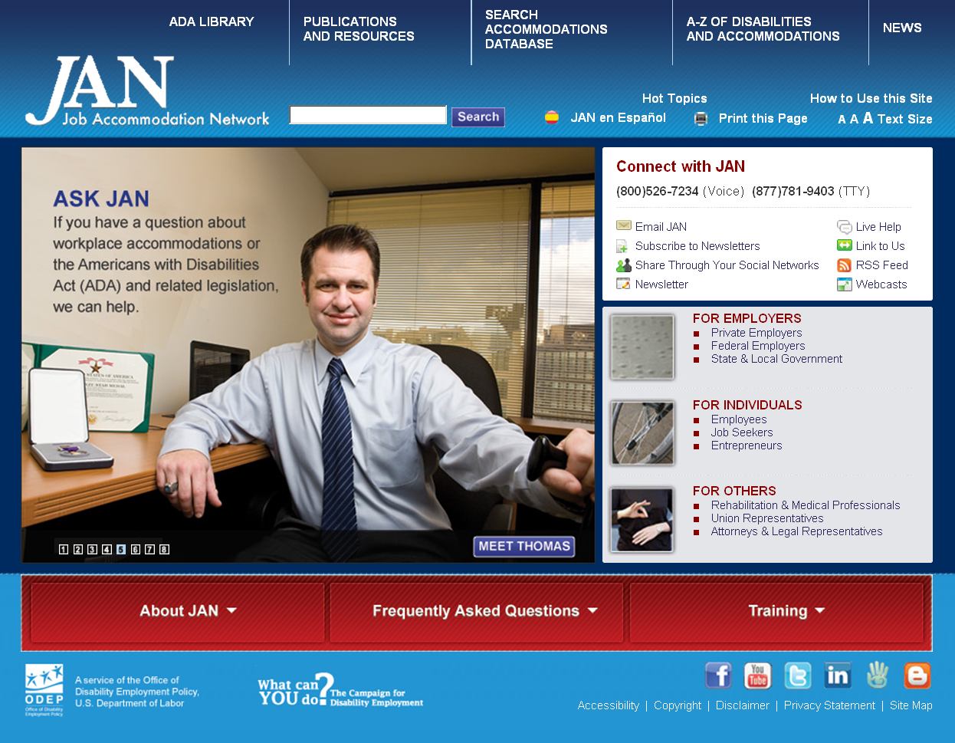
Contact
(800)526-7234 (V) & (877)781-9403 (TTY)
AskJAN.org & jan@askjan.org
(304)216-8189 via Text
janconsultants via Skype

