Slide 1
Accommodation and ADA Considerations: Reproductive Health Conditions and Pregnancy
Job Accommodation Network Accommodation and Compliance webcast Series Tracie DeFreitas, MS, Principal Consultant, ADA Specialist

Slide 2
Housekeeping
Technical Difficulties
Use the Q&A option at the bottom of the screen
800-526-7234 or 877-781-9403 (TTY) - or Live Chat at AskJAN.org
Frequently Asked Questions (FAQ) AskJAN.org/Training/JAN-Webcast-Frequently-Asked-Questions.cfm
Questions for Presenters
Use the Q&A option at the bottom of the screen

Slide 3
Housekeeping 2
PPT Slides
Click the link included in the webcast login email you received, see the link in the chat, or go to this webcast event from the Training page at AskJAN.org
Captioning
Use the closed caption (CC) option or captioning link in the chat

Slide 4
Discussion
Summary of Common Reproductive Health Conditions
Common Symptoms and Limitations and Effect on Working
Accommodation and Compliance Considerations

Slide 5
About Reproductive health Conditions
Reproductive health refers to the condition of our reproductive systems during all life stages
These systems are made of organs and hormone-producing glands, including the pituitary gland in the brain
Reproductive Health, National Institute of Environmental Health Sciences (NIEHS)

Slide 6
Common Reproductive Health Conditions
Endometriosis
Affects a woman’s uterus. Tissue that normally lines the uterus can grow on the ovaries, behind the uterus, on the bowels, or on the bladder, causing pain in the abdomen, lower back, or pelvic areas, infertility, and heavy menstruation. Endometriosis, MedlinePlus
Uterine Fibroids
Noncancerous tumors made of muscle cells and other tissues grow in and around the wall of the uterus, causing heavy and/or painful menstruation, lower back pain, “fullness” in the lower abdomen, and frequent urination. Uterine Fibroids, MedlinePlus
Interstitial Cystitis (IC)
Chronic bladder condition resulting in recurring abdominal or pelvic pressure and discomfort, frequent and/or urgent urination, tenderness, intense pain in the bladder or pelvic region, severe lower abdominal pain that intensifies as the urinary bladder fills or empties. Interstitial Cystitis, MedlinePlus

Slide 7
Common Reproductive Health Conditions (2)
Polycystic Ovary Syndrome (PCOS)
Condition where the ovaries or adrenal glands produce more male hormones than normal. Results in pelvic pain, excess hair growth or baldness or thinning hair, acne, oily skin, dandruff, or infertility. Increased risk of diabetes, heart disease, anxiety, and depression. Polycystic Ovary Syndrome, MedlinePlus
Premenstrual Dysphoric Disorder (PMDD)
Chronic condition where hormone levels begin to fall after ovulation, causing severe tension and irritability, depression, or anxiety, pain, bloating, headaches, and joint or muscle pain, fatigue or low energy, and difficulty thinking/focusing. PMDD, UpToDate
Cancers (e.g., Cervical, Ovarian, Uterine, Testicular)
Cancer that starts in the reproductive organs. May cause pain or pressure in the pelvic area, abdominal or back pain, bloating, frequent or urgent urination and/or constipation.

Slide 8
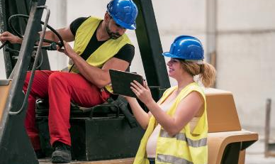
Other Reproductive Health Issues
Infertility, Pregnancy and Related Conditions (E.g., Hypertension, Gestational Diabetes Mellitus, Eclampsia, Postpartum Depression)
Menopause
Usually occurs naturally, most often after age 45, when the ovaries stop producing the hormones estrogen and progesterone. Results in changes in menstruation, hot flashes and/or night sweats, trouble sleeping, mood swings, and difficulty focusing. Menopause, MedlinePlus

Slide 9
Common Symptoms And Functional Limitations
Chronic pain in the abdomen, pelvis, bladder, back, muscles, joints, and headaches
Heavy or irregular menstrual bleeding
Frequent and/or urgent need to use the restroom
Difficulty thinking, focusing, remembering
Moodiness, irritability, depression, anxiety
Difficulty lifting, sitting, standing, pushing, pulling, reaching

Slide 10
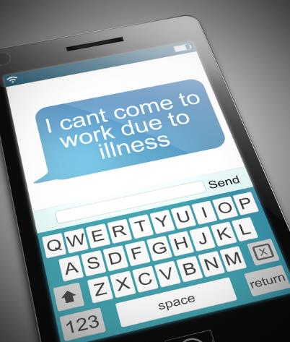
Common Work-Related Issues
Meeting attendance requirements
Performing essential job duties
Addressing personal needs
Completing executive functions
Interacting with others

Slide 11
Can we Talk? Normalize conversations to remove stigma
Employers
Create a safe space where employees know they can talk about challenges regarding all areas of their health
Normalize conversations about reproductive health, menstruation, self-care, mental health, etc., and work to remove stigma
Individuals
Advocate for yourself at work by prioritizing self-care and being open when struggling
Ask for what you need to do your best work; request reasonable accommodation

Slide 12
Facilitate the accommodation conversation
Not sure if it’s an accommodation request? Ask.
Examples:
“How can I help?”
“I want to clarify what you’re asking for and why it’s needed, so I can find out what we can do to help.”
Recognizing an Accommodation Request
Mother May I? Must I? Should I?
How Can I Help?

Slide 13
Gathering Information to Provide Accommodation
Inform the employee that information shared will be kept confidential
Establish the medical condition and need for accommodation, but limit inquiries to only what is necessary to provide accommodation (e.g., type of impairment, how it limits a major life activity, how accommodation will help)
Recognize that the individual will likely be the best resource regarding symptoms, limitations, impact on work, etc.
Sample Medical Inquiry in Response to an Accommodation Request Form Sample Medical Inquiry Form in Response to a Request for Leave as an Accommodation

Slide 14
Americans with Disabilities Act (ADA) Coverage
Given the ADA’s directive to construe disability broadly, err on the side of finding coverage if debatable
Focus on whether a reasonable accommodation can be provided
Remember employers are free to provide accommodations even if someone doesn’t meet the ADA definition of disability

Slide 15
Related Laws
Pregnancy Discrimination Act (PDA)
Family and Medical Leave Act (FMLA)
State employment protections against pregnancy discrimination and provisions for pregnancy accommodation
State Family and Medical Leave
State Civil Rights

Slide 16
SITUATIONS
AND
SOLUTIONS

Slide 17
Situation: Endometriosis
Robin has endometriosis and experiences chronic, debilitating pain. When she’s in a lot of pain, she is sometimes unable to work. Absences have been more frequent recently, leading Robin’s supervisor to issue an attendance warning. The employer is unaware of the reason Robin is calling off because she hasn’t disclosed the medical condition.

Slide 18
Solutions: Endometriosis
What can Robin do?
Disclose and explain the impact of the medical condition on meeting the attendance policy
Leverage the Family and Medical Leave Act (FMLA) and/or the ADA to request accommodation
What can the Employer do?
Ask, “How can we help?”
Modify the attendance policy, if reasonable
Approve intermittent leave under FMLA or ADA
Reasonable Accommodation and Undue Hardship Under the ADA (EEOC)

Slide 19
LEAVE: mind the interaction of FMLA & ADA
Leave can be provided under FMLA or ADA, and/or other programs/statutes
Can be intermittent and/or extended
ADA and FMLA leave must be job-protected
Indefinite leave not required or best practice

Slide 20
LEAVE: mind the interaction of FMLA & ADA (2)
Employer can request different documentation for each
ADA has undue hardship defense; FMLA does not, but FMLA has 12-week limit per 12-month period
If both FMLA and ADA apply, employer must provide leave under whichever statute provides greater rights to employees
Employer-Provided Leave and the ADA (EEOC)
Leave (JAN)
Family and Medical Leave Act (DOL)

Slide 21
where EMPLOYEE doesn’t know the solution Or Requested Solution is Ruled Out
Search for a solution even if the employee has only identified the problem, not proposed a particular accommodation
Consider employee preference when reasonable
If employee does have a proposed solution but it’s ruled it out, search for and offer an alternative reasonable accommodation if available, absent undue hardship
Use resources like JAN to help explore solutions

Slide 22
Solutions: Pain
Schedule periodic rest breaks
Allow a flexible work schedule and flexible use of leave time
Allow a self-paced workload
Implement ergonomic workstation design, e.g., ergonomic chair and adjustable workstation to alternate between sitting and standing
Allow telework
Access Employee Assistance Program (EAP) for coping with pain
Provide parking close to the worksite
Move workstation closer to the restroom
Allow time off for medical treatment
Reduce or eliminate physical exertion and workplace stress

Slide 23
Situation: Interstitial Cystitis (IC)
Alex has bladder symptoms from IC that have worsened due to prolonged sitting. His health care provider recommended behavioral therapy that requires a protocol of using the restroom every 2 hours. Physical therapy was also recommended for tight and tender pelvic muscles associated with IC.

Slide 24
Solutions: Interstitial Cystitis (IC)
What can Alex do?
Request ADA accommodations related to workstation, scheduling, attendance
What can the Employer do?
Provide an adjustable sit/stand desk to limit sitting for long periods
Offer break reminder software to prompt to stand and use restroom
Allow a modified/flexible break schedule to use restroom according to schedule
Provide workstation situated closer to restroom
Allow telework
Allow a flexible schedule and/or leave to access treatment

Slide 25
Situation: premenstrual dysphoric disorder (PMDD)
Jess was written up after violating the employer’s code of conduct related to prohibiting insubordination and inappropriate behavior between coworkers. They were having difficulty getting along with coworkers and yelled at their supervisor. Jess explained that they have been feeling significant tension and irritability and depression and anxiety due to PMDD.

Slide 26
Solutions: PMDD
What can Jess do?
Explain that symptoms of medical condition affect behavior/meeting conduct rule
Request to explore accommodations
What can the Employer do?
Determine whether the conduct rule is job-related and consistent with business necessity
If so, apply the rule but explore whether reasonable accommodation will enable the employee to follow the rule
Conduct
My Disability Made Me Do It! When It Does and Doesn’t Matter

Slide 27
Solutions: Emotional Regulation
Breaks for mental fatigue
Uninterrupted time for tasks that require significant concentration
Intermittent leave for medical appointments, counseling
Access Employee Assistance Program (EAP) for coping with stress
Adjust supervisory methods
Reduce stress/anger/impulsivity triggers – these strategies will vary according to triggers
Structured breaks as a physical outlet
Job or life coach to teach/reinforce techniques for managing impulsivity
Private workspace
Reduce distractions

Slide 28
Solutions: Supervisory Methods
Individual
Request to communicate with supervisor in a way that is comfortable (e.g., email instead of face to face)
Request clear expectations of responsibilities and consequences of not meeting standards
Employer
Offer positive praise and reinforcement
Provide day-to-day guidance and feedback
Give written job instructions via email
Schedule consistent meetings to set short- and long-term goals and review progress
Allow for open communication
Develop strategies to deal with conflict

Slide 29
Situation: PMDD (2)
Ally has severe anxiety and difficulty with time management, focus, and memory the week before and during menstruation. Working at home during the pandemic has enabled her to address these PMDD symptoms. She also obtained an emotional support animal during the pandemic. Now everyone is returning to the workplace. Ally requests to continue working at home.

Slide 30
Solutions: PMDD (2)
What can Ally do?
Explain why/how working at home addresses symptoms and limitations
Note that productivity and performance requirements were met while working
What can the Employer do?
Consider mandatory telework due to the pandemic as a trial period that demonstrated satisfactory performance of all essential functions
Engage in a flexible, cooperative interactive process if alternative effective accommodations must be explored (e.g., hybrid work arrangement)

Slide 31
Solutions: Anxiety
Identify and reduce triggers
Flexible schedule
Modified break schedule
Contact a support person when anxiety is triggered
Rest area/private space
Support animal
Support person

Slide 32
Solutions: Memory
Written instructions and checklists
Use a voice recorder
Additional training time for new tasks
Environmental cues for locations of items (e.g., labels, color coding, or bulletin boards)
Training refreshers
Minutes of meetings/trainings
Flowchart to indicate steps in a task
Verbal or pictorial cues
Color-coding scheme to prioritize tasks
Notebooks, planners, or sticky notes to record information/as reminders of dates/tasks

Slide 33
#MentalHealthAtWork
Whether you’re a CEO, worker, manager, supervisor or someone with a mental health condition, we ALL have a role to play to ensure a mental health-friendly workplace.
That’s the message behind the “Mental Health at Work: What Can I Do?” PSA.
Campaign for Disability Employment (CDE) “What Can I Do?” PSA
WhatCanYouDoCampaign.org

Slide 34
AskEARN.org
Mental Health Toolkit

Slide 35
Situation: infertility
Hannah has endometriosis and has had difficulty conceiving as a result. She will receive in vitro fertilization (IVF) treatments. To improve the chances of fertilization, Hannah’s health care provider recommends she avoid work stress.

Slide 36
Solutions: stress
Be flexible on the times that employees should be working
Provide additional breaks for de-escalation when needed
Reallocate marginal duties that cause undue stress
Allow support dog
Access EAP for coping with stress
Dealing with Stress in the Workplace
Dealing with Stress in the Workplace, Part 2

Slide 37
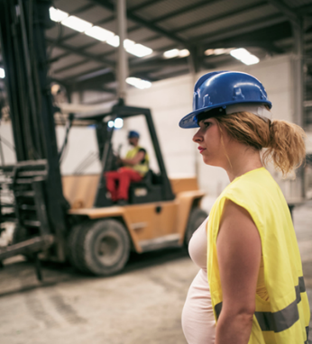
Situation: Pregnancy
Kristin is experiencing complications in the third trimester of pregnancy. She is restricted from lifting more than 10 lbs and must take frequent breaks to sit down. Kristin is wary of telling the employer she needs accommodations. The employer has light duty work available, but she believes the employer will not offer it because she doesn’t have a work-related injury.

Slide 38
Solutions: Pregnancy
What can Kristin do?
Approach the employer with solutions
Request a modified duty assignment for the short-term duration of the pregnancy
What can the Employer do?
If modified duty is provided to other similarly situated employees, provide temporary modified duty
If not, explore alternative effective solutions (e.g., job sharing, reassignment)

Slide 39
Solutions: Modified/Light Duty
Modified/light duty is temporary or permanent work that is physically or mentally less demanding than normal job duties
An employer may not deny an employee light duty because she is pregnant
May violate the PDA if light duty policy imposes significant burdens on pregnant employees that cannot be supported by a sufficiently strong justification
Enforcement Guidance on Pregnancy Discrimination and Related Issues (EEOC)

Slide 40
Solutions: Job Restructuring
If employee seeks to be excused from a marginal job duty:
Determine if the duty can be eliminated or swapped with another worker’s marginal duty
If employee seeks to be excused from a duty but it is an essential function:
Employer need not eliminate the duty as an accommodation, but determine if employee can be accommodated to perform the duty
If not, consider reassignment to a vacant position as the accommodation of last resort

Slide 41
Provide Short-term or Trial Accommodations
Consider providing a short-term solution as part of the accommodation process if it might demonstrate whether the accommodation will be effective, or enable an employee to continue working/return to work
Shows good faith effort
Temporary or Trial Accommodations

Slide 42
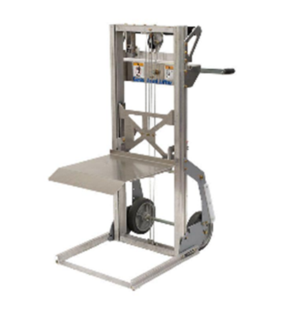
Solutions: Lifting
Reallocate lifting duties, if marginal
Assist when moving objects/people, to reduce weight
Organize items in a way that reduces the need to move items
Place frequently used tools and supplies at or near waist height
Reduce weight by separating items into smaller groups
Use a compact material handling device to lift, push, pull
Use a lift cart to move/raise items

Slide 43
Solutions: fatigue/Standing
Job restructuring
Periodic rest breaks
Reduced work schedule
Allow telework
Time for sitting, if job requires a lot of standing
Breaks to change position
Adjustable Workstations
Anti-Fatigue Matting
Low Task Chairs
Stand-Lean Stools
Wearable Anti-Fatigue Matting

Slide 44
Situation: Uterine Fibroids
Chelsea has uterine fibroids that cause heavy menstrual bleeding and pain. She needs frequent breaks to take care of personal health-related needs when experiencing these symptoms but is concerned about the time away from performing tasks and coworkers noticing frequent use of the restroom.

Slide 45
Solutions: Uterine Fibroids
What can Chelsea do?
Be open when struggling and advocate for herself at work by prioritizing self-care
Ask for what she needs to do her best work by requesting accommodation
What can the Employer do?
Don’t require employee to request to use the restroom
Don’t draw attention to employee when they are late or must leave early
Establish a discreet way to document breaks, coming in late
Limit requesting medical details about issues
Offer privacy to address issues

Slide 46
Situation: Menopause
Selena is experiencing symptoms of menopause that are making it difficult to function effectively at work, including extreme hot flashes, mood swings, and difficulty concentrating. She’s considering leaving the job, because she doesn’t know what she can do to improve the situation.

Slide 47
Solutions: Menopause
What can Selena do?
Educate the employer about her symptoms and ask what can be done to support her while going through this life transition
What can the Employer do?
Provide a workspace where temperature can be adjusted and/or provide a fan
Allow meetings to be attended remotely
Allow telework
Allow the employee to work when they’re most attentive and productive

Slide 48
Solutions: Maintaining Concentration
Reduce distractions in the work area
Provide space enclosures or a private office
Allow use of an environmental sound machine or a headset/earbuds to listen to music
Increase natural lighting or provide full-spectrum lighting
Reduce clutter in the employee’s work environment
Plan for uninterrupted work time
Divide large assignments into smaller tasks and steps
Effective Accommodation Practices: Executive Functioning Deficits

Slide 49
Accommodations are not One-Size-Fits-All
Impairments and limitations, as well as accommodation needs, are different based on the individual
Don’t use a one-size-fits-all approach; have the full conversation
Beware of any assumptions in determining what an individual can or cannot do, or what accommodation is needed
Make individualized assessments based on actual limitations, work history, and current ability to perform functions with accommodation

Slide 50
JAN Accommodation and Compliance Webcast Series
Thank you for attending: “Accommodation and ADA Considerations: Reproductive Health Conditions and Pregnancy”
Register for the next JAN webcast: AskJAN.org/events/register/2021-2022-webcast-series.cfm

Slide 51
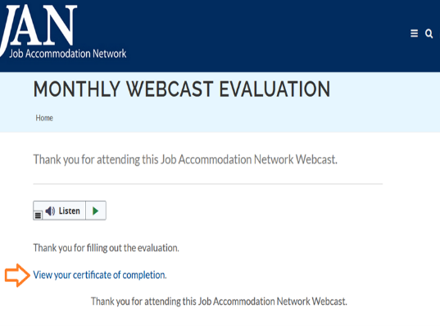
How do I claim the HR CEU?
Don’t close the JAN webcast browser
Complete the webcast evaluation in new window
Click on View your certificate of completion

Slide 52
Contact JAN for More Information
Visit
AskJAN.org
Call
800.526.7234
877.781.9403 (TTY)
Chat
@ AskJAN.org
Submit
JAN on Demand Inquiry @ AskJAN.org/JANonDemand.cfm
Email
JAN@AskJAN.org
Social Media
Facebook – Job Accommodation Network
Twitter – @JANatJAN

