Slide 1
Personal Use or Reasonable Accommodation: What’s What?
Job Accommodation Network (JAN) Accommodation and Compliance webcast Series Matthew McCord, MS, Senior Consultant, and Lisa Mathess, SHRM-CP, Lead Consultant

Slide 2
Housekeeping
Technical Difficulties
Q&A option at the bottom of the screen
800-526-7234 or 877-781-9403 (TTY) OR Live Chat at AskJAN.org
Frequently Asked Questions (FAQ) AskJAN.org/Training/JAN-Webcast-Frequently-Asked-Questions.cfm
Questions for Presenters
Q&A option at the bottom of the screen

Slide 3
Housekeeping 2
PPT Slides
Click the link included in the webcast login email you received, see the link in the chat, or go to this webcast event from the Training page at AskJAN.org
Captioning
Use the closed caption (CC) option or captioning link in the chat

Slide 4
Discussion Topics
Americans with Disabilities Act (ADA) and Personal Use:
Items
Amenities
Services
Medical Documentation
Ownership and Funding
Tricky Areas

Slide 5
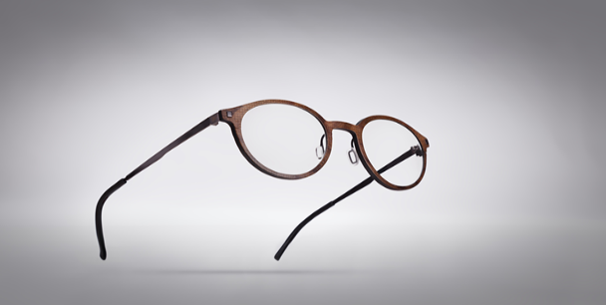
Personal Use Items
Items needed in accomplishing daily activities both on and off the job
Prosthetic limb
Wheelchair
Eyeglasses
Hearing aids
Similar devices if they are also needed off the job
ADA = Typically, not employer responsibility to provide these, but free to go above and beyond

Slide 6
Personal Use amenities
Employer not required to furnish personal use amenities, if not provided to employees without disabilities
Hot pot
Refrigerator
ADA = Employer is responsible for providing equal access to benefits/privileges of employment

Slide 7
Personal need services
Personal Attendant Services (PAS) for toileting/grooming not employer responsibility under title I of the ADA, unless on work-related travel
Limitations prompting the need for PAS exist on and off the job and thus, remain personal need services
Accommodation may be to permit PAS on site to provide services
Individual with the disability usually responsible for cost
Not to be confused with work-related aid and/or workplace personal assistance service
Rehabilitation Act, Section 501 regulations require federal agencies to provide PAS to certain employees with disabilities

Slide 8
Personal need Items in the workplace
Do employers have to allow employees with disabilities to use personal need items (canes, walkers, wheelchairs, hearing aids) or services (personal attendant care, service animals) in the workplace?
Allowing an employee with a disability to use a personal need item/service in the workplace is a form of accommodation
For example, it may be a reasonable accommodation for an employer to permit an individual who is blind to use a guide dog at work, even though the employer would not be required to provide a guide dog for the employee

Slide 9
Personal Use exceptions
Items that might otherwise be considered “personal” may be required as accommodation if specifically designed or required to meet job-related rather than personal needs. For example:
Specialty glasses to view computer monitor for visually impaired employee
Motorized wheelchair if worksite carpet is too thick for manual wheelchair
Reasonable Accommodation and Undue Hardship Under the ADA

Slide 10
What if an employee forgoes personal use items?
An employee claims their hearing aids hurt and won’t wear them to work. Can we require the employee to wear the hearing aids?
ADA requires an employer to provide reasonable accommodations to remove workplace barriers, regardless of what effect medications, treatment, or assistive devices may have on an employee’s ability to perform the job
Employer may still need to provide a reasonable accommodation

Slide 11
Photosensitivity Personal Need Item — Situation
A property inspector with a skin condition had to travel to different sites. The health care provider recommended the employee stay out of sunlight. The employee requested the employer pay for SPF- protectant clothing to limit UVB/UVA rays.

Slide 12
Photosensitivity Personal Need Item — Solution
The employee does not use the protective clothing at home, instead he opts to stay inside during daylight hours. The employer denied the request citing this was a personal need item.
Other accommodation considerations:
Schedule change

Slide 13
Personal Need service — situation
A clerk used a wheelchair and was successful at performing job tasks. Her medical condition progressed and limited her strength. The employee requested that female coworkers push her from the workstation to the restroom and assist her in transferring from the wheelchair to the toilet.

Slide 14
Personal Need service — solution
The employer contacted JAN to learn if they had to require female employees to help the clerk in the restroom.
It was explained that employers will want to approach these types of issues on a case-by-case basis and sort out any concerns about liability.
JAN also suggested referring the employee to local resources to acquire PAS, which may be beneficial for both parties.

Slide 15
Prescription glasses Personal Need item — situation
An electrical apprentice with a vision impairment learned they were required to wear safety glasses to participate in the training program. They typically wore eyeglasses, so they asked the employer for prescription-strength safety glasses as an accommodation.

Slide 16
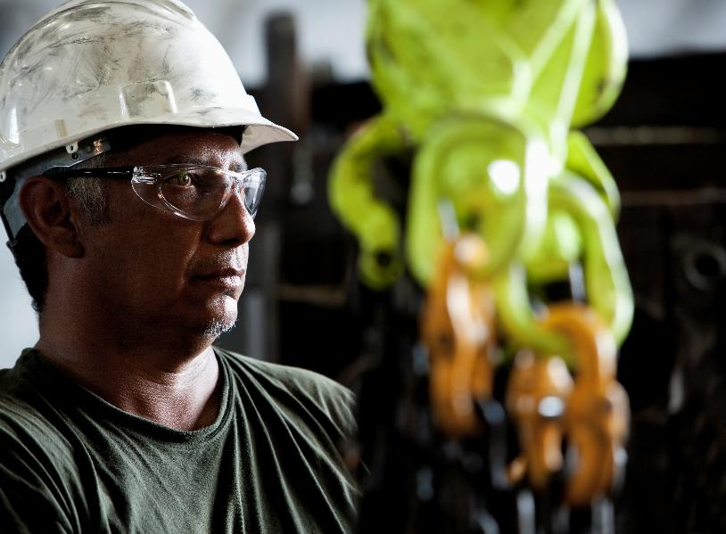
Prescription glasses Personal Need item — solution
The employer contacted JAN to learn whether there is an obligation to furnish prescription safety glasses.
In this case, it was explained that the glasses are necessary to meet the company safety standards rather than to meet the individual’s vision needs. Employers must determine what is reasonable on a case-by-case basis.
Alternative accommodations can be offered:
Goggles to wear over glasses
Side safety shields on glasses

Slide 17
MEDICAL DOCUMENTATION
MEDICAL DOCUMENTATION

Slide 18
Personal Use items & Medical documentation
When is a disability-related inquiry or exam job-related and consistent with business necessity under the ADA?
When there is a reasonable belief, based on objective evidence, that:
performance of job functions will be/is impaired by a medical condition, or
there is a direct threat due to a known medical condition
After accommodation is requested — when the disability or need for accommodation is not known or obvious
Typically, the job-related and consistent with business necessity standard is not met simply because an individual is using a personal use item — case-by-case determination

Slide 19
Should we request medical documentation?
A secretary returned to work from hip surgery with a walker. The secretary placed the walker next to their desk during their shift and used it to go to the restroom and when they left for the day.
A roofer who had to climb ladders and work from steep roof peaks came to work with a cane following cancer treatments. The employer observed that the roofer had a hard time navigating the worksite on their first day back to work.
Should we require medical documentation of the need to use the walker and/or cane?

Slide 20
Personal Use items & Medical documentation (2)
Hoops Theory — When request is for access to the same workplace adjustments, benefits or privileges available to employees without disabilities, disability-related information is not needed
To Ask or Not to Ask? - Knowing When to Request Medical Information
Mother May I? Must I? Should I?

Slide 21
OWNERSHIP/ FUNDING?
OWNERSHIP & FUNDING

Slide 22
Ownership — Who paid?
Who paid for the item?
If one party paid for 100% of the item, be it the employer or the employee, then this is good evidence that party owns the item.
Sharing cost of an item will make the question of ownership more difficult to answer. If it is decided that the cost of the item will be shared by both parties, it may be best to put into writing who will keep it later.

Slide 23
Ownership — Who controls?
Who controls how and where it is used?
If an employer has control over how a potential personal use item is used, this could be evidence that it is not necessarily a personal use item.
Keep in mind, personal use items are needed for both work and non-work-related tasks. If the employer has the power to limit the individual in using the item only for work-related tasks, then this may not be a personal use item.

Slide 24
Ownership — Sharing?
What if we Share?
The ADA does not prohibit an employer from going above and beyond minimum requirements.
If an employer wants to allow an individual to use accommodation items at home or for tasks that are not work-related, this will not obligate them do this in all other situations too.
Good Deeds Not Punished: Dispelling the Idea of Precedent Setting and the ADA

Slide 25
funding — Assistive technology Projects

Slide 26
funding — independent living centers

Slide 27
funding — rehabilitation services

Slide 28
TATION
TRICKY AREAS

Slide 29
Tricky Areas Telework & personal use Pre-Pandemic
Telework and Equipment — Pre-Pandemic Understanding
When employers do not provide workstation equipment, like desks and chairs, for employees to work at home as a benefit of employment, then the employee, not the employer, will generally be responsible for providing workstation equipment
When employees request to work from home as an accommodation, the issue of what equipment employers must provide is not clear-cut
ADA does not address this question, and to date, neither has the Equal Employment Opportunity Commission (EEOC)
Lack of equipment is not usually something related to the disability
Argument could be made that an employer may need to provide specialized equipment that a person is unlikely to have at home (e.g., screen reading software)
JAN's Accommodation and Compliance: Telework

Slide 30
Tricky Areas Telework & personal use during a pandemic
Telework and Equipment — During a Pandemic
Q 14. During a pandemic, must an employer continue to provide reasonable accommodations for employees with known disabilities that are unrelated to the pandemic, barring undue hardship?
“...If an employee with a disability needs the same reasonable accommodation at a telework site that he had at the workplace, the employer should provide that accommodation, absent undue hardship. In the event of undue hardship, the employer and employee should cooperate to identify an alternative reasonable accommodation.”
Pandemic Preparedness in the Workplace and the ADA
What You Should Know About COVID-19 and the ADA, the Rehabilitation Act, and Other EEO Laws (See also, D.14)

Slide 31
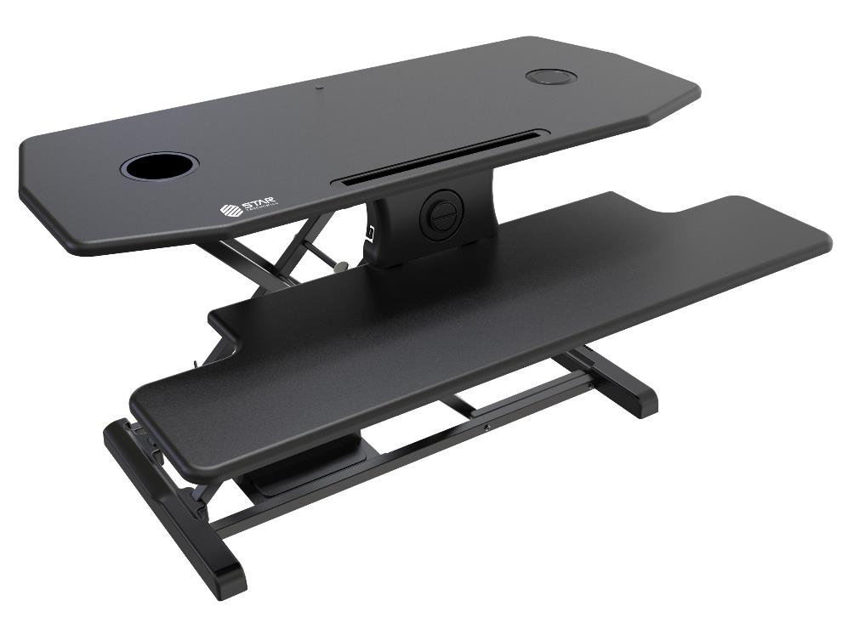
Tricky Areas Telework & personal use — situation
An employer was reviewing their remote work policies in light of the COVID-19 pandemic.
They contacted JAN seeking guidance on whether they need to consider providing office furniture like a sit/stand desk for employees who are teleworking.

Slide 32
Tricky Areas Telework & personal use — solution
After contacting JAN, the employer felt prepared to handle such requests if they arose.
The remote work policy was reviewed, and based on the information provided, was adjusted to reflect the atypical circumstances of a pandemic.

Slide 33
Tricky Areas Personal Use Amenities & Disabilities
What if an individual requires a personal use amenity due to a disability? For instance, an individual with diabetes needs to keep insulin refrigerated and asks to bring in a small refrigerator to store it in their office.
Alternative options can be explored:
Space in an existing refrigerator set aside for the individual to use?
What about privacy concerns?
Non-descriptive container to avoid raising questions?
Lockbox to prevent others from sneaking around?
Reasonable Accommodation and Undue Hardship Under the ADA – Q.24 Example

Slide 34
Tricky Areas Personal Use Amenities & Disabilities (2)
If there is no undue hardship, allowing the individual to bring in the amenity to use on site would still need to be considered and might be easier
Purchasing one may not be required depending on case-specific details, but an employer still may do so

Slide 35
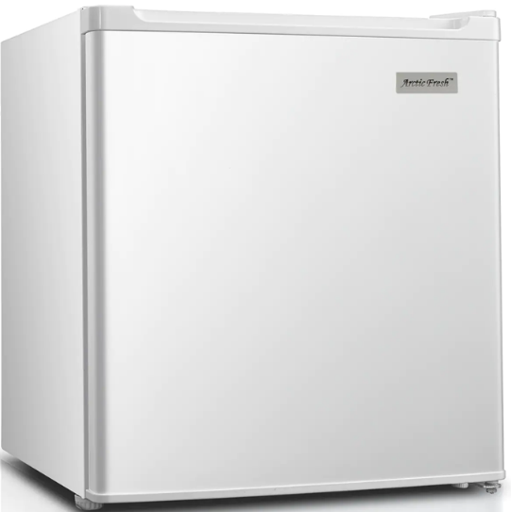
Tricky Areas Personal Use Amenities & Disabilities — situation
An employer received an accommodation request from an individual experiencing diabetic neuropathy.
The individual is requesting that the employer provide them with speech recognition software, a headset with a microphone to minimize typing, and a small refrigerator be provided to store their insulin, among other accommodations. The employer reached out to JAN for guidance.

Slide 36
Tricky Areas Personal Use Amenities & Disabilities — solution
The employer spoke with a JAN Consultant and later reported in the JAN follow-up survey that the accommodations were made. The speech recognition, the headset, and the refrigerator were all approved and paid for by the employer.
The employer stated that this decision allowed them to retain a qualified employee and avoid the cost of hiring and training a new employee.

Slide 37
Tricky Areas Biohazard containers
How do we handle disposal of used medical syringes (e.g., insulin) at work?
Biohazard/sharps container probably still personal use item = employee responsibility
Employer probably cannot insist that an employee provide a biohazard container for the workplace if the employee can safely dispose of the biohazard elsewhere
If employer is going to insist on specific safety protocols; practical guidance = provide the container
EEOC Informal Discussion Letter 3/23/04

Slide 38
Tricky Areas Above & Beyond ADA — Situation
A receptionist in training at an employment services provider was hard of hearing, had a vision impairment, and a history of meningitis. A diagnosis of dementia was also being explored.
After three weeks of training, he was still unable to answer the phone correctly. The employer talked with the trainee about obtaining different phone equipment and modifying training techniques, but the trainee was very stubborn and insistent about not needing help.

Slide 39
Tricky Areas Above & Beyond ADA — solution
The following equipment was purchased:
CCTV
Digital recorder
Phone with bump dots and headset
Tablets for writing with large lines
In/out board with pictorial representations
Hearing aids
Also helped with transportation

Slide 40
Tricky Areas Above & Beyond ada — Cost/benefit
Cost: $9,780
Benefit: At the time of the JAN follow-up survey, it was reported that the accommodation was implemented on a trial basis and was found to be effective.
With the accommodations, the receptionist was able to improve attendance and productivity.

Slide 41
Tricky Areas Mobility Aids
What if an employee requests that an employer purchase a mobility aid, such as a wheelchair or scooter?
“An employer does not have to provide as reasonable accommodations personal use items needed in accomplishing daily activities both on and off the job. Thus, an employer is not required to provide an employee with a prosthetic limb, a wheelchair, eyeglasses, hearing aids, or similar devices if they are also needed off the job.”
Reasonable Accommodation and Undue Hardship Under the ADA – General Principles
If the individual needs the mobility aid both on and off the job, the employer likely does not need to provide it
If the individual needs it solely for work, it might need to be considered as an accommodation alongside any other effective option, barring undue hardship

Slide 42
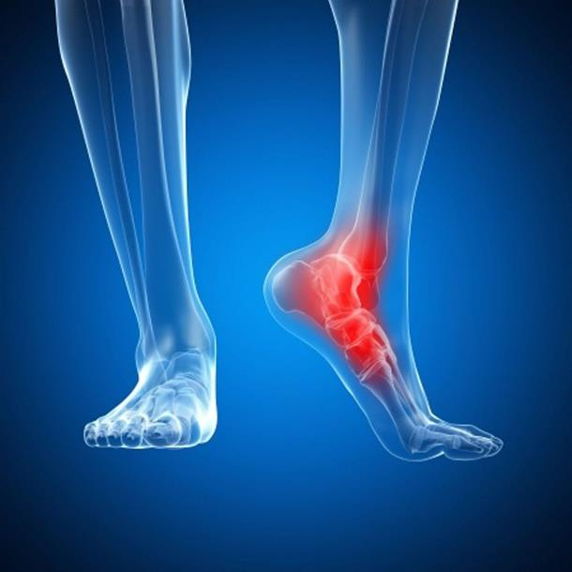
Tricky Areas Mobility Aids — situation
An individual with chronic pain in one foot requested to bring in and use their own electric kick scooter at work. They stated that they use this for personal tasks off the job, and it eliminates the pain they experience if they must stand or walk instead.
The employer reached out to JAN with questions regarding this request.

Slide 43
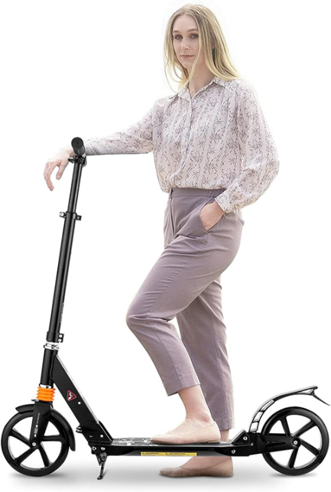
Tricky Areas Mobility Aids — solution
The employer spoke with a JAN Consultant and later participated in the JAN follow-up survey. In the survey, the employer stated that they allowed the individual to use their scooter at work.
They mentioned that the individual says the accommodation is effective and they have received no more reports of the individual’s foot pain impacting their job.

Slide 44
Tricky Areas Restroom Accessibility— situation
An individual with limited arm strength and mobility asked their employer to install a bidet toilet in the employee restroom because they had difficulty using toilet paper.

Slide 45
Tricky Areas Restroom Accessibility— Solution
Although not clearly defined by the ADA, the employer opted to furnish a bidet attachment to the existing facilities. This accommodation limited break time in the restroom and was effective in meeting the needs of the individual.

Slide 46
Questions?

Slide 47
JAN Accommodation and Compliance Webcast Series
Thank you for attending: “Personal Use or Reasonable Accommodation: What’s What?”
Register for the next JAN webcast: AskJAN.org/events/register/2021-2022-webcast-series.cfm

Slide 48
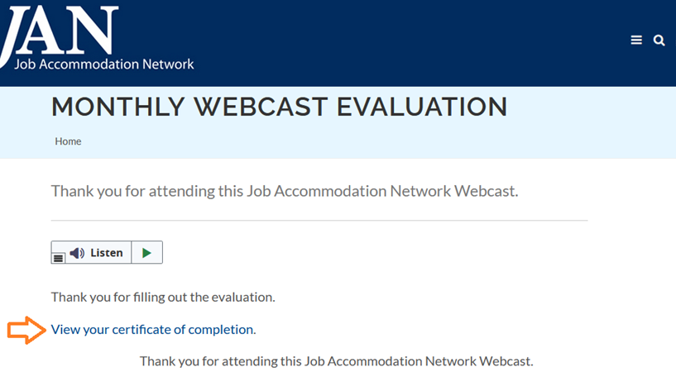
How do I claim the HR CEU?
Don’t close the JAN webcast browser
Complete the webcast evaluation in new window or go to: AskJAN.org/EvaluationReg.cfm
Click on View your certificate of completion

Slide 49
Questions? Contact JAN for More Information
Visit
AskJAN.org
Call
800.526.7234
877.781.9403 (TTY)
Chat
@ AskJAN.org
Submit
JAN on Demand Inquiry @ AskJAN.org/JANonDemand.cfm
Email
JAN@AskJAN.org
Social Media
Facebook – Job Accommodation Network
Twitter – @JANatJAN

