Slide 1
Key Mental Health Solutions in the Workplace
Melanie Whetzel, M. A., CBIS
Lead Consultant, Cognitive/Neurological Team

Slide 2
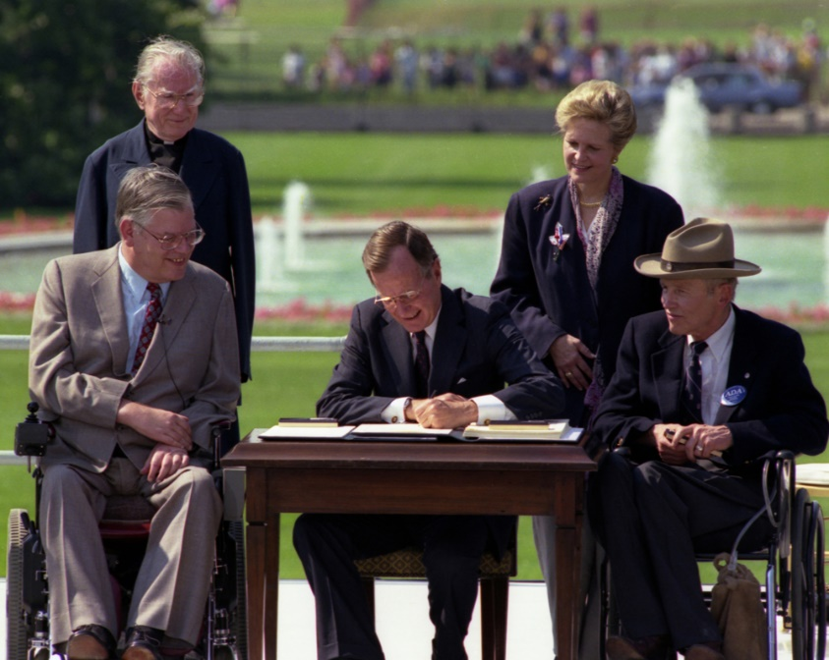
30th Anniversary of the ADA
The Americans With Disabilities Act will celebrate its 30th anniversary in July 2020.

Slide 3
Leave
Telework
Reassignment
Stress Reduction
Returning to Work
Modified Schedules
Supervisory Changes
Service/Support Animals
Performance and Conduct
Completing Essential Functions
Confidentiality and Morale Issues

Slide 4
Leave
Intermittent for counseling, medical visits
For evaluation and treatment
For hospitalization
Ineffective

Slide 5
Telework
Intermittent
Trial Period
Last Resort

Slide 6
Reassignment
Open position
Qualified

Slide 8
Stress Reduction
Identify stressors
Minimize/eliminate

Slide 9
Return To Work
Medical documentation
Employer cooperation with a plan
No interactive process while on leave

Slide 10
Modified/Reduced Schedule
Part-time transition to full-time
Set/Regular Schedule
Denial/Hardship

Slide 12
Supervisory Changes
Request for new supervisor
Request for new supervisory method

Slide 13
Service and Support Animals
As an accommodation
Training: Demonstration vs. certificate
Trial period

Slide 14
Performance and Conduct
Accommodate to meet standards
Zero Tolerance
Document

Slide 16
Completing Essential Functions
Assist in completion
Removal not required

Slide 17
Confidentiality
Strict rules
Morale issues

Slide 19
Resources:
Employees with Mental Health Impairments
http://AskJAN.org/media/Psychiatric.html
Employers' Practical Guide to Reasonable Accommodation Under the Americans with Disabilities Act (ADA)
http://AskJAN.org/Erguide
The ADA: Applying Performance and Conduct Standards to Employees with Disabilities
http://www.eeoc.gov/facts/performance-conduct.html

Slide 20
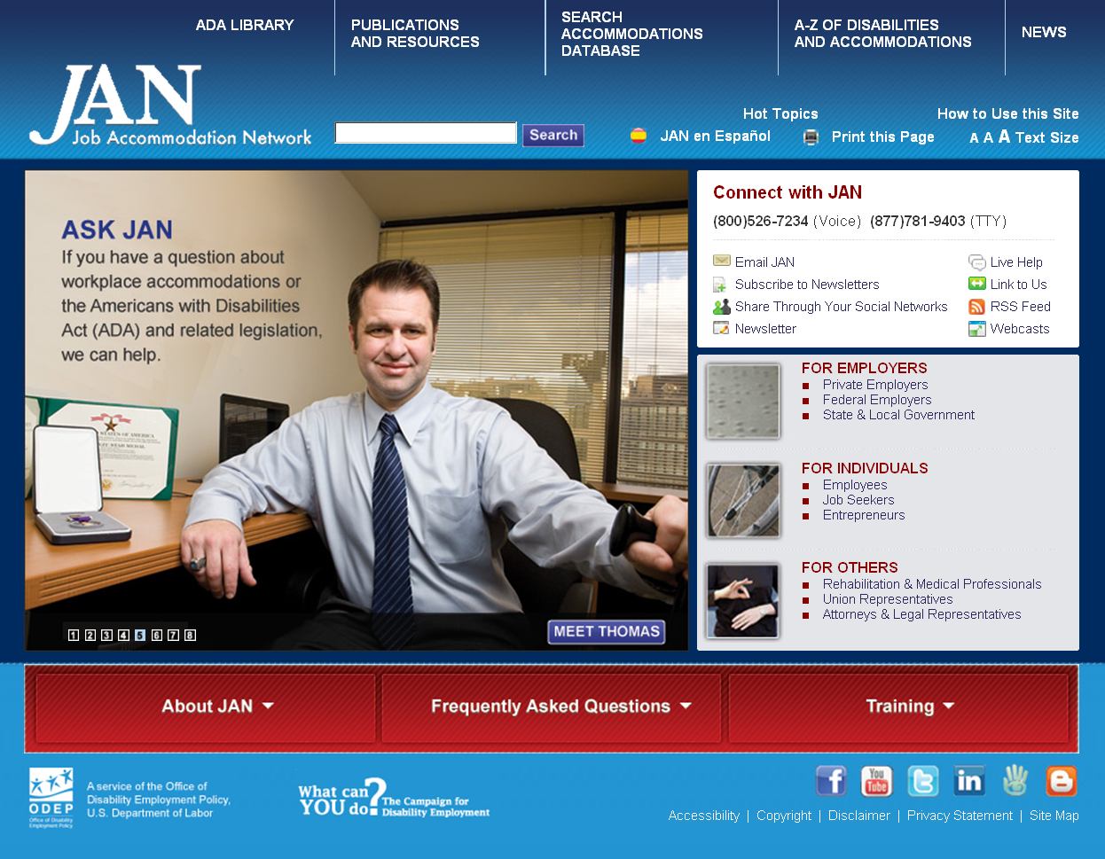
Contact
(800)526-7234 (V) & (877)781-9403 (TTY)
AskJAN.org & jan@askjan.org
(304)216-8189 via Text
janconsultants via Skype

