Slide 1
J
A
N
W
I
R
E
“Current Events” in Accommodation
Linda Carter Batiste, J.D., Principal Consultant
Beth Loy, Ph.D., Principal Consultant

Slide 2
“Current Events”
From JAN: ADA Anniversary
Home | Business | Politics | Technology | Living | World
ADA Turns 30

Slide 3
“Current Events”
From JAN: Numbers
44,000+ contacts per year
50% electronic
21.5 million Webpage requests per year
Home | Business | Politics | Technology | Living | World

Slide 4
“Current Events”
From JAN: Solution Videos
Smartpens, Speech Recognition Software, Telephone Amplification, CART, Microsoft/iPad Built-in Accessibility Features, Alternative Mice
Coming Soon
Ergonomic Chairs
Sit/Stand Workstations
Accessing Telephones with Hearing Aids
Color Coding as an Accommodation
https://askjan.org/events/Trainings.cfm
Home | Business | Politics | Technology | Living | World

Slide 5
“Current Events”
From JAN: Just-in-Time Training Videos
Interviewing an applicant with autism
Managing an accommodation request
Managing an accommodation that surfaces during a performance review
Retaining an individual with a chronic health condition
Communicating with someone with a speech impairment
Returning an injured employee to work
Performance and conduct management of an employee
https://www.youtube.com/JANinformation
Home | Business | Politics | Technology | Living | World

Slide 6
“Current Events”
From JAN: A to Z
Telework Page
Leave Page
Caregivers Page
Service and Emotional Support Animals Training Module
Coming Soon
MyJAN
https://askjan.org/a-to-z.cfm
Home | Business | Politics | Technology | Living | World

Slide 7
“Current Events”
Home | Business | Politics | Technology | Living | World
J
A
N
W
I
R
E
Stay Tuned @
AskJAN.org

Slide 8
“Current Events”
Costs / Benefits:
4 Surveys
Employer
Professional
Self / Individual
Self-Employment
Home | Business | Politics | Technology | Living | World

Slide 9
“Current Events”
Employer Follow-up Study
2,744 employers interviewed between January, 2004, and July 31, 2019
Home | Business | Politics | Technology | Living | World

Slide 10
“Current Events”
Finding: Employers want to provide accommodations so they can retain valued and qualified employees.
Home | Business | Politics | Technology | Living | World

Slide 11
“Current Events”
Results
Of the employers who called JAN for accommodation information and solutions, most were doing so to retain or promote (85%) a current employee.
On average (including those persons who had just been given a job offer or who were newly hired), the employees had been with the company about seven years, with an average wage of about $16 for those paid by the hour, or an average annual salary of about $51,900.
In addition, the individuals tended to be fairly well-educated, with 54% having a college degree or higher.
Home | Business | Politics | Technology | Living | World

Slide 12
“Current Events”
Situation: A call center employee with diabetes requested a change to the highly structured break schedule to allow her to take more frequent, shorter breaks.
Solution: As a reasonable accommodation, the employer provided flexibility in break time, as needed, not to exceed 30 minutes of total break time in an 8 hour work day.
Reported Benefit: The method of clocking in and out for breaks allowed both the employee and employer to monitor the use of time. The employer reported that the accommodation allowed the company to retain a qualified employee and to increase her productivity and attendance.
Reported Cost: $0.
Home | Business | Politics | Technology | Living | World

Slide 13
“Current Events”
Finding: Most employers report no cost or low cost for accommodating employees with disabilities.
Home | Business | Politics | Technology | Living | World

Slide 14
“Current Events”
Results
Over half of accommodations (58%) were made at no cost.
Of the 37% who experienced a one-time cost to make an accommodation, the typical cost of accommodating an employee was $500.
Only 25 (3%) said the accommodation resulted in an ongoing, annual cost to the company and 9 (1%) said the accommodation required a combination of one-time and annual costs.
Home | Business | Politics | Technology | Living | World

Slide 15
“Current Events”
Situation: A groundskeeper indicated he had developed a severe allergy to bee stings.
Solution: The employer had discovered an influx of bees on the grounds and subsequently hired a consultant to locate nests and develop a protocol for eradicating them. The employee also indicated that he carried an epi pen and requested a plan of action should he be stung.
Reported Benefit: With input from the employee, supervisors were trained on how to assist him, if needed. Reported Cost: $500.
Home | Business | Politics | Technology | Living | World

Slide 16
“Current Events”
Finding: Employers report accommodations are effective.
Home | Business | Politics | Technology | Living | World

Slide 17
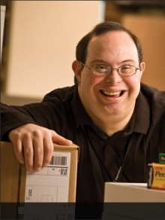
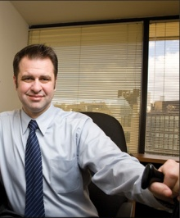
“Current Events”
Results
Of those responding, 74% reported the accommodations were either very effective or extremely effective.
Home | Business | Politics | Technology | Living | World

Slide 18
“Current Events”
Situation: A bank employee with fragrance sensitivity was having problems working due to irritants such as perfume and candles. She experienced nausea and migraines. Solution: As a reasonable accommodation, the agency made changes to its policy regarding the use of fragranced items. The employer also purchased an air purifier and provided all employees with education packets.
Reported Benefit: The employer reported that the accommodation was extremely effective because the "employee is able to work without worrying about getting sick from strong fragrances and odors."
Reported Cost: $200
Home | Business | Politics | Technology | Living | World

Slide 19
“Current Events”
The study results consistently showed that the benefits employers receive from making workplace accommodations far outweigh the low cost.
Home | Business | Politics | Technology | Living | World

Slide 20
“Current Events”
Home | Business | Politics | Technology | Living | World
J
A
N
W
I
R
E
Stay Tuned @
AskJAN.org/topics
/costs.htm

Slide 21
“Current Events”
Legal: Americans with Disabilities Act
ADA 30th Anniversary – July 26, 2020
Home | Business | Politics | Technology | Living | World

Slide 22
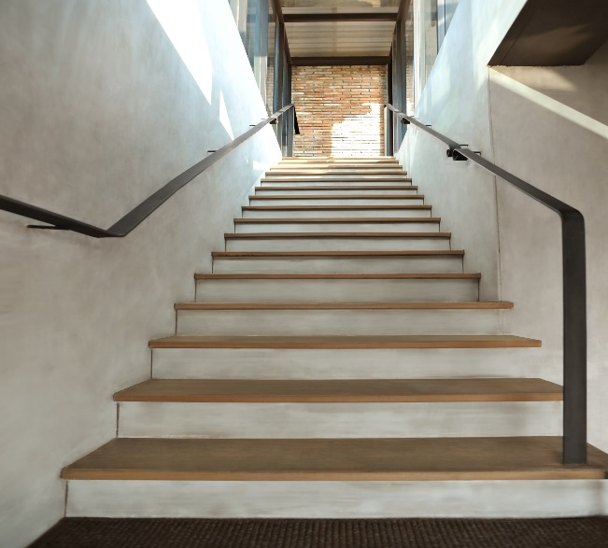
“Current Events”
Legal: Americans with Disabilities Act
Minimal ADA Compliance
An applicant uses a wheelchair.
When he arrived for his job
interview he could not enter the
building because it was
inaccessible. The employer
apologized and rescheduled the
interview at an accessible location.
Home | Business | Politics | Technology | Living | World

Slide 23
“Current Events”
Legal: Americans with Disabilities Act
Inclusive Practices
Notify applicants about where and how the interview will be conducted
Provide contact information for additional questions or to request accommodation
Hold interviews in an accessible location
Greet applicants at the door to identify any unforeseen accessibility issues
Think about accommodation needs ahead of time
Home | Business | Politics | Technology | Living | World

Slide 24
“Current Events”
Legal: Americans with Disabilities Act
Minimal ADA Compliance
An employer lets employees telework at their supervisors’ discretion. An employee with a disability asks to telework, but is denied by her supervisor who is against teleworking. The employee goes to HR, and goes through the accommodation process, and is allowed to telework as an accommodation.
Home | Business | Politics | Technology | Living | World

Slide 25
“Current Events”
Legal: Americans with Disabilities Act
Inclusive Practices
Don’t make employees with disabilities jump through extra hoops
Have an automatic review of any denial of accommodation by a supervisor
Have a centralized accommodation process and designated expert
Build accommodations into policies
Have flexible policies for all employees (telework, flexible schedules, leave)
Home | Business | Politics | Technology | Living | World

Slide 26
“Current Events”
Legal: Americans with Disabilities Act
Minimal ADA Compliance
An employer has been giving sit/stand workstations to any employees who request them, but after multiple requests decides to only give them if needed for a disability. The employer takes the workstations away from everyone and provides information about how to request one as an accommodation.
Home | Business | Politics | Technology | Living | World

Slide 27
“Current Events”
Legal: Americans with Disabilities Act
Inclusive Practices
Grandfather in the employees who already have workstations
Don’t remove the workstations until the accommodation process is complete
Practice universal design
Provide ergonomic workstations for all or at least provide some ergonomic equipment for all
Home | Business | Politics | Technology | Living | World

Slide 28
“Current Events”
Legal: Americans with Disabilities Act
Minimal ADA Compliance
An employee discloses that he is addicted to illegal drugs and wants to get help. He asks for leave time to go to rehab. The employer has a zero tolerance policy for illegal drug use and terminates the employee under the policy.
Home | Business | Politics | Technology | Living | World

Slide 29
“Current Events”
Legal: Americans with Disabilities Act
Inclusive Practices
Allow leave when an employee voluntarily comes forward and wants to get help
Use a last chance agreement
Allow all employees a chance for sponsored treatment
Provide an EAP and other workplace supports
Home | Business | Politics | Technology | Living | World

Slide 30
“Current Events”
Legal: Americans with Disabilities Act
Minimal ADA Compliance
An employee with PTSD was allowed to bring his service dog to work. His coworkers asked his supervisor why he was allowed to bring a dog to work. The supervisor indicated that she would not discuss another employee with coworkers.
Home | Business | Politics | Technology | Living | World

Slide 31
“Current Events”
Legal: Americans with Disabilities Act
Inclusive Practices
Provide options for how to respond to coworkers
Ask employees with disabilities if they would like to voluntarily educate coworkers
Do general disability awareness and etiquette training
Home | Business | Politics | Technology | Living | World

Slide 32
“Current Events”
Home | Business | Politics | Technology | Living | World
J
A
N
W
I
R
E
Stay Tuned @
AskJAN.org

Slide 33
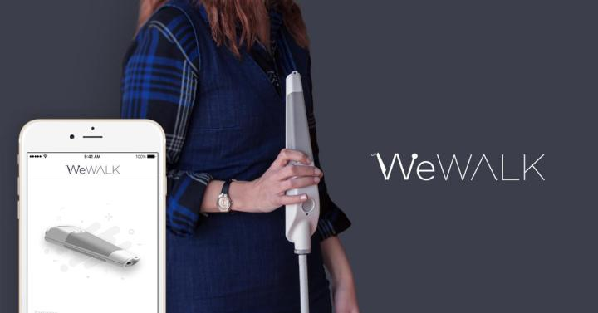
“Current Events”
Mobility: https://wewalk.io/en
WeWalk Smart Cane
Home | Business | Politics | Technology | Living | World

Slide 34
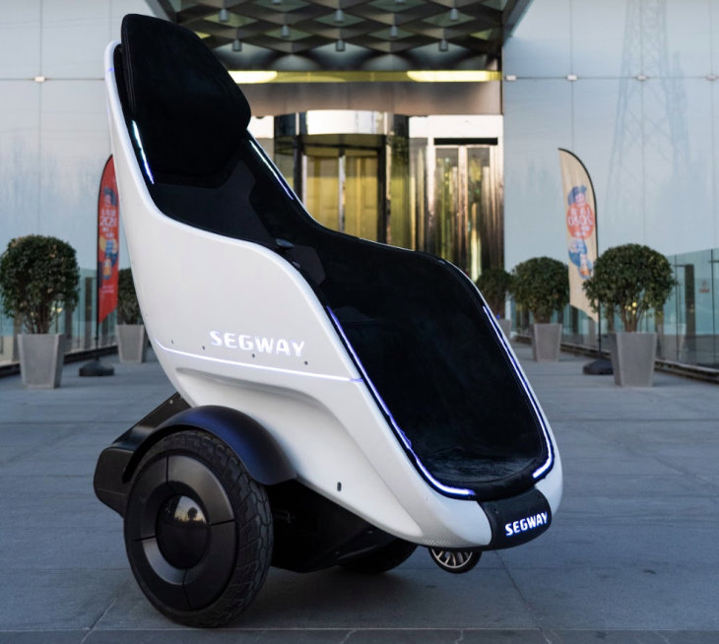
“Current Events”
Mobility: https://www.segway.com
Segway S-Pod
Home | Business | Politics | Technology | Living | World

Slide 35
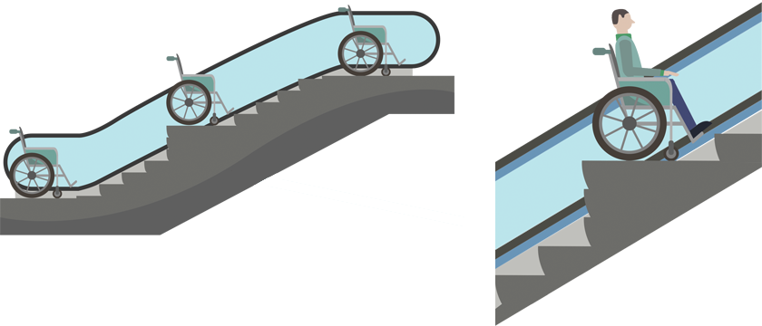
“Current Events”
Mobility: https://accessible-japan.com
Accessible Escalator
Home | Business | Politics | Technology | Living | World

Slide 36
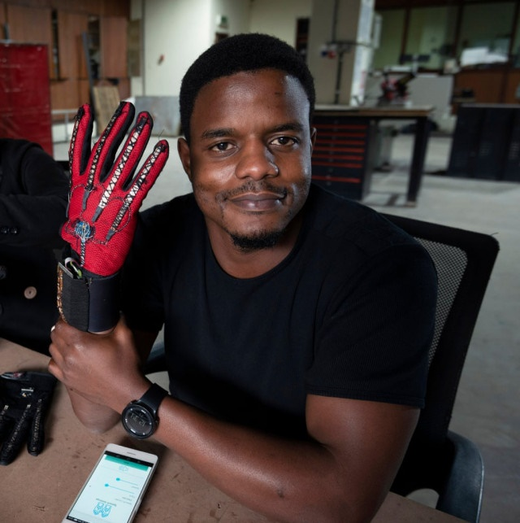
“Current Events”
Communicating: https://wearable-technologies.com
Sign-IO gloves
Home | Business | Politics | Technology | Living | World

Slide 37
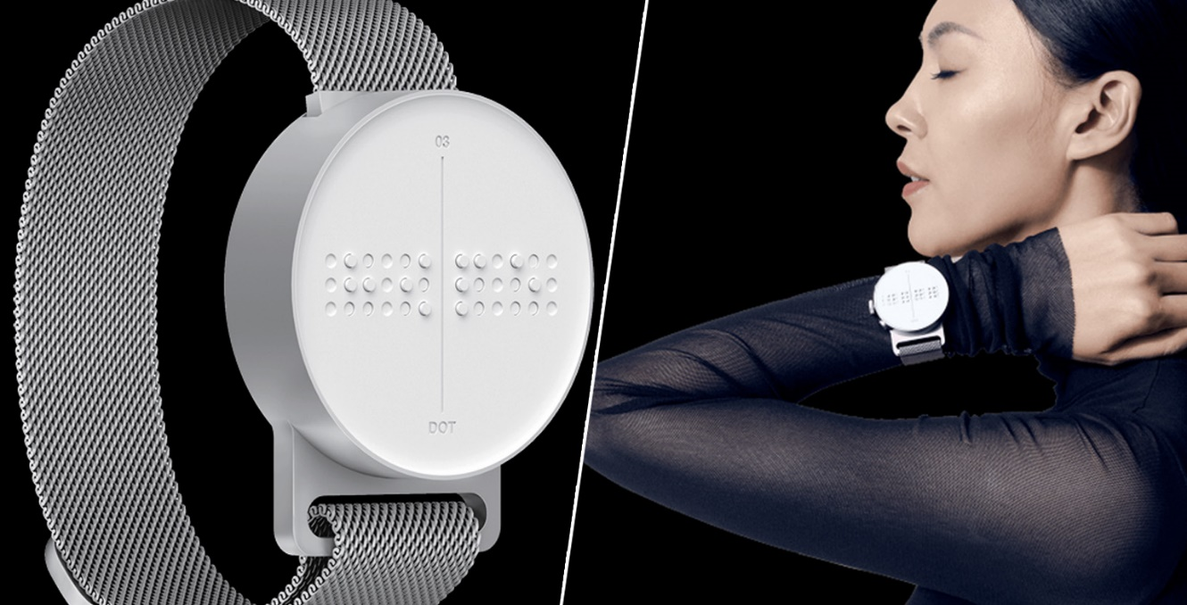
“Current Events”
Communicating: https://www.dotincorp.com
Dot Watch
Home | Business | Politics | Technology | Living | World

Slide 38
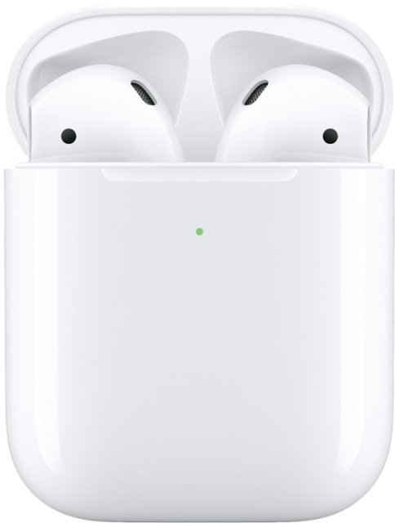
“Current Events”
Communicating: https://apple.com
AirPods Live Listen
Home | Business | Politics | Technology | Living | World

Slide 39
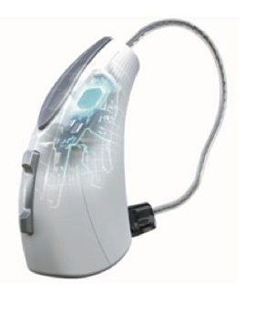
“Current Events”
Communicating: https://starkeypro.com
Livio AI Hearing Aids
Home | Business | Politics | Technology | Living | World

Slide 40
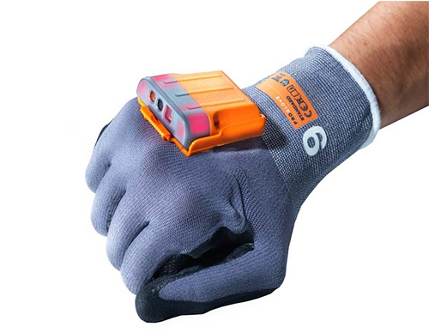
“Current Events”
Performing Tasks: https://barcodegiant.com
MARK 2 Wearable Glove Barcode Scanner
Home | Business | Politics | Technology | Living | World

Slide 41
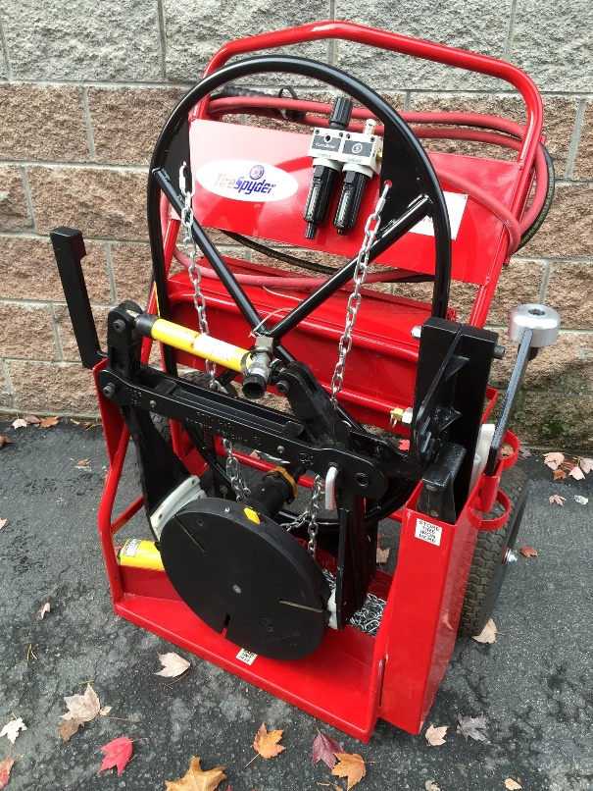
“Current Events”
Performing Tasks: https://www.facebook.com/TireSpyder/
Tire Spyder
Home | Business | Politics | Technology | Living | World

Slide 42
“Current Events”
Performing Tasks: https://www.scraper.com
Storm Floor Scraper
Home | Business | Politics | Technology | Living | World

Slide 43
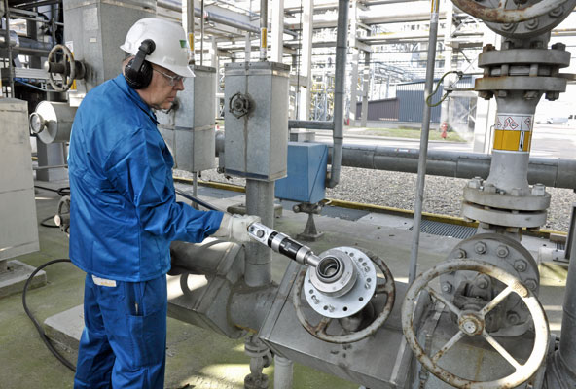
“Current Events”
Performing Tasks: https://netherlocks.com
Power Wrench
Home | Business | Politics | Technology | Living | World

Slide 44
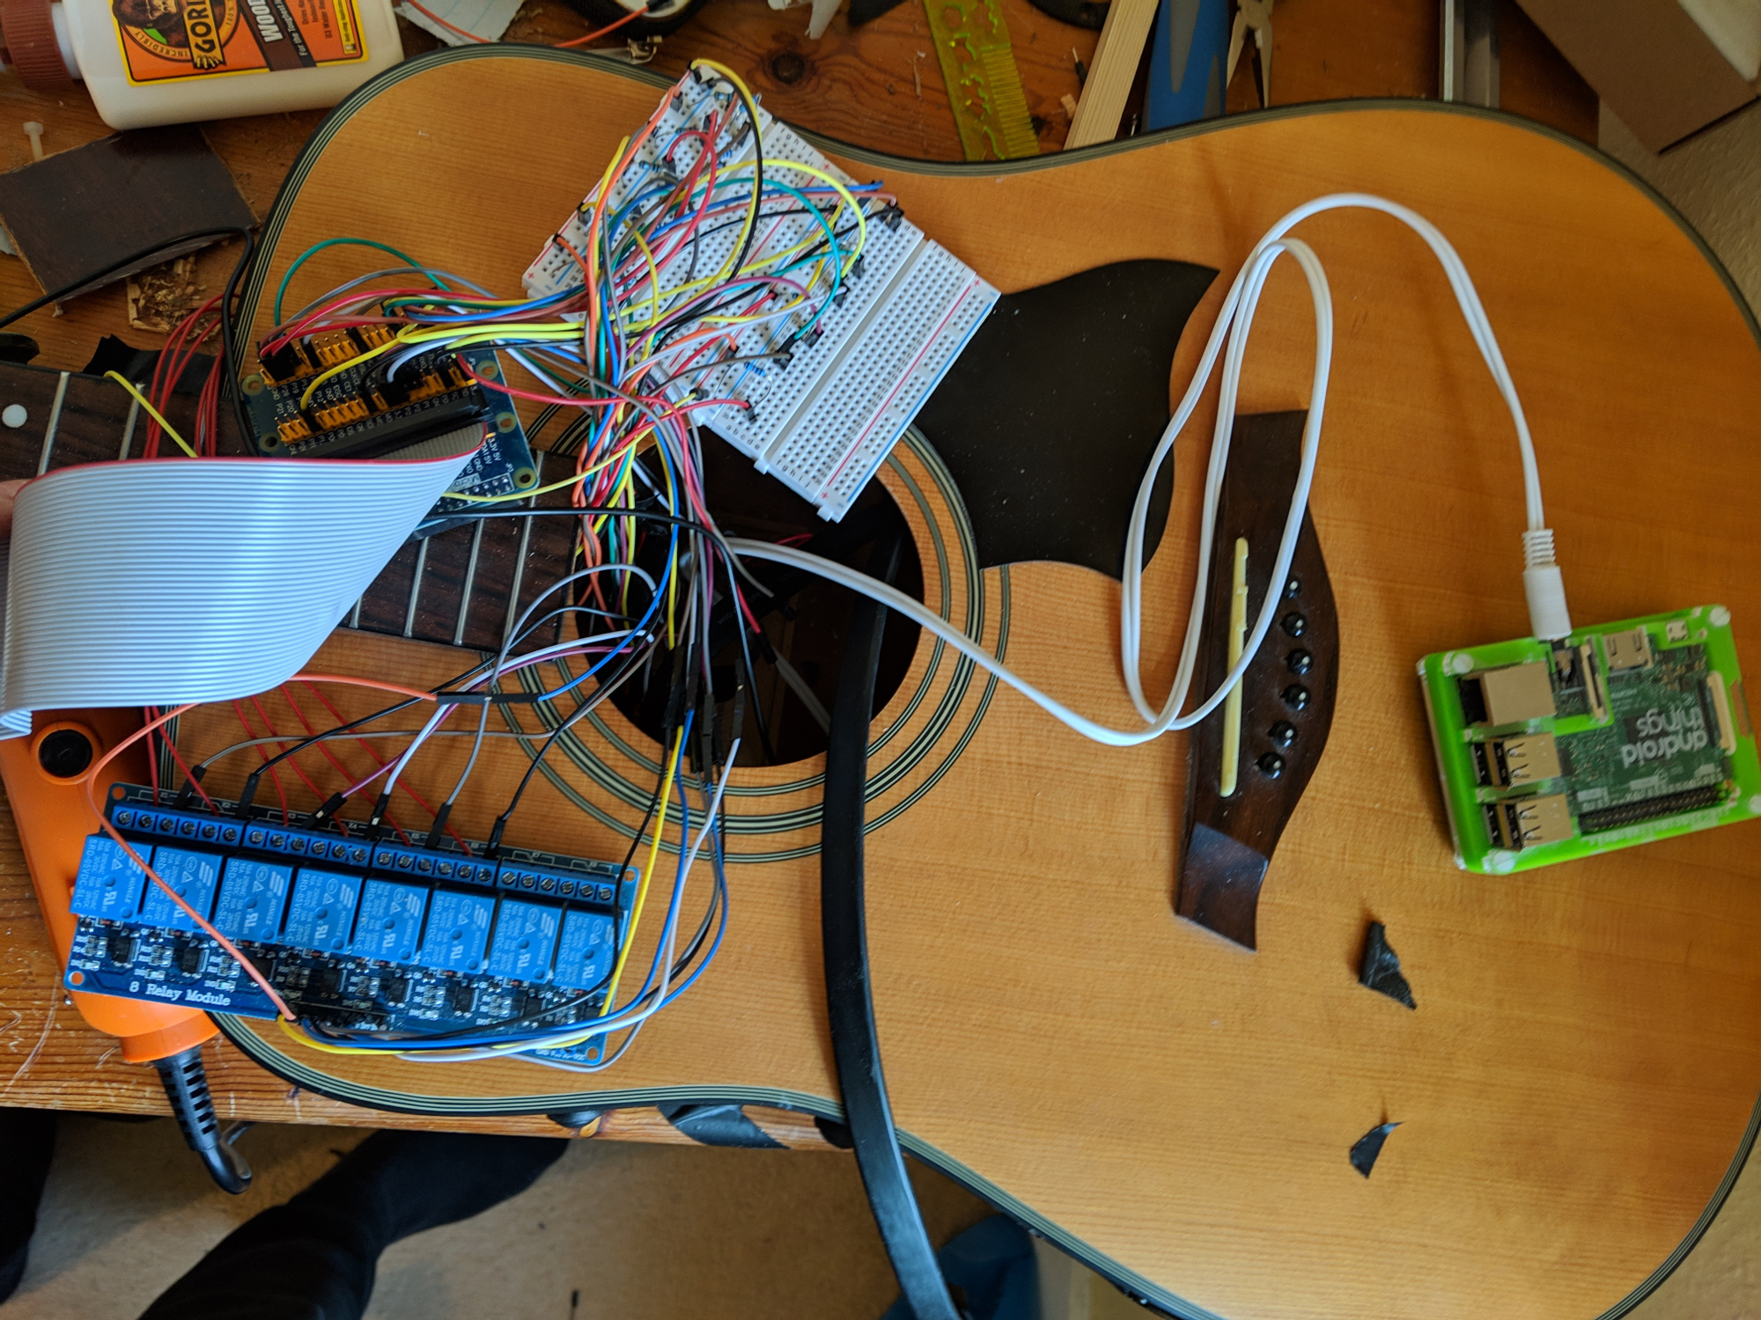
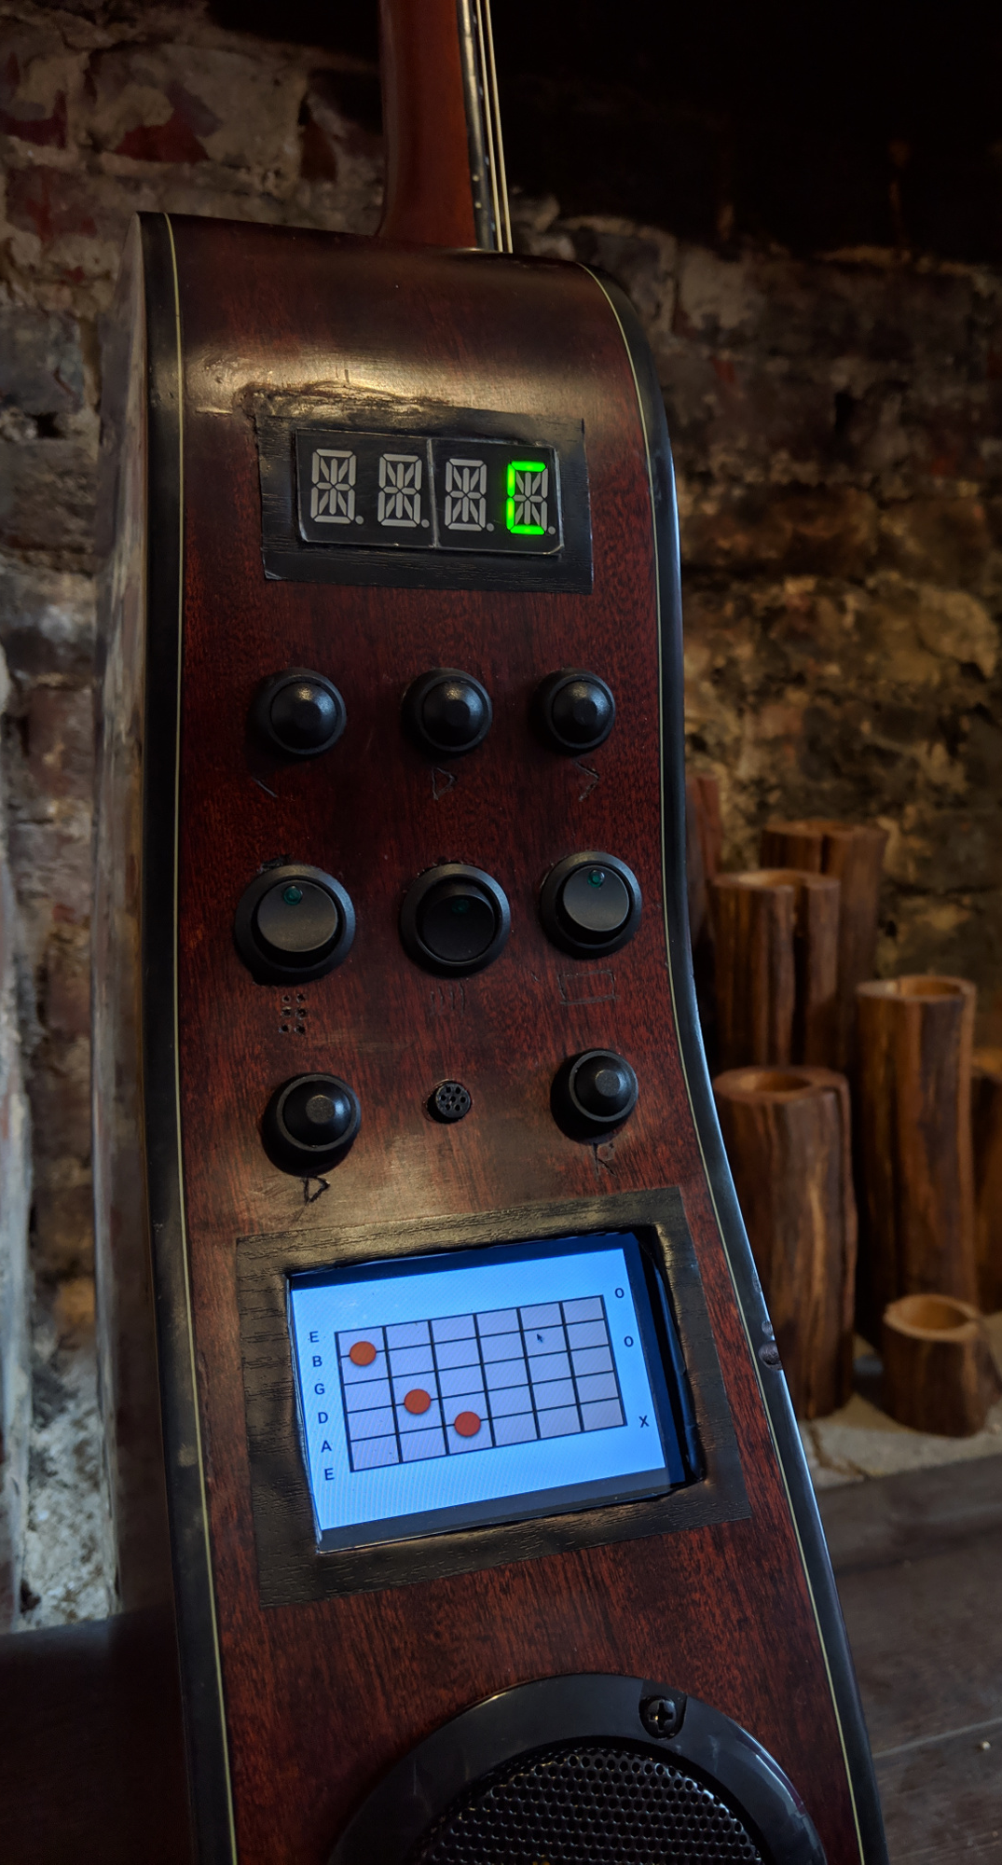
“Current Events”
Performing Tasks: http://www.chordassist.com
Chord Assist
Home | Business | Politics | Technology | Living | World

Slide 45
“Current Events”
Home | Business | Politics | Technology | Living | World
J
A
N
W
I
R
E
Stay Tuned @
AskJAN.org/SOAR

Slide 46
“Current Events”
Home | Business | Politics | Technology | Living | World
Living & Working

Slide 47
“Current Events”
Living & Working
Dealing with Medical Needs
Example: An employee with a mental health impairment must avoid undue stress
Example: An employee with diabetes must eat several small snacks throughout the workday
Example: An employee with epilepsy is having seizures at work
Example: An employee with a sleep disorder can’t sleep
Home | Business | Politics | Technology | Living | World

Slide 48
“Current Events”
Living & Working
Commuting To and From Work
Example: An employee with lupus and fatigue has a long commute
Example: An employee who is blind uses public transportation
Example: An employee with a gastrointestinal disorder has to use the restroom frequently
Home | Business | Politics | Technology | Living | World

Slide 49
“Current Events”
Living & Working
Struggling to Perform Job Functions
Example: An employee with a learning disability has difficulty reading
Example: An employee with cumulative trauma has difficulty typing
Home | Business | Politics | Technology | Living | World

Slide 50
“Current Events”
Living & Working
Temporary Barriers in the Workplace
Example: An employee has chemical sensitivity
Example: An employee who uses a wheelchair
Example: An employee with multiple sclerosis has temperature sensitivity
Home | Business | Politics | Technology | Living | World

Slide 51
“Current Events”
Home | Business | Politics | Technology | Living | World
J
A
N
W
I
R
E
Stay Tuned @
AskJAN.org/new

Slide 52
“Current Events”
Coronavirus
About
History begins in the late 1960s
Coronaviruses include SARS, MERS, and Wohan
Virus named after crown-like appearance of the projections on the surface
Severe acute respiratory syndrome-related coronaviruses discovered in bats
Severe epidemic in Wuhan, China, began December 12, 2019
Spread by airborne droplets of fluid
Can be deadly
Home | Business | Politics | Technology | Living | World

Slide 53
“Current Events”
Coronavirus
ADA
Make decisions based on facts, not speculation
Remember that the ADA medical inquiries rules apply
Rely on information from public health authorities such as WHO and CDC
Home | Business | Politics | Technology | Living | World

Slide 54
“Current Events”
Coronavirus
Accommodations
Modified break schedule
Removal of marginal functions
Flexible scheduling
Leave
Telework
Home | Business | Politics | Technology | Living | World

Slide 55
“Current Events”
Home | Business | Politics | Technology | Living | World
J
A
N
W
I
R
E
Stay Tuned @
AskJAN.org

Slide 56
“Current Events”
Contact
(800)526-7234 (V) & (877)781-9403 (TTY)
AskJAN.org & jan@askjan.org
(304)216-8189 via Text
janconsultants via Skype

