Slide 1
Wearable Round-Up!
Wearables as Assistive Technology for Workplace Accommodations
Teresa Goddard, M.S
Lead Consultant, Sensory Team
Brittany Lambert, M.S., CRC
Consultant, Sensory Teams
Notes:
Brittany

Slide 2
Overview
Overview
Wearable Devices
Applying New Solutions
Problems & Solutions
Time management
Medical management
Stress management
Information access
Communication
Accommodation Trends
Questions
Notes:
Brittany

Slide 3
What is Wearable Technology?
“A wearable device is defined as a monitoring modality that is worn by a user in daily life. It is usually integrated into items used daily (watch, eyeglass, ring, vest, gloves, belt, shirt, brassiere, shoes, necklace, and barrette) as an inseparable component. An individual customized size is usually required. It often moves with the user ubiquitously without any apparent or obtrusive parts.”
-Tamura, T., & Chen, W., Ph. D., (Eds.). (2018). Seamless healthcare monitoring: Advancements in wearable, attachable, and invisible devices. Cham: Springer.
Notes:
Brittany
Reference: Seamless Healthcare Monitoring

Slide 4
What is Wearable Technology?
“An attachable device is defined as a monitoring modality that should be attached onto the body noninvasively or can be touched occasionally by a user intentionally. It is not a necessary item but has an unnoticeable impact on daily life such as a tattoo, pad, pedometer, mobile phone, tablet, and other portable devices. It is usually ‘one-size fits all.’”
-Tamura, T., & Chen, W., Ph. D., (Eds.). (2018). Seamless healthcare monitoring: Advancements in wearable, attachable, and invisible devices. Cham: Springer.
Notes:
Brittany
Reference: Seamless Healthcare Monitoring

Slide 5
A Growing Market
56.7 million adults are predicted to use a wearable device at least once a month in 2019. An additional 3.8 million children and teens will have such a device.
Over 500 million wearable users were connected to 4G network in 2017, while the market is expected to grow by 89 million by 2022 connecting over 900 million.
Notes:
Brittany
Reference 1: https://www.emarketer.com/content/wearables-2019
Reference 2:
https://aithority.com/guest-authors/top-5-wearable-tech-trends-in-2019/

Slide 6
Workplace Needs
Productivity management
Medical management
Stress and symptom management
Information access
Communication
Notes:
Brittany

Slide 7
Smartwatches
Smartwatches have gained great popularity in the last five years. Displaying the time is only one of many functions these devices can perform. Smartwatches provide convenient access to thousands of apps, including those which allow users to increase productivity, track physical and mental status, and engage their surroundings in innovative ways.
Notes:
Teresa

Slide 8
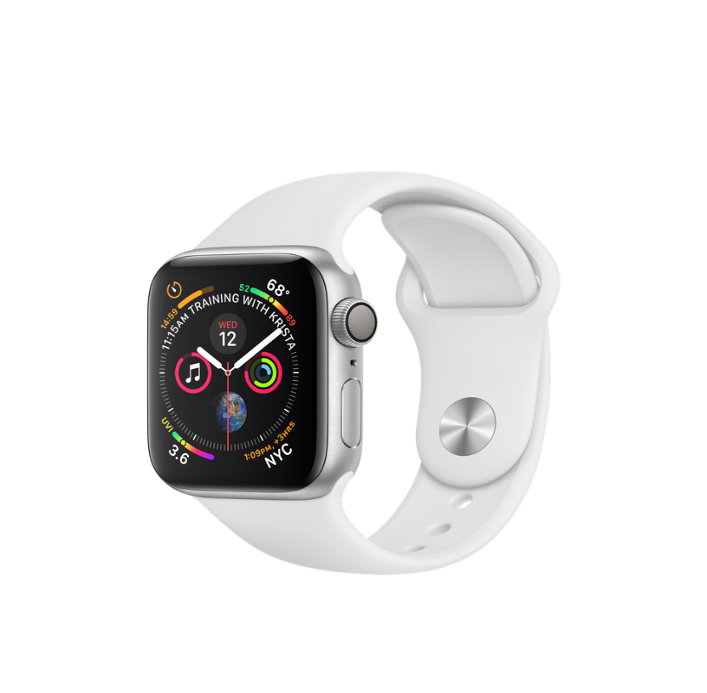
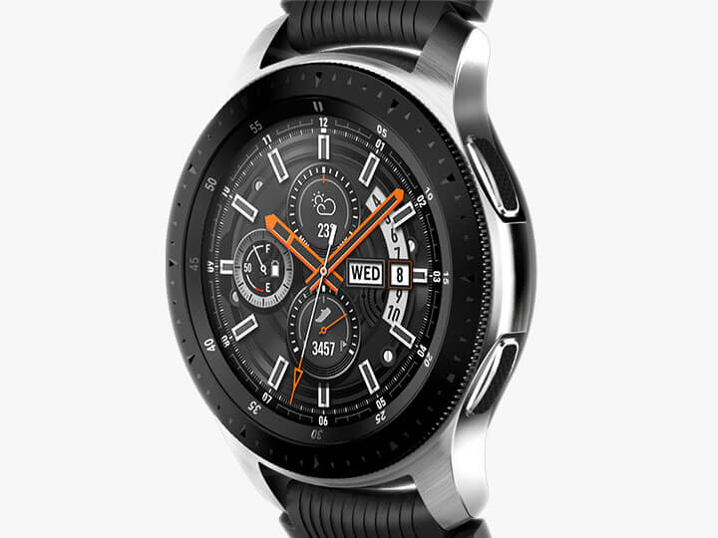
Smartwatches
Smartwatches to use with smartphones
Apple Watch
Android Wear
Samsung Gear
Notes:
Teresa

Slide 9
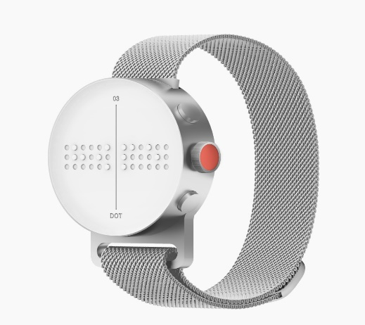
Smartwatches
Braille Watches/Talking Watches
Dot Watch
Notes:
Teresa Current price $399

Slide 10
Productivity Management
Example
A surgeon with attention deficit disorder was having difficulty getting to the operating suite on time.
Notes:
Brittany

Slide 11
Productivity Management
Past Accommodation:
Provide a Timex Datalink Watch programmed reminders of the employee’s surgery times and other appointments.
Newer Approaches:
Alerts delivered through smartphones and smartwatches.
Alerts delivered through a WatchMinder watch.
Notes:
Brittany

Slide 12
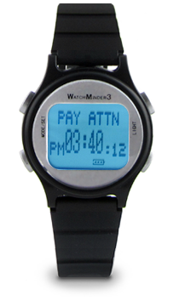
Time Management
Watches and Timers
Watches with alerts
WatchMinder
Time Timer Watch
Notes:
Brittany
Watchminder3 current price $69
Time Timer Watch Plus currently $95

Slide 13
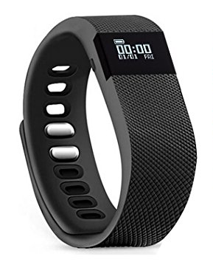
Time Management
Fitness trackers with alerting functions
Fitbit Ionic
Teslasz
Notes:
Brittany
Fitbit Ionic current price $249

Slide 14
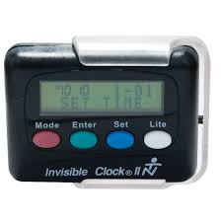
Time Management
Wearable Timers
Invisible Clock II
Notes:
Brittany
Invisible Clock ii current price $39.95

Slide 15
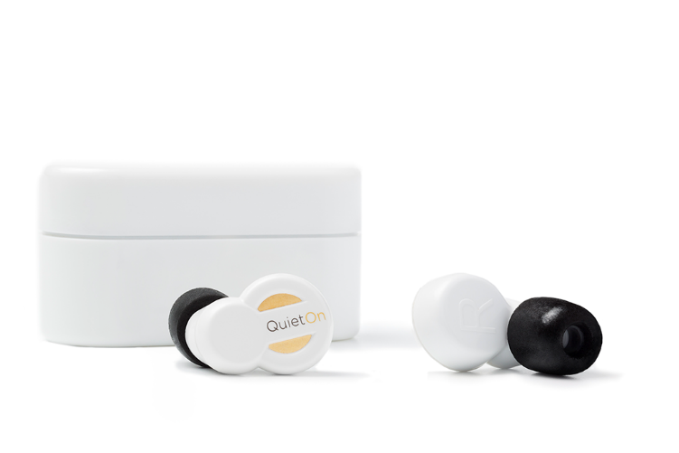
Concentration
Ear Plugs
QuietOn Noise Canceling Earbuds
Bose SoundSport Free wireless headphones
Notes:
Brittany
QuietOn 199,00 €
DUBS listed as unavailable on amazon, no other official shop link

Slide 16
Medical Management
Example
An accountant with narcolepsy had difficulty staying awake during the workday. He often fell asleep unexpectedly at his desk, putting him at risk of violating company policy.
Notes:
Teresa

Slide 17
Medical Management
Past Accommodation:
The employer provided a flexible start time, allowing the employee to begin his shift at a later time.
Newer Approach:
Provide a Doze Alert to detect head movements indicative of sleep.
Notes:
Teresa

Slide 18
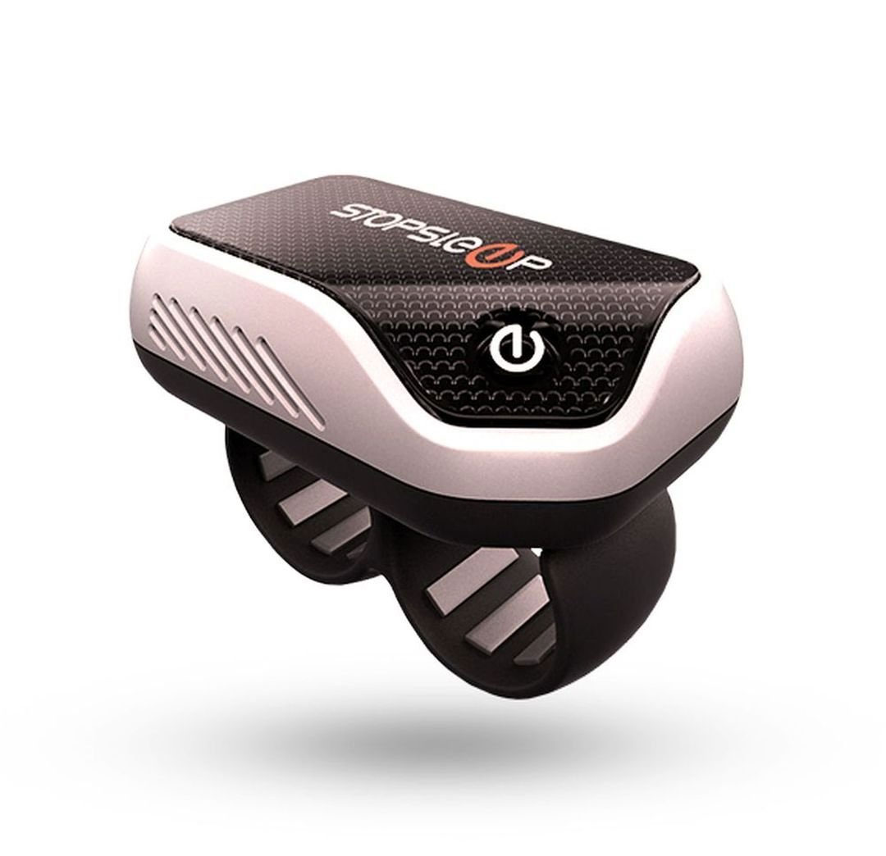
Medical Management
Sleep Detection
Doze Alert
Nozzer Watch
StopSleep
Notes:
TeresaDoze Alert $49.99
Nozzer Watch $112
StopSleep

Slide 19
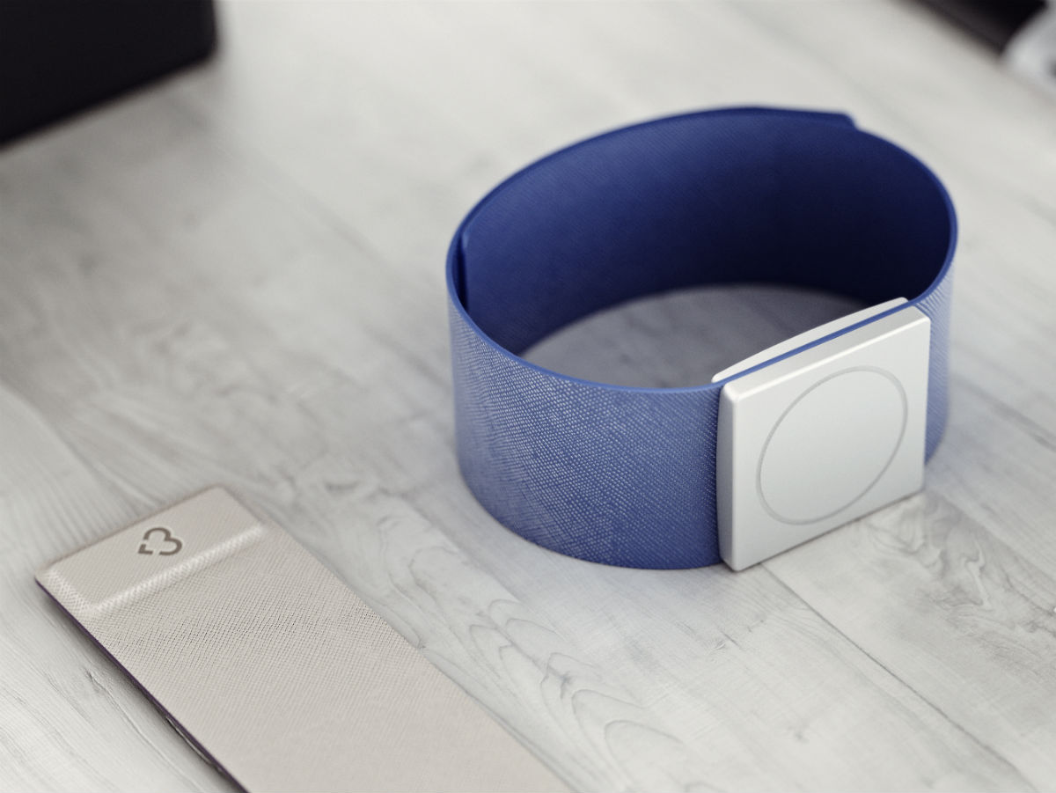
Medical Management
Seizure Detection
Smart Monitor SmartWatch
Embrace Watch
BioLert
Notes:
Teresa

Slide 20
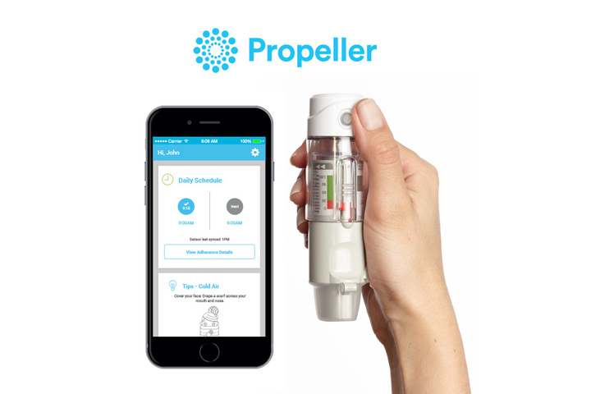
Medical Management
Respiratory Health and Allergen Management
Propeller Health
ViATOM Wearable Oxygen Monitor
Neckworn Air Cleaners
Notes:
Teresa

Slide 21
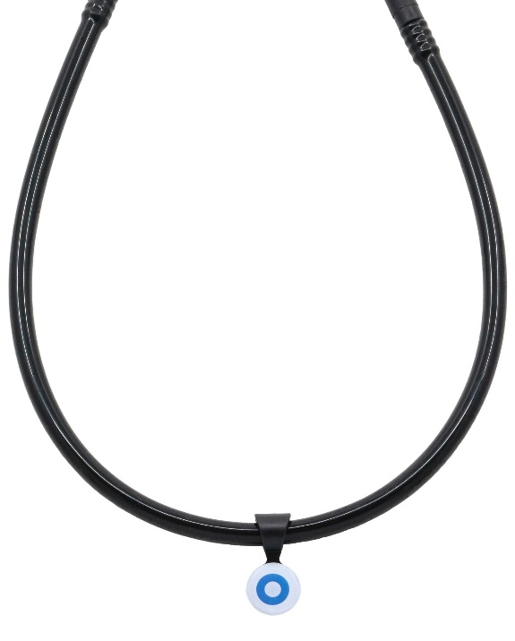
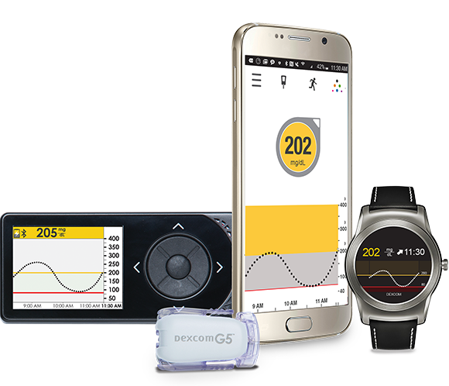
Medical Management
Diabetes Management
Dexcom G5 Mobile Continuous Glucose Monitoring System
Thrive Glucose Gel Medical Alert Necklace
Siren Socks
Notes:
Teresa

Slide 22
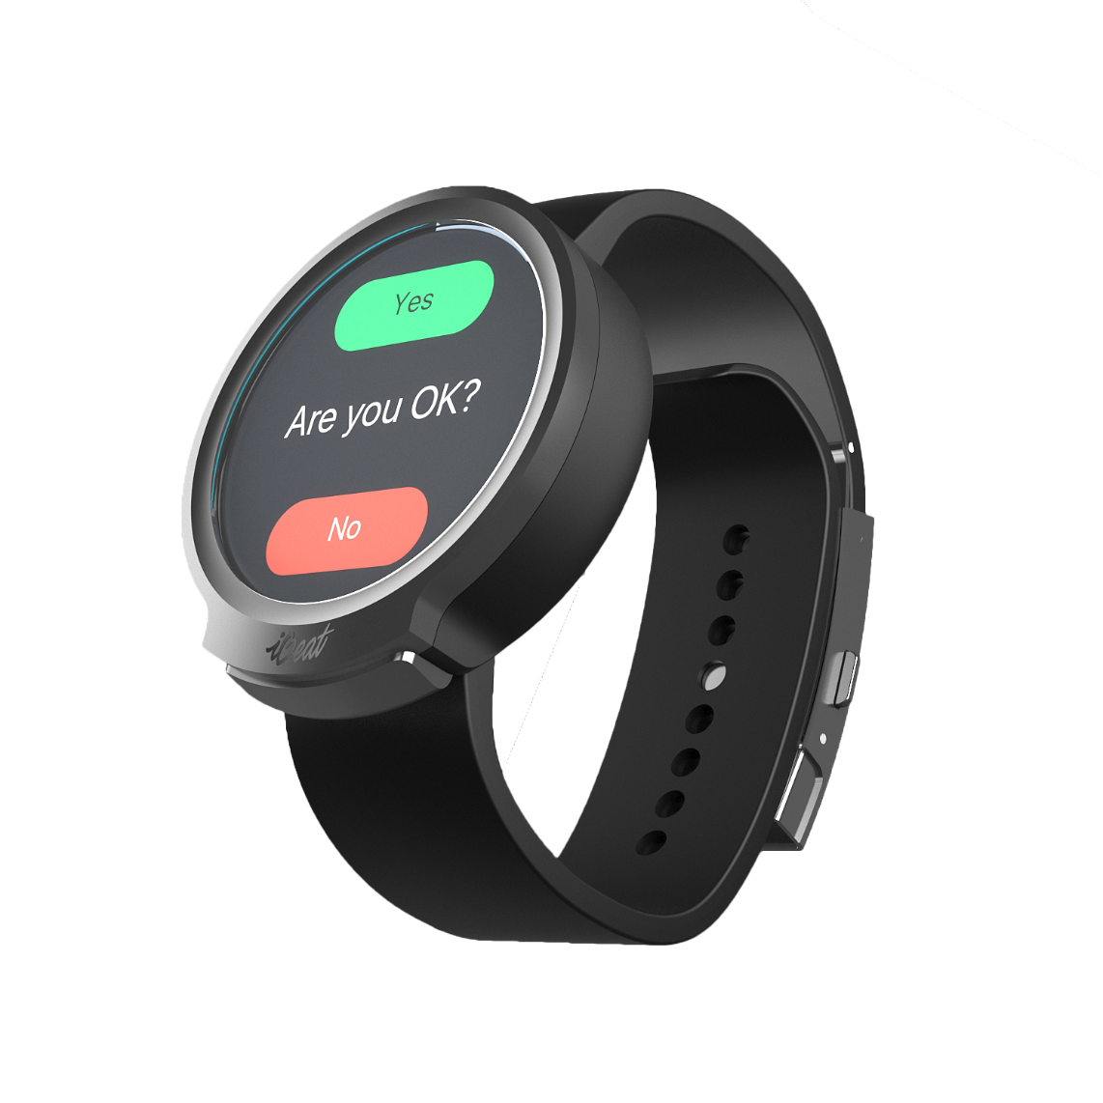
Medical Management
Cardiovascular Health
iBeat
Cardea SOLO
Notes:
Teresa

Slide 23
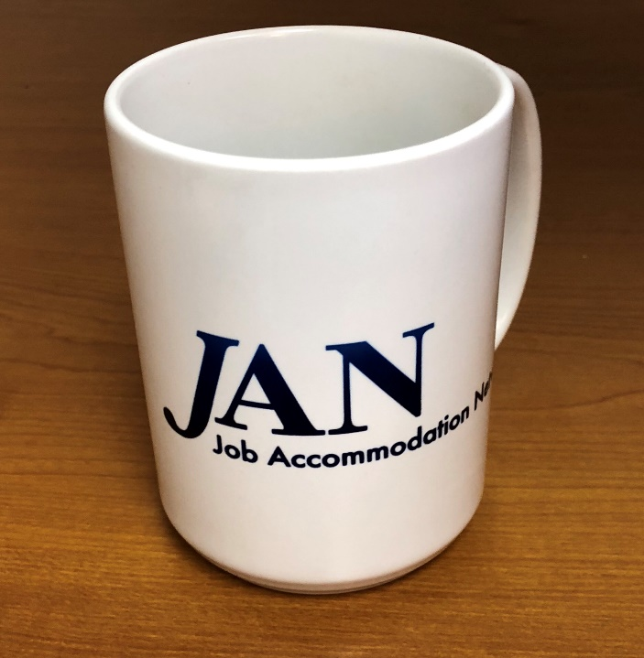
Information Access
Example
A barista was struggling to read product labels due to progressive vision loss.
Notes:
Brittany

Slide 24
Information Access
Past Accommodation
Provide the employee with an i.d. mate talking bar code scanner.
Newer Approach:
Program an OrCam My Eye to recognize products sold in the coffee shop
Notes:
Brittany

Slide 25
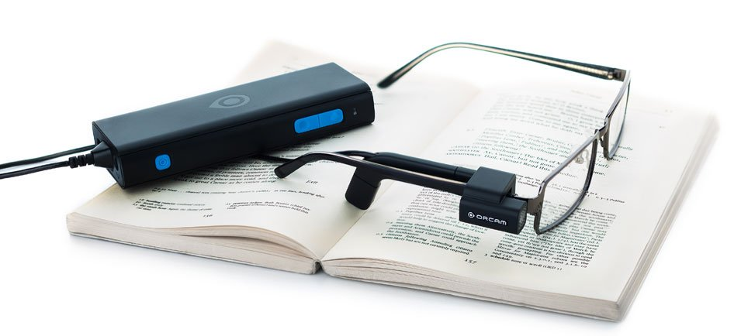
Information Access Solutions
Identification
OrCam MyEye
Aira
WayAround
Oxy-Iso Colorblindness Correction Glasses
BrainPort Vision Pro
Notes:
Brittany

Slide 26
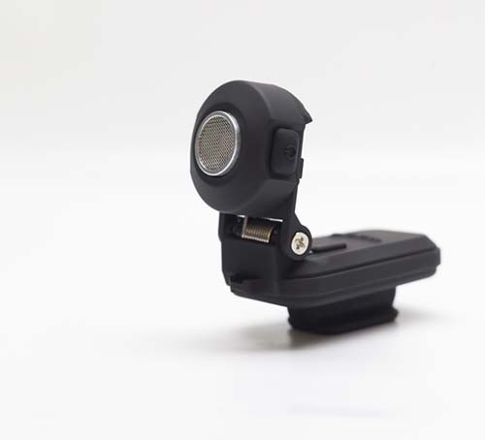
Information Access Solutions
Navigation
Wayband
Lechal
BuzzClip
Notes:
Brittany

Slide 27
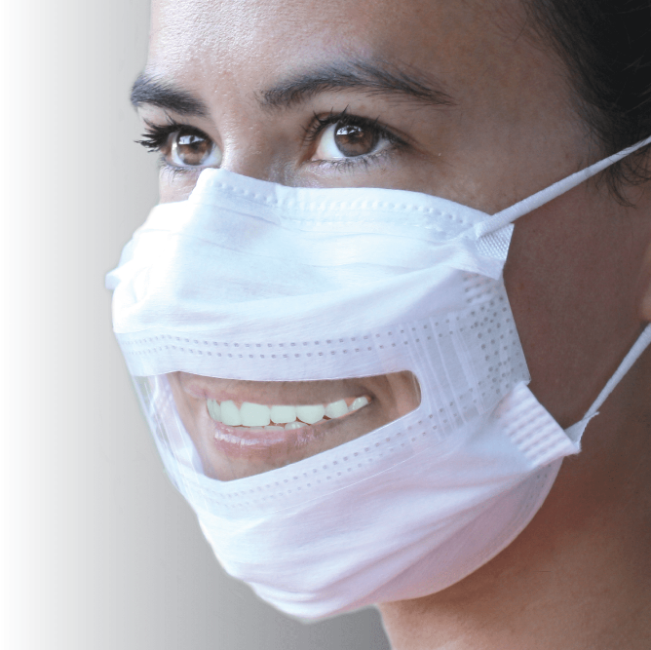
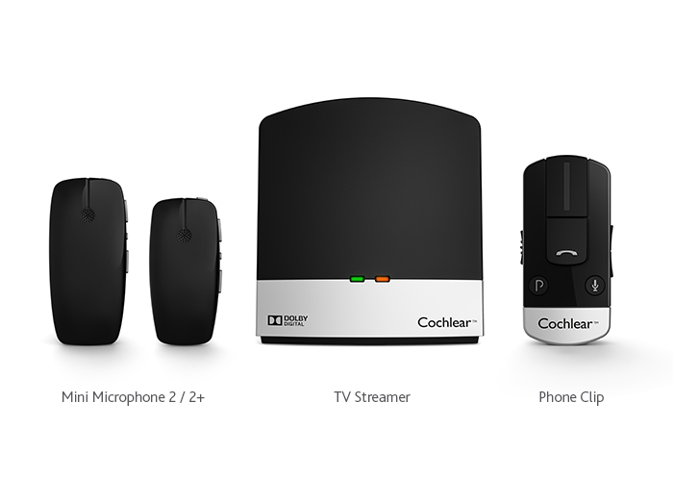
Information Access Solutions
Communication
Assistive Listening Devices
Hearing aids and accessories
Cochlear implants and accessories
Clear Face Masks
Communication Bracelets
Notes:
Brittany

Slide 28
Stress Management
Example
A human resource assistant in the benefits department was having difficulty concentrating due to anxiety and high stress.
Notes:
Teresa

Slide 29
Stress Management
Past Accommodation Ideas:
Modified break schedule, call support person, organization strategies/mentor, noise cancellation/white noise
New Ideas in Addition:
Utilize an app for breathing/meditation (potentially synced to smartwatch)
Wear product to monitor stress
Use app and or smartwatch to set reminders and “check in” on focus
Notes:
Teresa

Slide 30
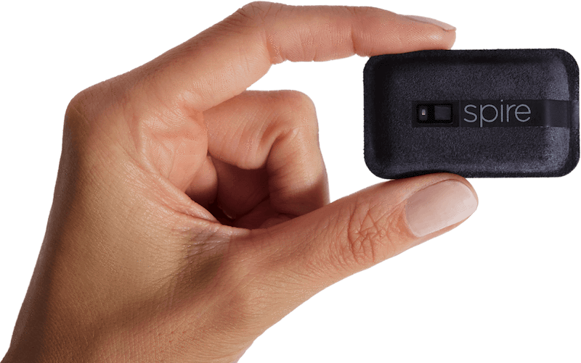
Stress Management
Respiratory Monitoring
Breathewell Wear
Spire Health Tag
Thync
Breathing and Meditation Apps
Notes:
Teresa

Slide 31
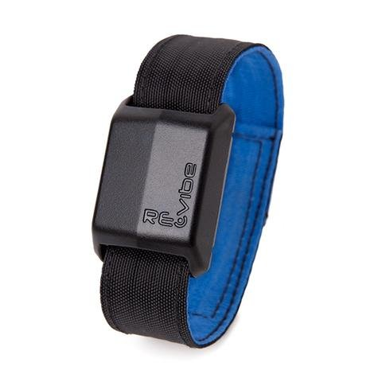
Stress Management
Habit Monitoring
Keen
RE-vibe
Notes:
Teresa

Slide 32
Wearables in the Workplace
Wearable device policies
Mobile devices such as tablets, cellular phones, smartphones, smartwatches, and other wearable devices can be valuable productivity tools when used appropriately. They can also help employees maintain work/life balance, use concentration and relaxation techniques, manage health conditions, and keep in touch with those who support them without tying up office equipment and phone lines.
However, devices can also serve as a distraction or, worse, pose a risk to data. As a result many employers are developing and updating policies on use of personal devices and governing what types of devices and apps can be purchased for employees.
Notes:
Brittany

Slide 33
Wearables in the Workplace
ADA implications for wearable device policies:
Policies must be applied in a nondiscriminatory way
Employers may need to consider policy modification as an accommodation
May need to determine whether the wearable device is a personal use item or an accommodation
May need to be open to an alternate device or accommodation in some settings
Ways to employ wearable devices as workplace accommodations:
Manage time, stress, and medical conditions
Access information needed at work
Meet communication needs
Notes:
Brittany

Slide 34
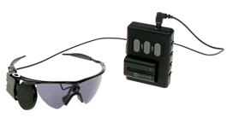
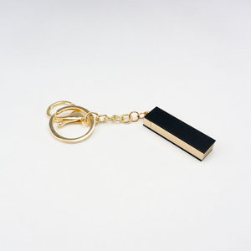
Wearables in Development
Retissa
Ultracortex "Mark IV" EEG Headset
Allergy Amulet
Orion from Second Sight
Tattoo Monitoring
Notes:
Teresa

Slide 35
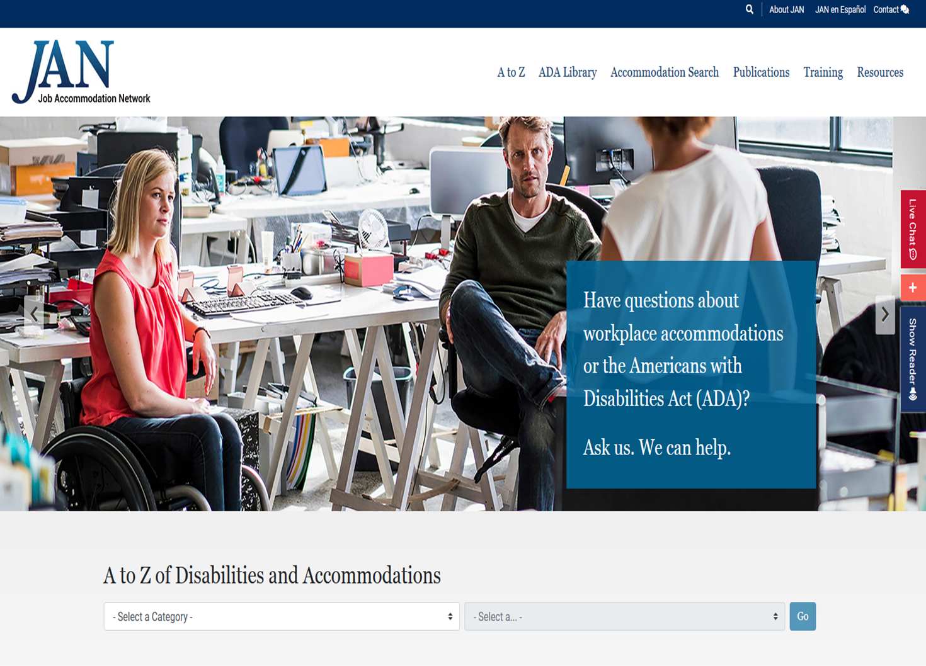
Q&A
Questions? AskJAN.org
Notes:
Teresa

Slide 36
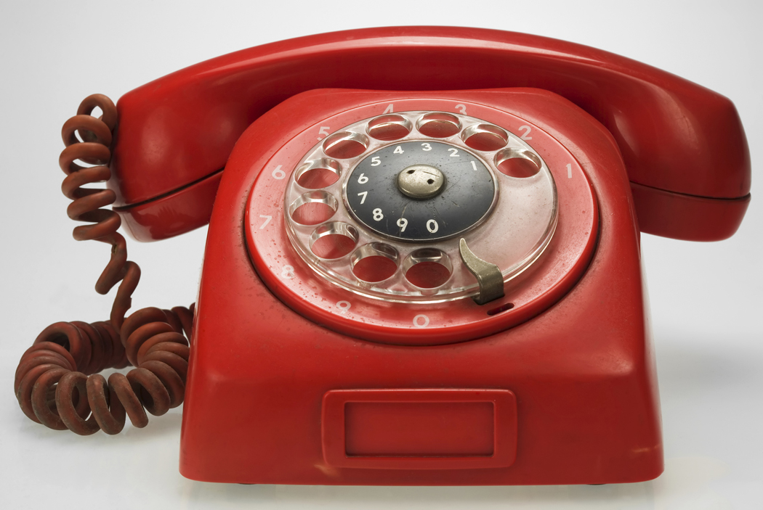
Contact JAN!
JAN Consultants can be reached M-F 9am-6pm ET
Phone - (800) 526-7234 (voice); (877) 781-9403 (TTY)
Email - jan@AskJAN.org
Skype - Janconsultants
Text - (304) 216-8189
Chat available online at http://AskJAN.org
Notes:
Teresa

