Slide 1
Accommodating Motor Impairments in Office, Industrial, and Healthcare Settings
Lisa Mathess
Matthew McCord
(800) 526-7234 (Voice)
(877) 781-9403 (TTY)
jan@askjan.org

Slide 2
Motor Impairments
Conditions can include:
Arthritis
Back Conditions
Cerebral Palsy
Cumulative Trauma Disorders
Carpal Tunnel
Rotator Cuff
Tendonitis
Multiple Sclerosis
Paraplegia

Slide 3
Office Setting
Adjustable Workstations for Office Settings
Desks and tables that are adjustable and allow individuals who use mobility aids to access them. They may also allow an individual to alternate between sitting and standing positions or use various types of chairs to be more comfortable.
Pain
Reaching
Sitting
Standing
Use of Mobility Aids
Addressing Requests for Sit/Stand Workstations at https://askjan.org/publications/consultants-corner/Addressing-Requests-for-Sit-Stand-Workstations.cfm

Slide 4
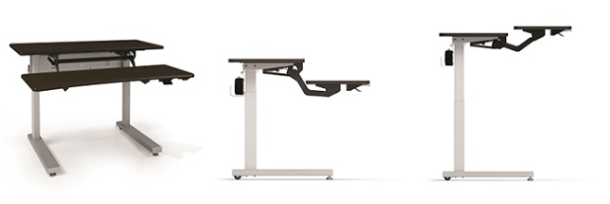
Office Setting
Adjustable Workstations for Office Settings
A secretary who uses a wheelchair due to having paraplegia is unable to access his workstation due to his wheelchair not allowing him to fit under it. He was provided with an adjustable workstation for office settings so that the desk could be adjusted to allow the individual to properly work at his desk.

Slide 5
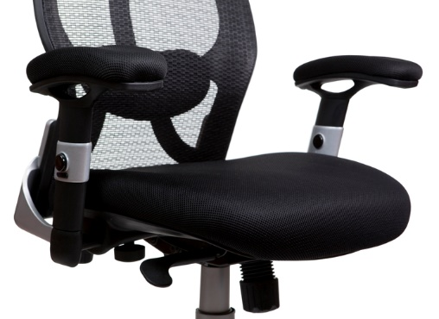
Office Setting
Ergonomic and Adjustable Office Chairs
Backrest, armrest, seat height, and pan angles are features that support neutral sitting positions.
Overall Body Weakness/Strength
Pain
Sitting
Best Practices for Addressing Requests for Ergonomic Chairs at https://askjan.org/publications/consultants-corner/vol12iss05.cfm

Slide 6
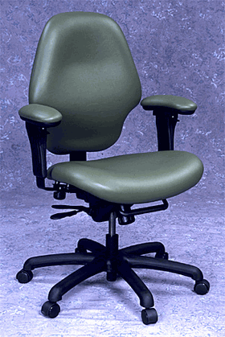
Office Setting
Ergonomic and Adjustable Office Chairs
A courthouse clerk with arthritis
in her back has been needing to
leave work early due to swelling
and pain.
She was provided with an
ergonomic and adjustable
office chair to help provide her
with additional back support.

Slide 7
Office Setting
Speech Recognition Software
Speech recognition software is made for computer users with a variety of limitations, including individuals with no hand or finger movement.
How to Train Your Dragon at https://askjan.org/articles/How-to-Train-Your-Dragon.cfm

Slide 8
Office Setting
Speech Recognition Software
A mental health counselor with
carpal tunnel syndrome was
having difficulty in typing up all
of his case notes.
He was provided with speech
recognition software to allow
him to complete his case notes
without needing to type on a
keyboard.

Slide 9
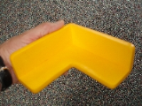
Office Setting
Padded Edging
Soft, protective padding used to cover posts, signs, walls and other surfaces to protect from injury.
Balancing
Dizziness
Seizure activity
Spasm/tremor/tic

Slide 10
Office Setting
Padded Edging
A research assistant with vertigo was concerned about falling and hurting herself by hitting his head on the edges of the tables in her work area. He was provided with padded edging on those tables to reduce the chance of injury.
Is the Room Spinning? Common Accommodations for Vertigo at https://askjan.org/articles/Is-the-Room-Spinning-Common-Accommodations-for-Vertigo.cfm

Slide 11
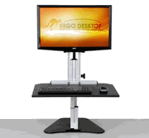
Office Setting
Sit Stand Desks/ Monitor Risers
Monitor risers allow a computer monitor to be adjusted to different heights or to be moved out of the way. Combined with a height adjustable keyboard tray, monitor risers may allow a sit-to stand workstation from a stationary desk.

Slide 12
Office Setting
Sit Stand Desks/ Monitor Risers
A 911 operator with Fibromyalgia was having difficulty with chronic pain when he sat at his desk for extended periods of time. He noted that the pain is best managed by alternating between sitting and standing frequently. He was provided a sit/stand desk to enable him to alternate between sitting and standing as needed.
Fibromyalgia in the Workplace at https://askjan.org/articles/Fibromyalgia-in-the-Workplace.cfm

Slide 13
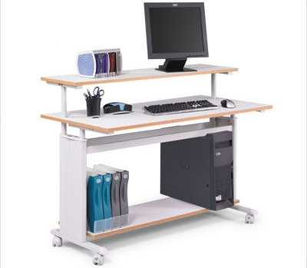
Accommodations - Office
JAN Study Example
A university worker had back surgery. Complications included loss of functionality in one hand, and damage to his larynx resulting in difficulty speaking. The employer called JAN looking for ideas to help the employee with workstation access and communication.

Slide 14
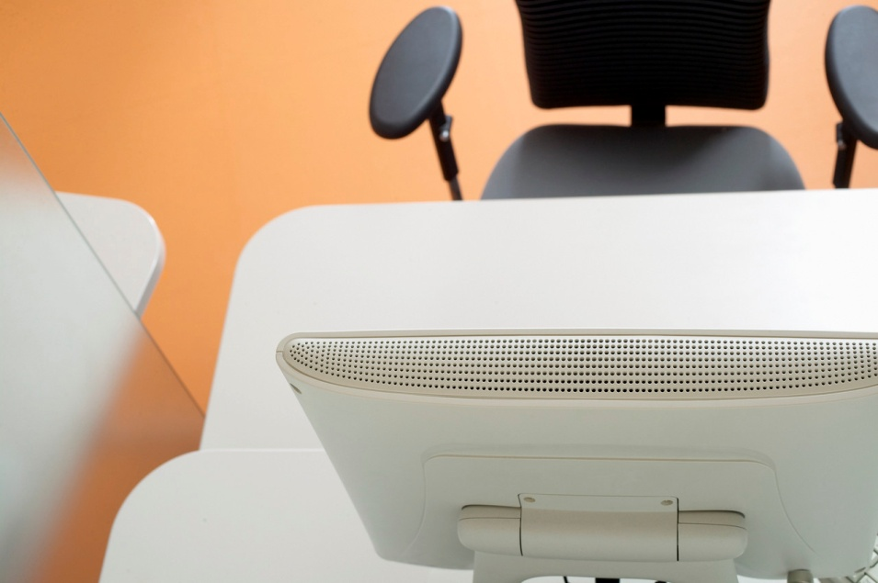
Accommodations - Office
Accommodation:
The employer bought a posture-enhancing keyboard holder, voice amplifier, Dragon software, and an ergonomic chair.

Slide 15
Accommodations - Office
Cost: One-time cost $5,000
Benefit: By making these accommodations, the employer maintained compliance with ADA and made their employee and manager happy.

Slide 16
Accommodations - Office
JAN Study Example
A customer service representative for a financial institution was experiencing vision and back issues secondary to Parkinson’s disease. He called JAN looking for guidance on the accommodation request process and information about assistive technology.

Slide 17
Accommodations - Office
Accommodation:
The employee requested and received a monitor for vision issues and an ergonomic chair for his back.

Slide 18
Accommodations - Office
Cost: $525
Benefit: The accommodations alleviated his symptoms, enabling him to continue working.

Slide 19
Ergonomics
Notes:
JAN offers information on ergonomics in the workplace including publications and resource guides. On this slide we have a screenshot of the JAN accommodation and compliance series on ergonomics in the workplace: a resource guide, which could be used to supplement the information presented in this training. Ergonomic products, including those mentioned in this training, can be found by using JAN’s searchable online accommodation resource or SOAR.

Slide 20
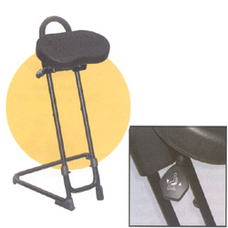
Industrial Setting
Stand Lean Stool
Stand-lean stools allow an individual to adjust his/her positioning, relieve standing strain by leaning, and relieve sitting pressure by leaning.
Decreased Stamina/Fatigue
Overall Body Weakness/Strength
Pain
Sitting
Standing

Slide 21
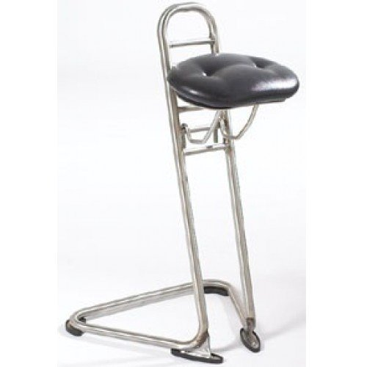
Industrial Setting
Stand/Lean Stool
An employee couldn’t stand due to bursitis in their hips but the job required them to perform restocking tasks while standing. The employer provided them with a stand/lean stool to enable them the reach and accessibility as standing but they weren’t bearing their weight.

Slide 22
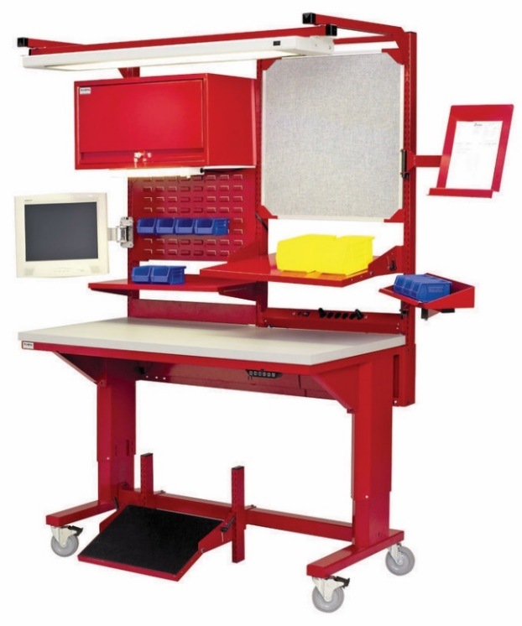
Industrial Setting
Adjustable Workstations- Industrial Settings
Desks and tables that are adjustable allow individuals who use mobility aids, have to alternate between sitting and standing positions, or use various types of chairs to be more comfortable.
Pain
Reaching
Sitting
Standing
Use of Mobility Aids

Slide 23
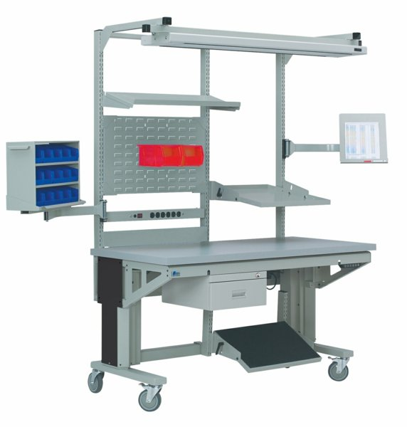
Industrial Setting
Adjustable Workstations- Industrial Settings
A carpenter with a neck injury was having difficulties with the amount of reaching needed to gather his tools from the walls and return them each day. He was provided with an Adjustable Workstation for Industrial Settings to make his tools more accessible and to allow him to keep them all in one place.

Slide 24
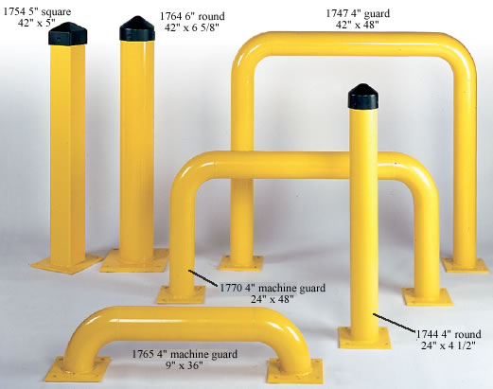
Industrial Setting
Machine Guards and Shields
Describes a variety of safety products used near industrial or manufacturing equipment. Machine guarding may include: safety shields, perimeter guards, quick disconnects, sensor starts, or safety signs.
Balancing
Dizziness
Seizure activity
Spasm/tremor/tic

Slide 25
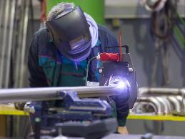
Industrial Setting
Machine Guards and Shields
A heavy equipment operator with epilepsy was concerned about her safety should she have a seizure while working. She was provided with a machine shield to provide a barrier between her and the machinery she operates.
Accommodation and Compliance Series: Employees with Epilepsy/Seizure Disorder at https://askjan.org/publications/Disability-Downloads.cfm?pubid=237364

Slide 26
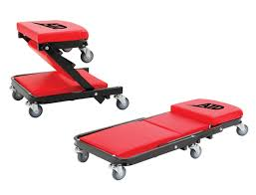
Industrial Setting
Mechanic’s Seats and Creepers
These devices help support those who work in mechanical or industrial environments and must access areas using awkward posture. These devices help support the worker.

Slide 27
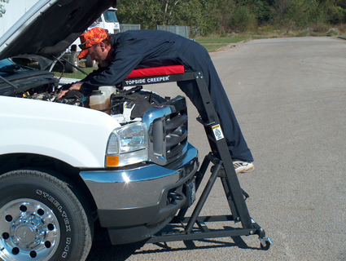
Industrial Setting
Mechanic’s Seats and Creepers
A mechanic with a back injury was experiencing severe pain when working due to needing to lean over the engine block for extended periods of time. He was provided with a mechanic’s creeper to provide support when needing to hold this posture.

Slide 28
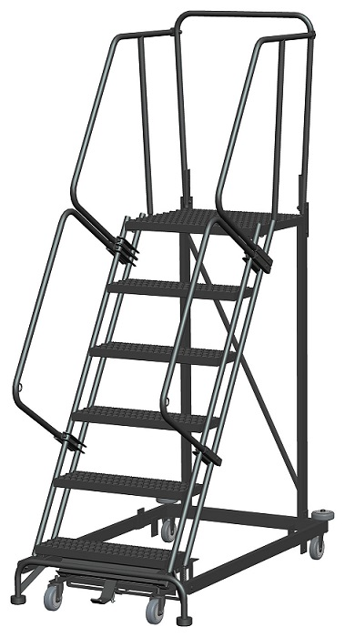
Industrial Setting
Rolling Safety Ladders
Rolling safety ladders are less steep than regular ladders, therefore, easier to climb; other features include handrails and locking casters.
Balancing
Climbing
Lifting
Reaching
Seizure Activity

Slide 29
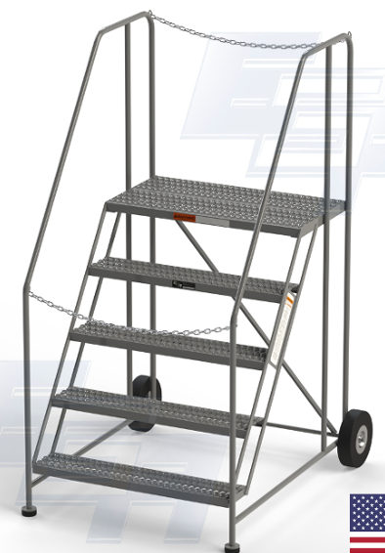
Industrial Setting
Rolling Safety Ladders
An electrician with shoulder injuries couldn’t climb a ladder. He had to reach overhead light fixtures. He was provided a rolling safety ladder to enable him to reach the lights without exacerbating his shoulders.

Slide 30
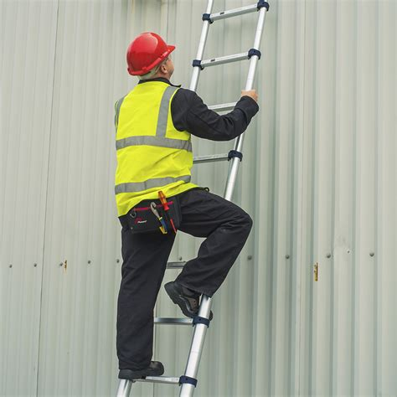
Accommodations - Industrial
JAN Study Example
A mechanic in a plastics manufacturing plant had bending and climbing restrictions due to a knee impairment. His job required that he climb onto machines 6-8 feet high.

Slide 31
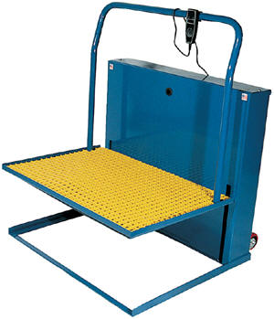
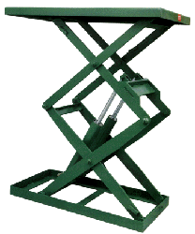
Accommodations - Industrial
Accommodation:
A JAN consultant suggested a portable aerial lifting device.

Slide 32
Accommodations - Industrial
Cost: Not reported
Benefit: The accommodations enabled the employee to continue working while maintaining workplace safety.

Slide 33
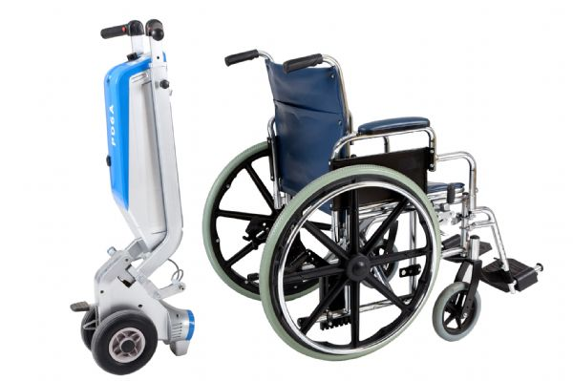
Healthcare Setting
Wheelchair Pushers
Wheelchair pushers assist in pushing, stopping and steering wheelchairs and their riders.
Pushing/Pulling

Slide 34
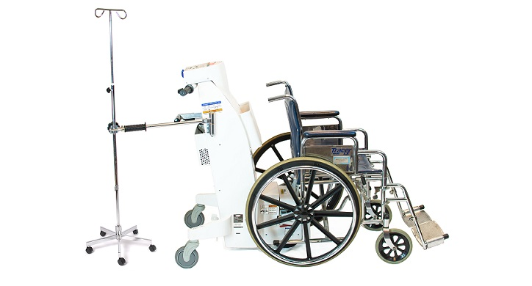
Healthcare Setting
Wheelchair Pushers
A certified nursing assistant with an arm amputation is having difficulty escorting patients in wheelchairs around the hospital due to pushing restrictions. The employer permitted the employee to use a wheelchair pusher to minimize that amount of pushing needed to escort these patients.

Slide 35
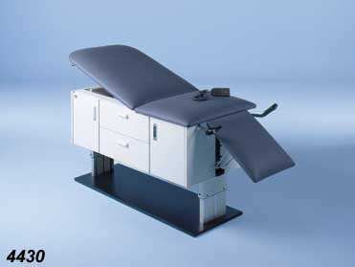
Healthcare Setting
Adjustable Exam Tables
Lifting, transferring, or examining patients can be difficult for individuals with certain impairments. Adjustable exam tables can be raised or lowered to the appropriate height necessary to examine, reposition, or assist patients in healthcare settings.
Bending
Carrying
Lifting

Slide 36
Healthcare Setting
Adjustable Exam Tables
A dental hygienist with osteoporosis was finding it difficult to exam and clean client’s teeth due to the amount of bending required. He was provided with an adjustable exam table so he could adjust the client’s position to reduce the amount of bending needed to do his job.

Slide 37
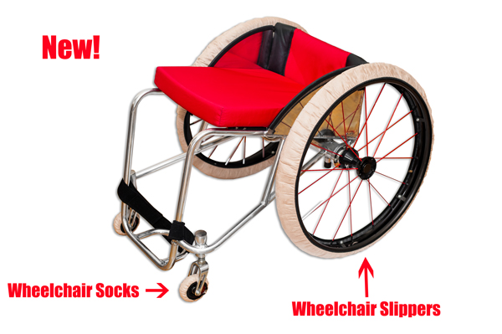
Healthcare Setting
Wheelchair Tire Covers
Cover your tires to keep dirt and germs from being transferred to the floors, and prevent the wheelchair from leaving tire marks on the floor.

Slide 38
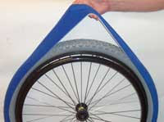
Healthcare Setting
Wheelchair Tire Covers
A surgical technician with quadriplegia was concerned about the use of her wheelchair in the operating room due to the tires potentially compromising the sterile environment. She was provided with wheelchair tire covers to use when in the sterile environment to reduce the chance of contamination.

Slide 39
Healthcare Setting
Power Lift IV Stands
These powered stands provide healthcare workers with hazard-free, ergonomic lifting solutions during procedures. These stands neutralizes bag weight to ease raising and lowering and prevent workplace hazards.
Lifting
Reaching

Slide 40
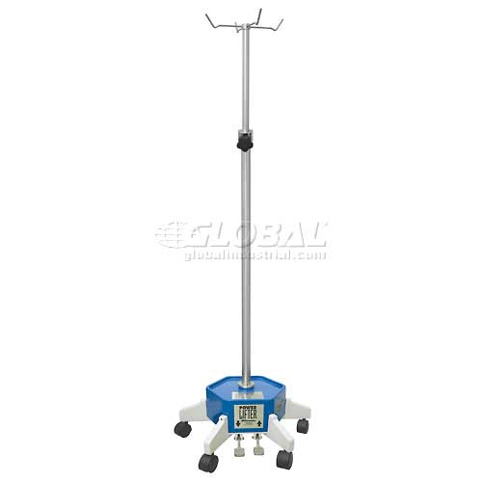
Healthcare Setting
Power Lift IV Stands
A Licensed Practical Nurse with a shoulder injury was having trouble lifting IV bags above chest level.
He was provided with a power lift IV stand to allow him to more easily place the IV bags at their required heights.

Slide 41
Healthcare Setting
Patient Lifts
A variety of products are available to assist health care professionals with lifting, moving, and transferring patients. Portable, ceiling mounted, sling, bedside, and heavy duty options are available.
Carrying
Lifting
Overall Body Weakness/Strength
Pushing/Pulling
Use of One Hand/Arm

Slide 42
Healthcare Setting
Patient Lifts
A certified nursing assistant with a back injury was having difficulty lifting patients when needing to change the linens on their bed. She was permitted to use a patient lift to enable her to change the linens without lifting the patient herself.

Slide 43
Healthcare Setting
Resources:
Healthcare Workers with Motor Impairments at https://askjan.org/blogs/jan/2015/07/healthcare-workers-with-motor-impairments.cfm
Healthcare Workers with Motor Impairments – Part 2 at https://askjan.org/blogs/jan/2015/08/healthcare-workers-with-motor-impairments-part-2.cfm

Slide 44
Accommodations - Healthcare
JAN Study Example
A pharmacist was having difficulties standing for eight hours a day on a tile floor.

Slide 45
Accommodations - Healthcare
Accommodation:
The work area was carpeted using extra padding, which assisted in reducing fatigue, and a sit/stand stool was purchased to assist the employee when standing. Employee was also permitted to take frequent rest breaks throughout the day, so another pharmacist was available to cover his breaks.

Slide 46
Accommodations - Healthcare
Cost: Approximate cost $2,500.
Benefit: The pharmacist could continue working without exacerbating his medical condition.

Slide 47
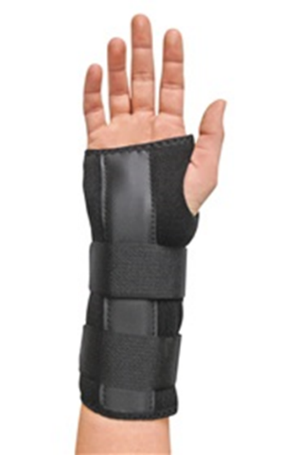
Accommodations - Healthcare
JAN Study Example
A nursing student with essential tremors wore a wrist brace to help to steady her hand. After she entered her clinicals, the nursing faculty became concerned about the brace and transmission of bacteria/infections from the brace to her glove and to the patients. The student covered the brace with a hospital gown but they did not think this offered adequate protection. The school called JAN looking for alternatives.

Slide 48
Accommodations - Healthcare
Accommodation:
A JAN consultant discussed the use of a disposable sleeve protector and provided information on a variety of options ranging from basic plastic covers to sterile surgical sleeve protectors. Noted that the hospital may already have some in stock that could be tried. JAN also referred to exceptionalnurse.com as a resource for the student.

Slide 49
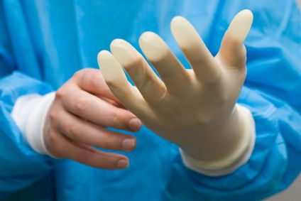
Accommodations - Healthcare
Cost: Not reported
Benefit: Caller felt better prepared for upcoming meetings regarding the student.

Slide 50
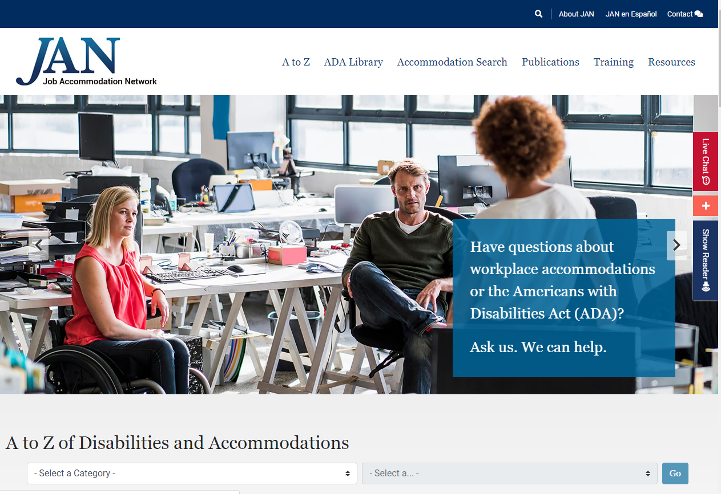
Questions? AskJAN.org

