Slide 1
Creating Inclusion at Northrup Grumman Corporation
The Career of Bob Vetere
With Lou Orslene, MSW, MPIA, CPDM
JAN Co-Director
Orslene@jan.wvu.edu

Slide 2
Bob and Jabot

Slide 3
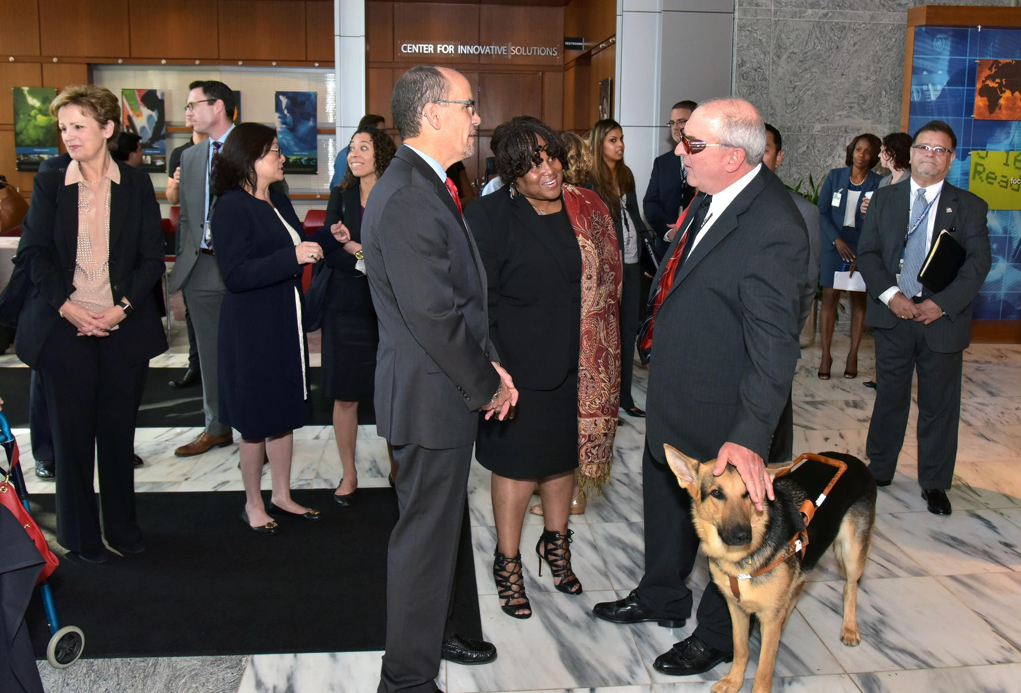
Discussion of NGC Disability Initiatives

Slide 4
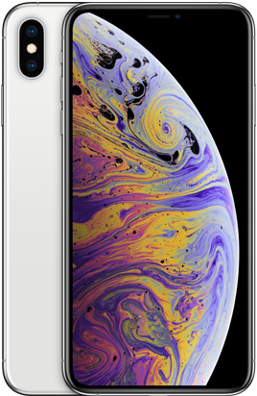
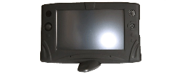
Workplace Technologies

Slide 5
Questions?

