Slide 1
J
A
N
W
I
R
E
“Current Events” in Accommodation
Linda Carter Batiste, J.D., Principal Consultant
Beth Loy, Ph.D., Principal Consultant

Slide 2
“Current Events”
From JAN: Numbers
47,000+ contacts per year
50% electronic
18 million+ Webpage requests per year
Home | Business | Politics | Technology | Living | World

Slide 3
“Current Events”
From JAN: Solution Videos
Smartpens
Speech Recognition Software
Telephone Amplification
Coming Soon
Alternative Mice
CART
iPad
Windows
https://AskJAN.org/events/Trainings.cfm
Home | Business | Politics | Technology | Living | World

Slide 4
“Current Events”
From JAN: Just-in-Time Training Videos
Interviewing an applicant with autism
Managing an accommodation request
Managing an accommodation that surfaces during a performance review
Retaining an individual with a chronic health condition
Communicating with someone with a speech impairment
Returning an injured employee to work
https://www.youtube.com/JANinformation
Home | Business | Politics | Technology | Living | World

Slide 5
“Current Events”
Home | Business | Politics | Technology | Living | World
J
A
N
W
I
R
E
Stay Tuned @
AskJAN.org

Slide 6
“Current Events”
Costs / Benefits:
4 Surveys
Employer
Professional
Self / Individual
Self-Employment
Home | Business | Politics | Technology | Living | World

Slide 7
“Current Events”
Employer Follow-up Study
1,182 employers interviewed between January, 2004, and December, 2006
1,205 employers interviewed between June 28, 2008, and July 31, 2018
Total of 2,387 Employers
Home | Business | Politics | Technology | Living | World

Slide 8
“Current Events”
Finding: Employers want to provide accommodations so they can retain valued and qualified employees.
Home | Business | Politics | Technology | Living | World

Slide 9
“Current Events”
Results
Of the employers who called JAN for accommodation information and solutions, most were doing so to retain or promote (83%) a current employee.
On average (including those persons who had just been given a job offer or who were newly hired), the employees had been with the company about seven years, with an average wage of about $14 for those paid by the hour, or an average annual salary of about $51,400.
In addition, the individuals tended to be fairly well-educated, with 55% having a college degree or higher.
Home | Business | Politics | Technology | Living | World

Slide 10
“Current Events”
Situation: An insurance specialist with post-traumatic stress disorder had difficulty handling stress and controlling his emotions. The employee’s physician stated that these limitations were due to his mental health impairment and the side effects of his diabetes. His job performance and attendance were declining.
Solution: As a reasonable accommodation, the employer allowed the employee to use a service animal.
Reported Benefit: By making this accommodation the company was able to retain a well-qualified employee.
Reported Cost: $0.
Home | Business | Politics | Technology | Living | World

Slide 11
“Current Events”
Finding: Most employers report no cost or low cost for accommodating employees with disabilities.
Home | Business | Politics | Technology | Living | World

Slide 12
“Current Events”
Results
Over half of accommodations (59%) were made at no cost.
Of the 36% who experienced a one-time cost to make an accommodation, the typical cost of accommodating an employee was $500.
Only 25 (3%) said the accommodation resulted in an ongoing, annual cost to the company and 9 (1%) said the accommodation required a combination of one-time and annual costs.
Home | Business | Politics | Technology | Living | World

Slide 13
“Current Events”
Situation: A quality control manager had trouble sitting for long periods of time due to chronic pain.
Solution: As a reasonable accommodation, the employer purchased a sit/stand workstation.
Reported Benefit: The employer stated that the accommodation allowed the employee to increase her productivity.
Reported Cost: $500.
Home | Business | Politics | Technology | Living | World

Slide 14
“Current Events”
Finding: Employers report accommodations are effective.
Home | Business | Politics | Technology | Living | World

Slide 15
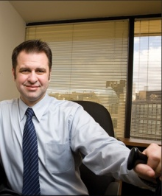
“Current Events”
Results
Of those responding, 75% reported the accommodations were either very effective or extremely effective.
Home | Business | Politics | Technology | Living | World

Slide 16
“Current Events”
Situation: A bank employee with fragrance sensitivity was having problems working due to irritants such as perfume and candles. She experienced nausea and migraines. Solution: As a reasonable accommodation, the agency made changes to its policy regarding the use of fragranced items. The employer also purchased an air purifier and provided all employees with education packets.
Reported Benefit: The employer reported that the accommodation was extremely effective because the "employee is able to work without worrying about getting sick from strong fragrances and odors."
Reported Cost: $200
Home | Business | Politics | Technology | Living | World

Slide 17
“Current Events”
The study results consistently showed that the benefits employers receive from making workplace accommodations far outweigh the low cost.
Home | Business | Politics | Technology | Living | World

Slide 18
“Current Events”
Home | Business | Politics | Technology | Living | World
J
A
N
W
I
R
E
Stay Tuned @
AskJAN.org/topics
/costs.cfm

Slide 19
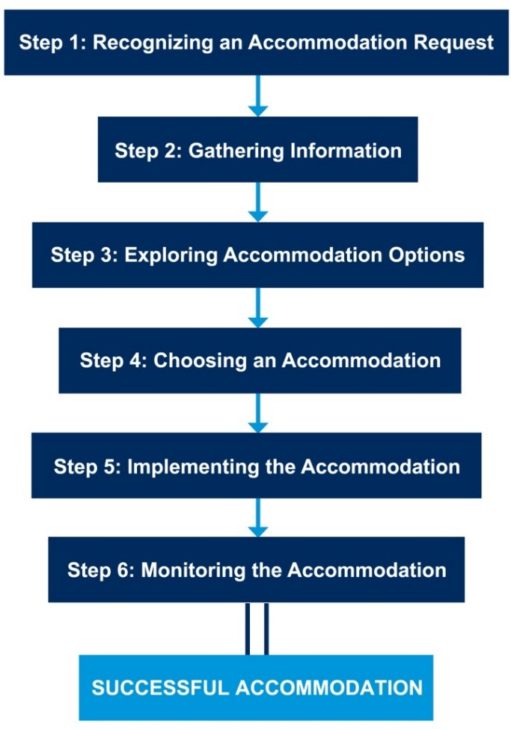
“Current Events”
Politics: Interactive Process, Breakdowns and Tips
Home | Business | Politics | Technology | Living | World

Slide 20
“Current Events”
Step 1: The Accommodation Request
Breakdown: Not recognizing the request
Tip: Medical condition + Causing a workplace problem = Accommodation request
Home | Business | Politics | Technology | Living | World

Slide 21
“Current Events”
Step 1: The Accommodation Request
Breakdown: Making an ambiguous request
Tip: Make a written request + Mention the ADA = Clarity and evidence
Home | Business | Politics | Technology | Living | World

Slide 22
“Current Events”
Step 2: Gathering Information
Breakdown: Asking for information that isn’t necessary
Tip: Think about what you need + Communicate with employee = Get just what you need
Home | Business | Politics | Technology | Living | World

Slide 23
“Current Events”
Step 2: Gathering Information
Breakdown: Not providing reasonable medical documentation
Tip: Ask questions + Show willingness to cooperate = Provide useful information
Home | Business | Politics | Technology | Living | World

Slide 24
“Current Events”
Step 3: Exploring Accommodation Options
Breakdown: Not considering options
Tip: Talk to employee + Use resources = Effective options
Home | Business | Politics | Technology | Living | World

Slide 25
“Current Events”
Step 3: Exploring Accommodation Options
Breakdown: Not considering options
Tip: Talk to employer + Use resources = Effective options
Home | Business | Politics | Technology | Living | World

Slide 26
“Current Events”
Step 4: Choosing an Accommodation
Breakdown: Not choosing an effective option
Tip: Know what’s effective + Consider employee’s preference = Effective option
Home | Business | Politics | Technology | Living | World

Slide 27
“Current Events”
Step 4: Choosing an Accommodation
Breakdown: Not being willing to accept another accommodation
Tip: Discuss alternative accommodations + Be flexible = Effective option
Home | Business | Politics | Technology | Living | World

Slide 28
“Current Events”
Step 5: Implementing the Accommodation
Breakdown: Incomplete implementation
Tip: Communicate + Make sure it works = Effective implementation
Home | Business | Politics | Technology | Living | World

Slide 29
“Current Events”
Step 5: Implementing the Accommodation
Breakdown: Not communicating
Tip: Communicate + Offer to educate = Effective implementation
Home | Business | Politics | Technology | Living | World

Slide 30
“Current Events”
Step 6: Monitoring the Accommodation
Breakdown: Accommodation stops working
Tip: Communicate!
Home | Business | Politics | Technology | Living | World

Slide 31
“Current Events”
Step 6: Monitoring the Accommodation
Breakdown: Accommodation stops working
Tip: Communicate!
Home | Business | Politics | Technology | Living | World

Slide 32
“Current Events”
Home | Business | Politics | Technology | Living | World
J
A
N
W
I
R
E
Stay Tuned @
AskJAN.org

Slide 33
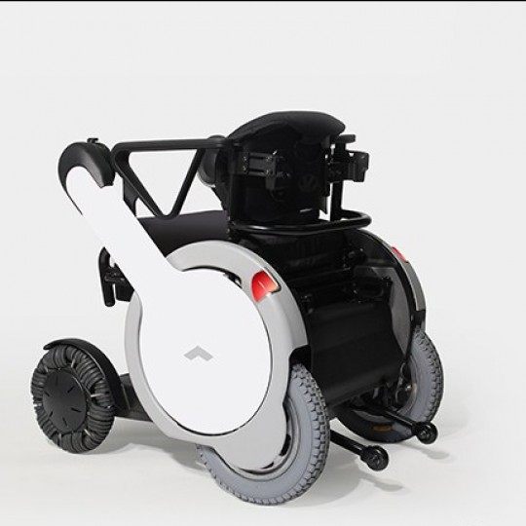
“Current Events”
Activities of Daily Living: http://whill.com
Model M Wheelchair
Home | Business | Politics | Technology | Living | World

Slide 34
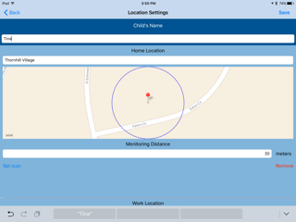
“Current Events”
Performing Tasks: http://clemsonlife.org
TaskAnalysisLife
Home | Business | Politics | Technology | Living | World

Slide 35
“Current Events”
Performing Tasks: https://instantpot.com
Instant Pot IP-Smart Bluetooth-Enabled Multifunctional Pressure Cooker
Home | Business | Politics | Technology | Living | World

Slide 36
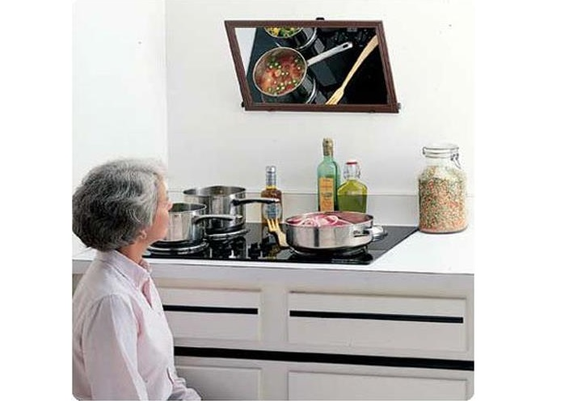
“Current Events”
Performing Tasks: http://soar.askjan.org/
Over-Stove Mirror
Home | Business | Politics | Technology | Living | World

Slide 37
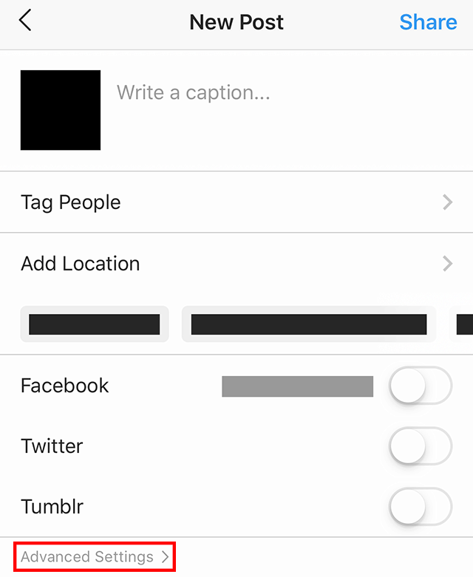
“Current Events”
Accessing Information: http://www.blitab.com
Instagram
Home | Business | Politics | Technology | Living | World

Slide 38
“Current Events”
Accessing Information: https://www.tactonom
Tactonom
Home | Business | Politics | Technology | Living | World

Slide 39
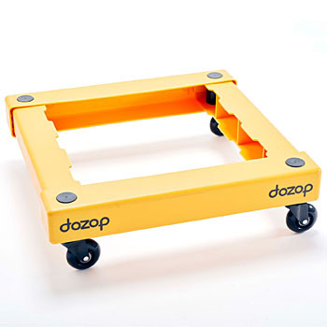
“Current Events”
Performing Tasks: https://dozop.com
Dozop
Home | Business | Politics | Technology | Living | World

Slide 40
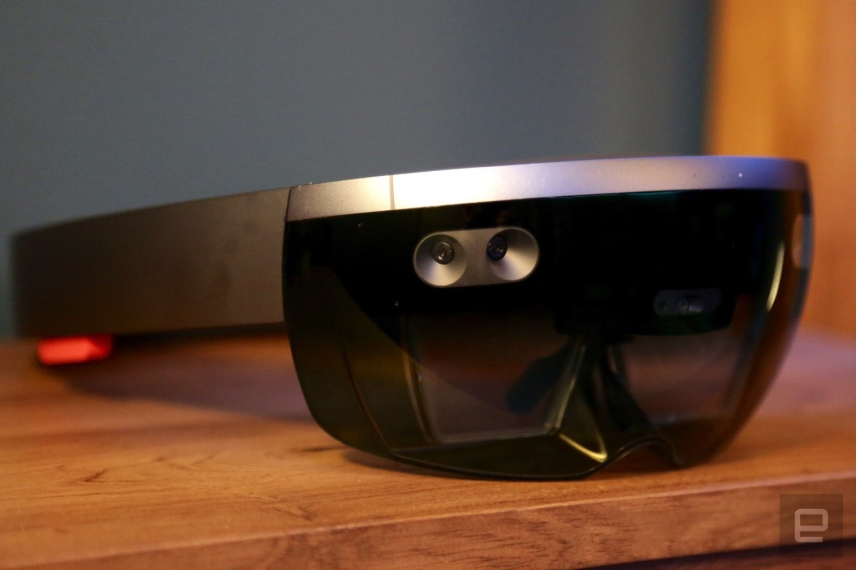
“Current Events”
Performing Tasks: https://www.Caltech.edu
Cognitive Augmented Reality Assistant (CARA)
Microsoft’s HoloLens
Home | Business | Politics | Technology | Living | World

Slide 41
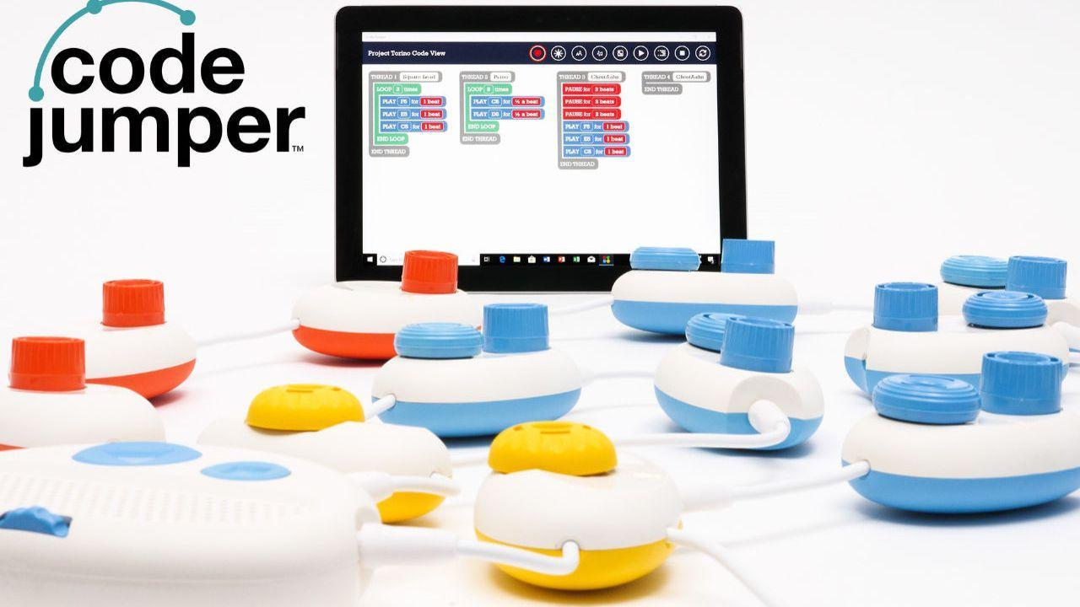
“Current Events”
Performing Tasks: http://www.microsoft.com
Code Jumper
American Printing House for the Blind
Home | Business | Politics | Technology | Living | World

Slide 42
“Current Events”
Home | Business | Politics | Technology | Living | World
J
A
N
W
I
R
E
Stay Tuned @
AskJAN.org/SOAR

Slide 43
“Current Events”
Living: Disability and Conduct
Home | Business | Politics | Technology | Living | World

Slide 44
“Current Events”
Living: Disability and Conduct
Employers can have and enforce conduct rules, but
Rules must be job-related and consistent with business necessity
Home | Business | Politics | Technology | Living | World

Slide 45
“Current Events”
Living: Disability and Conduct
Example: Employee with Tourette Syndrome
Must consider:
Symptoms
Job
Work environment
Home | Business | Politics | Technology | Living | World

Slide 46
“Current Events”
Living: Disability and Conduct
Rules that are approached on a case-by-case basis:
Dress codes
No animal policies
Leave policies
Schedules
No food and drinks at
the workstation
Probationary periods
Home | Business | Politics | Technology | Living | World

Slide 47
“Current Events”
Living: Disability and Conduct
Rules that are always job-related and consistent with business necessity:
Violence, threats of violence, stealing, or destruction of property
Insubordination
Disrespect toward clients and customers
Inappropriate behavior between coworkers
Inappropriate or offensive e-mails
Inappropriate use of the internet
Excessive use of the employer’s computers for purposes unrelated to work
Drinking alcohol or illegal use of drugs in the workplace
Home | Business | Politics | Technology | Living | World

Slide 48
“Current Events”
Home | Business | Politics | Technology | Living | World
J
A
N
W
I
R
E
Stay Tuned @
AskJAN.org/new

Slide 49
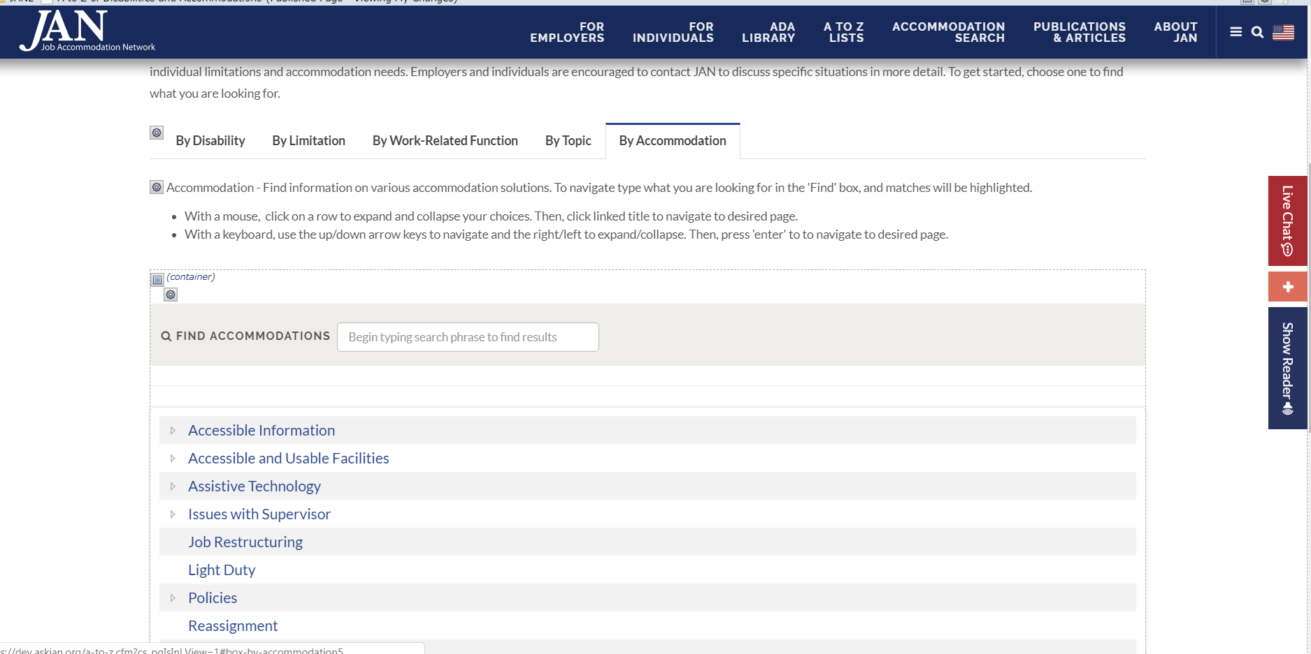
“Current Events”
AskJAN.org
Home | Business | Politics | Technology | Living | World

Slide 50
“Current Events”
Home | Business | Politics | Technology | Living | World
J
A
N
W
I
R
E
Stay Tuned @
AskJAN.org

Slide 51
“Current Events”
Contact
(800)526-7234 (V) & (877)781-9403 (TTY)
AskJAN.org & jan@askjan.org
(304)216-8189 via Text
janconsultants via Skype

