Slide 1
Hiring an Individual with Anxiety Disorder and Mild Stutter
October 1, 2017

Slide 2
Accommodation Primer
The basis for inclusive employment is the reasonable accommodation (RA) policy and process
The foundation for reasonable accommodation is a robust interactive process (IP)
The trigger for RA and IP is a request for an accommodation or recognition of an obvious barrier to someone with a known disability
A request for accommodation includes two essential elements — a medical condition and a related challenge at work

Slide 3
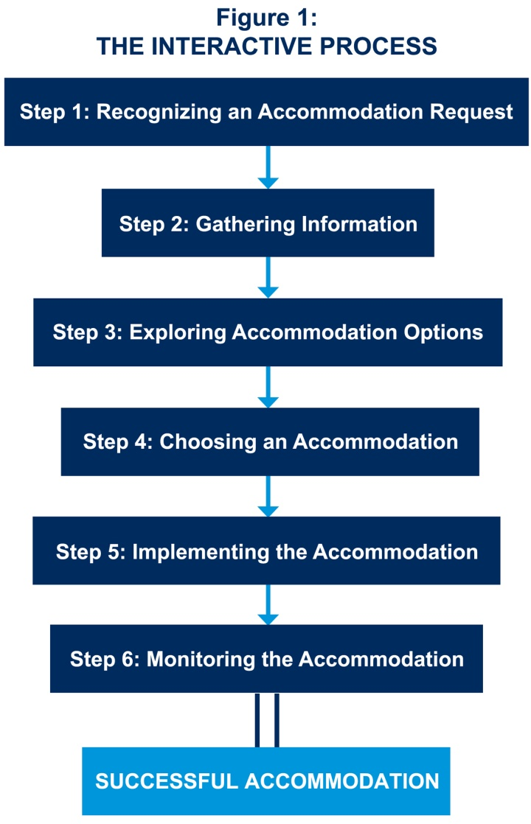
JAN’s Interactive Process
For tips about the process, go to: http://AskJAN.org/media/eaps/interactiveprocessEAP.doc

Slide 4
General Hiring Strategies for Inclusion
Ensure that application forms, application tracking systems, employment offices, and interviewing locations are universally accessible
Ensure that application and interviewing procedures comply with the Americans with Disabilities Act (ADA)
Inform applicants about the hiring process and how to request reasonable accommodation (RA)
“If you require reasonable accommodation in completing this application, interviewing, completing any pre-employment testing, or otherwise participating in the employee selection process, please direct your inquiries to…”

Slide 5
General Hiring Strategies for Inclusion
Make appropriate and reasonable accommodations for the hiring process.
For example:
Modify application policies and procedures
Provide materials in accessible formats
Modify interview methods
Provide a reader or interpreter
Provide equipment
Modify tests or training materials
Allow access for service or emotional support dog

Slide 6
Questions to Consider
When an applicant has an obvious impairment or voluntarily discloses disability or need for accommodation during hiring, consider the following:
How does information about medical impairment impact the hiring process?
Is there a reasonable belief that medical impairment/limitations will affect job performance?
Can a specific candidate be asked to demonstrate or describe how s/he would perform job duties?

Slide 7
Practices to Avoid
Surprises — avoid them by informing all in advance of accommodation processes
Neglecting to include EO/RA statement on career portal
Undervaluing the importance of partnering with skilled resources (e.g., CSAVR, NTID, Lime Connect, Bender, Sierra Group)
Not partnering with WRP, Emerging Leaders, EntryPoint!
Neglecting to recruit through disability-focused job banks (e.g., Ability Jobs, Gettinghired.com, America’s Job Exchange)
Failing to train recruiters and hiring managers on disability awareness, disability disclosure, and how to engage in the interactive process (IP)
Not having an expedited procurement process for application/onboarding accommodations
Notes:
EO – Equal Opportunity
RA – Reasonable Accommodation
CSAVR – Council on State Administrators of Vocational Rehabilitation - http://www.rehabnetwork.org/
NTID – National Technical Institute for the Deaf - http://www.ntid.rit.edu/
Lime Connect - http://www.limeconnect.com/
Bender Consulting Services, Inc. - http://www.benderconsult.com/
Sierra group - http://www.thesierragroup.com/
WRP - Workforce Recruitment Program - https://wrp.gov
Emerging Leaders - http://www.viscardicenter.org/nbdc/emerging-leaders/
EntryPoint! - https://www.aaas.org/program/entrypoint

Slide 8
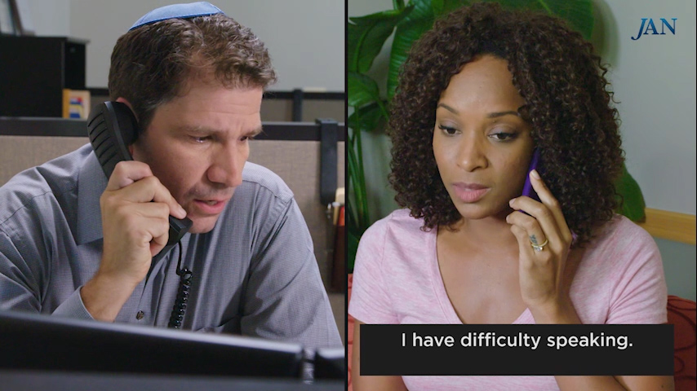
Toolkit Training Videos

Slide 9
Hiring Best Practices
Be mindful that disability is not always apparent
Inform all applicants how to request reasonable accommodation for hiring
Train recruiters to recognize accommodation request to understand their role and to know what to do next, i.e., reach out to Accommodation Specialist
Encourage recruiters to listen and clarify during conversations
Think outside the box — people can communicate in various ways

Slide 10
Hiring Best Practices
Examine the job description and consult with manager to ensure understanding of essential tasks
Get management buy-in first, then align the process
Ensure managers are supported by Human Resources, Employer Relations, Medical Management, and/or Diversity &Inclusion
Develop interview questions to be used for all candidates
Encourage a robust exchange with the candidate or new hire to clearly understand challenges and ideas for overcoming challenges

Slide 11
Hiring Best Practices
Focus on the job. Hiring manager asks, “I need to understand what you need to do to make you successful,” not “Tell me about your speaking problem”
Use resources such as JAN so managers can share the responsibility with the individual with a disability to suggest accommodation
Check with individual before implementing any ideas to ensure the candidate/employee is comfortable with the idea
If candidate/employees request, allow them to educate coworkers (e.g. when the person starts work or during NDEAM)
Notes:
NDEAM – National Disability Employment Awareness Month

Slide 12
Hiring Best Practices
Keep disability- and accommodation-related information confidential
Let applicants/candidates know who to contact if there is a need for a modification at work due to a personal reason, so the issue can be addressed privately
Made a business decision for personal reasons and do not discuss applicants’/candidates’ personal information with others

Slide 13
Accommodation Resources
Accommodation Ideas for Individuals with Anxiety Disorder
https://AskJAN.org/media/anxi.htm
Accommodation Ideas for Individuals with a Stuttering Disorder
https://AskJAN.org/media/stut.htm
For other disabilities and medical conditions, go to https://AskJAN.org/links/atoz.htm

Slide 14
Contact JAN
(800) 526-7234 (V) - (877) 781-9403 (TTY)
AskJAN.org
jan@AskJAN.org
(304) 216-8189 via Text
janconsultants via Skype

