Slide 1
Accommodation Solutions for Employees with Intellectual Disabilities
Melanie Whetzel, Principal Consultant, MA, CBIS, Cognitive/Neurological Team

Slide 2
Ask JAN! we can Help
Job Accommodation Network (JAN) was established in 1983
National, free consulting service
Funded by the U.S. Department of Labor’s Office of Disability Employment Policy/ODEP
Notes:
JAN was established in 1983 as a national, free consulting service - provided by the U.S. Department of Labor’s Office of Disability Employment Policy/ODEP -
that provides expert, trusted, and confidential guidance on job accommodations and Title I of the Americans with Disabilities Act (ADA) and related legislation.
We have a small staff of about 30 people, mostly located in Morgantown, WV. Our main office is located off campus at West Virginia University (WVU).
Next slide

Slide 3
Your Partner in the Accommodation Process
Practical guidance and technical assistance for employers, people with disabilities, and others on:
Accommodation process strategies
Job accommodation solutions
Title I of the ADA and related legislation
Self-employment and entrepreneurship options for people with disabilities
Notes:
JAN serves customers across the United States and has been doing so for 40 years. JAN provides free one-on-one practical guidance and technical assistance on job accommodation solutions, Title I of the Americans with Disabilities Act (ADA) and related legislation, and self-employment and entrepreneurship options for people with disabilities.
Services include consultation on job accommodation solutions, Title I of the Americans with Disabilities Act (ADA) and related legislation, information and referral, and disseminating hundreds of published JAN technical assistance resources to assist in the interactive accommodation process.
JAN is your partner in the accommodation process! We also maintain your confidentiality and don’t share your information with anyone.
JAN consultants are highly qualified and experienced thought leaders and innovators on disability employment issues. They come from various professional backgrounds (e.g., rehabilitation counseling, social work, ergonomics, education, legal, etc.). Most serve as a member of a specialty team: ADA, Cognitive/Neurological, Motor, Sensory, and Self-Employment. In addition to providing expert consultation, some consulting staff design and deliver customized training, speak nationally on ADA and job accommodation issues, and create JAN resources.
Employers, legal, HR, and rehabilitation professionals may access JAN services by telephone, live chat, and email. Others are encouraged to explore the AskJAN.org site and submit inquiries via email at JAN@askjan.org.
By providing trusted guidance on the employment provisions of the ADA and practical accommodation solutions, JAN helps cultivate disability inclusive workplaces where people feel welcome and where they are seen, valued, and appreciated for their contributions at work.
Next slide

Slide 4
Who can benefit from JAN Services?
Notes:
Who can benefit from JAN Services?
Anyone may contact JAN for assistance. Our primary customers are private employers of all sizes and federal, state, and local government agencies, but we also assist employee representatives, and service providers, as well as people with disabilities and their families.
JAN helps employers:
Hire, retain, and promote qualified employees with disabilities;
Recognize why hiring people with disabilities makes good business sense;
Learn about workplace accommodation options and practical solutions;
Comply with title I of the ADA
At AskJAN.org, you will find information for:
Employers and their representatives seeking guidance on practical ways to engage in the interactive process, provide job accommodation solutions, and comply with Title I of the ADA;
Individuals with medical conditions and disabilities seeking information about job accommodation solutions, employment rights under the ADA, and self-employment and entrepreneurship opportunities; and
Family members and rehabilitation, medical, educational, and other professionals in their effort to support successful employment outcomes for individuals with medical conditions and disabilities.
[Next few slides are examples of resources found on Er and IND pages at AskJAN]
Next slide

Slide 5
ASKJAN.ORG
5
Notes:
JAN offers an extensive website – AskJAN.org – that makes it easy to find the accommodation and ADA information you need.
You’ll find information by:
For Employers and Individuals – pages designed to provide targeted information for these customers
A to Z of disabilities, limitations, accommodations, topics, etc.
You can also directly access ADA regulations, technical assistance, and Equal Employment Opportunity Commission (EEOC) guidance via our ADA Library.
Throughout the site, you’ll find hundreds of informative JAN resources on accommodation and ADA topics, and referrals to relevant equipment, services, and organizations.

Slide 6
Reasonable Accommodations
6
Modifications or Changes:
to a job application process
to the work environment or to the manner in which the position is customarily performed that enable a qualified individual with a disability to perform the essential functions of the position
that enable an employee with a disability to enjoy equal benefits and privileges of employment as are enjoyed by other similarly situated employees without disabilities

Slide 7
DISCLOSURE
7

Slide 8
What is disclosure?
Disclosure is when you give out specific, personal information about your disability.
Important to provide:
The nature of the disability
The limitations, or how the disability affects your capacity to learn and/or perform the job effectively
Accommodations you will need in order to do the job

Slide 9
Why Disclose?
9
To ask for job accommodations
To receive benefits or privileges of employment
To explain an unusual circumstance

Slide 10
Situation: Asking for a Reasonable Accommodation
10
A production worker had difficulty grasping a plastic bottle to accurately apply an adhesive label and asked for help.

Slide 11
Situation: To receive benefits/privileges of employment
11
A bus garage employee with a reading disability, compounded by high anxiety when attempting to read, missed instructions and important announcements that were sent by email.

Slide 12
Situation: Unusual Circumstances
12
A warehouse worker in Florida had no issues at work until the air conditioning broke down and she began to have difficulty regulating her body temperature. She needed to disclose and ask for an accommodation.

Slide 13
How to Disclose?
13
The individual must let the employer know:
An adjustment or change at work is needed for a reason related to a medical condition
To request accommodation, an individual:
May use “plain English”
Need not mention the ADA
Need not use the phrase “reasonable accommodation”

Slide 14
Who to Disclose to?
14
Verbally or in writing, tell the…
Employer
Supervisor
Staff member
HR representative, or
Other appropriate person

Slide 15
Documenting a Disability: When to document
15
When the disability is NOT obvious
When the need for accommodation is NOT obvious

Slide 16
Documenting a Disability: What to document
16
Diagnosed impairment
Major life activity substantially limited by the impairment:
caring for oneself, performing manual tasks, seeing, hearing, eating, sleeping, walking, standing, lifting, bending, speaking, breathing, learning, reading, concentrating, thinking, communicating, and working.
major bodily functions, including but not limited to, functions of the immune system, normal cell growth, digestive, bowel, bladder, neurological, brain, respiratory, circulatory, endocrine, and reproductive functions.

Slide 17
Documenting a Disability: Who can document
17
Medical doctors
Psychiatrists and psychologists
Nurses
Physical or occupational therapists
Speech therapists
Vocational rehabilitation professionals
Licensed mental health professionals
Educational professionals

Slide 18
Reasons Not to Disclose Upfront
18
Unknown needs
Not required under ADA
Bad previous experience
Uninformed about the ADA rights

Slide 19
The 411 on Disability Disclosure: A Workbook for Youth with Disabilities
19
http://www.ncwd-youth.info/publications/the-411-on-disability-disclosure-a-workbook-for-youth-with-disabilities/
Information about ODEP can be found at dol.gov/odep/

Slide 20
Performance and Conduct
20

Slide 21
Situation: Performance
21
An administrative assistant was having difficulty with memory, organization, prioritization, and completing work in a timely manner.

Slide 22
Solution: Performance
22
The assistant was accommodated with color-coded checklists, weekly meetings with his supervisor, and a Time Timer clock to help with task completion timeliness.

Slide 23
Situation: Conduct
23
Susan is written up after several verbal warnings for inappropriate conduct, placed on a thirty-day plan of improvement, and warned that if the behavior doesn’t stop within that time she will be let go.
She discloses her disability and asks for accommodations to assist her in responding more appropriately to co-workers.

Slide 24
Solution: Conduct
24
The employer puts the plan of improvement on hold until they receive medical documentation and can put accommodations into place but does not rescind the discipline that occurred before the disability was known. Once accommodations are put into place, the employer starts the PIP.

Slide 25
OPTIONS: Job Accommodations
25

Slide 26
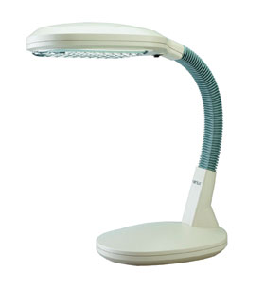
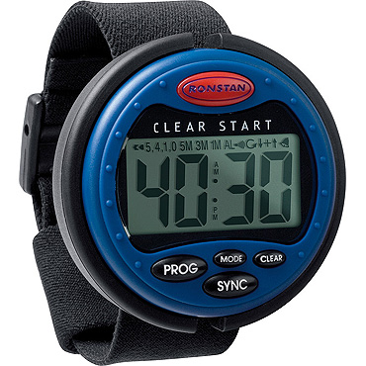
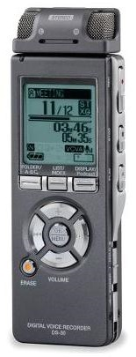
Purchasing or Modifying Equipment or Products
26

Slide 27
Situation: Equipment/Products 1
27
A mail clerk had difficulty remembering to go for his second mail collection run when he was involved in other tasks.

Slide 28
Solution: Equipment/Products 1
28
The mail clerk was provided with a watch that had a timer set for when he needed to start his run. The watch vibrated to alert him it was time to go.

Slide 29
Situation: Equipment/Products 2
29
An activities aide in an extended living facility had difficulty writing documentation in the daily log for the groups she assisted.

Slide 30
Solution: Equipment/Products 2
30
The aide was provided speech-to-text software that allowed her to dictate her notes, print them out, and then place them in the log/binder.

Slide 31
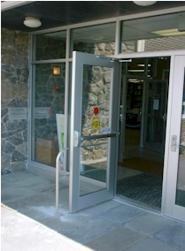
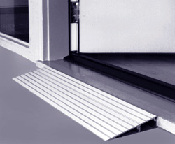
Making Work-sites accessible
31

Slide 32
Situation: Accessible Work-sites 1
32
An office worker was having difficulty with balance and walking steadily due to a brain injury. The employer had observed her falling a couple of times on the way to the printer and the restroom.

Slide 33
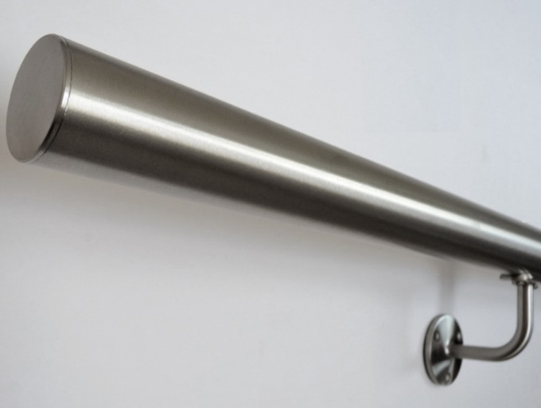
Solution: Accessible Work-sites 1
33
The employee was provided with handrails to and from her workspace and the common areas, her own printer, and her workstation setup was changed for easier access to files, materials, and equipment.

Slide 34
Situation: Accessible Work-sites 2
34
A food prep worker in a café had difficulty standing for her shift with only a thirty-minute lunch and short afternoon break. Her work became sloppy in the afternoons due to her fatigue.

Slide 35
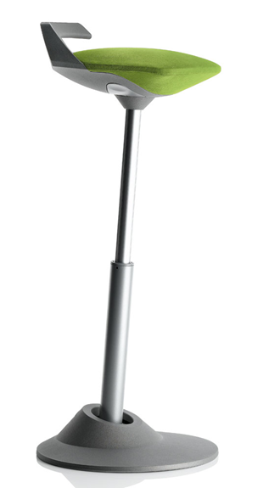
Solution: Accessible Work-sites 2
35
The employee was provided with a both an anti-fatigue mat to help her back and legs and a stand/lean stool that allowed her the ability to work in an upright position while her weight rested on the padded seat.

Slide 36
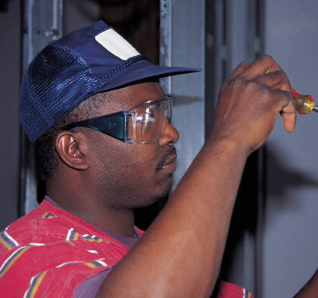
Job Restructuring
36

Slide 37
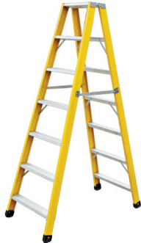
Situation: Job Restructuring 1
37
An employee with seizures and a member of a cleaning crew is restricted from working on a ladder. He can perform all of the functions of his job except for the task of maintaining the overhead lighting fixtures.

Slide 38
Solution: Job Restructuring 1
38
The job tasks of a second crew member include cleaning a small kitchen in the employee’s lounge, which is a task the first crew member can perform. The employer switched these specific tasks performed by the two crew members.

Slide 39
Situation: Job Restructuring 2
39
An employer required that all employees work overtime. An employee with Down syndrome asked to be excused from overtime because of fatigue and exacerbation of symptoms.

Slide 40
Solution: Job Restructuring 2
40
The employer denied the request, stating that overtime is an essential function.
But the process doesn’t end there!!

Slide 41
Modifying Schedule and Allowing Leave Time
41

Slide 42
Situation: Modified Schedule/Leave 1
42
A job coach called JAN advocating for an applicant with a disability. A job offer was made, but the schedule included unpredictable days and times. The applicant relied on public transportation to commute.

Slide 43
Solution: Modified Schedule/Leave 1
43
A consultant at JAN suggested asking for a schedule modification, specifically one that was consistent. This accommodation enabled the new hire to use the bus system to get to work on time.

Slide 44
Situation: Modified Schedule/Leave 2
44
Sally is returning to work after a somewhat-lengthy hospital stay for inpatient mental health treatment.

Slide 45
Solution: Modified Schedule/Leave 2
45
Sally is accommodated with a part-time schedule of working four to six hours Monday, Wednesday, and Friday, with Tuesdays and Thursdays off for therapy and recuperation. She plans to increase her hours, transitioning back to full time as she is able.

Slide 46
Modifying Policies
46

Slide 47
Situation: Modified Policies 1
47
A newly hired dog groomer at a large pet store was able to perform the essential functions of the job with no problems. But the employer’s policy only allowed a limited training time. Due to short-term memory deficits, the groomer had difficulty moving through the modules on the set schedule.

Slide 48
Solution: Modified Policies 1
48
She was accommodated with extended training and a more relaxed schedule for its completion. She was provided extra time with a trainer, as well as materials to take home to study.

Slide 49
Situation: Modified Policies 2
49
An employee who had difficulty with time management skills asked to use his phone and the apps he was accustomed to in order help him stay on task.

Slide 50
Solution: Modified Policies 2
50
The employer modified their “no cell phone use” policy and allowed this one employee to use the apps that would assist him in getting his work done in a timely manner.

Slide 51
Providing Readers, Interpreters, and Coaches
51

Slide 52
Situation: Readers/Interpreters/Coaches 1
52
A job applicant for a dog warden position in city government had difficulty reading and could not pass a required written test.

Slide 53
Solution: Readers/Interpreters/Coaches 1
53
The employer provided a reader for the testing as an accommodation.

Slide 54
Situation: Readers/Interpreters/Coaches 2
54
Josh’s job coach and employment specialist, Ed, had served him well during the job search, hiring, and training period. Ed also worked during this time to locate supports for Josh that could be put into place when Ed’s job was done, and he exited the workplace.

Slide 55
Solution: Readers/Interpreters/Coaches 2
55
Josh’s supervisor was pleased that a mentor, an older coworker who had befriended Josh, was identified. He would be able to help Josh in the same way Ed had on a more long-term basis.

Slide 56
Reassignment
56

Slide 57
Situation: Reassignment 1
57
A cashier encountered extreme difficulty counting back change accurately after the automatic change counter was removed.

Slide 58
Solution: Reassignment 1
58
When no effective accommodation could be provided, the employee was reassigned to a deli position where she would not have to handle money.

Slide 59
Situation: Reassignment 2
59
An employee who delivered meals locally asked for a change in position when the kitchen where the meals were prepared was being remodeled. The temporary kitchen was located in the city, where he was unable to drive.

Slide 60
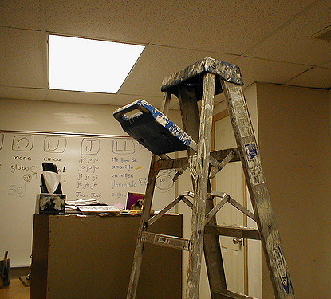
Solution: Reassignment 2
60
The driver was reassigned to a painting/light construction crew that was helping with the renovations at the kitchen. Since he would only be required to drive to the center where the kitchen was located, the driver was able to continue working with no problems.

Slide 61
Contact JAN for More Information
Visit
AskJAN.org
Call
800.526.7234
877.781.9403 (TTY)
Chat
@ AskJAN.org
Submit
JAN on Demand Inquiry @ AskJAN.org/JANonDemand.cfm
Email
JAN@AskJAN.org
Social Media
Facebook – Job Accommodation Network
Twitter – @JANatJAN

