Slide 1
Accommodating hidden disabilities with at
Lisa Mathess, ADA Specialist
Teresa Goddard, Assistive Technology Services

Slide 2
Learning objectives
First Key Learning Objective:
Participants will identify and apply JAN’s 6-Step Sample Interactive Process.
Second Key Learning Objective:
Participants will discuss five real-life workplace accommodations that have been implemented to harness the potential of employees with hidden disabilities.
Third Key Learning Objective:
Participants will participate in guided demonstration of JAN’s A to Z of Disabilities and Accommodations and will use the listings to identify three accommodation ideas.

Slide 3
Job Accommodation Network
Established in 1983
National, free consulting service
Expert, trusted, confidential guidance on job accommodations and disability employment issues
A service of the U.S. Department of Labor’s Office of Disability Employment Policy/ODEP

Slide 4
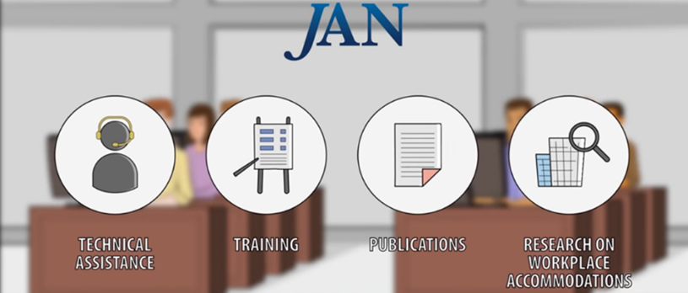
Practical Guidance and Technical Assistance
JAN provides free one-on-one practical guidance and technical assistance on:
Job accommodation solutions
Title I of the Americans with Disabilities Act (ADA) and related legislation
Self-employment and entrepreneurship options for people with disabilities

Slide 5
HIDDEN DISABILITIES

Slide 6
Examples of hidden disabilities
HIV/AIDS
Cancer
Diabetes
Heart conditions
Epilepsy
Sleep disorders
Hearing impairments
Respiratory impairments
Fibromyalgia
Brain injuries
Learning disabilities
Multiple sclerosis
Migraine headaches
Gastrointestinal disorders

Slide 7
Examples of hidden disabilities (2)
Mental health impairments
Addiction
Anxiety disorders
Bipolar disorder
Major depression
OCD
Panic disorder
PTSD

Slide 8
Common Limitations
Memory
Concentration
Fatigue/sleep
Managing stress
Breathing
Hearing
Fine and gross motor function
Emotional regulation
Temperature sensitivity
Dietary needs
Managing time
Pain
Photosensitivity
Coworker interaction
Suppressed immune system
Panic

Slide 9
Common Misconceptions
Employers sometimes think:
Hidden disabilities are not as severe as apparent disabilities
Hidden disabilities are hard to accommodate
People with hidden disabilities do not need accommodations
Accommodations are expensive

Slide 10
Key resources

Slide 11
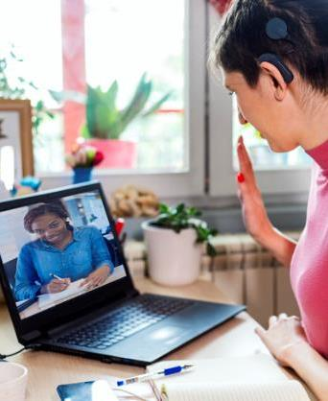
Common Accommodations
Making existing facilities accessible and useable
Job restructuring
Flexible or modified work schedules
Modifying policies
Acquiring or modifying equipment
Telework
Providing a qualified reader, interpreter, job coach
Access for service or emotional support animal
Reassignment to a vacant position
Leave

Slide 12
disclosure Resources
Disability Disclosure and the ADA
Dos and Don'ts of Disclosure
Disability Disclosure and Interviewing Techniques for Persons withs Disabilities

Slide 13
Employee Resources
How to Request an Accommodation: Accommodation Form Letter
Sample Language for Accommodation Request Letters
Practical Guidance for Medical Professionals: Providing Sufficient Medical Documentation in Support of a Patient's Accommodation Request

Slide 14
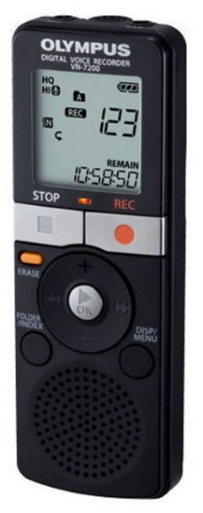
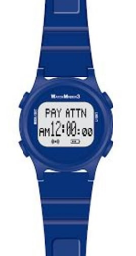
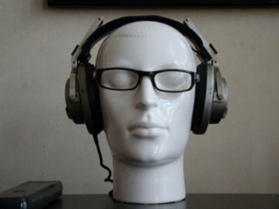
Cognitive AT options
Digital recorder
Environmental sound machine
Headset
Full-spectrum lighting
Smart watches

Slide 15
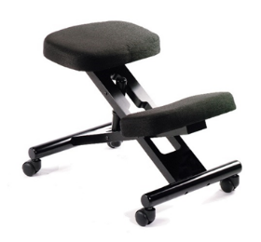
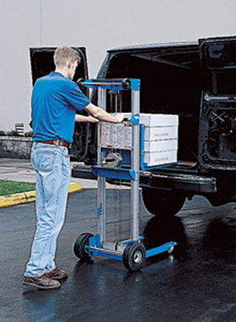
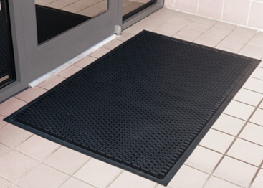
Fine & gross motor AT options
Carts
Compact material handling
Speech recognition software
Grab bars
Stand-lean stools
Work platforms

Slide 16
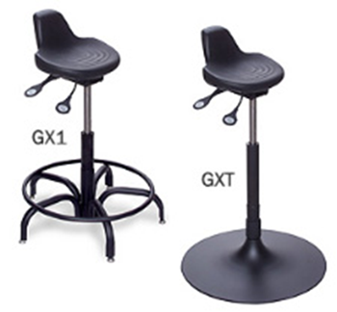
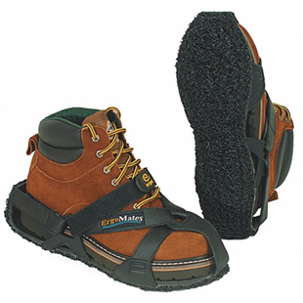
Body & fatigue weakness AT options
Anti-fatigue matting
Wearable anti-fatigue matting
Ergonomic equipment
Stand-lean stools
Scooters
Walkers
Wheelchairs

Slide 17
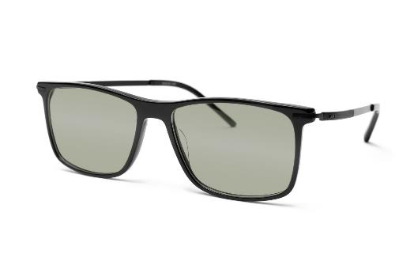
Vision at options
Hand/stand optical magnifiers
Anti-glare filters
Computer glasses
Screen reading software
Large-size high-resolution monitor
Choosing Among Options for Computer Users with Low Vision

Slide 18
ACCOMMODATION EXAMPLES

Slide 19
deaf situation
A welder who was deaf wanted to listen to music loudly enough to feel the vibrations. Unfortunately, the level they needed to feel the vibrations was found to be disruptive to the other workers.

Slide 20
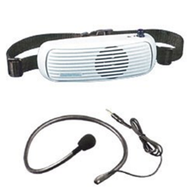
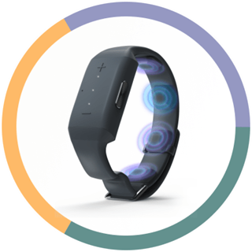
deaf solution
The employer contacted JAN regarding the disturbance of the music and accommodation ideas. The JAN consultant suggested a wearable speaker such as a Chattervox that the employee could wear facing their body instead of facing outward. They also discussed Neosensory and Sensate as other ways to provide tactile feedback while listening to music.

Slide 21
Deaf: one ear situation
A daycare employee who was deaf in one ear had difficulty with situational awareness as well as difficulty understanding what children were saying in a noisy environment.

Slide 22
Deaf: one ear solution
A JAN consultant discussed the Neosensory wristband, cyclist mirrors, soundproof panels, and captioning systems.
The JAN consultant also discussed cross-over hearing aids and more options if the employee would opt to pursue them.

Slide 23
Respiratory situation
An educational social worker with a respiratory impairment and fragrance sensitivity was teleworking during the pandemic. When the employer called employees back to the worksite, the employee requested to continue to telework.
When telework got denied, the employee requested a hybrid schedule which included 2 days on site, masks, air purifiers within the workspaces, and a private office to do case documentation.

Slide 24
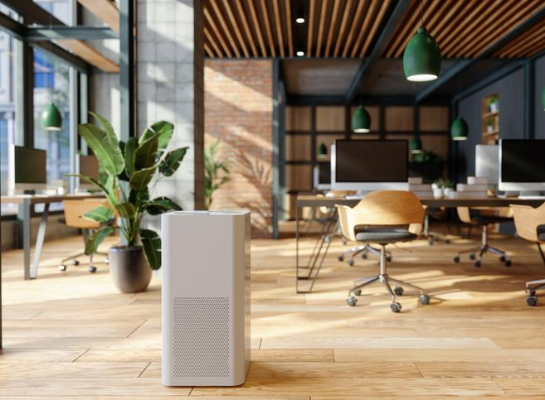
Respiratory solution
The employer denied telework but would permit a mask the employee paid for and agreed to work with the employee to identify an effective air purifier. The employer also provided an office space, even though it was not fully private.

Slide 25
Diabetes situation
A university maintenance worker with diabetes wore an insulin pump to help manage their diabetes. The pump was becoming a safety hazard around certain machinery. The worker started looking for vacant alternative roles.

Slide 26
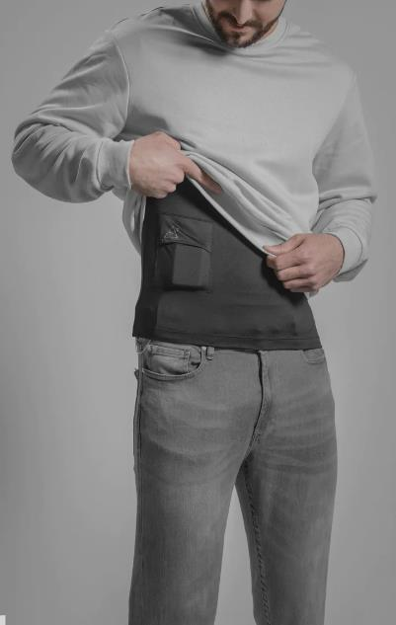
Diabetes solution
The employee was able to continue in the maintenance role with protective measures in place. He was provided with adaptive work shirts that kept the insulin pump out of harm’s way.

Slide 27
Gastrointestinal situation
A teacher with a gastrointestinal disorder needed access to a restroom due to urgency the medical condition caused. The classroom of students couldn’t be left unattended.

Slide 28
Gastrointestinal solution
The school district bought a radio the teacher could use to tell the main office she needed classroom coverage.
Cost: $500
Direct benefits:
Retained qualified employee
Eliminated training costs
Increased productivity

Slide 29
askJAN.org Resources

Slide 30
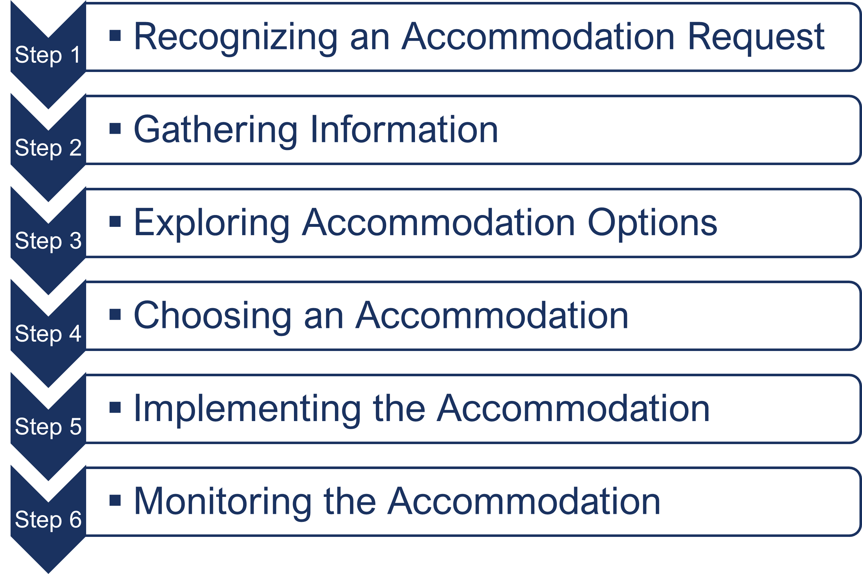
Interactive Process
A process for collaboratively identifying accommodation solutions AskJAN.org A to Z Topic: Interactive Process

Slide 31
AskJAN.org A to Z
A to Z of Disabilities and Accommodations

Slide 32
AskJAN.org by Disability

Slide 33
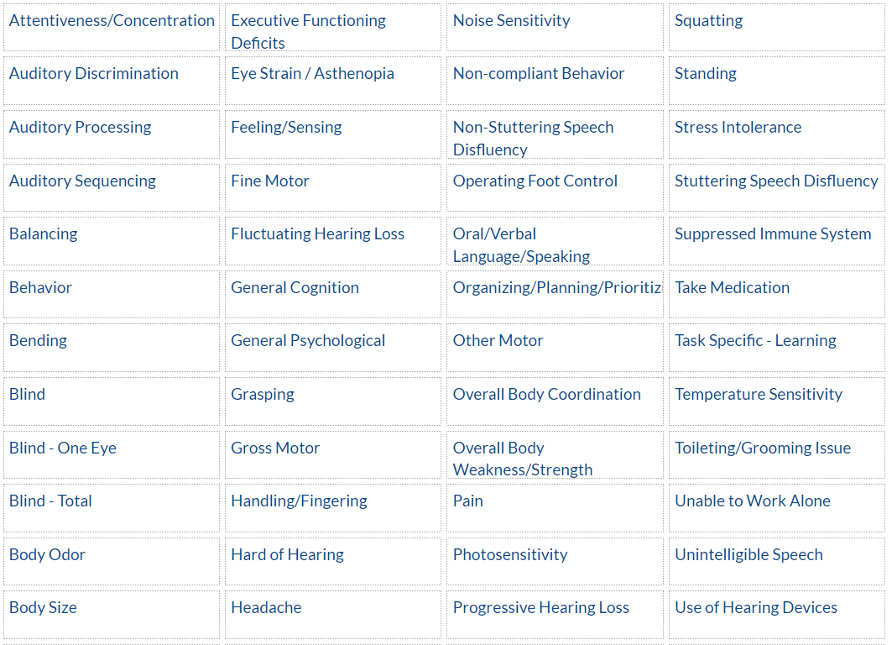
AskJAN.org by Limitation

Slide 34
AskJAN.org by Limitation — decreased stamina/fatigue

Slide 35
AskJAN.org by Topic

Slide 36
AskJAN.org by Topic — performance

Slide 37
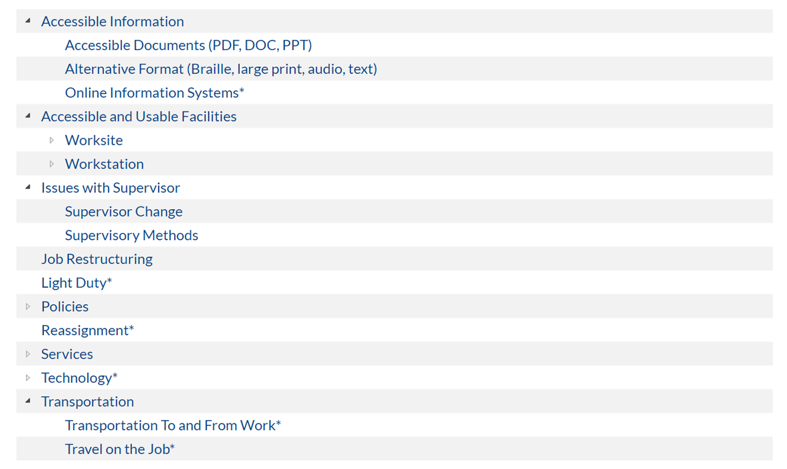
AskJAN.org by Accommodation

Slide 38
Contact JAN for More Information
Visit
AskJAN.org
Call
800.526.7234
877.781.9403 (TTY)
Chat
@ AskJAN.org
Email
JAN@AskJAN.org
Social Media
Facebook – Job Accommodation Network
Twitter – @JANatJAN

