Slide 1
Accommodation Solutions for Sleep Disorders
Alexis Popa, M.S. Consultant Melanie Whetzel, M.A., CBIS, Principal Consultant

Slide 2
Housekeeping
2
Technical Difficulties
Q&A option at the bottom of the screen
800-526-7234 or 877-781-9403 (TTY) OR Live Chat at AskJAN.org
Frequently Asked Questions (FAQ) AskJAN.org/Training/JAN-Webcast-Frequently-Asked-Questions.cfm
Questions for Presenters
Q&A option at the bottom of the screen

Slide 3
Housekeeping 2
3
PPT Slides
Click the link included in the webcast login email you received, see the link in the chat, or go to this webcast event from the Training page at AskJAN.org
Captioning
Use the closed caption (CC) option or captioning link in the chat

Slide 4
Accommodation Solutions for Sleep Disorders
4
Agenda
Real Life Situations
Relevant ADA Rules
Best Practices
Accommodation Examples
Questions and Answers

Slide 5
Types of Sleep Disorders
5
Insomnia — difficulty falling asleep or staying asleep throughout the night
Sleep apnea — abnormal patterns in breathing while you are asleep
Restless legs syndrome (RLS) — a sleep movement disorder causing an uncomfortable sensation and an urge to move the legs while you try to fall asleep
Narcolepsy — extreme sleepiness during the day and falling asleep suddenly during the day

Slide 6
Common Limitations associated with Sleep disorders
6
Memory Loss
Managing Time
Stress Intolerance
Sleeping/Stay Awake
Decreased Stamina/Fatigue
Attentiveness/Concentration
Executive Functioning Deficits
Organizing/Planning/Prioritizing
Effect of/Receive Medical Treatment

Slide 7
JAN Resources
7
JAN Publications Related to Sleep Disorders
Accommodations Related to Commuting To and From Work
Cataplexy: Rare But Relevant!
Dealing with Stress in the Workplace
Cognitive Impairment and the Accommodation Process
Executive Function Deficits, Higher Level Employees, and Accommodations
Getting to Work on Time
Memory Difficulties in the Workplace
What’s in a Routine?
Workin’ 9 to 5 – Not the Only Way to Make a Living
Available at https://AskJAN.org/disabilities/Sleep-Disorder.cfm

Slide 8
PERFORMANCE AND CONDUCT
8

Slide 9
Performance and conduct Situation (1)
9
Situation:
An employee with undisclosed insomnia and executive functioning deficits working at a call center was having difficulty performing intakes correctly and meeting deadlines. The supervisor sits down to talk with the employee about his performance.
Is this a good approach?

Slide 10
Performance and Conduct Best Practices (1)
10
ADA
Employers can hold all employees to the same standards of performance but should bring deficits to an employee’s attention as soon as possible.
Best Practice
Meet with the employee to talk about performance, where the employee should be, and how the employer can help him get there.

Slide 11
Performance and conduct Situation (2)
11
Situation:
An employee had difficulty with concentration, focus, and getting some of her tasks done on time due to a sleep disorder that affects mental fatigue and sleepiness. When the employee discusses it with the employer, the employer asks what they can do to help.
Is this a good approach?

Slide 12
Performance and Conduct Best Practices (2)
12
ADA
Employers can hold employees to standards of performance but need to begin the interactive process when an employee discloses a medical condition and connects it to a performance issue.
Best Practice
Meet with the employee, ask how to assist. Request medical documentation that may help with accommodation ideas.

Slide 13
Performance and conduct Situation (3)
13
Situation:
An employee has been arriving to work anywhere from fifteen minutes to two hours late for several weeks. When the manager asks about it, she belligerently says she has a medical issue and it is none of his concern.
Is this a good approach?

Slide 14
Performance and Conduct Best Practices (3)
14
ADA
Because employers can hold all employees to the same standards, medical issues or not, employees want to be cooperative and disclose a medical condition before it is too late.
Best Practice
A good opportunity to disclose a medical condition and ask for help is when it is brought to an employee’s attention that she is not meeting attendance standards.

Slide 15
TELEWORK AND COMMUTING
15

Slide 16
Telework and Commuting situation (1)
16
Situation:
An employee who is being counseled for attendance discloses that he has insomnia and asks for the ability to telework. His supervisor tells him to get his attendance in order and they will consider it.
Is this a good approach?

Slide 17
Telework and commuting Best Practices (1)
17
ADA
Employers can hold this employee to attendance standards but should start the interactive process without delay when an employee discloses and asks for an accommodation.
Best Practice
Treat the request as an accommodation request. Request medical documentation. Have a full conversation about how telework will be effective.

Slide 18
Telework and Commuting situation (2)
18
Situation:
An employee recently diagnosed with narcolepsy asked for a modified schedule to allow the use of public transportation. The employer denies the request, stating that employees are responsible for getting themselves to work.
Is this a good approach?

Slide 19
Telework and Commuting Best Practices (2)
19
ADA
Employers do not have to provide transportation to and from work but might have to consider other accommodations related to commuting problems such as modified schedule and telework.
Best Practice
Treat the request as an accommodation request and consider modifying the employee’s schedule.

Slide 20
Telework and Commuting Situation (3)
20
Situation:
An employee with a sleep disorder found working from home to be extremely beneficial. She asks to continue teleworking after her employer calls all employees back to the workplace after mandatory telework related to the pandemic. The employer tells the employee she will need to come into the office until the interactive process is complete.
Is this a good approach?

Slide 21
Telework and commuting Best Practices (3)
21
ADA
Employers do not have to provide an accommodation until the accommodation process is complete.
Best Practice
Allow telework to continue during the interactive process, especially if the issue is pandemic-related.

Slide 22
JOB RESTRUCTURING AND REASSIGNMENT
22

Slide 23
Job Restructuring and Reassignment situation (1)
23
Situation:
A long-term employee with a sleep disorder has begun to have difficulty completing the mandatory overtime recently instated by the employer. The employee is fatigued, inattentive, and has trouble getting through his regular schedule at times. When he discloses to his employer and asks to be exempt from the overtime, his supervisor says they will consider it.
Is this a good approach?

Slide 24
Job Restructuring/Reassignment Best Practices (1)
24
ADA
Employers must consider providing accommodations for employees with disabilities.
Best Practice
Determine if the overtime is essential and if changes in this employee’s schedule can be made. Discuss what alternate accommodations may be effective.

Slide 25
Job Restructuring and Reassignment situation (2)
25
Situation:
A veteran, who is now a delivery truck driver, has PTSD and a sleep disorder. He was having difficulty with his nightshift schedule. He requested a day shift instead. The employer responded that he just needs to do what he was hired to do.
Is this a good approach?

Slide 26
Job Restructuring/Reassignment Best Practices (2)
26
ADA
Employers do not have to create a position or bump someone else out of their current one.
Best Practice
Engage in the interactive process. Consider temporary accommodations to assist the driver until reassignment to a day shift position is possible.

Slide 27
Job Restructuring and Reassignment Situation (3)
27
Situation:
An employee at a manufacturing site had been successfully working the second shift. He experienced fatigue and difficulty with concentration due to disruption of his sleep patterns and couldn’t work the early shift a new manager assigned him to. The new manager was unconcerned and ignored the employee’s attempts to right the situation.
Is this a good approach?

Slide 28
Job Restructuring / Reassignment Best Practices (3)
28
ADA
Employers should respond quickly to requests for schedule changes that are linked to a medical condition.
Best Practice
Engage in the interactive process. Consider moving the employee back to the position his body was accustomed to and he had worked successfully in.

Slide 29
TRAVEL
29

Slide 30
Travel situation (1)
30
Situation:
A new employee traveling for training asks for the accommodation of a private room because of the use of a CPAP machine and the need for privacy. The employer responds by saying all travelers share rooms — it is policy.
Is this a good approach?

Slide 31
Travel Best Practices (1)
31
ADA
Employers can have policies they enforce, based on budgets and other factors.
Best Practice
Start the interactive process. Discuss the situation with the employee and address his concerns. Consider modifying the policy.

Slide 32
Travel situation (2)
32
Situation:
An employee with sleep apnea uses a CPAP machine that is not suitable for travel. After being promoted to a position that requires travel, she asks the employer to provide a smaller machine for her work-related travel. The employer denies the request as it is a personal use item.
Is this a good approach?

Slide 33
Travel Best Practices (2)
33
ADA
Employers do not have to provide personal use items as accommodations to employees.
Best Practice
Discuss the situation with the employee and determine how to assist her when traveling.

Slide 34
MEDICAL DOCUMENTATION
34

Slide 35
Medical Documentation Situation (1)
35
Situation:
An employee has been discovered sleeping on the job at various times throughout the day over a several-month time period. The employer reports a hesitancy to ask for medical documentation and, since they really don’t know what is going on, lets the incidents slide.
Is this a good approach?

Slide 36
Medical Documentation Best Practices (1)
36
ADA
Employers do not have to tolerate sleeping on the job.
Best Practice
Meet with the employee to alert them they have been sleeping and the behavior is not acceptable.

Slide 37
Medical Documentation Situation (2)
37
Situation:
An employer requests medical documentation from an employee to substantiate the need for an adjustable desk that she says will keep her awake. The employee states that she was diagnosed with narcolepsy many years ago but has no current documentation and has no desire to go through medical channels again.
Is this a good approach?

Slide 38
Medical Documentation Best Practices (2)
38
ADA
Employers can require medical documentation when the disability and need for accommodation are not obvious or already documented.
Best Practice
Consider providing the accommodation without documentation, unless it causes a hardship. Consider alternate, less-expensive ones.

Slide 39
Sleeping/stay Awake Products
39
Alternative Alarm Clocks
Bed Shaker Alarms
Dawn Simulators
Personal Alarms
Rolling Alarm Clocks
Sleep Alerting Devices
Talking Alarm Clocks
Vibrating Watches/Alarms
https://AskJAN.org/limitations/Sleeping-Stay-Awake.cfm

Slide 40
Sleeping/Stay Awake Services and Apps
40
Services
Wake-Up Call Services
Apps for Sleep/Fatigue
https://AskJAN.org/solutions/Apps-for-Sleep-Fatigue.cfm
Determining if Apps Are Right for You
https://AskJAN.org/articles/Determining-if-Apps-Are-Right-for-You.cfm

Slide 41
Questions
41

Slide 42
JAN Accommodation and Compliance Webcast Series
Thank you for attending: “Accommodation Solutions for Sleep Disorders”
Register for the next JAN webcast: AskJAN.org/events/register/2021-2022-webcast-series.cfm

Slide 43
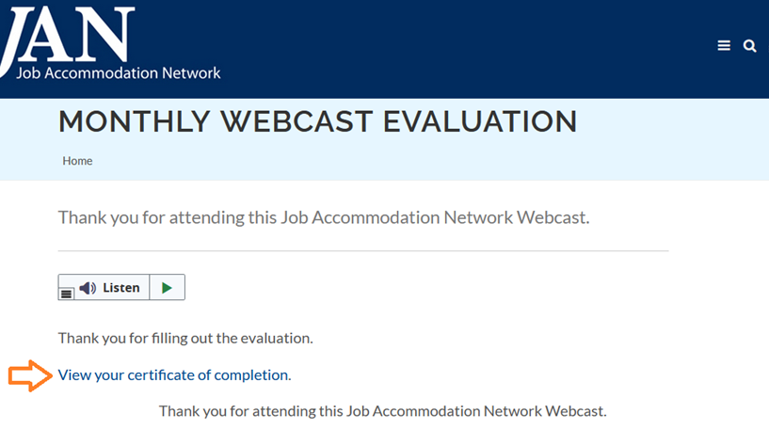
How do I claim the HR CEU?
Don’t close the JAN webcast browser
Complete the webcast evaluation in new window or go to: AskJAN.org/EvaluationReg.cfm
Click on View your certificate of completion

Slide 44
Questions? Contact JAN for More Information
44
Visit
AskJAN.org
Call
800.526.7234
877.781.9403 (TTY)
Chat
@ AskJAN.org
Submit
JAN on Demand Inquiry @ AskJAN.org/JANonDemand.cfm
Email
JAN@AskJAN.org
Social Media
Facebook – Job Accommodation Network Twitter – @JANatJAN

