Slide 1
Ask JAN!
Expert Q & A
October 2021
Notes:
Tracie
Welcome everyone and thank you for joining us for the JAN Accommodation and Compliance Series Webcast titled Ask JAN! Expert Q&A. My name is Tracie DeFreitas. Before we begin, we have some housekeeping items to cover. Next slide.

Slide 2

Housekeeping
Technical Difficulties
  Use the Q&A option at the bottom of the screen
  Call 800-526-7234 or 877-781-9403 (TTY)
  Use the Live Chat at AskJAN.org
  Access Frequently Asked Questions
  https://AskJAN.org/training/Frequently-Asked-Questions-About-JAN-s-Remote-Trainings.cfm
Questions for Presenters
  Use the Q&A option at the bottom of the screen
  Questions will be gathered into a queue

Slide 3

Housekeeping Cont’d
PPT Slides
  See the link included in the webcast chat
  Download from the Webcast Archive section
  of the Training page at AskJAN.org
Captioning
  Use the closed caption
  option at the bottom of the screen
  Transcript will be available with webcast archive
This event is being recorded
Please complete the evaluation at the end

Slide 4
Let’s Talk Accommodation/ADA
Back to the Basics
Return-to-Work
Future of Work

Slide 5

Back to the Basics
Remember when…

Slide 6

Situation 1
An employee provided a note from their health care provider that says telework is recommended because the employee is considered high-risk for severe illness from COVID, due to a medical condition.
When is the ADA interactive process triggered?

Slide 7

Situation 2
An employee asks for a reassignment to another position that will not cause as much stress. The medical documentation submitted states the employee should
be moved to a stress-free position.
What does this mean?
AskJAN.org A to Z by Topic:
Medical Exams & Inquiries

Slide 8

Situation 3
An employee submits medical documentation to his supervisor a week after being written up during a performance review. Medical documentation states the employee has difficulty with concentration and memory but doesn’t offer suggestions for accommodations to help. The employee didn’t suggest anything in the performance meeting.
What do we do now?

Slide 9

Situation 4
An employee requested accessible parking, but our parking lot meets ADA guidelines for the number of spaces. We think we can deny the request.
What do you think?
AskJAN.org A to Z by Topic:
Parking

Slide 10

Situation 5
I have an employee who wears hearing aids and doesn’t like their telephone headset.
What headset should I
get for this employee?

Slide 11

Return-to-Work
Plans may have changed…

Slide 12

Situation 6
An employee with panic disorder asked to continue teleworking after mandatory telework related to the pandemic was ended and employees were called back to the workplace. The employee was told she must come into the office the same as everyone else until
the interactive process is complete.
Is this the best approach?

Slide 13

Situation 7
Employees are returning to the office in November. An employee who had a heart transplant wants to keep teleworking, but I know they received two shots already. They should be able to return to work.
What’s up with that?
A Practical Approach to Telework as a Reasonable Accommodation During the Pandemic

Slide 14
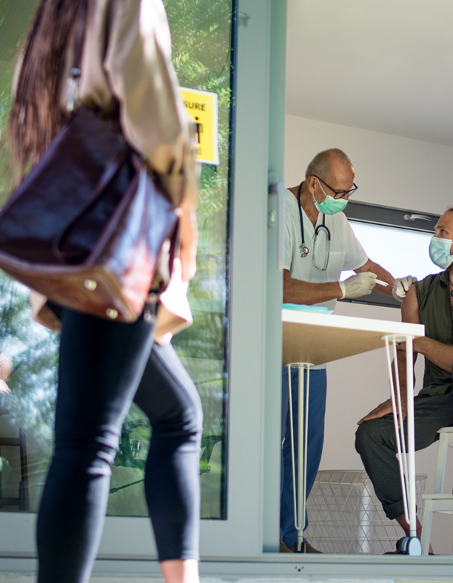
Situation 8
Employees returning on-site are mandated to be fully vaccinated. We’re receiving accommodation requests to be exempt for a medical reason.
Is there a form to request information?
Sample Template for Vaccine Exemption Based on Medical Condition

Slide 15



Future of Work
Hybrid
Telework
Wellbeing
Access and Inclusion

Slide 16
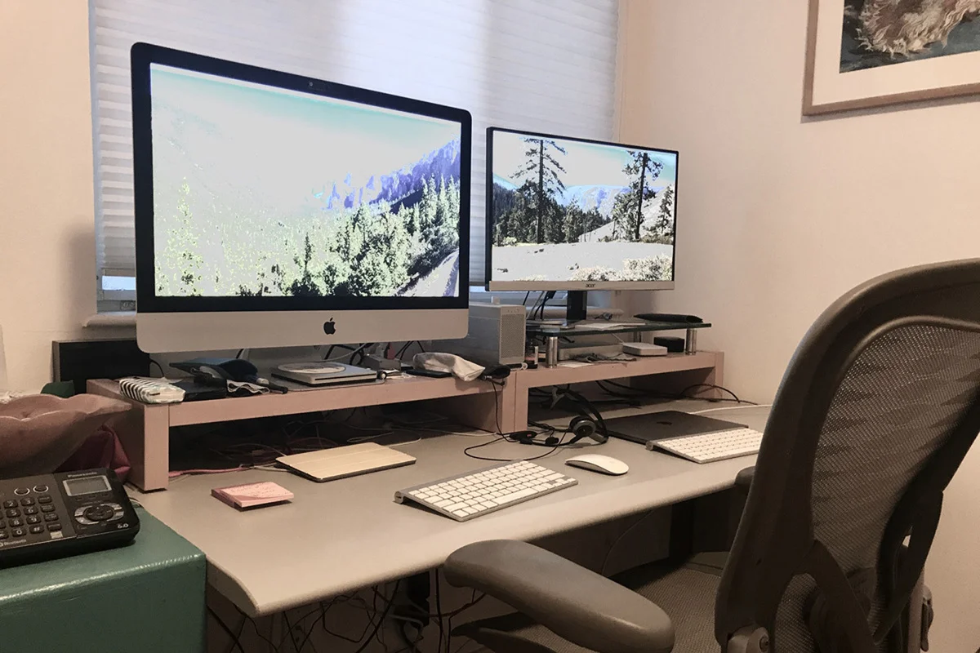
Situation 9
Some employees who are working hybrid are asking for workstation equipment at home that they were provided at the workplace as an accommodation.
Are workstation accommodations required for employees with disabilities working a hybrid schedule?

Slide 17
Situation 10
Remote meetings and trainings have been a time saver for our organization, so we plan to keep this practice
in place indefinitely. But these meetings need to be accessible to all staff.
Is automated captioning a good option for making
virtual meetings accessible?
Automated Captioning…

Slide 18

Situation 11
An employee has lupus and is also experiencing symptoms of Long COVID, including fatigue, body aches, and brain fog. A previous request to telework was denied because we didn’t think telework could work. Now the employee is requesting it again.
Does the fact that the
employee teleworked for
several months impact
whether telework should
be provided as an
accommodation now?
What You Should Know About COVID-19 and the ADA,
the Rehabilitation Act, and Other EEO Laws

Slide 19

Situation 12
An employee who has high anxiety and a mood disorder exacerbated by the pandemic requested to bring her support dog to work to help her cope with the daily stress that affects concentration and causes her to act erratically at times.
Do we have to allow the dog?
Emotional Support Animals in the Workplace:
A Practical Approach

Slide 20

On-the-Spot Questions!

Slide 21

NDEAM 2021 Theme
“America’s Recovery: Powered by Inclusion”
National Disability Employment Awareness Month (NDEAM) 2021

Slide 22

Thank you for attending!
Melanie Whetzel
Lead Consultant, Cognitive/Neuro Team
Teresa Goddard
Lead Consultant, Sensory Team
Lisa Mathess
Lead Consultant, Motor Team
Tracie DeFreitas
Principal Consultant, ADA Specialist

Slide 23

Need more information?
Visit AskJAN.org
Call JAN toll-free:
  800.526.7234 (V)
  877.781.9403 (TTY)
Use the JAN Live Chat @ AskJAN.org
Submit a JAN on Demand question @
AskJAN.org/JANonDemand.cfm
Email JAN @ JAN@AskJAN.org
Connect on social media
  Facebook – Job Accommodation Network
  Twitter – @JANatJAN

Slide 24
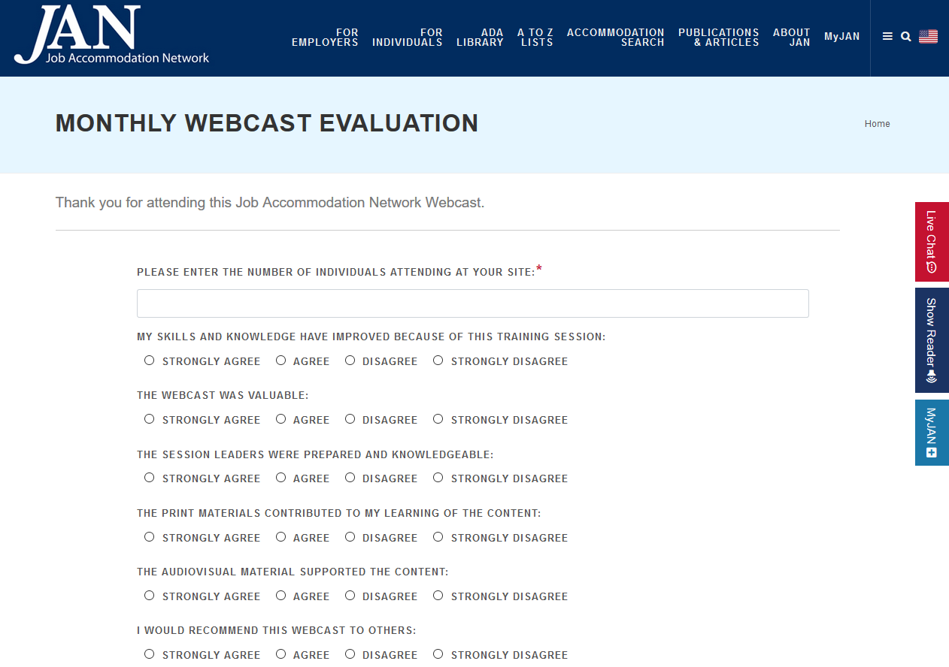
How do I claim the HR CEU?
Don’t close the JAN webcast browser.
CEU approval code will be provided via the certificate that comes up after completing the webcast evaluation.

