Slide 1
Providing Reasonable Accommodations to Veterans with Disabilities
James Potts, M.S., Senior Consultant Melanie Whetzel, M.A., CBIS, Principal Consultant

Slide 2
Housekeeping
2
Technical Difficulties
Q&A option at the bottom of the screen
800-526-7234 or 877-781-9403 (TTY) OR Live Chat at AskJAN.org
Frequently Asked Questions (FAQ) AskJAN.org/Training/JAN-Webcast-Frequently-Asked-Questions.cfm
Questions for Presenters
Q&A option at the bottom of the screen

Slide 3
Housekeeping 2
3
PPT Slides
Click the link included in the webcast login email you received, see the link in the chat, or go to this webcast event from the Training page at AskJAN.org
Captioning
Use the closed caption (CC) option or captioning link in the chat

Slide 4
REAL-LIFE SITUATIONS & SOLUTIONS
4

Slide 5
Disability Disclosure
5
Sam has PTSD and experiences nightmares that affect his sleep. As a result, he often has difficulty focusing on work and experiences mood swings which cause him to lose his temper. No disciplinary actions have been taken for his outbursts, but Sam doesn’t want to take any chances. He decides to disclose his disability and ask for accommodations.

Slide 6
Difficulties with Supervisors
6
After being unable to get along with his boss, an employee with TBI is requesting a change in supervisor as an accommodation.

Slide 7
Job Restructuring
7
An employee is frustrated with her employer who expects her to move as quickly as someone younger and without a disability.

Slide 8
Modifying Schedules
8
An employer required that all employees work overtime. Jake, an employee with PTSD, asked to be excused from overtime because of fatigue and exacerbation of symptoms.
The employer denied Jake’s request stating that overtime is an essential function.
But the process doesn’t stop there!

Slide 9
Acquiring/Modifying Equipment
9
Eric has trouble with organization and time management. He has struggled with meeting performance metrics and reached out to HR for accommodations.

Slide 10
Modifying Policies, Tests, Materials
10
An applicant with vertigo is required to take a pre-employment screening test to be considered for the position.

Slide 11
Issues of change
11
Skye, an employee with her own private workspace, is moving into a sea of cubicles once the employer moves offices to a smaller, more open office space.

Slide 12
Providing Services
12
A veteran in a new student services position has PTSD and a TBI. After disclosing his disability and requesting accommodations, his employer provided a cubicle close to an exit, where his back was against a wall. This helped alleviate some anxiety, but he still had difficulty with memory and organization.

Slide 13
Leave
13
Is Logan entitled to leave if his disability is not impacting his performance?

Slide 14
Telework
14
Denise is always hyper-vigilant and aware of her surroundings. While this may have been helpful during her military service, it can make completing her work difficult in a busy office space. Denise’s performance had slipped in the last several months, and her boss reached out to see if anything was wrong.

Slide 15
Service Animals
15
Terrence either needs his service animal in the workplace or to be approved for telework so he can be at home with his service animal.

Slide 16
Reassignment
16
An RN with nearly twenty years of experience in a veteran’s hospital was having great difficulty working in the emergency and critical care units due to an increase in symptoms when dealing with trauma. He asked to be reassigned as an accommodation.

Slide 17
Questions?
17

Slide 18
JAN Accommodation and Compliance Webcast Series
Thank you for attending: “Building a Disability-Inclusive Organization”
Register for the next JAN webcast: AskJAN.org/events/register/2021-2022-webcast-series.cfm

Slide 19
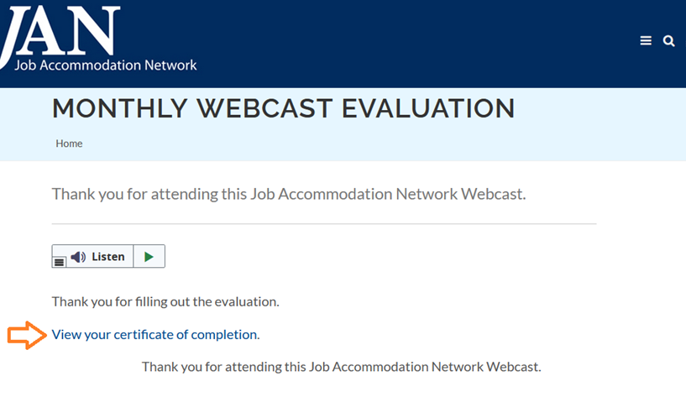
How do I claim the HR CEU?
Don’t close the JAN webcast browser
Complete the webcast evaluation in new window or go to: AskJAN.org/EvaluationReg.cfm
Click on View your certificate of completion

Slide 20
Contact JAN for More Information
20
Visit
AskJAN.org
Call
800.526.7234
877.781.9403 (TTY)
Chat
@ AskJAN.org
Submit
JAN on Demand Inquiry @ AskJAN.org/JANonDemand.cfm
Email
JAN@AskJAN.org
Social Media
Facebook – Job Accommodation Network
Twitter – @JANatJAN

