Slide 1
Requesting and Negotiating
Reasonable Accommodations
Linda Carter Batiste, J.D., Principal Consultant
Melanie Whetzel, M.A., CBIS, Lead Consultant
Alexis Popa, M.S., Consultant
Anna Saab, B.S., Employment Specialist

Slide 2
Overview
Overview:
Sample Interactive Process
General ADA Rules
Common Employee Questions
Resources

Slide 3
Reasonable Accommodation
In General:
Any change or adjustment to a job or work environment that permits a qualified applicant or employee with a disability to participate in the job application process, to perform the essential functions of a job, or to enjoy benefits and privileges of employment equal to those enjoyed by employees without disabilities.

Slide 4
Reasonable Accommodation
Includes:
Providing or modifying equipment or devices,
Job restructuring,
Part-time or modified work schedules,
Adjusting or modifying examinations, training materials, or policies,
Providing readers and interpreters,
Making the workplace readily accessible to and usable by people with disabilities, and
Reassignment to a vacant position.

Slide 5
Reasonable Accommodation
Does not include:
Removing essential functions,
Lowering production standards,
Creating new jobs or bumping coworkers,
Providing personal need items such as hearing aids and wheelchairs, or
Providing accommodations that create an undue hardship.

Slide 6
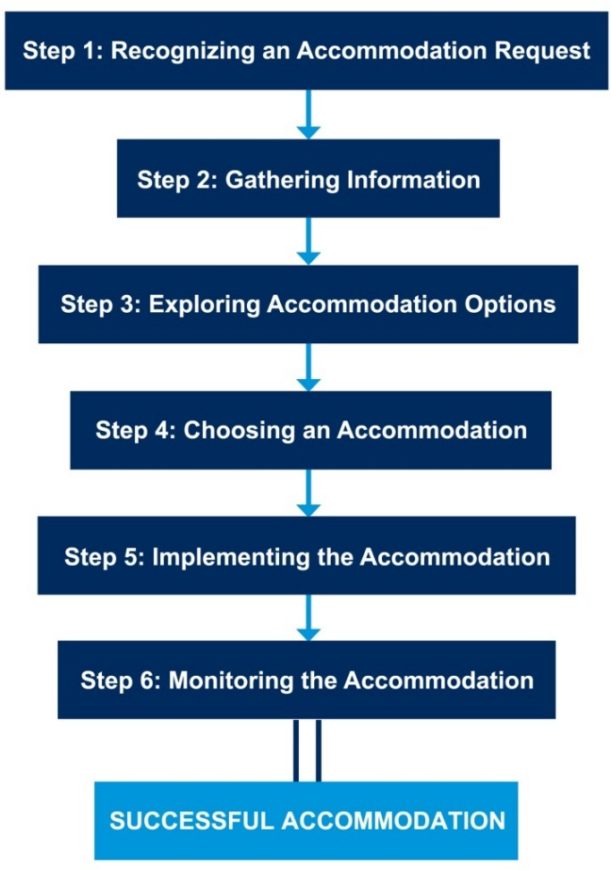
Sample ADA Interactive Process:
Interactive Process

Slide 7
Interactive Process
Step 1: Making a Request

Slide 8
Making a Request
Step 1: Making a Request
Does not have to be in writing
Do not have to use special or legal words
Must let your employer know that an adjustment or change is needed at work for a reason related to a medical condition

Slide 9
Making a Request
Question:
What is the best way to disclose a disability and request an accommodation?
Example:
An employee has MS and is having flareups and trouble doing her job. She has never told her employer about her MS and is worried that if she does, she might be fired.
What might you suggest?

Slide 10
Making a Request
Question:
Do I have to talk to my direct supervisor first?
Example:
An employee with a mental health impairment does not get along with her supervisor. The supervisor has said negative things about other employees with disabilities, so the employee is concerned about asking the supervisor for an accommodation but also concerned about going over the supervisor’s head.
What might you suggest?

Slide 11
Making a Request
Question:
How long does an employer have to respond to an accommodation request?
Example:
An employee on medical leave asked to telework as an accommodation over a month ago. The employer said they’d get to it as soon as they could, but they’re very busy. In the meantime, the employee is using up leave.
What might you suggest?

Slide 12
Resources
Disability Disclosure https://AskJAN.org/topics/Disability-Disclosure.cfm
Requesting and Negotiating a Reasonable Accommodation at https://AskJAN.org/publications/consultants-corner/vol03iss04.cfm
How to Request an Accommodation: Accommodation Form Letter at https://AskJAN.org/articles/accommrequestltr.cfm
Employees' Practical Guide to Requesting and Negotiating Reasonable Accommodation Under the ADA at https://AskJAN.org/publications/individuals/employee-guide.cfm
Employee Accommodation Inquiry Letter https://AskJAN.org/publications/consultants-corner/Employee-Accommodation-Inquiry-Letter.cfm

Slide 13
Interactive Process
Step 2: Providing Information

Slide 14
Providing Information
Step 2: Providing Information
Employers need to know that you have a disability and why an accommodation is needed
Focus should be on functional limitations
Employers can require medical documentation when the disability and need for accommodation are not obvious or already documented
Employers can require that the documentation come from an appropriate health care provider

Slide 15
Providing Information
Question:
What do I do if I think my employer is asking for too much medical information?
Example:
An employee with PTSD asked to turn his desk around so he doesn’t have his back to people. His employer asked for medical documentation, including his treatment history.
What might you suggest?

Slide 16
Providing Information
Question:
Do I have to have my doctor fill out specific forms?
Example:
An employee had her doctor write an accommodation support letter, and she turned it in with her request. Now her employer wants the doctor to fill out the employer’s form, but the doctor refuses.
What might you suggest?

Slide 17
Providing Information
Question:
How current does medical documentation need to be?
Example:
An employee with a learning disability tried to provide proof of disability using documentation that dated back to high school. The employer is questioning whether this documentation is too old and asks for updated medical information.
What might you suggest?

Slide 18
Resources
What Does “Sufficient” Mean? - A Deconstructive Series for ADA Terminology at https://AskJAN.org/articles/What-Does-Sufficient-Mean-A-Deconstructive-Series-for-ADA-Terminology.cfm
Documentation of a Learning Disability at https://AskJAN.org/publications/consultants-corner/vol05iss03.cfm
Practical Guidance for Medical Professionals: Providing Sufficient Medical Documentation in Support of a Patient's Accommodation Request at https://AskJAN.org/articles/EAPS/upload/medprofessionsEAP.doc
Medical Inquiry in Response to an Accommodation Request at https://AskJAN.org/articles/EAPS/upload/MedicalDocumentationinResponsetoRAEAP.doc

Slide 19
Interactive Process
Step 3: Exploring Accommodations

Slide 20
Exploring Accommodations
Step 3: Exploring Accommodations
Employers have a right to explore alternative accommodations other than the one requested
Employees have a duty to participate in exploring accommodations with the employer
An employer may use outside resources as long as confidentiality is maintained

Slide 21
Exploring Accommodations
Question:
Does my doctor have to recommend accommodations?
Example:
An employee with high blood pressure is experiencing flare ups because of work-related stress. He provides documentation of disability and limitations and tells the employer what he thinks will help, but his employer says his doctor has to say what accommodations he needs.
What might you suggest?

Slide 22
Exploring Accommodations
Question:
What if I don’t have any accommodation ideas?
Example:
An employee who is blind works in a call center and cannot access her employer’s new, customized database. Her employer says she will have to provide accommodation ideas before they can move forward but she doesn’t know how to fix the problem.
What might you suggest?

Slide 23
Exploring Accommodations
Question:
What if my employer says that a job duty is essential, but I can’t perform it?
Example:
A clerical worker is required to rotate through phone duty, but answering the phone is stressful and causes her anxiety disorder to flare up. She asks to be exempt from answering phones, but her employer says it’s an essential job duty.
What might you suggest?

Slide 24
Resources
A to Z at https://AskJAN.org/a-to-z.cfm
By Disability
By Limitation
By Work-Related Function
By Topic
By Accommodation
Accommodations for Difficulties with Assisting Others on the Telephone Due to Stress, Anxiety, and Interpersonal Communications at https://AskJAN.org/articles/Accommodations-for-Difficulties-with-Assisting-Others-on-the-Telephone-Due-to-Stress-Anxiety-and-Interpersonal-Communications.cfm

Slide 25
Interactive Process
Step 4: Choosing an Accommodation

Slide 26
Choosing an Accommodation
Step 4: Choosing an Accommodation
An employer gets to choose which accommodation will be implemented but the chosen accommodation must be effective
Employers are encouraged, when possible, to choose an employee’s preferred accommodation

Slide 27
Choosing an Accommodation
Question:
When choosing an accommodation, does my employer have to do what my doctor says?
Example:
An employee with a back condition turned in a doctor’s note that said he needed a stand-up workstation. The employer offered him rest breaks instead.
What might you suggest?

Slide 28
Choosing an Accommodation
Question:
What should I do if my employer offered an ineffective accommodation?
Example:
An employee with diabetes asked to telework during the pandemic. Her employer said that safety protocols such as social distancing, masks, and extra cleaning were in place, so the employee doesn’t need to telework. The employee doesn’t think this is effective.
What might you suggest?

Slide 29
Choosing an Accommodation
Question:
What should I do if my employer denies my accommodation?
Example:
An employee with a sleep disorder needs to take 30-minute naps during lunch break and asked her employer if she could take naps in her car. Her employer denied the request based on safety concerns.
What might you suggest?

Slide 30
Resources
Leave as an Ineffective Accommodation at https://AskJAN.org/articles/Leave-as-an-Ineffective-Accommodation.cfm
How to Inform an Employer That an Accommodation is Not Effective and a Sample Letter at https://AskJAN.org/articles/How-to-Inform-an-Employer-That-an-Accommodation-is-Not-Effective-and-a-Sample-Letter.cfm
Coming in the near future: Your Accommodation Request Was Denied. What Now?

Slide 31
Interactive Process
Step 5: Implementing the Accommodation

Slide 32
Implementing the Accommodation
Step 5: Implementing the Accommodation
Employers must take steps to implement an accommodation
Employees must cooperate in the process

Slide 33
Implementing the Accommodation
Question:
Does an employer have to grant an accommodation permanently?
Example:
An employee with bipolar disorder had problems sleeping and asked for a flexible start time. His employer granted the request but indicated it would be reviewed in three months. The employee is concerned because the need for the accommodation is long term.
What might you suggest?

Slide 34
Implementing the Accommodation
Question:
What should I do if HR approved my accommodation, but my supervisor doesn’t agree?
Example:
An employee with memory loss from a stroke asked to have his supervisor provide written work instructions and to break down large jobs into smaller tasks. HR approves the request, but his supervisor says she doesn’t have time to do this.
What might you suggest?

Slide 35
Implementing the Accommodation
Question:
What happens if my coworkers notice that I am being accommodated and they ask questions?
Example:
An employee with autism was allowed to bring his service animal to work, but coworkers are asking about it, and some have even tried to pet it.
What might you suggest?

Slide 36
Resources
A Guide for Coworker Interaction with Service Animals in the Workplace at https://AskJAN.org/publications/consultants-corner/Service-Animal-Etiquette.cfm
Confidentiality of Medical Information under the ADA https://AskJAN.org/publications/consultants-corner/vol11iss01.cfm
Providing Temporary or Trial Accommodation Solutions at https://AskJAN.org/publications/consultants-corner/vol12iss08.cfm
The Manager’s Dilemma: “An employee is asking about a co-worker’s accommodation. As a manager, what do I say?” at https://AskJAN.org/blogs/jan/2013/12/the-manager-s-dilemma-an-employee-is-asking-about-a-co-worker-s-accommodation-as-a-manager-what-do-i-say.cfm

Slide 37
Interactive Process
Step 6: Maintaining the Accommodation

Slide 38
Maintaining the Accommodation
Step 6: Maintaining the Accommodation
Employers have a duty to make sure an accommodation continues to be effective
Employees have a duty to inform the employer if an accommodation stops working or a change is needed

Slide 39
Maintaining the Accommodation
Question:
What should I do if my coworkers won’t support my accommodation?
Example:
An employee with fragrance sensitivity asked her employer to implement a fragrance policy banning employees from wearing perfumes and colognes. Coworkers complied for a while but then started wearing fragrances again.
What might you suggest?

Slide 40
Maintaining the Accommodation
Question:
Is it okay for my employer to ask me for new medical documentation after my accommodation is approved?
Example:
An employee with lupus was granted a reduced work schedule as an accommodation based on permanent restrictions. Her employer has a policy that all accommodations must be recertified annually.
What might you suggest?

Slide 41
Maintaining the Accommodation
Question:
Is my employer allowed to change my accommodation?
Example:
An employee has been allowed to telework as an accommodation for several years. A new supervisor notifies the employee that she is rescinding the accommodation because she wants all her employees in the office.
What might you suggest?

Slide 42
Resources
Monitoring Reasonable Accommodations at https://AskJAN.org/articles/EAPS/upload/employmentmonitoringEAP.doc
Changing or Removing a Reasonable Accommodation in the Workplace at https://AskJAN.org/publications/consultants-corner/Changing-or-Removing-a-Reasonable-Accommodation-in-the-Workplace.cfm
Recertifying the Ongoing Need for Accommodation at https://AskJAN.org/articles/Recertifying-the-Ongoing-Need-for-Accommodation.cfm
Annual Requests for Medical Documentation and Long-Term Accommodations at https://AskJAN.org/articles/Annual-Requests-for-Medical-Documentation-and-Long-Term-Accommodations.cfm
Can’t Ban Fragrances? Consider a Fragrance Free Zone at https://AskJAN.org/articles/Fragrance-Free-Zone.cfm

Slide 43
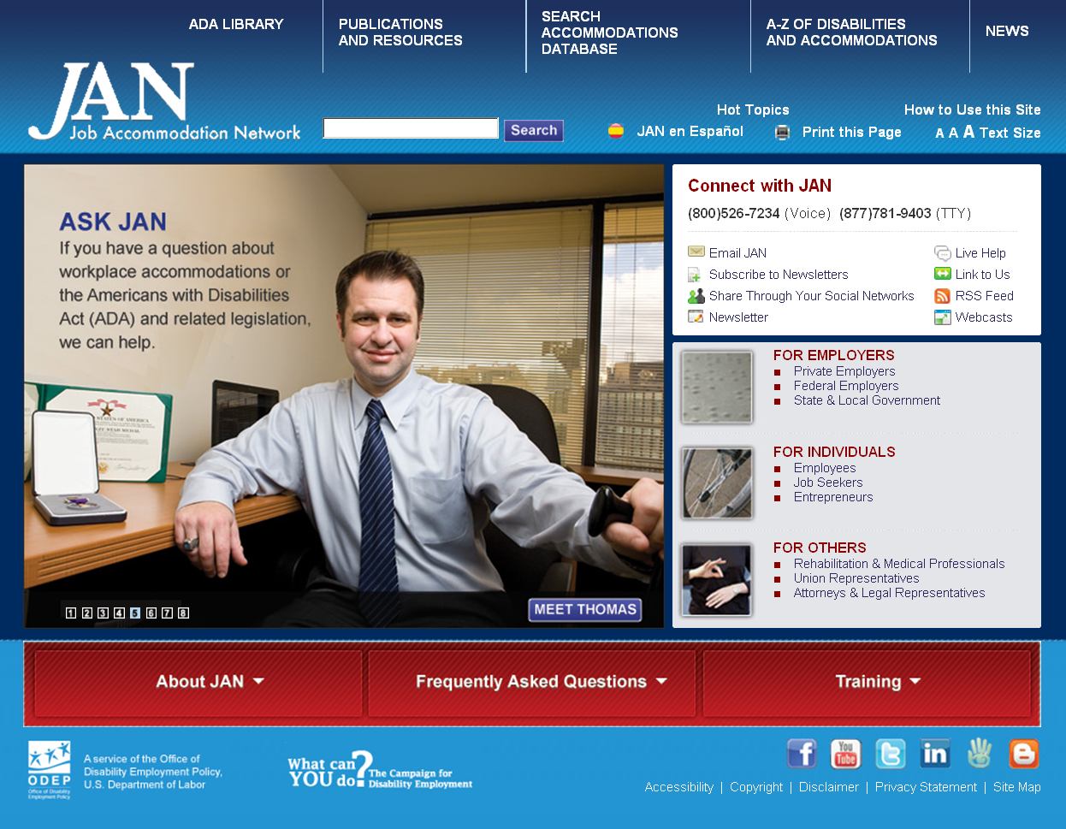
Contact JAN
Contact
(800)526-7234 (V) & (877)781-9403 (TTY)
AskJAN.org & jan@AskJAN.org
(304)216-8189 via Text
janconsultants via Skype

Slide 44
Completion Certificate
For a certificate of completion, visit
https://AskJAN.org/training/Webcast_Certificates/Certificate-February-9-2021.cfm

