Slide 1
Accommodation Solutions for Autoimmune Disorders
Teresa Goddard, M.S. Lead Consultant
Lisa Mathess, M.A., SHRM-CP, Lead Consultant

Slide 2

Housekeeping
Technical Difficulties
  Q&A option at the bottom of the screen
  800-526-7234 or 877-781-9403 (TTY)
  Live Chat at AskJAN.org
  Frequently Asked Questions (FAQ)
  https://AskJAN.org/training/JAN-Webcast-Frequently-Asked-Questions.cfm
Questions for Presenters
  Q&A option at the bottom of the screen
  Questions will be gathered into a queue

Slide 3
Housekeeping Cont’d
PPT Slides
  Click the link included in the webcast login email
Captioning
  Use the closed caption (CC) option or StreamText link shared in the webcast chat
  Transcript will be available with webcast archive
This event is being recorded
Please complete the webcast evaluation

Slide 4
About Autoimmune Diseases
People with autoimmune diseases frequently have unusual antibodies circulating in their blood that target their own body tissues.
Approximately 5 to 8% of the U.S. population (14 to 22 million people) is affected by autoimmune diseases.
Third most common category of disease in the country following cancer and heart disease.
The exact cause of autoimmune disease is unknown, but researchers attest that a combination of both genetic and environmental factors play a role in its development.
From: National Stem Cell Foundation

Slide 5
Common Autoimmune Diseases (1)
Rheumatoid Arthritis (RA)
  Common symptoms include pain and swelling in multiple joints, morning stiffness, general malaise and fatigue, muscle pain, joint deformities, decreased appetite, and weight loss.
Systemic Lupus Erythematosus (Lupus)
  Common symptoms include joint pain, skin rashes, seizures, oral ulcers, photosensitivity, and anemia.
Graves’ disease
  Common symptoms include nervousness or irritability, fatigue or muscle weakness, heat intolerance, trouble sleeping, hand tremors, rapid and irregular heartbeat, frequent bowel movements or diarrhea, weight loss, goite,r and retracted eyelids/bulging eyes.

Slide 6
Common Autoimmune Diseases (2)
Hashimoto's disease
  Common symptoms include feelings of fullness/tightness in the throat, trouble swallowing, swelling or bump in the front of the neck, tiredness, forgetfulness, depression, coarse dry skin, slow heartbeat, weight gain, constipation, and intolerance to cold.
Multiple sclerosis (MS)
  Common symptoms include blurred or double vision, muscle weakness, paresthesias (numbness or prickling sensations), pain, speech impediments, tremors, dizziness, depression, cognitive impairments (i.e., difficulties with concentration, attention, memory, and poor judgment), hearing loss, difficulty with coordination and balance, and partial or complete paralysis
Myasthenia Gravis (MG)
  Common symptoms include drooping eyelid, blurred or double vision, slurred speech, difficulty chewing and swallowing, weakness in the arms and legs, chronic muscle fatigue, and difficulty breathing

Slide 7
Common Autoimmune Diseases (3)
Cataplexy
  Common symptoms vary in severity from barely perceived loss of muscle tone (i.e., mild drooping of the eyelids) to a complete loss of tone in all voluntary muscles.
Gastrointestinal (GI) disorders
  Common symptoms range from mild to debilitating, include constipation, nausea, abdominal pain or diarrhea.
Guillain-Barré Syndrome (GBS)
  Common symptoms include varying degrees of weakness or tingling sensations in the legs, feelings that can — and most often times do — spread [symmetrically] to the arms and upper body.

Slide 8
Workplace Limitations
Standing for prolonged times
Maintaining balance
Keyboarding and mousing
Lifting materials or people
Concentration and memory issues
Working in extreme temperatures
Communicating with clients
Double vision
Visual acuity
Photosensitivity
Suppressed Immunity

Slide 9
Activities of Daily Living (1)
Accommodations:
Allow use of a personal aide/assistant/attendant at work
Allow use of a service animal at work
Make sure the facility is accessible
Move workstation closer to the restroom
Allow longer breaks
Refer to appropriate community services
Allow access to a refrigerator
Permit telework
Flexible schedule for medical treatments

Slide 10
Activities of Daily Living (2)
Assistive Technology:
Talking clocks for reminding individuals of work appointments
Medication management devices
Grooming & dressings aids
Thermal or cold wraps to help with muscle stiffness or pain while performing strenuous work tasks
Reachers to assist in grabbing items from the ground or from high places
Grip aids to assist with grasping items like pens

Slide 11

ADL Scenario (1)
Example
A clinical psychologist with MS told his employer that
he needed an exemption from a vaccine mandate due
to his condition.

Slide 12

ADL Scenario (2)
Accommodation
The employer engaged in the interactive process with the employee to understand whether a delay or a long-term exemption was more appropriate.

Slide 13
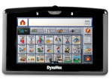
Speech Impairments
Assistive Technology:
Augmentative and Alternative Communication (AAC) device
Speech-generating communication devices with telephone
Voice amplification
Accommodation:
Communicate another way
Job restructuring

Slide 14
Speech Scenario (1)
Example
A federal employee with myasthenia gravis had previously received an ergonomic workstation and a parking-related accommodation to assist with fatigue.
However, when her job duties changed and she was required to use the telephone more frequently, she began to experience difficulties with intermittent hoarseness and vocal fatigue. This made it very difficult for her to be understood on the telephone.

Slide 15
Speech Scenario (2)
Accommodation
Initially, she tried using a voice amplification device for phones. This was semi-helpful as she was able to maintain her voice volume. She also tried using a voice amplifier for face-to-face conversations to limit vocal fatigue.
However, she still had difficulty being understood on the phone. Once her voice became hoarse the amplifier amplified her hoarseness and didn’t make her easier to understand. The employer contacted JAN and received information on TTYs and speech-generating devices that could be used with a telephone and would allow the employee to use the phone without using her voice.

Slide 16
Body Fatigue & Weakness (1)
Accommodations:
Allow use of a personal aide/assistant/attendant at work
Permit the use of a service animal
Perform ergonomic assessments
Allow a flexible work schedule & flexible use of leave time
Reduce or eliminate physical exertion & workplace stress
Schedule periodic rest breaks away from the workstation
Telework, work from home, or work remotely
Consider job restructuring
Worksite redesign/modified workspace

Slide 17
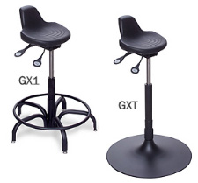
Body Fatigue & Weakness (2)
Assistive Technology:
Anti-fatigue matting
Wearable anti-fatigue matting
Ergonomic equipment
Stand-lean stools
Scooters
Walkers
Wheelchairs

Slide 18

Fatigue Scenario (1)
Example
A financial services consultant had been working remotely as part of her employer’s pandemic response. When her employer asked her to return to onsite work, she said that work from home was beneficial to her as she needed to lie down periodically to manage fatigue.

Slide 19
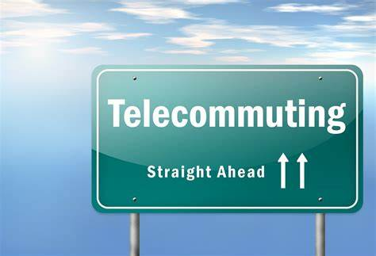
Fatigue Scenario (2)
Accommodation
The employer allowed a temporary extension of her telework, while exploring whether she could be provided a private space to lie down during breaks while onsite.

Slide 20
Vision Impairments (1)
Accommodations:
Magnify written material using hand/stand optical magnifiers
Provide large print material, screen reading software, and large-size high resolution monitor
Provide anti-glare guard and computer glasses to reduce glare
Install proper office lighting
Allow frequent rest breaks
Provide qualified reader
Implement voice output on office equipment

Slide 21

Vision Impairments (2)
Assistive Technology:
Hand/stand optical magnifiers
Anti-glare guard
Computer glasses
Screen reading software
Large-size high-resolution monitor
Choosing Among Options for Computer Users
with Low Vision

Slide 22
Vision Scenario (1)
Example
A social worker was falling behind on her documentation. She had myasthenia gravis. On days when her condition was exacerbated, she experienced increased fatigue and intermittent double vision. This caused her to have trouble using a computer in addition to headaches when attempting to complete her documentation during periods of double vision.

Slide 23
Vision Scenario (2)
Accommodation
The employee sought a referral to receive assistive technology services from a CATIS who could assist her in learning to use a computer without looking directly at
it during periods of double vision. In the short term, the employer provided voice recognition software and allowed the employee flexibility to take self-regulated breaks and to complete documentation in shorter increments at times that worked best for her.

Slide 24

Fine & Gross Motor Limitations (1)
Accommodations:
Ergonomic Assessment Providers
  Virtual
  On-Site
Ergonomic Software
  Assessment Tools
  Risk Analysis
  Workstation Design
https://AskJAN.org/topics/ergono.cfm

Slide 25
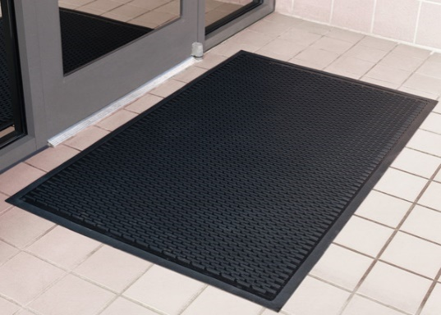
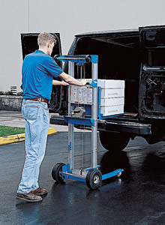
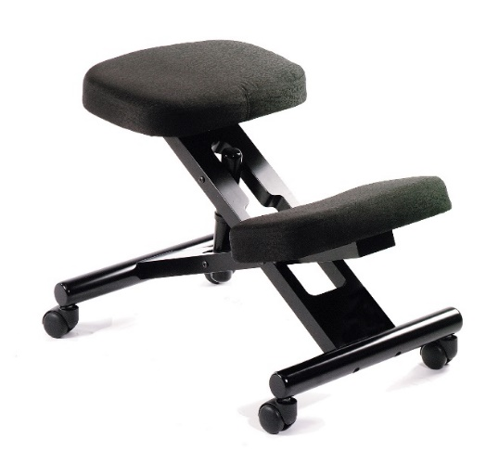
Fine & Gross Motor Limitations (2)
Assistive Technology:
Carts
Compact material handling
Speech recognition software
Grab bars
Stand-lean stools
Work platforms

Slide 26
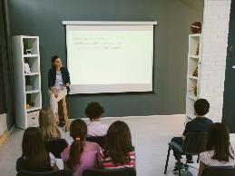
Motor Scenario (1)
Example
A junior high teacher with multiple sclerosis was preparing to return to work after a year of medical leave. She had difficulty standing due to lower extremity weakness so could not write on the chalkboard as much as needed.

Slide 27

Motor Scenario (2)
Accommodation
Her employer purchased a tablet with stylus and a projector, which allowed the teacher to sit and write on the tablet and project what she wrote on the chalkboard.
JAN's Accommodating Educators with Disabilities

Slide 28
Photosensitivity (1)
Accommodations:
General considerations:
  Provide flexible schedules/telework to avoid peak sun hours
  Limit exposure to water, ice, and other highly reflective surfaces
  Modify dress code policies to allow items that may reduce effects of fluorescent lighting and/or provide UV protection clothing/accessories
  Allow frequent rest breaks indoors or in shaded areas
If performing outdoor tasks: Combine tasks to limit exposures and allow flexible leave around low-ozone and sun flare events
If performing driving tasks: Provide window tinting and shades on work vehicles

Slide 29

Photosensitivity (2)
Assistive Technology:
UV-filtered computer screens
UV protection clothing/accessories
UV light filters
Alternate lighting
Filters in fluorescent light fixtures

Slide 30
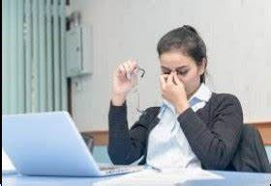
Photosensitivity Scenario (1)
Example
A federal employee with lupus had photosensitivity and was scheduled to attend training in a facility with fluorescent lighting, which aggravated the employee’s condition. The lights could not be turned off because it was too dark without them.

Slide 31

Photosensitivity Scenario (2)
Accommodation
The employer rented a training site without fluorescent lighting.

Slide 32
Memory Deficits
Accommodations:
Allow to record meetings
Provide type written minutes of each meeting
Use notebooks, calendars, or sticky notes to record information for easy retrieval
Provide written as well as verbal instructions
Allow additional training time
Provide written checklists
Provide environmental cues to assist in memory for locations of items (e.g., labels, color coding, or bulletin boards)
Post instructions over all frequently used equipment

Slide 33
Maintaining Concentration
Accommodations:
Reduce distractions in the work area
Provide space enclosures or a private office
Allow use of an environmental sound machine
Allow use of a headset to listen to music
Increase natural lighting or provide full-spectrum lighting
Reduce clutter in the employee’s work environment
Plan for uninterrupted work time
Divide large assignments into smaller tasks & steps
Restructure job to include only essential functions

Slide 34
Maintaining Stamina
Accommodations:
Allow flexible scheduling/part-time work schedules
Allow longer or more frequent work breaks
Provide additional time to learn new responsibilities
Provide self-paced workload
Provide backup coverage when employee needs to take breaks
Allow for time off for counseling
Allow use of supportive employment and job coaches
Allow employee to work from home part of the day
Provide for job-sharing opportunities

Slide 35
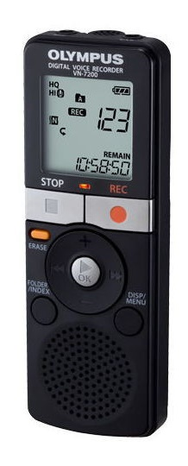
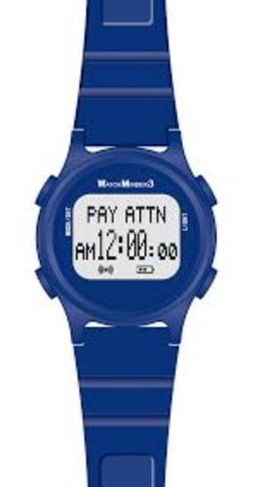
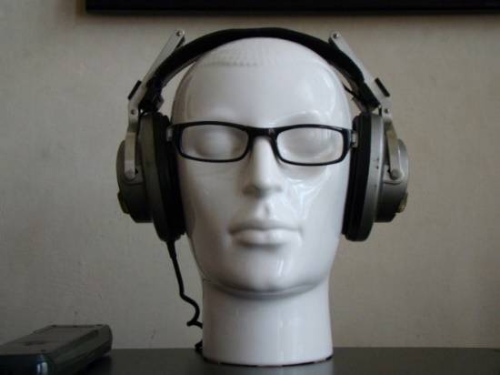
Cognitive Limitations
Assistive Technology:
Tape recorder
Environmental sound machine
Headset
Full-spectrum lighting
Smart watches

Slide 36

Cognitive Scenario (1)
Example
A bus driver with Hashimoto’s Thyroiditis was performing well in his day-to-day work but had a tendency to miss or be late to meetings required by his employer. When the employer approached him about the issue, he said the brain fog was causing him to forget about the meetings or to lose track of time when his daily routine was interrupted by a meeting.

Slide 37
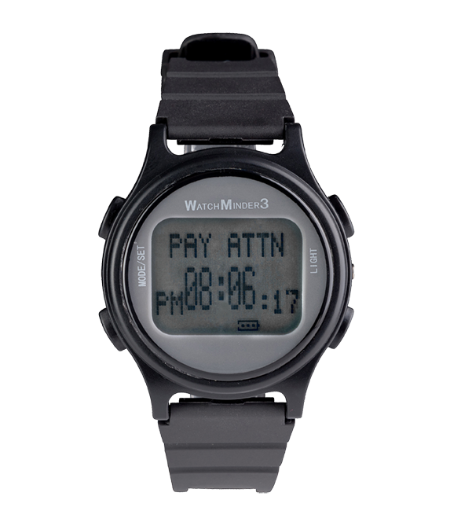

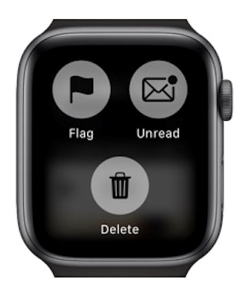
Cognitive Scenario (2)
Accommodation
The employer provided emailed reminders, but the employee was forgetting to check his email. The employer provided a smartwatch so that email notifications and meeting reminders could be received on the employee’s wrist.

Slide 38
Temperature Sensitivity (1)
Accommodations:
Modify worksite temperatures
  Allow use of heaters at workstations
  Maintain the ventilation system
  Redirect air conditioning and heating vents
  Provide work areas with separate temperature controls
Modify dress code
Allow flexible scheduling and flexible use of leave time during inclement weather
Telework, work from home, or work remotely
The Wonders of Winter – Accommodation Options for Cold Weather

Slide 39
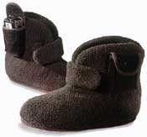
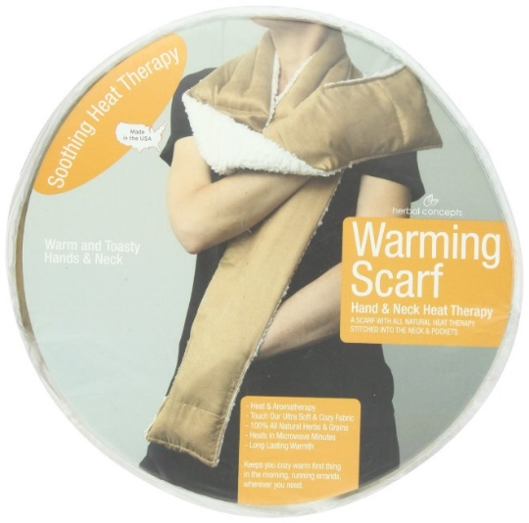
Temperature Sensitivity (2)
Assistive Technology:
Air deflectors
Fans
Portable air conditioners
Vent covers
Workstation space heaters
Heated clothing
Heated gloves
Cold resistant gloves

Slide 40
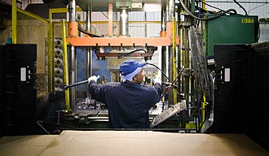
Temperature Scenario (1)
Example
A factory worker with myasthenia gravis was more susceptible to fatigue when he felt too warm.

Slide 41
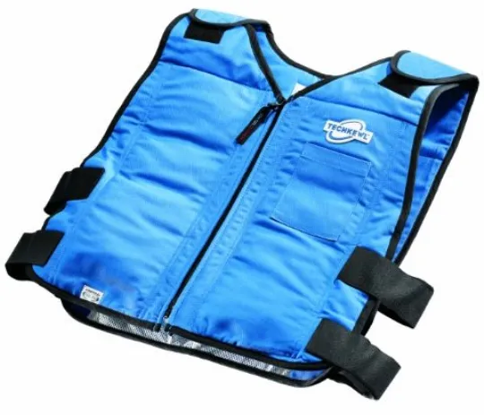
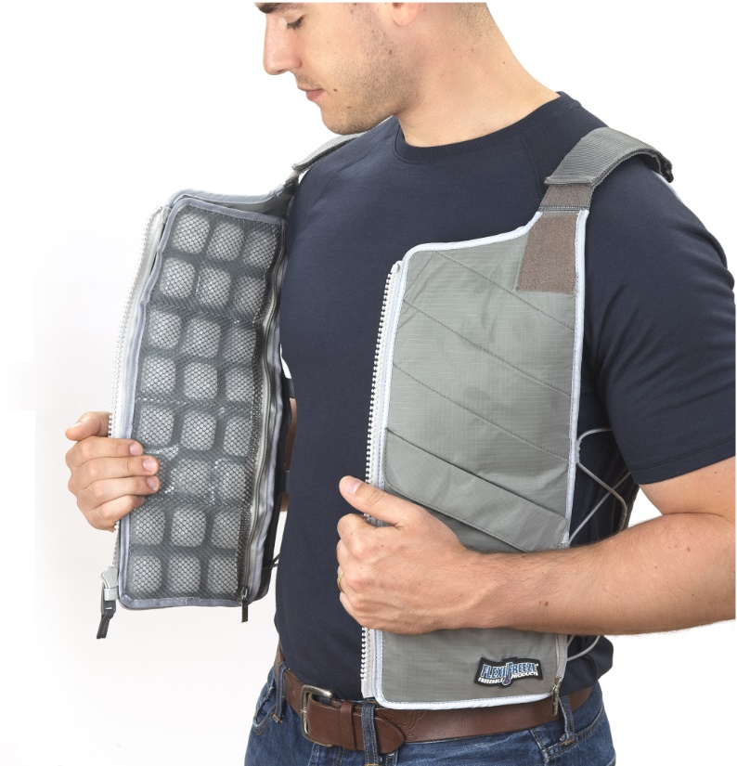
Temperature Scenario (2)
Accommodation
The employer provided a cooling vest.

Slide 42
Suppressed Immunity (1)
Accommodations:
Permit telework, remote work
Private office space
Modify schedules to limit the density of people in the workplace
Restructure job duties to eliminate or reduce the frequency of contact with others
Virtual communication/meetings/trainings/events

Slide 43
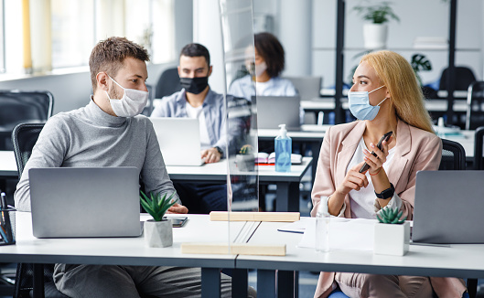
Suppressed Immunity (2)
Assistive Technology:
Provide other personal protective equipment (PPE)
Install a protective panel/shield
Request, provide, and/or allow employees to wear a mask, face covering, and/or face shield

Slide 44
Immunity Scenario (1)
Example
An IT professional was on leave and undergoing testing for unexplained pain when testing revealed that she had multiple sclerosis. She needed to have a series of infusions to treat this newly diagnosed condition. Her medical team advised against receiving any vaccines until the course of treatment was complete. Although otherwise cleared to return to work, she was temporarily unable to meet her employer’s expectations regarding vaccination.

Slide 45

Immunity Scenario (2)
Accommodation
The employer modified their vaccination policy to allow for the necessary delay in becoming fully vaccinated and allow the employee to work from home until she could meet the requirement. This also allowed the employee to return to work in a manner that was safer for her.

Slide 46

Questions
Questions

Slide 47

Need more information?
Visit AskJAN.org
Call JAN toll-free:
  800.526.7234 (V)
  877.781.9403 (TTY)
Use the JAN Live Chat @ AskJAN.org
Submit a JAN on Demand question @
AskJAN.org/JANonDemand.cfm
Email JAN @ JAN@AskJAN.org
Connect on social media
  Facebook – Job Accommodation Network
  Twitter – @JANatJAN

Slide 48
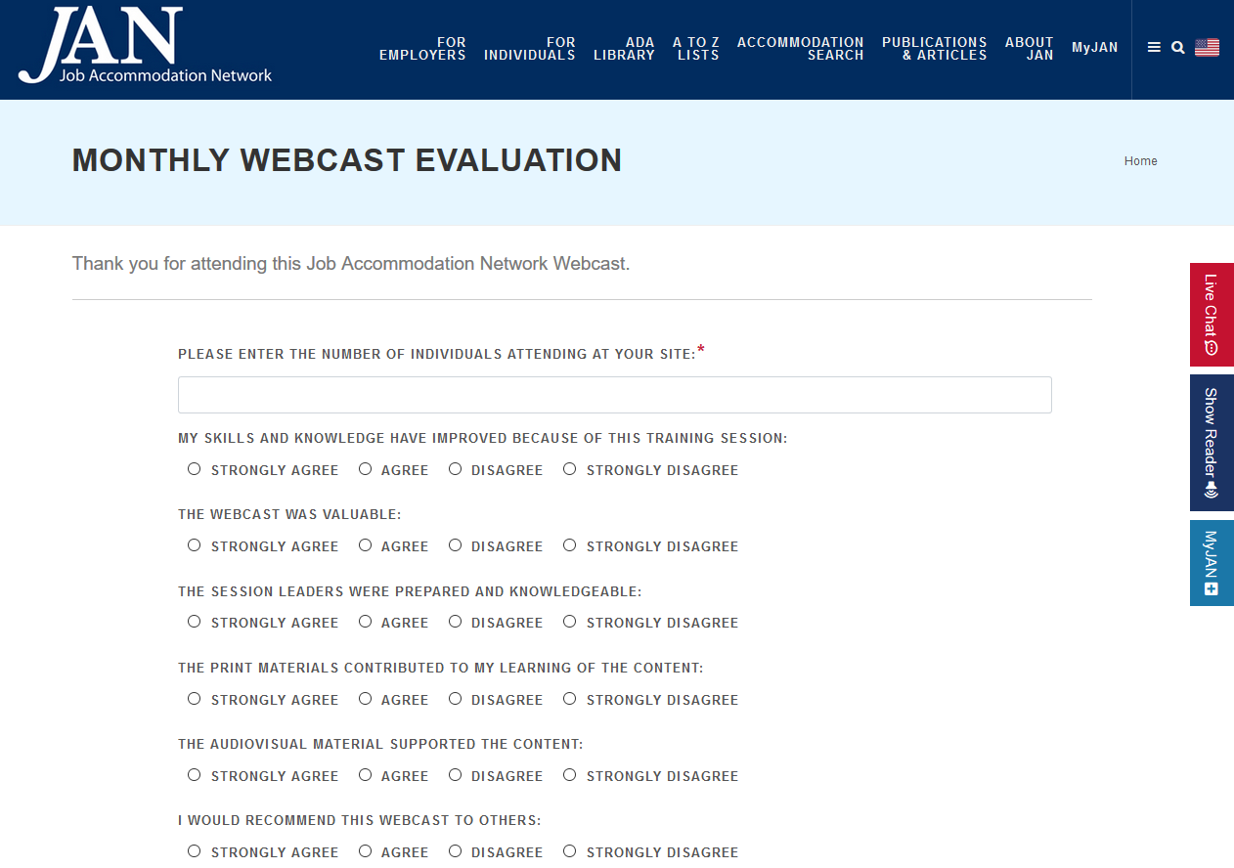
How do I claim the HR CEU?
Don’t close the JAN webcast browser.
CEU approval code will be provided via the certificate that comes up after completing the webcast evaluation.

