Slide 1
Accommodation and Compliance Webcast Series: AT Update – what’s new in 2023
Teresa Goddard, Lead Consultant, Assistive Technology Services & Sensory Team Lead Matthew McCord, Motor Team Senior Consultant Jose Gonzalez Lopez, Sensory & Motor Team Consultant

Slide 2
Housekeeping
Technical Difficulties
Q&A option at the bottom of the screen
800-526-7234 or 877-781-9403 (TTY) OR Live Chat at AskJAN.org
Frequently Asked Questions (FAQ) AskJAN.org/Training/JAN-Webcast-Frequently-Asked-Questions.cfm
Questions for Presenters
Q&A option at the bottom of the screen

Slide 3
Housekeeping 2
PPT Slides
Link to PPT is included in webcast login email, see the link now in the chat, or go to this webcast event from the Training page at AskJAN.org
Captioning
Use the closed caption (CC) option or captioning link in the chat

Slide 4
Discussion Topics
About JAN
What is Assistive Technology (AT)?
Interactive Process
Situations and Solutions
AT In Development
Questions

Slide 5
Ask JAN! We Can Help
Established in 1983
National, free consulting service
Expert, trusted, confidential guidance on job accommodations and disability employment issues
A service of the U.S. Department of Labor’s Office of Disability Employment Policy/ODEP

Slide 6
What is Assistive technology (AT)?

Slide 7
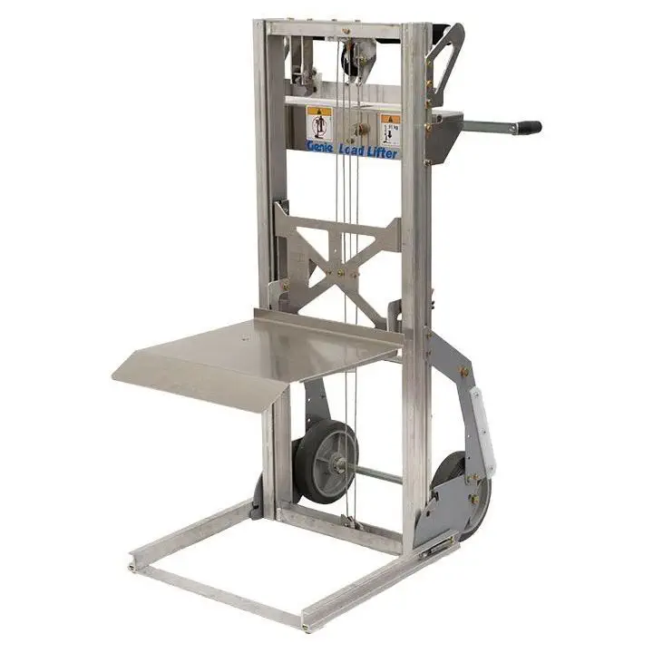
AT Defined
Assistive Technology (AT) can mean a device or service that can be used as a tool by a person with a disability to achieve or maintain functioning.

Slide 8
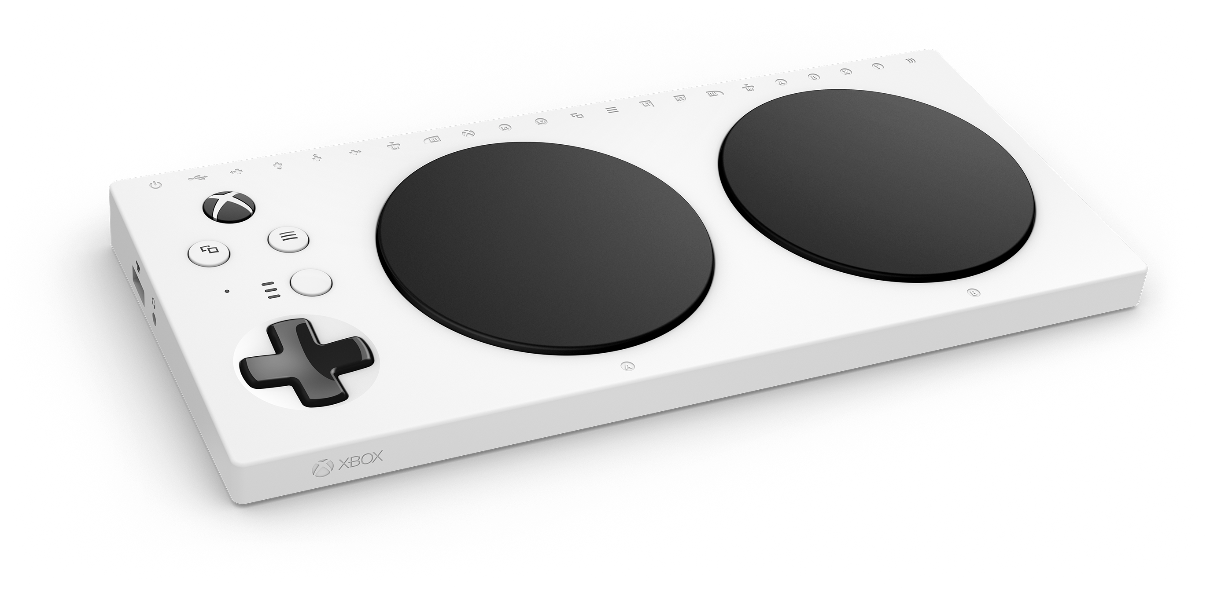
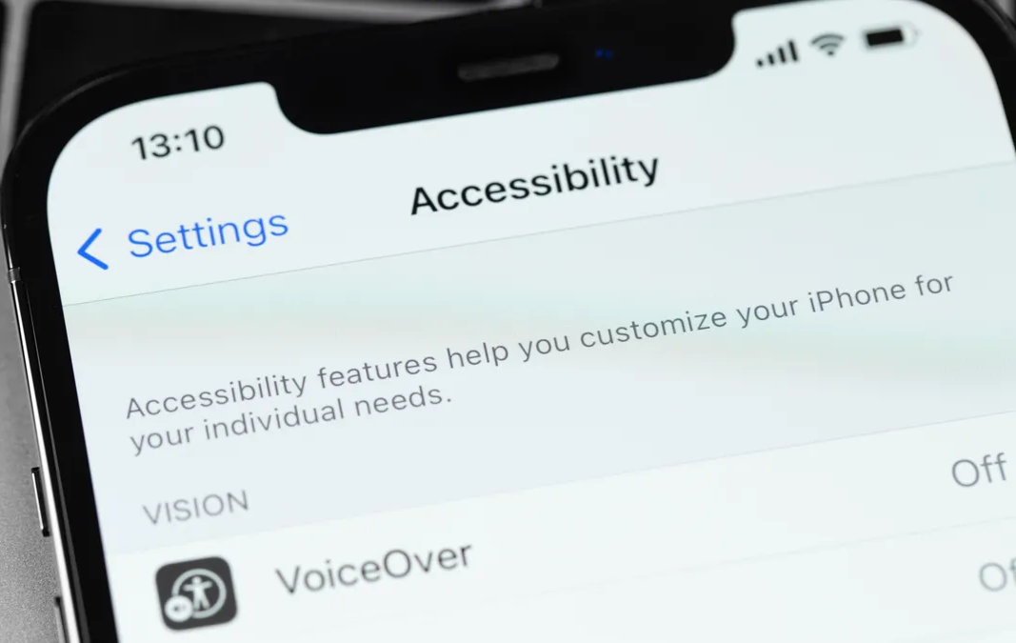
Traditional vs Mainstream Devices
Traditional AT can be devices that are used solely for completing a task by an individual with a disability.
Mainstream devices have become more accessible with the prevalence of mobile technologies and wearable devices.

Slide 9
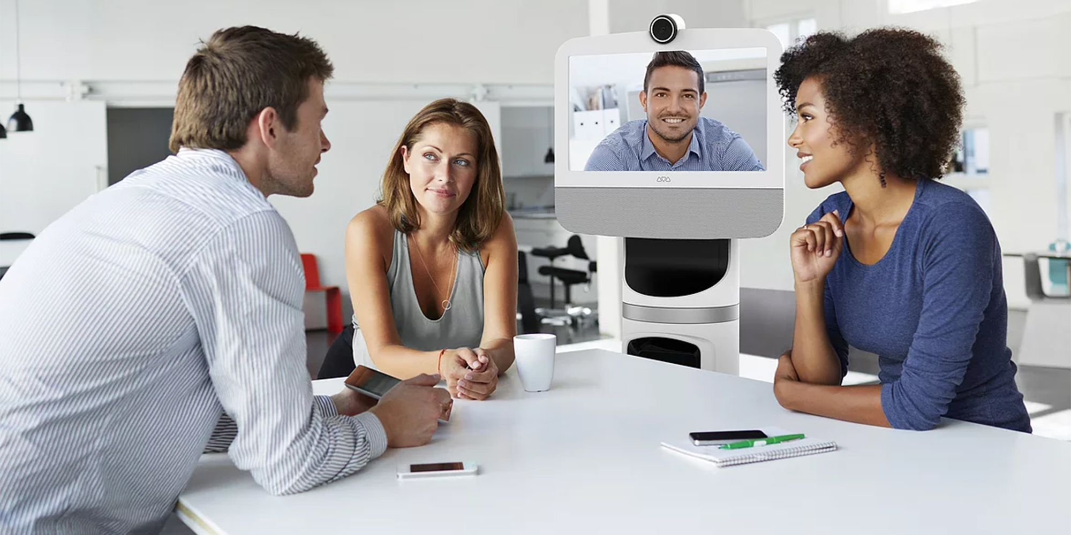
High-Tech vs Low-Tech AT Devices
High-Tech
Alternative Input Devices
Software
AAC Devices
Telepresence
Low-Tech
Workspace Modifications
Less expensive devices
Custom-designed or modified products
DIY

Slide 10
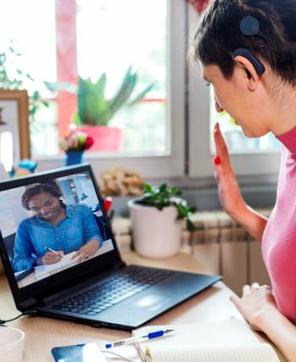
Combine Options for Effective Accommodations
Making existing facilities accessible and useable
Job restructuring
Flexible or modified work schedules
Modifying policies
Acquiring or modifying equipment
Telework
Providing a qualified reader, interpreter, job coach
Access for service or emotional support animal
Reassignment to a vacant position
Leave

Slide 11
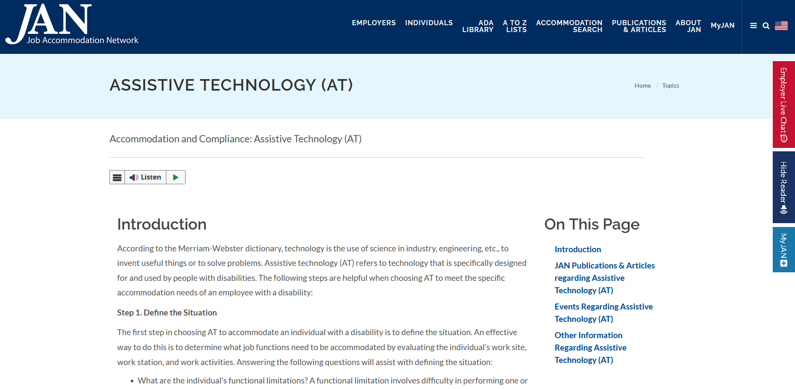
Finding Help
State Vocational Rehabilitation (VR) agencies
State AT Projects
Rehabilitation Engineering and Assistive Technology Society of North America (RESNA)
QIAT Community
Check out JAN’s resource on Assistive Technology (AT) for:
Selection tips
Referral resources
Situations and Solutions

Slide 12
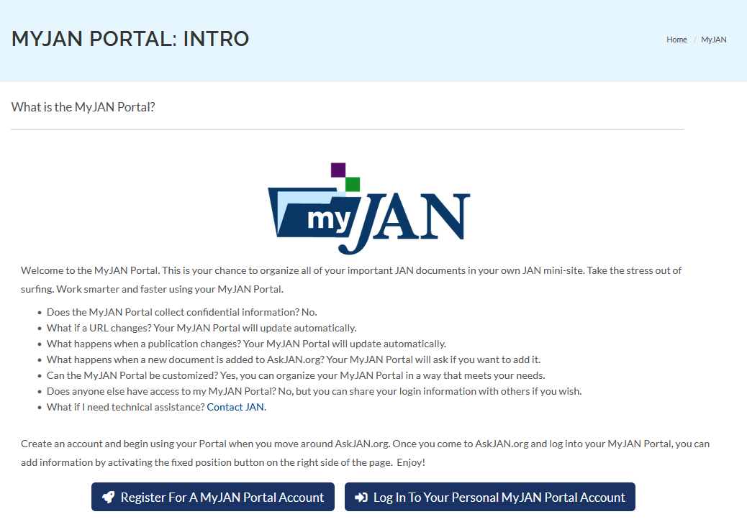
MyJAN
A personalized AskJAN.org experience. Simply make an account, add your favorite JAN resources to it, and never worry about hunting them down again.
Confidential
Updates Automatically
Customizable
And at No Cost!

Slide 13
How to stay up to date on new AT

Slide 14
Finding your path

Slide 15
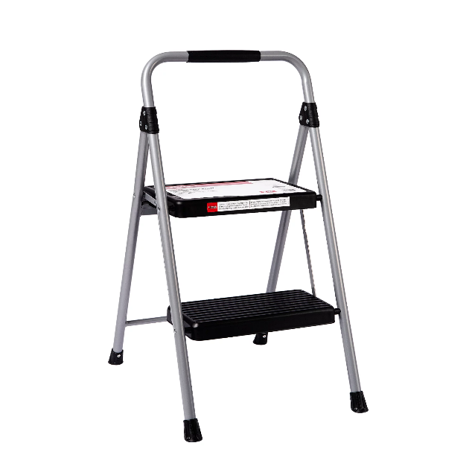
Typical Problem — Back
A little person working for a bank was using a step stool to work at the teller counter. However, constantly climbing up and down was causing them significant back pain.
The employer reached out to JAN seeking accommodation options that may help this individual with the pain they were experiencing.

Slide 16
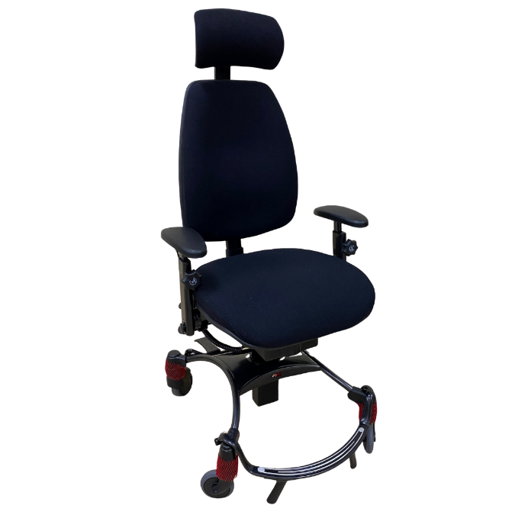
Typical Solution — Back
Options could include:
Lowering a portion of the teller counter to require the individual to climb less high.
Allowing the individual to work at the teller station that is designed for wheelchair-using customers.
Providing an elevating lift chair to raise the individual up higher so they don’t need to climb the step stool at all.

Slide 17
But What If? — Back
The counter cannot be altered, and there is no portion designed for wheelchair height? What if an elevating lift chair is too expensive?
A separate desk and chair could be set up in the lobby that would be more ergonomic, but this would require the individual to do more walking as they would be further away from what they need to do their tasks. Are there any other options that might help?

Slide 18
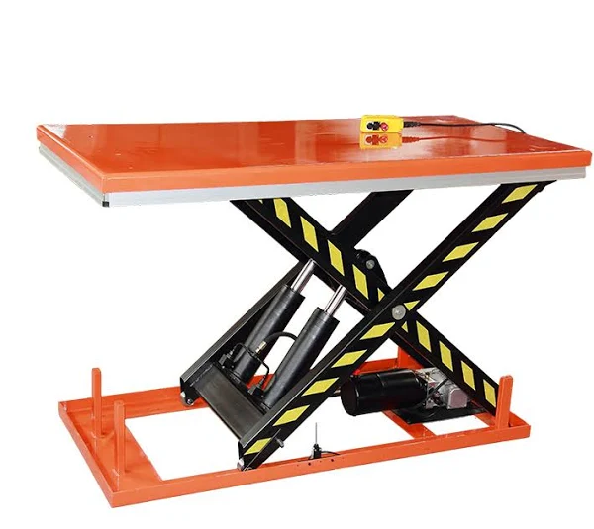
Targeted Solution — Back
A combination of an ergonomically designed chair for little people and an elevating lift table to place the chair on could work well.
With these items combined, the individual would have a supportive chair for their body size plus the ability to mechanically raise it up and down as needed throughout the day.

Slide 19
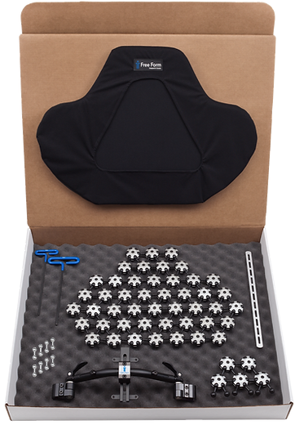
Product Spotlight — back kits
Free Form Back Kits
Customizable back supports for wheelchair users. Both upper and lower back shells can be purchased to tailor-make a chair back.

Slide 20
Typical Problem — Vision
A Human Resources Manager returned to work after a Traumatic Brain Injury (TBI). Due to this injury, he developed a visual processing disorder which causes the employee to take longer reading emails, resulting in delays in HR Department operations.

Slide 21
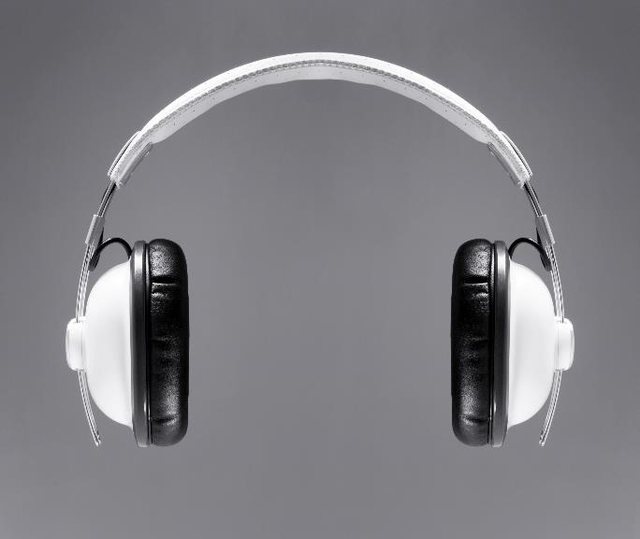
Typical Solution — Vision
The JAN consultant presented options for AT that do not rely on the employee's vision to access information. A screen reader can help by reading the email to the employee, as they are able to process auditory input with no difficulty.

Slide 22
Range of Approaches — Vision
What are some options to consider?
Find a secure and accessible location for AT storage
Designate someone to assist as a qualified reader
Seek assistance from State Vocational Rehabilitation (VR) or scripting vendor
Provide portable AT options
Orcam

Slide 23
But What if? — Vision
The employer was still concerned abut the employee’s ability to respond to emails in a timely manner, as they receive many emails, and the employee has trouble typing responses quickly.

Slide 24
Targeted Solution — Vision
The JAN consultant focused on other accommodation solutions that could be used in addition to the screen reader software. Including adding speech recognition software to have the employee dictate the emails to the computer or having a typist or assistant available to type what the employee dictates.

Slide 25
deaf situation
A welder who is deaf wanted to feel more included at the worksite. Other workers were allowed to select music to be played over the loudspeaker. He also wanted to do this.

Slide 26
Typical Solution — Inclusive Policies
This is less of an accommodation issue and more of an equal access issue. Employees with disabilities should be included in social activities in the workplace. This can even include providing an interpreter to assist with communication at employer-sponsored social events such as holiday parties. The employer allowed the employee to participate in selecting music.

Slide 27
But What if? — Hearing
To the dismay of administrative workers whose space shared a wall with the workshop, he wanted to listen to music loudly enough to feel the vibrations. Unfortunately, this was found to be disruptive to the other workers. HR contacted JAN in preparation for setting up a meeting with the employee and an interpreter.

Slide 28
Communication — ASL
Basic tips for communicating through a sign language interpreter:
Choose an effective interpreter
Prepare setting
Prepare participants
Consider notetaking assistance
Interact directly with person who is deaf
Relax and use normal tone and speed
Respect interpreter’s professional judgement and ethics
Consider also using captioning with interpreting in video calls

Slide 29
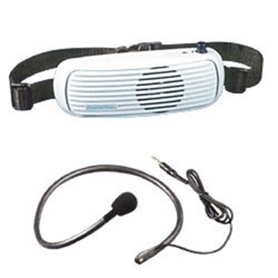
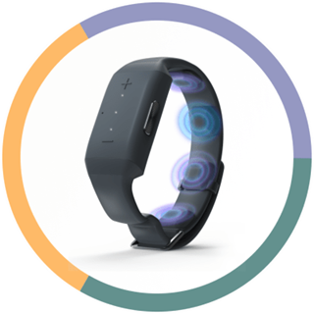
deaf solution
The JAN consultant suggested a wearable speaker, such as a Chattervox, that the employee could wear facing their body instead of facing outward. They also discussed Neosensory and Sensate as other ways to provide tactile feedback while listening to music.

Slide 30
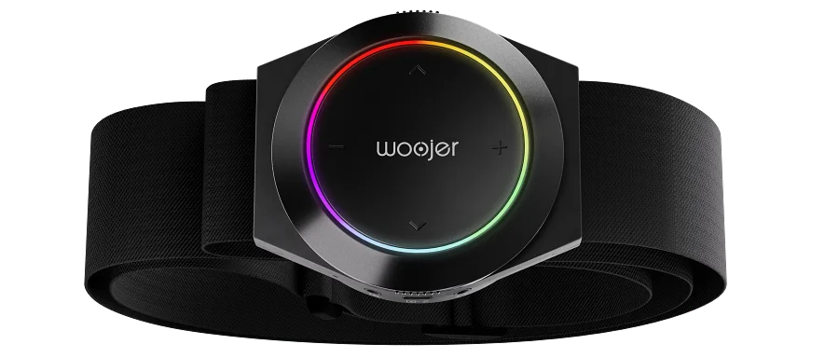
Updated Solution — Woojer Strap 3
Woojer Strap 3
This wearable strap allows one to feel sound from music, video soundtracks, etc.

Slide 31
Trends and Product Updates

Slide 32
2023 Hot Topics and Trends
Artificial Intelligence (AI)
As an accommodation
In hiring
Hybrid Work/Onsite
Ownership and equipment
Hidden Disabilities
Disclosure issues

Slide 33
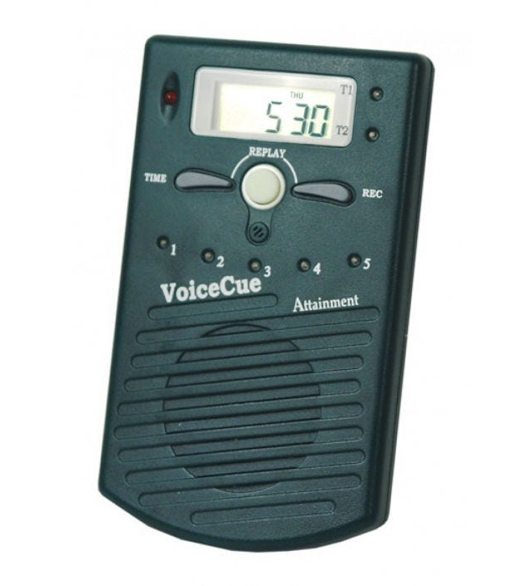
Gone but not forgotten
Attainment VoiceCue
Discreet auditory cueing
Wearable
Potential replacements
Picture schedule
Smartwatch/Smartphone reminders
Watchminder

Slide 34
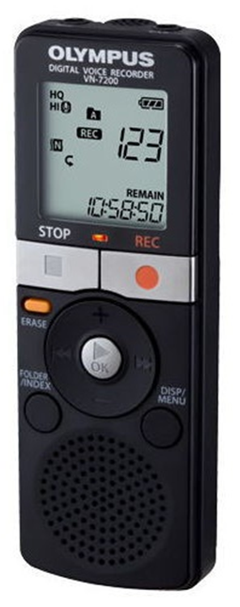
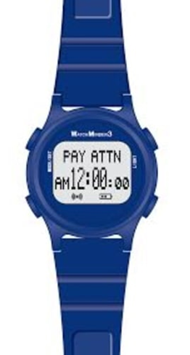
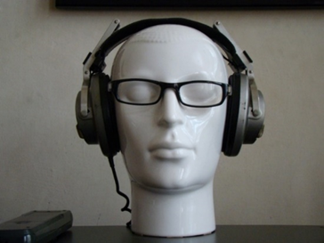
Additional Cognitive AT options
Digital Recorder
Environmental Sound Machine
Headset
Full-spectrum Lighting
Smart Watches

Slide 35
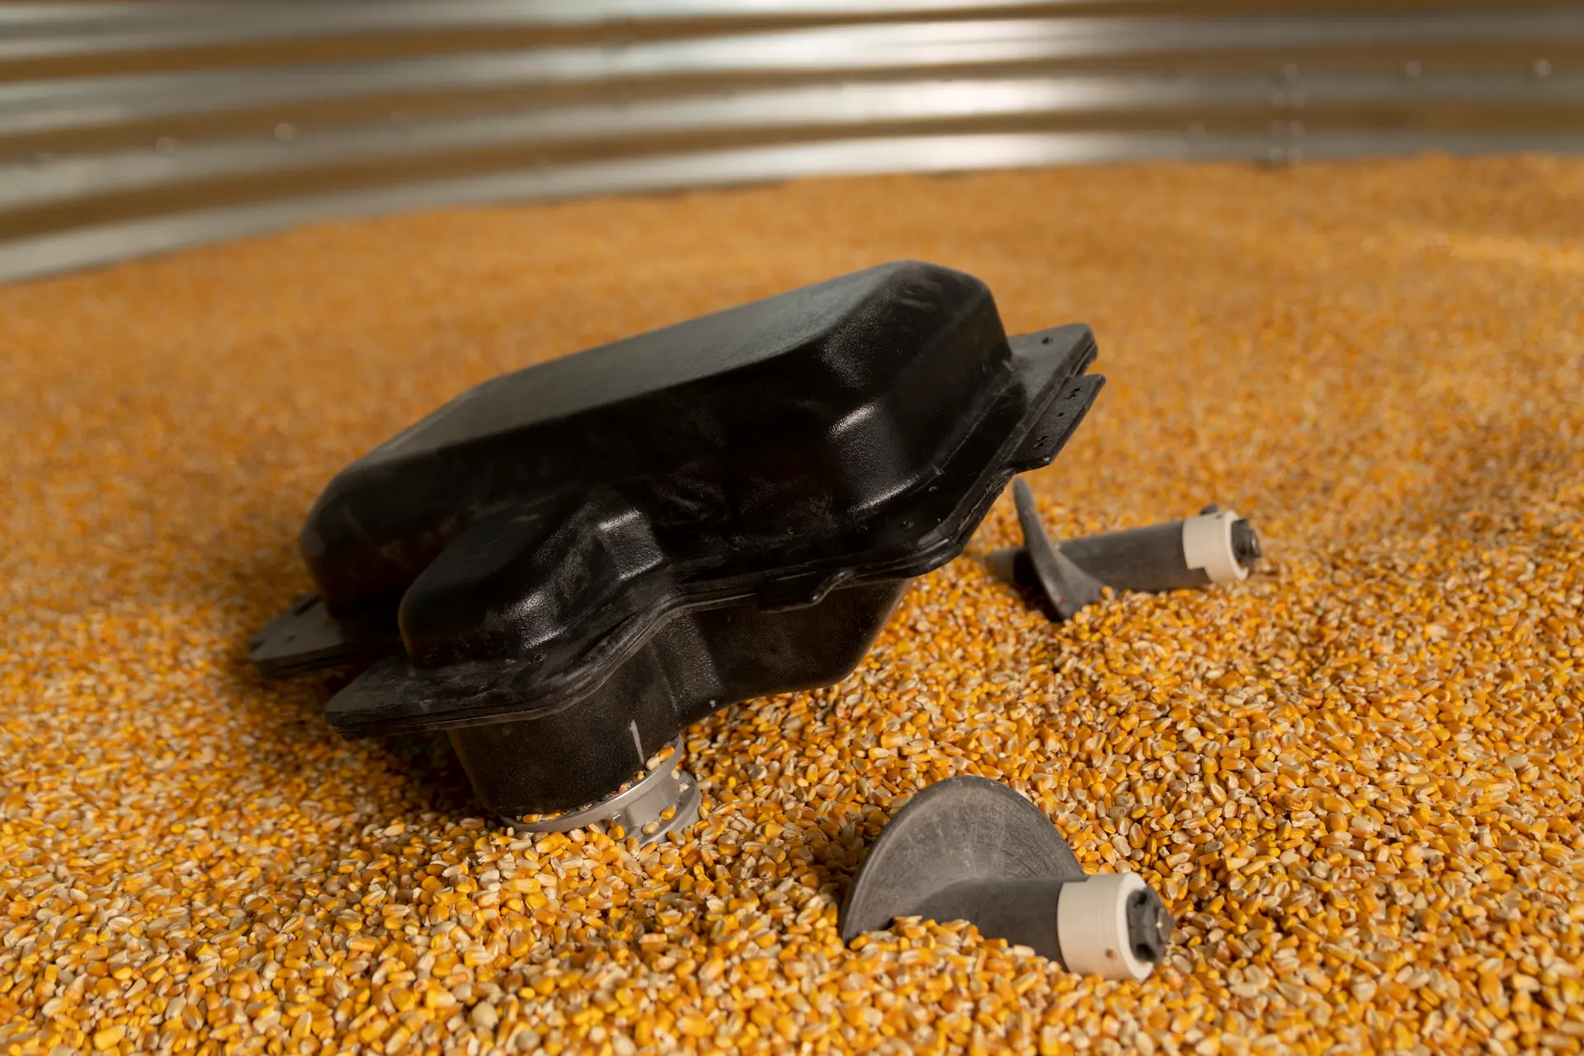
In Development — Farm Safety Innovation
Grain Weevil:
Grain Bin Management Robot
Redistributes grain in granaries
Reduces need to physically enter granary
Uses augurs to move through grain

Slide 36
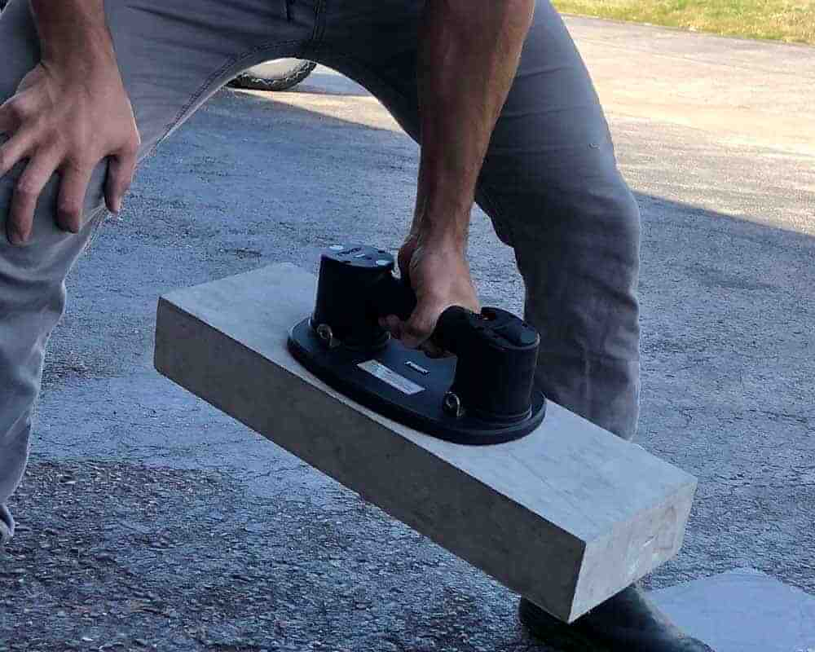
New Option — Construction Tool
GRABO Lifting Tool
This heavy-duty lift assist device can be used to lift, move, and carry concrete, glass, drywall, and more.

Slide 37
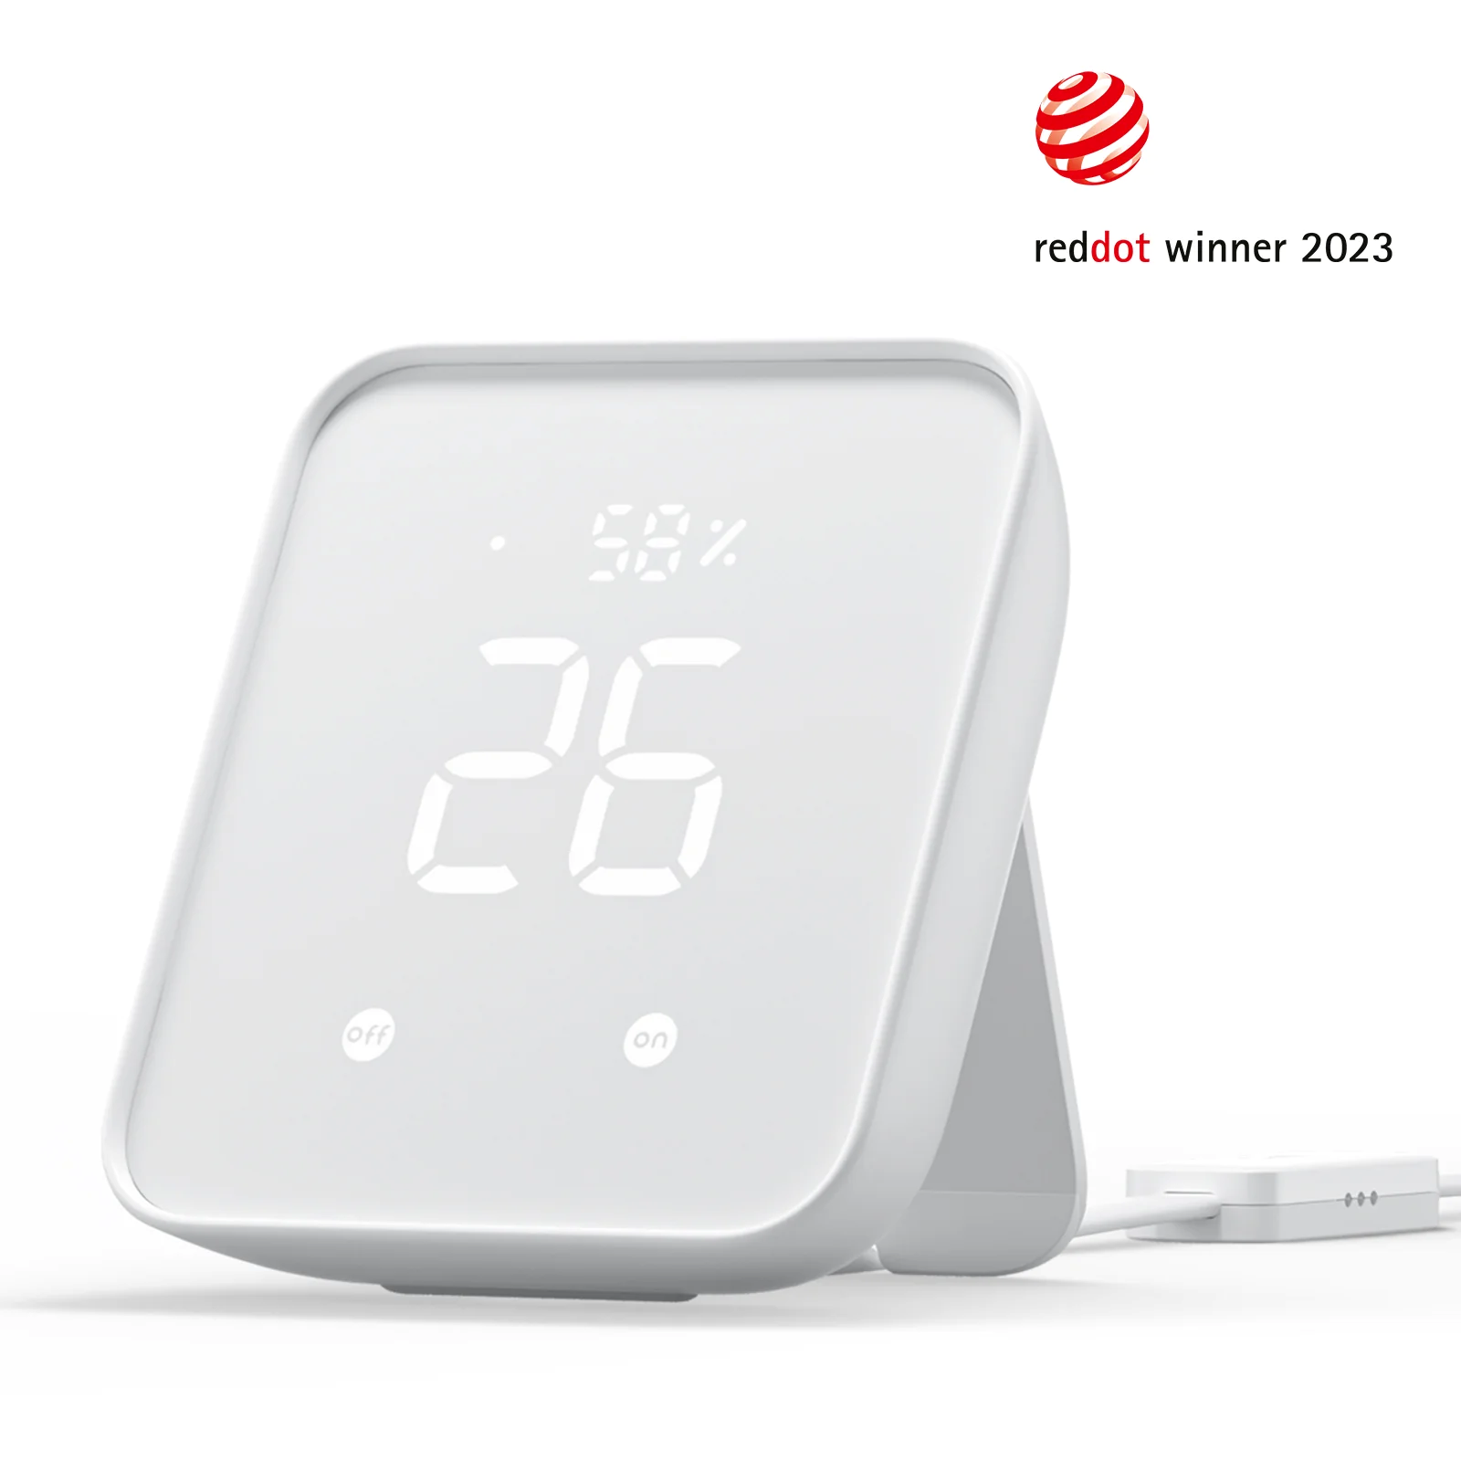
New Option — Switch Manager
SwitchBot Hub 2
This updated Hub for the SwitchBot smart home ecosystem can be used to control compatible blinds, curtains, and more. SwitchBot Hub 2 also supports old infrared appliances and can also connect other SwitchBot products via Bluetooth and Wi-Fi to build a more complete smart home experience.

Slide 38
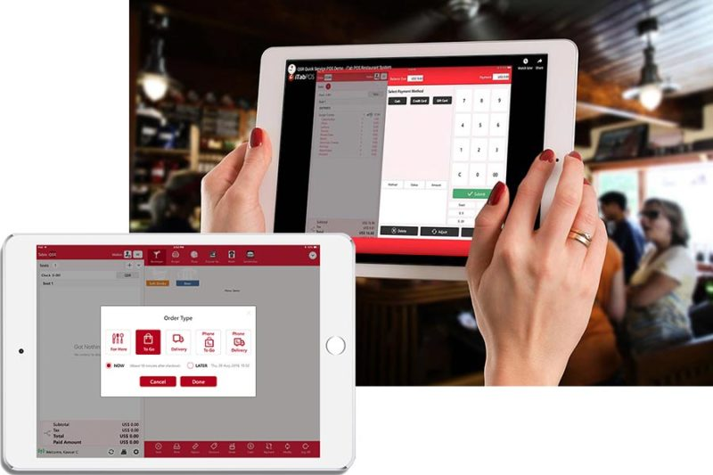
New Option — Accessible POS system for Food Service
iTab POS
iTab POS can navigate the order entry screen using text-to-speech technology but also provides built-in audible prompts and responses. For example, all items or products being rung up will be announced one by one.

Slide 39
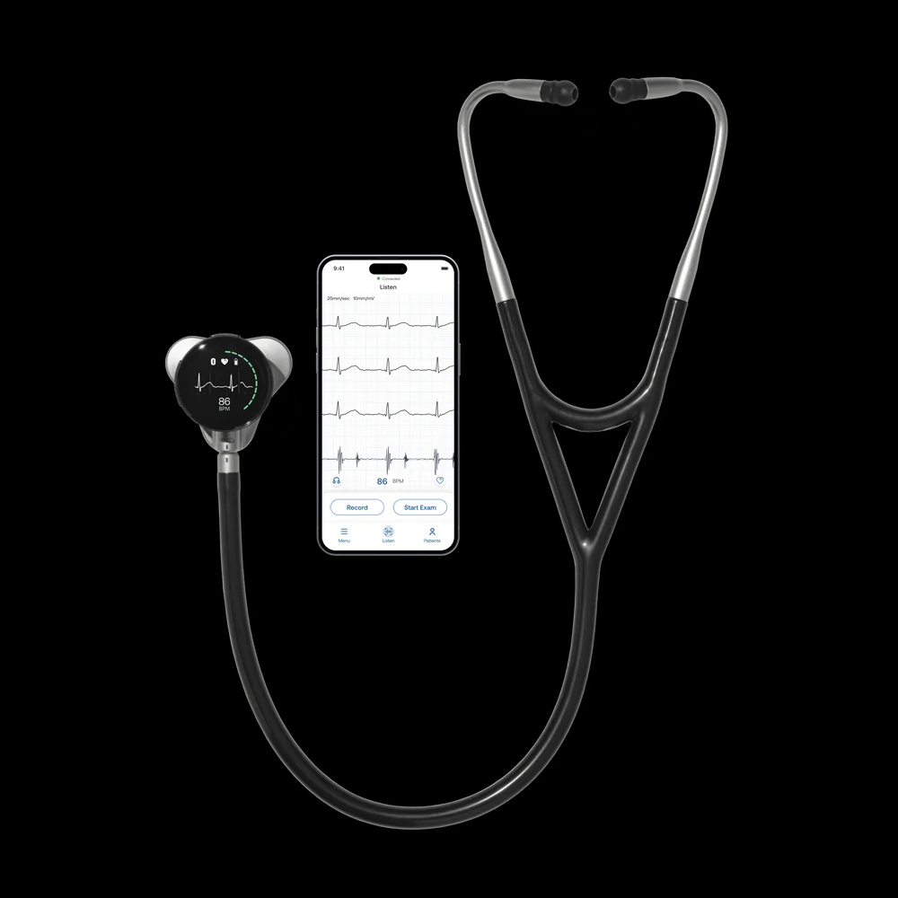
New Possibilities — Amplified digital Stethoscope
Eko CORE 500™ Digital Stethoscope
The CORE 500™ is the first digital stethoscope with high fidelity audio, a full-color display with disease indication, and 3-lead ECG.
Up to 40x amplification
Wireless listening option

Slide 40
Questions?

Slide 41
Thank you for attending “Assistive Technology (AT) Update – What’s New in 2023”
Next JAN Webcast: “Accommodation Solutions: Substance Use Disorder” Thursday, Sept 14 @ 2:00 p.m. ET
JAN Training Events & Resources AskJAN.org/Events/Trainings.cfm

Slide 42
Complete the Evaluation To claim the HR CEU
Don’t close the JAN webcast window
Evaluation will open in a new window
Complete the evaluation and click on “View your certificate of completion.”
Or scan QR code

Slide 43
Contact JAN for More Information
Visit
AskJAN.org
Call
800.526.7234
877.781.9403 (TTY)
Live Chat
@ AskJAN.org
Email
JAN@AskJAN.org
Social Media
Facebook – Job Accommodation Network Twitter – @JANatJAN

