Slide 1
Effective Use of a Support Person – Job Coach in the Workplace Janet D. Fiore, The Sierra Group Anne Hirsh, Job Accommodation Network

Slide 2
Janet D. Fiore, CEO – Accommodations Expert
A national authority on disability, diversity & compliance policy, diversity & accommodations award winner, social entrepreneur, and female executive whose own disabilities fuel her passion for workplace equality
A national authority on disability, diversity & compliance policy.
Frequent SME in the media: Forbes, Inc. Magazine, SHRM, Business Journal.
Advocate on the Hill, 300+ visits to Members of Congress & Administration, testified on Small Business
A woman, social entrepreneur, person with disabilities, and accommodations expert.
Has made over 10,000 workplace accommodations
The Sierra Group Academy trains/places approximately 300 adults with disabilities annually.
Runs RecruitDisablity.org, premier job board matching people with disabilities with employment
Responding to corporate demand for practical skills/certification, Janet released an online course that provides step by step tools for business professionals to grow their skills as a CERTIFIED DisabilityRecruiter©
Highlighted corporate clients include: Comcast | Tiffany & Company | Aetna | Toyota | FedEx Verizon Media Independence Blue Cross | MidAtlantic ADA Center | Capital One
janet.fiore@thesierragroup.com
800.973.7687
www.thesierragroup.com
“Together, we are driving up employment for Americans with Disabilities”

Slide 3
Learning Objectives
Debunk the MYSTERY of Competing Roles and Responsibilities
How to Support both Employer & Employee
Benefits of Onsite vs. Remote Job Coaching
Coaching for Skill Gaps, Behavior Modification, & Accommodation Utilization
How to Combine
Human Factors
Technology, and
Teams

Slide 4
Who Uses a Job Coach, Why & How Does it Happen
WHO:
Entry Level Employees
Career Professionals
WHY:
To Develop and Maintain Skills of the Job
HOW:
Coaches are hired by Employer, or State Voc Rehab Agency

Slide 5
Dual Role of the Coach
Employer Need During Onboarding & Retention
Duties of job learned and performed to meet quality and productivity standard
Employee’s Potential Needs During Onboarding & Retention
Extra time to learn
Extra assistance via a coach during training
Skill Mastery, Behavioral Adaptation, & Accommodation Use

Slide 6
Success Factors
Communication
Three way, open and inclusive of employer, employee and the support person/coach
Outcomes
Three way: the coach sees ensures that the duties of the job are carried out to the employer’s expectations; and that the employee is on a path to do the job independent of the coach
Perceptions
Three way: the coach ensures that the employer and the employee feel valued and assisted via the addition of the coach at the workplace

Slide 7
Scenario 1 – Entry Level Retail Job, requires “job save” coaching when duties are expanded
Young man on the autism spectrum works stocking shelves at a small pharmacy in greeting- card/novelty paper department
Duties shifted from stocking only to include cash register coverage as needed
OBSTACLES:
Learn the cash register
Learn flexibility of stopping and starting mid-task

Slide 8
Scenario 1, solution REMOTE vs ONSITE Hybrid Coaching Modalities
Cognitive Strategies: Job of stocking will never be done, always new inventory, and register coverage varies with foot traffic, etc.
Always do what my boss asks even when other work is not complete
Coaching onsite and between shifts regarding flexibility/frustration
Skill development: Learn how to operate register, count out change, etc.
Practice, develop muscle memory

Slide 9
Let’s have
a conversation about this.

Slide 10
Scenario 1, cont. Hybrid Coaching Modalities, cont.
PRE-COVID Coaching arrangement
ONSITE Support for “hard skills
ONSITE and between-shift coaching conversations for soft-skill development (include discussion on why to ask for and receive help, need to be flexible to bosses request, not one’s own judgment
During COVID-19 “Stay-at-Home” orders
Coach’s company was not performing on-site services due to health and safety concerns of its own workers with various disabilities
Employee was permitted to FaceTime with the Coach to:
Monitor and coach on skill development
Learn to increase productivity
After work calls regarding Flexibility and Behavior continued

Slide 11
Questions?

Slide 12
Scenario 2. – Skill Mastery Requires Extra Practice & Assistive Technology Use Call Center Setting
Middle aged woman with paraplegia and mild memory issues is hired to do remote customer service work. She has excellent computer and phone skills, plus basic familiarity with her AT that includes Speech Input and a customized ergonomic workstation (height adjustable desk, mouse/keyboard at angles to support her stylus input keying style.
Assist her in learning duties of the job
Learning to navigate proprietary software
Remembering the step action items required on each call
Meeting Call Per Hour Minimums
OBSTACLES:
AT will dramatically assist in her productivity, however she’s resistant to learn it
Memory Aids must be developed via joint input of supervisor, employee and coach
Frustration abounds not due to skills, but due to call time being higher than average

Slide 13
Questions?

Slide 14
Scenario 3 – Research & Design Professional Needs Job Coach for Human Factors during return-to-work post psychological trauma
Master’s level woman returns to work 6 months post accident
Employer provides accommodations for low vision and anxiety
Performance suffers because she “zones out” forgets details covered during team meetings
OBSTACLES presented to the Job Coach:
Co-Workers and Supervisor lack understanding
This heightens her anxiety response
She ”tunes out” during design team meetings/misses details

Slide 15
Questions?

Slide 16
Where and How Effective Job Coaching Happens is:
Situationally Dependent, and
Aided by:
Communication
Team Work
Trial and Error
- onsite
- remote interactions
Creativity, &
A sense of humor and actions that value all players and all outcomes

Slide 17
Results of Effective Use of Job Coach
Employer/Team
COACHEE
Morale maintained
Productivity maintained
Skill attainment goes up
Productivity met
Memory & Concentration improve
Work Flow Awareness is maintained
Use of Accommodations is situationally appropriate

Slide 18
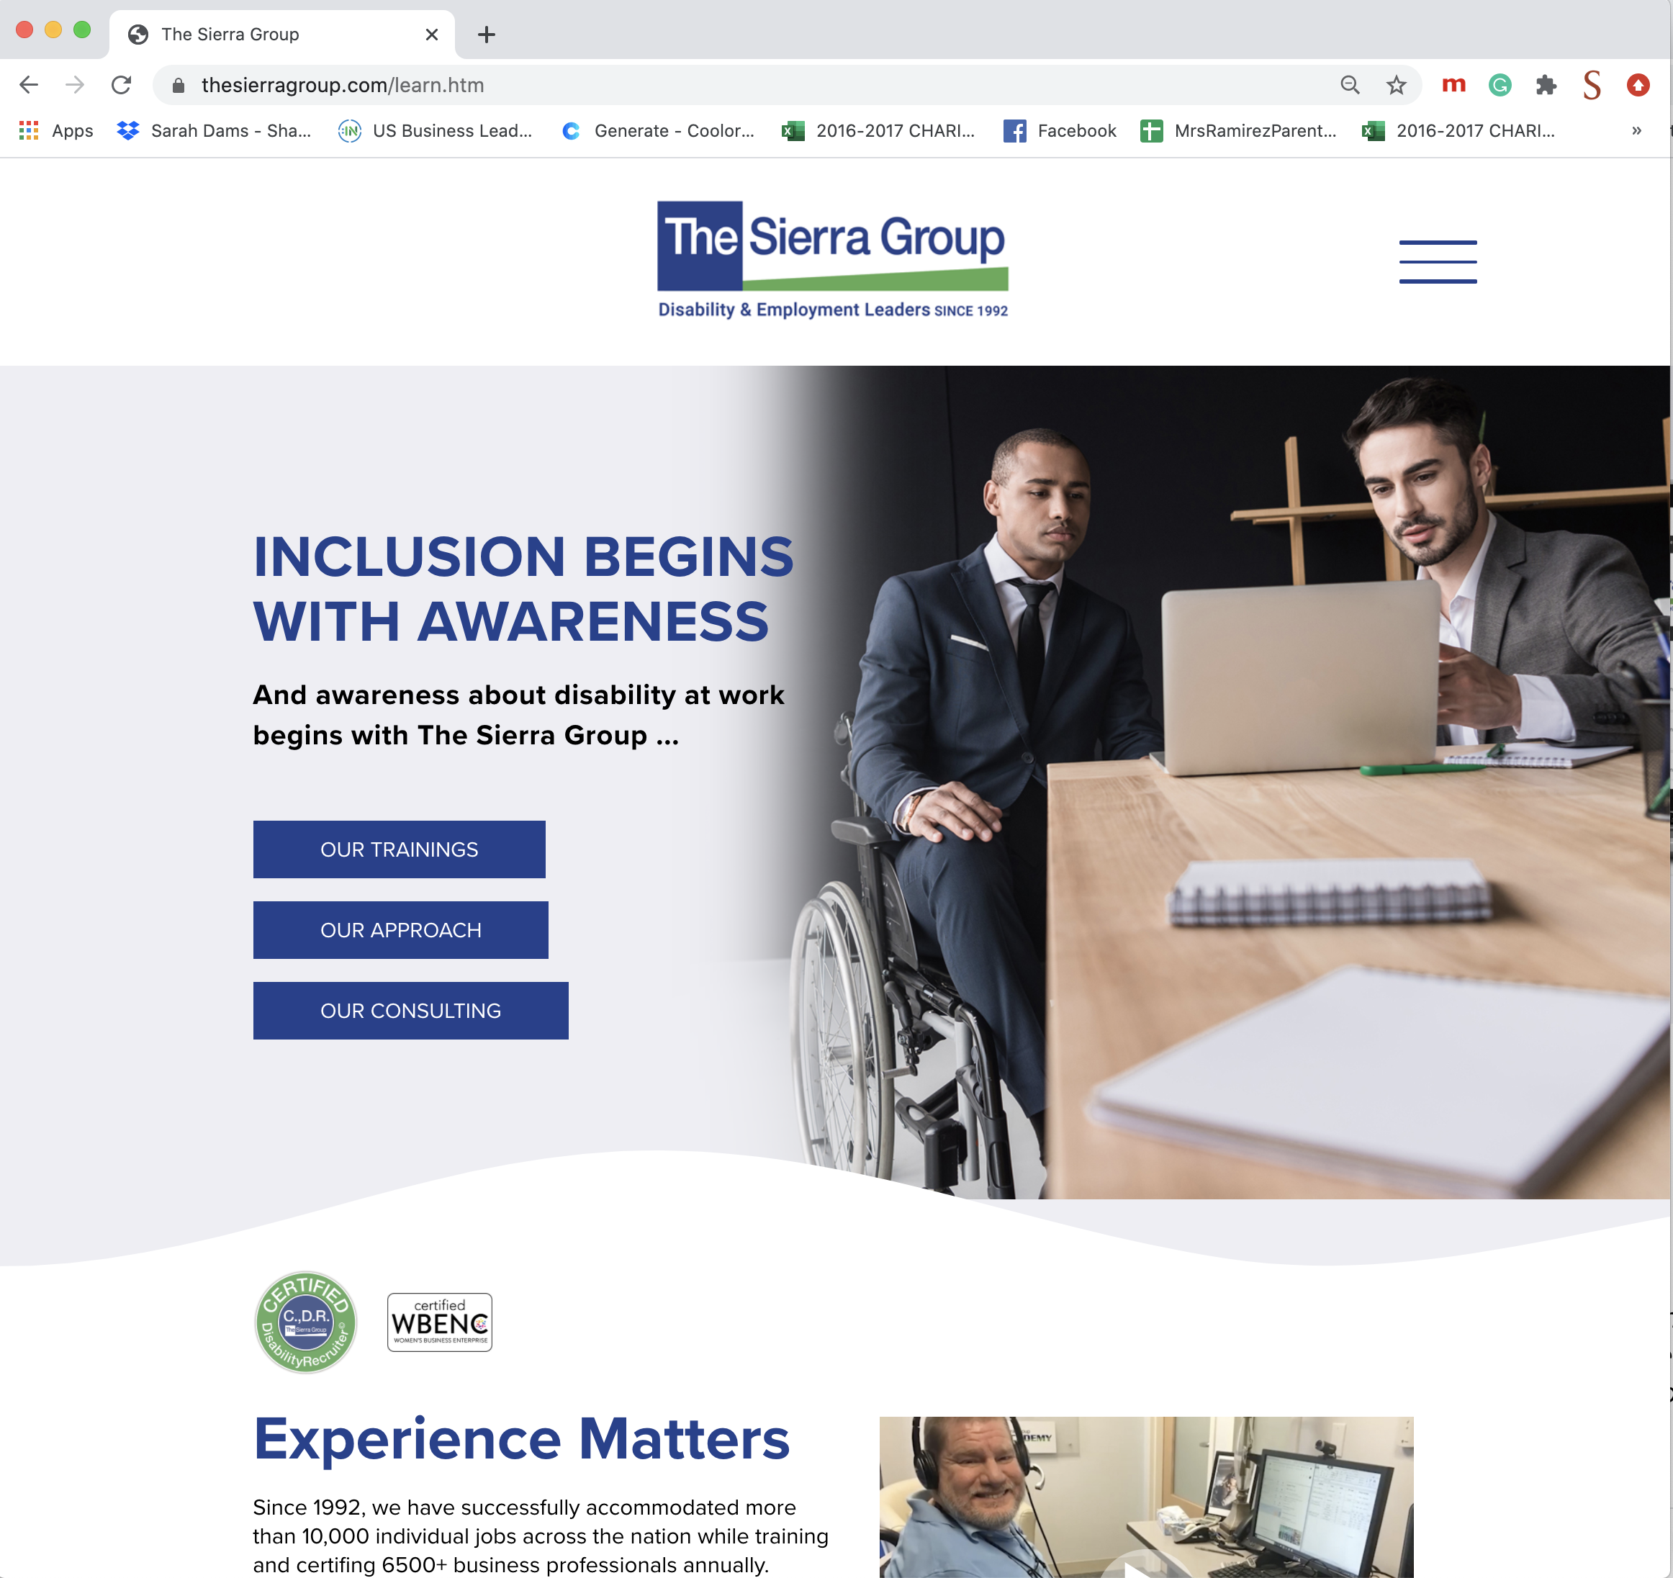
Please visit The Sierra Group for Workplace Coaching, Online training, Applicants and more …
Janet.Fiore@TheSierraGroup.com
800.973.7687
TheSierraGroup.com

Slide 19
Questions?

