Slide 1
Assistive Technology Basics
Teresa Goddard
Lisa Mathess
(800) 526-7234 (Voice)
(877) 781-9403 (TTY)
jan@askjan.org

Slide 2
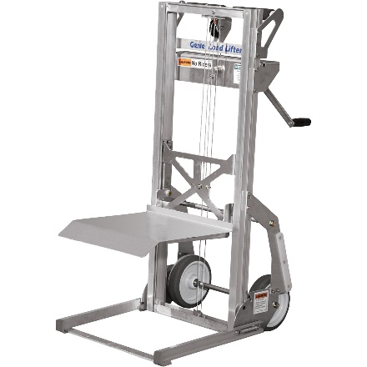
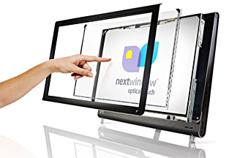
Assistive Technology
What is Assistive Technology?
Assistive Technology (AT) can mean a device or service that can be used as a tool by a person with a disability to achieve or maintain function.

Slide 3
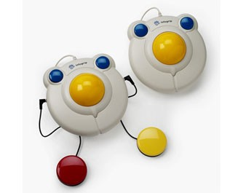
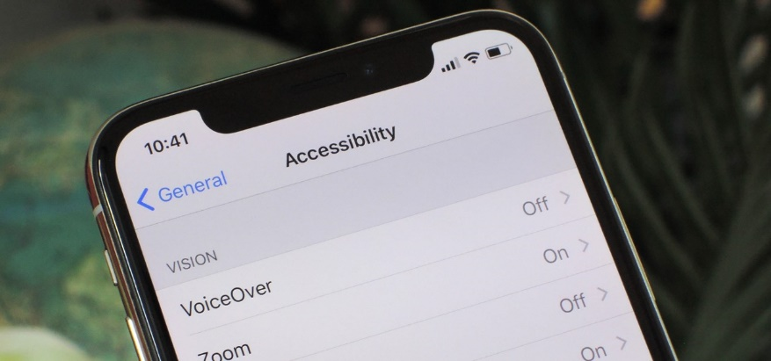
Assistive Technology
Traditional AT vs Mainstream Devices
Traditional AT could be devices that are used solely for completing a task by an individual with a disability
Mainstream devices have become more accessible with the prevalence of mobile technologies and wearable devices
Notes:
Low Tech, High Tech, Mainstream--- AT is anything that helps a PWD perform a specific task
Traditional AT -- such as magnifiers, alternative keyboards, or various software options for learning disabilities
Mainstream Devices -- For example, what was once add-on specialty features, is now a built in feature that everyone can use. We now have speech recognition, speech output, word prediction, color contrast, and alternative input devices as standard features on the devices we use for everyday life.

Slide 4
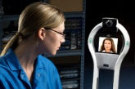
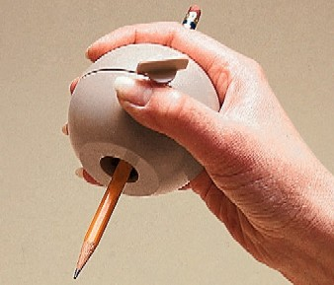
Assistive Technology
AT Devices
High Tech
Alternative input devices
Software
AAC devices
Low Tech
Workspace modifications
Less expensive devices
Custom-designed or modified products
Notes:
When we think of AT we might automatically think of high tech, futuristic devices rather than simple modifications. In this slide we have a picture of a woman communicating with a coworker through a robotic device, which is a newer technology that could be useful for someone who works from home. Other higher tech options could include alternative input devices, software, or alternative and augmentative communication devices-also called AAC devices.
But often, AT is low tech and can be implemented fairly easily. Workspace modifications can often be made at little to no cost and there are all kinds of inexpensive devices, such as the gripping aid pictured on this slide. AT might also be a custom designed or modified product and customization doesn’t always translate into high cost. Removing the legs of a computer desk can be a very low cost custom modification for an individual of short stature.

Slide 5
Assistive Technology
Alternative Input Methods
Alternate keyboards
Alternate mice
Speech recognition

Slide 6
Assistive Technology
Alternative Output Methods
Screen Reading
Screen Magnification

Slide 7
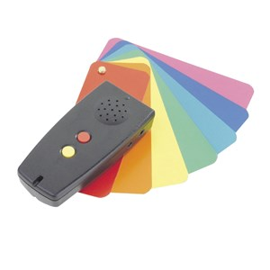
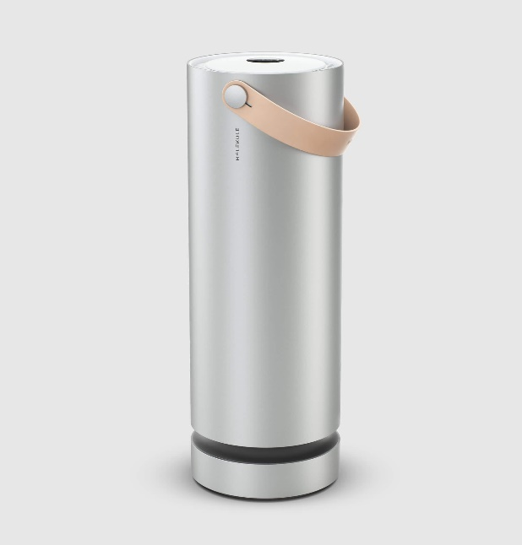
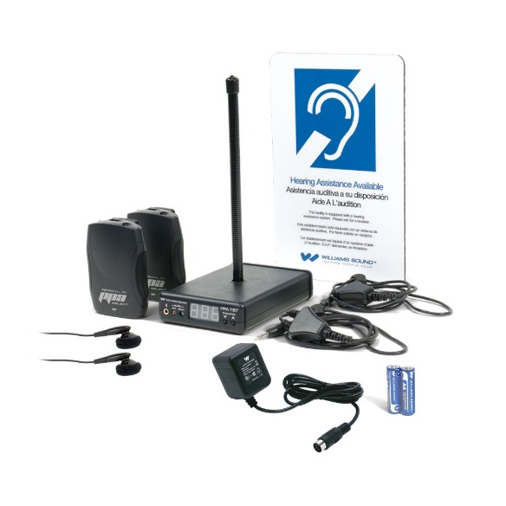
Assistive Technology
Frequently Requested Products – Sensory

Slide 8
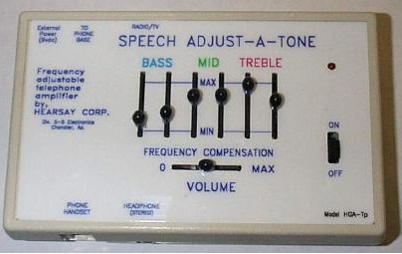
Assistive Technology
Speech Adjust-a-Tone Telephone Amplifier

Slide 9
Assistive Technology
Example
A nurse with a hearing impairment worked the night shift and had to talk to doctors who called for information. She was having difficulty hearing over the telephone. The employee asked to be moved to a day shift where there would be other nurses who could talk to the doctors, but there were not any openings on the day shift.

Slide 10
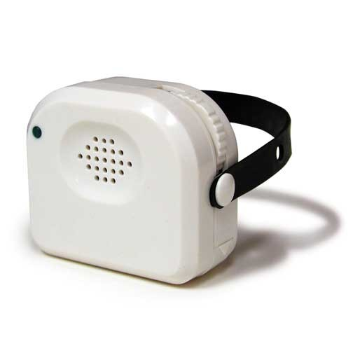
Assistive Technology
Accommodation
The employer purchased a telephone amplifier, which enabled the nurse to hear effectively over the telephone.

Slide 11
Assistive Technology
Screen reading/magnification
ZoomText
ZoomText Fusion
Dolphin SuperNova

Slide 12
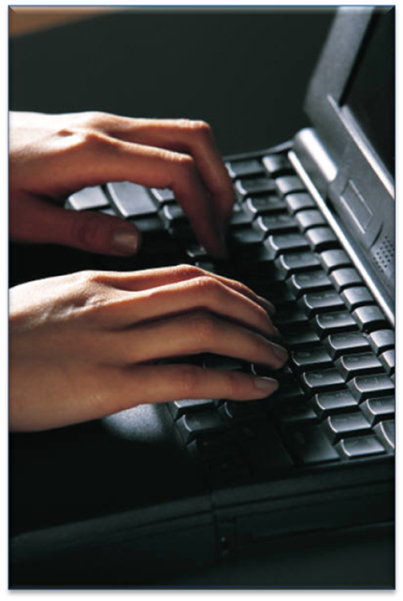
Vision and Accommodation
Example
A health care worker with low vision was having difficulty using her computer.

Slide 13
Vision and Accommodation
Accommodation
At first, the employer tried upgrading the employee’s operating system, but when that wasn’t effective the employer purchased screen magnification software. The company retained a highly valued a skilled employee and sent a message to her department that “We care,” even in a big company.
Notes:
Health care databases- some are accessible- some are not---

Slide 14
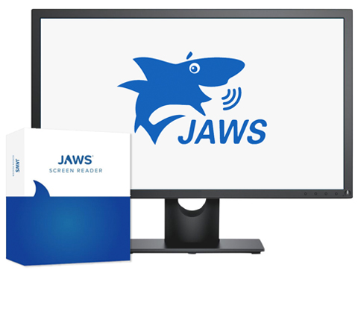
Assistive Technology
Screen reading
JAWS
Dolphin Screen Reader
NVDA

Slide 15
Situation & Solution
Example
A bus garage employee who had difficulty reading but had excellent listening comprehension skills often missed instructions and important announcements that were sent via e-mail.

Slide 16
Situation & Solution
Accommodation
The employee was provided with screen reading software that allowed him to listen to the e-mails that he received. His performance greatly improved, as well as his attendance at meetings and gatherings.

Slide 17
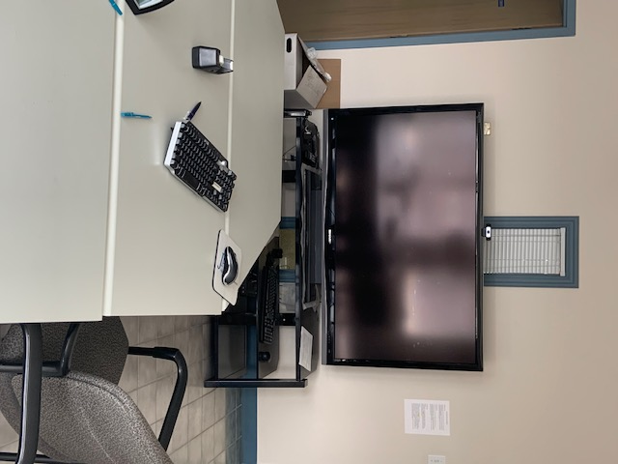
Assistive Technology
Large Computer Monitor

Slide 18
Situation & Solution
Example
A psychologist who was legally blind asked to be excused from providing mental health services via telehealth. The employer was temporarily restructuring her job to allow for this while seeking solutions to assist her in better interpreting client’s facial expressions and body language via video feed.

Slide 19
Situation & Solution
Accommodation
A JAN Consultant discussed the benefits of larger monitors and explained ways of changing positioning of cameras to improve her chance to observe body language.

Slide 20
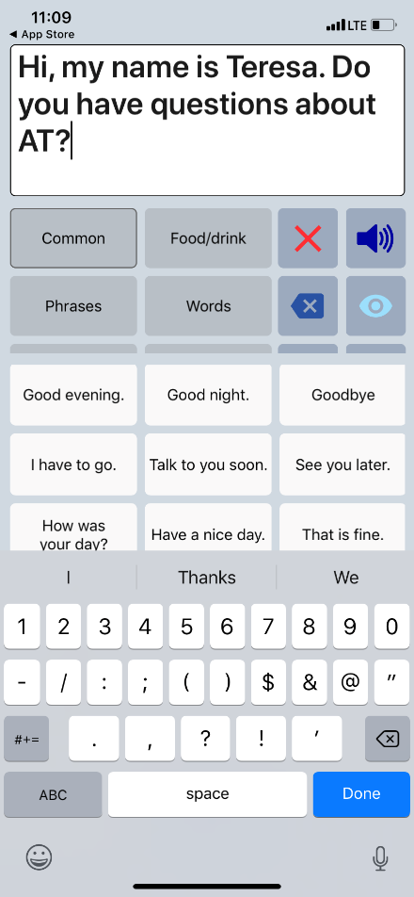
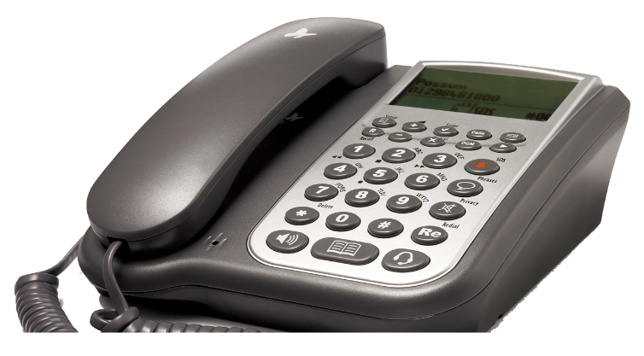
Assistive Technology
Speech-Generating Solutions
Phone Link
Speech Assistant AAC
Sero Phone

Slide 21
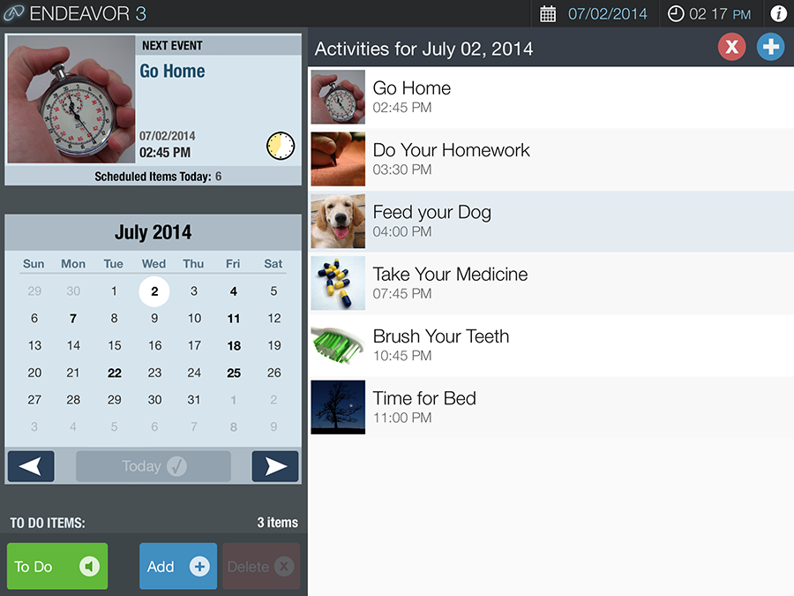
Assistive Technology
Organization Software
Notes:
Many individuals – including people with intellectual disabilities, traumatic brain injuries, early onset dementia, and certain learning disabilities – have difficulty remembering when to perform key activities such as taking medications, turning off appliances, attending appointments, remembering work tasks, or any other routine or non-routine activity of daily living. Endeavor 3 provides a format for these individuals to complete tasks independently and on time, thus freeing up staff or caregiver time and greatly enhancing the individual’s independence and quality of life.

Slide 22
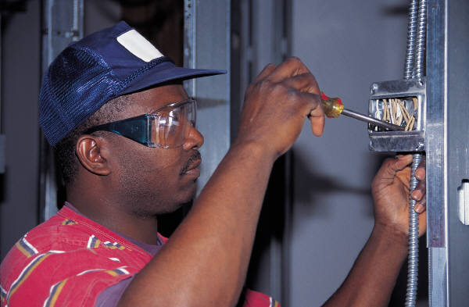
Situation & Solution
Example
An electrician’s helper with an intellectual disability needed to attend periodic licensure trainings. He had difficulty taking effective notes and remembering information in the meetings.

Slide 23
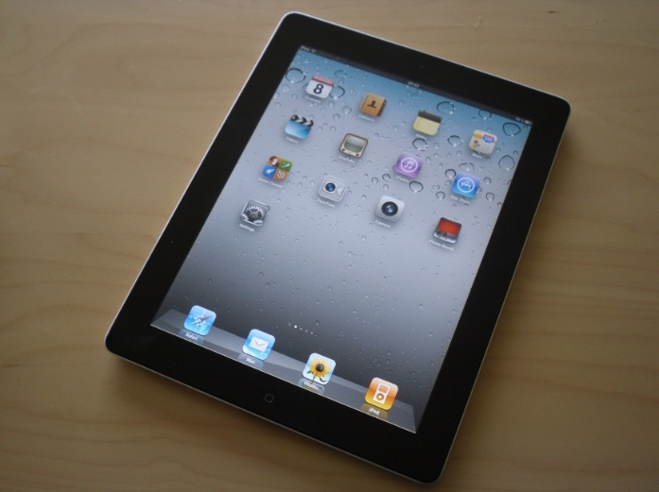
Situation & Solution
Accommodation
The employee was provided an iPad with apps that would record the trainings. This enabled him to listen to the trainings as many times as he needed. He was also provided training on how to use the device and the apps.

Slide 24
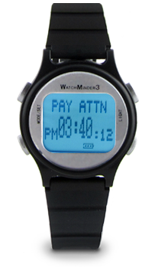
Situation & Solution
Watch Minder

Slide 25
Situation & Solution
Example
A pediatrician with ADHD was having difficulty meeting the performance standards at work. She was struggling to meet the patient quota per day and often had to stay late to finish her duties. This was starting to cause issues with coworkers picking up extra patients and the employer having to pay overtime. They tried a few accommodations but were struggling to find something effective. The employer called JAN looking for some ideas.

Slide 26
Situation & Solution
Accommodation
After speaking with a JAN consultant, the employer provided a WatchMinder vibrating watch as an accommodation. The watch was set to alert the employee every five minutes (vibrate). This helped the employee pace herself throughout the day and break down what she needed to accomplish during each five-minute interval of the appointment.
Notes:
Cost: $100
Benefit: An accommodation was made and the employee was able to improve performance.

Slide 27
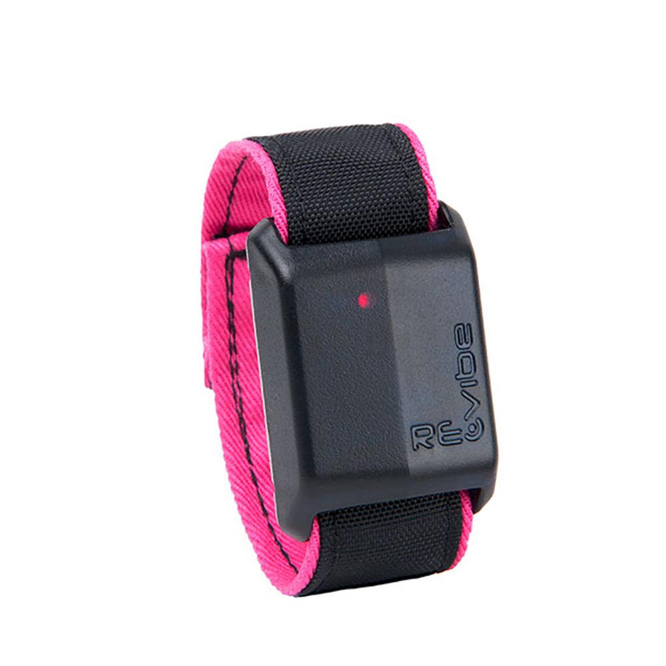
Assistive Technology
Alternative solutions
Revibes, smart watches

Slide 28
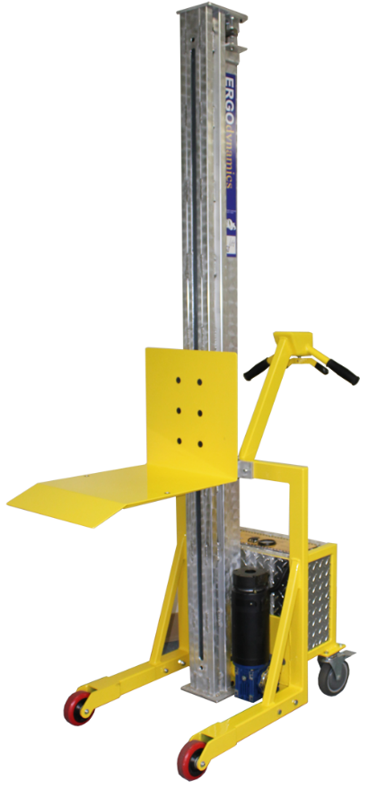
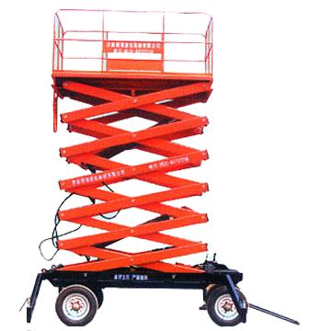
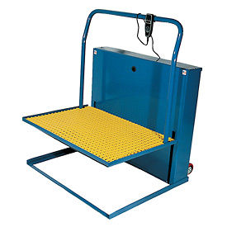
Assistive Technology
Compact Lifting Devices vs Work Platforms

Slide 29
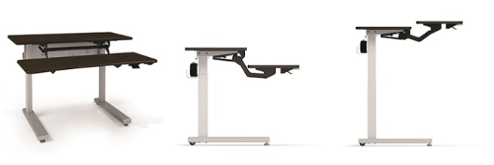
Assistive Technology
Adjustable Workstation

Slide 30
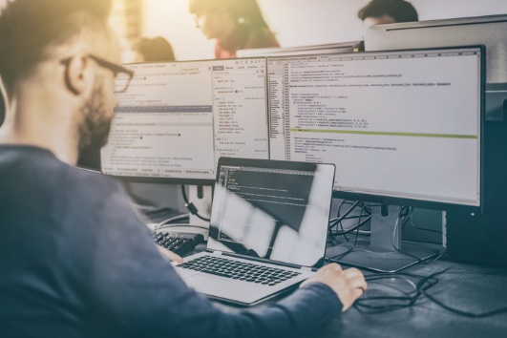
Situation & Solution
Example
An employment consultant had sciatic nerve pain. They found it too painful to sit for 8 hours a day behind a desk.

Slide 31
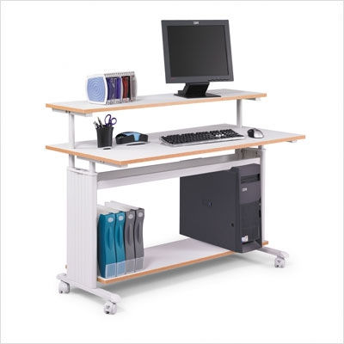
Situation & Solution
Accommodation
After learning their rights from a JAN consultant, the employee requested and was approved to receive an adjustable workstation for office settings. This enabled the employee to work comfortably and keep up production standards.

Slide 32
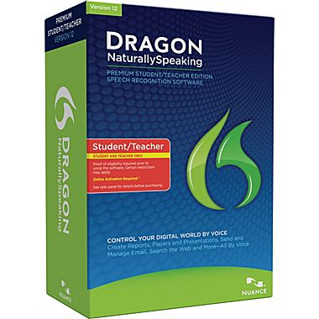
Assistive Technology
Speech Recognition Software
Notes:
Aka speech to text

Slide 33
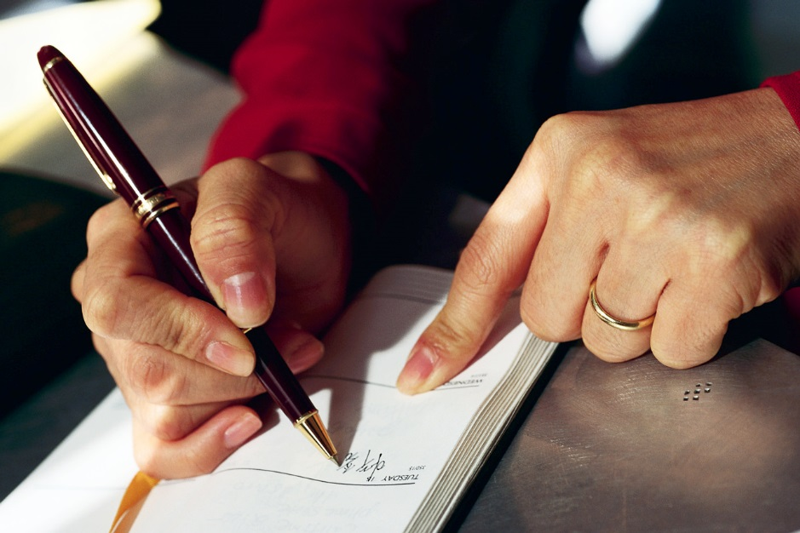
Situation & Solution
Example
An activities aide in an extended living facility had difficulty writing documentation in the daily log for the groups she assisted.
Notes:
Aka speech to text

Slide 34
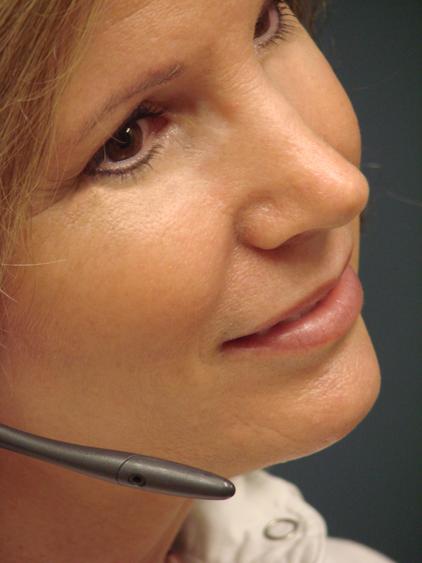
Situation & Solution
Accommodation
The aide was provided speech-to-text software that allowed her to dictate her notes from a computer, print them out, and then place them in the log/binder.

Slide 35
Situation & Solution
Example
A nurse case manager with a newly acquired hand impairment was struggling to complete patient documentation. Her performance was falling behind company quota.

Slide 36
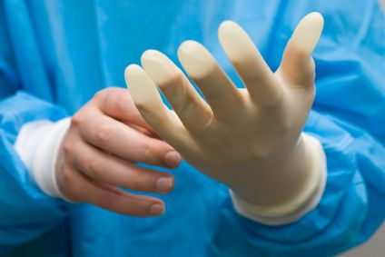
Situation & Solution
Accommodation
A JAN consultant explained speech recognition, specifically Dragon Medical, that can be used in the health care industry.
This enabled the employee to compete patient documentation in a timely manner.

Slide 37
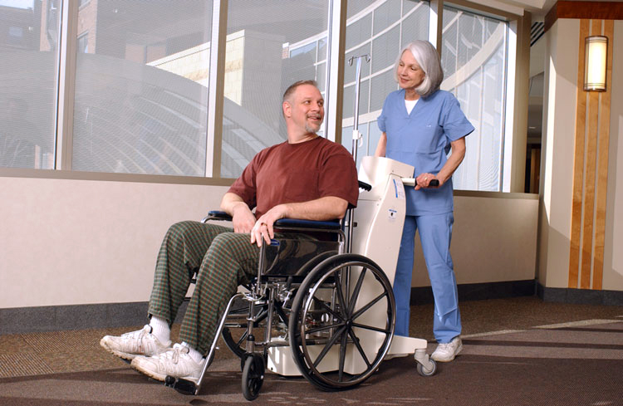
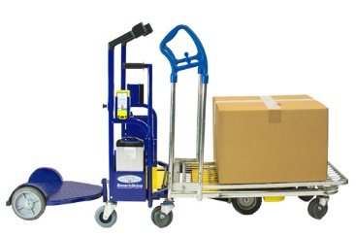
Assistive Technology
Little-Known Gems
Dane technologies

Slide 38
Assistive Technology
How much does AT cost?
Over half of accommodations (59%) were made at no cost.
Of the 36% who experienced a one-time cost to make an accommodation, the typical cost of accommodating an employee was $500.
Only 25 (3%) said the accommodation resulted in an ongoing, annual cost to the company and 9 (1%) said the accommodation required a combination of one-time and annual costs.
Notes:
Finding #2: Most employers report no cost or low cost for accommodating employees with disabilities.
Of the 718 employers who were able to provide cost information related to accommodations they had provided, 423 (59%) said the accommodations needed by their employee cost absolutely nothing. Another 261 (36%) experienced a one-time cost. Only 25 (3%) said the accommodation resulted in an ongoing, annual cost to the company and 9 (1%) said the accommodation required a combination of one-time and annual costs. Of those accommodations that did have a one-time cost, the median one-time expenditure as reported by the employer was $500. When asked how much they paid for an accommodation beyond what they would have paid for an employee without a disability who was in the same position, the median answer given by employers was $300.

Slide 39
Assistive Technology
Meeting Complex Needs
In-House
Customization
AbleData
EBay
State AT Projects
RESNA
AgrAbility

Slide 40
Assistive Technology
Wearable/ Mobile device policies
Mobile devices such as tablets, cellular phones, smartphones, smartwatches, and other wearable devices can be valuable productivity tools when used appropriately. They can also help employees maintain work/life balance, use concentration and relaxation techniques, manage health conditions, and keep in touch with those who support them without tying up office equipment and phone lines.
However, devices can also serve as a distraction, or worse, pose a risk to data. As a result many employers are developing and updating policies on use of personal devices and governing what types of devices and apps can be purchased for employees.
Notes:
Teresa

Slide 41
Assistive Technology
ADA implications for wearable device policies:
Policies must be applied in a nondiscriminatory way
Employers may need to consider policy modification
May need to determine whether the wearable device is a personal use item or an accommodation
May need to be open to an alternate device or accommodation in some settings
Ways to employ wearable devices as workplace accommodations:
Manage time, stress, and medical conditions
Access information needed at work
Meet communication needs
Notes:
Teresa

Slide 42
Assistive Technology
Example
An employee at a community college asked for a Bluetooth streamer to assist with access to meetings and trainings and to enhance day-to-day conversation. The employer wanted to purchase it but also wanted to have some rules for how to keep it from being damaged.

Slide 43
Assistive Technology
Accommodation
After learning from a JAN consultant about ownership and control of products, the employer’s HR department made the decision to provide an assistive listening device.
Notes:
Cost: Less than $1,000
Benefit: The employer reported that the accommodation was extremely effective and resulted in improved worker productivity, morale, and safety, as well as allowing them to save on workers’ compensation while retaining a qualified employee.

Slide 44
Assistive Technology
How do I know what AT to get?
Talk with the employee
Prior experience
Recommendations
Get IT involved
Consult with specialists
Audiologist
Ergonomist
AT/ Web Accessibility Specialists
Call JAN!

Slide 45
Assistive Technology
Can I try before I buy?
State AT Projects
Demonstration
Device Loan
Reutilization
State Financing
https://AskJAN.org/concerns/State-Assistive-Technology-Projects.cfm

Slide 46
Assistive Technology
Where can I find more AT Information?
Abledata
Agrability
AT Conferences
Assistive Technology Industry Association (ATIA)
CAP
Helen Keller National Center (HKNC)
State AT Projects
RESNA
JAN

Slide 47
Assistive Technology
JAN Multimedia Training Microsite
https://AskJAN.org/events/Multimedia-Training-Microsite.cfm
JAN's Assistive Technology in the Workplace
https://AskJAN.org/topics/tech.cfm

Slide 48
Job Accommodation Network
JAN Consultants can be reached M-F 9am-6pm ET
Phone - (800) 526-7234 (voice); (877) 781-9403 (TTY)
Email - jan@AskJAN.org
Skype - Janconsultants
Text - (304) 216-8189
Chat available online at http://AskJAN.org

Slide 49
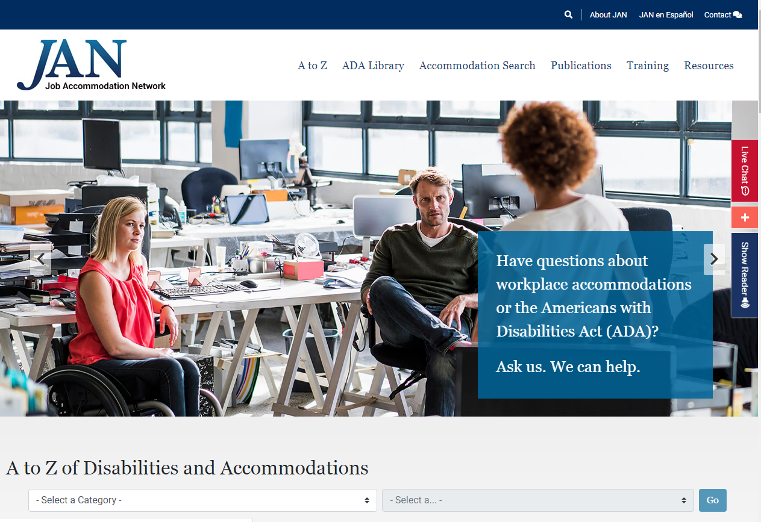
Questions? AskJAN.org

