Slide 1
Managing Performance of an Employee with an Opioid Addiction Disability Inclusion & Best Practices for the Employee Lifecycle

Slide 2
Opioid Addiction and Accommodations
Issues Covered in this Presentation:
Recognizing an Accommodation Request
Separating Discipline from the Accommodation Request
Opioid Addiction as a Disability
Confidentiality of Medical Information
Best Practices

Slide 3
Opioid Addiction and Accommodations
Recognizing an Accommodation Request

Slide 4
Elements of a Request
Two elements of a request for an accommodation:
A medical condition
A workplace challenge — either behavioral or performance — related to the medical condition

Slide 5
What if you are not sure?
Ask:
“Is there anything we can do to support you in meeting the conduct or performance requirements?”
No mention of disability or accommodation = no worrying about the ADA’s medical inquiry rules
Extend support
Opens the door to engage in the interactive process
Good management practice overall

Slide 6
Why is it important to train supervisors?

Slide 7
Opioid Addiction and Accommodations
Separating Discipline from the Accommodation Request

Slide 8
Separating Discipline from the Accommodation Request
If an employee states that her disability is the cause of a conduct problem or requests accommodation, the employer may still discipline the employee for the misconduct. If the appropriate disciplinary action is termination, the ADA would not require further discussion about the employee’s disability or request for reasonable accommodation.
From https://www.eeoc.gov/facts/performance-conduct.html#conduct

Slide 9
Separating Discipline from the Accommodation Request
If the discipline is something less than termination, the employer should begin an “interactive process” to determine whether an accommodation will correct a conduct problem, and, if so, what accommodation would be effective.
From: https://www.eeoc.gov/facts/performance-conduct.html#conduct

Slide 10
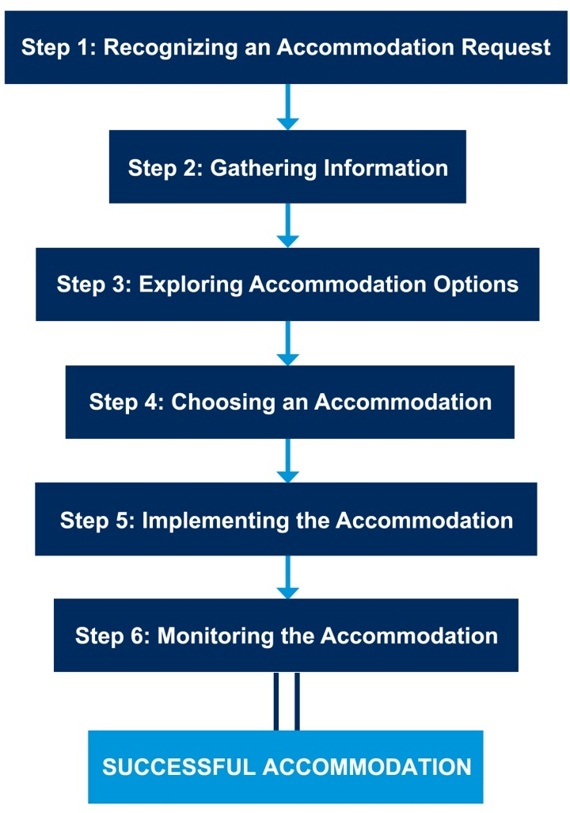
JAN’s Interactive Process
Six-Step Process

Slide 11
HR and Managers Play a Key Role
HR professionals, supervisors, and managers should:
Apply conduct and performance standards uniformly
When discussing challenges the employee is having, should focus on the behavior and performance, not the disability
Offer clear expectations for how employees must improve in order to meet standards

Slide 12
Opioid Addiction and Accommodations
Opioid Addiction as a Disability under the ADA

Slide 13
How to tell…
…if an employee might have a drug problem:
Interpersonal relations with coworkers deteriorate
Rarely admits errors or accepts blame for errors or oversights
Progressive deterioration in personal appearance and hygiene
A personality change that includes mood swings, anxiety, depression, lack of impulse control, suicidal thoughts or gestures
Increasing personal and professional isolation
Ordinary tasks require greater effort and consume more time

Slide 14
How to tell…
…if an employee might have a drug problem:
Absences without notification and an excessive use of sick days
Frequent disappearances from the work site, long unexplained absences, improbable excuses
Unreliability in keeping appointments and meeting deadlines
Work performance that alternates between periods of high and low productivity
Mistakes made due to inattention, poor judgment, and bad decisions
Confusion, memory loss, and difficulty concentrating or recalling details and instructions

Slide 15
Does the ADA apply?
It depends.
Casual/recreational use ≠ impairment, disability
Drug addiction = impairment, may be a disability — alters normal brain function
Current illegal use may result in lost ADA coverage

Slide 16
What can you do if…
…you want to give the employee a chance to get treatment?
Last Chance Agreements
Used in lieu of termination
Employer agrees not to terminate, employee agrees to employer’s terms

Slide 17
Other Accommodations
Apps for Miscellaneous Mental Health/Control of Anger & Emotions
Behavior Modification Techniques
Counseling/Therapy
Employee Assistance Program
Environmental Sound Machines/Tinnitus Maskers/White Noise Machines
Flexible Schedule/Intermittent FMLA
On-site Mentoring
Supervisory Methods
Support Animal

Slide 18
Opioid Addiction and Accommodations
Confidentiality of Medical Information

Slide 19
Confidentiality
All personnel must respect employee confidentiality. Ensuring the confidentiality of all medical information obtained in connection with a request for reasonable accommodation, as well as the confidentiality of all associated communications during the interactive process, is required by federal law.
All documentation must be kept in a file separate from an individual’s personnel file. Non-medical information obtained during this process is shared on an as-needed basis with those involved in providing a reasonable accommodation.

Slide 20
Confidentiality
Script for managers when co-worker asks about another employee’s accommodation:
“…we look and treat employees individually and make considerations based upon good business reasons which allows for privacy of each individual.”
Or
“I’m not going to discuss other employees with you, but if there is a reason you need to change the way you work, I’d be happy to discuss it with you.”

Slide 21
Opioid Addiction and Accommodations
Best Practices

Slide 22
Best Practices
Encourage all employees to seek support and request accommodation before performance suffers
Ask what can be done to support employees in meeting performance and conduct requirements
Provide training to all personnel on the elements of disability disclosure
Conduct analysis on ADA coverage
Determine policy and process — last chance agreement? — involving employees with a opioid addiction and communicate to all personnel

Slide 23
Best Practices
Know that information needed to document disability may come from various sources including addiction counselors
Postpone performance warning if there is recognition of a disclosure and request for accommodation
Do not use staff morale or fear that other employees will request accommodations as a reason to deny accommodation for an employee with a disability
Ensure managers feel supported in the accommodation process enabling them to implement effective accommodations

Slide 24
Best Practices
Keep disability and accommodation-related information confidential
Let employees know who to contact if there is a need for a modification at work due to a personal reason, so the issue can be addressed privately
Made a business decision for personal reasons and do not discuss employees' personal information with others

Slide 25
Practices to Avoid
Failing to establish expectations/standards at outset and not in writing
Applying standards haphazardly as opposed to uniformly and consistently
Neglecting to apply standards to employees with disabilities
Failing to document performance/conduct issues early or ever
Not recognizing disclosure/reasonable accommodation request in the context of performance management
Failing to engage in the interactive process in response to disability disclosure/RA request
Disregarding the need to provide accommodations in support of performance improvement

Slide 26
JAN Resources
Expert consultation
AskJAN.org
800.526.7234 or 877.781.9403 (TTY)
Chat, JAN on Demand, Skype, Text, Social Media
AskJAN.org: A-Z, SOAR, Legal library
JAN Training Modules and FREE Webcast Series
JAN Quarterly Enewsletter
Free mobile accommodation management app
Accommodation Toolkit

Slide 27
For More Information
Contact JAN
(800) 526-7234 (V) - (877) 781-9403 (TTY)
AskJAN.org
jan@askjan.org
(304) 216-8189 via Text
janconsultants via Skype
Thank you for attending!

