Slide 1
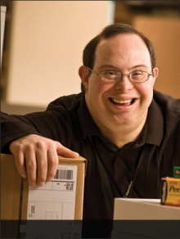
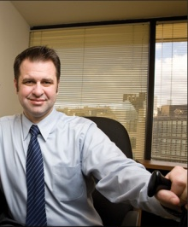
Promoting a Deaf Employee
August 28, 2018

Slide 2
Accommodation Primer
The basis for inclusive employment is the reasonable accommodation (RA) policy and process
The foundation for reasonable accommodation is a robust interactive process (IP)
The trigger for RA and IP is a request for an accommodation or recognition of an obvious barrier to someone with a known disability
A request for accommodation includes two essential elements — a medical condition and a related challenge at work

Slide 3
What is the Interactive Process?
A collaborative effort to identify effective accommodation solutions
Creates a standard of practice
Facilitates communication and inclusion
Demonstrates good faith
Leads to ADA compliance

Slide 4
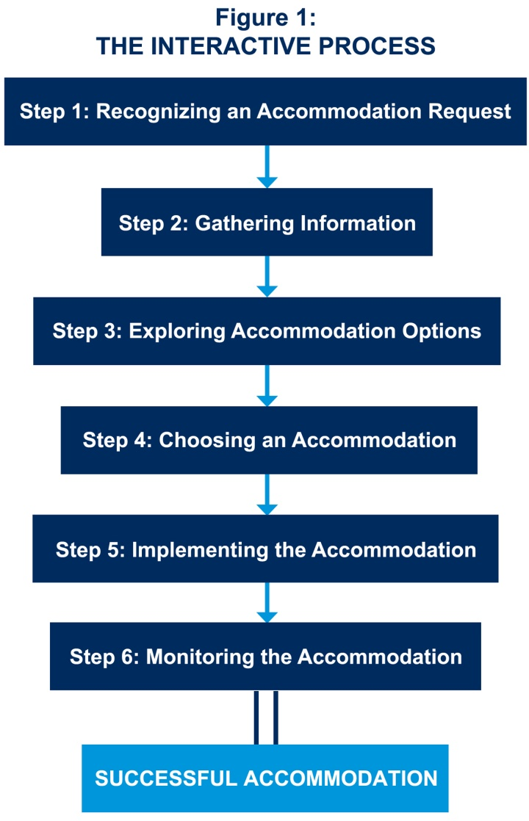
JAN’s Interactive Process
For tips about the process, go to https://AskJAN.org/topics/interactive.cfm

Slide 5
Questions to Consider
About the medical impairment:
What is the nature of the impairment?
What are the limitations/restrictions?
How long will the impairment last?
What is the duration of restrictions?
Can medical documentation be obtained?
Yes, when the disability and need for accommodation are not known or obvious
Notes:
For more on the ADAAA definition of disability, go to : http://AskJAN.org/corner/vol05iss04.htm

Slide 6
Questions to Consider
About job functions & performance:
What job functions, policies, or procedures are affected by the limitations?
Is performance or conduct affected?
Are there any safety issues?
Can job functions be performed in a different way?

Slide 7
Questions to Consider
About job accommodations:
What type of accommodation is needed?
Job Restructuring, Modified Schedules, Modified Policies, Assistive Technology, Telework, Leave, Reassignment, Service Animal, etc.
Is the accommodation reasonable — meaning feasible or plausible?
Will the accommodation be effective?
Is the employee still qualified?

Slide 8
Practices to Avoid
Failing to recognize a request for reasonable accommodation (RA) and not engaging in the interactive process (IP)
Being curt, non-empathetic, failing to listen with intent
Ignoring timeframes for responding/implementing accommodation
Neglecting to adequately document IP
Failing to work collaboratively with employee
Making excuses for why accommodation can’t be provided
Neglecting to communicate accommodations to essential personnel
Failing to monitor accommodations

Slide 9
Toolkit Training Videos

Slide 10
Employees Who Are Deaf or Hard of Hearing
What challenges do employees who are deaf or hard of hearing experience on the job?
Interacting with customers, supervisors, and coworkers
Receiving information and asking questions during meetings and trainings
Communicating by telephone
Meeting safety standards
Responding to auditory signals
Taking vital signs

Slide 11
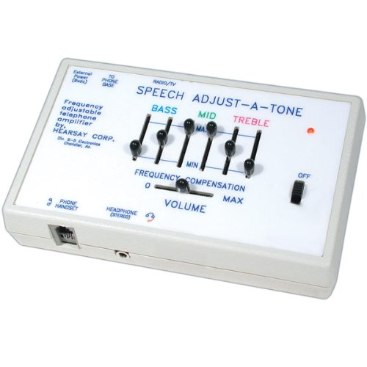
Employees Who Are Deaf or Hard of Hearing
Hearing – Telephone
Adaptors for hearing aids
Telephone Amplification
Captioning
Relay services
Relay equipment
Amplified phones
Alternate methods

Slide 12
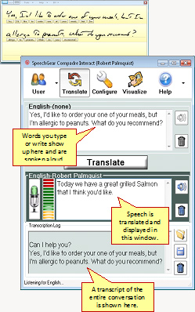
Employees Who Are Deaf or Hard of Hearing
Hearing – Face to Face
Interpreters
Captioning/CART Services
Assistive Listening Devices
Hearing Aid Compatible Tech
Communication Access Technologies
Apps
Communication Etiquette

Slide 13
Employees Who Are Deaf or Hard of Hearing
JAN often makes the following accommodation suggestions regarding workers who are deaf or hard of hearing who need to work around moving equipment or operate vehicles or forklifts in the workplace:
Establish set paths of travel for vehicles and pedestrians.
Establish and enforce rules requiring all moving equipment, forklifts, and vehicles to stop and flash lights/beep horn at intersections.
Install flashing strobe lights on moving vehicles.
Install a directional worker alert system that provides a visual warning.
Install industrial mirrors around the work environment.
Voluntary use of a hat or vest of a unique color.
Position a rear vision camera so that a vehicle operator will be able to see behind him/her.

Slide 14
Etiquette for Engaging Individuals
Who are Deaf
Ensure the workplace is accessible - assistive listening devices, remote captioning, video relay, and sign language interpreters are just some of the solutions to access issues
When working with a colleague that has significant hearing loss ask them what is the best way (their preference) to communicate information with them
People may already have communication devices they need - so don’t assume they do not
When you need to get the attention of a colleague who is deaf, you may need to tap them on their shoulder, flash the light off and on, or wave your hand and ensure that you face them directly when you speak
Expressive body language and facial expressions can greatly help individuals who are deaf to understand tone and intent when communicating, even if no actual signs used

Slide 15
Etiquette for Engaging Individuals
Who are Deaf
For most people rudimentary sign language (e.g. alphabet and commonly used words/phrases) is easier to learn than another spoken language and can be beneficial to all in noisy workplace environments
Communicating differently, e.g. using ASL and various tools, is just that — different, NOT less effective or less clearly understood
Co-workers who are not deaf can also let it be known when interpreters may be needed
One of the highest workplace priorities is safety. So it is important to orient employees with disabilities to the emergency evacuation procedures. These procedures should be discussed with employees and adjustments made to the procedure if the emergency evacuation in the event the adjustment is needed to ensure the safety of the employee

Slide 16
Best Practices
Create a culture of inclusion in the workplace where all employees have the ability to contribute and be successful
Ensure judgements are made on facts and not beliefs nor stereotypes
Ensure employees are provided with the same training opportunities as other employees
Consider providing a mentor for the employee to assist them in identifying opportunities for growth

Slide 17
Best Practices
Employers report that camaraderie and teamwork improve when individuals who are deaf or hard of hearing join the team as it prompts looking at how work could be done more effectively and safely
Advocacy by supervisors in conjunction with upper management is key to career development - this “ally” behavior overcomes the common myths and stereotypes that can keep individuals with disabilities from advancing. This behavior should be encouraged and positively reinforced by corporate leadership for workplace disability inclusion efforts.
Individuals with hearing related disabilities have full lives outside of work like everyone else

Slide 18
Best Practices
Tips for working with a sign language interpreter
Speak to the person who is deaf, not the interpreter
Use a natural rate of speech but be prepared to slow down or repeat if asked
Provide handouts and key vocabulary in advance.
Allow the interpreter and person who is deaf to have input into the room arrangement
If you don’t want something interpreted, don’t say it
In group settings have one person speak at a time
Use captioned videos if possible even when an interpreter is present

Slide 19
Best Practices
Keep disability- and accommodation-related information confidential
Let employees know who to contact if there is a need for a modification at work due to a personal reason, so the issue can be addressed privately
Made a business decision for personal reasons and do not discuss employees personal information with others

Slide 20
Accommodation Resources
Registry of Interpreters for the Deaf, Inc. https://AskJAN.org/organizations/Registry-of-Interpreters-for-the-Deaf-Inc.cfm
Communication Service for the Deaf https://www.csd.org/
Accommodation and Compliance Series: Employees with Deafness https://AskJAN.org/publications/Disability-Downloads.cfm?pubid=475451
Relay Calls: Types and How to Make a Call https://AskJAN.org/articles/Relay-Calls-Types-and-How-to-Make-a-Call.cfm
Communication Access Realtime Translation (CART) as a Work-Site Accommodation for Individuals who are Deaf or Hard of Hearing https://AskJAN.org/publications/consultants-corner/vol01iss07.cfm
Accommodating Employees with Hearing Aids: A Beginner's Guide to T-coils https://AskJAN.org/articles/Accommodating-Employees-with-Hearing-Aids-A-Beginner-s-Guide-to-T-coils.cfm

Slide 21
Contact JAN
(800) 526-7234 (V) - (877) 781-9403 (TTY)
AskJAN.org
jan@AskJAN.org
(304) 216-8189 via Text
janconsultants via Skype

