Slide 1
Accommodation & Compliance Series The Way I See It: Accommodation Process Perspectives from Different Points of View
Lore Lee, Consultant Matthew McCord, Motor Team Senior Consultant Lisa Mathess, Principal Consultant, ADA Specialist Tracie DeFreitas, Director of Training and Outreach

Slide 2
Housekeeping
Technical Difficulties
Q&A option at the bottom of the screen
800-526-7234 or 877-781-9403 (TTY) OR Live Chat at AskJAN.org
Frequently Asked Questions (FAQ) AskJAN.org/Training/JAN-Webcast-Frequently-Asked-Questions.cfm
Questions for Presenters
Q&A option at the bottom of the screen

Slide 3
Housekeeping 2
PPT Slides
Link to PPT is included in webcast login email, see the link now in the chat, or go to this webcast event from the Training page at AskJAN.org
Captioning
Use the closed caption (CC) option or captioning link in the chat

Slide 4
National Disability Employment Awareness Month (NDEAM) October 2023
National Disability Employment Awareness Month (NDEAM) celebrates the contributions of America’s workers with disabilities and showcases supportive, inclusive employment policies and practices that benefit employers and employees.
DOL.gov/NDEAM

Slide 5
Accommodation Process Perspectives from Different Points of View
Point of View (POV)—noun phrase
A particular attitude or way of considering a matter
A position or perspective from which something is considered or evaluated
Employer POV and Employee POV— The way I see it…

Slide 6
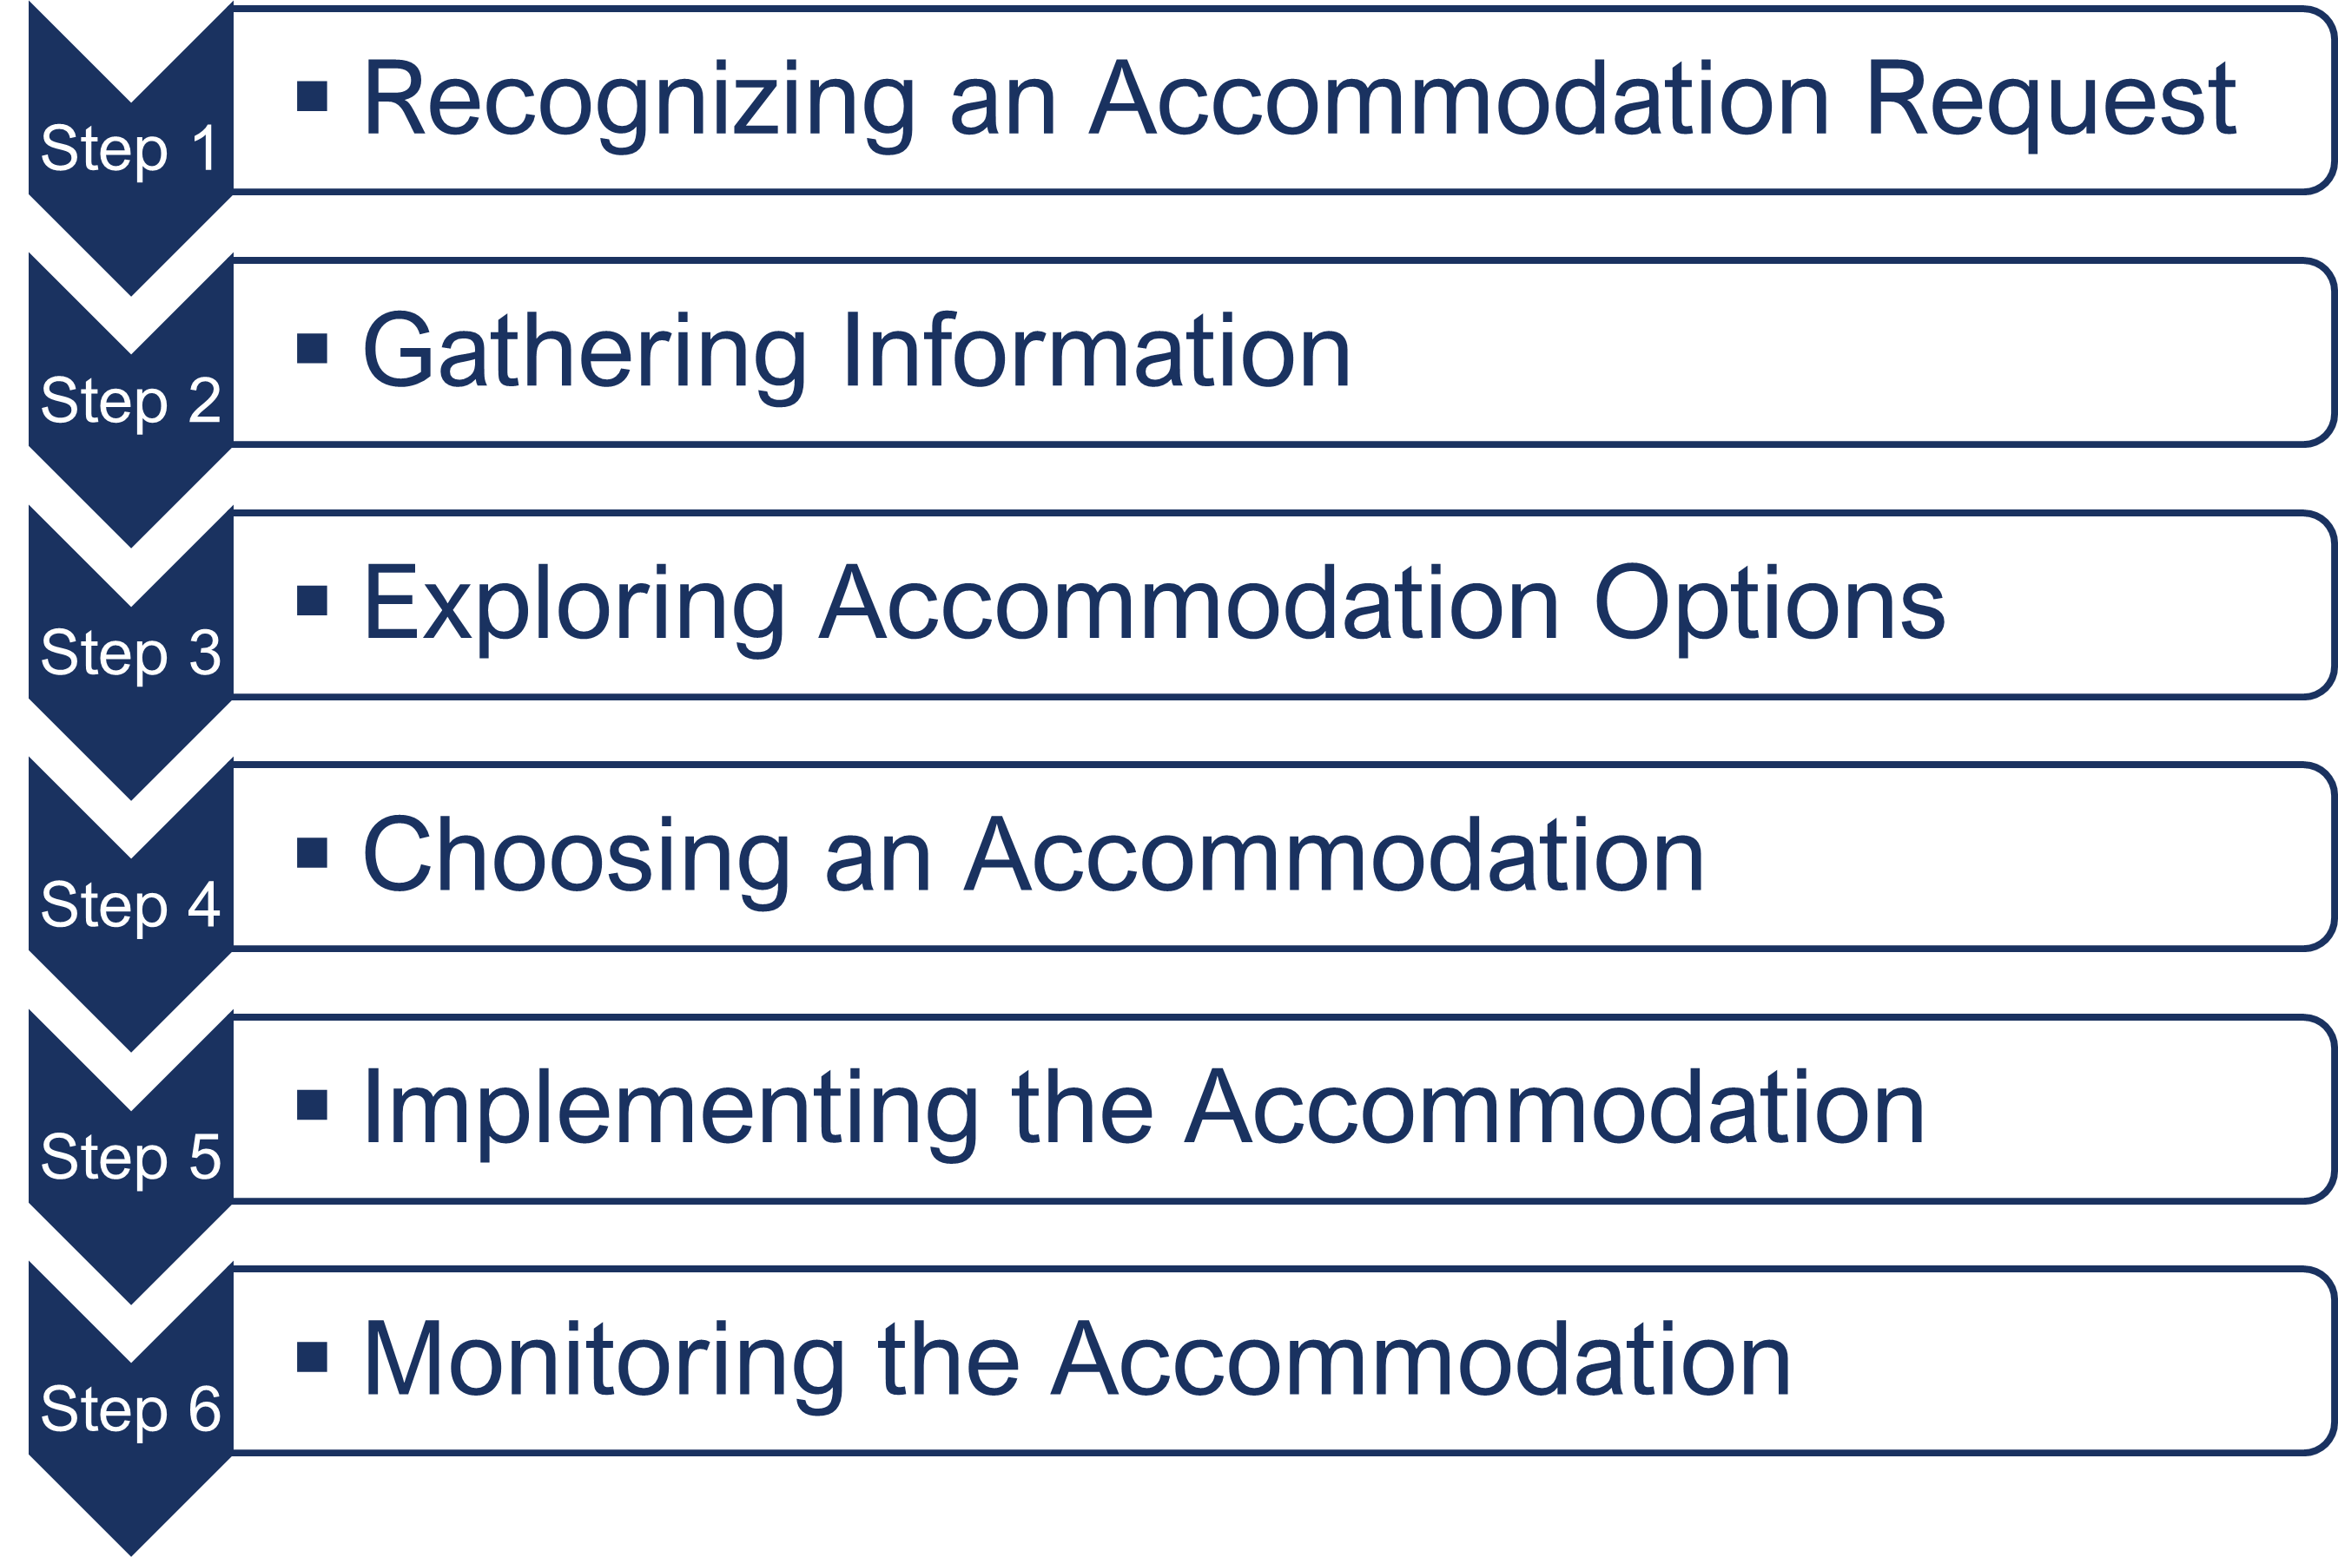
Interactive Accommodation Process
A process for collaboratively identifying accommodation solutions AskJAN.org A to Z Topic: Interactive Process

Slide 7
POV—Performance Issue or Request Ignored
Sam experiences severe migraines triggered by workplace noise and overhead fluorescent lighting. Sam asked their manager whether they could wear noise-canceling earbuds and turn off the lights above their workstation.
The manager said they needed to check with human resources, but after three weeks Sam did not receive follow-up from the manager, and no changes were made. Sam continued to experience migraines, which impacted their attendance and performance.

Slide 8
POV—How Can I Help or Reluctant to Disclose
Lea became distressed when coworkers asked questions she felt pressured to answer. She often reacted in an irritable and unprofessional way.
After a disciplinary meeting with her supervisor, Lea disclosed that she has a disability exacerbated by the stress caused by interacting with peers but would not provide any additional information when the employer asked whether anything could be done to help.
Lea wanted to keep her personal health information private.

Slide 9
POV—Policy Modification Justification or Privacy Right
Taylor is a property manager who asked to bring their emotional support dog to work to accompany them while in the office and when showing rental properties.
Taylor did not offer the employer any information to support their ADA request. The employer does not ordinarily allow dogs in the workplace.

Slide 10
POV—nice to know or No Need to Know
Patrick is an attorney who is receiving treatment for cancer. Due to having difficulty handling job-related stress, he requested a temporary reduction in hours.
The accommodation was granted, but Patrick asked that his supervisor not be informed about the reason the accommodation was granted, out of concern for how the supervisor might treat him.

Slide 11
POV—Follow the Rules or Needs Not Met
Rebecca works at a small long-term care facility. She needs an accessible parking space but has difficulty finding a space in the employee lot and often parks in the visitor parking area.
Employees are required to park in a designated lot. The employer asked Rebecca not to park in the visitor lot, but Rebecca believes she should be allowed because she has a parking placard issued by the DMV.

Slide 12
POV—Stuck in the Waiting Place or Support Needed
Callie experienced significant leg and back pain when sitting for long periods of time. She also needed to use the restroom frequently. She requested additional breaks beyond the time ordinarily allowed.
The employer requested documentation to support the need for additional breaks and to help explore accommodations to address the sitting limitation, but Callie was unable to provide the documentation in timely manner.

Slide 13
POV—Return to the Workplace or Enough is Enough
Adrian’s employer is returning employees to the worksite. Adrian is immunocompromised and is concerned about the risk of exposure to COVID. He has worked at home successfully for two years (the past 6 months as an accommodation) and the job duties will not change at the worksite. Adrian requested to continue the telework accommodation.
The employer required Adrian to recertify the need for accommodation, even though medical information was provided six months ago.

Slide 14
POV—Equal Access to Leave or Personal Time Off
Travis was experiencing limitations related to generalized anxiety disorder and depression. Travis began treatment with a new healthcare provider who adjusted his medications and recommended bi-weekly counseling sessions for two months.
Travis had one week of accrued paid leave but did not want to use accrued leave to attend counseling appointments. Instead, intermittent unpaid leave was requested as an ADA accommodation so Travis could reserve accrued time for vacation days.

Slide 15
POV—Meeting Business Needs or Retaliation
Andy is a retail sales manager who was frequently late to work due to flare-ups of a gastrointestinal disorder. Andy was responsible for opening the store and being tardy affected business operations. He was written up for tardiness according to the attendance policy.
After working through the accommodation process, the employer modified the attendance policy to allow unplanned absences during flare-ups but also reassigned Andy to an afternoon shift.

Slide 16
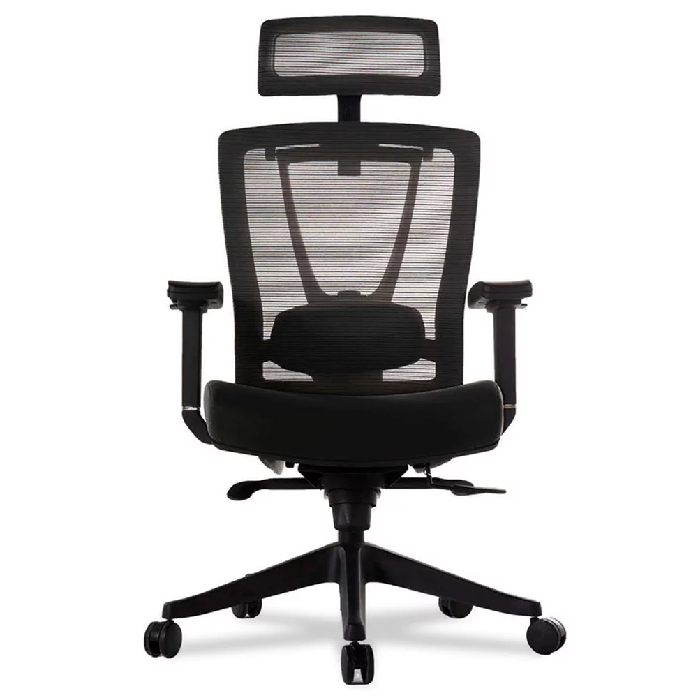
POV— Alternative accommodation or Ineffective Solution
Donna has degenerative disc disease and experienced severe back pain and numbness after sitting for long periods of time. Donna provided medical documentation and asked for a specific ergonomic chair that was rather expensive.
The employer opted to get a less-expensive ergonomic chair, selected from a list of preferred vendors the company used.
Donna continued to experience back pain and numbness while sitting in the new chair.

Slide 17
The Way I See IT
Many point of view differences can be resolved with effective communication
Employers and employees should engage in good-faith dialogue
Transparency leads to trust
Clarity prevents conflict
Communication is best approached in a non-adversarial way
Be open to the idea that you might be mistaken or misunderstanding

Slide 18
Questions?

Slide 19
Thank you for attending “Accommodation Process Perspectives from Different Points of View”
Next JAN Webcast: “Accommodation Solutions: Respiratory Conditions, Allergies, & Fragrance Sensitivity” Thursday, Nov. 9 @ 2:00 p.m. ET
JAN Training Events & Resources AskJAN.org/Events/Trainings.cfm

Slide 20
Complete the Evaluation To claim the HR CEU
Don’t close the JAN webcast window
Evaluation will open in a new window
Complete the evaluation and click on “View your certificate of completion.”
Or scan QR code

Slide 21
For More Information – Contact JAN
Visit
AskJAN.org
Call
800.526.7234
877.781.9403 (TTY)
Live Chat
@ AskJAN.org
Email
JAN@AskJAN.org
Social Media
Facebook and LinkedIn – Job Accommodation Network X (Twitter) – @JANatJAN

