Slide 1
Accommodation & Compliance Series Accommodation Solutions: Respiratory Conditions, Allergies, & Fragrance Sensitivity
Teresa Goddard, Lead Consultant – Assistive Technology Services
Jose Gonzalez Lopez, Consultant – Sensory/Motor Teams

Slide 2
Housekeeping
Technical Difficulties
Q&A option at the bottom of the screen
800-526-7234 or 877-781-9403 (TTY) OR Live Chat at AskJAN.org
Frequently Asked Questions (FAQ) AskJAN.org/Training/JAN-Webcast-Frequently-Asked-Questions.cfm
Questions for Presenters
Q&A option at the bottom of the screen

Slide 3
Housekeeping 2
PPT Slides
Link to PPT is included in webcast login email, see the link now in the chat, or go to this webcast event from the Training page at AskJAN.org
Captioning
Use the closed caption (CC) option or captioning link in the chat

Slide 4
What is a “Reasonable Accommodation”?
A reasonable accommodation is any change in the work environment or in the way things are usually done that results in equal employment opportunity for an individual with a disability.
Examples of reasonable accommodation include making existing facilities accessible, job restructuring, modifying work schedules, reassignment, acquiring or modifying equipment or devices, adjusting or modifying policies, and providing qualified readers or interpreters (EEOC, 1992).
Technical Assistance Manual for Title I of the Americans with Disabilities Act (ADA)

Slide 5
Complex Reasonable Accommodation Issues: Respiratory Impairment
Conflicting accommodation needs
Limited ability to impact air quality
Limited availability of private workspaces
Some job tasks need to be done on-site
Security and productivity concerns about telework
Limited ability to restrict foods and fragrances introduced to the workplace by clients and customers
Lack of coworker cooperation with policies
Responding to harassment of employee with allergies
Safety concerns

Slide 6
General Accommodations to prevent reactions
Remove the allergen or irritant
Remove air fresheners
Change workplace cleaning products
Change employer-provided soaps in restrooms
Eliminate mold
Choose safe caterers for work-sponsored events

Slide 7
General Accommodations to prevent reactions (2)
Remove the person from the allergen or irritant
Relocate workstation
Trade outdoor tasks for indoor tasks during pollen season
Restructure job to prevent exposure
Consider telework/flexiplace on full- or part-time basis
Trial period to assess feasibility
Allow telework/leave during renovations
Leave less effective when alternative reasonable and effective accommodations can be provided
Reassign—last resort

Slide 8
General Accommodations to prevent reactions (3)
Reduce exposure to the allergen or irritant
Modify the work schedule
Allow fresh air breaks
Provide an air purification system designed specifically for the irritant in question (e.g., colognes versus smoke)
Modify communication methods
Consider implementing fragrance policy
Consider implementing food ban

Slide 9
General Accommodations to prevent reactions (4)
Remove person from the area as needed
When cleaning
When repairs are being done
When employee reacts to chemicals
Notes:
Teresa
Let's take a closer look at option one, removing the person
Sometimes a person might need to leave an area only occasionally. For example, they may need to take a day or work from home on days when the office is being cleaned, or when products like pesticides are being used in the building.
People with certain respiratory conditions may need to take time off for work from home, when construction or repair work is taking place. For instance, a person who reacts to the odor of industrial glue, or the smells that are released by new carpet or new furniture may need to give those materials some time to off gas before they come back to work.
Also, it may help if a person knows that they can leave the area, or leave the building temporarily when they are having a reaction. For this reason, it can be very helpful to find a safe path of travel out of the building. That way when the person is trying to leave to recover, they aren't continuously exposed to things that trigger their symptoms on their way out of the building, or on their way to a safe area like a fragrance free break room or bathroom.

Slide 10
Accommodations: Allergies
Accommodations to Manage Condition
Plan of Action
Plan in case of a reaction at work
Voluntary
Develop with employee
Time off for treatment/recovery
Safe storage of medication and food
Accommodations to manage symptoms and side effects
Modified schedule
Ergonomic management of fatigue
Accommodations for pain/difficulty concentrating

Slide 11
Live Event Considerations—Access to Food & Beverages
Alternatives for dietary restrictions
Serving area arranged for mobility aid/service animal access
Avoid cross-contamination when preparing and serving
Be prepared to provide assistance retrieving food and beverages
Seating arrangements for varying social distance needs

Slide 12
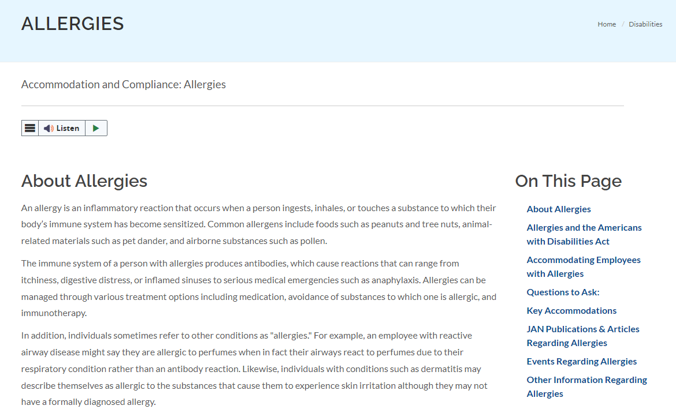
AskJAN.org—A to Z By disability: allergies
12

Slide 13
Long COVID and Respiratory Impairments
Difficulty breathing or shortness of breath
Fatigue
Cough
Some people have developed respiratory impairments after recovering from COVID

Slide 14
Accommodation Issues: Multiple Chemical Sensitivity (MCS) / Fragrance Sensitivity
Misunderstandings on All Sides: Individual’s Experience
Migraines and brain fog may make communication difficult
Not sure what chemical is causing the problem
Does not feel good
Does not feel understood
May feel picked on
Notes:
Teresa
As mentioned earlier, here at the job accommodation network. We talked to both employers and employees. Sometimes we even get questions from coworkers and friends and family members. So our perspective is a little bit unique because we get to talk to people who are involved with all aspects of accommodations.
When it comes to fragrance issues in the workplace, an issue that comes up again and again is a sense that one's challenges are being misunderstood. This feeling of being misunderstood by the way can be experienced by almost anyone involved in the accommodation process.
First, I'd like to talk from the perspective of an individual with MCS or another form of fragrance sensitivity. Remember fragrance sensitivity can be a component of several different conditions including multiple chemical sensitivity or MCS, respiratory conditions such as reactive airway disease, and asthma, migraines, and allergies. Additionally conditions that may not meet the definition of disability such as pregnancy can also have a fragrance component.
When an individual is experiencing a sensitivity, they often describe it as being sensitive to strong fragrances. In some cases, though they may just have realized over time that they experience certain symptoms like migraines, nausea, or excessive coughing when they are around people who are wearing perfume or cologne. Sometimes people associate their symptoms with objects as well such as scented candles, or air freshener. Because of the way our sense of smell works, is not always easy to figure out exactly which sent in an environment is causing a problem. This is partially because most of us are able to detect multiple scents at one time, but have difficulty telling where the scents are coming from without some context
clues.
Have you ever tried to re-create a recipe by trying to figure out what herbs and spices were used? It was probably easier for you to get certain ingredients correct, because they were very prominent in the recipe, and perhaps you can even see them, like the tomatoes and spaghetti sauce. But I bet that when it came to the herbs and spices. It was a little more challenging. You may have even had to guess and use trial and error to figure out whether to add basil, oregano. You probably used your knowledge of what usually goes into spaghetti sauce to figure out to add basil, oregano, rather than cloves. In the same way an individual with fragrant sensitivity uses their knowledge of the types of things that people usually used to get ready for the morning and to wash their clothes to try to figure out what sent may be causing the problem.
Another challenge is that sometimes the fragrance and self is not causing the person's headache or nausea or other reaction. Sometimes a fragrance is simply used to mask the odor of the chemicals and cleaning agents in a product. Sometimes ingredients of a product may trigger symptoms in a person who is chemically sensitive, but they don't realize it because they notice the fragrance that is masking the smells of those ingredients.
Some people describe this as trying to find the one discordant note being played by a musician and an orchestra. We hear the louder notes first. Sometimes it's only after the horns and violins have gone quiet that we can hear a problem with the piccolo.
Incidentally, one reason why it is so challenging to find truly fragrance free shampoos and conditioners is that the ingredients, that is, the chemicals used to make these products tend to have an unpleasant "chemical" odor. Even products that are unscented may have a masking center added so that the orders of the ingredients are less prominent. This is done so that people will buy a product. How often have you been in the shampoo aisle of the grocery store and seen people flipping open the caps of shampoos and conditioners to see if they like scent?
Here at JAN I once to talk to a woman with autism who was actually unable to tolerate fragrance free products because she found the chemical odors of the ingredients and personal care products to be so distracting that it was hard to get through her day. So there is a flipside to this fragrance issue too.
What we hear over and over again from people with fragrance sensitivity is that they just want to feel well. They may have a lot of trouble figuring out exactly what is causing them to feel unwell. They may have gone through a lot of trial and error in their own personal lives trying to figure out what products they can use without feeling sick. Because the condition is relatively uncommon and somewhat stigmatized people may feel that others don't understand what they're going through. They may also feel that their coworkers are picking on them or testing them, and in some cases it may be true. However sometimes people have these feelings even when the people around them are truly trying to do their best.

Slide 15
Accommodation Issues: MCS / Fragrance Sensitivity (2)
Misunderstandings on All Sides: Co-workers’ Experience
Do not understand the condition
Feel insulted
Notes:
Teresa
As I mentioned previously, misunderstandings can happen on all sides. Many times a coworker will be happy to change or eliminate one product like a hand lotion or perfume. If that helps, great. But people often find it frustrating to eliminate or replace multiple products from their personal care, or laundry routine. This is especially common when someone has changed their routine multiple times, perhaps even with some costs incurred, but there coworker is still saying that they are having difficulty. Sometimes people even think that there coworker is faking symptoms in order to control others and make them feel bad.
Scents are powerfully symbolic in our culture. Many of us use certain fragrances to relax or to feel energized. Some scents, especially floral scents are associated with important life events like getting married or falling in love. Food scents can also bring back positive memories from childhood, or we may associate scents like cinnamon and clove with holidays. When we can't remember or celebrate events with scents, we might feel deprived or that are memories and feelings aren't important. When we wear something that makes us feel good because of its fragrance, we may feel insulted when someone says that it makes them feel ill.
It may help to remember that people with fragrance sensitivity can have these powerful positive associations with scents too. Most people don't develop a sensitivity until adulthood, and it may get worse over time. But overlaid on top of this are negative events where exposure to a fragrance that used to evoke positive feelings instead brought out a powerful migraine, waves of nausea, or a sense that one's throat was about to close.
One person who was explaining her experience to me, said that once a year, her husband gets out a bottle of cologne that keeps hidden away all through the year. He goes outside, sprays it into the air and stepped through it, just to give himself a light mist of scent. Then his wife is fragrance sensitive comes outside and they kiss. He immediately goes inside and takes a shower so that he can be with her for the rest of the day. They both have positive associations with the scent of this cologne that he wore when they were first dating, but she can't be around him when he is wearing it.

Slide 16
Accommodation Issues: MCS / Fragrance Sensitivity (3)
Misunderstandings on All Sides: Employer’s Experience
Cannot get clear information
Frustrated because accommodation efforts not working
Feels like a fix may not be possible, cannot control product use
Notes:
Teresa
Often people who are fragrant sensitive in their coworkers initially try to work things out one-on-one on an informal basis. A supervisor or HR professional may not even realize that there is a problem until they start getting angry emails and phone calls, or until they confront an individual with fragrant sensitivity about frequent absences.
Some of the topics that frequently come up during our calls with employers involve such issues as difficulty getting accurate information, frustration when a good faith attempt to accommodate doesn't work out, or worrying that it may not actually be possible to do what fragrant sensitive employee is asking.
One difficulty with getting information is that medical providers often don't have definitive tests that they can perform to prove what is causing symptoms. Employers often ask for lab tests, when there isn't a lab test in existence or when the only tests that might give them the information that they want aren't covered by the employees insurance. Employers often don't realize that when they ask a doctor to provide a list of the substances to which a person reacts. That list may come from a conversation between the employee and the doctor. Sometimes doctors may also give fake recommendations like, "avoid strong fragrances," without specifying what fragrances they mean. Sometimes this is medically appropriate, depending on the medical condition. However with other conditions, person may be primarily sensitive to one specific substance even in very small amounts. For example, a person with a severe food allergy may react to very small concentrations of the scent of that food, but may be okay with other scents, even if they are strong. However, a person with reactive airway disease who is sensitive to strong fragrances and that they cause a burning sensation in the chest, or a tendency to cough, may be okay with mild scents. It's as though every case is different, which makes it difficult for employers to generalize and work from their past successes to come up with strategies. Another issue that causes frustrations for employers is that the first attempted accommodating may not work. Often an employer will be very willing to do something like remove the air fresheners from a bathroom, but feel frustrated when the person is still experiencing symptoms after this step is taken.
Fragrance policies are frequent point of contention. They can work well if everyone is on board and acting in good faith, but they are particularly challenging in settings where people deal with members of the public. After all, members of the public haven't read the employee handbook. Also, most people can understand the need to limit perfumes and colognes, but they may not think of their laundry soap as being fragranced.
Employees sometimes ask employers to make a workplace fragrance free. There are certain things that are within an employer's control, like the cleaning products that they purchase for use in the workplace, or what is written in the employee handbook, but employers sometimes worry about trying to implement a fragrance free policy, knowing that it is very challenging to truly eliminate all scented products from an environment. They may also worry about creating conflict among their staff, or about what members of the public will think about the policy.

Slide 17
Accommodation Issues: MCS / Fragrance Sensitivity (4)
End result = Power struggle, hurt feelings, and frustration on all sides
Notes:
Linda
So what can be done to overcome these challenges? We want to share with you some accommodation ideas to explore and what types of workplace environments. Each might work best in. We can't tell employers whether any specific accommodation will work; our role is to give the employer or employee some ideas to explore to see if they might work.
So let's look at the big picture:

Slide 18
Accommodation Ideas: MCS / Fragrance Sensitivity
Maintain good indoor air quality
Discontinue the use of fragranced products
Use only unscented cleaning products
Provide scent-free meeting rooms and restrooms
Modify workstation location
Modify the work schedule

Slide 19
Accommodation Ideas: MCS / Fragrance Sensitivity (2)
Allow for fresh air breaks
Provide an air purification system designed specifically for the irritant in question (e.g., colognes versus smoke)
Modify communication methods
Modify or create a fragrance-free workplace policy
Telework

Slide 20
Accommodation Ideas: Remove chemicals
Chemical-free zones
Entrance
Classroom
Route of travel to restroom, break room, etc.

Slide 21
Airborne Food Allergy Situation
An employee contacted JAN with concerns that their employer was not following the accommodations they requested that were in place in the past. This was due to another department in the same building restarting a bi-weekly coffee networking event that was ongoing pre-pandemic. The employee is severely allergic to coffee and previous accommodations were put in place to remove all possible exposure sources on the floor where she worked, including alternate entrances, redirecting ventilation, and coffee-free shared areas.

Slide 22
Options to Consider: Eliminate / reduce exposure
Mask/respirator
Air purifier
Ventilation

Slide 23
Accommodation Ideas: Restricting Foods
Note: While implementing policies restricting certain foods is not fail-safe, it may help to reduce exposure.
Post signs at building entrances and in hallways, restrooms, waiting rooms, breakrooms, classrooms, and cafeterias alerting people that certain foods are restricted due to a severe food allergy.
Send memos to employees mentioning that if a person has eaten the offending food to let others know so the proper precautions may be taken. Some allergic reactions occur when a person has contact with someone who has eaten an offending food.
Send occasional memos encouraging compliance with the policy.
Enforce the policy with consequences for violations.
JAN’s Accommodation and Compliance: Food Allergy

Slide 24
Fragrance Sensitivity Situation
A park worker with fragrance sensitivity related to perfumes and colognes was accommodated through an informal fragrance policy and cooperation by coworkers.
Recently the employer purchased fragranced air fresheners for all restrooms in the worker’s area, including those not open to the public. The worker brought surgical masks from home to wear into the restrooms but still experienced symptoms.
After contacting the vendor of the air fresheners on her own, the employee learned a fragrance-free option is available.

Slide 25
Could the employer have avoided this problem?
YES!
When purchasing new products and equipment:
Accessibility issues may need to be addressed
Employees may need to communicate accommodation modification needs

Slide 26
Options to Consider
Remove chemicals
Use alternative products
Education
Voluntary bans

Slide 27
Service Animal vs Allergies Example
A newly hired federal employee requested to bring a service dog into the workplace. After starting, a co-worker informed the employer of a severe allergy to animals. The employer moved one employee’s workstation, provided an air purifier for the employee with the allergy, established separate routes of travel, maintained a regular cleaning schedule, and allowed the employees to communicate in alternative ways, other than face-to-face communication.

Slide 28
Accommodations: Service Animal vs Allergies
Balance accommodation needs
Eliminate or reduce in-person contact
Establish separate paths of travel
Use air purifiers
Modify cleaning regimen
Consider offering dander management products to employee
JAN’s Service Animals and Allergies in the Workplace

Slide 29
Respiratory Situation
An educational social worker with a respiratory impairment and fragrance sensitivity was teleworking during the pandemic. When employees were called back to the worksite, the employee requested to continue teleworking.
When telework was denied, the employee requested a hybrid schedule of 2 days on-site and 3 at home, masks, air purifiers within the workspaces, and a private office to do case documentation.

Slide 30
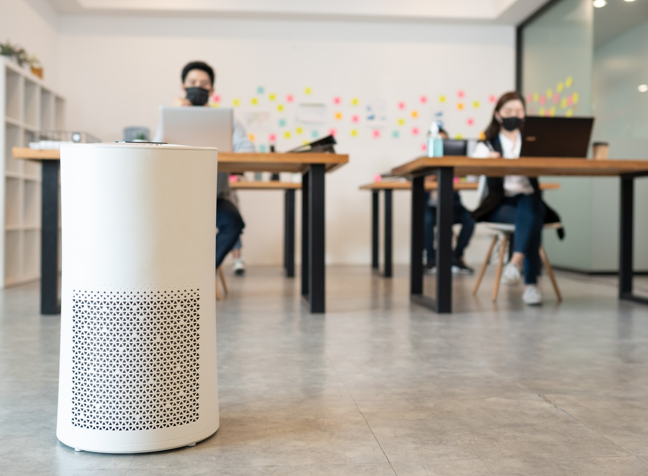
Respiratory solution
The employer denied telework but would permit a mask the employee paid for and agreed to work with the employee to identify an effective air purifier. The employer also provided an office space, even though it was not fully private.

Slide 31
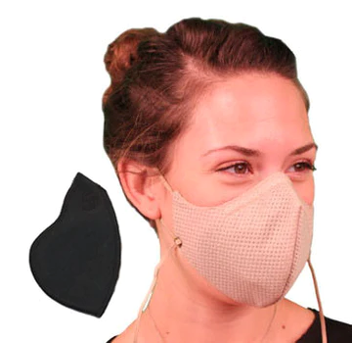
New Option—Masks for Respiratory Triggers
Honeycomb Pollution Mask with Coconut Classic Filter from I Can Breathe!® Masks
This mask and filter combo features a reusable washable shell and a replaceable filter containing activated carbon. It is designed to reduce exposure to smoke, acrid air, dust, pollution, fragrances, diesel fumes, mold, and other particles.
Notes:
Teresa
https://icanbreathe.com/

Slide 32
Cleaning Product Situation
A nurse at a hospital experienced anaphylaxis when exposed to chlorine fumes, even at low concentrations. The hospital made several accommodations, which included:
Providing safe paths of travel from the parking lot to the employee's immediate work area and from the work area to the cafeteria
Providing alternative cleaning products at the work location
Developing an emergency plan of action
Removing the function of patient transport
Providing a parking space on the same level as the work area to avoid elevators since her most recent reaction took place when she was exposed to air coming from an opening elevator door
Attempts to reduce/eliminate chlorine in the open cafeteria area that is accessed by the public

Slide 33
Cleaning Product Solution
Working together, the nurse and hospital developed paths of travel that allowed her to avoid elevators. The employer and employee also explored use of face masks and respirators, but, after consultation with the employee's medical team, it was determined that neither option would reduce chlorine to an acceptable level.

Slide 34
Cost / Benefit
Cost: Not reported
Benefit: Too soon to tell. The employer is still working on finding a way for the employee to access the cafeteria

Slide 35
Developing New Allergies Situation
A supply technician in the federal government had been working in a warehouse for about 10 years. They developed allergies to dust and mold and could no longer work in the warehouse. They asked the employer to reassign their warehouse duties to another employee, leaving them to do office tasks.
The employer countered that this would require removing essential functions of the job. The employer also noted that there was no other available employee who could take on the duties in the warehouse.

Slide 36
Solution for a New Allergy
The employee was reassigned to an alternative position.

Slide 37
Cost / Benefit
Cost: $0
Benefit: An accommodation was made.

Slide 38
Sick Building Situation
An educational career counselor with asthma and allergies typically completed charting in an office in the basement of one of the buildings where she worked. Something about that building exacerbated breathing problems and caused headaches.

Slide 39
Sick Building Solution
The employee submitted an RA request for an air purifier, but the employer initially declined to purchase it because they thought it was a personal use item.
After further discussion, the counselor was given permission to buy a desk air purifier, and the employer reimbursed this expense.

Slide 40
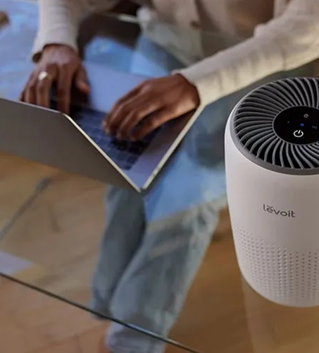
Cost / Benefit (3)
Cost: Unknown
Benefit: According to the employee, the accommodation is just fine for the office, but does not address other areas at the worksite.

Slide 41
AskJAN.org Resources
A to Z: Allergies
A to Z: Food Allergy
A to Z: Fragrance Sensitivity
A to Z: Long COVID
A to Z: Multiple Chemical Sensitivity
A to Z: Respiratory Impairments

Slide 42
Questions?

Slide 43
Thank you for attending “Accommodation Solutions: Respiratory Conditions, Allergies, & Fragrance Sensitivity”
JAN Training Events & Resources AskJAN.org/Events/Trainings.cfm

Slide 44
Complete the Evaluation To claim the HR CEU
Don’t close the JAN webcast window
Evaluation will open in a new window
Complete the evaluation and click on “View your certificate of completion.”
Or scan QR code

Slide 45
For More Information – Contact JAN
Visit
AskJAN.org
Call
800.526.7234
877.781.9403 (TTY)
Live Chat
@ AskJAN.org
Email
JAN@AskJAN.org
Social Media
Facebook and LinkedIn – Job Accommodation Network X (Twitter) – @JANatJAN

