Slide 1
Return to Work After COVID-19
Focus on Mental Health and Cognitive Impairments
James Potts, M.S. Senior Consultant
Melanie Whetzel, M.A., CBIS, Lead Consultant

Slide 2

Housekeeping
Technical Difficulties
  Use the Q&A option at the bottom of the screen
  Call 800-526-7234 or 877-781-9403 (TTY)
  Use the Live Chat at AskJAN.org
  Access Frequently Asked Questions
  https://AskJAN.org/training/Frequently-Asked-Questions-About-JAN-s-Remote-Trainings.cfm
Questions for Presenters
  Use the Q&A option at the bottom of the screen
  Questions will be gathered into a queue

Slide 3

Housekeeping Cont’d
PPT Slides
  See the link included in the webcast chat
  Download from the Webcast Series Archive section
  of the Training page at AskJAN.org
Captioning
  Use the closed caption
  option at the bottom of the screen
  Transcript will be available with webcast archive
This event is being recorded
Please complete the evaluation at the end

Slide 4
Return to Work Agenda
Agenda
Real Life Situations
  Relevant ADA Rules
  Best Practices
COVID-related Accommodation Examples
  Case-by-Case Basis
  Telework
  Essential Functions
  Fear and Anxiety
  Service Animals
  Long COVID
Questions and Answers

Slide 5
JAN Resources
JAN Publications Related to the Pandemic
Coronavirus (COVID-19), Stress, and Mental Health Conditions
Engaging in the Interactive Process During the Pandemic
The ADA and Managing Reasonable Accommodation Requests from Employees with Disabilities in Response to COVID-19
Masks for COVID-19 Management and ADA Accommodations
Teleconference Accessibility and Hearing — Keeping Deaf and Hard of Hearing Employees in the Loop
Accommodation Strategies for Returning to Work During the COVID-19 Pandemic
COVID-19 Long Haulers and the Americans with Disabilities Act
Available at https://AskJAN.org/topics/COVID-19.cfm

Slide 6
Case-by-Case Basis
Individualized
Case–by–Case Basis
One-Size Does Not Fit All

Slide 7

Case-by-Case Situation 1
After returning to work during the pandemic, an employee with panic disorder requests a private office and no interactions with the public or coworkers because she fears catching COVID. The employer denies the request stating that sufficient safety precautions are in place.

Slide 8

Case-by-Case Situation 2
A union employee was required to attend in-person training. When the employee arrived, he noticed a 100% mask policy for entrance into the building. The employee explained to the trainer he has limitations related to PTSD and cannot wear a mask. The trainer told him to wear the mask or get out.

Slide 9

Questions
Questions

Slide 10
Telework
TELEWORK

Slide 11

Telework Situation 1
An employee with panic disorder asks to continue teleworking after her employer calls all employees back to the workplace after mandatory telework related to the pandemic. The employer tells the employee she will need to come into the office until the interactive process is complete.

Slide 12

Telework Situation 2
Tom is requesting telework, but his supervisor is not wanting to approve the accommodation based on performance concerns. Company policy allows telework, but the benefit is based on performance. Tom and his providers explained how his performance will improve by working from home; Tom’s anxiety of being in the workplace and the distracting environment are impacting his ability to focus.

Slide 13
Questions (2)
Questions

Slide 14
Essential Functions
Essential Functions

Slide 15
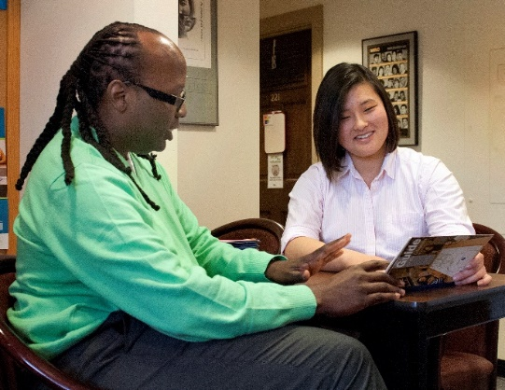
Essential Functions Situation 1
An employee who was sent home to work at the start of the pandemic has submitted three different doctor’s notes documenting that she cannot return to the workplace. Her employer did not require her to do some of the essential functions while at home, but now it has become necessary for those tasks to be done in the workplace by the employee.

Slide 16

Essential Functions Situation 2
A peer counselor moved while teleworking during COVID. Some continued telework is possible, but the employer is requiring employees to perform in-person services when requested by consumers.

Slide 17
Questions (3)
Questions

Slide 18
Fear, Anxiety, Safety
Fear, Anxiety,
and
Safety Concerns

Slide 19

Fear / Anxiety Situation 1
In a small coffee shop, all employees must be able to alternate between making drinks, cooking food, and serving customers. An employee with a mental health condition asks
not to serve customers who are not wearing masks.

Slide 20
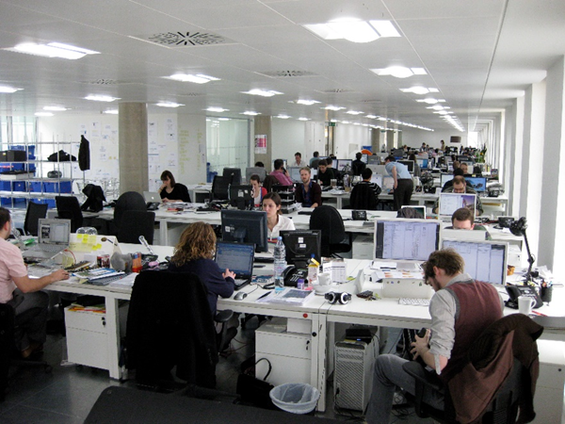
Fear / Anxiety Situation 2
An employee who has been in the workplace during the pandemic is now asking that the employer require others to remain at home teleworking, because he states he cannot tolerate close contact with coworkers.

Slide 21
Questions (4)
Questions

Slide 22
Service Animals
SERVICE and EMOTIONAL SUPPORT ANIMALS

Slide 23

Service Animals Situation 1
Telework is being phased out as an employer returns all employees to the physical workplace. During COVID an employee with anxiety obtained a dog and formed a deep connection. Being around the animal has greatly improved the employee’s mental health and he wants to continue working from home.

Slide 24
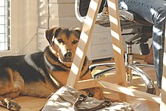
Service Animals Situation 2
An employee with PTSD asks to bring an emotional support animal to work. The employer denies the request because the employee did not need the accommodation before the pandemic.

Slide 25
Questions (5)
Questions

Slide 26
Long COVID
Long COVID
DOJ/HHS guidance:
https://www.hhs.gov/civil-rights/for-providers/civil-rights-covid19/guidance-long-covid-disability/index.html

Slide 27

Long COVID Situation 1
An employee returning to work after having COVID-19 asked for periodic rest breaks to help her deal with ongoing fatigue and stress intolerance. The employer denied the request after deciding that COVID-19 is not a disability.

Slide 28

Long COVID Situation 2
Jules is a customer service agent finding it difficult to keep up with the constant barrage of phone calls and remember pertinent information to relay to customers quickly. She asked for the accommodations of no phone calls, but more chats with time off between the chats to gather her thoughts. Her employer denied both due to her performance standards and business need.

Slide 29
Questions (6)
Questions

Slide 30

Need more information?
Visit AskJAN.org
Call JAN toll-free:
  800.526.7234 (V)
  877.781.9403 (TTY)
Use the JAN Live Chat @ AskJAN.org
Submit a JAN on Demand question @
AskJAN.org/JANonDemand.cfm
Email JAN @ JAN@AskJAN.org
Connect on social media
  Facebook – Job Accommodation Network
  Twitter – @JANatJAN

