Slide 1
Accommodation Solutions for Executive Functioning Deficits
Job Accommodation Network (JAN) Accommodation and Compliance webcast Series
Alexis Popa, MS, Consultant, and Melanie Whetzel, MA, CBIS, Lead Consultant

Slide 2
Housekeeping
Technical Difficulties
Q&A option at the bottom of the screen
800-526-7234 or 877-781-9403 (TTY) - or Live Chat at AskJAN.org
Frequently Asked Questions (FAQ) https://AskJAN.org/Training/JAN-Webcast-Frequently-Asked-Questions.cfm
Questions for Presenters
Q&A option at the bottom of the screen

Slide 3
Housekeeping 2
PPT Slides
Click the link included in the webcast login email you received
Captioning
Use the closed caption (CC) option or captioning link shared in the webcast chat
Transcript will be available with webcast archive

Slide 4
Executive Functioning
Executive functions are high-level mental processes or abilities that influence and direct more basic abilities like attention and memory.
The term executive function describes a set of cognitive abilities that include the ability to:
plan, organize, and strategize;
pay attention to and remember details;
start and stop actions; and
form concepts and think abstractly.
Executive functions also enable us to behave in appropriate ways.

Slide 5
Executive Functioning and Disability
Disabilities that may occur or be exacerbated and limit the ability to fully use higher level thinking skills include:
Autism
Epilepsy
Brain injury
Long COVID
Multiple sclerosis
Mental health conditions
Learning and intellectual disabilities
Alzheimer’s and other forms of dementia
Attention deficit hyperactivity disorder (ADHD)

Slide 6
Common Limitations
Memory
Attention
Multi-tasking
Organization
Concentration
Time management
Getting to work on time
Hyperactivity/Impulsivity
Managing mental fatigue

Slide 7
Memory
7

Slide 8
Memory Situation 1
A receptionist in a large office had difficulty remembering faces/names and keeping track of the in/out status of the various case managers on staff.

Slide 9
Memory Solution 1
A Velcro in/out board was provided with a photo and name of each case manager. When entering or leaving the building, staff members prompted the receptionist as to their status, and he would then move their photo from the “in” to the “out” column or vice versa. This allowed him to keep track of their status and better serve clients who were trying to contact them.

Slide 10
Memory Situation 2
A veteran in a new customer service position has PTSD and a TBI. After disclosing these disabilities and requesting accommodations, the employer provided a cubicle close to an exit, where the employee’s back was against a wall. This helped alleviate some anxiety, but the employee still had difficulty with memory and organization.

Slide 11
Memory Solution 2
The employer obtained a job coach through the VA to help the employee adjust to the new position. The job coach helped to develop a customized form for taking notes, a system for organizing the employee's workspace, and suggested email communication so the employee would have written responses. Breaks were also added into the employee’s day to help reduce stress and fatigue.

Slide 12
Memory Situation 3
Jessica is a med student who is struggling with expressing what accommodation ideas she has as well as communicating with the employer during ADA meetings and remembering discussion points.

Slide 13
Memory Solution 3
Jessica requests to have a support person present with her during important meetings to help not only in remembering key points but also to assist in better understanding the process of her accommodations.

Slide 14
Q & A Break

Slide 15
Learning
Thinking
Learning
Attention

Slide 16
Learning Situation 1
Hailey is applying for jobs and is having difficulty answering interview questions that require abstract thinking about scenarios she must recall from past employment or experiences.

Slide 17
Learning Solution 1
Hailey reached out to JAN for accommodation solutions she could request. For example, she could ask for interview questions to be provided in advance and extended time to answer questions. It was also suggested that she practice interview techniques and answering common questions.

Slide 18
Learning Situation 2
Deondre was a good employee who was able to meet the performance standards set by his employer for many years until he had a stroke that limited his cognitive abilities. After a medical leave, Deondre returned to work but was unable to complete several duties of his job.

Slide 19
Learning Solution 2
Deondre’s employer provided accommodations, but there were very few that were effective and none that helped Deondre meet his former level of productivity. In this case, the employer agreed that reassignment to a less-demanding job was the best solution.

Slide 20
Learning Situation 3
Tina became seriously ill from COVID-19 and was hospitalized three different times. When she was able to return to work, Tina was unable to learn the new operating system that was installed while she was out. Tina was experiencing lasting effects from COVID-19, resulting in difficulty with memory and learning.

Slide 21
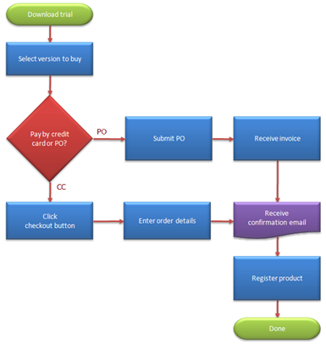
Learning Solution 3
JAN suggested extended training that met Tina’s needs in ways she could learn best, post-COVID. This included videos, hands-on instruction, and a trainer who could be available for questions. A color-coded flow chart of steps to remember was also recommended.

Slide 22
Organization

Slide 23
Organization Situation 1
An IT consultant who was very skilled at finding solutions to problems had difficulty with organization and remembering multiple tasks and information gained in meetings.

Slide 24
Organization Solution 1
This employee was given an advanced organizer to help obtain information from the meeting in a more organized and meaningful way. He was also permitted to record meetings to later review what was discussed and make sure important information was not missed. The employee’s supervisor also agreed to send information about tasks and assignments via email.

Slide 25
Organization Situation 2
Ty, who worked for an online catalog retailer, was having difficulty serving customers over the phone. He disclosed that he has a disability and requested reassignment to a position that does not require talking to people over the phone but involves communicating via online chats and emails.

Slide 26
Organization Solution 2
Since there were no vacant positions that the employee was qualified for that didn’t involve talking to customers, the employer asked what was needed to enable the employee to serve customers on the phone. Due to short-term memory deficits, Ty didn’t feel prepared to answer callers’ questions on the fly. Accommodation ideas included advanced one-on-one training, a mentor to help with organization, and prepared resources that could be located quickly and read easily.

Slide 27
Q & A Break 2

Slide 28
Concentration and Focus

Slide 29
Concentration & Focus Situation 1
Nigel is a case manager who had difficulty completing required documentation. Nigel’s workstation is in a noisy, open cubicle area that limits his ability to focus and concentrate. With no private space available, Nigel believes a change in office hours may help.

Slide 30
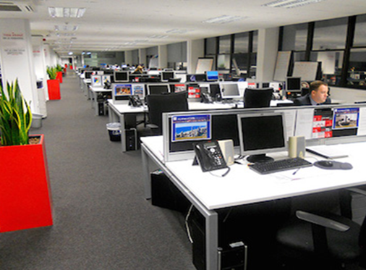
Concentration & Focus Solution 1
Nigel’s supervisor agrees that the office is hectic when staffed and approves a schedule change. Nigel was allowed to work two hours earlier, not only before the arrival of co-workers but also when he has the most mental acuity and ability to focus.

Slide 31
Concentration & Focus Situation 2
John is a teacher who has ADHD and is having difficulty managing varied tasks at the workplace during the pandemic. He describes feeling overstimulated and overwhelmed towards the end of each school day.

Slide 32
Concentration & Focus Solution 2
John sends an email to the HR department explaining his diagnosis, how he has managed limitations in the past, and how the pandemic has changed this. John includes a letter from his health care provider to support his statements and asks to meet with the employer to explore accommodations.

Slide 33
Time Management

Slide 34
Time Management Situation 1
An employee who works outside landscaping has trouble with time management and task completion. He works for a small employer who cannot provide the direct supervision necessary. The employee was using his phone to help manage time, but the employer felt it made it look like he was off task.

Slide 35
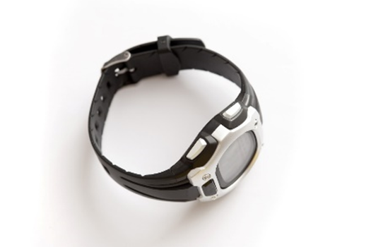
Time Management Solution 2
JAN suggested a daily written list of tasks and a watch with multiple settings programmable to varying amounts of time. The watch was set to vibrate and the task needing to be completed or started appeared on the face of the watch. The employee was trained to set the watch for daily tasks.

Slide 36
Time Management Situation 3
Al is extremely upset because the employer has written him up for being late. The next occurrence will result in termination. Because Al disclosed a disability during the interview, he feels that the employer should know he is unable to be on time and cannot be held accountable for tardiness.

Slide 37
Time Management Solution 3
Al should have notified the employer that tardiness is related to ADHD the first time it was brought to Al’s attention as a problem. That way he and the employer could have explored accommodation ideas that may have spared Al from reaching the point of termination.

Slide 38
Time Management/ Tardiness Solutions
The HR manager talked with Al about ways he may be able to better manage time in the morning, enabling Al to get to work on time:
Have a routine of keeping things in place
Prepare for tomorrow’s work tonight
Create checklists for yourself and others
Place sticky notes where you will see them
Turn off distractions — including cell phones
Use a timer or programmable watch to pace self

Slide 39
Final Q & A Break

Slide 40
JAN Accommodation and Compliance Webcast Series
Thank you for attending JAN’s “Accommodation Solutions for Executive Functioning Deficits”
Register for the next JAN webcast: AskJAN.org/events/register/2021-2022-webcast-series.cfm

Slide 41
Questions? Contact JAN for More Information
Visit
AskJAN.org
Call
800.526.7234
877.781.9403 (TTY)
Chat
@ AskJAN.org
Submit
JAN on Demand Inquiry @ AskJAN.org/JANonDemand.cfm
Email
JAN@AskJAN.org
Social Media
Facebook – Job Accommodation Network
Twitter – @JANatJAN

Slide 42
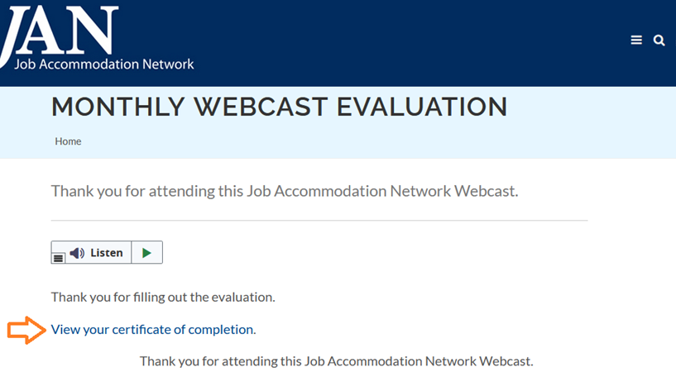
How do I claim the HR CEU?
Don’t close the JAN webcast browser
Complete the webcast evaluation in new window
Click on View your certificate of completion

