Slide 1
ADA and Accommodation Lessons Learned: Stay at Work/Return to Work Edition
Job Accommodation Network (JAN) Accommodation and Compliance webcast Series Lisa Mathess, SHRM-CP, Lead Consultant, and Tracie DeFreitas, MS, Principal Consultant

Slide 2
Housekeeping
Technical Difficulties
Q&A option at the bottom of the screen
800-526-7234 or 877-781-9403 (TTY) - or Live Chat at AskJAN.org
Frequently Asked Questions (FAQ) https://AskJAN.org/Training/JAN-Webcast-Frequently-Asked-Questions.cfm
Questions for Presenters
Q&A option at the bottom of the screen

Slide 3
Housekeeping 2
PPT Slides
Click the link included in the webcast login email you received
Captioning
Use the closed caption (CC) option or StreamText link shared in the webcast chat
Transcript will be available with webcast archive

Slide 4
Discussion Topics
Purpose and Benefits of Stay-at-Work (SAW) and Return-to-Work (RTW) Programs
Overview of Relevant Laws
ADA and Accommodation Lessons Learned

Slide 5
Purpose of SAW and RTW Programs
SAW: To keep an injured, disabled, or temporarily impaired worker on the job, if medically feasible
RTW: To return an injured, disabled, or temporarily impaired worker to the workplace as soon as medically feasible

Slide 6
SAW Program benefits
Reduce number of lost workdays
Maintain workforce productivity
Lower risk of condition becoming long-term or permanent disability
Reduce costs

Slide 7
RTW Program benefits
Retain valued employees
Enhance workforce productivity
Save on recruiting/training costs
Reduce costs

Slide 8
Key protections
There are 3 key protections for employees that employers need to think about when analyzing SAW/RTW initiatives:
Americans with Disabilities Act (ADA), as amended
Family and Medical Leave Act (FMLA)
Workers’ Compensation (WC)
Determine what laws may be in play
One or more of these may need to be considered — in some cases, all three

Slide 9
Overview of ADA and FMLA
ADA
Employers with 15 or more employees
“Disability” as defined by ADA; can perform essential functions of job with or without a reasonable accommodation
Unpaid leave as reasonable accommodation for term needed, if not undue hardship
FMLA
Employers with 50 or more employees/1250+ hours and 1 year of service
“Serious health condition” as defined by FMLA
Up to 12 weeks of unpaid leave; can be intermittent

Slide 10
Overview of WC and Other protections
WC
Employer of any size, even small (state-specific)
Injury arising out of or in the course of employment, with some exceptions
Leave based on nature of injury and medical opinion through workers’ compensation process
Other Protections
State civil rights/human rights laws
State disability benefits programs
Wage and Hour laws

Slide 11
Occupational Injury, Disability, And/or Serious Health Condition
WC
Occupational injury or illness
ADA Definition of Disability
Has/had a physical or mental impairment that substantially limits/limited one or more major life activities
FMLA Serious Health Condition
Requires hospitalization
Incapacitates for more than 3 consecutive days with ongoing medical treatment
Chronic conditions that flare and cause incapacitation
Pregnancy

Slide 12
SAW/RTW Lessons Learned Training Strategy
Follow a path that leads to a positive employment outcome
Note SAW/RTW “wrong turns”
Offer lessons and practical guidance to stay on track

Slide 13
Wrong Turns: SAW/RTW And The interactive Process
Failing to engage in IP/recognize need for accommodation
Dismissing temporary injuries/impairments
Applying a 100% healed policy

Slide 14
Lesson 1: Follow ADA path to address SAW/RTW Issues
Worker need not say “reasonable accommodation” when requesting help
Assume worker likely qualifies under ADA
Avoid immediately rejecting request for accommodation
Engage in interactive dialogue about reasonable accommodation
Ask for details on how individual’s proposal would work
Try to respond with a reasonable alternative
Try to get “buy-in” from individual
Document all discussions

Slide 15
Lesson 2: Consider Accommodating Temporary Injuries/Impairments to Stay On Track
Dismissing temporary injuries/impairments can lead to lost productivity
Assess key protections — WC and/or ADA or neither
Consider a practical approach to SAW/RTW
Provide temporary adjustment/reasonable accommodation to enable employee to stay at work
Situation: A registered nurse who was pregnant was restricted in lifting due to underlying medical conditions. She was fearful she would lose her job.
Solution: The employer transferred this employee to a non-patient care nursing role until the employee delivered the baby and was cleared to lift.

Slide 16
Lesson 3: steer clear of the 100% Healed Policy
Employer-Provided Leave and the ADA (EEOC)
RTW and Reasonable Accommodation, 100% Healed Policies
“Regarded as” claims
Blanket exclusions
ADA requires individualized case-by-case analysis — engage in an interactive process
Situation: A security guard ready to RTW had a 50lb lifting restriction. The employer had a “100% Restriction-Free” policy; the employee was denied RTW until restriction-free and able to lift 50+ lbs.
Solution: The employee cited ADA and showed that the job never required lifting 50lbs. He was able to perform the essential functions of the job and requested a policy modification.

Slide 17
Wrong Turns: SAW/RTW and Exploring Accommodations
Using inaccurate job descriptions
Only offering modified/light duty to workers with occupational injuries
Removing essential job functions
Neglecting to consider temporary/trial accommodations
Undervaluing transitional work arrangements

Slide 18
Lesson 1: Use The Job Description As a Navigational Tool
Not required but can be a good business practice
Content, nature, and functions of job can change
Identify essential functions of the job; update periodically
Consider job analysis
Situation: A food service manager with a back impairment was preparing to RTW after surgery.
Solution: The employer provide a detailed job description that included the requirements and environment. This information was used to request temporary modified duty, which enabled the employee to RTW earlier than anticipated.
Job Descriptions https://AskJAN.org/topics/jobdesc.cfm

Slide 19
Lesson 2: Modified/Light Duty Is A path
ADA doesn’t require creation of light duty position
May temporarily restructure original position to mirror light duty
Reassign to vacant light duty position — even if intended for WC situations
Situation: A maintenance worker had a 10lb lifting restriction. The job duties were physically well beyond medical restrictions. Employer wanted information about creating light duty positions.
Solution: JAN provided information on light duty definitions and accommodation solutions for light duty positions. The employer had a vacant delivery driver position that the employee was able to perform for a short period of time.
Light Duty https://AskJAN.org/topics/liduty.cfm

Slide 20
Lesson 3: get around the Bump with Job Restructuring
Reallocation of marginal tasks
Performing essential functions in a different way
Temporary removal of essential functions can be helpful — but not required (ever or permanently)
May require other forms of accommodation (e.g., equipment, schedule modification)
Situation: A teacher with seasonal affective disorder (SAD) was experiencing extreme fatigue that was expected to persist for several months due to a change in medication and the onset of winter.
Solution: The employee was temporarily accommodated with the removal of two extra duty requirements. The employer found no hardship in removing early and late bus duties during the winter months to address the extreme fatigue.

Slide 21
Lesson 4: Temporary Accommodations Can get You There
Shows good faith effort
Keeps employees working/expedites return to work
Could be ADA violation if not granted
Situation: An employee who was recently diagnosed with hypersomnia was taking new medications but continued to struggle with getting to work on time.
Solution: The employer agreed to a temporary flexible schedule while adjusting to the medication. The health care provider believed this would be effective. Options were also explored to help the employee remain more alert throughout the day.
Temporary or Trial Accommodations https://AskJAN.org/topics/Temporary-Accommodations.cfm

Slide 22
Lesson 5: Merge with A Transitional Work Arrangement
Transition back to full-time work over a short period
No set requirement under the ADA to allow this
Can benefit the employee from a medical standpoint
Can benefit the employer from a productivity standpoint
Situation: A custodian who was experiencing ongoing effects from COVID-19 was able to work but not at full capacity. The employee asked to return part-time and gradually increase hours over several weeks.
Solution: The employer agreed to a transitional work arrangement for 6 weeks, with the expectation that the employee would be able to resume full-time work at the end of the transitional period.

Slide 23
Wrong Turns: SAW/RTW and Medical Information
Broad-reaching or inappropriate request for functional capacity eval or fitness for duty exam
Insisting on independent medical examination (IME)
Making SAW/RTW decisions based on unsubstantiated safety/direct threat concerns

Slide 24
Lesson 1: Covering Too Much Ground May Go Too Far
Release to RTW may include information needed about abilities/limitations to proceed with accommodations
Focus on present ability to perform essential functions
FCE may identify unknown limitations
Fitness for duty
Be mindful of FMLA rules
ADA job-related and consistent with business necessity

Slide 25
Lesson 2: Pay attention to The signals
Recognize what medical information is known and whether it is sufficient
Sufficient information specifies existence of an ADA disability and need for accommodation
May require IME if information is insufficient
Check other IME rules
Situation: A forklift operator wanted to request accommodations to help alleviate pain they experienced while sitting for long stretches of time. The employee provided their supervisor a medical note from their provider simply stating the employee needed to take breaks or have a different seat.
Solution: Once HR received the medical note, they explained to the employee how the note didn’t have enough information to show disability, functional limitations, and lacked information to support the accommodation request. HR gave the employee 15 days to provide sufficient information.

Slide 26
Lesson 3: Know Before You Go — Identify the Safety Risk
Direct threat analysis does not include assumptions
Significant risk of substantial harm, to employee or others, which cannot be eliminated or reduced by reasonable accommodation
Specific risk must be identified
Must be current, not speculative or remote, and based on present ability to safely perform job duties
Must be based on objective medical or other factual evidence
Must consider reasonable accommodation
ADA Tech Assist Manual, title I, Chapter IV. 4.5 Standards Necessary for Health and Safety: A "Direct Threat“ https://AskJAN.org/publications/ada-specific/Technical-Assistance-Manual-for-Title-I-of-the-ADA.cfm#spy-scroll-heading-60

Slide 27
Wrong Turns: SAW/RTW and The Final Journey
Neglecting to explore reassignment to enable SAW/RTW
Not following reassignment rules
Providing indefinite leave
Keeping an employee on leave to avoid accommodating

Slide 28
Lesson 1: Reassignment Is a Path To Discover
Can be temporary or permanent reassignment
ADA does not require employer to create a position
May require other forms of accommodation (e.g., equipment, schedule modification)
Can be the best option for all parties
Situation: A mail clerk in a corporate office was not able to lift items heavier than 15 lbs. Most packages weighed more than this, and there were few clerks available to reallocate this task.
Solution: The employee was reassigned to a filing clerk position that was vacant while an employee was on medical leave. This was a temporary arrangement but allowed the employee to continue working and eliminated costs associated with hiring a temporary employee for the filing clerk job.

Slide 29
Lesson 2: Follow Reassignment Rules
Follow the law in-play that offers the greatest protection — WC, ADA, FMLA
Reassignment means not required to compete
Equivalent vacancies first, lower-level next
Inform employee about available vacancies
Reassignment https://AskJAN.org/topics/Reassignment.cfm

Slide 30
Lesson 3: Leave should Lead Back to work
Leave can be provided under FMLA, ADA, WC and/or other programs/statutes
Can be intermittent and/or extended
ADA and FMLA leave are job protected
Indefinite leave not required or best practice
Repeated extensions/open-ended
Situation: An employee originally accommodated with a 12-week leave for depression asked for an 8-week extension which the employer provided. At the end of the extension, the employer received a note stating the employee was not ready to return, and no anticipated date of return was provided.
Solution: The employer requested information from the employee’s mental health provider about a firm return date. None could be given. The employer determined they could not extend the leave again or hold the position.

Slide 31
Lesson 4: Leave should not be a Detour or SHORT CUT
Leave is ineffective if an employee can work with accommodations
Can’t force an employee to take ADA leave instead of providing accommodations to enable stay at work
Can’t force an employee to stay at work if FMLA eligible
Can’t force employees to take leave until the ADA interactive process is complete (most situations)
Leave as an Ineffective Accommodation https://AskJAN.org/articles/Leave-as-an-Ineffective-Accommodation.cfm

Slide 32
Follow The path that leads to positive SAW/RTW outcomes
Thank you for attending: ADA and Accommodation Lessons Learned: Stay at Work/Return to Work Edition

Slide 33
Questions? Contact JAN for More Information
Visit
AskJAN.org
Call
800.526.7234
877.781.9403 (TTY)
Chat
@ AskJAN.org
Submit
JAN on Demand Inquiry @ AskJAN.org/JANonDemand.cfm
Email
JAN@AskJAN.org
Social Media
Facebook – Job Accommodation Network
Twitter – @JANatJAN

Slide 34
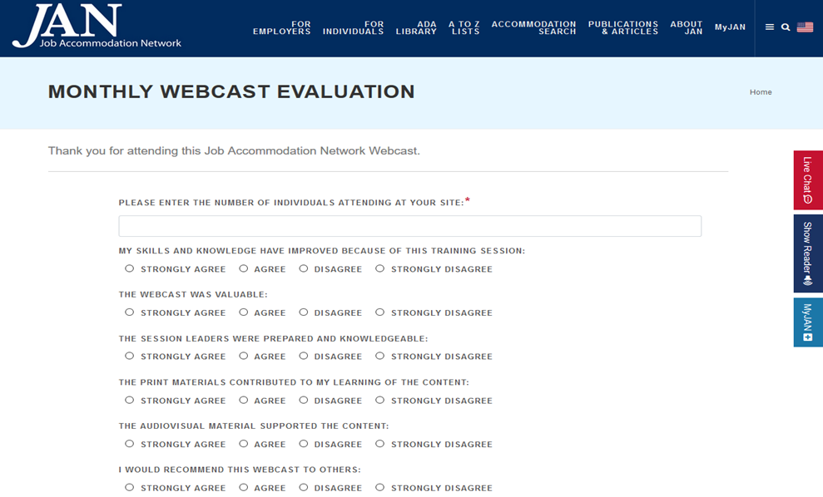
How do I claim the HR CEU?
Don’t close the JAN webcast browser
CEU approval code will be provided via the certificate that comes up after completing the webcast evaluation
Thank you for attending!
Register for the next JAN event: https://AskJAN.org/events/register/2021-2022-webcast-series.cfm

