Slide 1
Ergonomics for Teleworkers
Job Accommodation Network (JAN) Accommodation and Compliance webcast Series
Lisa Mathess, Lead Consultant, SHRM-CP, and Matthew McCord, Senior Consultant, CRC

Slide 2

Discussion Topics
Ergonomic Basics
Ergonomic Assessments
Common Problems and Remedies/Products
Tips and Resources for Home Office Setup

Slide 3
Definition of ergonomics
Ergonomics is the science of fitting jobs to people
Human Factors is concerned with the application of what we know about people, their abilities, characteristics, and limitations to the design of equipment they use, environments in which they function, and jobs they perform. (Human Factors and Ergonomics Society)
An applied science concerned with designing and arranging things people use so that the people and things interact most efficiently and safely. (Merriam-Webster)

Slide 4
Statistics
Musculoskeletal disorders (MSDs) account for 33% of all workplace injury cases
A recent report from the United States of America suggests that one in two adult Americans live with a musculoskeletal condition*
Prolonged sitting increases risk for heart disease, diabetes, cancer, and death, even among people who exercise regularly**
*(2019 World Health Organization WHO)
**(2015 Annals of Internal Medicine)

Slide 5
Msd Signs and symptoms
Signs or symptoms associated with computer use:
Numbness or a burning sensation in the hand
Reduced grip strength in the hand
Swelling or stiffness in the joints
Pain in wrists, forearms, elbows, neck, or back
Reduced range of motion in the shoulder, neck, or back
Dry, itchy, or sore eyes
Blurred or double vision
Aching or tingling
Cramping
Weakness
OSHA eTools https://www.OSHA.gov/SLTC/etools/computerworkstations/index.html

Slide 6

Ergonomic benefits
Reduced Workers’ Compensation claims
Reduced leave due to injuries
Create a safe and inclusive workspace
Satisfy ADA accommodation obligations

Slide 7
Ergonomic evaluations
Can benefit an array of medical conditions:
Back Injuries
Bursitis
Carpal Tunnel Syndrome
Epicondylitis (Tennis Elbow)
Hernia
Tendonitis
Trigger Finger
Thoracic Outlet Syndrome

Slide 8
Universal design
Adopt culture of access for all — universal design reduces the need for individualized accommodations
Telework as benefit of employment
Ergonomic adjustable chairs
Adjustable desks
External monitors separate from laptop
Computers preloaded with various AT software
Selection of alternative mice and keyboards
  Universal Design in the Workplace
  Accessible Computer Workstations: A Snapshot

Slide 9
Ergonomic assessments: Workstation (1)
Eyes
Position monitor 18 to 28 inches away from user
Top of monitor should be at or slightly below eye level
Angle should be 0–7 degrees
Proper lighting
Head, Neck, and Shoulders
Input documents positioned to minimize head movement
Frequently used items within easy reach
Head and neck aligned when using phone and when looking at monitor
User aligned in front of computer

Slide 10
Ergonomic assessments: Workstation (2)
Arms, Elbows, Wrists, and Hands
Are shoulders relaxed?
Are elbows appropriately angled (not bent upward or stretched forward)?
Are wrists appropriately angled while keyboarding, mousing, or using equipment or tools?
Wrists should not be resting while typing
Does mouse or tool fit user’s hand?
Check for hard or sharp edges
Are arms or hands fatigued from overuse?

Slide 11
Ergonomic assessments: Workstation (3)
Back, Legs, and Feet
Chair should support back
Feet should rest firmly on the floor
Hips and knees should rest comfortably
Seat pan should be comfortable and the correct size
Room between top of legs and underside of desk
User should be able to move chair around freely

Slide 12
Ergonomic assessments: Activities
Work Activities:
Are materials within reach?
Are tools provided that can help with tasks?
Check for repetitive tasks
Check for tasks that require exertion

Slide 13
Ergonomic assessments: Other
Consider individual needs:
Personal use items
Assistive technology
Environmental Observations
Noise levels
Air quality
Temperature variations
Variance in day-to-day activities or rotations

Slide 14
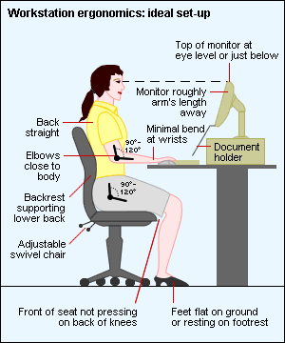
Ergonomic assessments:
Ideal Setup
From http://www.ergonomics-info.com

Slide 15

Practices to avoid when working remotely

Slide 16

Master bedroom with a view — and neck strain!

Slide 17

Cozy on the couch or aggravating injury?

Slide 18

It’s a family affair!

Slide 19

Sit on the floor, type with one hand, hold papers with the other!

Slide 20

Ergonomics At AskJAN.org
Additional JAN Resources
Ergonomic Assessment Providers
  Virtual
  On-Site
Ergonomic Software
  Assessment Tools
  Risk Analysis
  Workstation Design
Ergonomic Equipment
https://AskJAN.org/topics/ergono.cfm

Slide 21

JAN Resources
https://AskJAN.org/a-to-z.cfm

Slide 22

Ergonomics — sitting (1)
Problem: Sitting
Remedies:
  Back is supported
  Feet are grounded
  Arms are supported
  Maintain posture

Slide 23
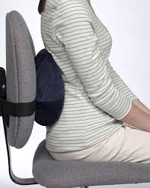
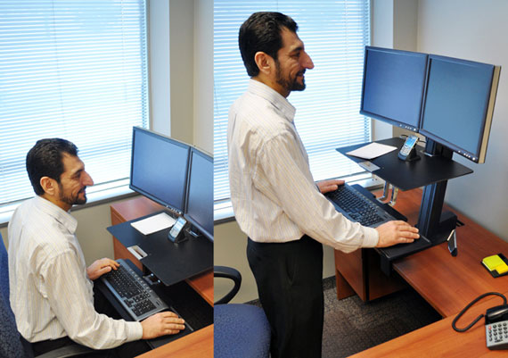
Ergonomics — sitting (2)
Problem: Sitting
Products:
  Lumbar support cushion
  Appropriate ergonomic chair
  Adjustable-height workstation
  Footrest

Slide 24
JAN Ergonomic Resources
Best Practices for Addressing Requests for Ergonomic Chairs
https://AskJAN.org/publications/consultants-corner/vol12iss05.cfm
Solution Showcase: Adjustable Workstations
https://www.YouTube.com/watch?v=K0x9KncL1jY
Solution Showcase: Ergonomic Chairs
https://www.YouTube.com/watch?v=Muap_TNy3WA

Slide 25

Ergonomics — Laptop (1)
Problem: Using notebook computer
Remedies:
  Connect to full-size monitor
  Adjust height
  Connect to keyboard/mouse
  Support forearms
  Use wheeled luggage to transport

Slide 26
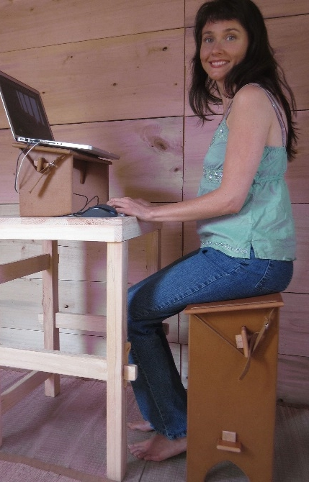
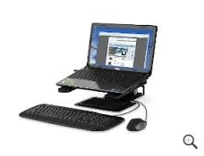
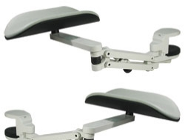
Ergonomics — Laptop (2)
Problem: Using notebook computer
Products:
  Docking station
  Forearm supports
  Be inventive!

Slide 27

Ergonomics — Keyboard (1)
Problem: Keyboarding/Mousing
Remedies:
  Alter/adjust placement of keyboard or mouse
  Keyboard height allows for straight wrists
  90-degree angle
  Consider different sizes
  Adjust armrest on chair
  Consider wrist/mouse rests
  Do not look at keyboard while typing

Slide 28
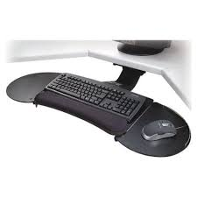
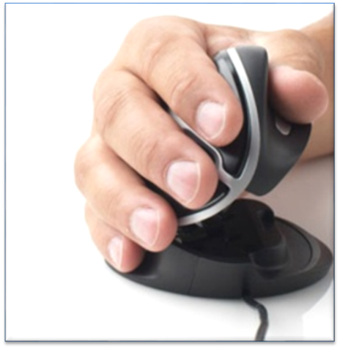
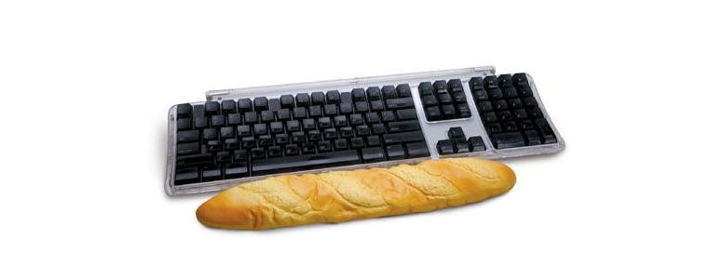
Ergonomics — Keyboard (2)
Problem: Keyboarding/Mousing
Products:
  Alternative keyboard
  Alternative mouse
  Articulating keyboard tray
  Wrist rest
  Forearm rest

Slide 29
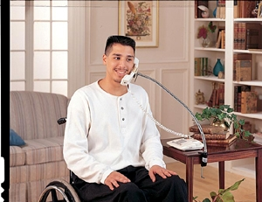
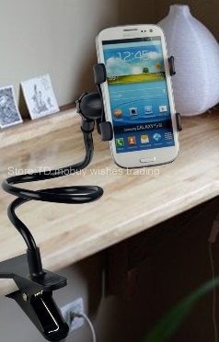
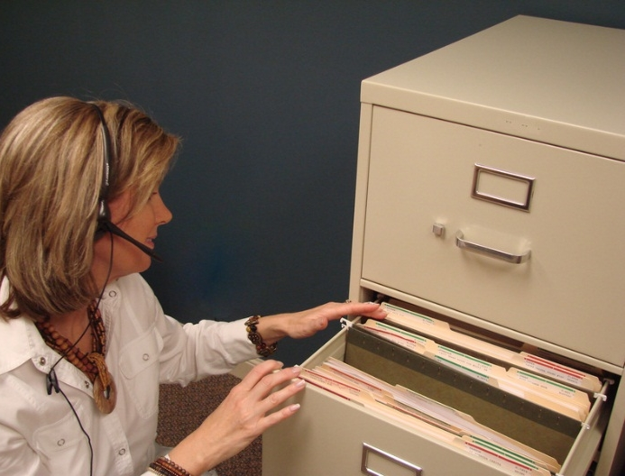
Ergonomics — Phone Use
Problem: Phone use
Remedies:
  Relax shoulders
  Keep head upright
  Adjust placement of phone to minimize reach
  Stand up when talking on the phone
Products:
  Use a “hands free” headset
  Gooseneck phone holder
  Speakerphone

Slide 30
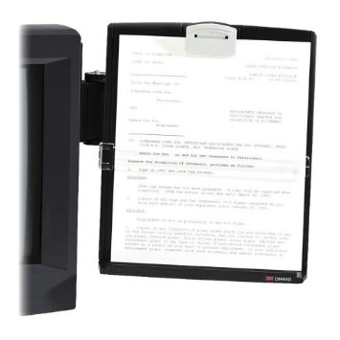
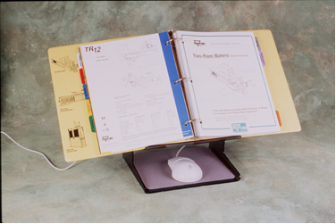
Ergonomics — Reading Papers
Problem: Reading documents
Remedies:
  Keep head upright
  Slant documents to read
  Stand up or move to another chair if not needing computer
Products:
  Book/Copy holders
  Get creative — Use your cookbook holder!

Slide 31

Ergonomics —
Eye Strain
Problem: Eye strain
Remedies:
  Reposition monitor
  Clean monitor
  Reduce glare
Products:
  Monitor riser or arm
  Task lighting
  Window shades
  Anti-glare filter

Slide 32
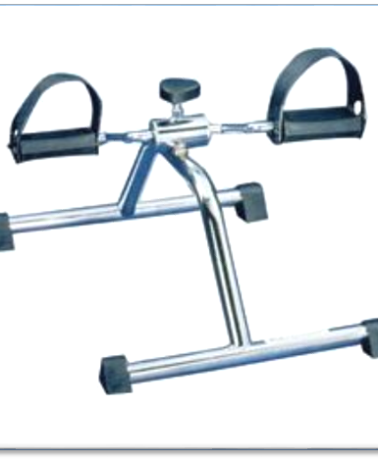
Ergonomics — Fatigue
Problem: Fatigue
Remedies:
  Occasional changes in posture
  Alternate sit/stand
  Micro-breaks/recovery pauses
  Stretching
Products:
  Adjustable height workstation
  Treadmill or bike workstations
  Alarms or daily reminders to stretch

Slide 33
Telework considerations: Job Restructuring
Job Restructuring
Removing marginal job tasks
Restructuring when duties are performed — most-difficult tasks during the time of day the employee has the most mental energy or stamina/is most productive/is most available
Noise canceling headset to remove distractions, apps for concentration
Communicate in alternative ways (e.g., email, chat)
Designate uninterrupted time for tasks that require significant concentration, specific days for meetings
Take breaks to address mental fatigue

Slide 34
Telework considerations:
Flexible Work Arrangements
Flexible Work Arrangements
Flexible work schedule (e.g., adjustable start/finish, reduced hours, alternative shift, altering when functions are performed)
Flexible and/or scheduled breaks to move around, use the restroom, chat with coworkers, service providers, etc.
Allowing time to be made up
Access to leave when cannot perform duties
Make Telework Work

Slide 35

Telework Considerations: Equipment- Ergonomics
AskJAN.org, A to Z: Topic:
Ergonomics in the Workplace
  Office Ergonomics: Your How-to Guide
  Your Home Office Is an Ergonomic Time Bomb. Here's How to Make It Better
  How to Set Up Your Ergonomic Home Office: Six Essential Ergonomics Tips for Remote Workers
  Coronavirus – Ergonomics Tips for Working at Home

Slide 36
Telework and COVID-19 (1)
During ordinary times — Accommodation (equipment) requirements for telework = complex and not addressed by ADA regulations or formal EEOC enforcement guidance
Pandemic Preparedness in the Workplace and the ADA (EEOC)
What You Should Know About COVID-19 and the ADA, the Rehabilitation Act, and Other EEO Laws (EEOC)
  During a pandemic, if IWD needs the same reasonable accommodation at a telework site that was provided at the workplace, employer should provide that accommodation, absent undue hardship
  Did not need an accommodation in the workplace Pre-COVID but now needs one while teleworking?
    Engage in the interactive process

Slide 37
Telework And COVID-19 (2)
Equipment Delivery and Setup
Duty to deliver and set up equipment needed as accommodation for telework?
  Not addressed by EEOC
Safety
Telework.gov – Useful resource; federal government
  Self-Assessment and Safety Checklist

Slide 38

Ergonomic Assessment Resources (1)
OSHA Computer Workstations eTool
  Good working positions
  Workstation components
  Checklists
  Work Process
  Workstation Environment
  OSHA Computer Workstations eTool

Slide 39
Ergonomic Assessment Resources (2)
DoD/CAP Workplace Ergonomics Reference Guide 2nd Edition
  Ergonomic needs assessment
  Ergonomic checklist
    Chair
    Preventing posture problems
    Workstation
    Lighting
    Healthy work practice
http://CAP.mil/Documents/CAP_Ergo_Guide.pdf

Slide 40

Telework Ergonomic Tips (1)
Colorado State University
  Use a good chair
  Raise your chair
  Support your feet
  Raise your monitor
  Use an external keyboard and mouse
https://source.colostate.edu/ergonomic-tips-for-working-from-home/

Slide 41

Telework Ergonomic Tips (2)
HumanTech
  Consider your environment
    Opt for existing desk/table
    Adjust lighting
  Consider your equipment
    Low-cost options
    DIY laptop stands (templates)
    Consider your habits
      Micro breaks
https://www.HumanTech.com/dont-work-from-the-couch-tips-to-improve-your-home-office/

Slide 42
Exercises for work!
NIH Exercises and Stretches
Eye exercise
Musculoskeletal exercises
Warming up for work
Back exercises
Aerobic exercise
Proper rest
https://www.ors.od.NIH.gov/sr/dohs/HealthAndWellness/Ergonomics/Pages/exercises.aspx

Slide 43

20-20-20 Rule
Get up and move! AVOID prolonged sitting!
Stand up (and walk around if you can) while talking on the telephone
Use alarm or notification to increase circulation by standing up and changing position at least once every hour
Stretch 1–2 minutes every 30, 45, or 60 minutes
At home, walk to kitchen to get drink of water
Practice the 20 – 20 – 20 rule!
  For 20 seconds every 20 minutes look 20 feet away

Slide 44
COVID-19 Resources (1)
JAN COVID-19 resource page
  ADA and Accommodation Lessons Learned: COVID-19 Edition
  FAQ: COVID-19 Vaccination and the Americans with Disabilities Act
  Long COVID and the Americans with Disabilities Act
  Requesting and Negotiating Accommodations During the Pandemic
  Recognizing an ADA Accommodation Request During the Pandemic

Slide 45
COVID-19 Resources (2)
JAN COVID-19 resource page
  The ADA and Managing Reasonable Accommodation Requests from Employees with Disabilities in Response to COVID-1
  Coronavirus (COVID-19), Stress, and Mental Health Conditions
  Masks for COVID-19 Management and ADA Accommodations
  Accommodation Strategies for Returning to Work During the COVID-19 Pandemic
  A Practical Approach to Telework as a Reasonable Accommodation During the Pandemic
  Telework Accommodation Request Flowchart

Slide 46
COVID-19 Resources (3)
What You Should Know About COVID-19 and the ADA, the Rehabilitation Act, and Other EEO Laws
Pandemic Preparedness in the Workplace and the ADA
COVID-19 “Ask the EEOC” Webinar and accompanying transcript
Federal Laws Protect You Against Employment Discrimination During the COVID-19 Pandemic

Slide 47
Questions? Contact JAN for More Information
Visit
AskJAN.org
Call
800.526.7234
877.781.9403 (TTY)
Chat
@ AskJAN.org
Submit
JAN on Demand Inquiry @ AskJAN.org/JANonDemand.cfm
Email
JAN@AskJAN.org
Social Media
Facebook — Job Accommodation Network
Twitter — @JANatJAN

