Slide 1
Accommodation solutions for gastrointestinal disorders
Job Accommodation Network (JAN) Accommodation and Compliance webcast Series Matthew McCord, MS, Senior Consultant, and Julie Davis, MS, Consultant

Slide 2
Housekeeping
Technical Difficulties
Q&A option at the bottom of the screen
800-526-7234 or 877-781-9403 (TTY) OR Live Chat at AskJAN.org
Frequently Asked Questions (FAQ) AskJAN.org/Training/JAN-Webcast-Frequently-Asked-Questions.cfm
Questions for Presenters
Q&A option at the bottom of the screen

Slide 3
Housekeeping 2
PPT Slides
Link to the PPT is included in the webcast login email you received
Captioning
Use the closed caption (CC) option or captioning link shared in the webcast chat
Transcript will be available with webcast archive

Slide 4
Discussion Topics
What is a Gastrointestinal Disorder?
What are some common Gastrointestinal Disorders?
What sort of accommodations can be helpful?
What does a real-life accommodation scenario look like?

Slide 5
About Gastrointestinal disorders
People with gastrointestinal disorders will often have complications with the digestive processes of absorbing nutrients and eliminating bodily waste.
Approximately 60~70 million Americans are affected by at least one annually.
About 10% of all annual hospitalizations are attributed to treating them.
The direct medical costs for treating them is estimated to exceed $100 billion each year.
Opportunities and Challenges in Digestive Diseases Research: Recommendations of the National Commission on Digestive Diseases. National Institute of Diabetes and Digestive and Kidney Diseases

Slide 6
Common Gastrointestinal disorders
Celiac’s Disease
Common symptoms include bloating, cramping, constipation, diarrhea, fatigue, nausea, weight loss, and vomiting.
Crohn’s Disease
Common symptoms include blood in the stool, cramping, diarrhea, fatigue, fever, and weight loss.
Cyclic Vomiting Syndrome
Common symptoms include abdominal pain, diarrhea, headaches, lightheadedness, nausea, and vomiting.

Slide 7
Common Gastrointestinal disorders 2
Diverticulitis
Common symptoms include abdominal tenderness, abdominal pain (that can be constant and last for several days), constipation, fever, nausea, and vomiting.
Food Allergies
Common symptoms include abdominal pain, diarrhea, hives, lightheadedness, nausea, swelling of the throat, tingling in the mouth, and vomiting.
Gastroesophageal Reflux Disease (GERD)
Common symptoms include burning sensations in the chest, chest pain, coughing, and disrupted sleep.

Slide 8
Common Gastrointestinal disorders 3
Gastroparesis
Common symptoms include abdominal pain, acid reflux, bloating, feeling full despite having eaten very little, nausea, vomiting undigested food.
Irritable Bowel Syndrome
Common symptoms include abdominal cramping, bloating, changes in frequency of bowel movements, and mucus in the stool.
Ulcerative Colitis
Common symptoms include abdominal cramping, blood or pus in the stool, diarrhea, fatigue, fever, urgency to defecate, inability to defecate despite this urgency, rectal pain.

Slide 9
Workplace Limitations
Arriving at work on time
Becoming fatigued easily
Commuting to and from work
Difficulty managing stressful situations
Dietary considerations for work-related events
Disruptive odors
Urgently needing access to a restroom

Slide 10
Accommodations: Workplace Modifications
Closer access to restroom, breakroom, office equipment, and employee parking lot
Limit long meetings/calls, if possible
Reduce clutter in the work area for easier access
Relocate employee to private area away from high traffic areas

Slide 11
Accommodations: Workplace Modifications 2
Assistive Technology Options
Adjustable Desk Top Workstations
Air Deflectors
Ergonomic and Adjustable Office Chairs
Monitor Risers
White Noise Machines

Slide 12
Scenario: Workplace Modifications
Scenario
Employee stated that being able to alternate between sitting and standing alleviated their gastrointestinal symptoms.

Slide 13
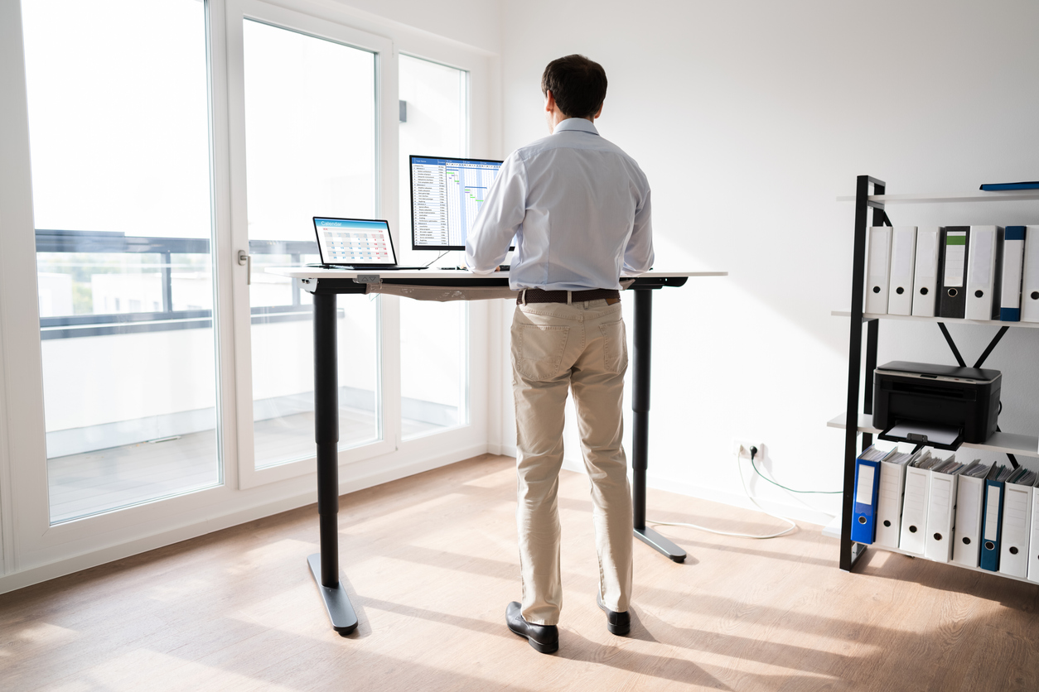
Solution: Workplace Modifications
Solution
Employer purchased a sit-stand desk so employee could complete the job duties while alternating between sitting and standing.

Slide 14
Accommodations: Schedule Modifications
Flexible schedule
Modified break schedule
Part-time or reduced hours
Teleconferencing meeting
Telework

Slide 15
Scenario: Schedule Modifications
Scenario
An employee who works in a call center has a gastrointestinal disorder and must take frequent restroom breaks. Productivity is measured by the number of calls taken.

Slide 16
Solution: Schedule Modifications
Solution
The employer continued to require all employees to meet productivity standards but moved the employee closer to the restroom and allowed him to take flexible breaks. He was also allowed to make up time for breaks taken beyond what all employees are entitled to.

Slide 17
Accommodations: Dignity Issues
Don’t draw attention to employee when they are late or must leave early
Employee should not have to request to use the restroom
Establish a discreet way to document breaks, coming in late
Limit requesting medical details about issues
Offer privacy to address issues

Slide 18
Scenario: dignity Issues
Scenario
Employee with a food allergy had an accident after eating contaminated food and needed to change their clothes.

Slide 19
Solution: dignity Issues
Solution
Employer discreetly let the employee go home to change and telework for the remainder of the day.

Slide 20
Accommodations: body odor
Additional breaks to improve hygiene
Adjusting schedule to work when others are not present
Personal attendant to assist in maintaining hygiene
Private area where hygiene needs are met
Working remotely

Slide 21
Accommodations: body odor 2
Assistive Technology Options
Air Cleaners – Chemical/Odor Removal
Air Deflectors
Fans
Odor Absorption
Odor Control

Slide 22
Scenario: body odor
Scenario
An employer was seeking additional options to accommodate an individual who had bowel incontinence after surgery.

Slide 23
Solution: body odor
Solution
JAN staff suggested modifying the work schedule so the individual could work during hours when fewer people were around and allowing the individual to have a private space to clean themselves and to store soiled clothes while at work.

Slide 24
Accommodations: stress
Allow service animals
Be flexible on the times that employees should be working
Provide additional breaks for de-escalation when needed
Reallocate marginal duties that cause undue stress
Seek services through Employee Assistance Programs

Slide 25
Scenario: stress
Scenario
An individual requested a hybrid telework schedule and written agendas for meetings, to assist them in reducing their stress levels at work. But the employer was not sure they could allow these accommodations long-term.

Slide 26
Solution: stress
Solution
JAN staff discussed the possibility of a trial period. This way the individual’s accommodation could be approved now while the employer could evaluate their ability to handle the accommodations long term during the trial.

Slide 27
Accommodations: dietary needs
Allow schedule flexibility around mealtimes
Enforce policies to prohibit triggering foods in common areas
Ensure viable options are provided at employer-sponsored events
Provide miniature refrigerators or coolers to keep food separated

Slide 28
Scenario: dietary needs
Scenario
An individual with Celiac’s Disease who travels for work requested accommodations because the events that they must attend for their job did not have gluten-free meal options.

Slide 29
Solution: dietary needs
Solution
JAN suggested that since the employer will know ahead of time the events they will be sending the individual to that will involve multiple catered meals, they could contact the event coordinators and let them know of their employee’s dietary needs.

Slide 30
Accommodations: commute
Allow flexibility in shift start times
Arrange carpools or rideshares
Permit working from separate office spaces closer to employee homes
Provide telework

Slide 31
Scenario: commute
Scenario
An employer implemented a post-COVID return to work requirement that all employees work on site 3 days a week. The individual contacted JAN because they felt like they needed to continue working from home due to the urgency they experience when needing to use the restroom.

Slide 32
Solution: commute
Solution
JAN suggested that the employee detail all the barriers that working on-site would impose, and then also detailing how telework easily meets all these needs while also not incurring the employer any additional costs to implement.

Slide 33
Accommodations: leave
ADA leave can be used continuously or intermittently
If making up missed time later is not possible, leave can be used to cover time away
Maximum leave under ADA is not a set amount like under the Family and Medical Leave Act (FMLA)
Review for leave eligibility under all applicable laws

Slide 34
Scenario: leave
Scenario
An individual working as a medical resident had to have their gallbladder removed. They exhausted FMLA leave but presented a note from their health care provider stating that they can return to work with several medical restrictions.

Slide 35
Solution: leave
Solution
As the employer was aware that the individual would be re-evaluated by their health care provider in a month, the employer extended the individual’s leave until after that appointment as an accommodation.

Slide 36
Accommodations: fatigue
Job restructuring
Periodic rest breaks
Reduced work schedule
Telework
Time for sitting, if job requires a lot of standing

Slide 37
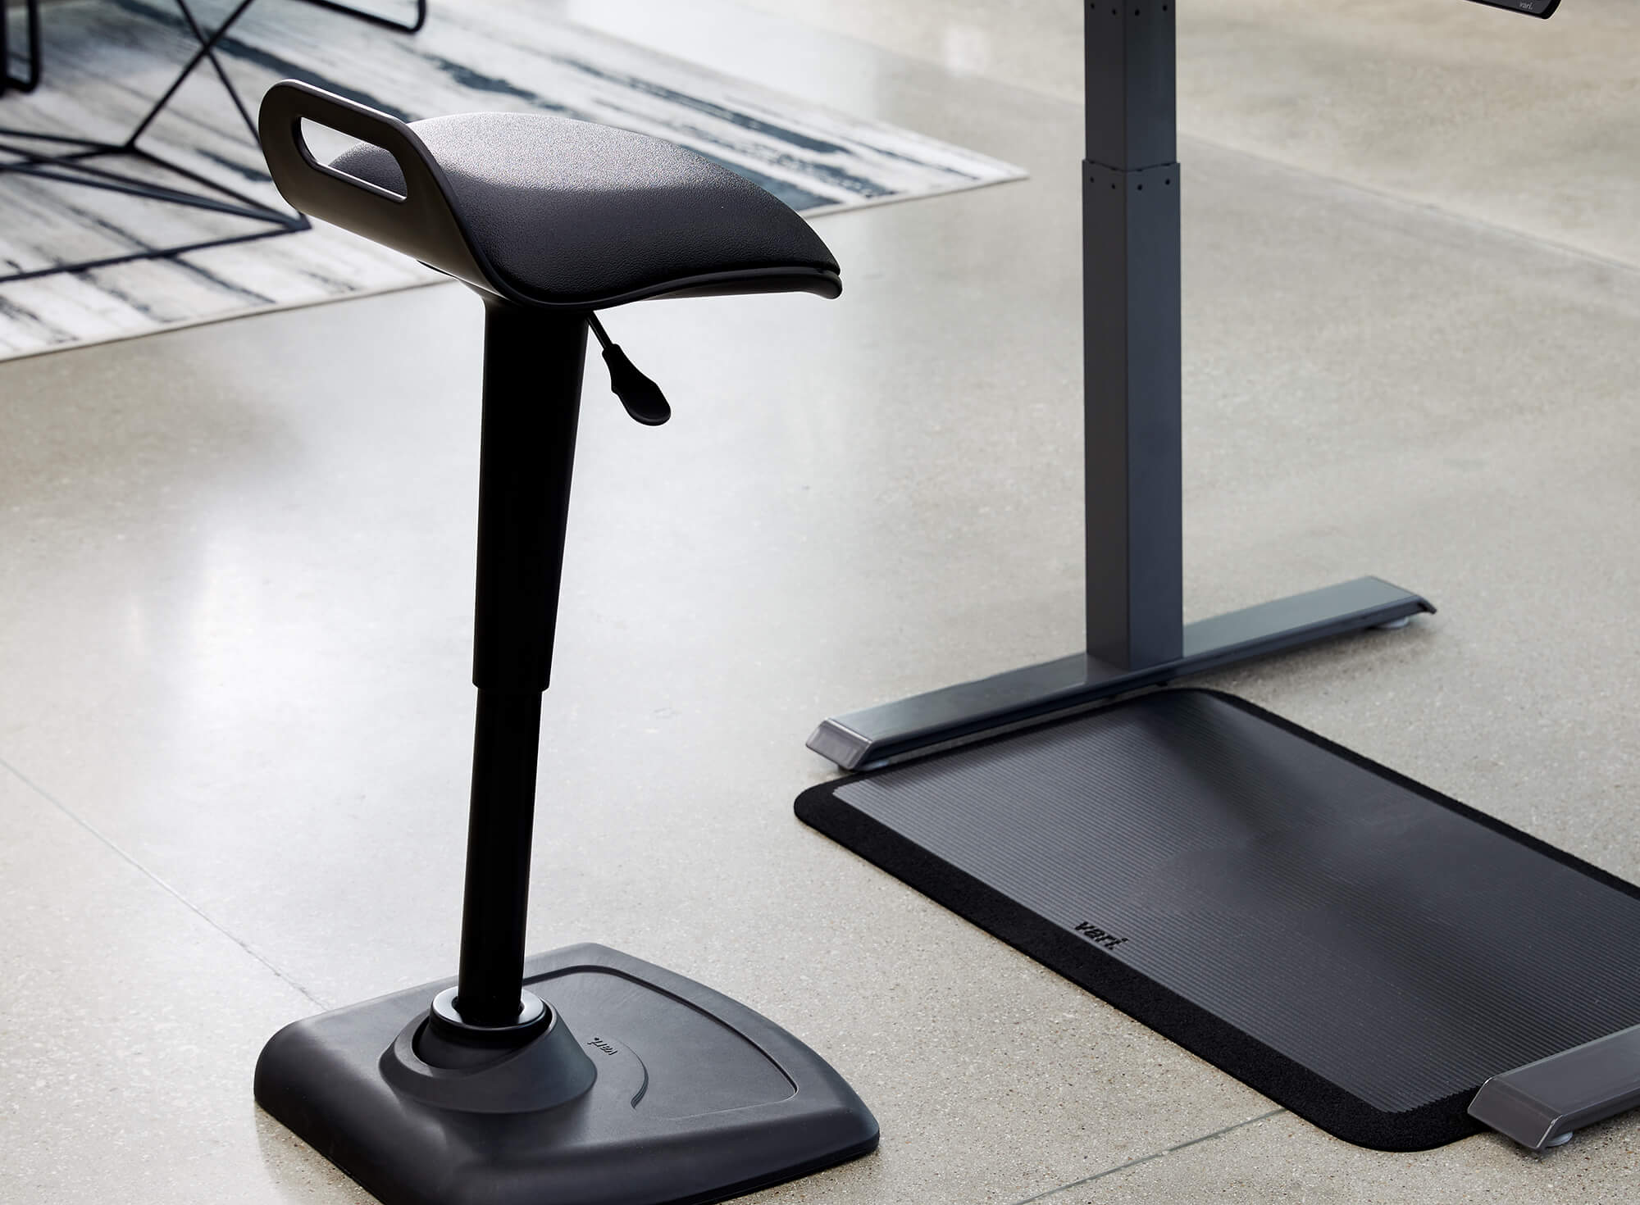
Accommodations: fatigue 2
Assistive Technology Options
Adjustable Workstations
Anti-Fatigue Matting
Low Task Chairs
Stand-Lean Stools
Wearable Anti-Fatigue Matting

Slide 38
Scenario: fatigue
Scenario
Employee gets nauseous and fatigued after a gastrointestinal episode.

Slide 39
Scenario: fatigue 2
Solution
Employer allows the individual to take a break and lie down until the employee feels better since it is for a short amount of time.

Slide 40
Accommodations: reassignment
Consider reassignment to a vacant position if the individual cannot be accommodated to complete the essential job duties in current role or because of undue hardship
Individual should not be required to compete for a vacant position so long as they are qualified
Individual should be placed in an equivalent position (e.g., pay, status, benefits, etc.) provided an equivalent position is available
Reassignment should be considered as an accommodation of last resort

Slide 41
Scenario: reassignment
Scenario
Employee was a train brakeman who experienced flare-ups from colitis. They did not have the flexibility to use the restroom when needed, due to safety concerns.

Slide 42
Scenario: reassignment 2
Solution
Employer reassigned employee to an equivalent position where a restroom was easily accessed.

Slide 43
Questions?

Slide 44
JAN Accommodation and Compliance Webcast Series
Thank you for attending JAN’s “Accommodation Solutions for Gastrointestinal Disorders”
Register for the next JAN webcast: AskJAN.org/Events/Register/2021-2022-Webcast-Series.cfm

Slide 45
How do I claim the HR CEU?
Don’t close the JAN webcast browser
Complete the webcast evaluation in new window or go to: AskJAN.org/EvaluationReg.cfm
Click on View your certificate of completion

Slide 46
Questions? Contact JAN for More Information
Visit
AskJAN.org
Call
800.526.7234
877.781.9403 (TTY)
Chat
@ AskJAN.org
Submit
JAN on Demand Inquiry @ AskJAN.org/JANonDemand.cfm
Email
JAN@AskJAN.org
Social Media
Facebook – Job Accommodation Network
Twitter – @JANatJAN

