Slide 1
Ask JAN! Q&A: Sensory Team Edition March 14, 2024
Teresa Goddard, Lead Consultant – Assistive Technology Services
Jose Gonzalez Lopez, Consultant – Sensory/Motor Teams
AskJAN.org
JAN is a service of the U.S. Department of Labor’s Office of Disability Employment Policy/ODEP.

Slide 2
Training Overview
Ask JAN! Q&A: Sensory Team Edition 03/14/2024
JAN consultants offer one-on-one consultation to help brainstorm accommodation ideas, provide practical guidance for addressing workplace accommodation issues, and work as a partner in the accommodation process. During this Ask JAN! Q&A, the JAN Sensory Team consulting staff will engage in an interactive discussion about trending job accommodation and Americans with Disabilities Act (ADA) topics and will field attendee questions related to sensory impairments, such as deafness, hearing aid use, blindness, and low vision, and immunological and respiratory conditions, such as allergies and asthma. The team will also discuss accommodation topics related to interpreting and captioning, digital accessibility, technology for print and image access, indoor air quality, and more.
60 minutes

Slide 3
Housekeeping
Technical Difficulties
Captioning
PPT Slides
Questions
Use the Q&A feature,
Live Chat at AskJAN.org, or email Training@AskJAN.org
FAQ: JAN Webcasts
Use the closed caption (CC) feature or captioning link in chat
Link included in webcast login email and in the chat, or go to this webcast event from the Training page at AskJAN.org
Use the Q&A feature

Slide 4
Agenda
About the Job Accommodation Network (JAN)
JAN Sensory Team Overview
Accommodation Topics and Live Q&A
Referrals and Resources

Slide 5
JAN Overview

Slide 6
About the Job Accommodation Network
Established in 1983
National, free consulting service
Expert, trusted, confidential guidance on job accommodations and disability employment issues
A service of the U.S. Department of Labor’s Office of Disability Employment Policy/ODEP

Slide 7
What does JAN’s Sensory Team do?

Slide 8
Sensory Topics
Vision
Hearing
Deaf-Blind
Communication Disorders
Respiratory System, Allergies, and Immune System
Skin Conditions
Diabetes

Slide 9
Common Sensory Accommodation Topics

Slide 10
Hearing Aids & Phones
Understand the type and features of the hearing aid to ensure the options being considered will work with them
Bluetooth-compatible hearing aid users can benefit from a Bluetooth streaming device to directly connect the phone and the hearing aid together
Hearing aids users without Bluetooth features may benefit from a “hearing aid-compatible” headset

Slide 11
Interpreters
Choose an effective interpreter
Prepare setting
Background noise
Prepare participants
Provide material in advance when possible
Establish meeting etiquette expectations
Consider notetaking assistance
Interact directly with person who is deaf
Relax and use normal tone and speed
Respect interpreter’s professional judgement and ethics

Slide 12
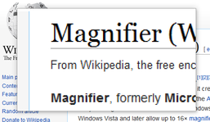
Low Vision & Computer Monitors
Larger monitors and external screen magnifiers are popular options but may not be long-term solutions.
It can be helpful to adjust system settings to increase the sizes of icons, text, and the mouse pointer on screen.
The use of screen magnification software (Zoomtext) and screen reading software (JAWS) can also be very helpful to consider.

Slide 13
Questions?
Use the Q&A Feature

Slide 14
Service Animals
Under Title I of the ADA, service and emotional support animals may be a form of accommodation. This means they are reviewed like all other accommodations.
Employers have the right to ensure the animal can perform the task the individual needs them to do and will not be a disturbance.
Title III of the ADA handles service animals differently. Be aware of whether the work area is considered a public space.

Slide 15
Allergies
Remove the allergen
Change cleaning products used, remove air fresheners, increase frequency of cleanings
Remove employee from area
Move workstations, create latex-free zones within hospitals, allow working from home
Reduce exposure as much as possible
Provide air purifiers, allow breaks away from area, modify schedule if allergen is coming from coworkers

Slide 16
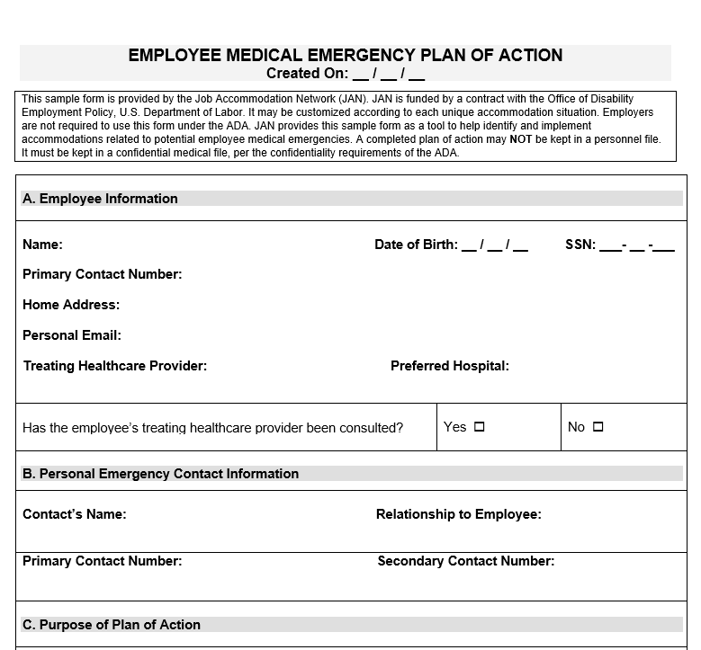
Managing Conditions
Plan of Action
Plan in case of a reaction at work
Voluntary
Develop with employee
Time off for treatment/recovery
Accommodations to manage symptoms and side effects
Modified schedule
Job Restructuring
Ergonomic management of fatigue

Slide 17
More Questions?
Use the Q&A Feature

Slide 18
Hot Topics in 2024

Slide 19
Sensory Team Hot Topics
AI as an Accommodation
Virtual Sighted Assistance
Accessible XR
Recording, Captioning, and Notetaking Tools
Telework and Return-to-Office Initiatives

Slide 20
Common Referrals and Resources

Slide 21
Sensory Team—Common Referrals and Resources
State Assistive Technology (AT) Projects
The Rehabilitation Engineering and Assistive Technology Society of North America (RESNA)
XR Access
Ventilation Mitigation Strategies
National Institute of Environmental Health Sciences (NIEHS) – Indoor Air Quality
Clean Air in Buildings Challenge

Slide 22
AskJAN.org— By Audience, A to Z, ADA Library, Publications, Training

Slide 23
A to Z of Disabilities & Accommodations
Click on the tabs to browse the index!
By Disability
By Limitation
By Work-Related Function
By Topic
By Accommodation
23

Slide 24
Examples of Sensory A to Z Resources
A to Z: Allergies
A to Z: Blindness and A to Z: Low Vision
A to Z: Food Allergy
A to Z: Fragrance Sensitivity
A to Z: Hearing Impairment and A to Z: Deafness
A to Z: Long COVID
A to Z: Multiple Chemical Sensitivity
A to Z: Respiratory Impairment
A to Z: Speech-Language Impairment

Slide 25
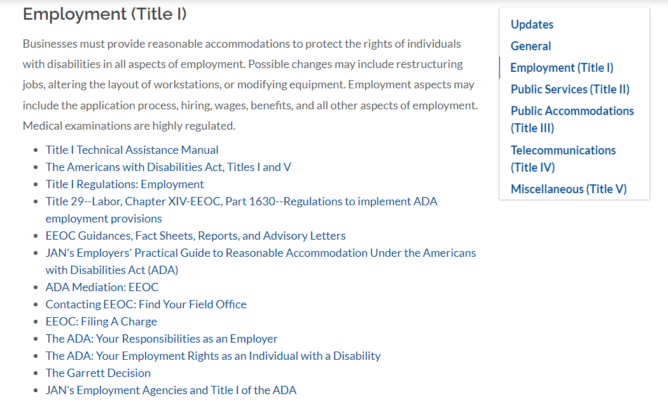
ADA Library
Primary topics:
ADA Amendments Act (ADAAA)
General ADA topics
Employment (Title I)
Title I Regulations
Equal Employment Opportunity Commission (EEOC) Guidance Documents, Fact Sheets, Reports, and Advisory Letters
25

Slide 26
MyJAN—A Personalized AskJAN.org Experience
Allows users to organize any JAN webpage available at AskJAN.org by category— Accommodation, Legal, and Other
Offers easy access to most frequently used JAN resources
Receive notice of newly released JAN resources
Choose and save JAN resources by color-coded category and order of importance to the user

Slide 27
Still have questions? Ask JAN! We can help.
AskJAN.org
800.526.7234
Live Chat @ AskJAN.org
Email JAN@AskJAN.org
27

Slide 28
Social Media
Job Accommodation Network
Job Accommodation Network
JANatJAN
JANinformation

Slide 29
Next JAN Webcast Accommodating Employees with Diverse Cognitive and Neurological Needs April 11, 2024 2:00-3:00 ET Training Information AskJAN.org/Events/Training.cfm

Slide 30
Thank you for attending! Please complete the webcast evaluation 1 HR Certification Institute CEU is available after attending the live webcast (03/14/2024)

