Slide 1
Accessibility as a Key to Inclusion
Teresa Goddard MS, Lead Consultant

Slide 2
Discussion Topics
JAN Overview
Accessibility
Questions

Slide 3
Ask JAN! We Can Help
The Job Accommodation Network (JAN) is the leading source of free, expert, and confidential guidance on job accommodations and disability employment issues.
JAN is a service of the U.S. Department of Labor’s Office of Disability Employment Policy/ODEP.

Slide 4
Job Accommodations & ADA
JAN provides free one-on-one practical guidance and technical assistance on:
Job accommodation solutions
Title I of the Americans with Disabilities Act (ADA) and related legislation, and
Self-employment and entrepreneurship options for people with disabilities

Slide 5
AskJAN.org
5
Practical Guidance
A to Z Lists
Disability
Limitation
Work-related function
Topic
Accommodation
Practical Guides for Employers and Employees
ADA and Rehabilitation Act Library
Interactive Process

Slide 6
ACCESSIBILITY AND INCLUSION
6
Notes:
Merriam-Webster defines inclusion as, " the act or practice of including and accommodating people who have historically been excluded."
Today I'm going to talk in detail about various aspects of accessibility. Accessibility as a disability related concept is essential to including individuals with disabilities. When spaces, resources, and events are not accessible to people with disabilities people may falsely believe that they are not interested in being part of the space when in fact they were simply unable to enter it. This can also be true for attendance at events and use of resources. When we don't plan ahead for accessibility, we may not even realize who is been excluded.

Slide 7
Accessibility definition
“Accessibility” refers to the design of products, devices, services, activities, or facilities so people with disabilities can use or participate in them. The Americans with Disabilities Act (ADA) and the Rehabilitation Act have guidelines for facility design that vary depending on the age and use of the facility. Both laws also have requirements for making services and activities accessible to people with disabilities. In addition to legal requirements, there are also best practice guidelines for accessibility.

Slide 8
JAN resources: Accessibility
JAN’s Accessibility Page
JAN’s Accommodation and Compliance: Digital/Web Accessibility

Slide 9
Accessibility and In-Person Events
Accessible Information Exchange: Meeting on a Level Playing Field – U.S. Department of Justice (DOJ) Publication
Accessible Live Training Events – JAN Publication
Accessible Meeting & Event Checklist – Cornell University Publication
Accessible Meetings, Events & Conferences Guide – Mid-Atlantic ADA Center Publication
How to Make Presentations Accessible to All – W3C Web Accessibility Initiative Publication
Planning an Accessible Meeting or Event Checklist – Employer Assistance and Resource Network on Disability Inclusion (EARN) Publication
Planning an Accessible Training Checklist – EARN Publication

Slide 10
Accessibility and Virtual Events
Accessible Virtual Meeting Platform Resources – JAN Publication
Checklist for an Accessible Virtual Meeting & Presentation – Partnership on Employment & Accessible Technology (PEAT) Publication
Create Accessible Meetings – General Services Administration Publication
How to Handle Captioning & ASL Requests for Virtual Meetings – PEAT Publication
Planning an Accessible Meeting or Event Checklist – EARN Publication
Planning an Accessible Training Checklist – EARN Publication
Teleconference Accessibility and Hearing — Keeping Deaf and Hard of Hearing Employees in the Loop – JAN Publication

Slide 11
Typical meeting accessibility issue
11
Example
A team of engineers includes hearing, hard of hearing, and deaf employees. Some need captioning, some need ASL, and some need no accommodation beyond their personal assistive devices and a group with effective meeting etiquette.

Slide 12
Typical solution
12
Accommodation
A typical approach is to provide CART services and interpreting services as needed. It can also be helpful to see if employees who use hearing aids would benefit from assistive listening devices or systems that are compatible with their hearing aids, to address background noise, and to encourage habits for effective meetings such as appropriate turn-taking.

Slide 13
Typical Challenge
13
Challenge
The team struggled with communication following a sudden pivot to remote work and use of remote meeting platforms.

Slide 14
Typical Options
14
Options
Relay services
Adjusting the volume
Dialing in for audio/telephone amplification
Automated captioning
Increased use of chat functions
Remote CART/Video Remote Interpreting
Seeking solutions from an audiologist

Slide 15
Lessons Learned
15
Outcomes
Automated options were not always accurate
Jargon
Background noise
Good for on-demand need or as a backup option
Remote CART and VRI were trusted by employees
Chat could be used to interject, share links, and get clarification without interrupting meeting flow
Increased use of chat was helpful for employees with other impairments
Employees like having more volume control
Some found dialing in to be effective

Slide 16
Accessible Facilities
Accessible Stadiums – DOJ Publication
Accessibility under the ADA – JAN Publication
Guide to the ADA Accessibility Standards – Access Board Publication
Making Shared Workspace More Accessible for Employees with Disabilities – JAN Publication
Physical Accessibility in the Workplace – JAN Publication
Uniform Federal Accessibility Standards (UFAS) – Access Board Publication

Slide 17
Web accessibility Standards
Accessibility Standards
Web Content Accessibility Guidelines (WCAG)
Section508.gov

Slide 18
Web accessibility Tools
WebAIM's WCAG 2 Checklist
508 Standards Applicability Checklist
The Partnership on Employment & Accessible Technology (PEAT) Resources
Digital Accessibility
TechCheck
Web Accessibility
Website Accessibility Vendors
DOJ Guidance on Web Accessibility and the ADA

Slide 19
Accommodations versus accessibility
An accommodation is a change in the workplace or in the way things are done in the workplace.
May be requested and implemented.
Accessibility refers to the design of products, devices, services, activities, or facilities so people with disabilities can use or participate in them.
Quick tip: provide accommodations to meet individual needs but plan accessibility to address the needs of everyone.

Slide 20
JAN’s Toolkit
20

Slide 21
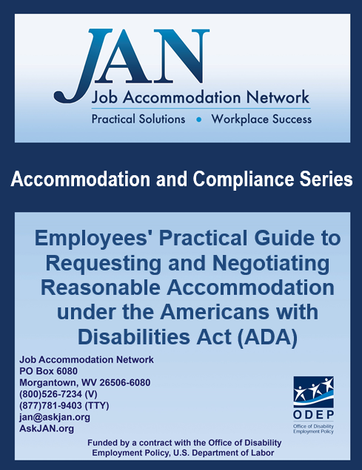
Employee Resources
How to Request an Accommodation: Accommodation Form Letter
Sample Language for Accommodation Request Letters
Practical Guidance for Medical Professionals: Providing Sufficient Medical Documentation in Support of a Patient's Accommodation Request

Slide 22
Questions? Contact JAN for More Information
Visit
AskJAN.org
Call
800.526.7234
877.781.9403 (TTY)
Chat
@ AskJAN.org
Submit
JAN on Demand Inquiry @ AskJAN.org/JANonDemand.cfm
Email
JAN@AskJAN.org
Social Media
Facebook – Job Accommodation Network Twitter – @JANatJAN

