Slide 1
AT Update: what’s new in 2022
Teresa Goddard, Sensory Team Lead Consultant Matthew McCord, Motor Team Senior Consultant Christy McCune, Sensory Team Consultant

Slide 2
Housekeeping
Technical Difficulties
Q&A option at the bottom of the screen
800-526-7234 or 877-781-9403 (TTY) OR Live Chat at AskJAN.org
Frequently Asked Questions (FAQ) AskJAN.org/Training/JAN-Webcast-Frequently-Asked-Questions.cfm
Questions for Presenters
Q&A option at the bottom of the screen

Slide 3
Housekeeping 2
PPT Slides
Click the link included in the webcast login email you received, see the link in the chat, or go to this webcast event from the Training page at AskJAN.org
Captioning
Use the closed caption (CC) option or captioning link in the chat

Slide 4
Discussion Topics
About JAN
What is Assistive Technology (AT)?
Interactive Process
Situations and Solutions
AT In-Development
Questions

Slide 5
Job Accommodation Network
Established in 1983
National, free consulting service
Expert, trusted, confidential guidance on job accommodations and disability employment issues
A service of the U.S. Department of Labor’s Office of Disability Employment Policy/ODEP

Slide 6
What is Assistive technology (AT)?

Slide 7
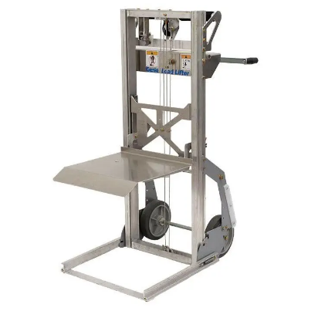
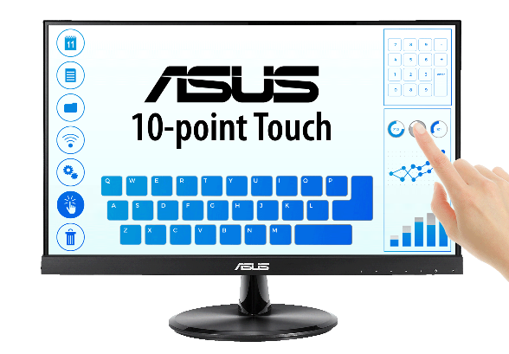
AT Defined
Assistive Technology (AT) can mean a device or service that can be used as a tool by a person with a disability to achieve or maintain functioning.

Slide 8
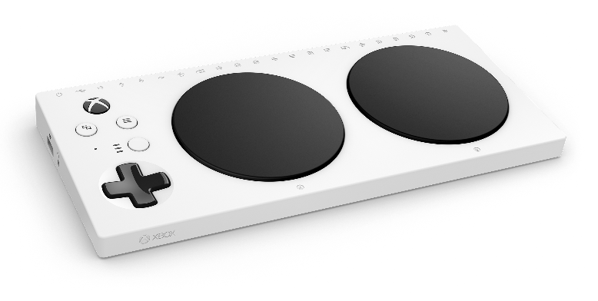
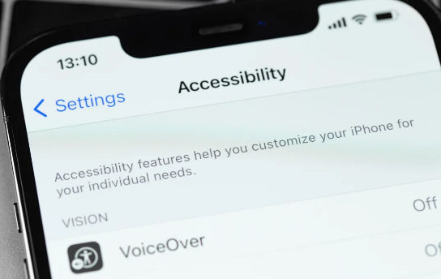
Traditional vs Mainstream Devices
Traditional AT can be devices that are used solely for completing a task by an individual with a disability.
Mainstream devices have become more accessible with the prevalence of mobile technologies and wearable devices.

Slide 9
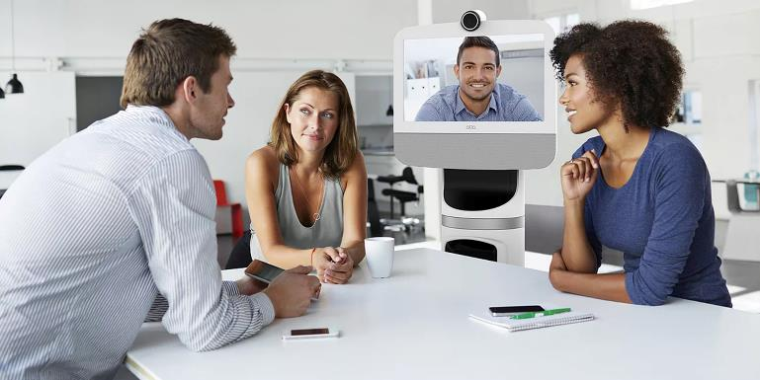
High-Tech vs Low-Tech AT Devices
High-Tech
Alternative Input Devices
Software
AAC Devices
Telepresence
Low-Tech
Workspace Modifications
Less expensive devices
Custom-designed or modified products
DIY

Slide 10
How to stay up to date on new AT

Slide 11
Finding your path

Slide 12
Typical Problem — Vision
A new hire just began working in a school cafeteria. She has low vision and had been working with a team of professionals to learn how to use strategies and assistive technologies for a variety of on-the-job tasks.

Slide 13
Typical Solution — Vision
The worker explained to her new supervisor how she could use assistive technology and strategies to perform tasks such as serving students, cleaning tables, navigating the kitchen and cafeteria, and putting away cleaning products. She had some initial difficulty navigating.
Some typical solutions for navigating include:
Allowing an orientation and mobility specialist to come to the workplace
Orientation and mobility tools
Cane
Proximity detector
Service animal
Set paths of travel

Slide 14
Range of Approaches — Vision
What are some options to consider?
Find a secure and accessible location for AT storage
Designate someone to assist as a qualified reader
Seek assistance from State Vocational Rehabilitation (VR) or scripting vendor
Provide portable AT options
Orcam
Aira IO
Portable digital magnifier
Seeing AI

Slide 15
But What if? — Vision
The employer had very specific concerns about the individual being able to correctly identify cleaning chemicals. There were also concerns about eventually being able to correctly enter lunch numbers and performing other record-keeping tasks using computers, ID cards, and other materials and equipment, and about how the employee would appropriately use assistive technology in a kitchen setting without violating health codes or damaging the technology.

Slide 16
Targeted Solution — Vision
The JAN consultant discussed some common options including color-coded and tactile labels, designating someone to double-check labels and provide reading assistance as needed, and making any necessary software accessible.
We also discussed small portable and wearable items that could be stored in a pouch or pocket or worn on the head. For example, Orcam OCR products are available in handheld or head-worn designs and can be used to read printed text aloud.
A newer approach is virtual sighted assistance.

Slide 17
Product Spotlight — Vision Product
AIRA IO
Currently in beta testing, the Aira Desktop app allows virtual sighted assistance for computer-based tasks.

Slide 18
Typical Problem — Typing
An employee working in the healthcare industry is having trouble with computer use due to only having the ability to use one hand.
The employer contacted JAN for accommodation ideas to assist this individual, as until now the individual has been switching between the keyboard and mouse with one hand, and this has caused them to work more slowly than others in the same role.

Slide 19
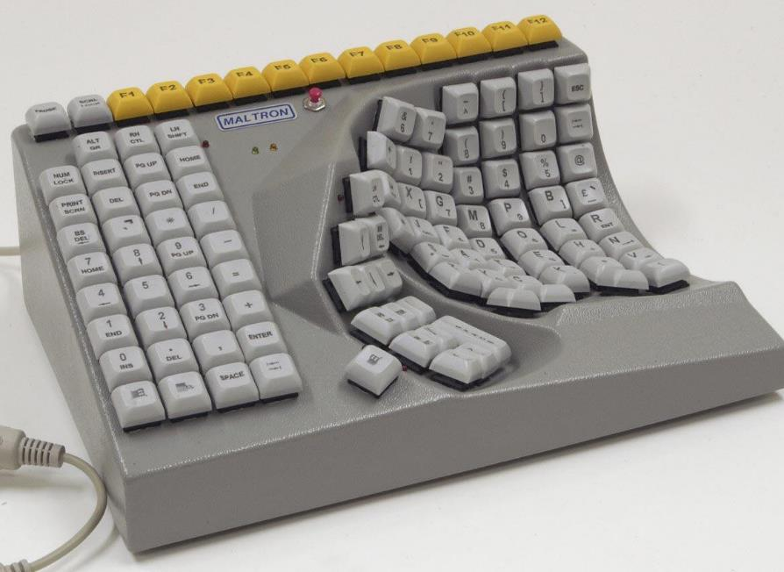
Typical Solution — Typing
Options could include:
Alternative mousing options that are not operated via the hands
Miniature keyboards
One-handed keyboards
Speech recognition software

Slide 20
But What if? — Typing
The individual agrees that speech recognition is the best option and wants to proceed with that as the accommodation. However, they work with sensitive information that should be kept confidential.
Speech recognition would require the individual to speak that information out loud for the software to dictate it for them. How can the employer help to make sure that this data is not overheard by others nearby who should not be privy to those details?

Slide 21
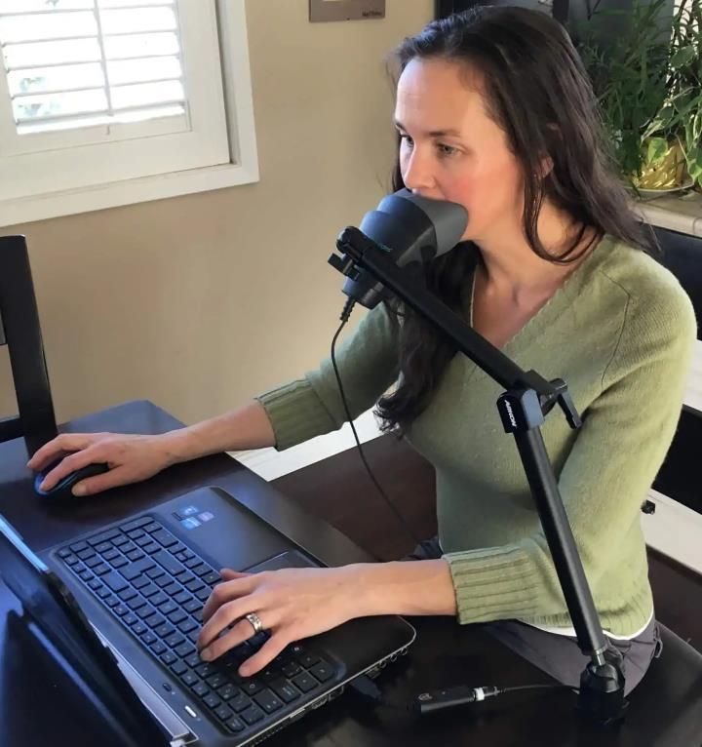
Targeted Solution — Typing
Stenomasks were originally designed for use in courtrooms to enable Stenographers to verbally dictate court proceedings without disrupting the court.
A USB adapter might be needed to use this with a typical computer.

Slide 22
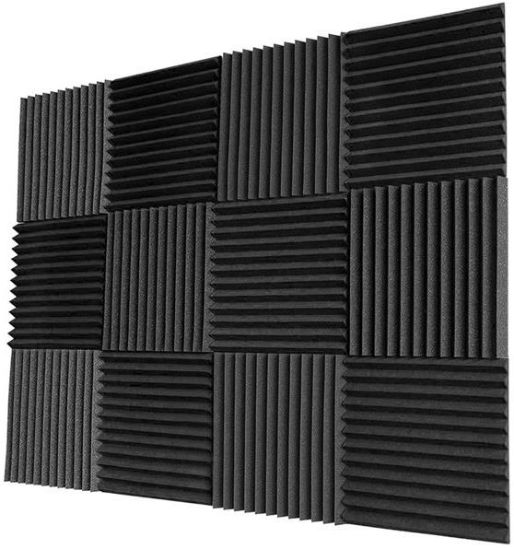
Additional Approaches — Typing
Additional solutions could include:
Allowing the individual to work remotely
Cubicle walls with soundproof panels
Moving the workstation to a more private work area

Slide 23
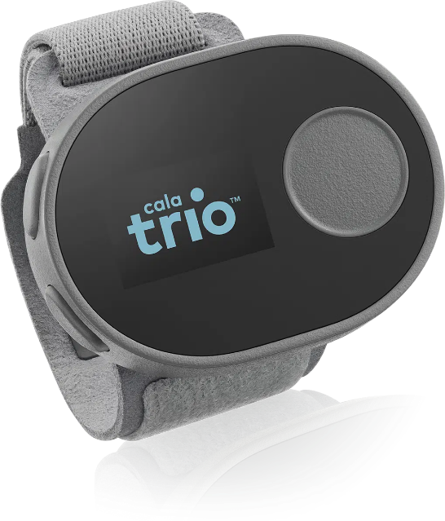
Product Spotlight — Cala Trio
The Cala Trio
A wrist-worn stimulator to help alleviate the impact of tremors on tasks like typing or writing.

Slide 24
Typical Problem — Hearing
A newly hired roofer was deaf and used ASL. He needed to receive instructions at the worksite.

Slide 25
Typical Solution — Hearing
A typical approach is to provide interpreting services as needed. ASL can be especially important to ensure effective communication in important meetings and to provide equal access to benefits and privileges of employment such as training. Some employees may be able to effectively use other communication support, such as automated captioning or alternative communication methods such as texting, instant messaging, typing, and handwritten notes.

Slide 26
Communication — ASL
Basic tips for communicating through a sign language interpreter:
Choose an effective interpreter
Prepare setting
Prepare participants
Consider notetaking assistance
Interact directly with person who is deaf
Relax and use normal tone and speed
Respect interpreter’s professional judgement and ethics
Consider also using captioning with interpreting in video calls

Slide 27
But What if? — Hearing
Sometimes the typical accommodations simply aren't a good fit. This is particularly common when the nature of the work and the work setting make it difficult to implement an employee's preferred solution.
The roofer needed to receive instructions from a supervisor while on-site. However, due to the changing locations and safety concerns it was difficult to find an interpreter who could meet the employee’s need. There were also safety concerns, and practical concerns about line of sight and working at heights. Additionally, the fact that frequent but brief communication would be needed contributed to concerns about costs.

Slide 28
Similar Issues — Hearing and Meetings
A typical approach is to provide CART and interpreting services as needed. It can also be helpful to see if employees who use hearing aids would benefit from hearing aid- compatible assistive listening devices/systems, to address background noise, and to encourage effective meeting habits like appropriate turn taking.
Typical meeting options:
Microphones/Meeting etiquette
CART/Interpreting as needed
Assistive Listening Systems
Automated captioning
Notetaking assistance/Written Materials
Seek solutions from an audiologist

Slide 29
Targeted Solution — Hearing
The JAN Consultant discussed a range of low-tech and high-tech communication supports that did not require connectivity.
Options:
Pen and paper
Whiteboard
Supervisor leaning basic signs
Signtel

Slide 30
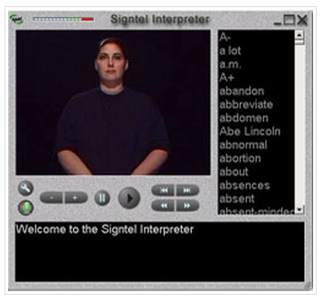
Product Spotlight — Hearing Product
Signtel
A communication device that turns spoken English into basic signing. Signtel does not require internet connectivity.

Slide 31
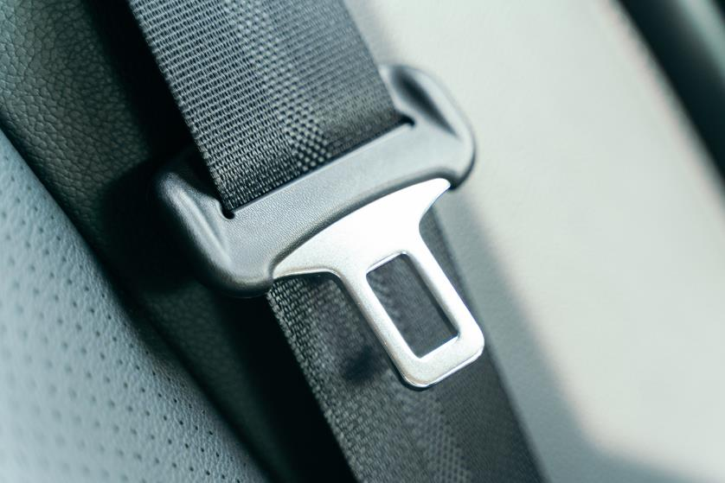
Typical Problem — Back
An employee working for the IRS was recently in a car accident and injured their back.
The employer reached out to JAN seeking accommodation options that may help this individual with the pain they experience when sitting for prolonged periods of time.

Slide 32
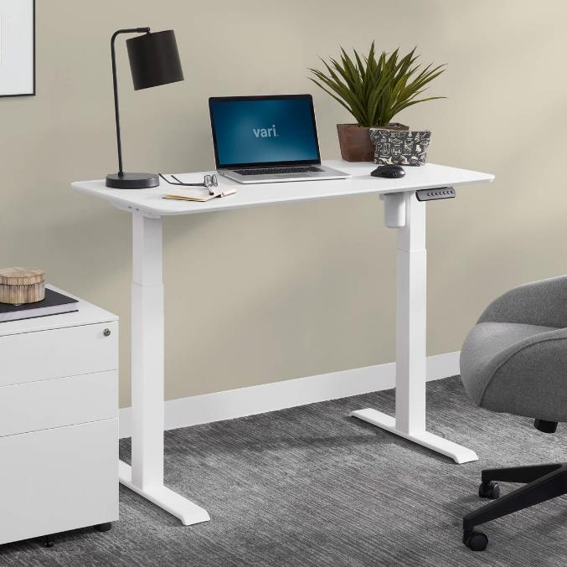
Typical Solution — Back
Options could include:
Adjustable workstation with a desktop that can be raised and lowered
Height-adjustable monitor stand with attached keyboard and mouse tray
A dedicated sitting workstation and a separate dedicated standing workstation

Slide 33
But What If? — Back
The individual’s back pain is not relieved by alternating between sitting and standing? In this situation the employer already thought of this option and offered it to the individual, but the individual stated that it would not help. They mentioned that they only get relief when they lie down.
As the need is from an injury, leave time could be helpful to allow more time for the individual to recover from the accident. But are there any other options that might allow the individual to return to work sooner?

Slide 34
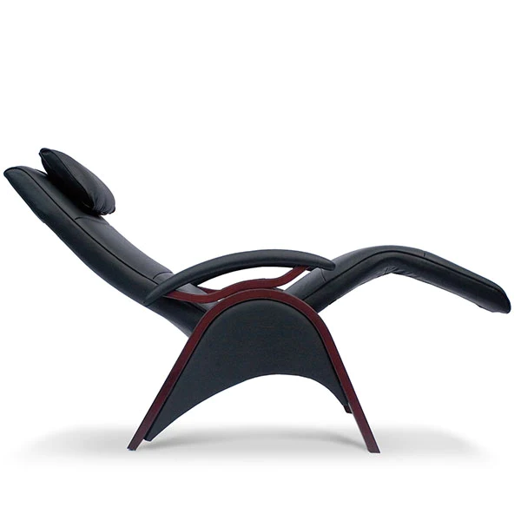
Targeted Solution — Back
A Zero Gravity reclining office chair allows sitting in an upright posture and then alternating into a supine posture as needed.
Several models use a motor to do this, so the chair remains in a static position until it is purposefully changed.

Slide 35
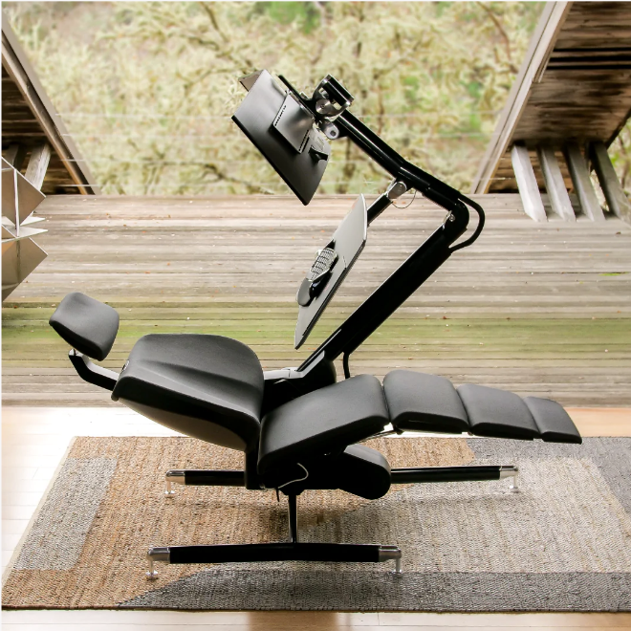
Targeted Solution 2 — Back
There are also Supine Workstations.
These tend to be an entire workstation package: a desk, a chair, and a monitor stand combination that all recline in unison.

Slide 36
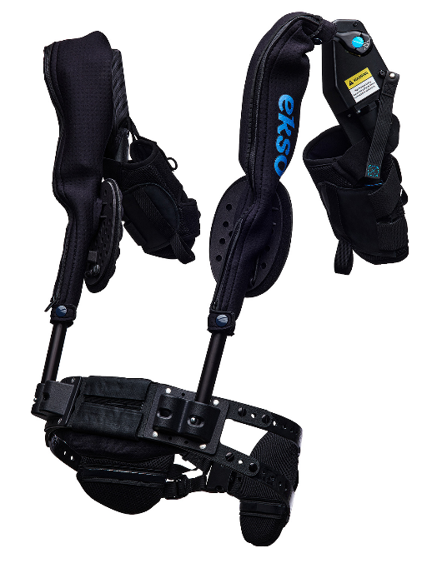
Product Spotlight — Esko EVO
The Esko EVO
An exoskeleton vest that provides physical labor support. Designed to help reduce worker fatigue as well as work-related injuries.

Slide 37
AT In Development

Slide 38
2022 Solutions and Trends
Data Security
Hybrid Work
Return to the Workplace

Slide 39
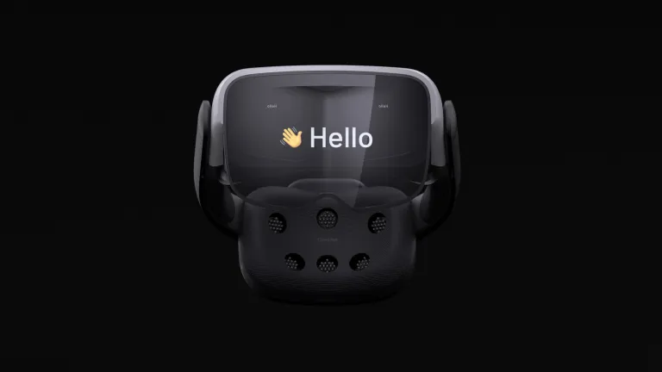
In Development — Wearable AAC
Cognixion ONE is a wearable AAC device with an AR display and a choice of three methods of access
Switch
Head Pointing
Brain-Computer Interface

Slide 40
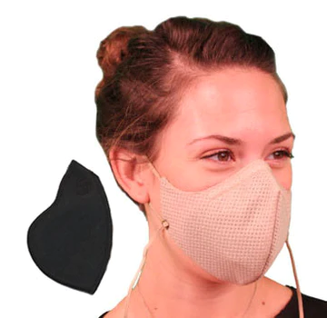
New Option — Masks for Respiratory Triggers
Honeycomb Pollution Mask with Coconut Classic Filter from I Can Breathe!® Masks
This mask and filter combo features a reusable washable shell and a replaceable filter containing activated carbon. It is designed to reduce exposure to smoke, acrid air, dust, pollution, fragrances, diesel fumes, mold, and other particles.

Slide 41
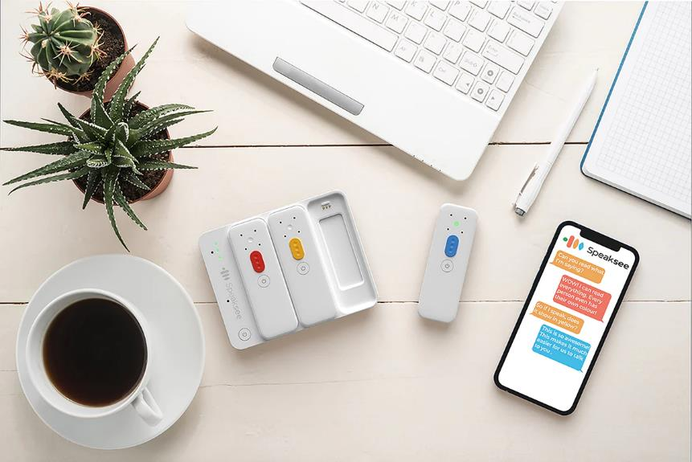
New Possibilities — Captioning
Speaksee AutoCaption captions virtual meetings on multiple meeting platforms and displays captions on computers and tablets.
Designed for in-person meetings, Speaksee Microphones capture audio at close range for captioning and/or streaming to hearing aids. Each speaker’s words are transcribed and color-coded in the Speaksee app.

Slide 42
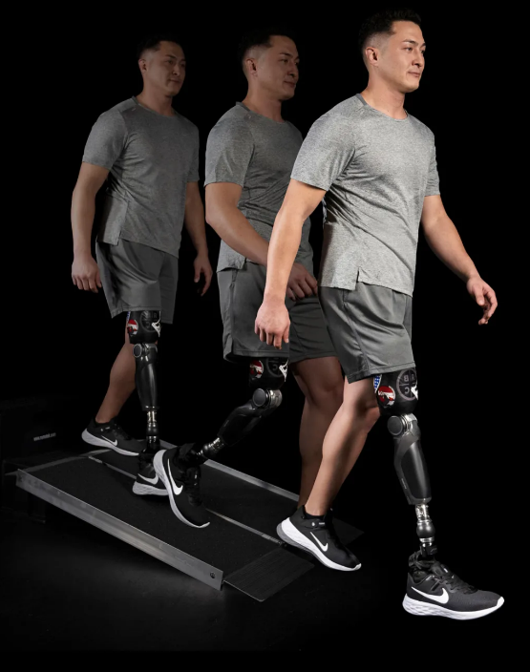
Ossur’s Power Knee — Recently Released
Ossur released a new motorized leg prosthesis in February of this year.
The Power Knee utilizes a motor to help provide increased stability when descending slopes and stairs but also increased power when walking, standing up, and climbing.

Slide 43
Questions?

Slide 44
JAN Accommodation and Compliance Webcast Series
Thank you for attending: “AT Update: What’s New in 2022”
Register for the next JAN webcast: AskJAN.org/events/register/2021-2022-webcast-series.cfm

Slide 45
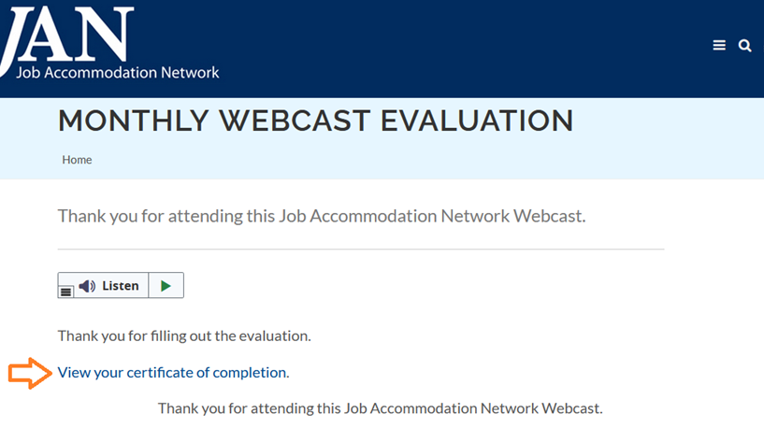
How do I claim the HR CEU?
Don’t close the JAN webcast browser
Complete the webcast evaluation in new window or go to: AskJAN.org/EvaluationReg.cfm
Click on View your certificate of completion

Slide 46
Questions? Contact JAN for More Information
Visit
AskJAN.org
Call
800.526.7234
877.781.9403 (TTY)
Chat
@ AskJAN.org
Submit
JAN on Demand Inquiry @ AskJAN.org/JANonDemand.cfm
Email
JAN@AskJAN.org
Social Media
Facebook – Job Accommodation Network
Twitter – @JANatJAN

