Slide 1
USBLN Breakout Session: Effective Communications to Reduce Disability Stigma within your Organization
Disability Inclusion: The Future Redefined
USBLN National Conference and Biz2Biz Expo
September 21, 2016

Slide 2
Agenda:
Disability Inclusion: The Future Redefined
USBLN National Conference and Biz2Biz Expo
A Focus on Sigma
What do you think of when you hear the word “Stigma?”
What is it?
Why is it Important?
A Focus on Solutions
What is the impact of legacy and leadership?
What are the key, foundational messages necessary?
What are replicable, sustainable, and proven practices that you can utilize in your organization?
How do we “Lean in” on what to do about it?
A Focus on Action
Plan: What to do on Monday?
Notes:
Expectations: Phyllis Rupert and Lonie Haynes:
Will
Set the context regarding:
what is stigma,
why this is important to address,
how they have approached it at Highmark.
Will work on segues and audience engagement strategies -may use polling technology.

Slide 3
Introduction:
Disability Inclusion: The Future Redefined
USBLN National Conference and Biz2Biz Expo
What do you think of when you hear the word “Stigma?”
Sigma: What is it?
Stigma: Why is it Important?
Solutions: Do you have proven practices in your organization that have been successful in reducing or eliminating stigma?
Notes:
Expectations: Phyllis Rupert and Lonie Haynes:
Will
Set the context regarding:
what is stigma,
why this is important to address,
how they have approached it at Highmark.
Will work on segues and audience engagement strategies -may use polling technology.

Slide 4
What is Stigma?
Disability Inclusion: The Future Redefined
USBLN National Conference and Biz2Biz Expo
Definitions:
A mark of disgrace associated with a particular circumstance
quality, or person: “the stigma of mental disorder.”
A set of negative and often unfair beliefs that a society or group
of people have about something
Social stigma is the extreme disapproval of (or discontent with)
a person or group on socially characteristic grounds that are
perceived, and serve to distinguish them, from other members
of a society. Stigma may then be affixed to such a person, by
the greater society, who differs from their cultural norms.
References: Bing, Merriam Webster “simple definition;” Wikipedia, “social stigma”

Slide 5
Negative Responses
Disability Inclusion: The Future Redefined
USBLN National Conference and Biz2Biz Expo

Slide 6
Difference between Bias and Stigma
Disability Inclusion: The Future Redefined
USBLN National Conference and Biz2Biz Expo
Beyond Bias – Medical Model vs. Social Model
Types of Stigma – Social, Professional
Stigma Continuum – Deb Dagit

Slide 7
Why Is it Important to Address?
Disability Inclusion: The Future Redefined
USBLN National Conference and Biz2Biz Expo
The disadvantages of and isolation resulting from stigma are real and can be more debilitating when left unaddressed
Stigma effects health as well as productivity
Sigma can stop people from seeking help and support – this is especially difficult in performance
Stigma also sets a tone and culture for the work
environment that is at odds with popular culture
A Culture that includes stigma can be an environment at increased risk for harassment

Slide 8
How Do We Address Stigma?
Disability Inclusion: The Future Redefined
USBLN National Conference and Biz2Biz Expo
Awareness of Bias and Inclusion strategies
and practices are key
Educational Arc: Awareness, Engagement, and
Commitment
Human Resources First in Education and Engagement
Cultural competency through relationships and
interactions
Working Together sessions
Employee or Business Resource Groups
On site visits by and interaction with Students with Disabilities
V.O.I.C.E. Collaborate engagement

Slide 9
How Do We Take This Back?
Disability Inclusion: The Future Redefined
USBLN National Conference and Biz2Biz Expo
Final Action Plan
Where do we start with stigma?

Slide 10
September 2016
Disability Inclusion: The Future Redefined
USBLN National Conference and Biz2Biz Expo
Effective Communications to Reduce Disability
Stigma within your Organization
USBLN Conference
Rick J. Wilson
Director – Diversity & Inclusion

Slide 11
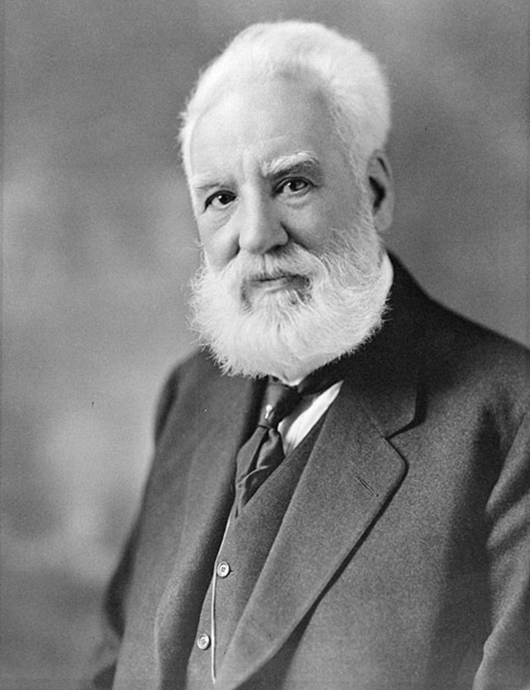
AT&T: Built on a Foundation of Inclusion
Disability Inclusion: The Future Redefined
USBLN National Conference and Biz2Biz Expo

Slide 12
Disability Inclusion: The Future Redefined
USBLN National Conference and Biz2Biz Expo
Raising sensitivity, awareness, and understanding of challenges facing individuals with disabilities
Supporting programs that promote advancement and remove challenges impeding full employment, development, optimum productivity, and independent living of people with disabilities
Making technology accessible to people with disabilities with the understanding that universal design ensures overall business success and helps to improve the lives and productivity of people with disabilities
Providing programs such as mentoring, scholarships, one-on-one counseling, online resources, group resources & support, and teaching mobility device feature functionality
Leading various events through the year to raise awareness and funds for causes such as Autism and Alzheimer’s

Slide 13
Disability Inclusion: The Future Redefined
USBLN National Conference and Biz2Biz Expo
2016 Wireless Independence Now! Workshops (WIN)
Led by the AT&T Corporate Accessibility Technology Office and the Rehabilitation
Engineering Research Center for Wireless Technologies (Wireless RERC), workshops
are conducted for people with disabilities, caregivers, and professionals on how to use
accessibility features found on smartphones and tablets.
Workshops will focus on accessibility features helpful for the following users:
• People who use hearing aids
• People who use text and video services
• People who have communication difficulties
• People who have difficulty seeing
• People with attention, concentration, or sensory difficulties
• People with dexterity or mobility impairments
• Caregivers and Professionals who assist people with disabilities

Slide 14
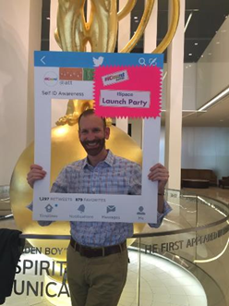
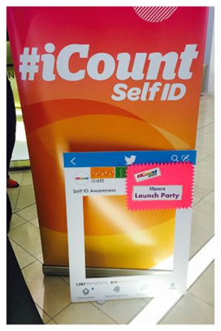
Disability Inclusion: The Future Redefined
USBLN National Conference and Biz2Biz Expo
Multi-dimensional Marketing Campaign
Email, Mobile App, Text Messaging, Internal Home Page, Social Media,
Diversity Councils
Launch Party at our annual Employee Resource Group Conference
Collaborative Cross-HR and Business Unit Launch
Internal & External Social Media
Employee Resource Groups

Slide 15
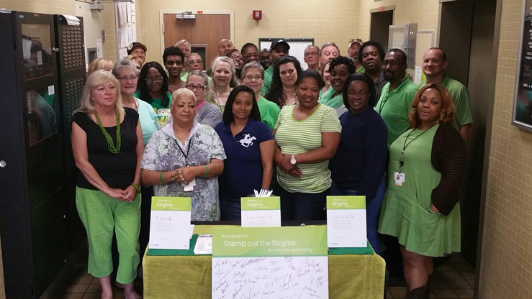
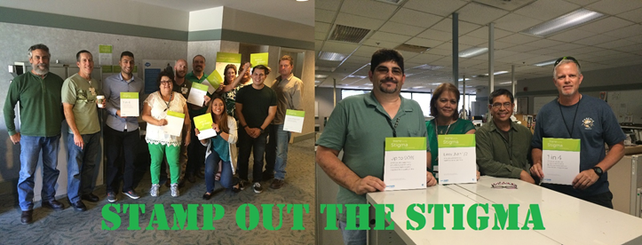
Benefits: Stamp Out the Stigma (Mental Health)
Disability Inclusion: The Future Redefined
USBLN National Conference and Biz2Biz Expo
Goals:
Awareness
Education
Treatment Options
Visibility
Acceptance

Slide 16
September 2016
Disability Inclusion: The Future Redefined
USBLN National Conference and Biz2Biz Expo
Effective Communications to Reduce Disability
Stigma within your Organization
USBLN Conference
Won Shin
Ernst & Young LLP
Senior Manager Director – Transaction Advisory Services - Tax

Slide 17
Including People of “Diverse Abilities” is part of the DNA of EY
Disability Inclusion: The Future Redefined
USBLN National Conference and Biz2Biz Expo
Our History
Arthur Young, co-founder of EY was deaf and had low vision
Originally trained as a lawyer, his disabilities made it difficult to practice in the courtroom
He turned to the field of accounting where he could leverage his skills and training
He became an entrepreneur and innovative, not despite his disabilities, but because of them

Slide 18
Disability Inclusion: The Future Redefined
USBLN National Conference and Biz2Biz Expo
Our Present
Disability is just another kind of difference, e.g., culture, language, ethnicity, sexual orientation, gender and generation
However, as with other kinds of differences, disabilities may make some people uncomfortable for any number of reasons
People are “effectively” disabled by two things: environment and perception (i.e., stigma)
Create an environment for your people to be the most productive they can because, as a business, that makes us the most profitable that we can be

Slide 19
Create a Productive and Comfortable Work Environment
Disability Inclusion: The Future Redefined
USBLN National Conference and Biz2Biz Expo
Hold inclusive meetings
Interact with colleagues

Slide 20
Be Inclusive
Disability Inclusion: The Future Redefined
USBLN National Conference and Biz2Biz Expo
It’s not about political correctness, it’s about respect
Watch your words
Just ask
Respect differences
Resist judgment
Make eye contact

Slide 21
Be Inclusive
Disability Inclusion: The Future Redefined
USBLN National Conference and Biz2Biz Expo
Deaf and Hard of Hearing
Ask questions
Speak face to face
Be proactive
Confirm understanding
Set expectations

Slide 22
Be Inclusive
Disability Inclusion: The Future Redefined
USBLN National Conference and Biz2Biz Expo
Blind and Low Vision
Identify yourself and others in the room
Ask if the person would like to take your arm
Be specific in giving directions
Walk on the side away from the person’s cane or service dog – and don’t pet or distract the dog

Slide 23
Be Inclusive
Disability Inclusion: The Future Redefined
USBLN National Conference and Biz2Biz Expo
Accessible PowerPoint Presentations
Include captions for videos
Describe images, objects or graphics in text
Increase visibility for people with low vision or colorblindness
Describe hyperlinks
Give each slide a unique title

Slide 24
Employee Resource Group (ERG)
Disability Inclusion: The Future Redefined
USBLN National Conference and Biz2Biz Expo
Use ERGs to help create allies and raise awareness
ERGs can be an important knowledge center on disability issues, both internally and in the marketplace
Creating an open environment promotes authenticity

Slide 25
Additional Resources
Disability Inclusion: The Future Redefined
USBLN National Conference and Biz2Biz Expo
See Attachments

Slide 26
An Inclusive Work Environment Boosts the Bottom Line and Fuels The Spirit
Disability Inclusion: The Future Redefined
USBLN National Conference and Biz2Biz Expo

Slide 27
What is Stigma?
Disability Inclusion: The Future Redefined
USBLN National Conference and Biz2Biz Expo
A set of negative and often unfair beliefs that a society or group of people have
Stigma brings experiences and feelings of:
Shame
Blame
Hopelessness
Distress
Misrepresentation in the media
Reluctance to seek and/or accept necessary help

Slide 28
Disability Inclusion: The Future Redefined
USBLN National Conference and Biz2Biz Expo
PwD are
distributed throughout
every type of job and profession
PwD: Who Are They and Why Not Self-Identifying?
People who experience
certain non-apparent
conditions that are highly
stigmatized are particularly reluctant
to self-identify (e.g. depression,
anxiety, attention deficit
disorder, dyslexia, hearing
loss, heart conditions,
etc.)
Someone with whom you work is probably a person with a disability or an ally and has not self-identified

Slide 29
“Very Important” Factors, when Deciding NOT to Disclose a Disability to an Employer
Disability Inclusion: The Future Redefined
USBLN National Conference and Biz2Biz Expo
Desire for Privacy
(27.9% Agree)
No Impact on Job Ability
(44.0% Agree)
Risk Being Viewed Differently
(53.8% Agree)
Risk Being Treated Differently
(57.8% Agree)
Supervisor May Not Be Supportive
(60.1% Agree)
Fear of Limited Opportunities
(61.1% Agree)
Risk of Losing Health Care
(61.5% Agree)
Employer May Focus on Disability (62.0%)
Risk of Being Fired/Not Hired (73.0%)
Emerging Employment Issues for People with Disabilities: Disability Disclosure, Leave as a Reasonable Accommodation,
Use of Job Applicant Screeners by Sarah von Schrader, Valerie Malzer, William Erickson, Susanne Bruyère.
http://digitalcommons.ilr.cornell.edu/edicollect/1288

Slide 30
“Very Important” Factors, when Deciding TO Disclose a Disability to an Employer
Disability Inclusion: The Future Redefined
USBLN National Conference and Biz2Biz Expo
Belief in New Opportunities
(40.7% Agree)
Disability in Diversity Statement
(48.9% Agree)
Knowing of Other Successes
(49.9% Agree)
Active Disability Recruiting
(50.5% Agree)
Disability Friendly Workplace
(56.8% Agree)
Supportive Supervisor Relationship
(63.5% Agree)
Need for Accommodation (68.2% Agree)
Emerging Employment Issues for People with Disabilities: Disability Disclosure, Leave as a Reasonable Accommodation,
Use of Job Applicant Screeners by Sarah von Schrader, Valerie Malzer, William Erickson, Susanne Bruyère.
http://digitalcommons.ilr.cornell.edu/edicollect/1288

Slide 31
Two Models of Disability: A Contrast
Disability Inclusion: The Future Redefined
USBLN National Conference and Biz2Biz Expo
Medical Model
Disability is a deficiency or abnormality
Being disabled is negative
Disability is in the person
The solution for disability-related problems is cure
The expert is the professional
Social Model
Disability is a difference from average
Being disabled, in itself, is neutral
Disability is in the relationship between the person and society/environment
The solution is removing the barriers [-changing the relationship] between the person and society/environment
The expert can be: the person, an advocate, anyone who changes the social relationship
Source: Dr. Carol Gill, PhD, University of Illinois

Slide 32
What Allies Do: As A Friend
Disability Inclusion: The Future Redefined
USBLN National Conference and Biz2Biz Expo
Encourage people who identify as having a disability to have a talk with their manager, Employee Relations Manager, and/or Human Resources Business Partner about accommodation resources
Be an empathetic listener and maintain any requested confidences
Be aware of and able to readily direct people to your company’s Reasonable Accommodations process

Slide 33
What Allies Do: As A Colleague
Disability Inclusion: The Future Redefined
USBLN National Conference and Biz2Biz Expo
Offer assistance/support when a person with a disability is struggling to reach or carry something, open a door, or otherwise fully participate safely and comfortably in the work environment
If offer of assistance is declined, accept this as a positive exchange
Interrupt bias in the form of negative or prejudicial comments or jokes
Promote an inclusive work environment that improves engagement
Identify and help remove barriers to full inclusion
When microphone is available, encourage usage for people who are hearing impaired

Slide 34
What Allies Do: As A Colleague
Disability Inclusion: The Future Redefined
USBLN National Conference and Biz2Biz Expo
Remind co-workers that 75% of disabilities are non-apparent and it is likely that people with disabilities are on most of our teams
Enhance the company’s compliance profile and external reputation by completing the self-identification process whether you have a disability or not
Become informed and do your best to regularly utilize disability etiquette and respectful language choices (link to http://www.united spinal.org/pdf/DisabilityEtiquette.pdf)

Slide 35
What Allies Do: As A Manager
Disability Inclusion: The Future Redefined
USBLN National Conference and Biz2Biz Expo
Include workplace accommodations information during regular 1-on-1 and group meetings
Recognize the value of talent with disabilities and intentionally include this population in recruiting, retention and development efforts
Recognize the emerging market of people with disabilities as valuable to the business
Ensure that all meeting invitations include an opportunity to request an accommodation if needed
Offer accommodations examples such as wheelchair access, sign language interpreter, dietary requirements, flexible work arrangements, quiet work area

Slide 36
Fostering Allies: Company Best Practices
Disability Inclusion: The Future Redefined
USBLN National Conference and Biz2Biz Expo
Highmark: Sharing your Ally Story
Sodexo: Webex with employees and customers
Merck: Engaging all ERG’s
Boston Scientific: Executive Sponsor Stories with training
TD Bank: ”Road Shows”
Prudential: Employees and Managers sharing their ally stories

Slide 37
Effectively Reducing Stigma
Appendix

Slide 38
E&Y References & Resources

