Slide 1
The Impact of COVID-19 on Mental Health Accommodations
James Potts, M.S., CRC, Senior Consultant Melanie Whetzel, M.A., CBIS, Lead Consultant

Slide 2
Mental Health
Agenda
Most common accommodation / ADA issues related to mental health and COVID-19
Question-and-Answer Opportunities
Masks
Performance and Conduct
Telework
Service Animals
Additional Examples
Final Questions and Discussion
Notes:
We have divided this webcast into areas where we have received the most inquiries. Please feel free to submit questions in these and other areas. We will be taking questions at the end of each section related to that section and holding other questions until the end. We hope you can learn much during the next hour. (Or something similar)

Slide 3
Masks
Notes:
Many individuals are reaching out because of inability to wear a face mask. One of the more common reasons is claustrophobia. The first round of accommodation ideas should always be – is there a face covering that this individual can wear and is effective? In this situation, there is usually no ability to wear a face covering of any kind. RA ideas would be spacing, restructuring, plexiglass, work from home.
Anxiety PTSD. Face shield? Gaiter? Wearing a mask in high traffic areas or until they get to private area? Allowing more frequent breaks to take off masks.
Sensory. Threads tied around one’s head instead of elastic ban. Face shields that wrap around the next instead of across the head. If none, back to no covering possible.

Slide 4
Mental Health
Example:
Kara, a sales representative at a high-end boutique, requested to wear a face mask, face shield, and additional PPE while performing her customer service duties.
Notes:
Kind of talking about how far we have come, look at this accommodation situation back when the pandemic first starting in the U.S. and how this request was viewed.
This was within the first couple weeks when the U.S. shut down.
Kara is a sales representative at a high-end clothing store and requested to utilize a face mask, face shield, and additional PPE while performing her customer service duties. Her employer denied the request because customers complained they felt unsafe. ER used that seeing the employee in PPE made them feel unsafe as undue hardship/losing business.
At the time local/state’s gave minimal direction. EEOC said employers may require, but did not really state they must require employees wear PPE. Employer at the time said wearing the PPE negatively impacted business operations.

Slide 5
Mental Health
Example:
Shelly is unable to abide by the new mask mandate at work. What can she do if her employer will not allow a face shield as an alternative?
Notes:
Shelly’s PTSD did not impact her from performing the essential functions of her job prior to the pandemic. However, since her employer mandated that everyone must wear masks in the building, Shelly has called off and has exhausted her leave benefits. Shelly offered to wear a face shield which does not impact her negatively, but the employer has refused

Slide 6
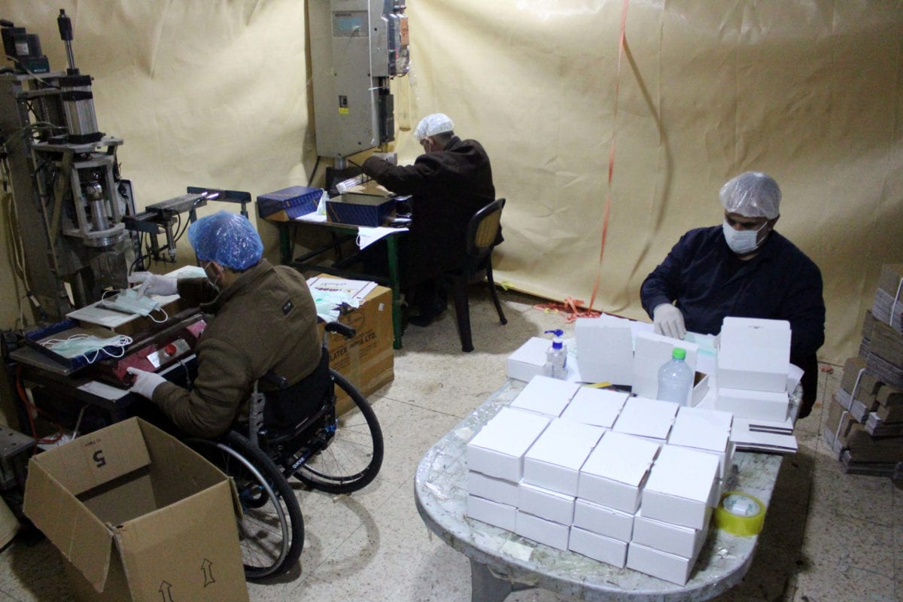
Mental Health
Example:
Wren had concerns when her husband, who had been exempt from wearing a mask, was suddenly required to when policies and mandates changed.
Notes:
Wren’s husband had medical documentation stating that he was unable to work while wearing a mask. His supervisor called him on Sunday evening when the state and local mandate changed requiring masks. He suggested the employee stay home the following morning in order to get things worked out. Wren wanted info in order to file a complaint for discrimination.
Talk about JAN services, offer appropriate EEOC guidance (from that EEOC document about pandemic stuff), alternative RA ideas, and then still explain it is their right to contact EEOC or state agency to file a complaint if they feel rights are violated. – this what you were going for on this one?

Slide 7
Questions?
Notes:
John is a long-haul trucker with general anxiety disorder. John never needed accommodations previously and was always able to manage his condition independently. The pandemic has worsened John’s anxiety to heights he never experienced, and he is requesting to bring his emotional support animal on the road with him.

Slide 8
8
Performance
and
Conduct
Notes:
ER can hold all employees to the same standards of performance and conduct but would consider accommodations to help EE meet the standards.
Employers do not have to excuse an employee from performing essential job functions as an accommodation but can do so if they choose. And during the pandemic, some ER relaxed those standards as EE were sent home to work, many of whom could not perform their essential functions from home.

Slide 9
Mental Health
Example:
Olivia, well known for her professional tone and superior work performance, began using inappropriate language during Zoom meetings and missing deadlines. After the most recent incident resulted in a written warning, she disclosed her mental health condition has worsened and asked for help.
Notes:
Or how about Olivia…
Olivia was well known for her professional tone and superior work performance. Over the last several months, her supervisor noticed concerning language during Zoom meetings and assignments being turn in late. Each time the supervisor reached out to help, Olivia responded that she was just adjusting to new work from home guidelines. After the most recent incident resulted in a written warning, she disclosed her mental health condition has worsened from working at home/feeling isolated and asked for help.

Slide 10
Mental Health
Example:
Jay’s employer referred him to EAP after a brief inquiry about his performance and conduct. Jay was relieved, as he was expecting to be terminated.
Notes:
Mostly with possible addiction/alcohol where there is no disclosure but suspicion. Lots of employers are reaching out to JAN specifically to see how they can help their employees during these times (both with and without disabilities). Some employers are telling me their preference not jumping straight to discipline, but really seeing how they can help their employees deal with these difficult times.
But still holding employees responsible for getting/doing better. Basically, Hey we noticed some things and want you to be aware of services EAP provides. Please let us know how we can help, as currently the behavior/performance is not where it needs to be. Without improvement, action is necessary.
Employers offering EAP more frequently before going straight to discipline, instead of creating a PIP and working backwards.

Slide 11
Mental Health
Example:
Is Logan entitled to leave if his disability is not impacting his performance?
Notes:
Logan, a top sales performer, reached out and asked for 30 days leave due to a medical situation. He disclosed an addiction problem that has significantly increased since working from home. The employer was perplexed, they saw no performance problems and reached out asking if this request was required as an accommodation.

Slide 12
Questions?
Notes:
John is a long-haul trucker with general anxiety disorder. John never needed accommodations previously and was always able to manage his condition independently. The pandemic has worsened John’s anxiety to heights he never experienced, and he is requesting to bring his emotional support animal on the road with him.

Slide 13
Telework
Notes:
When the world started working from home…

Slide 14
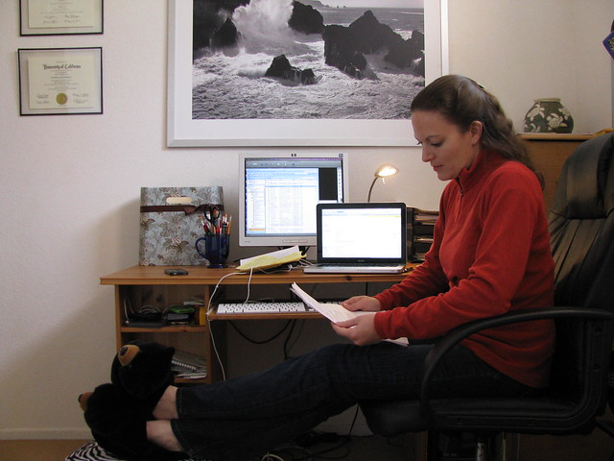
Mental Health
Example:
Anne is requesting to telework permanently now that her employer is requiring all employees to return to the office.
Notes:
Anne requested to work from before COVID shutdowns started in the U.S. During the interactive process, her employer voiced concerns that she would be unable to perform the essential functions from home and the conversation pivoted to accommodations in the workplace. During the pandemic, Anne’s entire workplace shifted to work from home. Now the employer is wanting employees to return to the workplace. Anne wants to know if the employer can deny her request for accommodation to work from home permanently. She feels the time everyone spent working from home proves it is a feasible request, and she needs the solution to help with her limitations. Then drag the EEOC guidance talk through all the stuff about essential functions, were the in-house RA effective (because ER could choose) but if not, and EE proved they can do the job – then could be a good argument.

Slide 15
Mental Health
Example:
J.T. never realized how beneficial working from home was on her mental health. Now her employer is requiring her return to the office. What are her options?
Notes:
J.T. has thrived since her office went fully virtual at the beginning of the pandemic. Now, the employer has determined all employees must return to the office. J.T. had never considered requesting reasonable accommodation for her general anxiety disorder and tried her best to push on. However, now that she has glowing reviews and feels telework is a valid option – she reaches out to request telework as a reasonable accommodation.
she never knew how much effort it cost her to be social on the job and how much it took from her life. Her performance is amazing and she isn’t too worn out from the social interactions and has a much better work / life balance, happier, etc
And be sure to evaluate each request on a case-by-case basis.

Slide 16
Mental Health
Example:
JoJo, an employee with depression, disclosed to her employer that she was feeling isolated at home, which was causing a flareup of her condition. She asked for more interaction with her supervisor and coworkers.
Notes:
When employees are no longer in face-to-face environments with their employers extra steps must be taken to ensure that communication remains open and thorough, and help employees feel more connected and stay informed of the business. Where before the employer could just walk down the hall and speak with an employee, now it requires more of an intentional effort. Many employers have added phone calls to their schedules so that they can keep in touch and check in with their employees. Video platforms are being used to schedule meetings where employees can get together with their coworkers. As an example, we’re doing a twice-monthly Coffee Break meeting at JAN to keep us all connected while we are working from home. While some employees thrive with limited contact with their coworkers and teammates, many others experience isolation and are able to benefit from the scheduled contact.
The ER asked JoJo what specific types of communication would work best for her - an excellent practice. Many employees with disabilities experience difficulty with communication in the workplace without the added layer of the pandemic and all that has come along with it. ER can look at a change in supervisory method, which likely will include alternate communication methods. The purpose being of course, to keep employees engaged, informed, and performing to their greatest ability. Changes in supervisory method could include adjusting communication styles, such as modifying how, when, and how often they communicate assignments, instructions, or training. Modifications include more in-person interactions with conversation instead of emails, or fewer face-to-face contacts and more in writing. Providing an advanced organizer or agenda before a meeting or a training could be effective in helping employees stay focused and keep up on the information being presented.

Slide 17
Mental Health
Example:
Ari, an employee with depression, disclosed to his employer that he was feeling isolated at home, which was causing a flareup of his condition. He asked to return to the office.
Notes:
At first the ER told Ari he just had to stick it out at home because of the pandemic, everyone was having issues. But when his performance plummeted and the ER had difficulty getting a response from him, they sent him information about the interactive process and asked him to participate immediately. The ER determined how they could accommodate Ari by increasing safety measures to allow him to return to the workplace as quickly as was safely possible.

Slide 18
Mental Health
Example:
Gia was sent home to work, even though she was unable to perform the essential functions of her position. When she was called back to work, Gia demanded to remain at home due to anxiety of contracting the virus — it had worked for everyone so far.
Notes:
The fact that an employer temporarily excused performance of one or more essential functions…does not mean that the employer permanently changed a job’s essential functions and could require the EE to start performing all of the functions again when needed.

Slide 19
Questions?
Notes:
John is a long-haul trucker with general anxiety disorder. John never needed accommodations previously and was always able to manage his condition independently. The pandemic has worsened John’s anxiety to heights he never experienced, and he is requesting to bring his emotional support animal on the road with him.

Slide 20
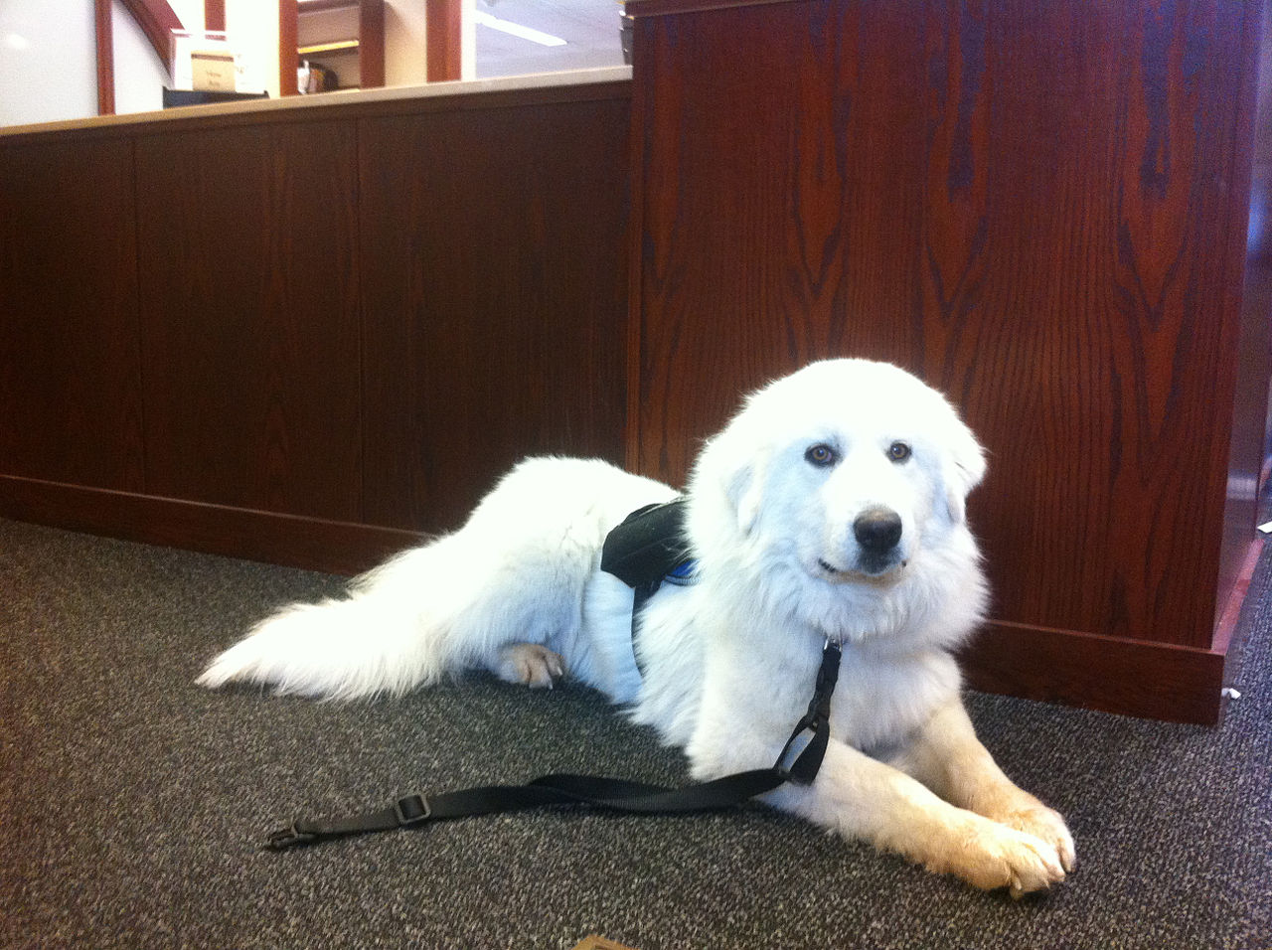
Service Animals

Slide 21
Mental Health
Example:
John is a long-haul trucker with general anxiety disorder.
Notes:
John is a long-haul trucker with general anxiety disorder. John never needed accommodations previously and was always able to manage his condition independently. The pandemic has worsened John’s anxiety to heights he never experienced, and he is requesting to bring his emotional support animal on the road with him.

Slide 22
Mental Health
Example:
Randi asked to bring her newly acquired emotional support animal to work with her after returning from leave. She was recently diagnosed with PTSD after the death of both of her parents from COVID. Her employer offered telework instead.

Slide 23
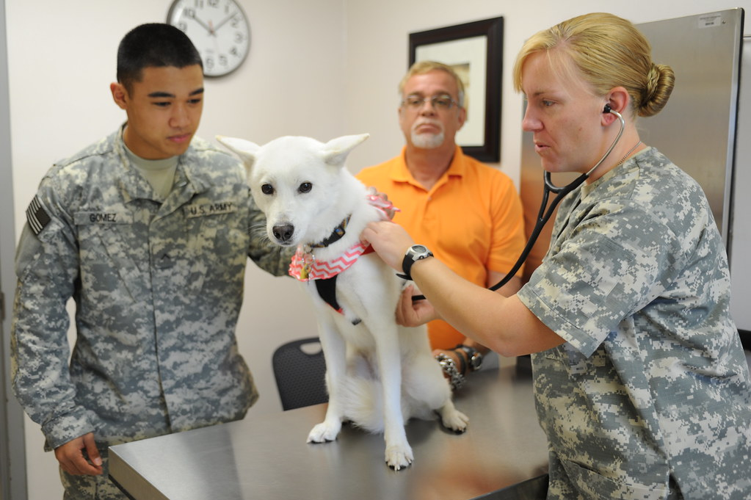
Mental Health
Example:
Victor’s service animal cannot get timely treatment during the pandemic. Does this fall under the ADA?
Notes:
Victor relies on his service animal for both mobility and mental health in the workplace. Unfortunately, his service animal required surgery which kept getting delayed due to COVID complications. Victor indicated there are no alternatives to utilizing his service animal. The employer determined the employee was ineligible for FMLA and emailed JAN to discuss option under the ADA.

Slide 24
Mental Health
Example:
Trying to navigate the interactive process during the COVID pandemic, Tom feels his employer is not moving fast enough after multiple delays.
Notes:
Tom requested to bring his service animal to the job site before everyone went to telework full time. He has repeatedly asked for updates on his accommodation request and wants to have an agreement in place when the office decides everyone can return. His employer has responded it is not the most pressing business decision, but that he will have a response before being asked to return. Tom feels the employer is not acting expeditiously. Tom’s employer feels the employee is currently accommodated because he has his service animal while working from home and feels by giving an answer before return to the office, they are within their rights to tend to other matters.

Slide 25
Questions?
Notes:
John is a long-haul trucker with general anxiety disorder. John never needed accommodations previously and was always able to manage his condition independently. The pandemic has worsened John’s anxiety to heights he never experienced, and he is requesting to bring his emotional support animal on the road with him.

Slide 26
Additional Examples

Slide 27
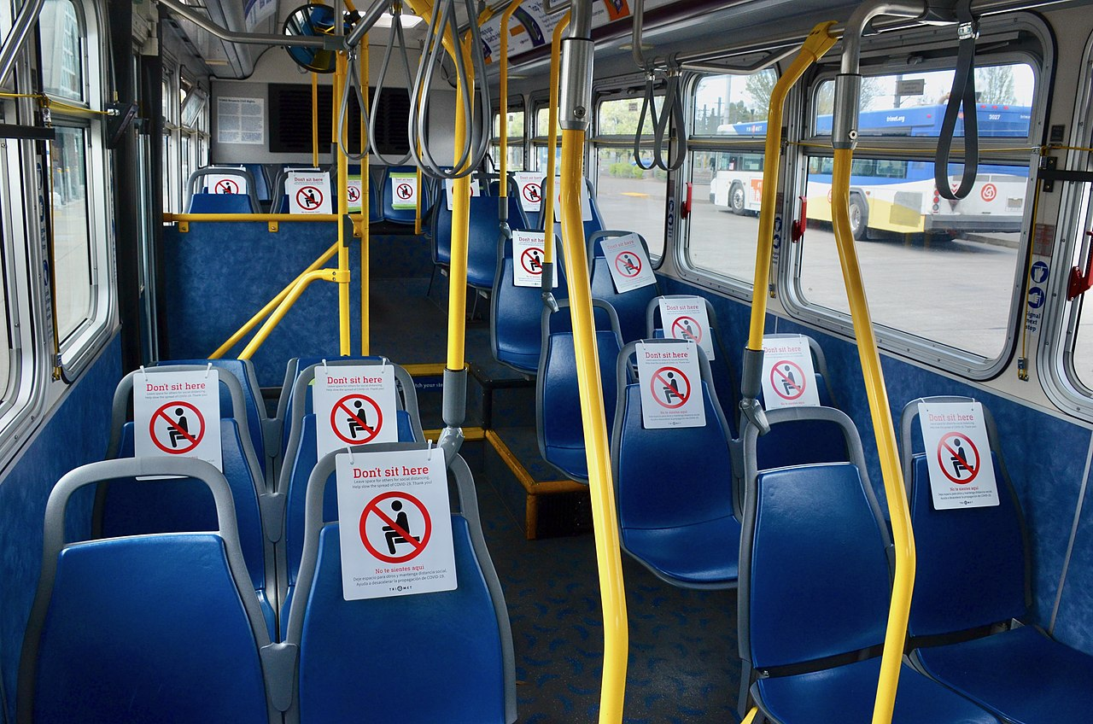
Mental Health
Example:
Can an employer force an employee who cannot drive due to seizures to utilize public transportation during a pandemic?
Notes:
Bailey had a seizure and is unable to drive for the next 6 months. He is unable to perform his maintenance duties from home, and the employer wanted to know their obligations if he cannot get himself to work everyday. Specifically, can they require an employee utilize public transportation during a pandemic?

Slide 28
Mental Health
Example:
Greg works in healthcare and is requesting leave until the pandemic is over.
Notes:
Greg works in healthcare and was told during the beginning of the pandemic that his job could only be performed in person. Greg has used up all his leave entitlements, and his employer is asking when he can return and what accommodations he needs. Greg requests leave until the pandemic is over.

Slide 29
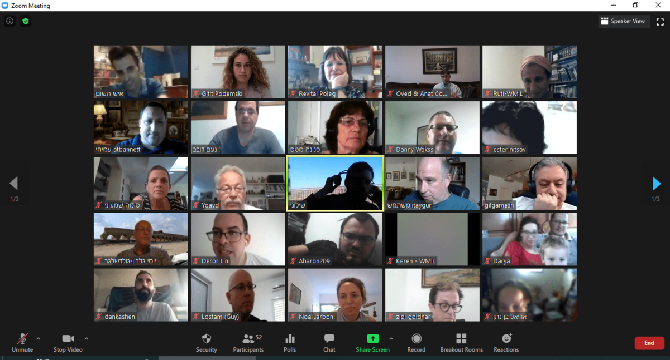
Mental Health
Example:
Lucas has trouble attending all these Zoom meetings!
Notes:
Lucas has social anxiety. Since moving to a virtual environment, he is being required to attend Zoom meetings 2-3 times per week and the content almost never applies to his position. These meetings are the source of extreme anxiety, and Lucas has taken to calling out instead of attending on these days. His supervisor noticed this behavior and asked if there was anything wrong. Lucas explained his anxiety and that he has a hard time speaking up and making waves with others. His boss explained reasonable accommodation, and they worked with HR setting up an agreement being excused from Zoom meetings. For those thinking, why not just turn off your camera. Lucas felt extreme anxiety being the only one without a camera, and since there was no specific reason he needed to participate – he was excused.

Slide 30
Mental Health
Example:
An employer required that all employees work a rotating schedule, which included time at a customer window. Jem asked to be excused from the window because of difficulty interacting with strangers who might have COVID.
Notes:
The employer denied Jem’s request, stating that rotating to all positions is an essential function. But the process doesn’t stop there!! The employer should talk with the employee to determine what can be done to ease her anxieties about contracting the virus. Are more safety measure required? What specifically is Jem’s fear and uncertainty? How can the ER reduce or eliminate that fear / concern?

Slide 31
Questions?
Notes:
John is a long-haul trucker with general anxiety disorder. John never needed accommodations previously and was always able to manage his condition independently. The pandemic has worsened John’s anxiety to heights he never experienced, and he is requesting to bring his emotional support animal on the road with him.

Slide 32
Contact JAN
Visit AskJAN.org
Submit a JAN on Demand question @ AskJAN.org/JANonDemand.cfm
Email JAN @ jan@askjan.org
Use the JAN Live Chat button @ AskJAN.org
Leave a voicemail message. JAN staff will contact you via email or a call:
800.526.7234 (V)
877.781.9403 (TTY)
Connect on social media
Facebook – Job Accommodation Network
Twitter – @JANatJAN

