Slide 1
AT Update: What’s New in 2021
August 10, 2021
Teresa Goddard, Lead Consultant, JAN Sensory Team
Matthew McCord, Senior Consultant, JAN Motor Team

Slide 2

JAN Webcast Housekeeping
Technical Difficulties
  Use the Q&A option at the bottom of the screen
  Use the Live Chat at AskJAN.org
  Access Frequently Asked Questions
  https://AskJAN.org/training/Frequently-Asked-Questions-About-JAN-s-Remote-Trainings.cfm
Questions for Presenters
  Use the Q&A option at the bottom of the screen
  Gathered into a queue
  Time permitting, answered at the end

Slide 3

Housekeeping Cont’d
PPT Slides
  See the link included in the webcast chat
  Download from the Webcast Archive section
  of the Training page at AskJAN.org
Captioning
  Use the closed caption
  option at the bottom of the screen
  Transcript will be available with webcast archive
This event is being recorded
Please complete the evaluation at the end

Slide 4

Objectives
  About JAN
  What is AT?
  Interactive Process
  Situation and Solutions
  AT In-Development
  Questions

Slide 5
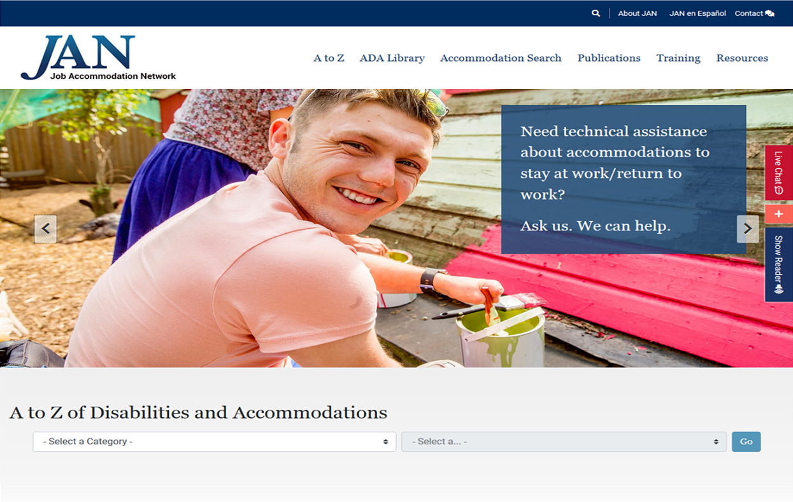
About JAN
Over 30 Years of Service
Consultation on:
  Job Accommodation
  Americans with Disabilities Act/Rehabilitation Act
  Entrepreneurship
Experienced
Free
National
Easy to Use
Confidential

Slide 6
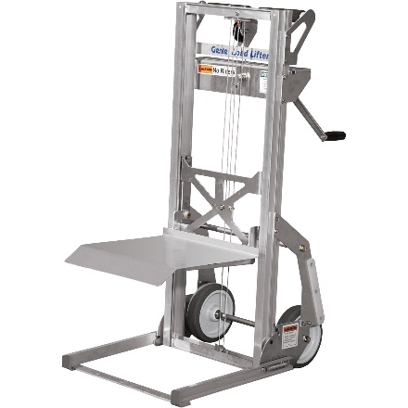

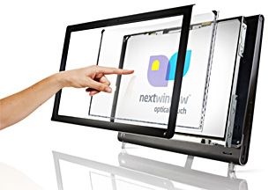
Assistive Technology
What is Assistive Technology?
Assistive Technology (AT) can mean a device or service that can be used as a tool by a person with a disability to achieve or maintain function.

Slide 7
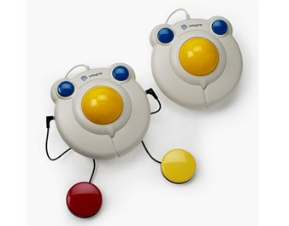
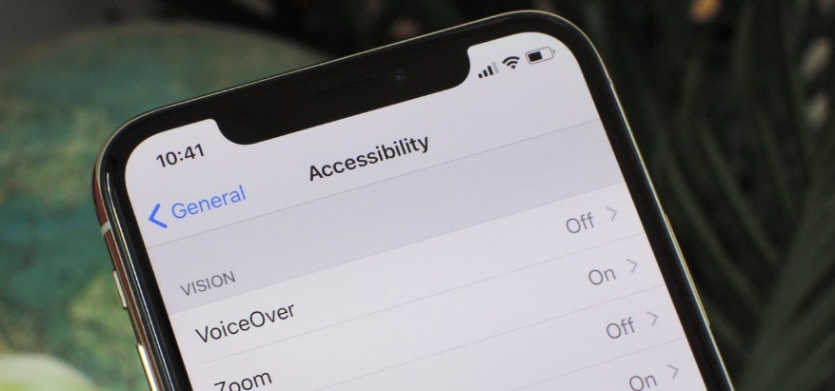
Traditional or Mainstream
Traditional AT vs Mainstream Devices
Traditional AT could be devices that are used solely for completing a task by an individual with a disability
Mainstream devices have become more accessible with the prevalence of mobile technologies and wearable devices

Slide 8
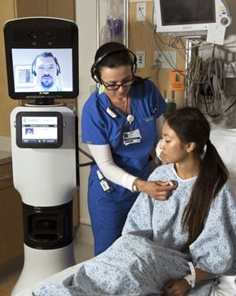
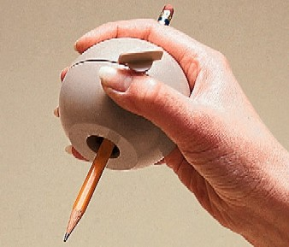
High Tech and Low Tech
AT Devices
High Tech
  Alternative input devices
  Software
  AAC devices
  Telepresence
Low Tech
  Workspace modifications
  Less expensive devices
  Custom-designed or modified products
  DIY

Slide 9




Staying Up to Date on New AT
Want to be in the know?

Slide 10

Finding Your Path

Slide 11
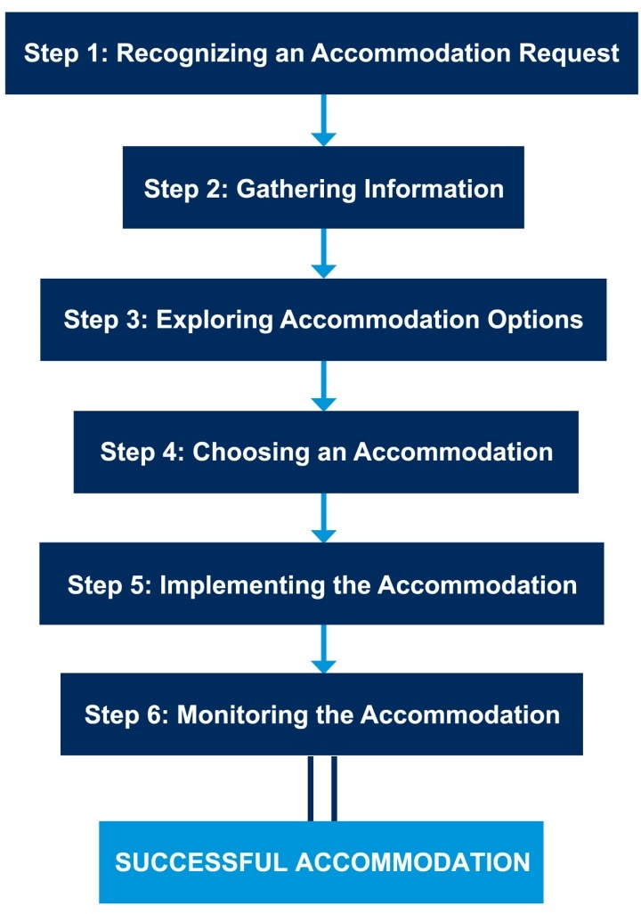
JAN’s Interactive Process

Slide 12
Typical Problem - Vision
JAN Example #1
A massage therapist who was legally blind needed to access printed information including
a master schedule to confirm, schedule and
plan for appointments.

Slide 13
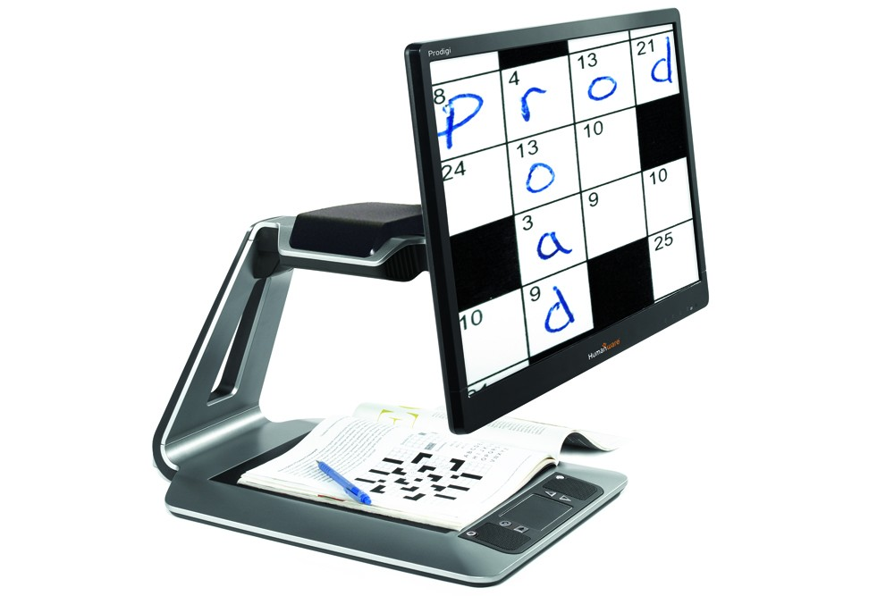
Typical Solution - Vision
Provide an accessible digital version or a CCTV.
Prodigi™ Desktop electronic magnifier from Humanware

Slide 14

But What If? - Vision
The digital format is taking too long to implement, and the CCTV is not always available because of where it is stored?

Slide 15
Similar Issues - Vision
Most health systems use electronic medical record systems.
What are the access issues?
Records systems vary in terms of accessibility
Updates may temporarily break accessibility
Some information may be more convenient in hard copy, such as tables displaying coworker schedules
Handwritten notes and signatures may not be screen reader friendly

Slide 16
Targeted Solution - Vision
What are some options to consider?
Find secure and accessible location for AT storage
Designate someone to assist as a qualified reader
Seek assistance from State VR or scripting vendor
Provide portable AT options
  Orcam
  Aira
  Portable digital magnifier
  Seeing AI

Slide 17
Typical Problem - Typing
JAN Example #2
A customer service representative who worked in a call center was having trouble completing tasks fast enough.
They had Carpal Tunnel and as the workday went on their pain got worse and caused them to slow down. Their talk time metric was too high, and they were afraid that they would be written up if it did not improve.

Slide 18
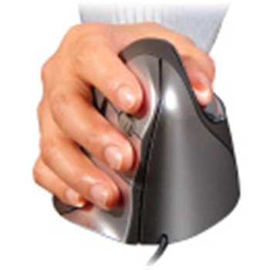
Typical Solution - Typing
JAN suggested that the employee disclose their disability to the employer and request accommodations. Solutions included options like an alternative keyboard that requires less force to type on, a vertical mouse, and a workstation assessment to have it more ergonomically set- up for their use.

Slide 19

But What If? - Typing
There are no ergonomic issues with the workstation and these alternative input devices do not help? Or, what if the individual's Carpal Tunnel is so severe that they normally only use one of their hands to use the computer? Is there anything that may be a better fit for these needs?

Slide 20

Targeted Solution - Typing
Speech Recognition software can help to minimize keyboard usage. For a call center environment, a softphone configured to mute the representative or a dual-channel headset may be needed alongside the software to ensure the caller does not hear the individual dictating to the computer.

Slide 21
Additional Approaches - Typing
More specialized devices can also be explored. Things like miniature keyboards, one-handed keyboards, or alternative mousing devices that monitor head or eye movements in place of moving a physical device.
Beyond AT options, a flexible schedule may help by breaking up the individual's workday to allow for more breaks to rest their wrists.

Slide 22
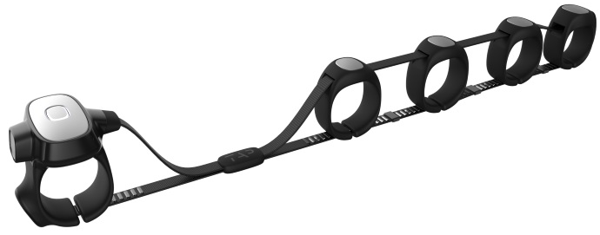
New and Improved
Tap Strap 2
Device currently available that allows keyboarding and mousing to be done with
finger taps and hand gestures.

Slide 23
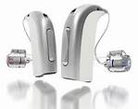
Typical Problem - Hearing
JAN Example #3
A team of engineers includes hearing, hard of hearing and deaf employees. Some need captioning, some need ASL, and some need no accommodation beyond their personal assistive devices and a group with effective meeting etiquette.

Slide 24
Typical Solution - Hearing
A typical approach is to provide CART services and interpreting services as needed. It can also be helpful to see if employees who use hearing aids would benefit from assistive listening devices or systems that are compatible with their hearing aids, to address background noise, and to encourage habits for effective meetings such as appropriate turn taking.

Slide 25
Communication - ASL
Tips for communicating through a sign language interpreter
Choose an effective interpreter
Prepare setting
  Background noise
Prepare participants
  Provide material in advance when possible
  Establish meeting etiquette expectations
  Consider notetaking assistance
Interact directly with person who is deaf
Relax and use normal tone and speed
Respect interpreter’s professional judgement and ethics

Slide 26
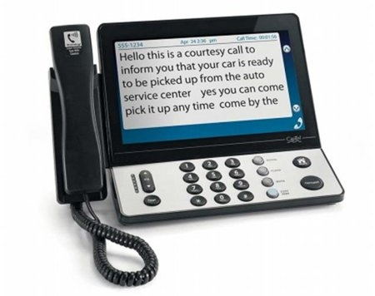
But What If - Hearing
The team struggled with communication following a sudden pivot to remote work and use of remote meeting platforms?

Slide 27
Similar Issues - Hearing
Various team members tried to find solutions
on their own.
What were some attempted options?
Relay services
Adjusting the volume
Dialing in for audio/telephone amplification
Automated captioning
Increased use of chat functions
Remote CART/Video Remote Interpreting
Seeking solutions from an audiologist

Slide 28
Targeted Solution - Hearing
What was learned?
Automated options were not always accurate
  Jargon
  Background noise
  Good for on demand need or as a backup option
Remote CART and VRI were trusted by employees
Chat could be used to interject, share links, and get clarification without interrupting meeting flow
Increased use of chat was helpful for employees with other impairments
Employees likes having more volume control
Some found dialing in to be effective

Slide 29
Typical Problem - Back
JAN Example #4
An LPN has recently injured their back and needs to avoid heavy lifting, pushing and pulling while it heals.
The employer is concerned about the employee's ability to perform the chest compressions required to do CPR in the event on an emergency.

Slide 30
Typical Solution - Back
A typical way that this need would be handled would be with a temporary reassignment to a less physically demanding position.
For instance, allowing the LPN to work at the nurse's station and take care of calls, do paperwork, and the like for a time until the LPN can return to their normal duties.

Slide 31
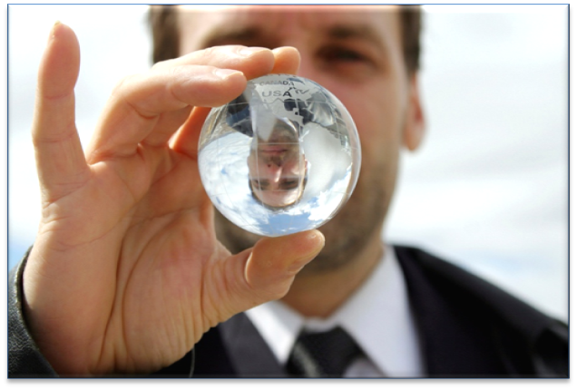
But What If? - Back
There are no vacant positions to reassign the individual into? Or the individual does not want to work in this different capacity?
Leave time may be effective, but isn't there some other way to accommodate that enables stay at work?

Slide 32
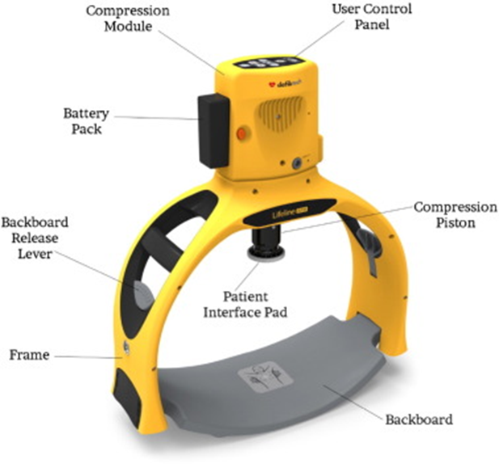
Targeted Solution - Back
A Hands-Free Resuscitation Device assists people in performing CPR chest compressions.
Once secured to the patient, it can be activated and will perform CPR chest compressions in place of the medical staff.

Slide 33
Targeted Solution 2 - Back
It may also be helpful to investigate the schedule and ensure that the LPN will not be working alone. This way the LPN can perform other necessary tasks aside from the CPR chest compressions to assist the patient in need.
Tasks like operating the bag valve mask, calling for help, retrieving AEDs, and the like are vital and need to be done as well.
Developing a plan of action can be helpful here to ensure this division of duties is understood by the LPN and their coworkers.

Slide 34
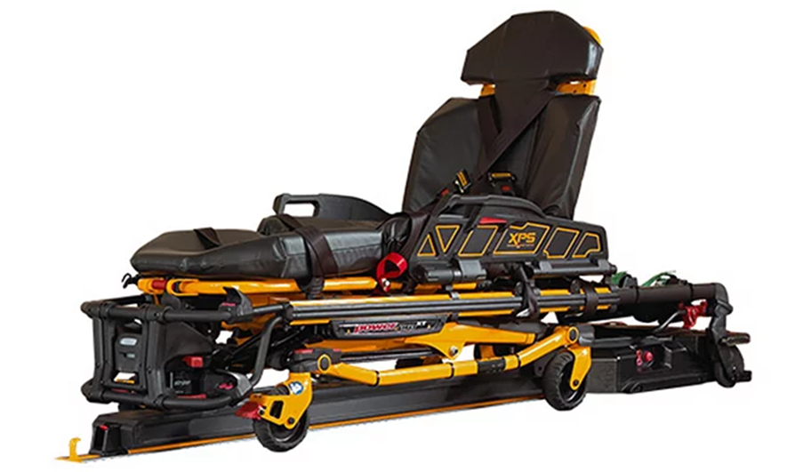
New Solutions, Old Problems
Electric Ambulance Stretcher
Electronically controlled medical gurneys that reduce the need to physically move patients.

Slide 35
2021 Solutions and Trends
What’s New with E-Readers?
American Thermoform: Multi-line Digital Braille E-Reader
Warm lighting options
What about a Service Cat?
New vaccine given to the animal
Molekule Air Mini
Hearing vs. Masks?
Clear face masks
Automated captioning options
Amplification

Slide 36
Old Solutions, New Possibilities
What’s New in Automated Captioning?
Interpretype now uses cloud-based transcription for increased accuracy in small group meetings
Streamer from Auditory Sciences offers a remote solution
Ava now offers human assisted captioning
Otter AI now marketed for assisted notetaking
Zoom offers built in and third-party integrated options

Slide 37
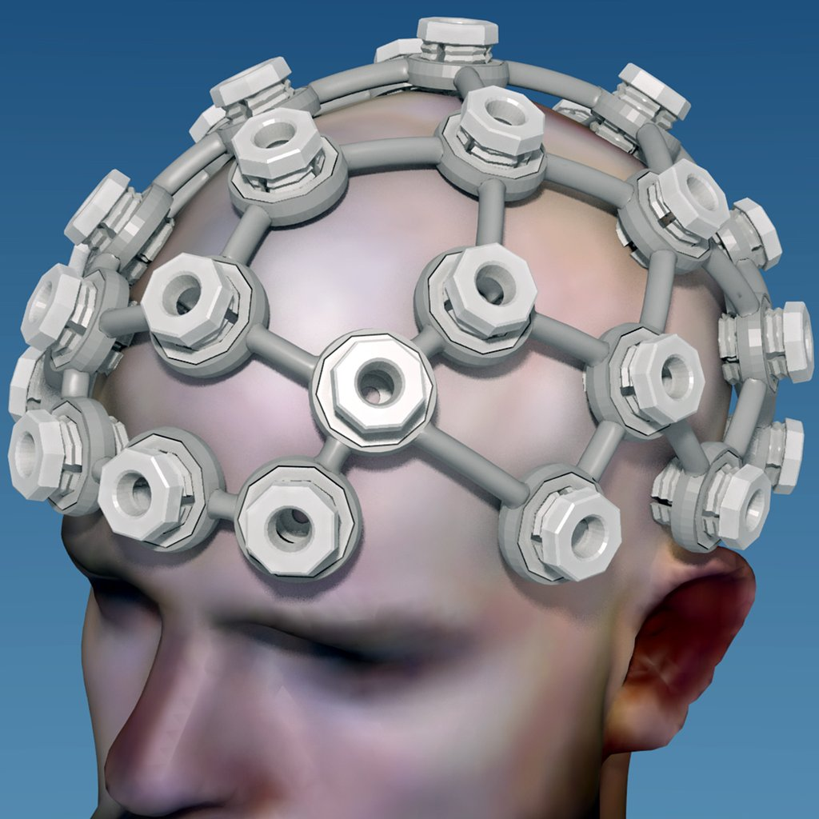
In Development
Brain Computer Interface
Device in development allows thinking of saying a word instead of typing via BCI

Slide 38
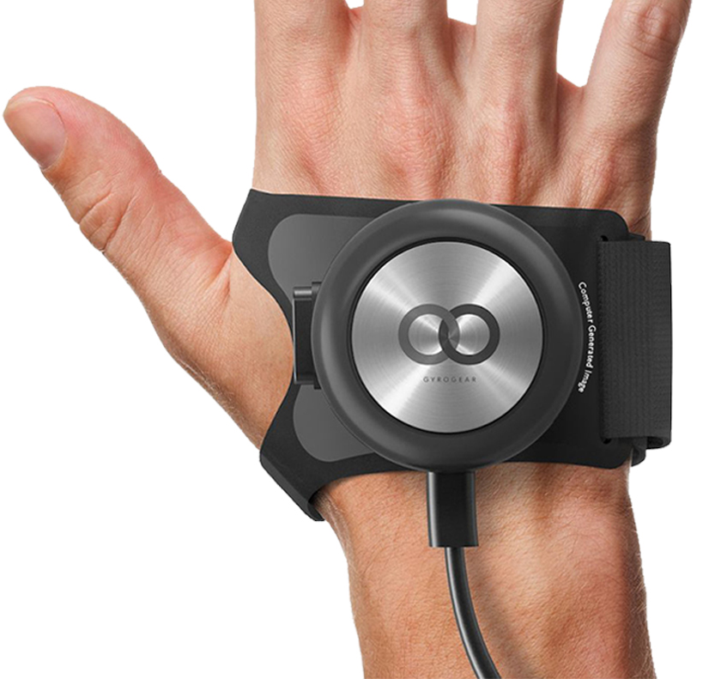
In Development - Tremors
Gyroglove
Device in development that uses gyroscopes to help manage hand tremors

Slide 39
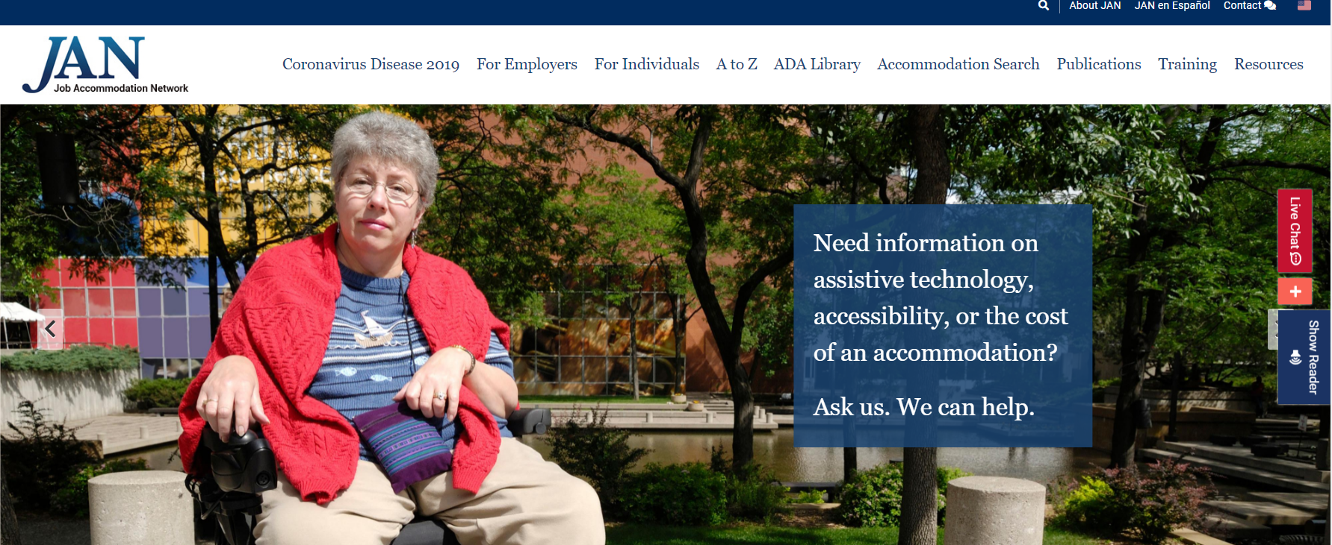
Visit AskJAN.org
Need information on assistive technology? Ask JAN!

Slide 40

Questions?

Slide 41

Contact JAN
Visit AskJAN.org
Submit a JAN on Demand question @
AskJAN.org/JANonDemand.cfm
Email JAN @ JAN@AskJAN.org
Use the JAN Live Chat @ AskJAN.org
Leave a voicemail message.
JAN staff will contact you via email or a call:
  800.526.7234 (V)
  877.781.9403 (TTY)
Connect on social media
  Facebook – Job Accommodation Network
  Twitter – @JANatJAN

Slide 42
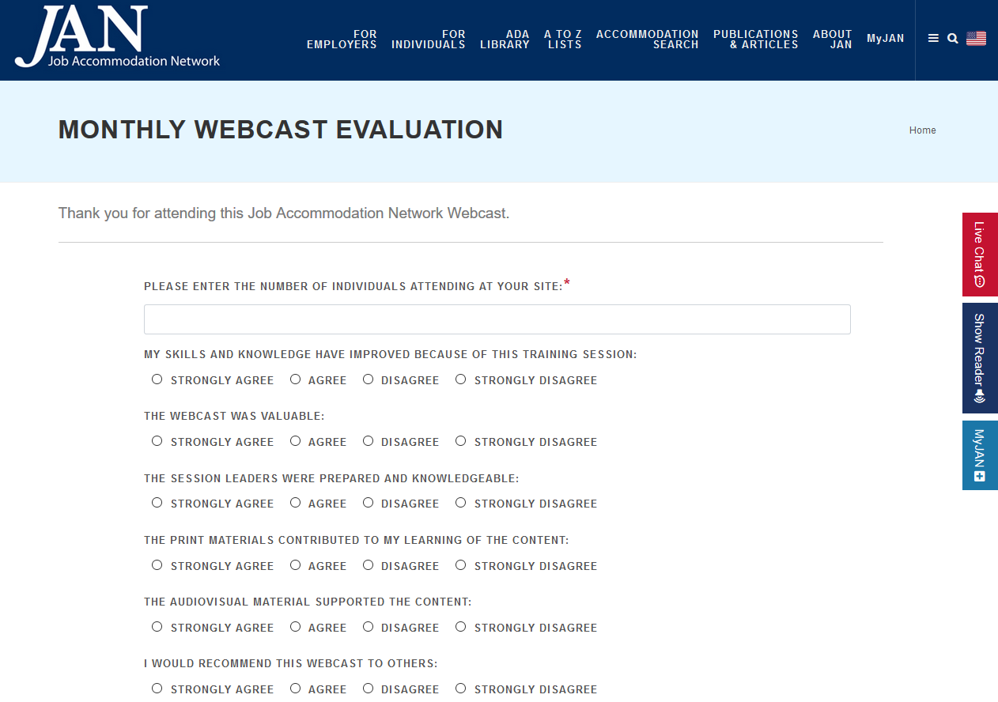
HR CEU?
Don’t close the JAN webcast window.
CEU approval code will be provided via the certificate that shows after completing the webcast evaluation.

