Slide 1
Accommodation and Compliance Webcast Series: Accommodation solutions for Neurodivergent workers
Melanie Whetzel, M.A., CBIS, Principal Consultant, Cognitive/Neurological Team Lead

Slide 2
Housekeeping
Technical Difficulties
Q&A option at the bottom of the screen
800-526-7234 or 877-781-9403 (TTY) or Live Chat at AskJAN.org
Frequently Asked Questions (FAQ) AskJAN.org/Training/JAN-Webcast-Frequently-Asked-Questions.cfm
Questions for Presenters
Q&A option at the bottom of the screen

Slide 3
Housekeeping 2
PPT Slides
Link to PPT is included in webcast login email, or see the link now in the chat, or go to this webcast event from the Training page at AskJAN.org
Captioning
Use the closed caption (CC) option or captioning link in the chat

Slide 4
What is Neurodiversity?
Neurodiversity is the range of differences in individual brain function, usually regarded as a normal variation in the human population, including:
learning
information processing
thinking
behavior traits

Slide 5
Neurodiversity (2)
Although the term neurodiversity is especially used in the context of autism spectrum disorders, other cognitive/neurological disabilities can be included:
attention deficit/hyperactivity disorder
mental health conditions
intellectual and learning disabilities

Slide 6
Common Limitations
Social Skills
Organization
Concentration
Sensory Issues
Issues of Change
Time Management
Stress Management
Coworker Interaction
Speaking/Communicating

Slide 7
NEURODIVERSITY AND THE ADA

Slide 8
Definition of Disability
An individual has a disability under the ADA if he or she:
has a physical or mental impairment which substantially limits one or more major life activities;
has a record of such an impairment; or
is regarded as having an impairment.

Slide 9
Disability Disclosure
Disclosure is when you give out specific, personal information about your disability.
Important to provide:
The nature of the disability
The limitations, or how the disability affects your capacity to learn and/or perform the job effectively
Accommodations you will need in order to do the job

Slide 10
Why Disclose?
Why Disclose?
To ask for job accommodations
To receive benefits or privileges of employment
To explain an unusual circumstance

Slide 11
Hiring
Accommodations for Hiring
Fewer interviewers
Demonstration of skills
Questions provided in advance
Instruction sheet/card to help
Job coach/parent as support
Informational interview first, by phone
Optimal time for interview

Slide 12
Fewer Interviewers
A job applicant for a position in a prison working directly with the inmates asked to have the interview questions sent to him so he could submit the answers in writing in lieu of participating in an interview with multiple people.

Slide 13
Demonstration of Skills
Syd, interviewing for a job of camera operator, was asked many abstract questions during the interview that he considered irrelevant to his skill level and qualifications for the job. He asked if he could instead show the interviewer/employer his skills at using the camera.

Slide 14
Questions Provided in Advance
Hailey is applying for jobs and finds herself having difficulty when the interview questions require abstract thinking of scenarios she can recall from past employment or experiences. She requested a list of interview questions in advance and extended time during the interview to give her more time to process the information while formulating a response.

Slide 15
Instruction Sheet / Note card
Sylvia is a programmer who tends to tell too much information about herself and her love for computer languages. She wrote a brief biography about herself that included her education and experience with programming that she carries with her to refer to during interviews, so she doesn’t get too wordy and off track.

Slide 16
Job Coach / Parent as support
Matthew is a candidate for a new job. He asks that his dad be allowed to support him in the interview, not as a mouthpiece, but to help him feel more comfortable in an unfamiliar situation and location so that he can respond in ways that better communicate his knowledge and experience.

Slide 17
Informational Interview First, By phone
In order to help him analyze the work environment, Joshua asked for an informational interview by phone to help him determine if the job might be a good fit before he went any further in the process.
This was also a great first step to help gain confidence and establish rapport before an in-person meet is required.

Slide 18
Optimal Time for interview
A school psychologist interviewing for a new position prefers an early morning appointment where he can best represent himself as he has more energy and concentration at that time. If given the choice of several appointment times, the applicant may not have to disclose his disability at this stage and request the early time slot.

Slide 19
Questions

Slide 20
Succeeding and Advancement
Accommodations for Succeeding and Advancing
Mentoring
Support animal
Working remotely
Job restructuring
Modifying policies
Modifying schedules
Reassignment
Employee Assistance Program (EAP)
Ensure continuous feedback from manager
Ensure opportunities to participate in training

Slide 21
Mentor / Job coach / support person
Milly had a successful history of working in retail but was returning to work after being out for many years due to her disability. She requested a job coach, as she felt her social skills were lacking not only due to her disability, but also because she had been home for so long.

Slide 22
Support Animal
Jules requested to bring her new support animal to the office to help her with the stress associated with her recent promotion to a new division with more advanced job duties, procedures, and new coworkers.

Slide 23
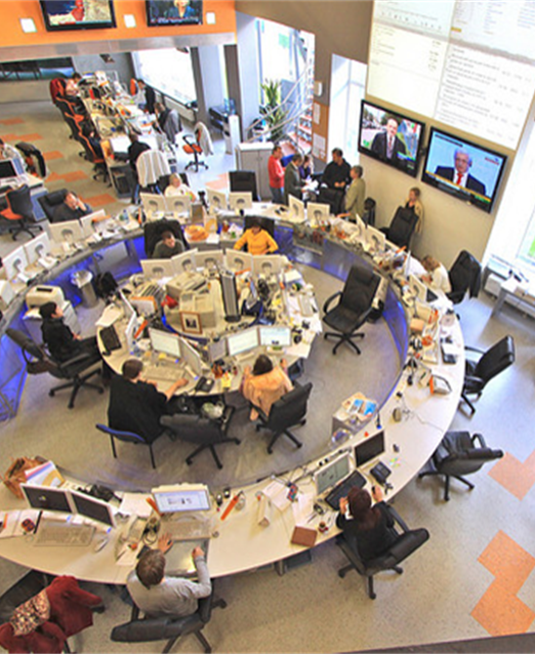
Working remotely
Jack is a reporter who has difficulty with sensory overload while working in a crowded, busy, noisy, and very bright newsroom. He asked for the accommodation of working from home when he was on deadline.

Slide 24
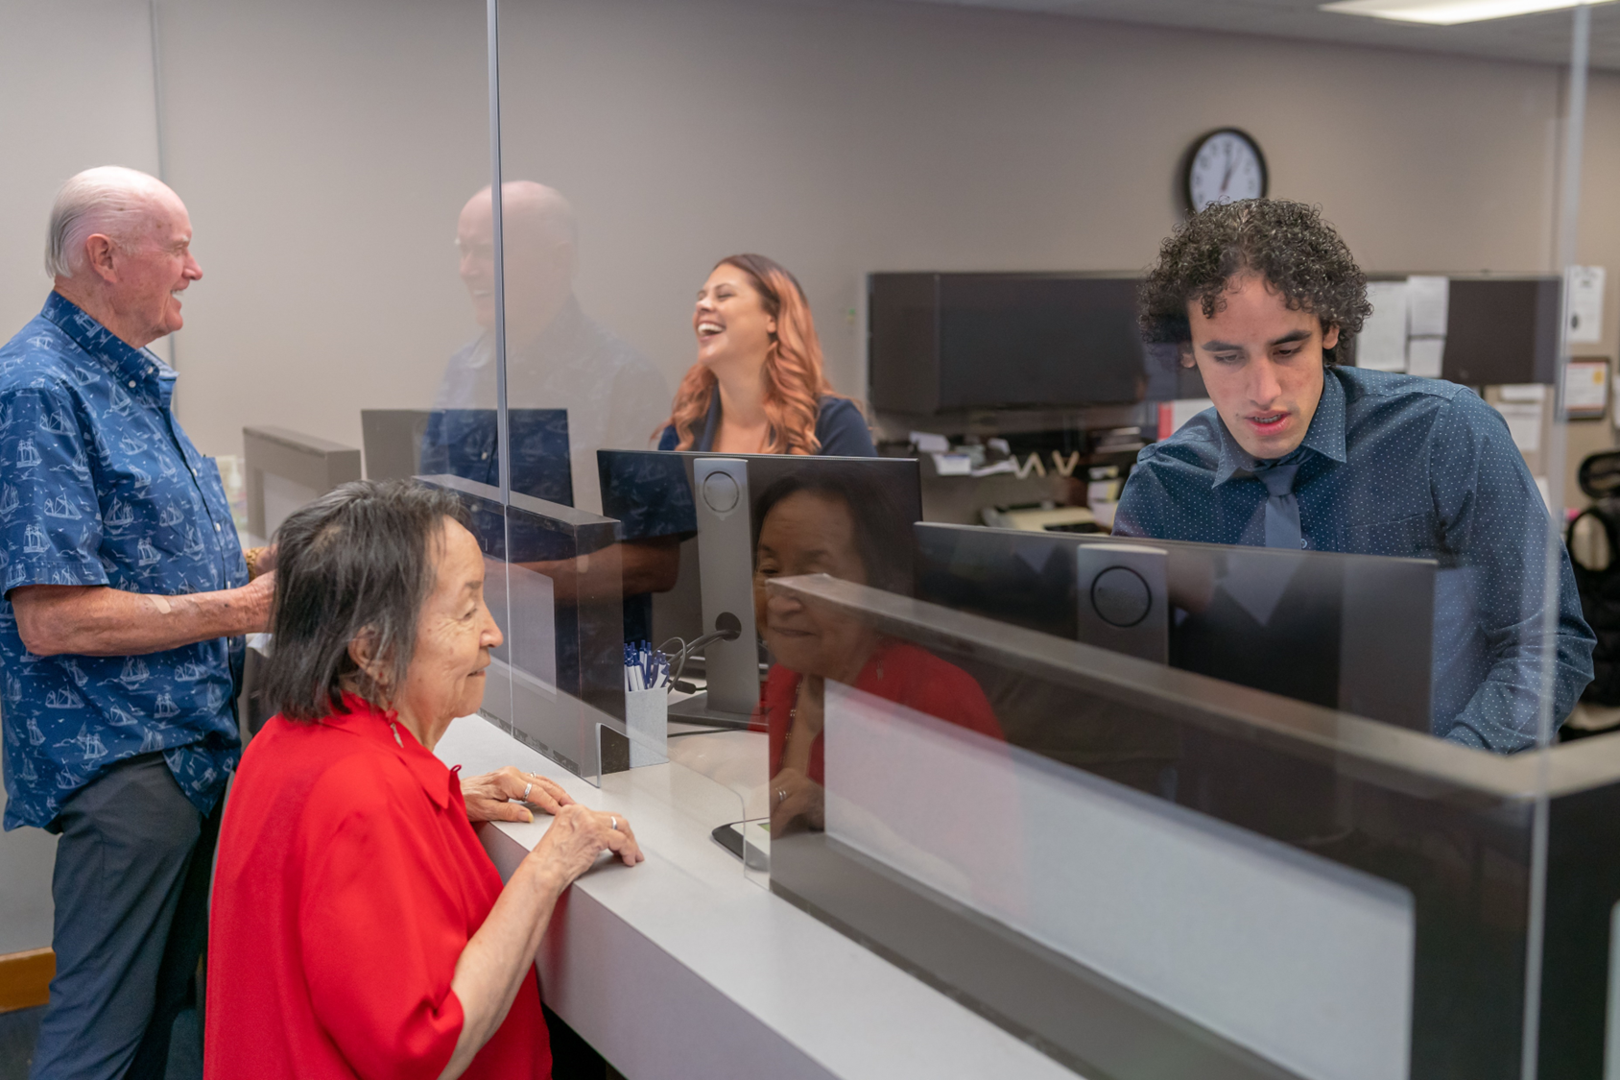
Job restructuring
An employer required that all employees work a rotating schedule, which included time at a customer service window. Becker, an employee on the autism spectrum who experiences significant social anxiety, asked to be excused from the window duty because of difficulty interacting with strangers.

Slide 25
Modifying Policies
Lea became overly stressed when asked questions by her coworkers that she felt pressured to answer. She often reacted with anger, usually slamming her fist on her desk and shouting for others to leave her alone. After being pulled into a second disciplinary meeting with her supervisor, Lea disclosed and asked for assistance in handling stress levels at work.
*Bonus

Slide 26
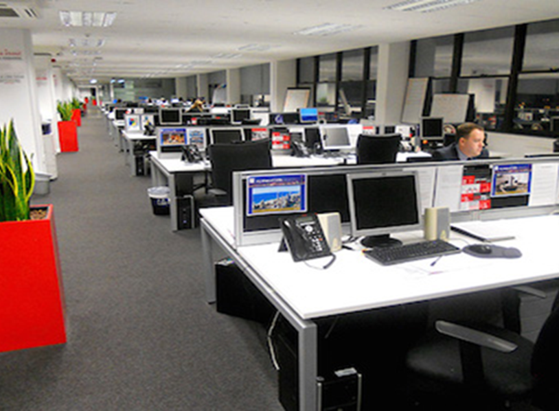
Modifying Schedules
Nigel is a case manager who has difficulty getting his required documentation completed. He works in a cubicle in a noisy open area that limits his ability to focus and concentrate. With no private space available, he feels a change in the set office hours may help.

Slide 27
Reassignment
Due to communication issues related to her disability, an employee had difficulty getting along with her supervisor and requested a reassignment. The employer asked JAN how to determine if this would be the best solution.

Slide 28
Employee assistance program (EAP)
JJ had difficulty handling change in the workplace and had punched his arm through a wall several times when he hadn’t been warned ahead of time that adjustments would need to be made. He asked for written notification of changes at least 24 hours in advance.

Slide 29
ensure continuous feedback from manager
Ty was very skilled at resolving IT problems but had difficulty with organization and remembering multiple tasks and information gained in meetings. As he began to take on a lead role, he knew he needed assistance.

Slide 30
ensure opportunities to participate in training
Dom requested the ability to participate in the upcoming mandatory in-person training sessions from home, as being in a large group is difficult for him and hampers his ability to pay attention and learn.

Slide 31
Resources
A to Z of Disabilities and Accommodations
Accommodation and Compliance: Autism Spectrum
Equal Employment Opportunity Commission (EEOC) Applying Performance and Conduct Standards to Employees with Disabilities

Slide 32
Questions (2)
32

Slide 33
Thank you for attending “Accommodation solutions for Neurodivergent workers ”
Next JAN Webcast: “Accommodation Solutions for Fine Motor Limitations” Thursday, May 11 @ 2:00 p.m. ET
JAN Training Events & Resources AskJAN.org/Events/Trainings.cfm

Slide 34
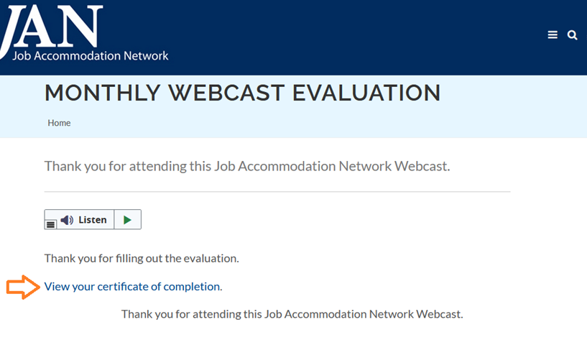
How do I claim the HR CEU?
Don’t close the JAN webcast browser
Complete the webcast evaluation in new window
Click on “View your certificate of completion.”
Or go to AskJAN.org/EvaluationReg.cfm

Slide 35
Contact JAN for More Information
Visit
AskJAN.org
Call
800.526.7234
877.781.9403 (TTY)
Live Chat
@ AskJAN.org
Email
JAN@AskJAN.org
Social Media
Facebook – Job Accommodation Network Twitter – @JANatJAN

